Slide 1
Environment Setup
Suite Service

Slide 2
Using Gitlab
git clone https://gitlab.captechlab.com/lkerr/HotelServiceSkill.git
This will create the project folder in whatever directory you’re in
Create a branch off of master
git branch <name of your branch>
Switch to your branch
git checkout <name of your branch>
Add changes to your branch
git add .
git commit –m “<my message>”
git push

Slide 3
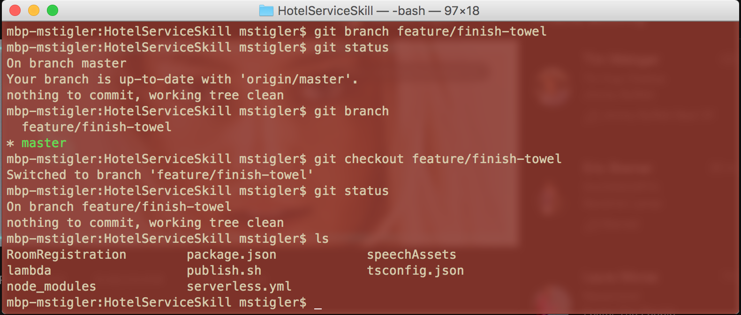
Using Gitlab

Slide 4
Installing Node
https://nodejs.org/en/download/
Pick the download for your platform
Node comes with NPM

Slide 5
Installing NPM Packages
Typescript (optional)
npm install –g typescript
Serverless
npm install –g serverless
These are defined in our package.json file, but we can go ahead and install here

Slide 6
AWS Command Line Interface (CLI)
http://docs.aws.amazon.com/cli/latest/userguide/installing.html
Once installed, use the following to set your access key and secret access key (you will need this to upload to lambda from the command line and to use serverless)
aws configure

Slide 7
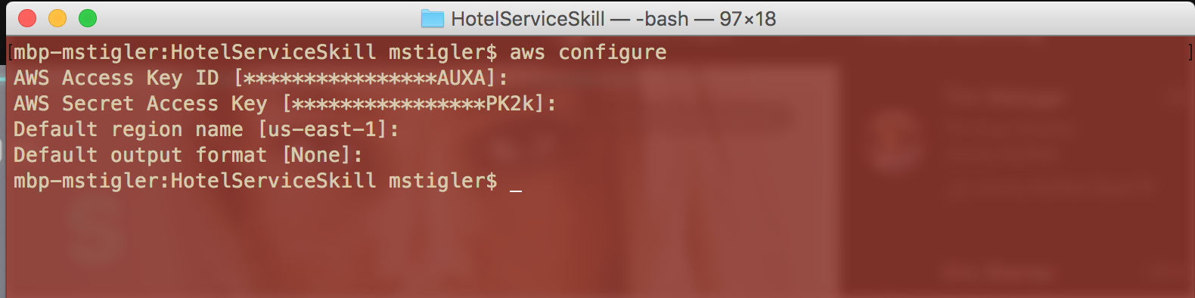
AWS Command Line Interface (CLI)

Slide 8
Visual Studio Code (optional)
https://code.visualstudio.com/
Open your project in VSCode and use extensions and git from VS Code
If you’re using typescript, build your code after writing it (Command/Cntrl + Shift + B)

Slide 9
Using Serverless
Add any new files you created to the function package in serverless.yml
Deploy to our AWS account
serverless deploy
See your changes in AWS (* This will overwrite the current lambda function)

Slide 10
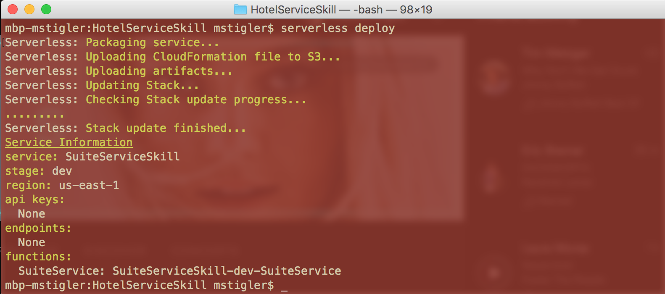
Using Serverless

Slide 11
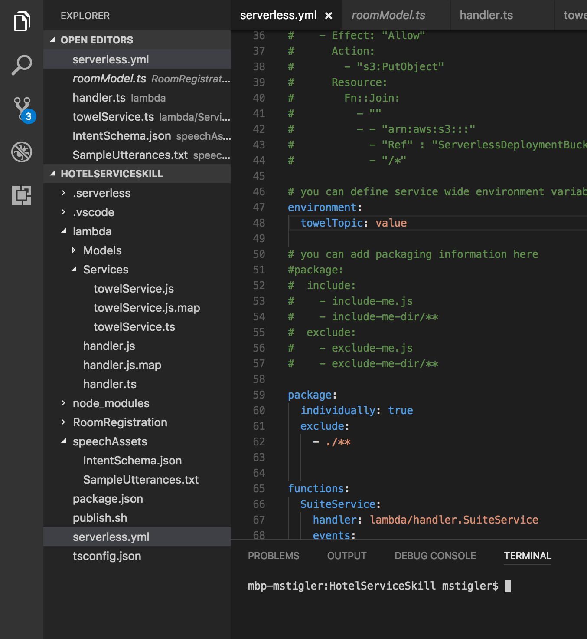
Project Structure
Models:
We didn’t do a model example, but there is one in ”RoomRegistration”. This is where we will store all models
Handler:
The handler will hold all of our Alexa intent responses and implementations. We will import services here and use them
Services:
This is where all of our AWS logic will live. (Toothbrush notification example)
Speech Assets:
Add and edit intents and utterances here. Then upload to the Alexa Developer portal
Serverless.yml
Add new files in serverless before deploying, add environment variables. Not much else needs to be changed in here

