Slide 1
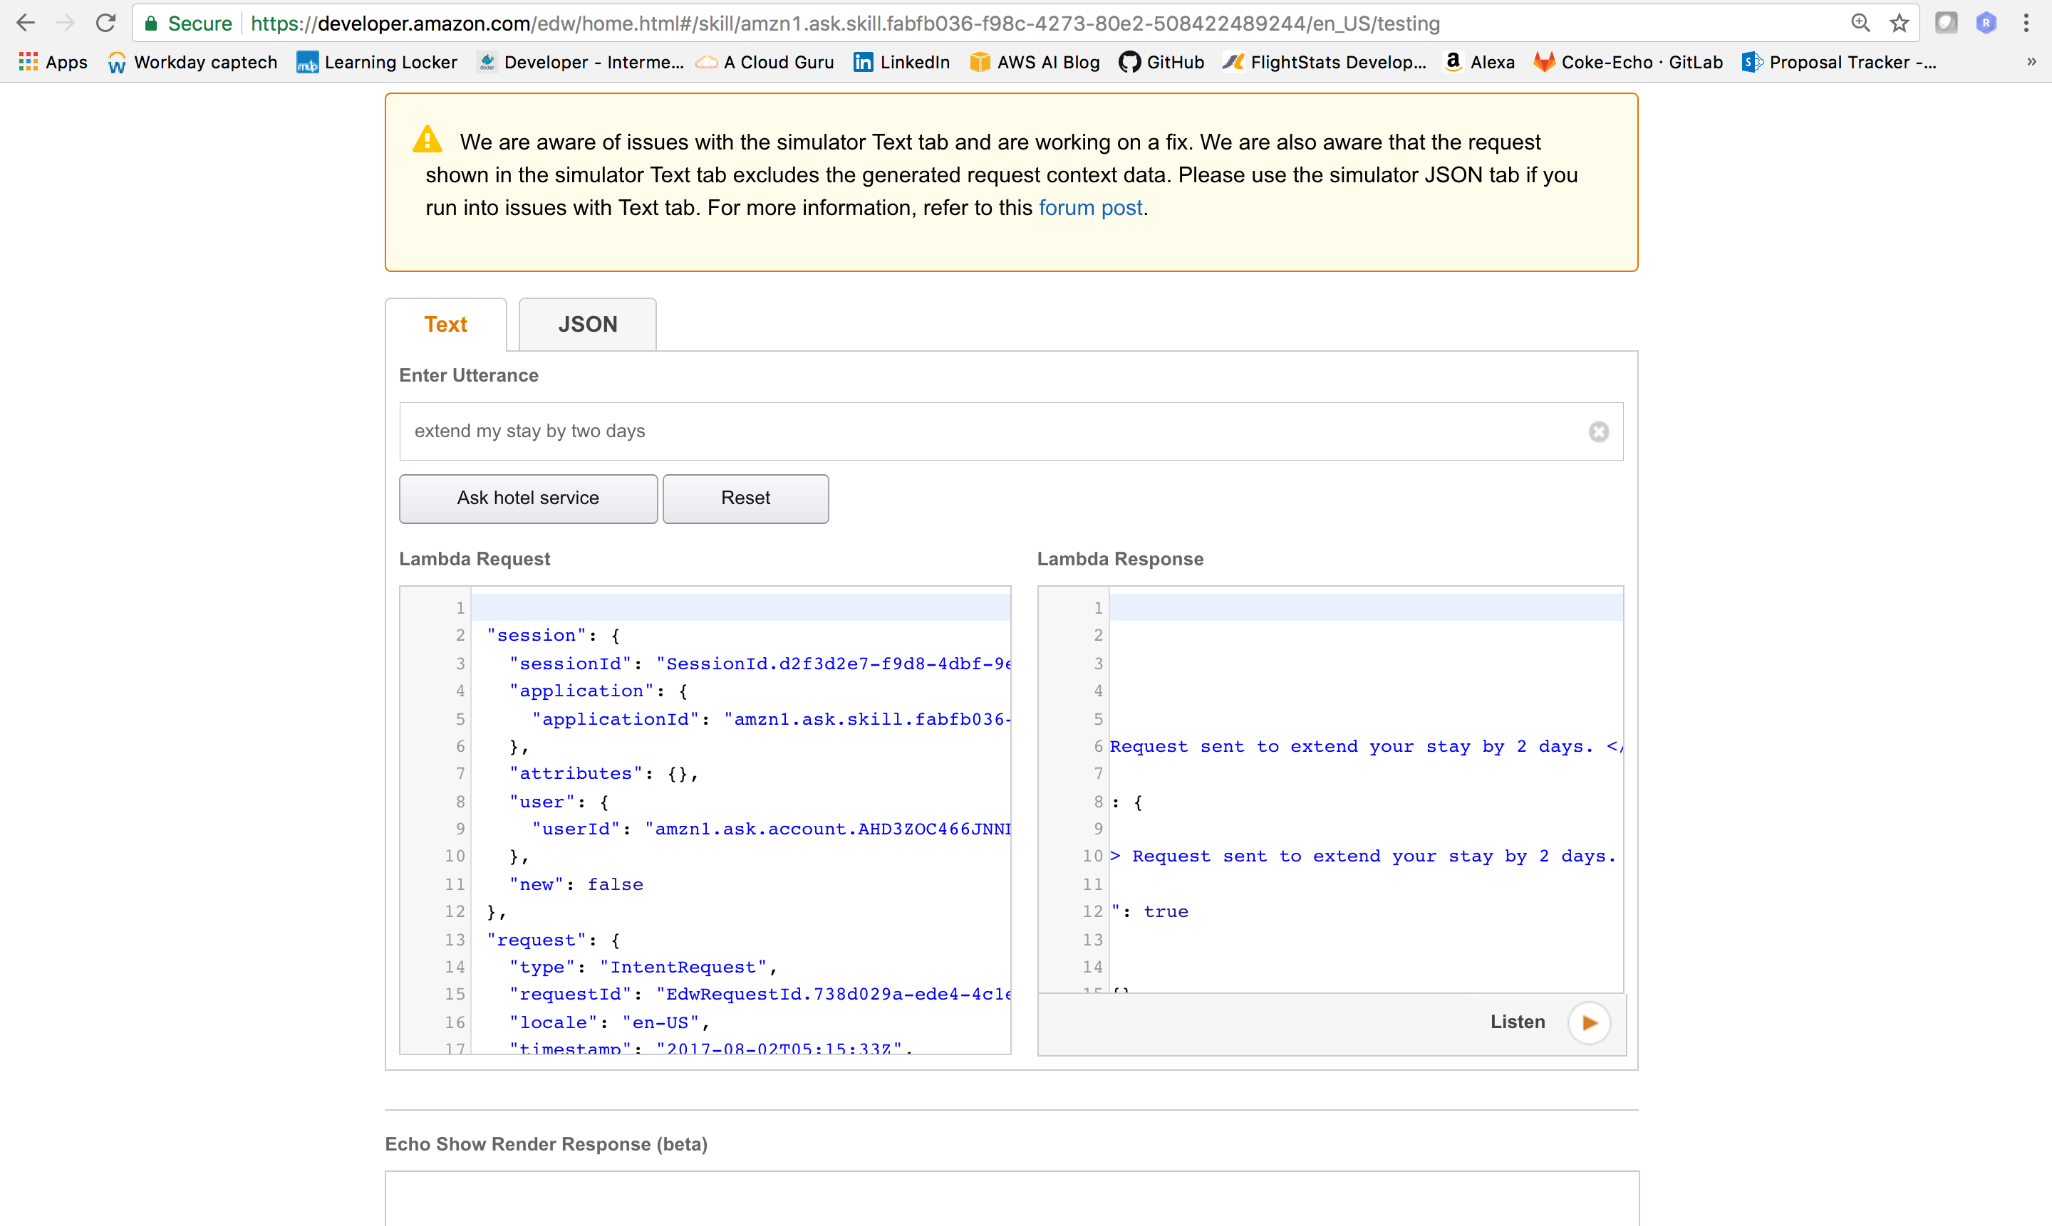
1. User requests to extend stay

Slide 2
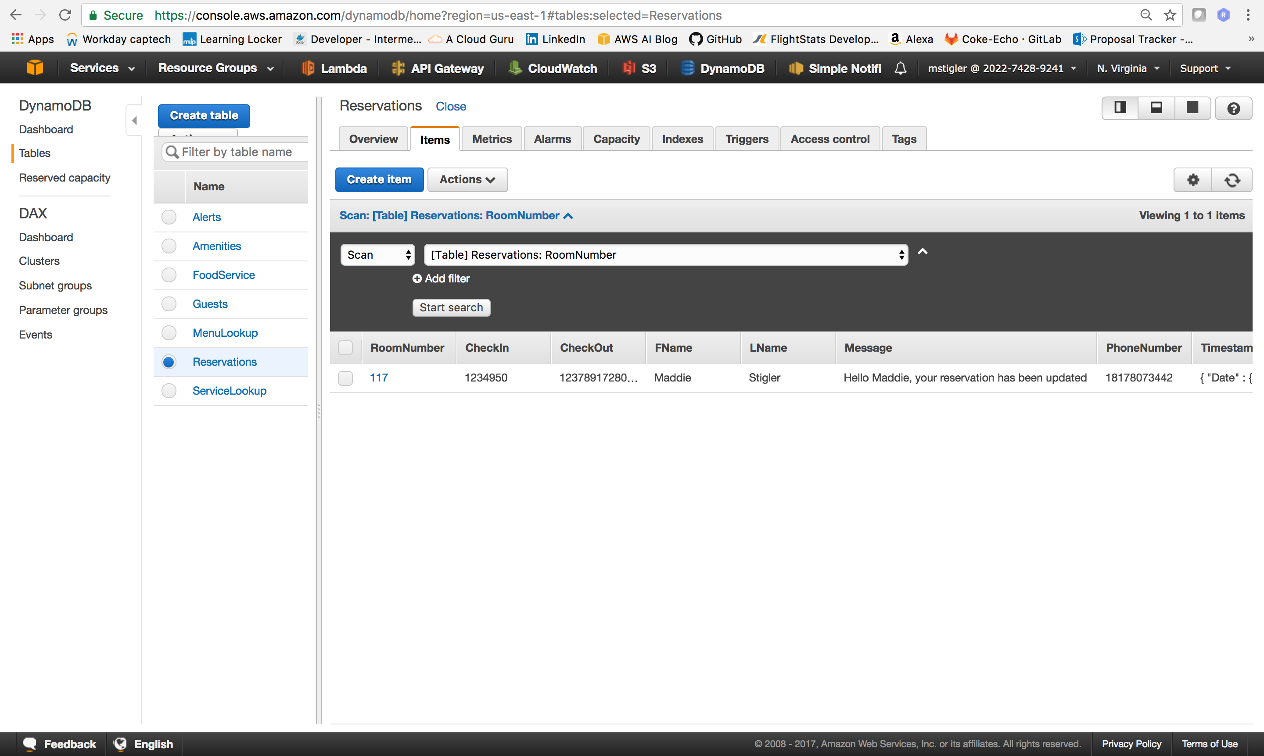
2. PUT request from alert service adds to Reservations table

Slide 3
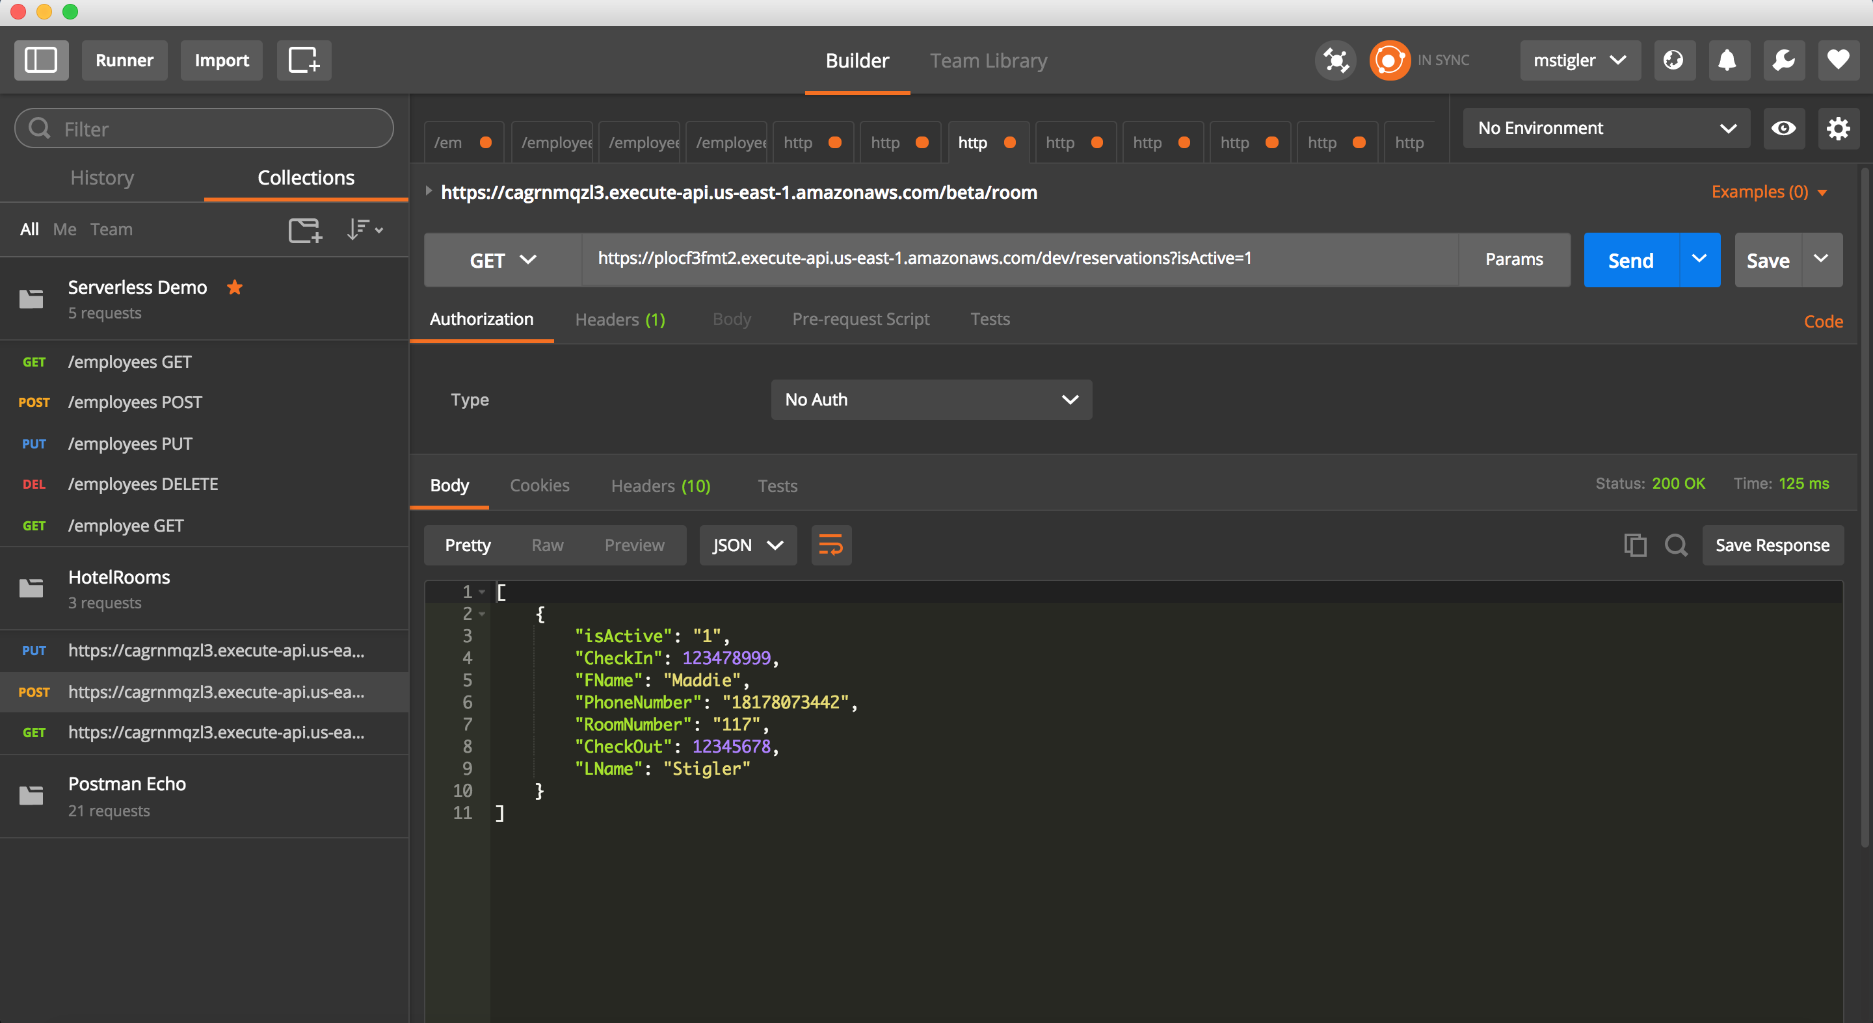
3. GET request shows Reservations Table

Slide 4
4. POST request to https://plocf3fmt2.execute-api.us-east-1.amazonaws.com/dev/reservations updates reservation table, guest table, and sends a text to the guest

