Slide 1


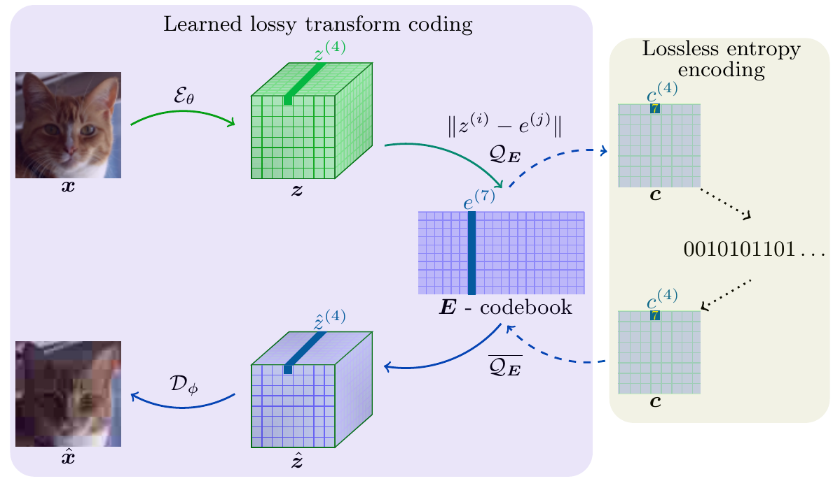
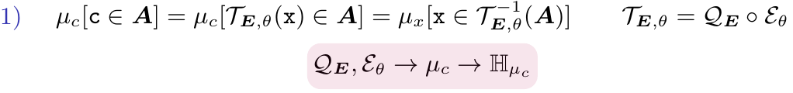
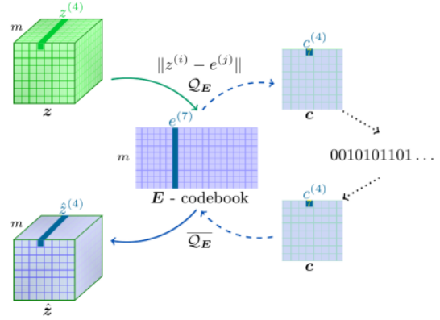
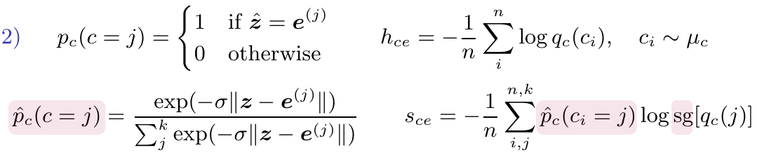
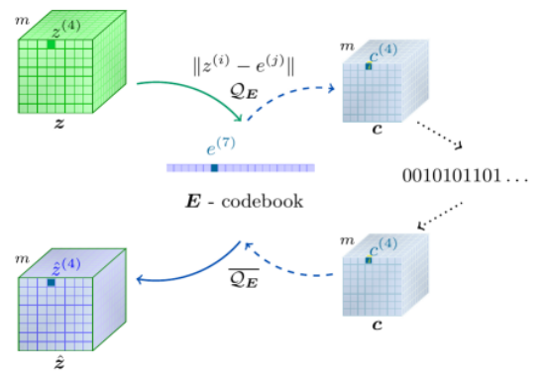
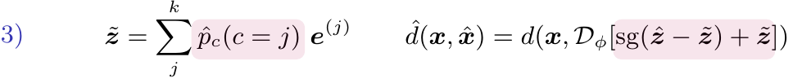
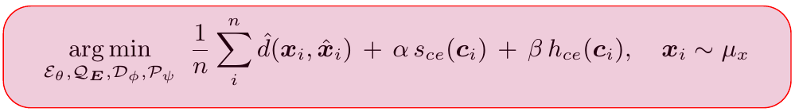

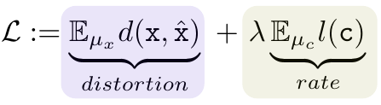
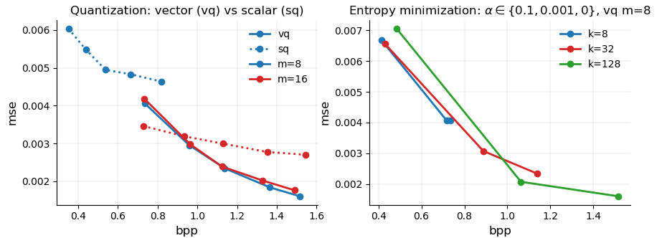
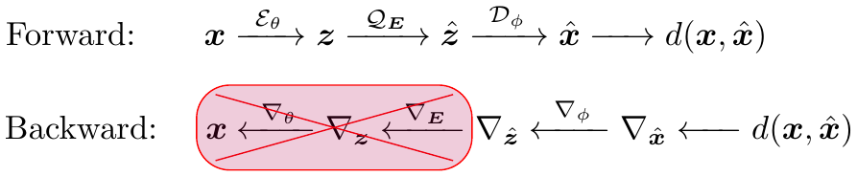

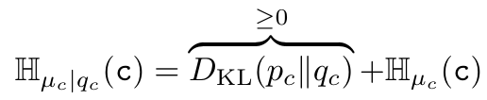






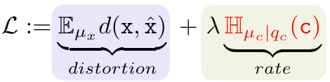

Learned transform compression with optimized entropy encoding
Magda Gregorová, Marc Desaules Alexandros Kalousis
[name.surname]@hesge.ch
Geneva School of Business Administration,
HES-SO University of Applied Sciences of Western Switzerland
Learned transform coding with vector quantization and lossless entropy encoding
Quantization
Solutions
Nearest neighbour search
Push-forward mesure & soft quantization: hard and soft cross-entropy
Vector vs scalar quantization: message length vs flexibility
vector quantization
message: short
flexibility: low
scalar quantization
message: long
flexibility: high
Rate-distortion trade off
Proof of concept experiments
Compression loss: learn encoder, decoder and quantization codebook
Problems
CIFAR: vector vs scalar quantization, effect of soft cross-entropy term
Quantization gradients: codebook and encoder not updated
Shannon: optimal code length ≈ entropy
Entropy minimization: cross-entropy objective not learning code transform
Code distribution: approximate by learned distribution
solid / dashed lines - vector / scalar quantization; blue / red - m = 8 / 16 channels in latent representation; points from left to right - increasing number of codebook words k ={8, 16, 32, 64, 128}; α=0, β=1, σ=1
all lines vector quantization with m=8 channels in latent representation; blue / red / green -
k = 8 / 32 / 128 codebook words; points from right to left increasing strength of soft cross-entropy α = {0, 0.001, 0.1}, β=1, σ=1
Cross-entropy loss: rate as cross-entropy instead of entropy
References
Agustsson, E., Mentzer, F., Tschannen, M., Cavigelli, L., Timofte, R., Benini, L., & Van Gool, L. (2017). “Soft-to-Hard Vector Quantization for End-to-End Learning Compressible Representations.” arXiv:1704.00648.
Balle, J., Laparra, V. & Simoncelli, E. P. (2017). “End-to-end Optimized Image Compression.” ICLR.
Mentzer, F., Agustsson, F., Tschannen, M., Timofte, R., Van Gool, L. (2018). “Conditional Probability Models for Deep Image Compression.” CVPR.
Theis, L., Shi, W., Cunningham, A. & Huszar, F. (2017). “Lossy Image Compression with Compressive Autoencoders.” ICLR.
van den Oord, A., Vinyals, O. & Kavukcuoglu, K. (2017). “Neural Discrete Representation Learning.” NeurIPS.
Minimization of cross-entropy only with respect to the learned distribution q_{c} approximating the unknown code distribution p_{c} is suboptimal. It brings q_{c} close to p_{c} and hence reduces the number of extra bits needed due to using q_{c} instead of the true p_{c} but it does not encourage low entropy of the true code distribution.

