Slide 1
Department of Artificial Intelligence Project Progress Seminar Winter 2024 (Session: 2024-2025)
Title of the Project:-
Women's Disease Risk Assessment and Care Navigator
Presented by:-
Pranali Bhope (B-08)
Mishri Gube (B-07)
Sejal Khumbhare (B-12)
Shraddha Jha (B-13)
Guide:- Prof. Madhuri Sahu
Incharge:- Prof. A. Thomas
Department of Artificial Intelligence
G H Raisoni College of Engineering

Slide 2
Aim & Objective
Aim:
Development of a Web Application that can identify women at higher risk of specific diseases or conditions, such as PCOS, Osteoporosis, Postpartum depression and Diabetes using Machine Learning .
Objectives:
Utilize machine learning algorithms to identify women at higher risk for specific diseases such as PCOS, osteoporosis, postpartum depression and diabetes enabling timely medical intervention.
Provide users with comprehensive information about the symptoms, risk factors, and preventive measures for these conditions, thereby increasing awareness and encouraging proactive health management.
Offer a confidential and stigma-free environment for women to seek health assessments and information, encouraging more women to take charge of their health without fear of societal judgment.

Slide 3

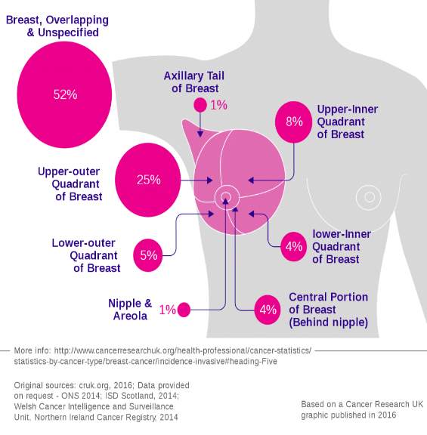

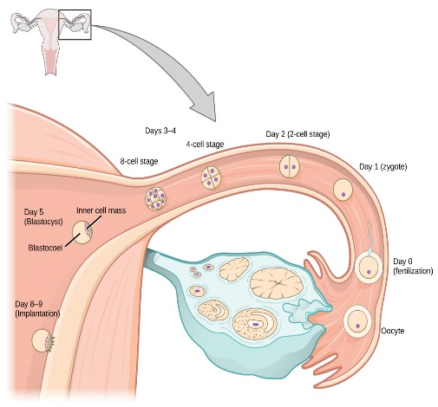
Introduction
India's female adult mortality rate stands alarmingly high at 185.9 deaths per 1,000 female adults. This statistic underscores a critical health issue that necessitates immediate attention and intervention.
Among the prevalent health concerns are Polycystic Ovary Syndrome (PCOS), osteoporosis, postpartum depression and diabetes.
A significant factor contributing to these health issues is the widespread ignorance of symptoms. Furthermore, financial constraints and societal taboos and stigmas often prevent women from seeking timely medical attention.
The project aims to develop a web application which will utilize machine learning to identify women at higher risk for specific conditions, including PCOS, osteoporosis, postpartum depression and diabetes thereby outlining the critical issues faced by women in India regarding health, identifies the root causes, and presents a tech-based solution to mitigate these problems.

Slide 4
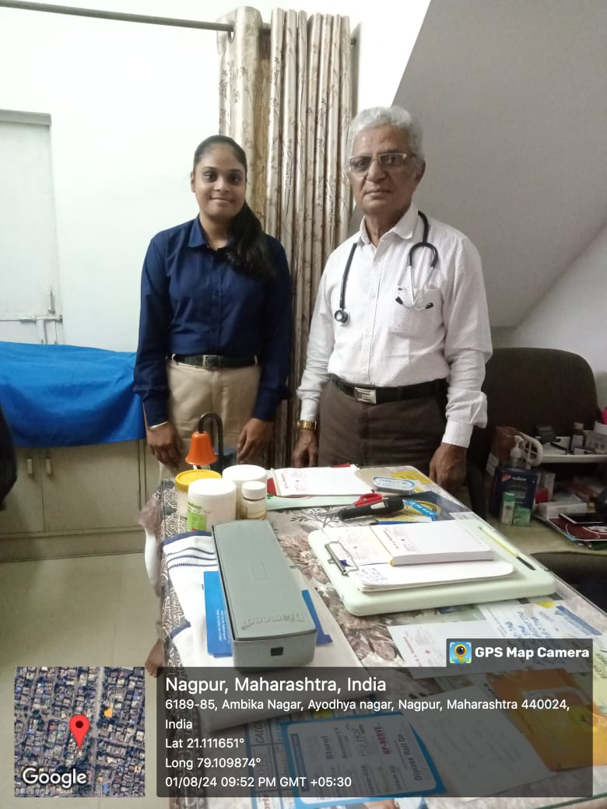
Case Study
Dr. Nandanwar, a specialist in osteoporosis, practices at Sai Clinic, located in Ambika Nagar, Ayodhya Nagar, Nagpur.
He focuses exclusively on the diagnosis and treatment of osteoporosis and other bone health issues. His expertise includes managing and treating osteoporosis through various therapeutic approaches.
He approved of parameters for general symptoms for detecting this disease.
Additionally, he has provided valuable assistance and guidance on our major project focusing on bone-related diseases in women, including their pros and cons and further osteoporosis research.
Dr. Nandanwar : an osteologist

Slide 5
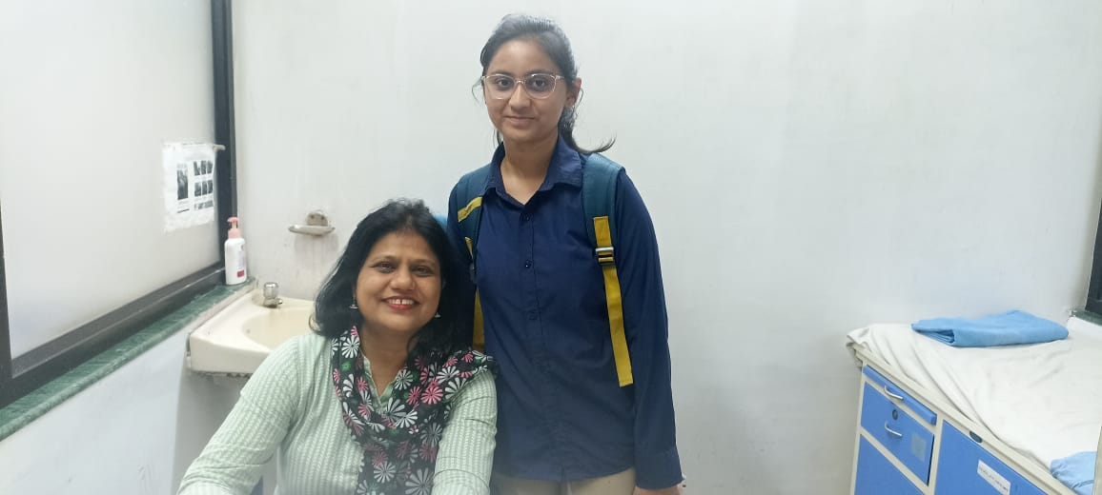
Case Study
Dr. Nikita, a gynecologist and women's health specialist, practices at Lata Mangeshkar Hospital, located in Hingna Rd, Police Nagar, Nagpur, Maharashtra.
She focuses on the diagnosis and treatment of conditions related to the female reproductive system, offering a range of services from routine check-ups and how to manage conditions such as endometriosis, polycystic ovary syndrome (PCOS), postnatal depression and menopause.
She added additional parameters in PCOS like Irregular periods, Scanty period, Heavy period, Difficulty in getting periods to add in our dataset and for postnatal depression she explained the causes and approved the parameters in our dataset.
Additionally, she has provided valuable assistance and guidance on our major project related to datasets and various women's health issues.
Dr. Nikita : Gynecologist

Slide 6
Proposed Methodology
The proposed system aims to enhance women's disease by addressing strategies, challenges, and implications. It serves as a framework for governments, organizations, and individuals to create a safer environment for women, requiring cooperation for empowering women.
User Input
(Symptoms, History, Age, Lifestyle, etc.)
Data Preprocessing
(Data Cleaning, Normalization using Python)
Model Selection
(Machine Learning)
Prediction
(Risk Assessment)
Recommendations
(Care Navigation)
Display Result
(User Interface)
(Streamlit)

Slide 7
Implementation & Result
=
User Input Form: This part collects input from the user, allowing them to enter their age and symptoms. The inputs are gathered in a Pandas DataFrame for easy manipulation.
Data Preprocessing: This section cleans and prepares the data for prediction. It includes converting categorical symptoms into numerical representations.
Train the Model: This block loads the dataset, splits it into training and testing sets, and trains the Logistic Regression model. The model is cached for performance improvement.
Make Predictions: The model is used to predict the risk based on user inputs.
Display Results: This function displays the risk assessment results to the user based on the predictions made by the model.
Main Function: This combines all the components into a cohesive application that runs the Streamlit server and presents the user interface.

Slide 8
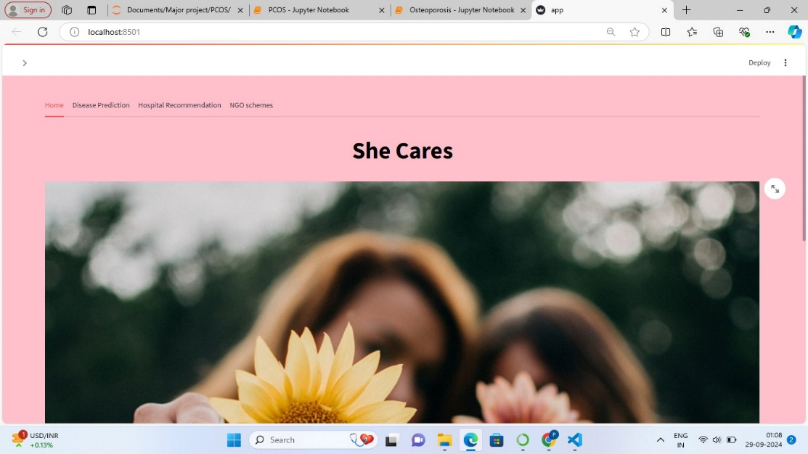
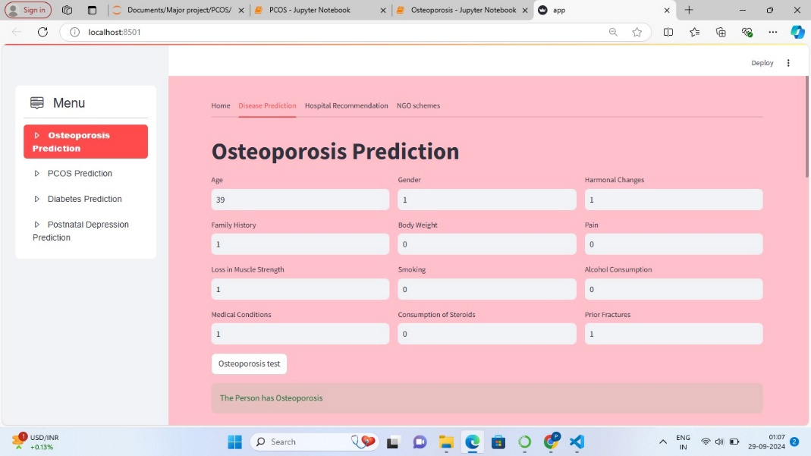
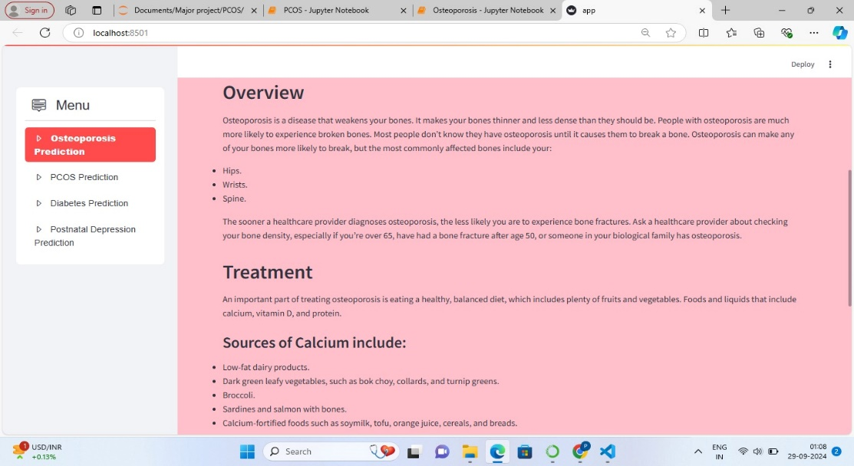
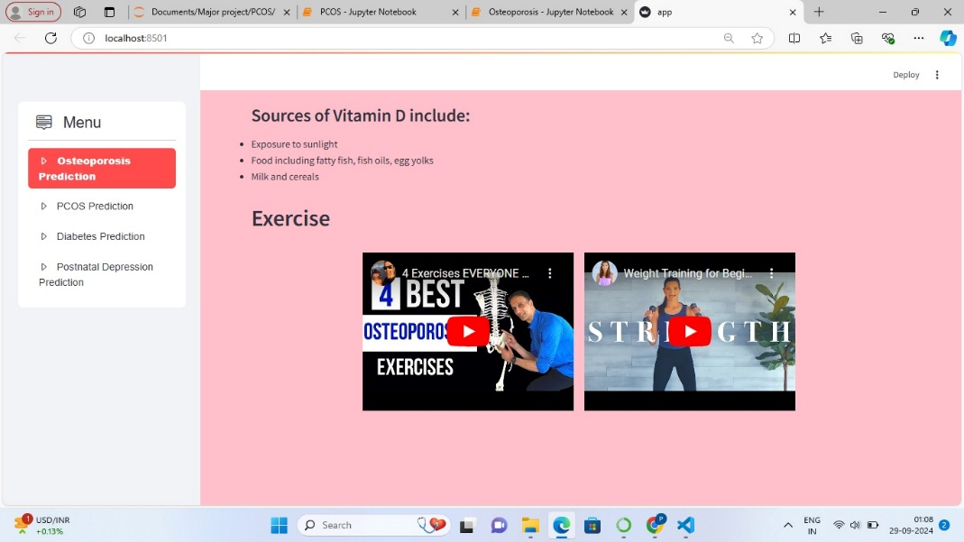
=

Slide 9
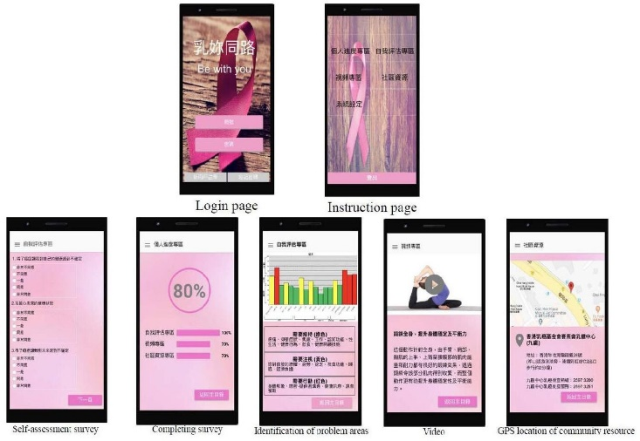



Possible Solution
Creating a prediction model that may detect conditions including PCOS, osteoporosis, postpartum depression and diabetes that are more likely to occur.
In order to lower the risk of the illness at the primary level, experts recommend balanced meals, frequent exercise, and stress management during this time.
GOOGLE Maps recommendations for the best clinics and hospitals in the vicinity for medical care.
Arising awareness of the availability of different government health plans and the financing discounts offered by NGOs to families in need.

Slide 10
Scope Women's Disease Risk Assessment and Care Navigator
Diagnosis of Diseases like Osteoporosis, PCOS, Postpartum depression and Diabetes .
Saves treatment by creating Awareness of funding concessions for economic backward families provided by the NGOs and creating awareness of the availability of various Government health schemes.
Collaboration with Hospitals saves both Doctors time and families cost.

Slide 11
Limitations
Data Availability and Quality: Limited availability of real time data.
Computational Resources: High computational requirements for real-time processing.
Integration Challenges: Difficulty integrating with real time data.
Privacy and Ethical Considerations: Issues regarding privacy and data usage.

Slide 12
Conclusion
In conclusion the rising high female adult mortality rate in India, driven by prevalent conditions such as PCOS, osteoporosis, postpartum depression and diabetes,
underscores an urgent need for effective health interventions. Ignorance of symptoms, financial constraints, and societal stigmas contribute significantly to these health issues. Developing a web application leveraging machine learning and deep learning algorithms offers a promising solution. This application aims to facilitate early detection, provide personalized risk assessments, and raise awareness about these conditions. By offering a secure, accessible, and confidential platform, the application can empower women to take proactive steps in managing their health, ultimately reducing mortality rates and improving overall health outcomes.

Slide 13
Thank You!

