Slide 1
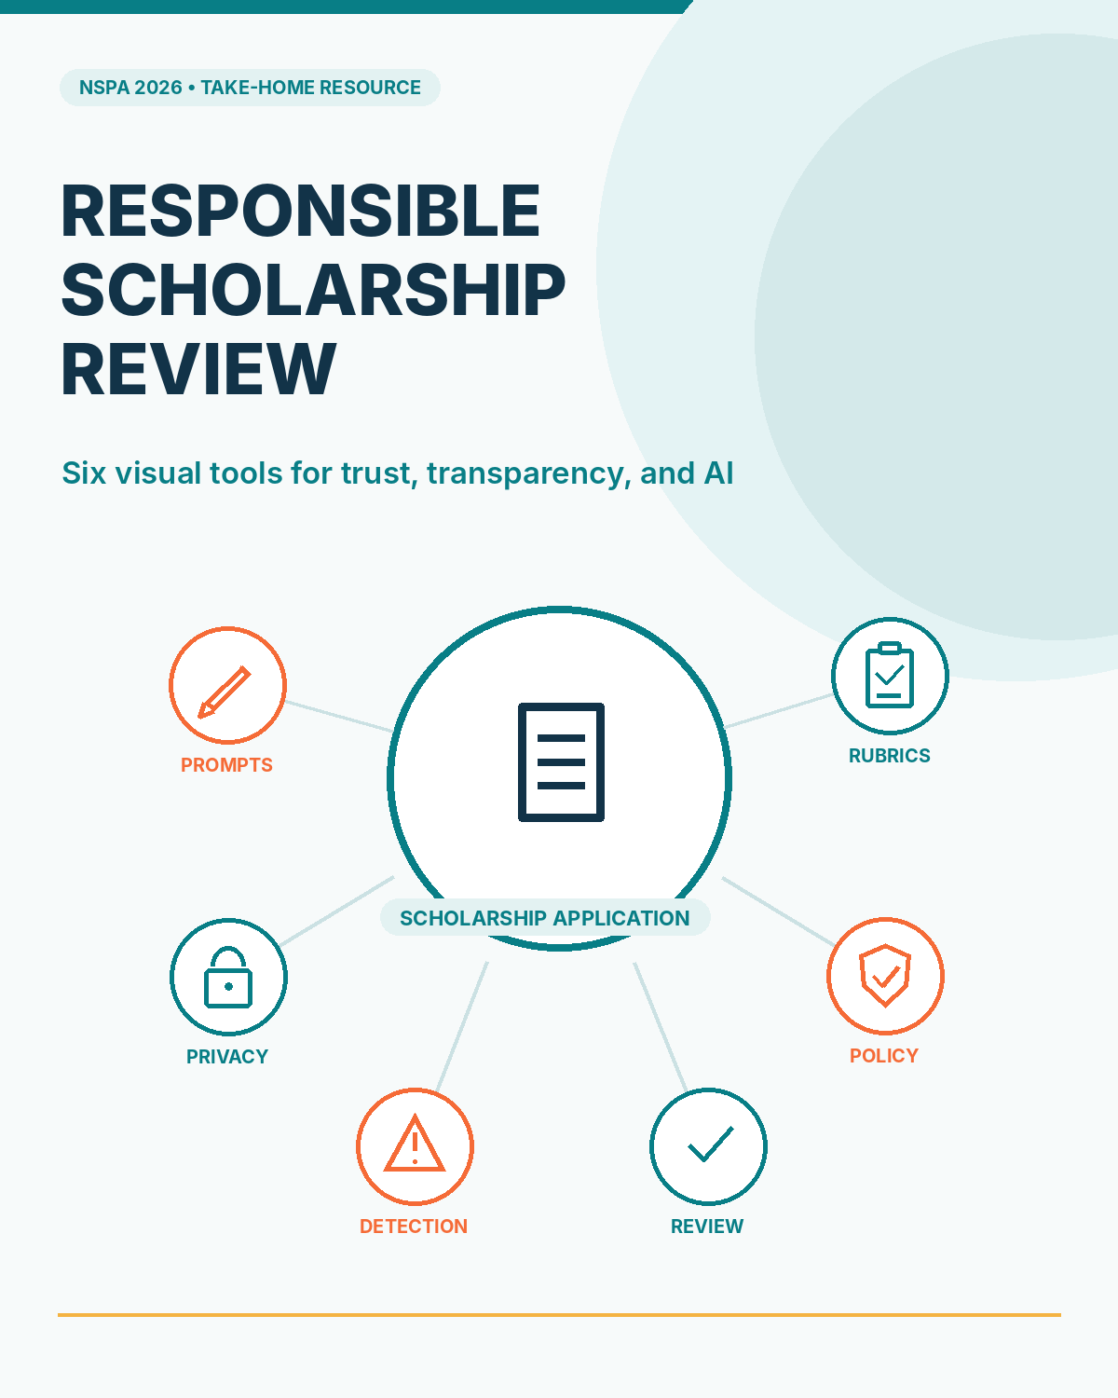
Notes:
This toolkit provides six standalone visual references for responsible scholarship reviews.

Slide 2
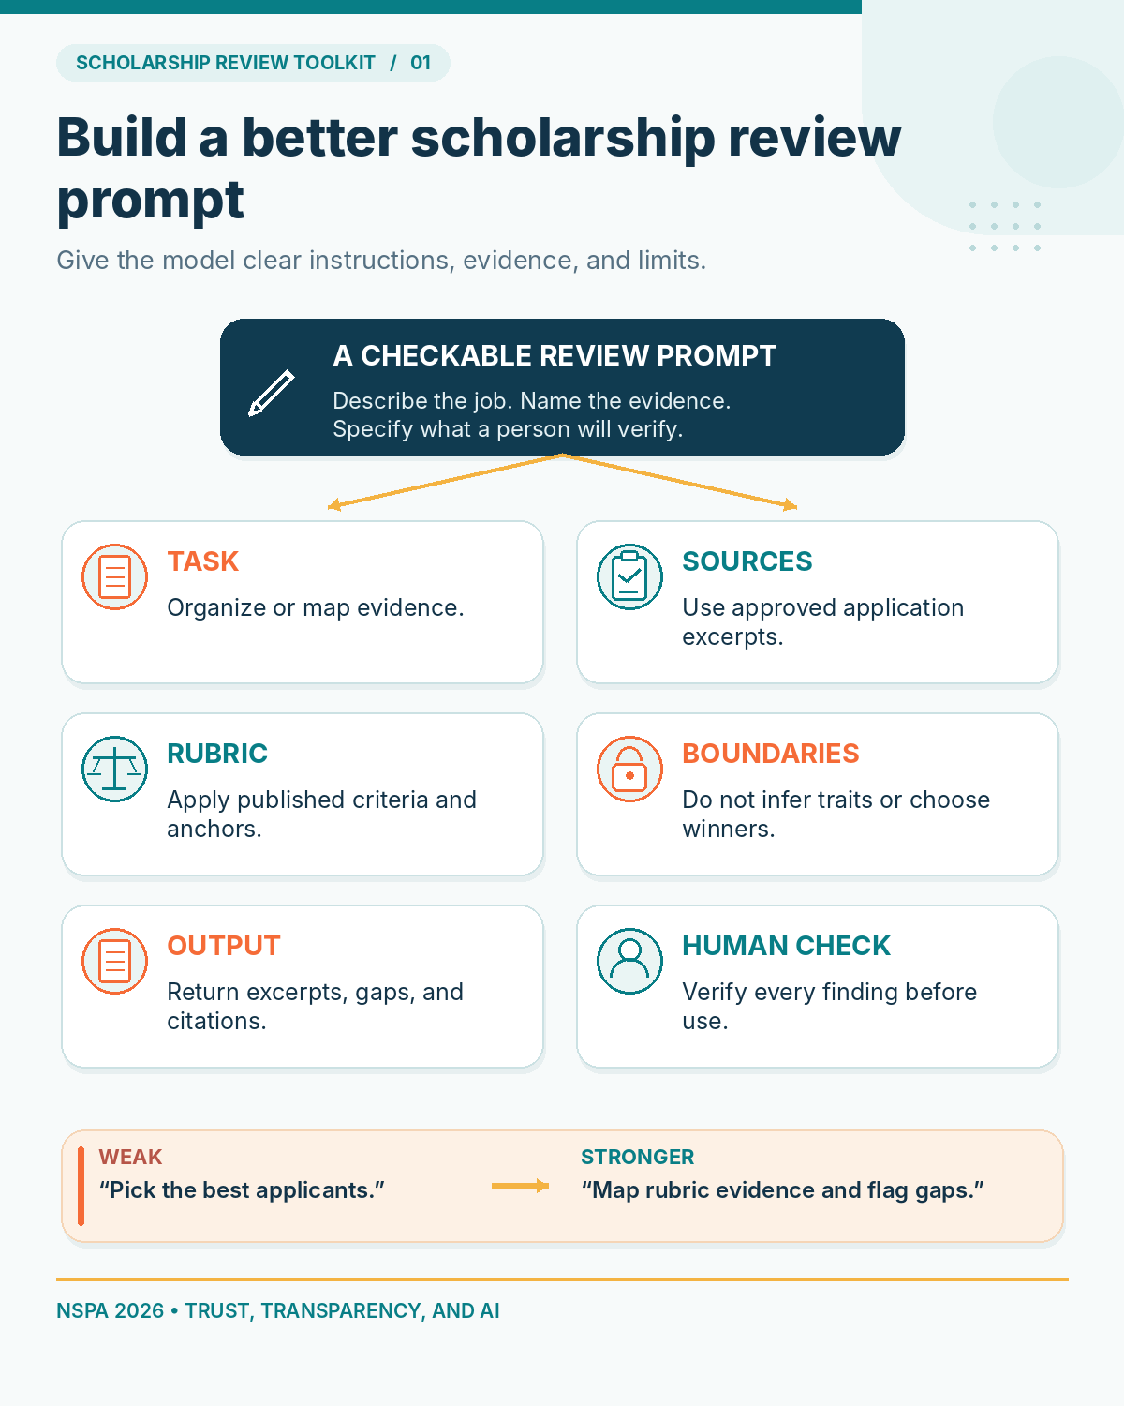
Notes:
A clear prompt names the task, sources, rubric, boundaries, output, and human verification.

Slide 3
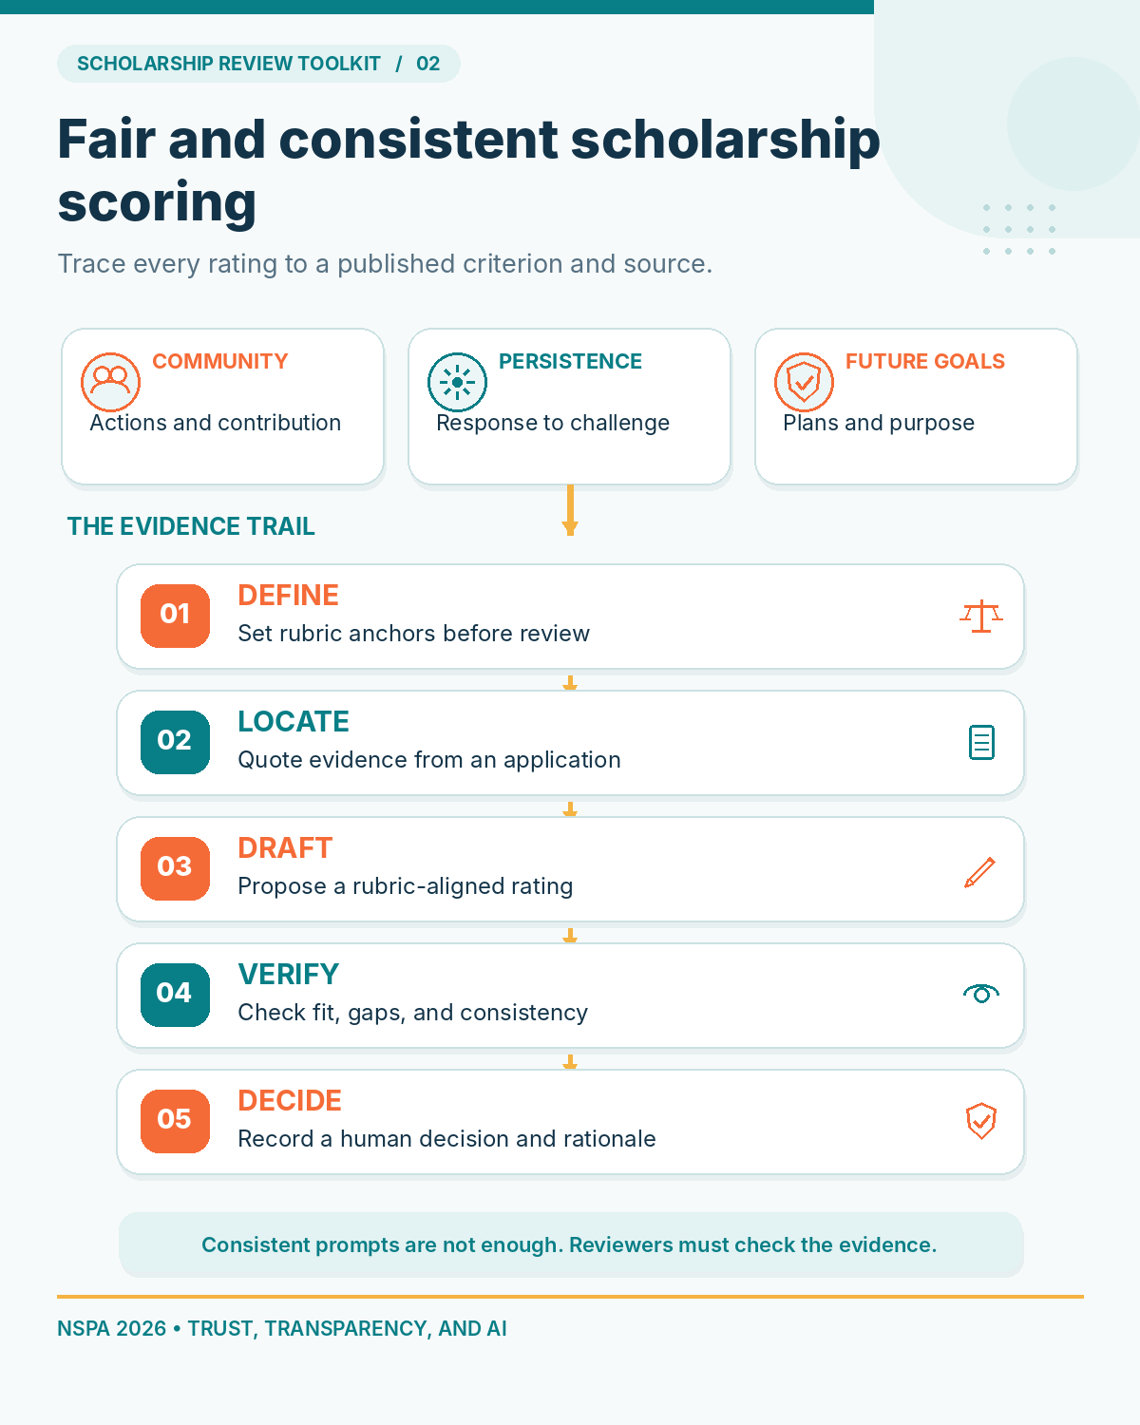
Notes:
A defensible score follows the evidence from published criteria to a human decision.

Slide 4
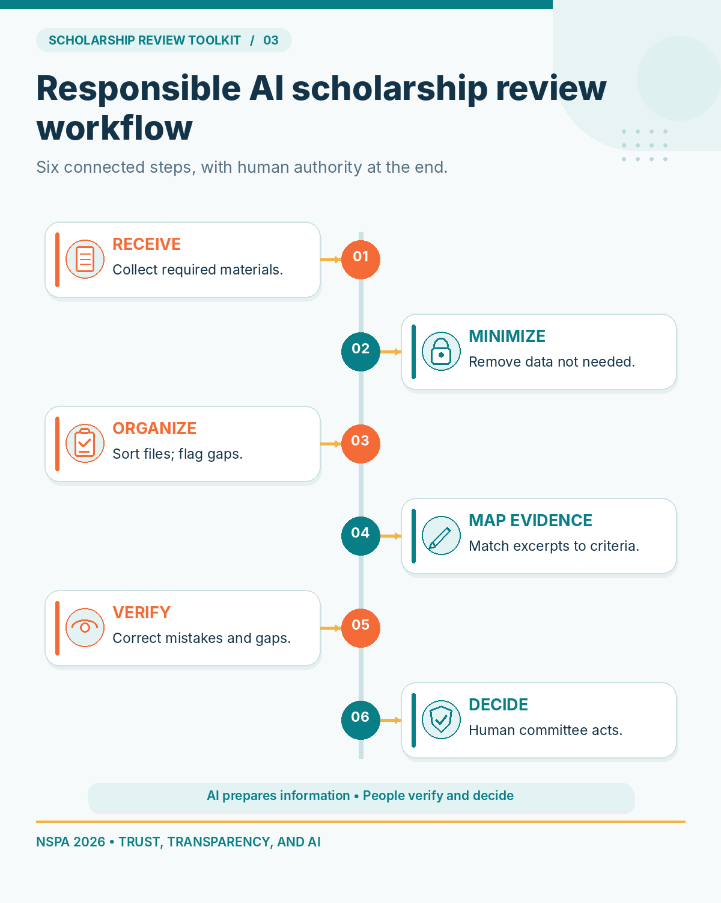
Notes:
The scholarship review workflow uses AI for support but leaves final decisions with people.

Slide 5
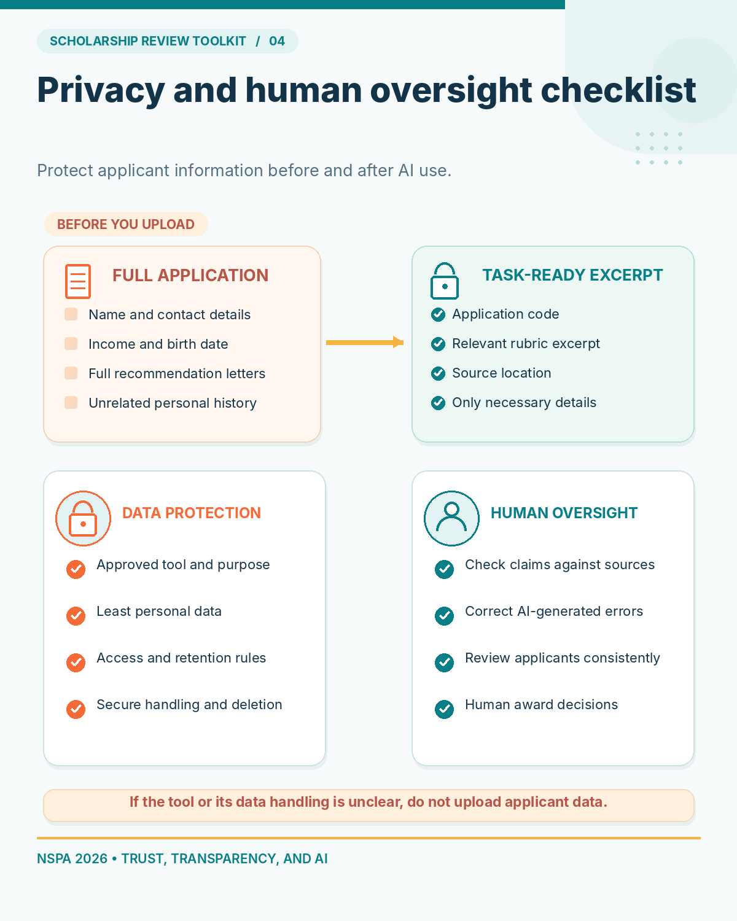
Notes:
Minimize applicant information and maintain meaningful human oversight.

Slide 6
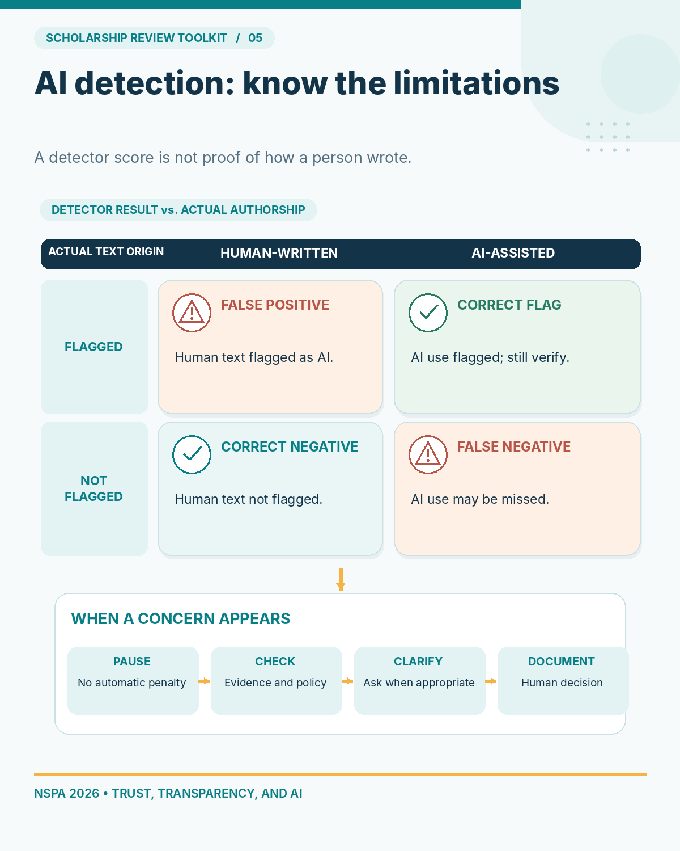
Notes:
AI detectors can return false positives and false negatives and should not decide eligibility.

Slide 7
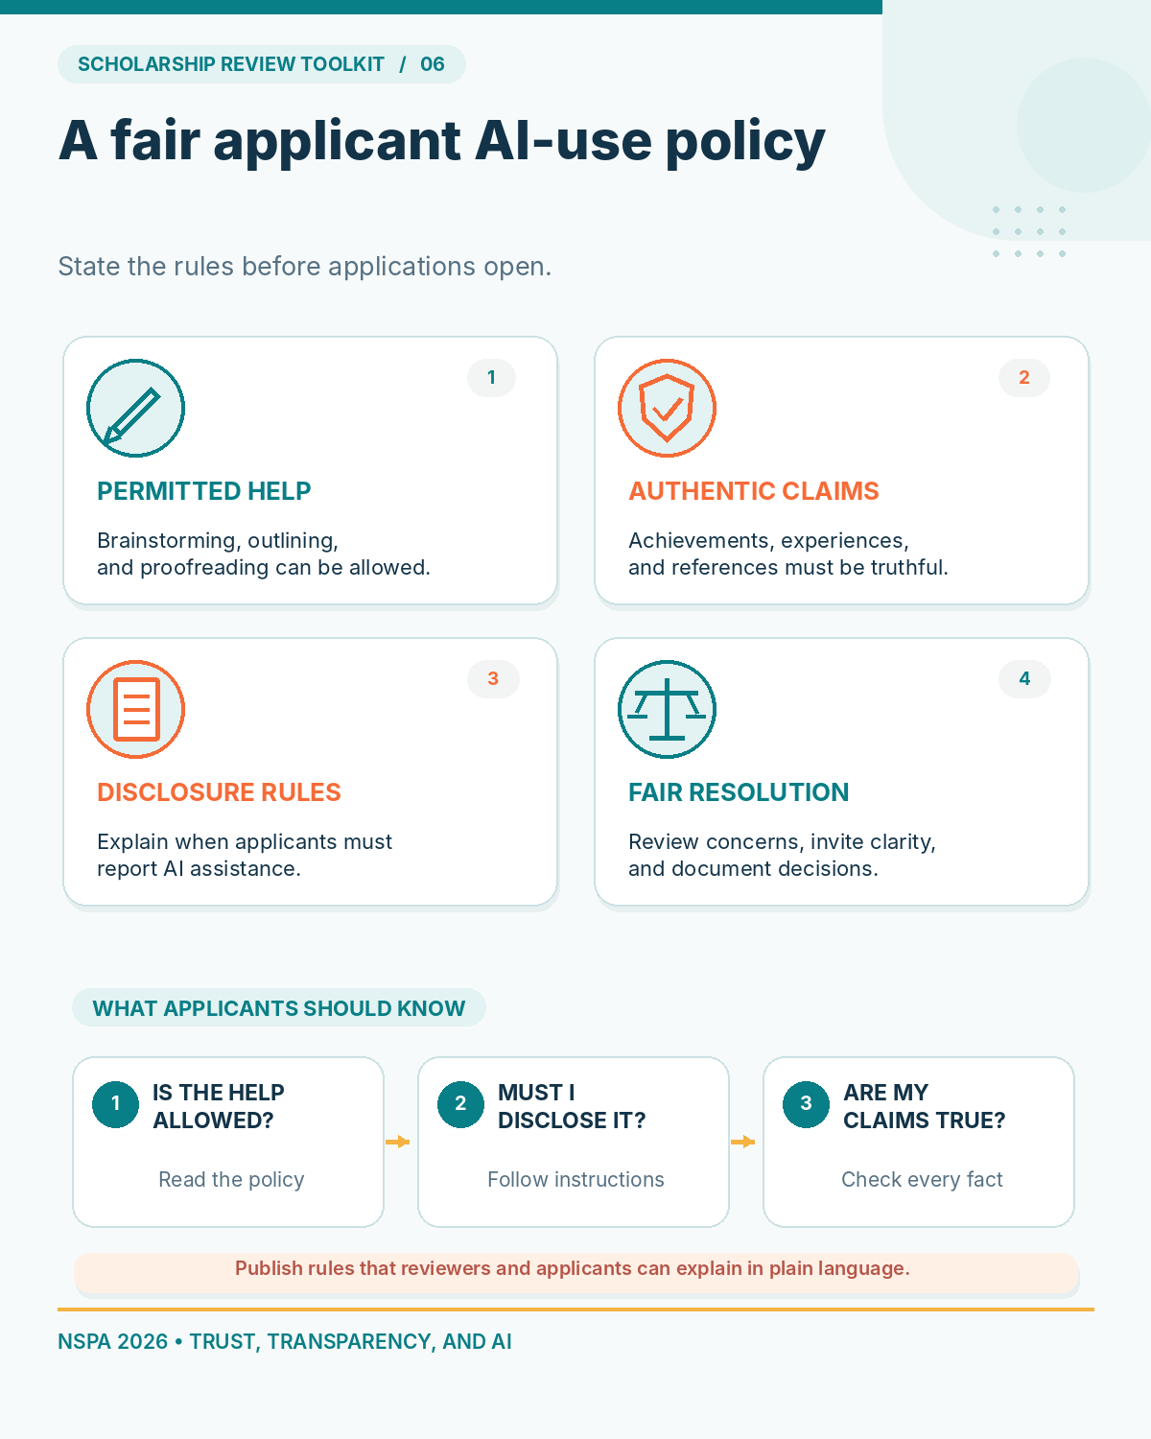
Notes:
Publish applicant AI-use rules before application deadlines.

