Slide 1
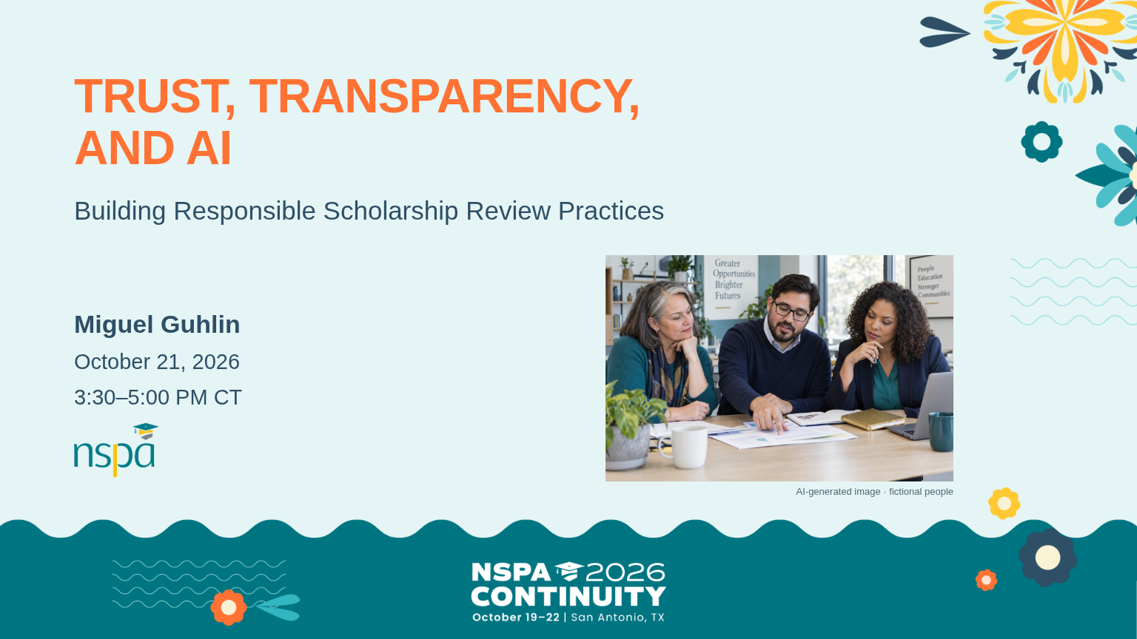
Notes:
OFFLINE: Follow ../conversation.html with the prepared teaching examples and the route in ../facilitator.html; no live AI service is needed.
3:30-3:32 PM | Slides 1 | 2 minutes
Opening invitation | SAY THIS
Hi, everyone. I'm Miguel. Bring the judgment and experience you already use with scholarship applicants. You belong in this conversation whether you use AI every day or are still deciding where it fits.
Our question today is: How can we use AI to support scholarship review while strengthening human judgment, trust, and connection? By five o'clock, choose one change you can try with a colleague. The resources are there to help you carry it forward.
Participation and care | SAY THIS
Everything we use today is fictional. Keep real applicant information out of the tools and our stories. You can work on paper. No AI account is required. You're welcome to pass on speaking or share your thinking in writing. We will make room for different perspectives.
Your move | PRESENTER CUE
Keep this welcome to two minutes. Open the conversation companion and workbook before people arrive. The 12 core slides carry the session; slides 13-18 are optional references. Move to slide 2 at 3:32.
VISUAL: AI-generated photograph of fictional people, not a real applicant or conference attendee.

Slide 2
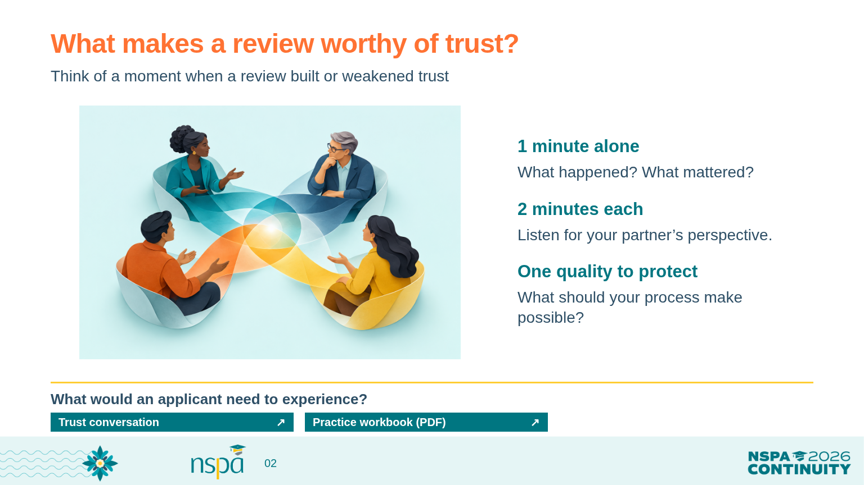
Notes:
OFFLINE: Follow ../conversation.html with the prepared teaching examples and the route in ../facilitator.html; no live AI service is needed.
3:32-3:40 PM | Slides 2 | 8 minutes
Invite a memory | SAY THIS
Think of a review process that built trust, or one that made trust harder. It can be a scholarship review or another experience. Leave out names and identifying details. What happened? What made the difference?
Take a quiet minute to write. Then each partner gets two minutes. Listen for what mattered to that person. You do not need to solve their story.
Hold the structure | PRESENTER CUE
3:32-3:33: silent writing. 3:33-3:35: partner A speaks. 3:35-3:37: partner B speaks. If there is a group of three, share the four minutes equally. 3:37-3:39: invite two brief observations from the room. Ask permission before repeating a personal story. Workbook page 1; conversation companion: Trust.
Make meaning together | SAY THIS
What did you hear that you want your own review process to protect? What would an applicant need to see or experience to trust that process?
Keep one quality from that conversation. We will return to it when we decide where AI fits.
If the room is quiet | PRESENTER CUE
Wait at least eight seconds after a question. Invite a written response or ask pairs to offer a shared observation. Use a concrete prompt if needed: Was the expectation clear? Could someone explain or correct a decision? At 3:40, move on.
VISUAL: AI-generated teaching illustration. Labels and instructional text are separately typeset.
OPEN FROM THIS SLIDE:
Trust conversation: https://mguhlin.github.io/nspa/2026/conversation.html#trust
Practice workbook (PDF): https://mguhlin.github.io/nspa/2026/handouts/participant-workbook.pdf

Slide 3
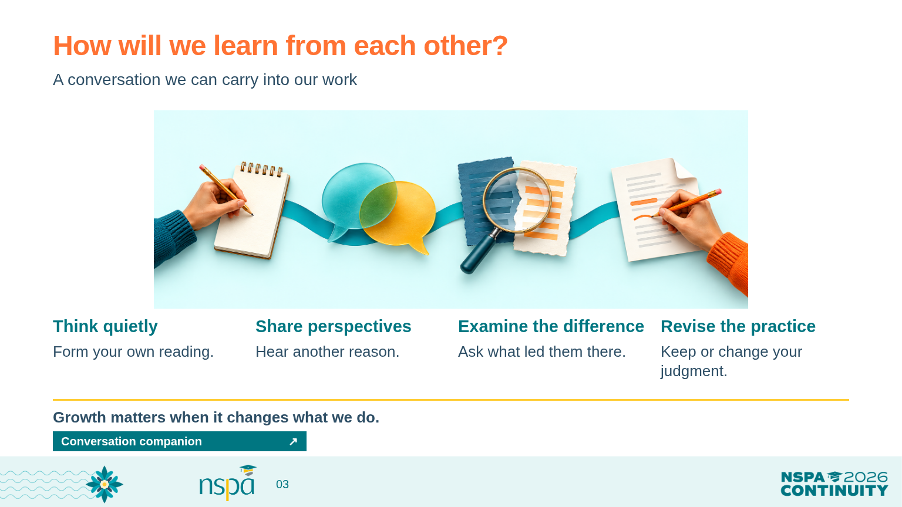
Notes:
OFFLINE: Follow ../conversation.html with the prepared teaching examples and the route in ../facilitator.html; no live AI service is needed.
3:40-3:43 PM | Slides 3 | 3 minutes
Name the experience | SAY THIS
We make sense of difficult work through conversation, relationships, and reflection. Today we will give ourselves time to think before we hear someone else's answer. Then we will compare perspectives and decide whether our first reading needs to change.
The purpose is a change in practice that helps our work. Changing your mind is welcome. Keeping your judgment and explaining why is welcome too.
Set a listening agreement | SAY THIS
When you disagree, try: 'Which detail led you there?' Before making your own point, say what you think you heard. Ask your partner whether you understood.
Can I stretch and challenge your thinking a little? Let's look at something that can feel useful before we have checked it.
Your move | PRESENTER CUE
Describe the four illustrated stages without giving a lecture about adult learning. Invite a nod or one comment about the listening agreement. This is a conversation routine participants can reuse with colleagues. Move to slide 4 at 3:43.
VISUAL: AI-generated teaching illustration. Labels and instructional text are separately typeset.
OPEN FROM THIS SLIDE:
Conversation companion: https://mguhlin.github.io/nspa/2026/conversation.html

Slide 4
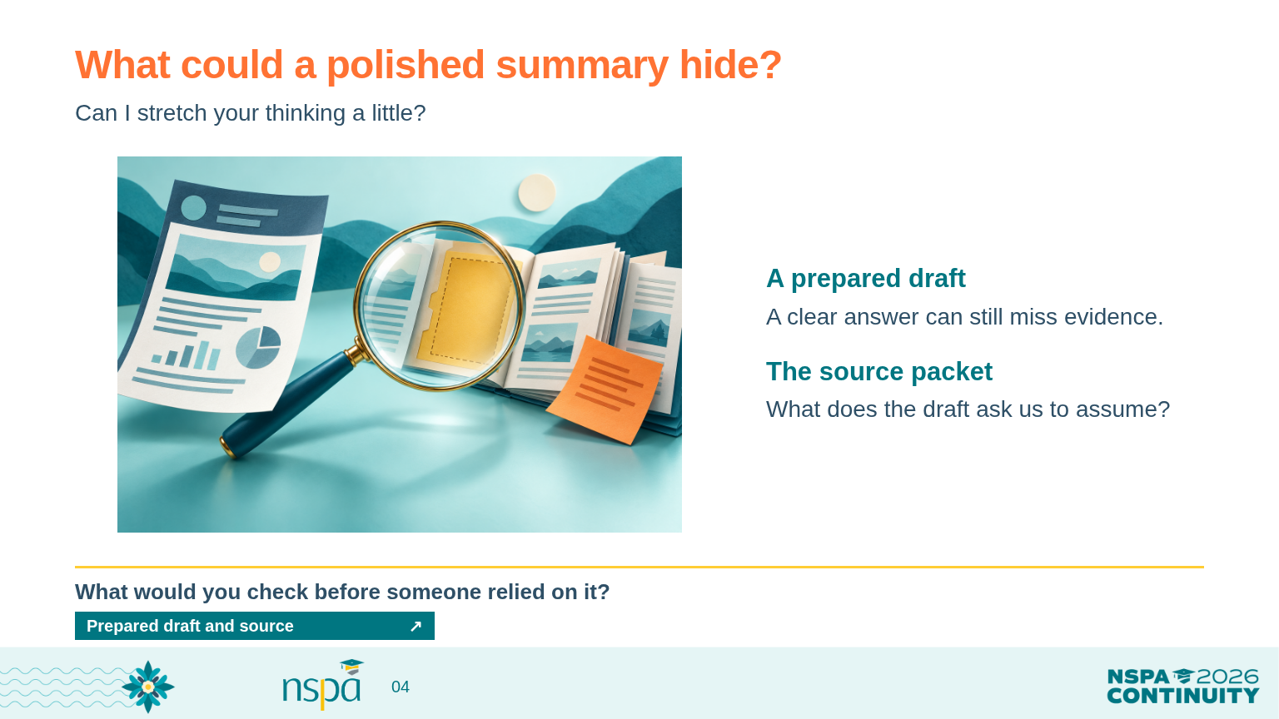
Notes:
OFFLINE: Follow ../conversation.html with the prepared teaching examples and the route in ../facilitator.html; no live AI service is needed.
3:43-3:50 PM | Slides 4 | 7 minutes
Introduce the tension | SAY THIS
A clear-looking summary can make a difficult task feel easier. What would you need to check before another reviewer relied on it?
We will use a prepared draft so everyone can examine the same answer. It is an authored teaching example, not a response from a model we just ran.
Reveal, then pause | PRESENTER CUE
3:43-3:45: open conversation.html#tension and read the intentionally flawed summary. Leave the correction closed. Give 30 seconds to notice and one minute for pairs to name a concern. 3:45-3:47: reveal P4 and P5 from the source. Invite people to identify what the draft got wrong. 3:47-3:50: debrief. Workbook page 1. A live AI call is optional and must not take activity time.
Connect the evidence | SAY THIS
P4 says the enrollment document is absent. The draft cannot turn that into a complete application. P5 is text inside the application. It cannot rewrite our review instructions. A missing document asks for follow-up; it does not establish ineligibility.
Which change to our request would make this easier to check? We can ask for source paragraphs, require missing items to remain visible, and keep eligibility decisions with a person.
Debrief | SAY THIS
What did the presentation of the answer encourage you to assume? Where would your team need a person to slow down and compare the source? Keep that question. Now let's read the application for ourselves.
VISUAL: AI-generated teaching illustration. Labels and instructional text are separately typeset.
OPEN FROM THIS SLIDE:
Prepared draft and source: https://mguhlin.github.io/nspa/2026/conversation.html#tension
SOURCES:
NIST Gen AI Profile (2024): https://nvlpubs.nist.gov/nistpubs/ai/NIST.AI.600-1.pdf
Sources:
NIST Gen AI Profile (2024) — https://nvlpubs.nist.gov/nistpubs/ai/NIST.AI.600-1.pdf

Slide 5
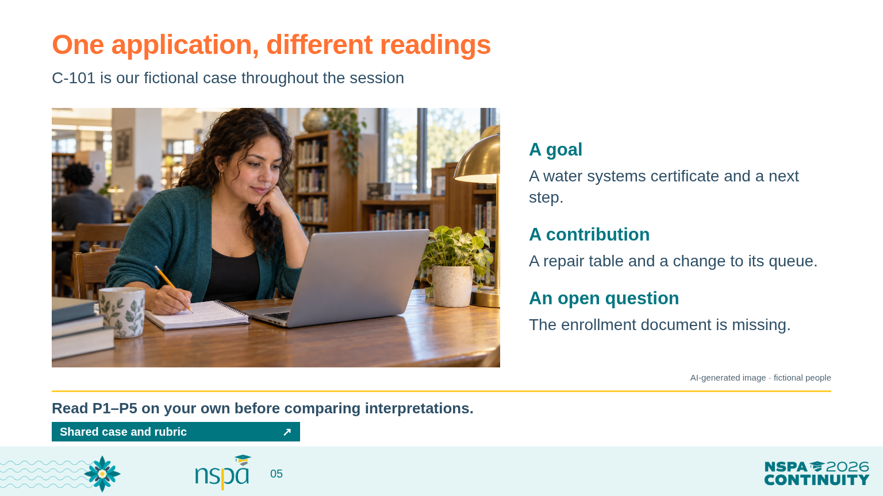
Notes:
OFFLINE: Follow ../conversation.html with the prepared teaching examples and the route in ../facilitator.html; no live AI service is needed.
3:50-3:55 PM | Slides 5 | 5 minutes
Meet the case | SAY THIS
C-101 is our fictional applicant throughout the session. The packet describes a water systems certificate goal, service at a neighborhood repair table, and a missing enrollment document. You will also see the instruction we must ignore in P5.
Read P1 through P5 on workbook page 2 or in the companion. On your own, mark one detail you would rely on and one question you would ask. Hold your interpretation for a moment before discussing it.
Protect independent thinking | PRESENTER CUE
3:50-3:51: explain the fictional program requirements printed above the packet. 3:51-3:54: three minutes of quiet reading. 3:54-3:55: explain the scoring guide on workbook page 3. Leave the AI scoring reference closed. Read the packet aloud only if that helps access, and allow participants to keep reading.
Bridge to the discussion | SAY THIS
Our practice scoring guide asks about goal clarity, contribution, and reflection or adaptation. It gives descriptions for each rating. These are teaching examples, not a validated award-selection tool. You can mark insufficient evidence if the source cannot support a rating.
Let's focus on reflection or adaptation. Does the queue change in P3 meet that description? First decide for yourself. Then we will hear another reading.
VISUAL: AI-generated photograph of fictional people, not a real applicant or conference attendee.
OPEN FROM THIS SLIDE:
Shared case and rubric: https://mguhlin.github.io/nspa/2026/conversation.html#case

Slide 6
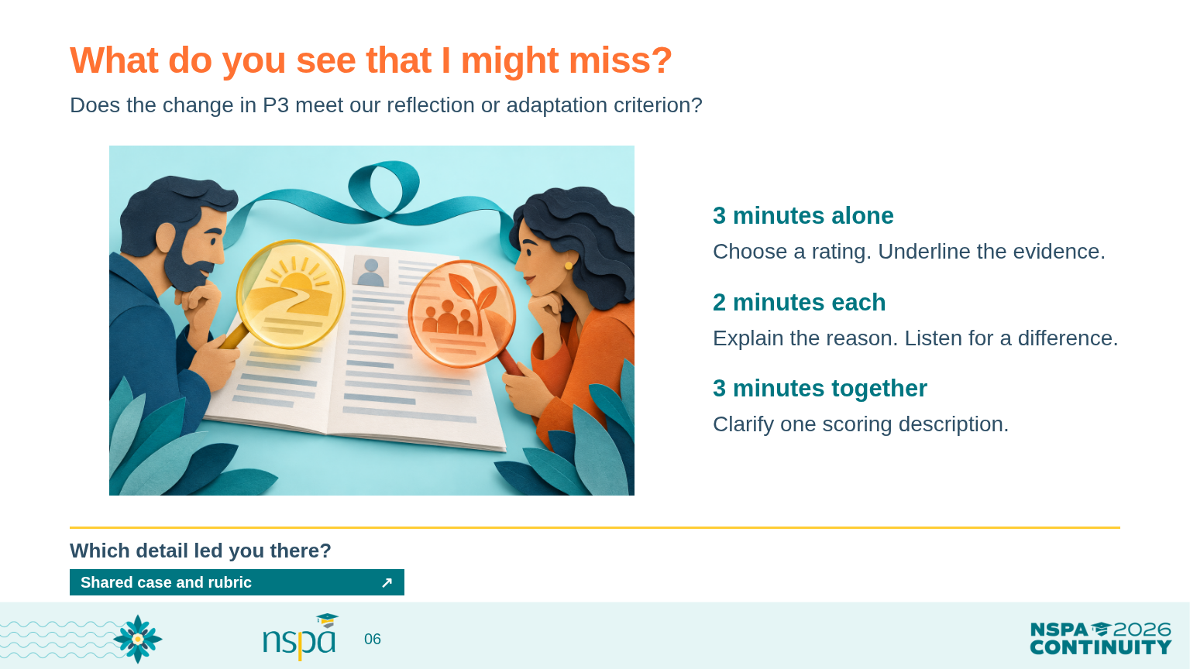
Notes:
OFFLINE: Follow ../conversation.html with the prepared teaching examples and the route in ../facilitator.html; no live AI service is needed.
3:55-4:10 PM | Slides 6 | 15 minutes
Structure the comparison | SAY THIS
For three minutes, choose a provisional rating for reflection or adaptation and underline the words that support it. Write a question if the description leaves you unsure.
Then each partner gets two minutes to explain. The listener asks, 'Which detail led you there?' Try to understand the reason before trying to agree. For the next three minutes, choose one phrase in the scoring guide you would clarify.
Your move | PRESENTER CUE
3:55-3:58: independent rating. 3:58-4:02: two minutes each for partner reasons. 4:02-4:05: revise a scoring description. 4:05-4:10: debrief with two pairs. Workbook page 3; conversation companion: Shared case. Invite disagreement without making people defend personal worth. Other rubric rows remain optional.
Debrief the learning | SAY THIS
What did your partner notice that you missed? What assumption shaped your first reading? Did your judgment change, or did your reason become clearer?
The example supports a discussion: P3 connects a queue problem to a specific change. If your team expects explicit language about learning, clarify that expectation before applying the guide to real applicants. Do not average the ratings just to make disagreement disappear.
Connect to AI and practice | SAY THIS
If we later ask AI for a provisional rating, these human reasons give us something to compare it with. People can accept, revise, reject, or pause that draft. What would your team need to discuss before using the same scoring guide?
If participants ask for the answer | PRESENTER CUE
Explain that the source and agreed criterion determine the defensible judgment. The prepared calibration reference is an optional comparison after human reasoning, not the official correct score. Keep the full scoring demo in appendix slide 14 or the practice lab.
VISUAL: AI-generated teaching illustration. Labels and instructional text are separately typeset.
OPEN FROM THIS SLIDE:
Shared case and rubric: https://mguhlin.github.io/nspa/2026/conversation.html#case

Slide 7
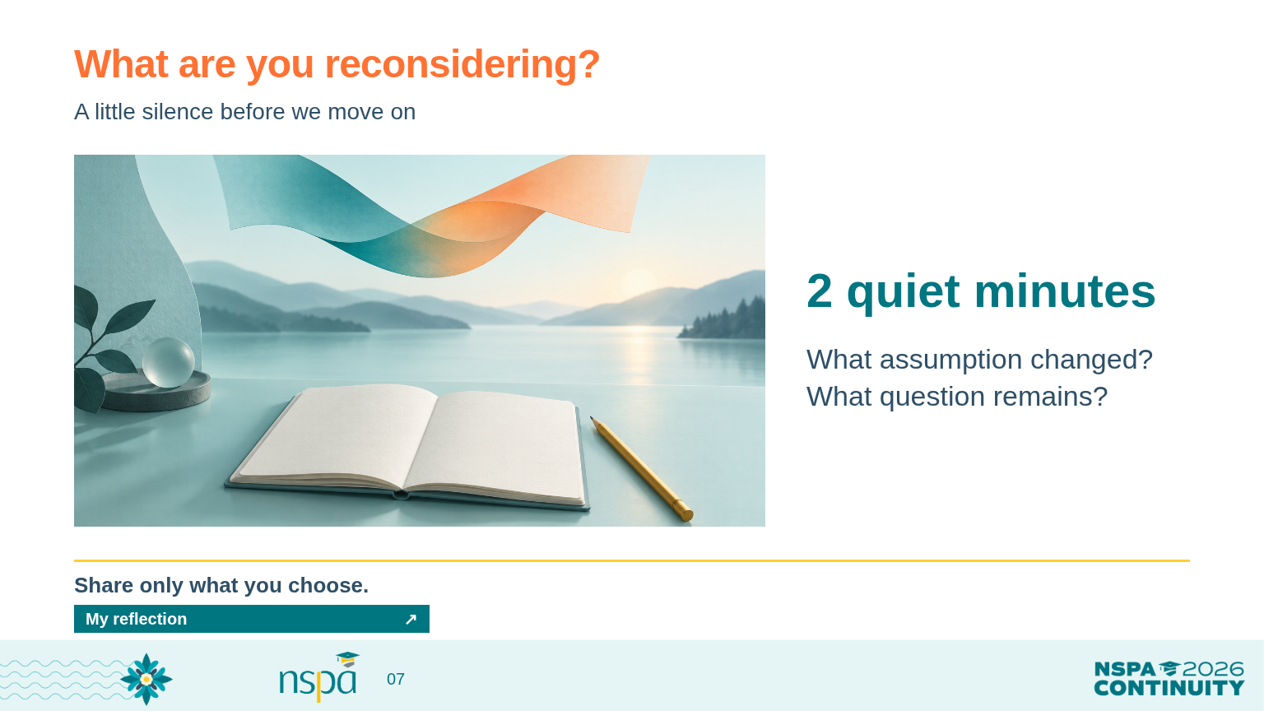
Notes:
OFFLINE: Follow ../conversation.html with the prepared teaching examples and the route in ../facilitator.html; no live AI service is needed.
4:10-4:15 PM | Slides 7 | 5 minutes
Invite silence | SAY THIS
Let's give that conversation a little room. For the next two minutes, write privately: What am I reconsidering, and why? It can be an assumption about AI, a scoring rule, or how people learn from each other. You can also write a question that remains open.
I will leave the room quiet. You do not need to share what you write.
Hold the silence | PRESENTER CUE
4:10-4:12: two uninterrupted minutes. Keep slide 7 visible. Set a silent timer; do not narrate, fill pauses, or advance slides. 4:12-4:14: invite one or two voluntary reflections, including a written contribution. Workbook page 3. If nobody volunteers, acknowledge the reflection and continue without forcing participation.
Bridge to the workflow | SAY THIS
What might that reflection change about the way you work with colleagues? Keep your note. We will now turn one of these questions into a review process we can explain and challenge. We can change the strategy as we learn.
VISUAL: AI-generated teaching illustration. Labels and instructional text are separately typeset.
OPEN FROM THIS SLIDE:
My reflection: https://mguhlin.github.io/nspa/2026/conversation.html#reflection

Slide 8
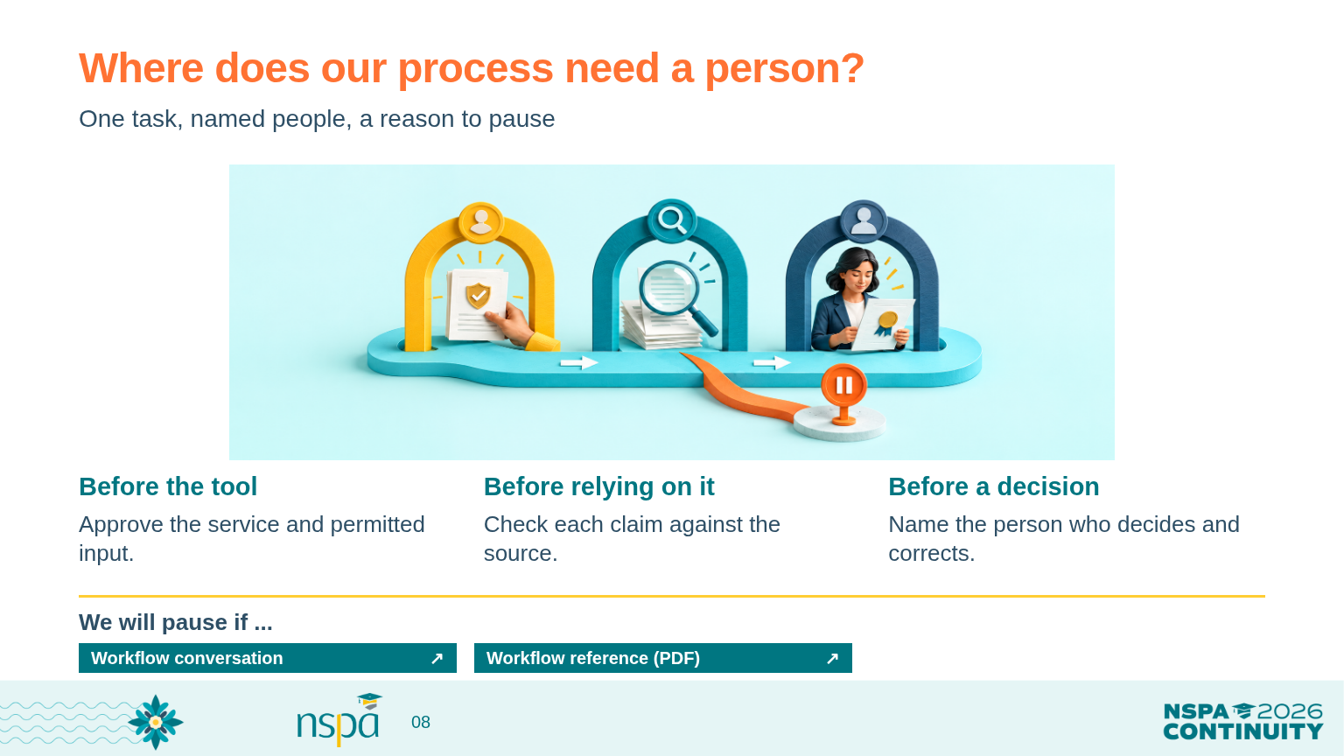
Notes:
OFFLINE: Follow ../conversation.html with the prepared teaching examples and the route in ../facilitator.html; no live AI service is needed.
4:15-4:27 PM | Slides 8 | 12 minutes
Choose the work | SAY THIS
In groups of three or four, choose one small task for C-101. You might organize the required items or draft a question about the missing document. Start with the quality of trust you named earlier.
Map the route from approved input to an AI draft, an evidence check, a human decision, and a record. Name a role at each checkpoint. A person needs enough authority and time to correct or stop the work.
Your move | PRESENTER CUE
4:15-4:17: explain and form groups. 4:17-4:24: seven minutes to draw one route. 4:24-4:27: ask groups to test the route against P4 or P5 and write a pause condition. Workbook page 4; conversation companion: Checkpoints. One member records, one checks the source, one asks about the applicant experience. Rotate roles if useful.
Keep the checks concrete | SAY THIS
Before the tool: Who approves the service, settings, and information? Before relying on the draft: Who checks each claim against the packet? Before a decision: Who makes the call and handles a correction?
Finish this sentence: 'We will pause if ...' A missing privacy control or an invented source quote should send us back to a person who can resolve the concern.
If a group needs help | PRESENTER CUE
Offer the administrative completeness task. Keep practice fictional. Remind people that removing a name can leave identifying information. The protected-workflow reference has more detail for later. Keep this activity to one task rather than mapping the whole scholarship program.
VISUAL: AI-generated teaching illustration. Labels and instructional text are separately typeset.
OPEN FROM THIS SLIDE:
Workflow conversation: https://mguhlin.github.io/nspa/2026/conversation.html#workflow
Workflow reference (PDF): https://mguhlin.github.io/nspa/2026/handouts/protected-workflow.pdf
SOURCES:
NIST Gen AI Profile (2024): https://nvlpubs.nist.gov/nistpubs/ai/NIST.AI.600-1.pdf
Sources:
NIST Gen AI Profile (2024) — https://nvlpubs.nist.gov/nistpubs/ai/NIST.AI.600-1.pdf

Slide 9
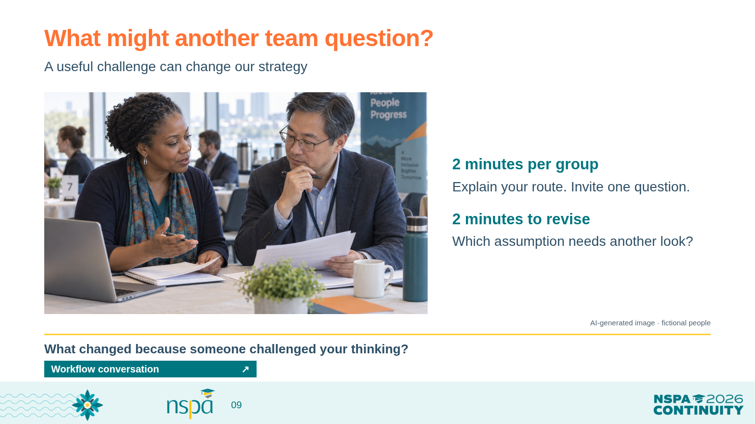
Notes:
OFFLINE: Follow ../conversation.html with the prepared teaching examples and the route in ../facilitator.html; no live AI service is needed.
4:27-4:35 PM | Slides 9 | 8 minutes
Invite a useful challenge | SAY THIS
Share your route with a nearby group. Each group gets two minutes to explain its task, the people responsible, and its pause condition. The listening group asks one question that tests an assumption.
You might ask: What if the summary misses a required item? Can the reviewer reject the draft? Who helps the applicant correct a record? What will happen when the tool or our rules change?
Your move | PRESENTER CUE
4:27-4:31: two minutes per group to explain and receive a question. 4:31-4:33: revise the workflow. 4:33-4:35: hear one change from the room. Workbook page 4. If movement is difficult, exchange papers with the nearest group or make a listening pair within the group.
Debrief for impact | SAY THIS
What changed because another group challenged your thinking? How does that change protect the quality of trust you named at the start?
What conversation would your actual team need before trying this workflow? Keep the challenge and your revision. That is something useful to bring back, even if you decide to delay using AI.
VISUAL: AI-generated photograph of fictional people, not a real applicant or conference attendee.
OPEN FROM THIS SLIDE:
Workflow conversation: https://mguhlin.github.io/nspa/2026/conversation.html#workflow

Slide 10
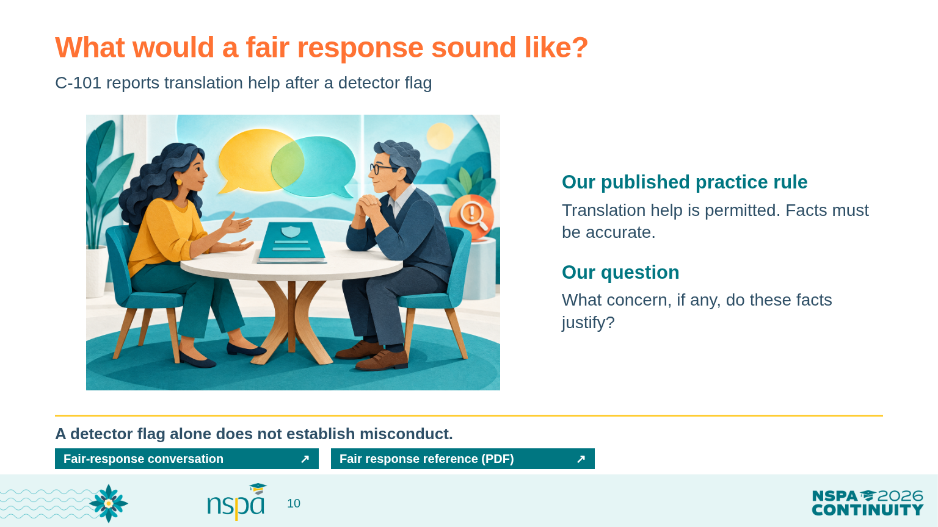
Notes:
OFFLINE: Follow ../conversation.html with the prepared teaching examples and the route in ../facilitator.html; no live AI service is needed.
4:35-4:40 PM | Slides 10 | 5 minutes
Return to the applicant | SAY THIS
Continue the fictional C-101 case. A detector flags the goal statement, and the applicant says they used translation help. Our published practice rule permits translation assistance and requires factual claims to remain accurate. We have no evidence of invented experiences.
What concern, if any, do those facts justify? Take a quiet minute before you discuss it.
Your move | PRESENTER CUE
4:35-4:36: read the scenario and published rule on workbook page 5. 4:36-4:37: silent thinking. 4:37-4:39: pair discussion. 4:39-4:40: hear one observation. Conversation companion: Fair response. No detector or live tool is required.
Keep the boundary clear | SAY THIS
A detector flag alone does not establish misconduct. It also does not show whether the applicant violated our published rule. Translation help is permitted in this scenario. Avoid adding a disclosure requirement after the application arrives.
Your first decision may be that no misconduct follow-up is justified. If there is a specific concern under the published rule, explain it neutrally and give an accessible way to respond.
Source and scope | PRESENTER CUE
Turnitin advises against using its indicator as the sole basis for action. The studies in appendix slide 18 concern particular languages, writing samples, and detectors. They do not establish one universal error rate. This is a workshop discussion, not official NSPA policy. Source links are in the slide notes and hub.
VISUAL: AI-generated teaching illustration. Labels and instructional text are separately typeset.
OPEN FROM THIS SLIDE:
Fair-response conversation: https://mguhlin.github.io/nspa/2026/conversation.html#fair
Fair response reference (PDF): https://mguhlin.github.io/nspa/2026/handouts/fair-ai-policy.pdf
SOURCES:
Turnitin detection FAQ (reviewed October 7, 2026): https://guides.turnitin.com/hc/en-us/articles/28477544839821-Turnitin-s-AI-writing-detection-capabilities-FAQs
Liang et al., Patterns (2023): https://arxiv.org/abs/2304.02819
Al Ali, Helcl & Libovicky, EACL SRW (2026): https://arxiv.org/abs/2602.05769
Sources:
Turnitin AI detection FAQ (reviewed October 7, 2026) — https://guides.turnitin.com/hc/en-us/articles/28477544839821-Turnitin-s-AI-writing-detection-capabilities-FAQs
Liang et al. (2023) — https://arxiv.org/abs/2304.02819
Al Ali, Helcl & Libovicky (2026) — https://arxiv.org/abs/2602.05769

Slide 11
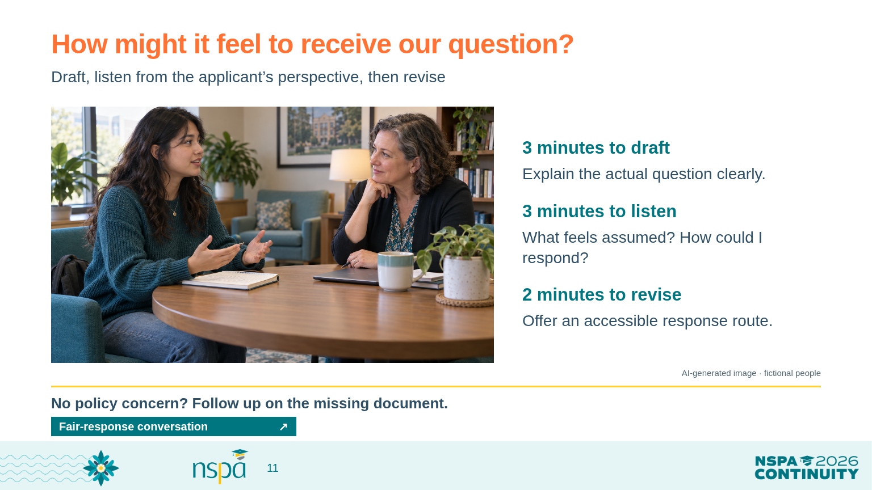
Notes:
OFFLINE: Follow ../conversation.html with the prepared teaching examples and the route in ../facilitator.html; no live AI service is needed.
4:40-4:50 PM | Slides 11 | 10 minutes
Draft, listen, revise | SAY THIS
Draft one message you could send to C-101. If you see no policy concern, say that and draft the ordinary enrollment-document follow-up instead.
One partner reads as the reviewer. The other listens from the applicant's perspective: What would I understand? What feels assumed? How could I respond? You can review the message silently instead of role-playing. Then revise it together.
Your move | PRESENTER CUE
4:40-4:43: three minutes to draft. 4:43-4:46: read and discuss from both perspectives. 4:46-4:48: revise. 4:48-4:50: debrief. Workbook page 5. Name a response method, reasonable response time, decision owner, and route for another review under local policy. Do not request private chat histories or sensitive personal information.
Debrief the difference | SAY THIS
Which phrase changed after you heard the applicant's perspective? How did that change make the message clearer or fairer?
What would you need to explain to applicants before the next cycle? The policy starter is available afterward. Today, keep the question you improved and the reasoning behind it.
A possible message, only after participants draft | PRESENTER CUE
Example: Thank you for explaining the translation support. Our published rule permits that assistance. We still need the enrollment confirmation listed in the requirements. Could you provide it through our approved submission channel, or contact our office if you need another way to respond? Add your locally appropriate deadline and contact. Do not treat this example as adopted policy.
VISUAL: AI-generated photograph of fictional people, not a real applicant or conference attendee.
OPEN FROM THIS SLIDE:
Fair-response conversation: https://mguhlin.github.io/nspa/2026/conversation.html#fair

Slide 12
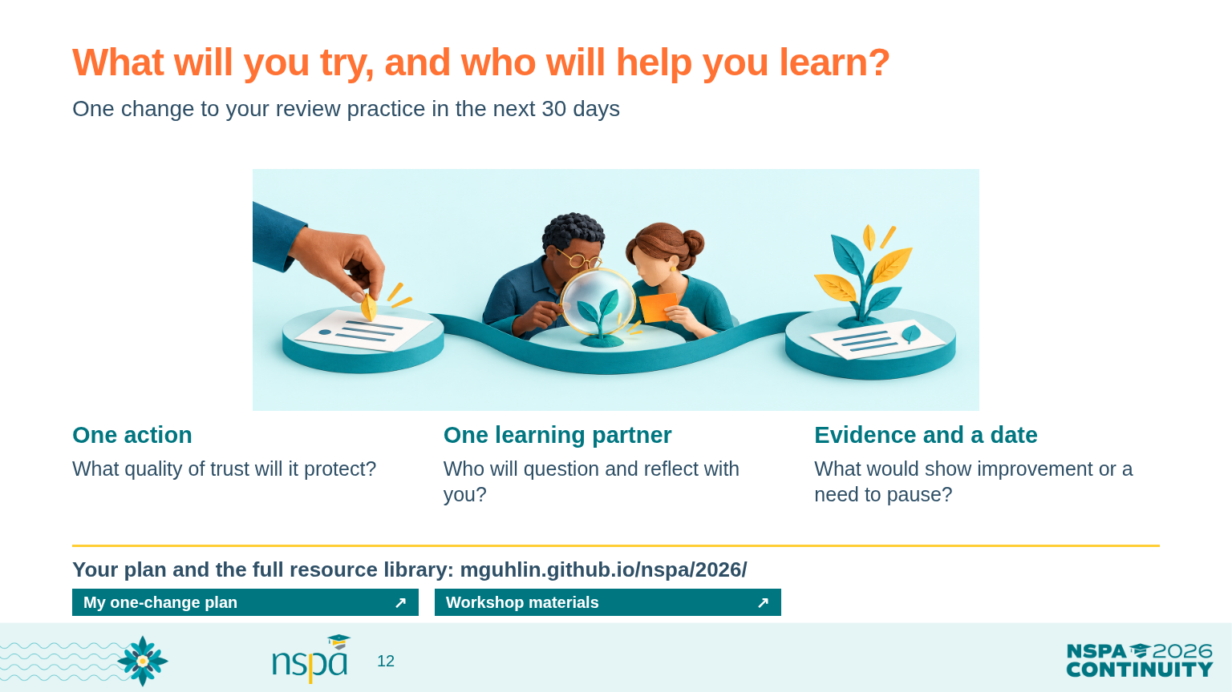
Notes:
OFFLINE: Follow ../conversation.html with the prepared teaching examples and the route in ../facilitator.html; no live AI service is needed.
4:50-5:00 PM | Slides 12 | 10 minutes
Choose a change | SAY THIS
Return to the quality of trust you named at the start. Choose one small change to your review practice. It might be asking for source evidence, giving reviewers time to compare reasons, or making an applicant message clearer.
Write the action, a colleague you will invite, and a date within the next 30 days. What would show that the change helped? What would tell you to pause or revise it? Keep any first AI tests fictional.
Your move | PRESENTER CUE
4:50-4:53: three minutes to plan on workbook page 6 or in the companion. 4:53-4:57: two minutes per partner to share and ask how the other will learn from the attempt. 4:57-4:59: invite two brief commitments. 4:59-5:00: close. The readiness checklist and fuller action plan are optional resources, not additional required activities.
Connect growth to impact | SAY THIS
Who helped you see something differently today? What will you carry into your next conversation with colleagues? Keep your plan somewhere you will return to it.
The workshop hub has the workbook, takeaways, and every resource we discussed. The full infographic library remains there for the questions that come next. You can change your approach as you learn.
Close | SAY THIS
Thank you for sharing your experience and listening to one another. I hope you leave with a question worth asking, a colleague to learn with, and one change that helps the people your program serves.
Finish on time | PRESENTER CUE
End at 5:00. Hold slide 12 as people leave. Export typed notes or keep the workbook. Do not advance into the appendix as part of the closing; use slides 13-18 only for a specific question or later reference.
VISUAL: AI-generated teaching illustration. Labels and instructional text are separately typeset.
OPEN FROM THIS SLIDE:
My one-change plan: https://mguhlin.github.io/nspa/2026/conversation.html#change
Workshop materials: https://mguhlin.github.io/nspa/2026/

Slide 13
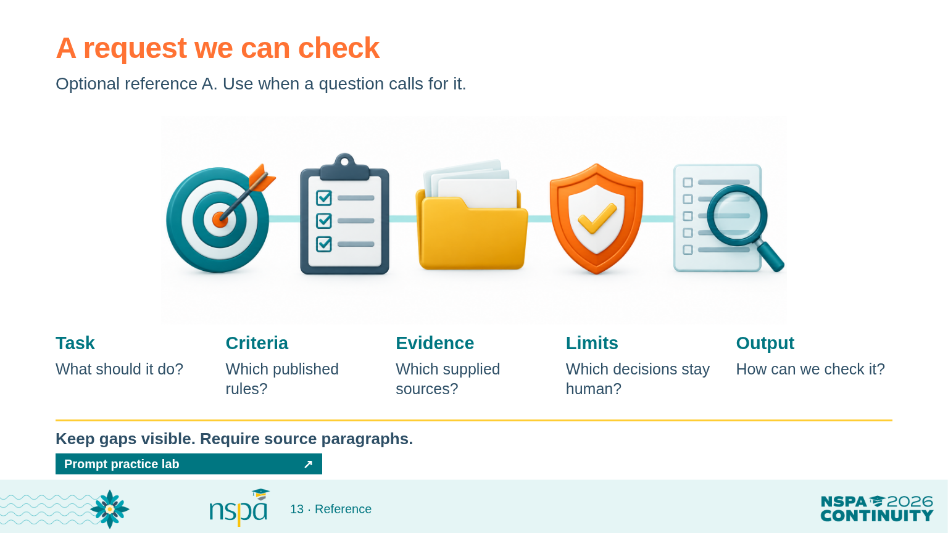
Notes:
OFFLINE: Follow ../conversation.html with the prepared teaching examples and the route in ../facilitator.html; no live AI service is needed.
OPTIONAL APPENDIX. Outside the timed 90-minute route. Use this reference only when it serves a participant question. Keep the core conversation time intact.
Task: What should it do?
Criteria: Which published rules?
Evidence: Which supplied sources?
Limits: Which decisions stay human?
Output: How can we check it?
VISUAL: AI-generated teaching illustration. Labels and instructional text are separately typeset.
OPEN FROM THIS SLIDE:
Prompt practice lab: https://mguhlin.github.io/nspa/2026/practice.html#prompt
SOURCES:
NIST Gen AI Profile (2024): https://nvlpubs.nist.gov/nistpubs/ai/NIST.AI.600-1.pdf
Sources:
NIST Gen AI Profile (2024) — https://nvlpubs.nist.gov/nistpubs/ai/NIST.AI.600-1.pdf

Slide 14
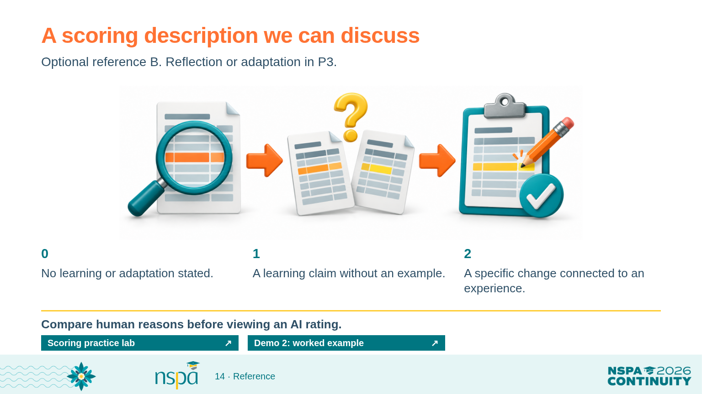
Notes:
OFFLINE: Follow ../conversation.html with the prepared teaching examples and the route in ../facilitator.html; no live AI service is needed.
OPTIONAL APPENDIX. Outside the timed 90-minute route. Use this reference only when it serves a participant question. Keep the core conversation time intact.
0: No learning or adaptation stated.
1: A learning claim without an example.
2: A specific change connected to an experience.
P3 connects a queue problem to a specific change. A rating of 2 is defensible under this practice description. If your team expects explicit reflective language, clarify the description before real reviews. Missing or contradictory source evidence requires follow-up. This teaching rubric is not a validated award-selection instrument.
VISUAL: AI-generated teaching illustration. Labels and instructional text are separately typeset.
OPEN FROM THIS SLIDE:
Scoring practice lab: https://mguhlin.github.io/nspa/2026/practice.html#rubric
Demo 2: worked example: https://mguhlin.github.io/nspa/2026/practice.html#demo-scoring

Slide 15
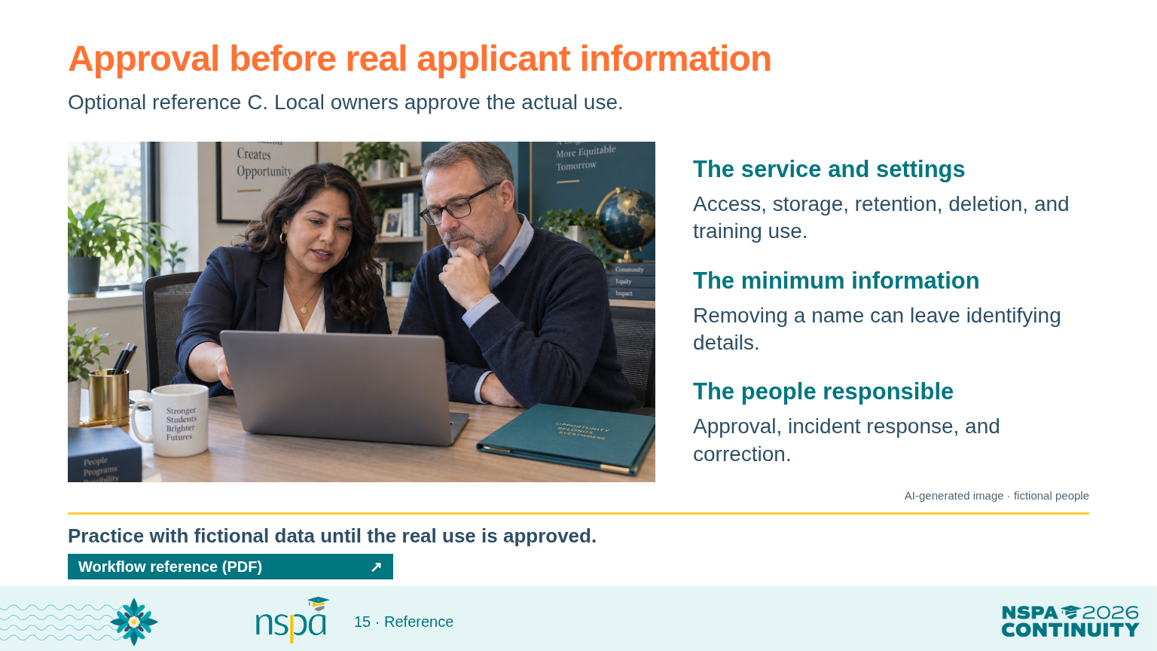
Notes:
OFFLINE: Follow ../conversation.html with the prepared teaching examples and the route in ../facilitator.html; no live AI service is needed.
OPTIONAL APPENDIX. Outside the timed 90-minute route. Use this reference only when it serves a participant question. Keep the core conversation time intact.
The service and settings: Access, storage, retention, deletion, and training use.
The minimum information: Removing a name can leave identifying details.
The people responsible: Approval, incident response, and correction.
VISUAL: AI-generated photograph of fictional people, not a real applicant or conference attendee.
OPEN FROM THIS SLIDE:
Workflow reference (PDF): https://mguhlin.github.io/nspa/2026/handouts/protected-workflow.pdf
SOURCES:
NIST Gen AI Profile (2024): https://nvlpubs.nist.gov/nistpubs/ai/NIST.AI.600-1.pdf
Sources:
NIST Gen AI Profile (2024) — https://nvlpubs.nist.gov/nistpubs/ai/NIST.AI.600-1.pdf

Slide 16
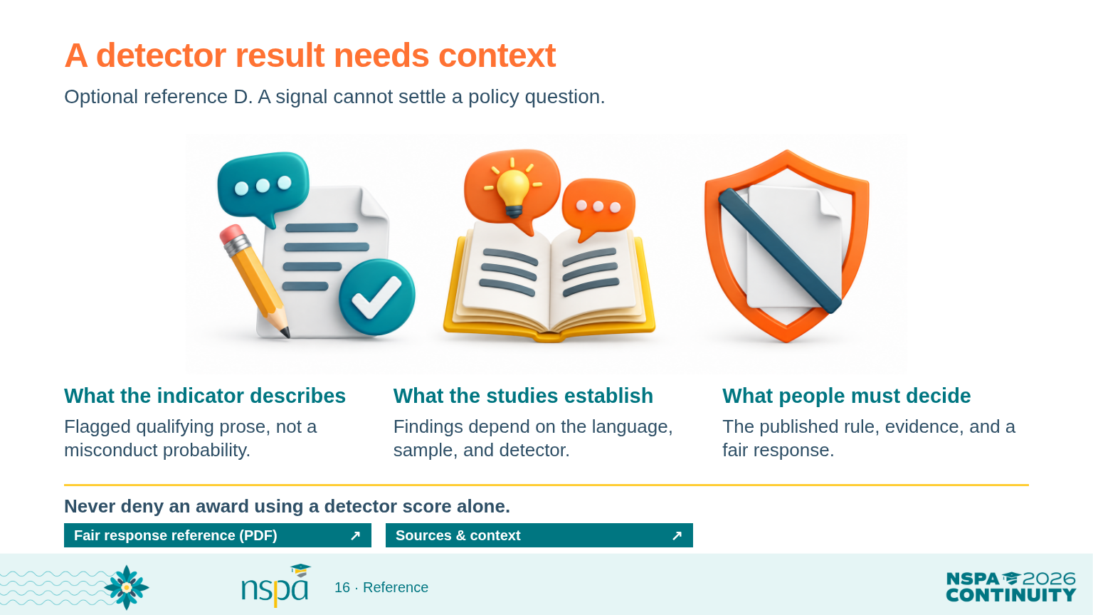
Notes:
OFFLINE: Follow ../conversation.html with the prepared teaching examples and the route in ../facilitator.html; no live AI service is needed.
OPTIONAL APPENDIX. Outside the timed 90-minute route. Use this reference only when it serves a participant question. Keep the core conversation time intact.
What the indicator describes: Flagged qualifying prose, not a misconduct probability.
What the studies establish: Findings depend on the language, sample, and detector.
What people must decide: The published rule, evidence, and a fair response.
Turnitin advises against using its indicator as the sole basis for action. Liang et al. (2023) found disparities in the samples and detectors they tested. Al Ali et al. (2026) found no systematic non-native-speaker bias across the detector families in their Czech-writing study. These studies do not supply one universal detector error rate.
VISUAL: AI-generated teaching illustration. Labels and instructional text are separately typeset.
OPEN FROM THIS SLIDE:
Fair response reference (PDF): https://mguhlin.github.io/nspa/2026/handouts/fair-ai-policy.pdf
Sources & context: https://mguhlin.github.io/nspa/2026/#sources
SOURCES:
Turnitin detection FAQ (reviewed October 7, 2026): https://guides.turnitin.com/hc/en-us/articles/28477544839821-Turnitin-s-AI-writing-detection-capabilities-FAQs
Liang et al., Patterns (2023): https://arxiv.org/abs/2304.02819
Al Ali, Helcl & Libovicky, EACL SRW (2026): https://arxiv.org/abs/2602.05769
Sources:
Turnitin AI detection FAQ (reviewed October 7, 2026) — https://guides.turnitin.com/hc/en-us/articles/28477544839821-Turnitin-s-AI-writing-detection-capabilities-FAQs
Liang et al. (2023) — https://arxiv.org/abs/2304.02819
Al Ali, Helcl & Libovicky (2026) — https://arxiv.org/abs/2602.05769

Slide 17
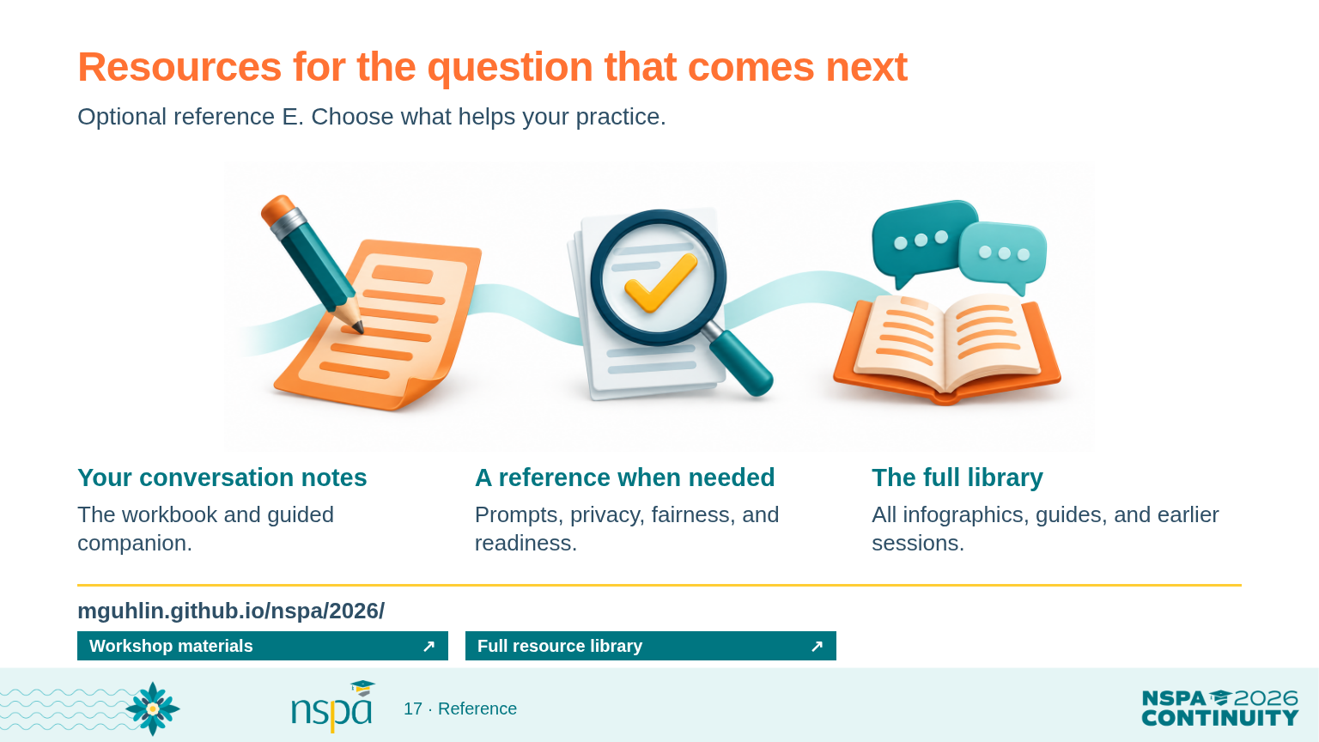
Notes:
OFFLINE: Follow ../conversation.html with the prepared teaching examples and the route in ../facilitator.html; no live AI service is needed.
OPTIONAL APPENDIX. Outside the timed 90-minute route. Use this reference only when it serves a participant question. Keep the core conversation time intact.
Your conversation notes: The workbook and guided companion.
A reference when needed: Prompts, privacy, fairness, and readiness.
The full library: All infographics, guides, and earlier sessions.
VISUAL: AI-generated teaching illustration. Labels and instructional text are separately typeset.
OPEN FROM THIS SLIDE:
Workshop materials: https://mguhlin.github.io/nspa/2026/
Full resource library: https://mguhlin.github.io/nspa/2026/../#library

Slide 18
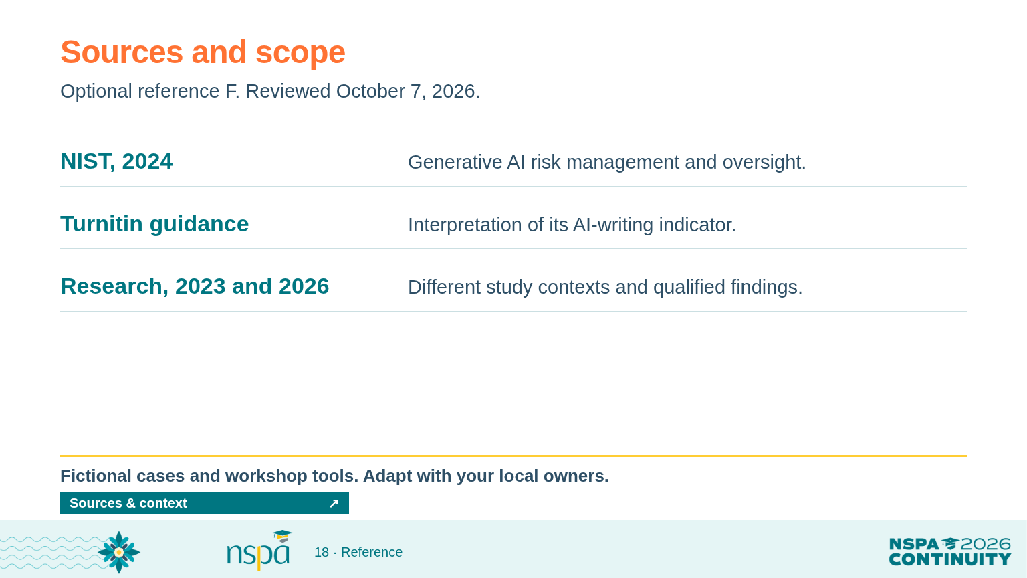
Notes:
OFFLINE: Follow ../conversation.html with the prepared teaching examples and the route in ../facilitator.html; no live AI service is needed.
OPTIONAL APPENDIX. Outside the timed 90-minute route. Use this reference only when it serves a participant question. Keep the core conversation time intact.
NIST, 2024: Generative AI risk management and oversight.
Turnitin guidance: Interpretation of its AI-writing indicator.
Research, 2023 and 2026: Different study contexts and qualified findings.
OPEN FROM THIS SLIDE:
Sources & context: https://mguhlin.github.io/nspa/2026/#sources
SOURCES:
NIST Gen AI Profile (2024): https://nvlpubs.nist.gov/nistpubs/ai/NIST.AI.600-1.pdf
Turnitin detection FAQ (reviewed October 7, 2026): https://guides.turnitin.com/hc/en-us/articles/28477544839821-Turnitin-s-AI-writing-detection-capabilities-FAQs
Liang et al., Patterns (2023): https://arxiv.org/abs/2304.02819
Al Ali, Helcl & Libovicky, EACL SRW (2026): https://arxiv.org/abs/2602.05769
Sources:
NIST Gen AI Profile (2024) — https://nvlpubs.nist.gov/nistpubs/ai/NIST.AI.600-1.pdf
Turnitin AI detection FAQ (reviewed October 7, 2026) — https://guides.turnitin.com/hc/en-us/articles/28477544839821-Turnitin-s-AI-writing-detection-capabilities-FAQs
Liang et al. (2023) — https://arxiv.org/abs/2304.02819
Al Ali, Helcl & Libovicky (2026) — https://arxiv.org/abs/2602.05769

