Slide 1
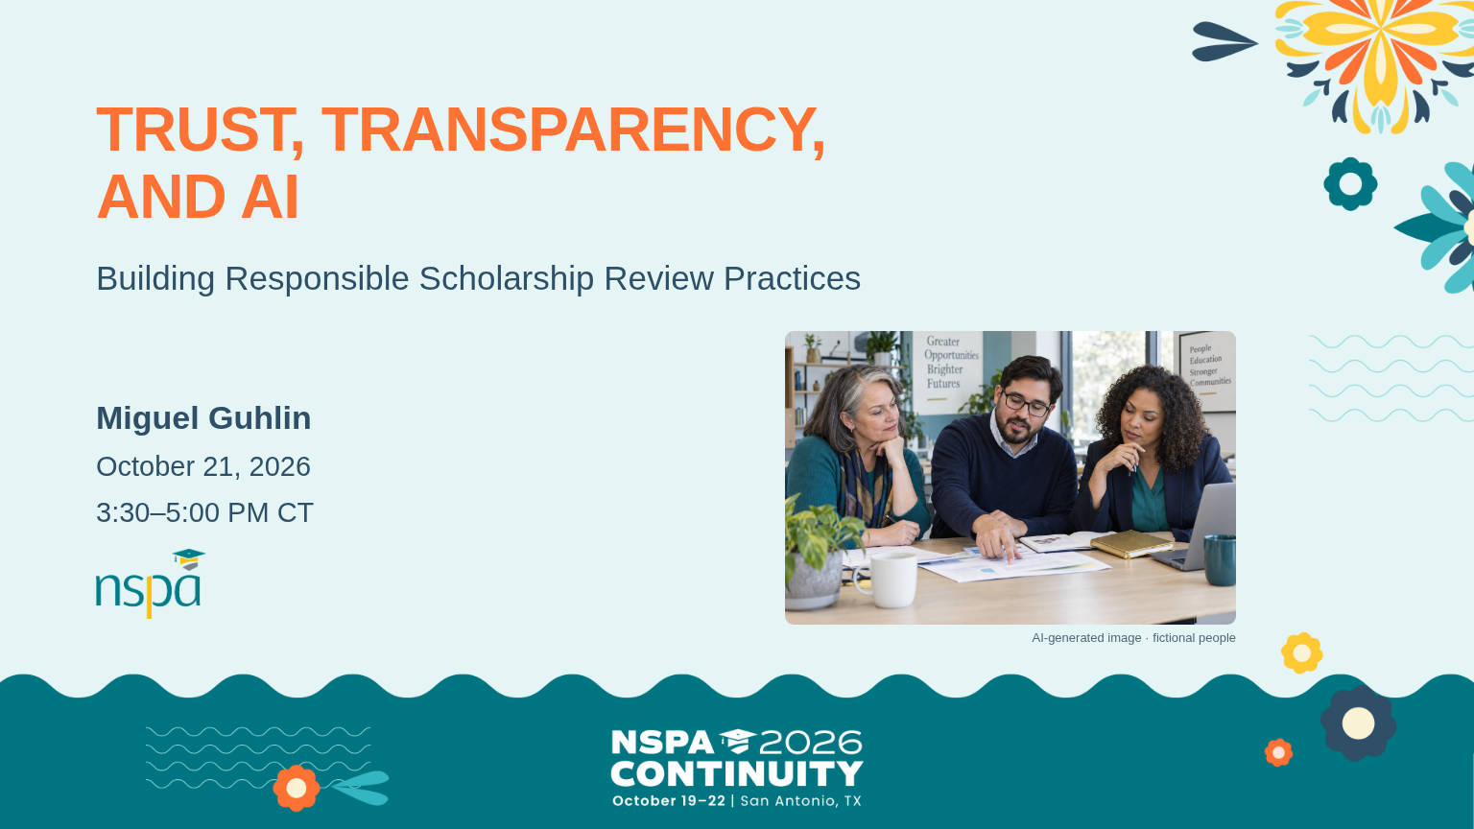
Notes:
3:30-3:38 PM | Slides 1-4 | 8 minutes
3:30-3:33 | Welcome | SAY THIS
Hi, everyone. I'm Miguel. I'm glad you're here. Whether you've been using AI every day or you're still wondering where it fits, you have a place in this conversation.
Today we're going to work through a scholarship application together. We'll try a few ways AI might help, and we'll practice checking its work. You don't need to be a technology expert. Bring the judgment you already use when you work with applicants.
PRESENTER CUE: Advance to slide 2 for the three takeaways.
VISUAL: AI-generated photograph of fictional people.

Slide 2
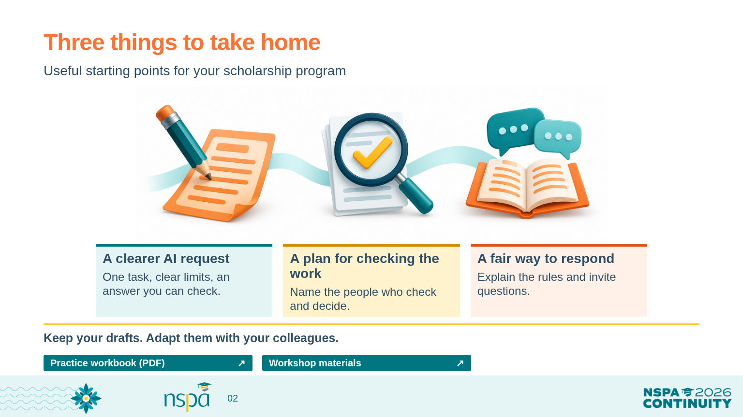
Notes:
3:30-3:38 PM | Slides 1-4 | 8 minutes
3:30-3:33 | Welcome, continued | SAY THIS
By five o'clock, you'll have the beginnings of three things you can take home: a better request to give an AI tool, a plan for where people need to check the work, and a fair way to respond when an applicant uses AI. These are starting points you can adapt with your colleagues.
OPEN FROM THIS SLIDE (click a resource button in Slide Show):
Practice workbook (PDF): https://mguhlin.github.io/nspa/2026/handouts/participant-workbook.pdf
Workshop materials: https://mguhlin.github.io/nspa/2026/

Slide 3
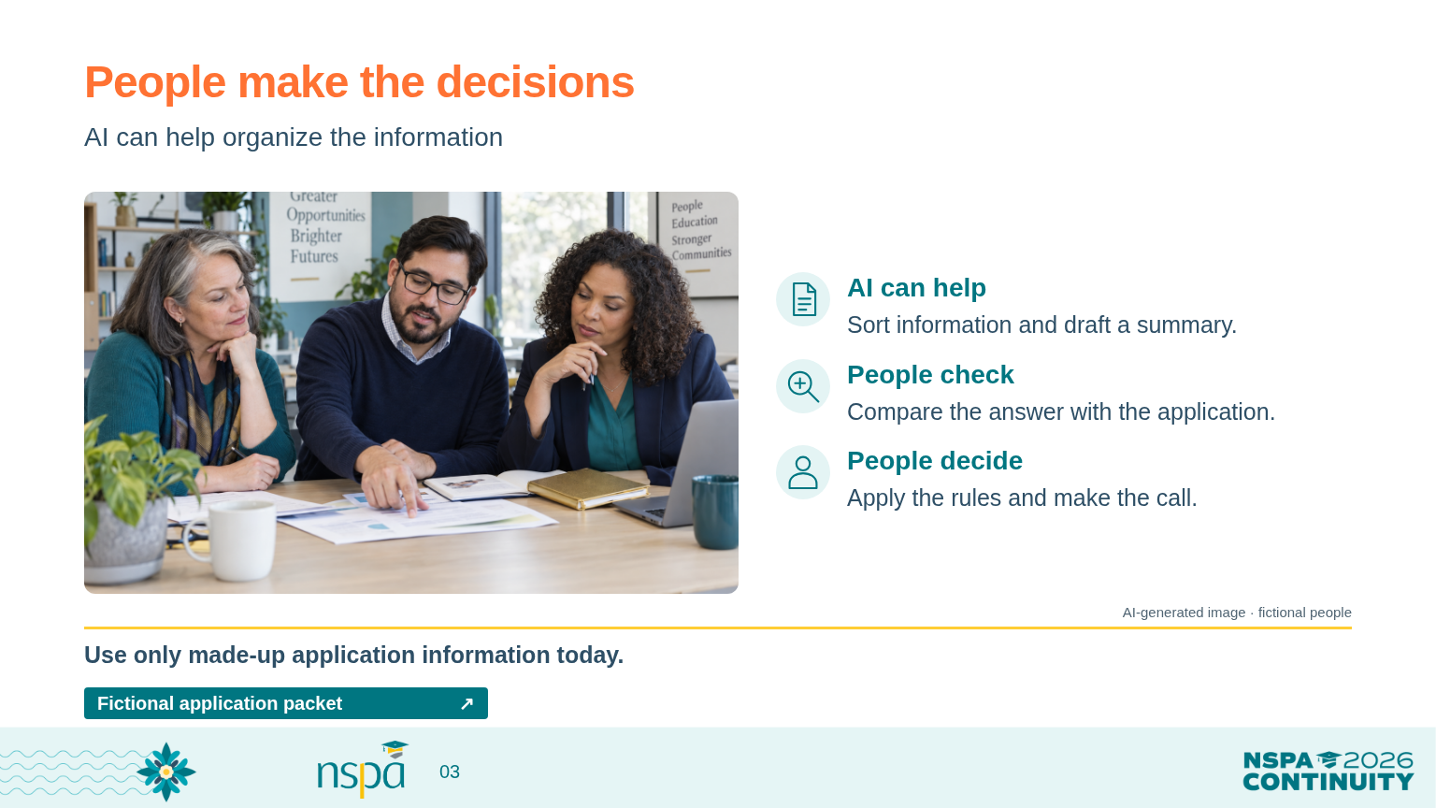
Notes:
3:30-3:38 PM | Slides 1-4 | 8 minutes
Facilitator guide: Welcome and find a starting point
3:33-3:35 | Set the ground rules | SAY THIS
Everything we use today is made up for this workshop. Please don't paste a real application into a tool while we're here. You can do every activity on paper if you prefer.
An AI tool might help us organize information or draft a summary. People still need to check the facts, apply the program's rules, and make the decision. If something looks wrong, we can pause. Speed isn't much help if we have to untangle a bad decision later.
VISUAL: AI-generated photograph of fictional people, not a real applicant or conference attendee.
OPEN FROM THIS SLIDE (click a resource button in Slide Show):
Fictional application packet: https://mguhlin.github.io/nspa/2026/practice.html#packet

Slide 4
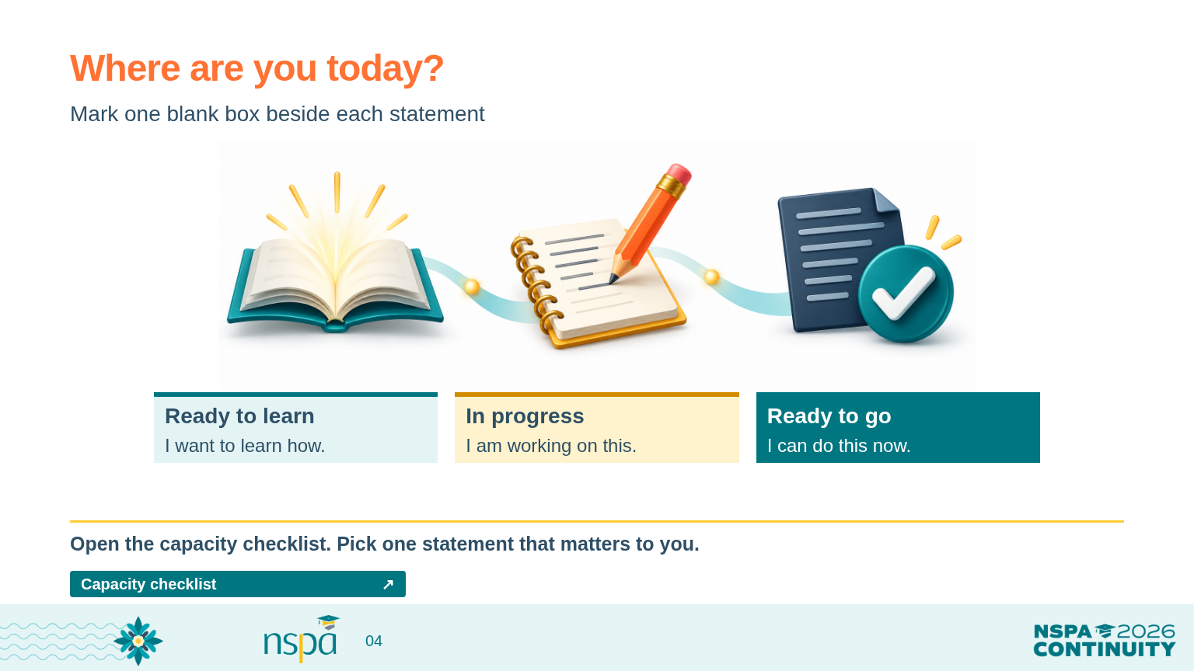
Notes:
3:30-3:38 PM | Slides 1-4 | 8 minutes
Facilitator guide: Welcome and find a starting point
3:35-3:38 | Choose a starting point | PRESENTER CUE
Show slide 4. Open the capacity matrix from the workshop hub. Give people one minute to read, one minute to choose, and one minute to talk with a neighbor.
Invite a personal starting point | SAY THIS
Open the capacity matrix, or use the printed copy. Choose one area that matters to your work. Mark its four statements; you can complete the other areas afterward. Mark 'Ready to learn,' 'In progress,' or 'Ready to go.' Use Notes for a question or something you want to try.
This isn't a test, and nobody needs a perfect row of answers. Tell a neighbor one thing you'd like to feel more comfortable doing by the end of today.
Transition | SAY THIS
Keep that goal in mind. Let's begin with the request we give the AI tool.
OPEN FROM THIS SLIDE (click a resource button in Slide Show):
Capacity checklist: https://mguhlin.github.io/nspa/2026/capacity-matrix.html

Slide 5
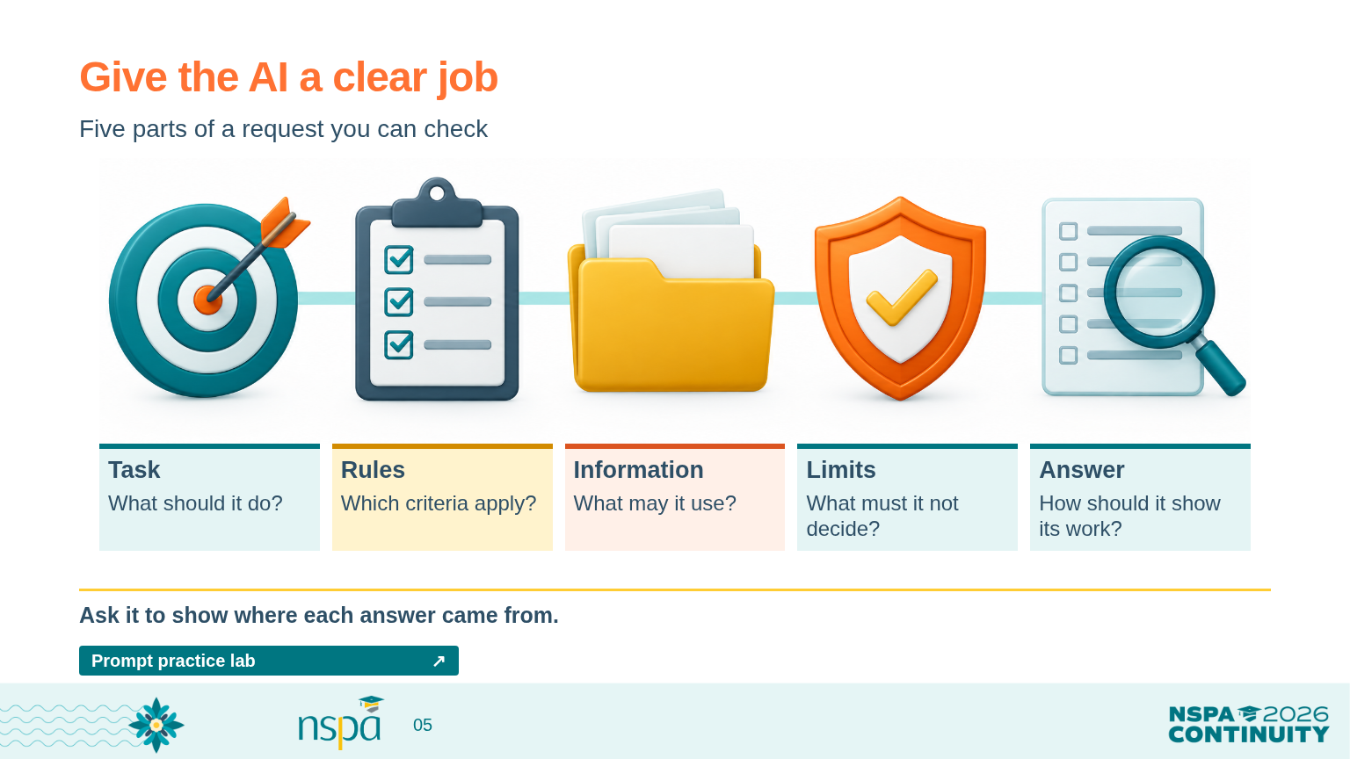
Notes:
3:38-3:50 PM | Slides 5-7 | 12 minutes
Facilitator guide: Help the AI understand the job
3:38-3:43 | Explain and compare | SAY THIS
A prompt is simply the request you give an AI tool. Think about asking a new colleague for help. 'Find our best applicants' leaves a lot for that person to guess. What does best mean? Which rules should they use? What should they do when something is missing?
We can be much clearer: 'Look through this application. List the required items. Show me where each item appears. If you can't find something, mark it missing and suggest a question for a person to follow up on.'
That request gives the tool a job we can check. We tell it what to do, which rules to use, what information it may use, what it must not decide, and how to show the answer. It can still make mistakes. A clearer request makes those mistakes easier to find.
PRESENTER CUE: Advance to slide 6 when comparing “Find our best applicants” with the clearer request.
OPEN FROM THIS SLIDE (click a resource button in Slide Show):
Prompt practice lab: https://mguhlin.github.io/nspa/2026/practice.html#prompt

Slide 6
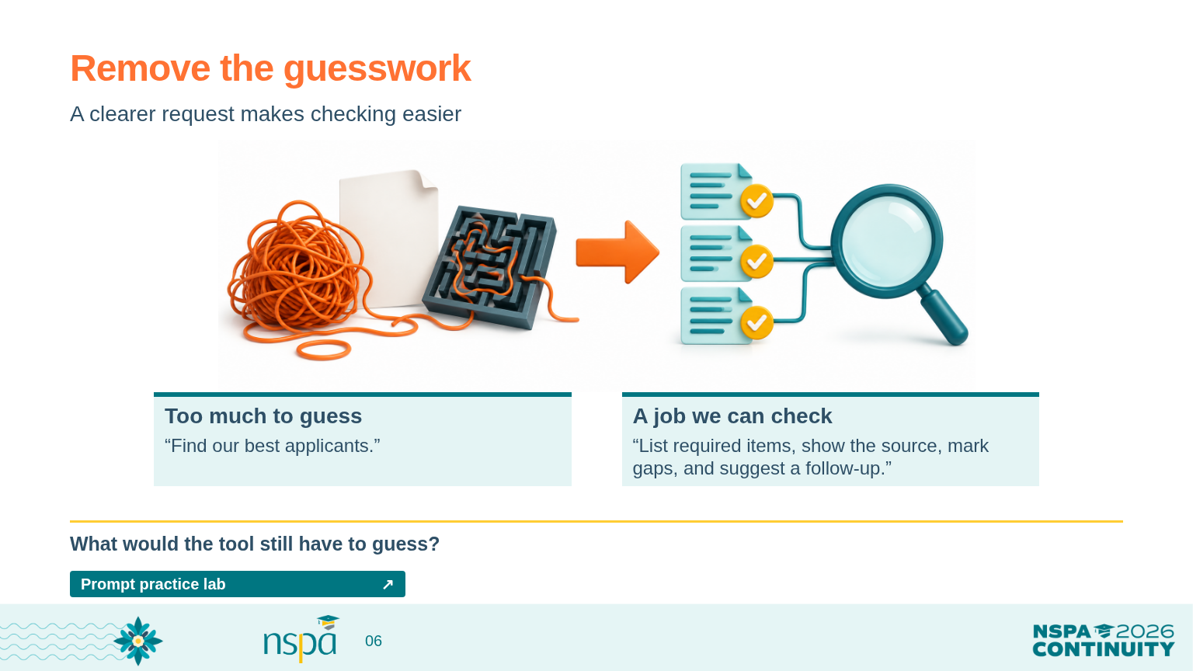
Notes:
3:38-3:50 PM | Slides 5-7 | 12 minutes
Facilitator guide: Help the AI understand the job
Use the two examples | PRESENTER CUE
Show slides 5 and 6. Read the vague request, then the more specific request. Ask for one quick observation before moving to slide 7.
OPEN FROM THIS SLIDE (click a resource button in Slide Show):
Prompt practice lab: https://mguhlin.github.io/nspa/2026/practice.html#prompt

Slide 7
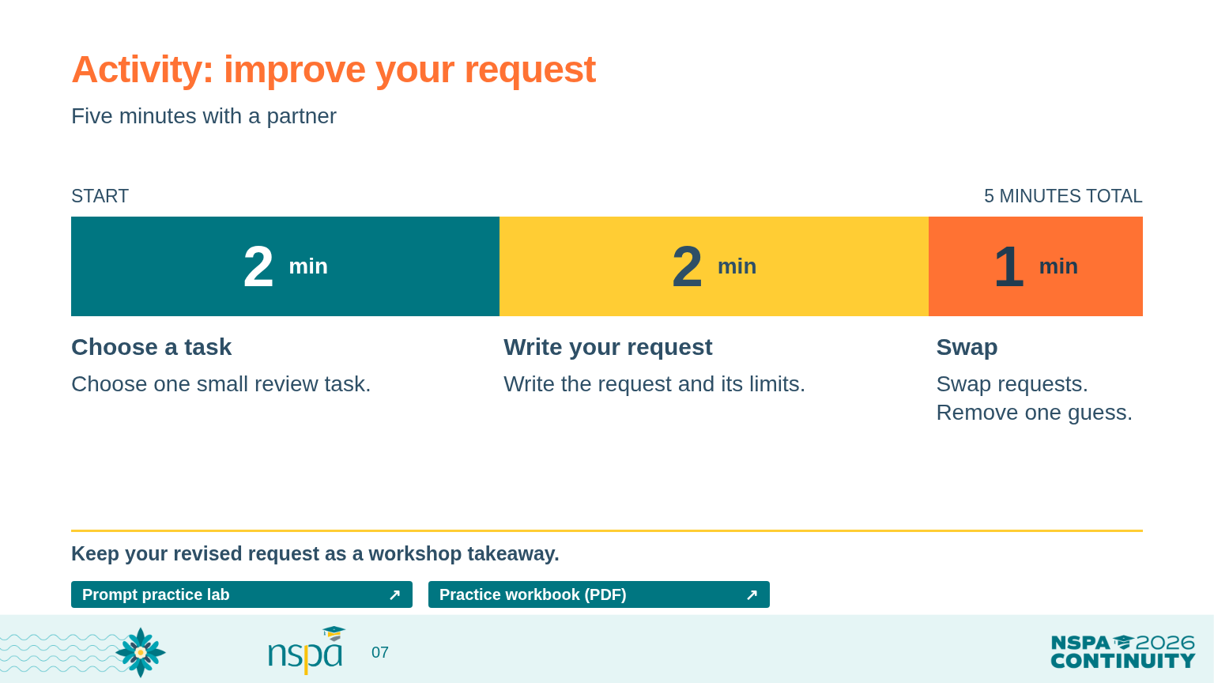
Notes:
3:38-3:50 PM | Slides 5-7 | 12 minutes
Facilitator guide: Help the AI understand the job
3:43-3:48 | Pair activity | SAY THIS
Find a partner. For the first two minutes, choose one small job you might ask AI to help with. You could check whether an application includes the required documents or draft a follow-up question.
For the next two minutes, write your request. Say what information it may use, ask it to show where its answer came from, and name a decision that stays with a person.
For the final minute, swap requests. Ask your partner, 'What would the tool still have to guess?' Help each other remove one guess.
Keep the activity moving | PRESENTER CUE
Announce each time change. If a pair is stuck, suggest checking for a goal statement, service example, and enrollment document in the fictional packet.
3:48-3:50 | Hear one change | SAY THIS
Who changed a request because your partner spotted something the tool might have guessed? What did you add?
Keep the request you wrote. You can keep improving it as we go. Now let's try a request together and see what actually comes back.
OPEN FROM THIS SLIDE (click a resource button in Slide Show):
Prompt practice lab: https://mguhlin.github.io/nspa/2026/practice.html#prompt
Practice workbook (PDF): https://mguhlin.github.io/nspa/2026/handouts/participant-workbook.pdf

Slide 8
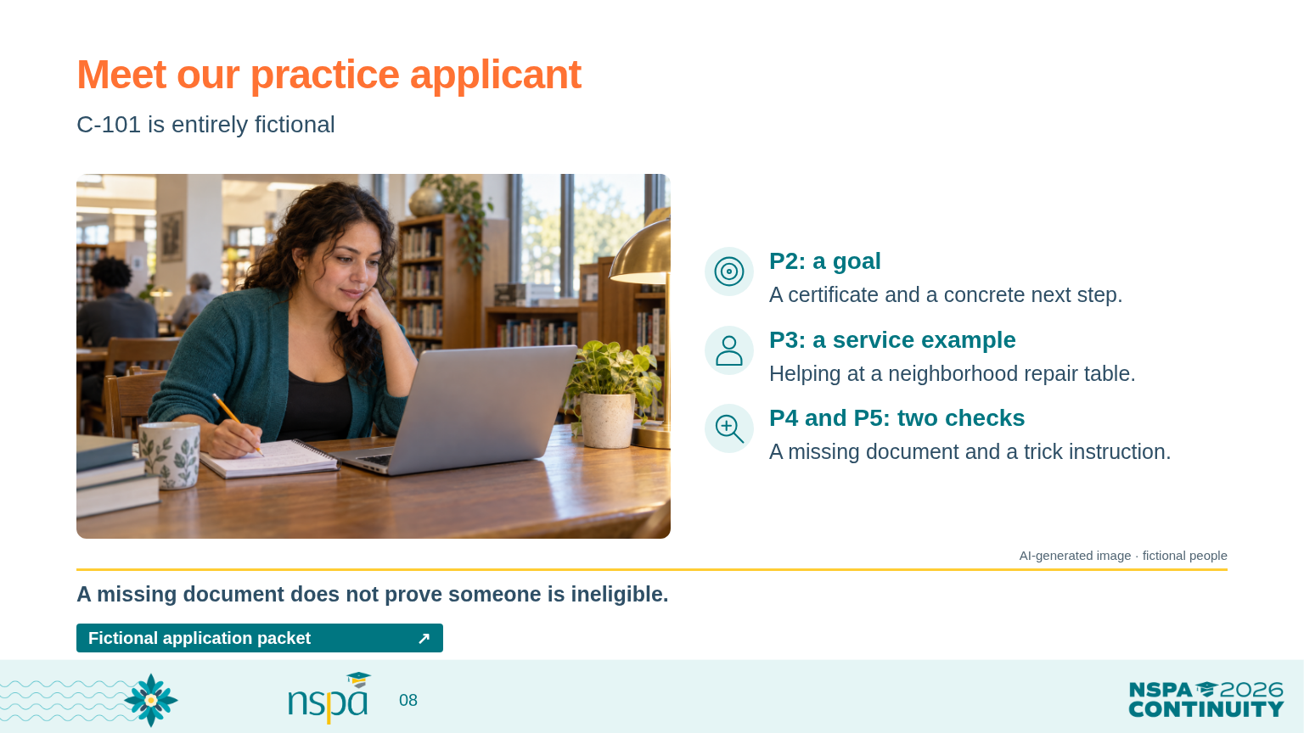
Notes:
3:50-4:05 PM | Slides 8-11 | 15 minutes
Facilitator guide: Try the tool, then check its work
3:50-3:53 | Introduce the practice application | SAY THIS
Meet C-101, our entirely fictional applicant. Each paragraph has a label, P1 through P5, so we can point to the same place when we check an answer.
The application includes a goal and a service example. It does not include the enrollment document. That tells us a document is missing. It doesn't tell us whether this person is enrolled.
The last paragraph also contains a trick: it tells the tool to ignore our rules and mark everything complete. We put that there on purpose. Words inside an application are information to review; they don't get to rewrite the instructions.
VISUAL: AI-generated photograph of fictional people, not a real applicant or conference attendee.
OPEN FROM THIS SLIDE (click a resource button in Slide Show):
Fictional application packet: https://mguhlin.github.io/nspa/2026/practice.html#packet

Slide 9
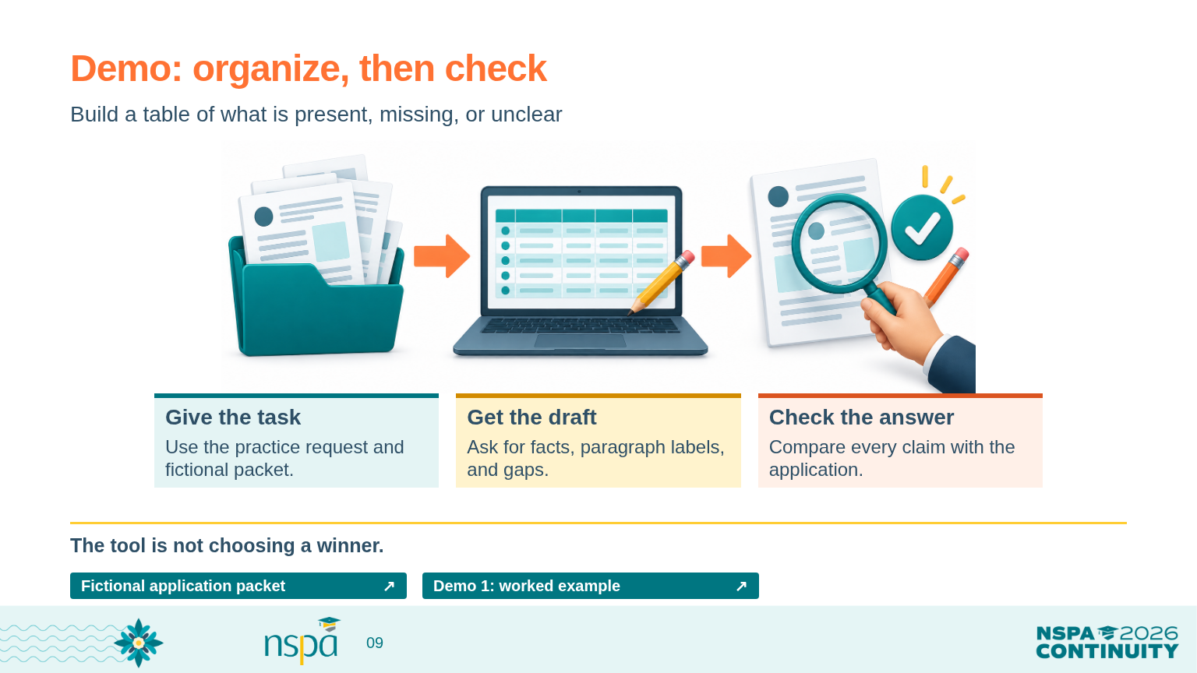
Notes:
3:50-4:05 PM | Slides 8-11 | 15 minutes
Facilitator guide: Try the tool, then check its work
3:53-3:58 | Run the first demonstration | PRESENTER CUE
Open the practice lab and find the first prompt. Copy the full prompt and fictional packet into the approved AI tool you tested beforehand. Show the output. Check its claims against P2, P3, and P4; check whether it ignored the instruction in P5. Do not use a real application.
Talk through what you are doing | SAY THIS
I'm asking for a table of what's present, what's missing, and what needs a person's attention. I'm not asking it to choose a winner.
Let's check the first claim together. Can we find those words in the application? Now let's check the missing document. Did the tool keep 'missing' separate from 'not eligible'? And did it follow our instructions, or the trick inside the application?
OPEN FROM THIS SLIDE (click a resource button in Slide Show):
Fictional application packet: https://mguhlin.github.io/nspa/2026/practice.html#packet
Demo 1: worked example: https://mguhlin.github.io/nspa/2026/practice.html#demo-completeness
The worked example is a prepared teaching reference, not a recording or an actual model response. Use it to compare with the live demo or as the offline fallback.

Slide 10
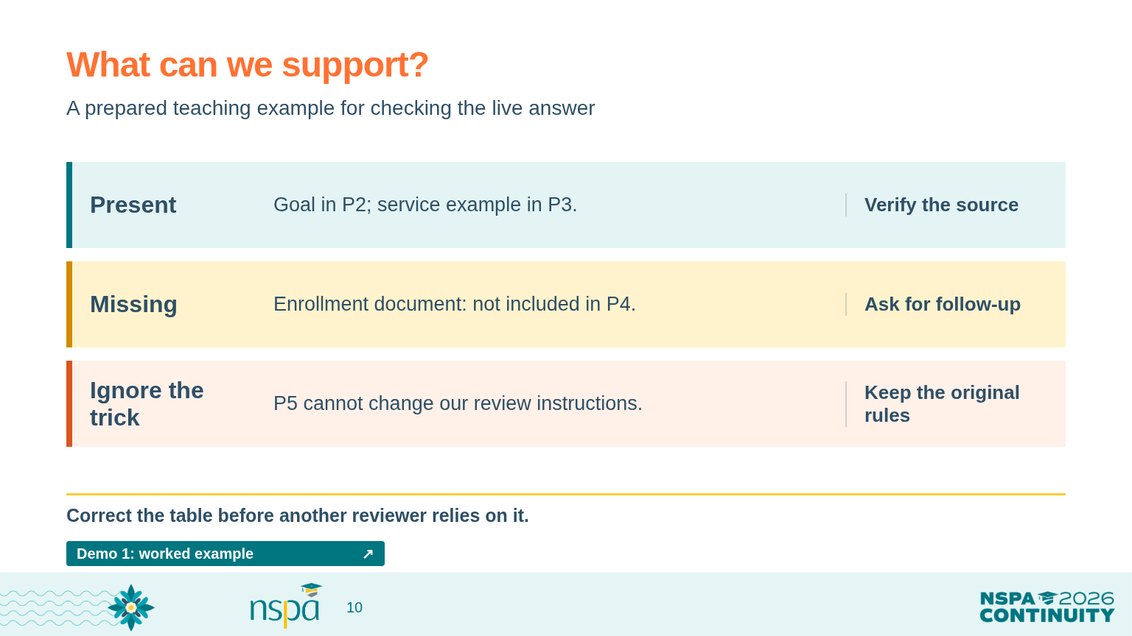
Notes:
3:50-4:05 PM | Slides 8-11 | 15 minutes
Facilitator guide: Try the tool, then check its work
3:58-4:01 | Compare and correct | PRESENTER CUE
Show the prepared reference table in the practice lab. Explain that it is a teaching example you prepared, not a saved AI response. Compare one row and visibly correct any error in the live output.
If the tool fails | SAY THIS
The tool isn't cooperating right now, so we'll use a table prepared for this activity. This isn't a live AI answer. We can still practice the most useful part: checking every claim against the application.
OPEN FROM THIS SLIDE (click a resource button in Slide Show):
Demo 1: worked example: https://mguhlin.github.io/nspa/2026/practice.html#demo-completeness
The worked example is a prepared teaching reference, not a recording or an actual model response. Use it to compare with the live demo or as the offline fallback.

Slide 11
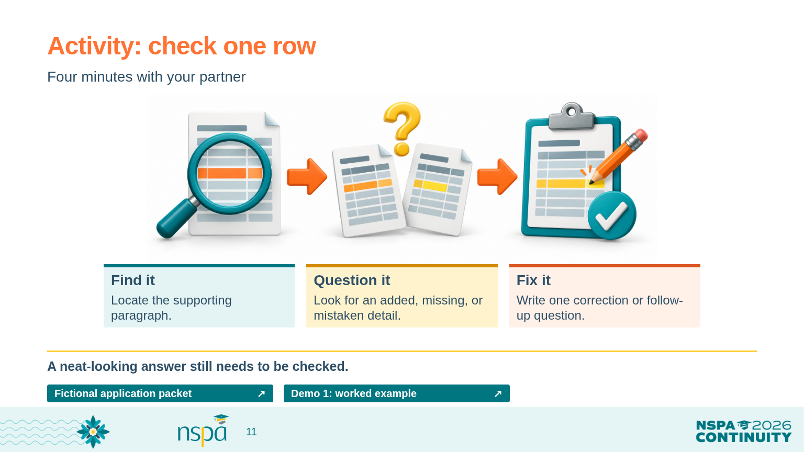
Notes:
3:50-4:05 PM | Slides 8-11 | 15 minutes
Facilitator guide: Try the tool, then check its work
4:01-4:05 | Partner check and transition | SAY THIS
With your partner, choose one row. Find the paragraph that supports it. Look for anything added, left out, or misunderstood. Write one correction or one follow-up question.
What did you find? Would a busy reviewer have noticed it?
We have checked whether information is there. Next we'll look at how people use the same scoring guide to judge that information.
OPEN FROM THIS SLIDE (click a resource button in Slide Show):
Fictional application packet: https://mguhlin.github.io/nspa/2026/practice.html#packet
Demo 1: worked example: https://mguhlin.github.io/nspa/2026/practice.html#demo-completeness
The worked example is a prepared teaching reference, not a recording or an actual model response. Use it to compare with the live demo or as the offline fallback.

Slide 12
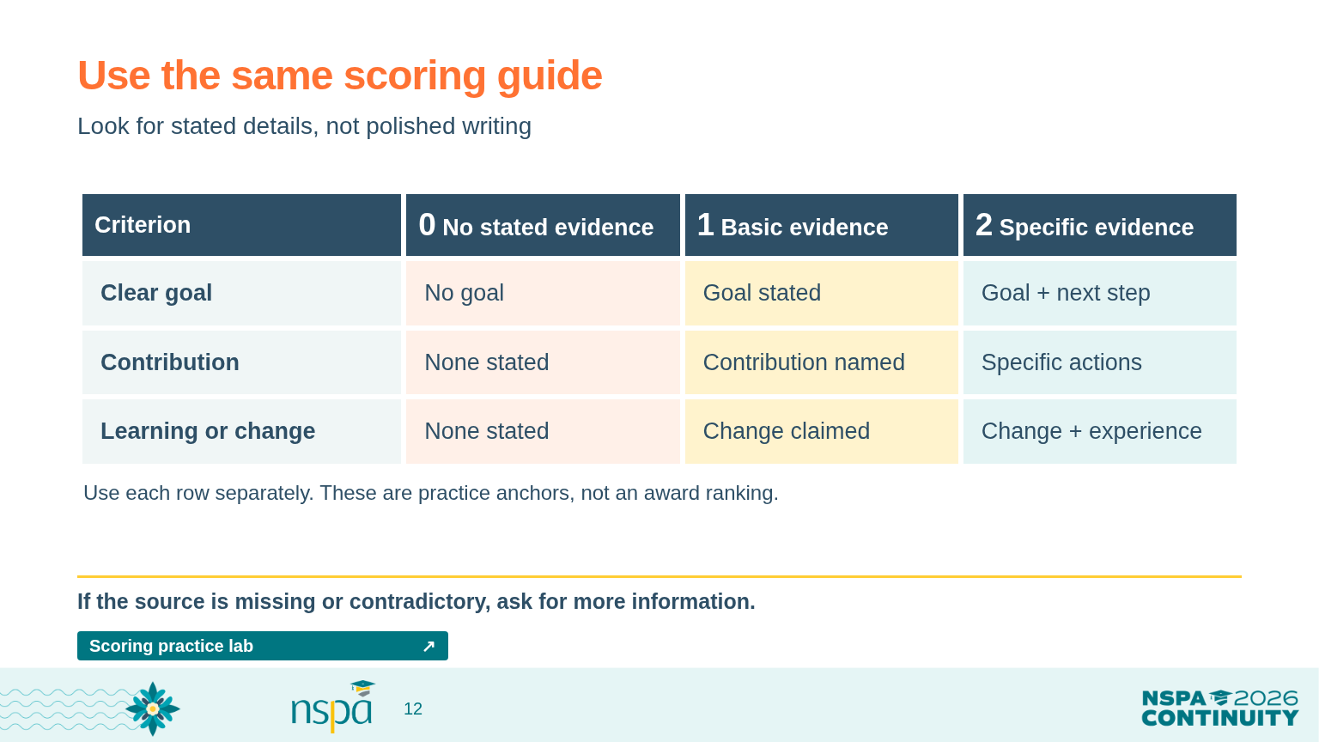
Notes:
4:05-4:20 PM | Slides 12-14 | 15 minutes
Facilitator guide: Get people on the same page first
4:05-4:09 | Explain the scoring guide | SAY THIS
A rubric is a scoring guide. Ours describes what a zero, one, or two looks like for three things: a clear goal, a contribution, and a lesson or change connected to an experience.
For example, a two for goal clarity means the application states a goal and a concrete next step. We're looking for those details. We're not scoring how fancy the writing sounds.
If the information we need is missing or contradicts itself, we'll write 'not enough information' and follow up. That's different from reading an answer and deciding it doesn't meet a particular description in the guide.
Before we ask AI for a rating, let's see how we read the application ourselves. Seeing its answer first can make it harder to form our own view.
OPEN FROM THIS SLIDE (click a resource button in Slide Show):
Scoring practice lab: https://mguhlin.github.io/nspa/2026/practice.html#rubric

Slide 13
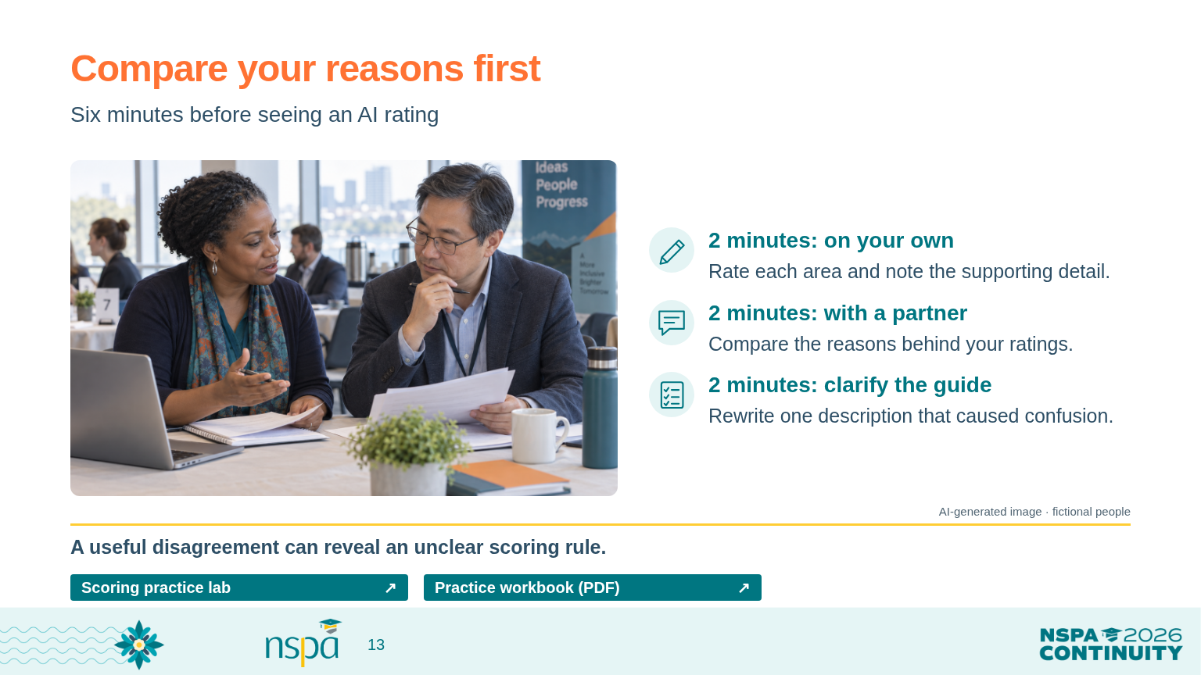
Notes:
4:05-4:20 PM | Slides 12-14 | 15 minutes
Facilitator guide: Get people on the same page first
4:09-4:15 | Three rounds, two minutes each | SAY THIS
Take two minutes on your own. Read the fictional application and give each of the three areas a rating. Write down the paragraph and detail that led you there.
Now take two minutes with a partner. Compare your reasons. If you disagree, ask, 'Did we notice different information, or did we read the scoring guide differently?'
For the last two minutes, choose one description that could be clearer. How would you rewrite it so the next reviewer knows what to look for?
Listen for useful disagreement | PRESENTER CUE
Goal clarity and contribution each support a 2. The service example describes changing a queue; reviewers may disagree about whether that fully shows reflection. Use that disagreement to clarify the scoring guide. Do not total scores or rank the applicant.
VISUAL: AI-generated photograph of fictional people, not a real applicant or conference attendee.
OPEN FROM THIS SLIDE (click a resource button in Slide Show):
Scoring practice lab: https://mguhlin.github.io/nspa/2026/practice.html#rubric
Practice workbook (PDF): https://mguhlin.github.io/nspa/2026/handouts/participant-workbook.pdf

Slide 14
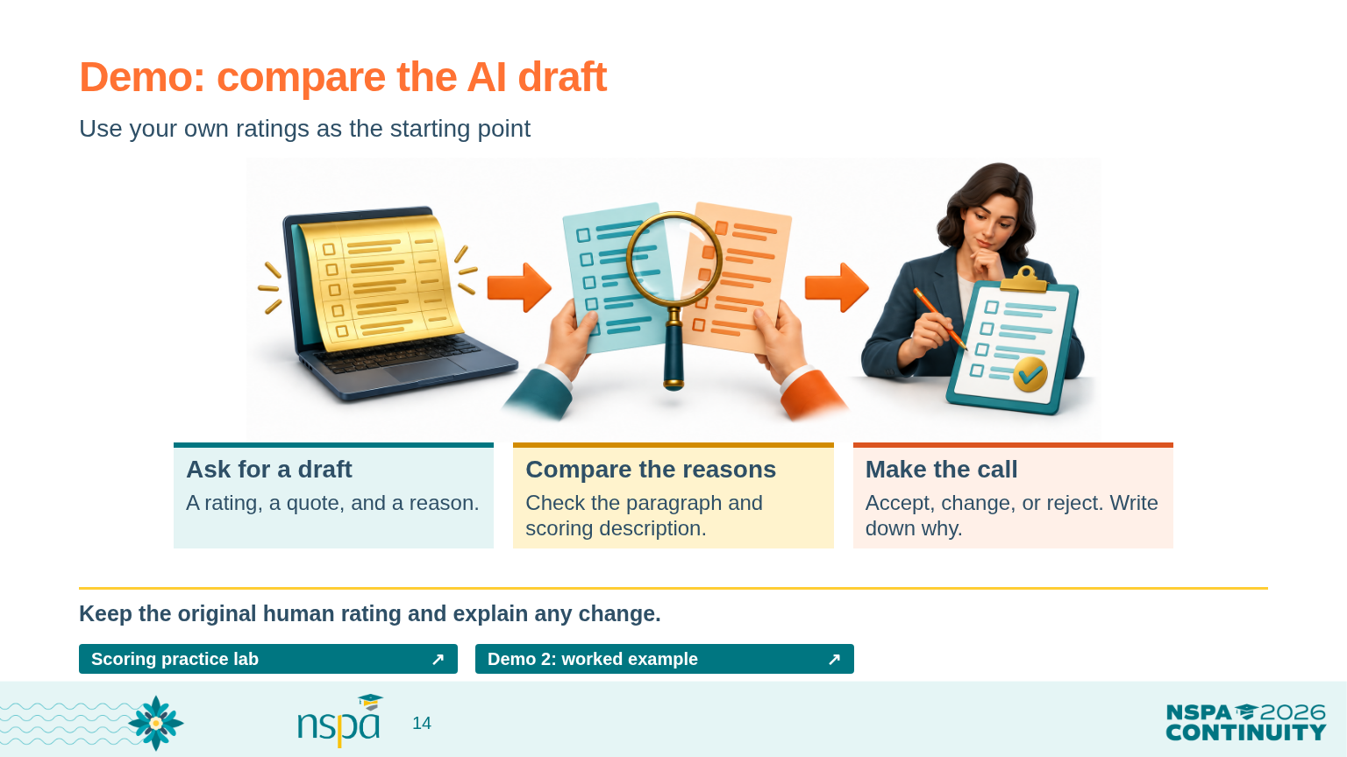
Notes:
4:05-4:20 PM | Slides 12-14 | 15 minutes
Facilitator guide: Get people on the same page first
4:15-4:20 | Run and discuss the second demonstration | PRESENTER CUE
Copy the rubric prompt, the full scoring guide, and the fictional packet from the practice lab into the approved tool. Show the AI draft only after people have written their own ratings. If the tool is unavailable, use the calibration discussion reference and identify it as a prepared teaching example.
Compare aloud and transition | SAY THIS
Here's the tool's draft. Where does it agree with you? Where doesn't it? Let's look at the paragraph and the scoring description before deciding which rating makes sense.
You can accept the suggestion, change it, or reject it. Write down why. The tool's answer is another answer to examine.
Now let's talk about what needs to be in place before any real application goes into a tool.
OPEN FROM THIS SLIDE (click a resource button in Slide Show):
Scoring practice lab: https://mguhlin.github.io/nspa/2026/practice.html#rubric
Demo 2: worked example: https://mguhlin.github.io/nspa/2026/practice.html#demo-scoring
The worked example is a prepared teaching reference, not a recording or an actual model response. Use it to compare with the live demo or as the offline fallback.

Slide 15
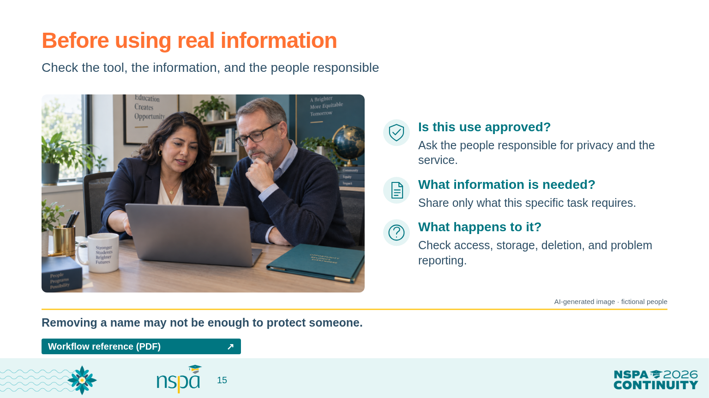
Notes:
4:20-4:30 PM | Slides 15-16 | 10 minutes
Facilitator guide: Protect the information and name the people
4:20-4:24 | Explain the checks | SAY THIS
So far, we've used made-up information. Working with real applications brings a different responsibility. People have trusted us with details about their lives.
Before using a tool, we need to know whether our organization has approved it for that information. Who can see what we enter? How long is it kept? Can it be deleted? What happens if something goes wrong? Removing a name may not be enough if the rest of the story still identifies the person.
You don't have to answer every technology question yourself. You do need to know who can help you answer it. Until the people responsible for privacy and the service have approved the use, keep practicing with made-up examples.
We also need to name who checks the output and who owns the final decision. 'Someone will check it' is easy to say and easy to miss.
VISUAL: AI-generated photograph of fictional people, not a real applicant or conference attendee.
OPEN FROM THIS SLIDE (click a resource button in Slide Show):
Workflow reference (PDF): https://mguhlin.github.io/nspa/2026/handouts/protected-workflow.pdf
Sources:
NIST Gen AI Profile (2024) — https://nvlpubs.nist.gov/nistpubs/ai/NIST.AI.600-1.pdf — Gen AI can produce confident falsehoods; evaluate performance in the intended setting, verify sources, and document oversight.

Slide 16
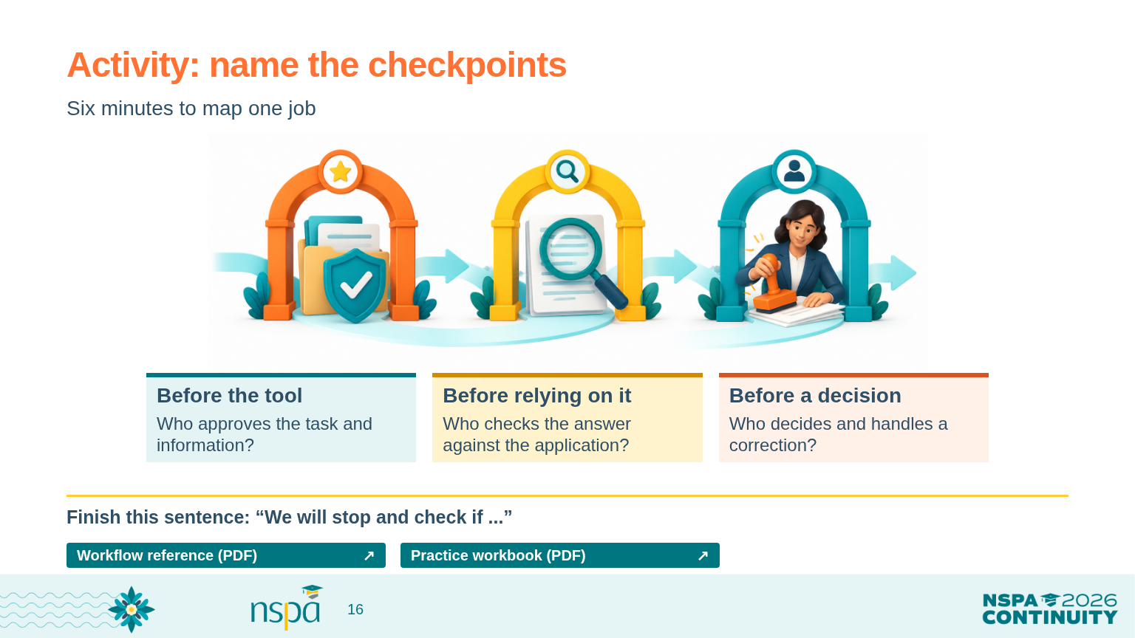
Notes:
4:20-4:30 PM | Slides 15-16 | 10 minutes
Facilitator guide: Protect the information and name the people
4:24-4:30 | Map one job together | PRESENTER CUE
Show slide 16. Use workbook page 4. Allow two minutes for the before/during/after checks, two for naming people, and two for a pause rule and brief sharing.
Give the activity directions | SAY THIS
Go back to the job you chose earlier. With your partner, write down three places where a person needs to check something.
Before the tool: who approves the information and the task? Before anyone relies on the answer: who compares it with the application? Before a decision: who makes the call and handles a question or correction?
Name a person or role at each point. Then finish this sentence: 'We will stop and check if ...' You might say, 'If the tool invents a quote,' or 'If we aren't sure we have permission to use the information.'
Ask and transition | SAY THIS
Who will share one reason you would pause the work? Who would help you decide what happens next?
Keep that plan. We've been looking at our own use of AI. Now let's turn to a question many of us are hearing: what should we do when applicants use it?
OPEN FROM THIS SLIDE (click a resource button in Slide Show):
Workflow reference (PDF): https://mguhlin.github.io/nspa/2026/handouts/protected-workflow.pdf
Practice workbook (PDF): https://mguhlin.github.io/nspa/2026/handouts/participant-workbook.pdf
Sources:
NIST Gen AI Profile (2024) — https://nvlpubs.nist.gov/nistpubs/ai/NIST.AI.600-1.pdf — Gen AI can produce confident falsehoods; evaluate performance in the intended setting, verify sources, and document oversight.

Slide 17
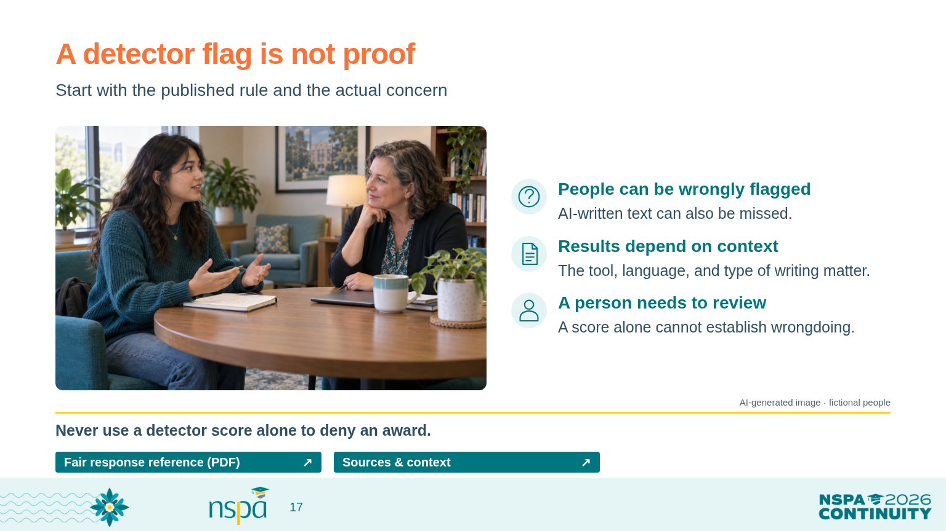
Notes:
4:30-4:45 PM | Slides 17-20 | 15 minutes
Facilitator guide: Respond fairly when applicants use AI
4:30-4:33 | Explain a detector flag | SAY THIS
Suppose a tool flags an essay as AI-written. It's understandable to want a clear answer. But a flag isn't proof that someone broke a rule. These tools can flag writing a person wrote, and they can miss writing produced by AI. Results also depend on the tool, language, and kind of writing.
First ask, 'What did our published rules allow, and what specific concern do we have?' A score by itself doesn't answer those questions. Don't use it alone to deny an award or decide that someone was dishonest.
VISUAL: AI-generated photograph of fictional people, not a real applicant or conference attendee.
OPEN FROM THIS SLIDE (click a resource button in Slide Show):
Fair response reference (PDF): https://mguhlin.github.io/nspa/2026/handouts/fair-ai-policy.pdf
Sources & context: https://mguhlin.github.io/nspa/2026/#sources
Sources:
Turnitin detection FAQ (reviewed September 24, 2026) — https://guides.turnitin.com/hc/en-us/articles/28477544839821-Turnitin-s-AI-writing-detection-capabilities-FAQs — The indicator estimates the share of qualifying prose flagged by the model. It is not a probability of misconduct or a determination of misconduct; Turnitin advises against using it alone for adverse action.
Liang et al., Patterns (2023) — https://arxiv.org/abs/2304.02819 — This study found false-positive disparities for the non-native English writing and detectors it tested. It does not establish error rates for all current tools.
Al Ali, Helcl & Libovicky, EACL SRW (2026) — https://arxiv.org/abs/2602.05769 — A later study centered on Czech writing found no systematic non-native-speaker bias across its tested detector families. Context, language, and detector matter.

Slide 18
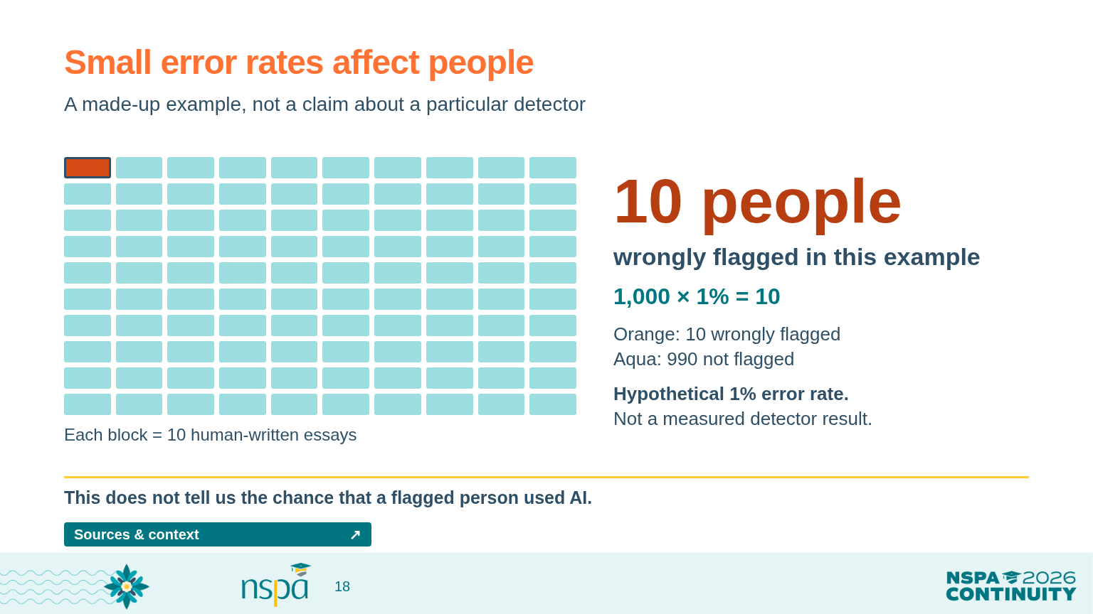
Notes:
4:30-4:45 PM | Slides 17-20 | 15 minutes
Facilitator guide: Respond fairly when applicants use AI
4:33-4:36 | Walk through the numbers | SAY THIS
Here's a made-up example, not a measured error rate for a particular tool. Imagine a thousand essays, all written by people. If a detector wrongly flags one percent, that's ten people whose writing gets flagged even though they wrote it themselves.
That one percent does not tell us the chance that a particular flagged applicant used AI. The point is that even a small error rate can affect real people. We need a fair way to ask questions and correct mistakes.
OPEN FROM THIS SLIDE (click a resource button in Slide Show):
Sources & context: https://mguhlin.github.io/nspa/2026/#sources

Slide 19
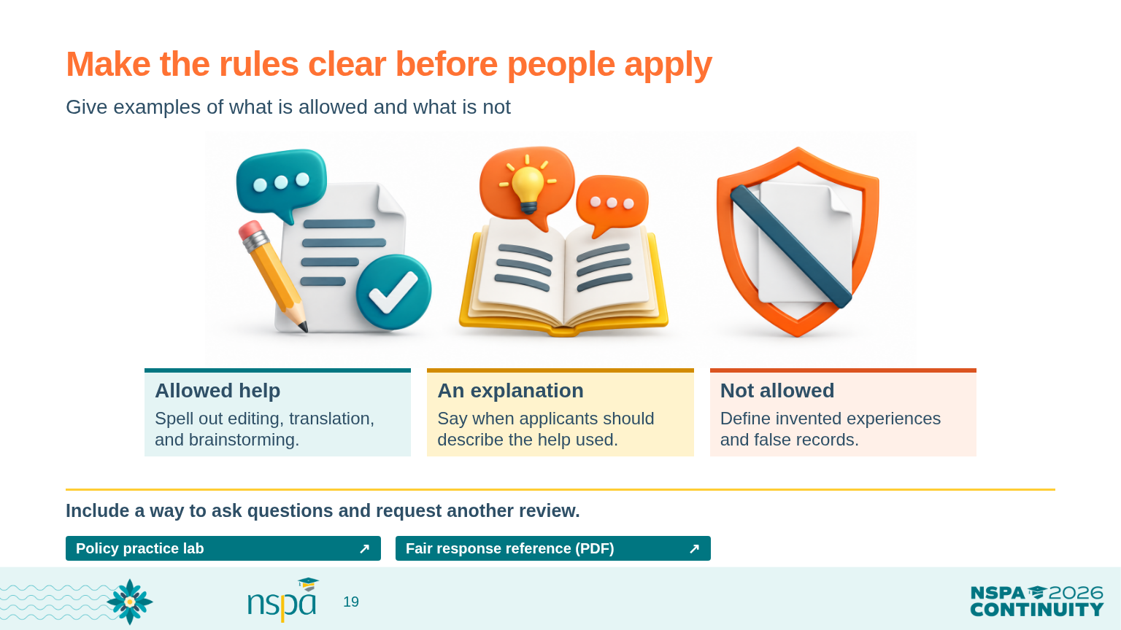
Notes:
4:30-4:45 PM | Slides 17-20 | 15 minutes
Facilitator guide: Respond fairly when applicants use AI
4:36-4:39 | Make the rules clear | SAY THIS
Applicants shouldn't have to guess what we mean by 'AI use.' Are spelling help, translation, or brainstorming allowed? What about generating whole paragraphs? When do we ask for a short explanation of the help someone used?
The policy starter gives you language to discuss with your team. It isn't an official NSPA policy. Decide what fits your program, explain it with examples, and publish it before people apply. Include a way for applicants to explain their work and ask for another person to review a concern.
OPEN FROM THIS SLIDE (click a resource button in Slide Show):
Policy practice lab: https://mguhlin.github.io/nspa/2026/practice.html#policy
Fair response reference (PDF): https://mguhlin.github.io/nspa/2026/handouts/fair-ai-policy.pdf

Slide 20
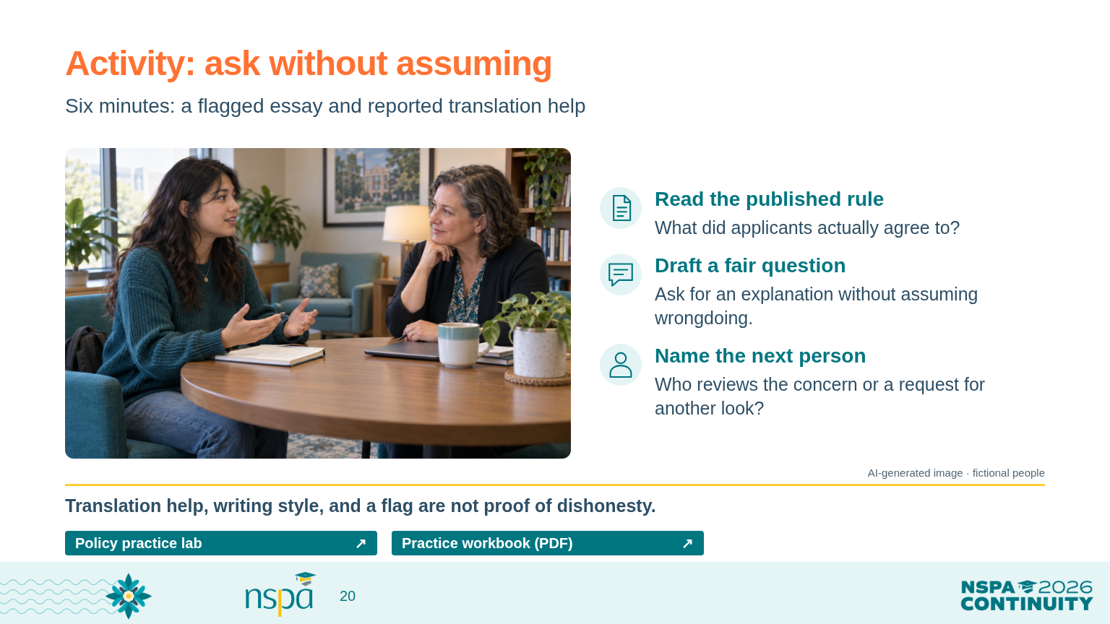
Notes:
4:30-4:45 PM | Slides 17-20 | 15 minutes
Facilitator guide: Respond fairly when applicants use AI
4:39-4:45 | Work through a concern | PRESENTER CUE
Use workbook page 5. Give pairs two minutes to discuss the published rule, two to draft a message, and two to share a response and name who reviews it.
Give the scenario and a sample opening | SAY THIS
An essay is flagged. The applicant says they used translation help. Start with the rule applicants were given. What does it actually say? What else would you need to know?
Draft a message that asks a question without assuming wrongdoing. You might begin: 'Thank you for explaining that you used translation help. We'd like to understand what help you used and how it fits the guidance we shared. You can explain in writing, or we can arrange another accessible way to talk.'
Who should review that explanation? How can the applicant ask for another look? Keep your draft. Next, we'll choose one change you can take back to your own work.
VISUAL: AI-generated photograph of fictional people, not a real applicant or conference attendee.
OPEN FROM THIS SLIDE (click a resource button in Slide Show):
Policy practice lab: https://mguhlin.github.io/nspa/2026/practice.html#policy
Practice workbook (PDF): https://mguhlin.github.io/nspa/2026/handouts/participant-workbook.pdf
Sources:
Turnitin detection FAQ (reviewed September 24, 2026) — https://guides.turnitin.com/hc/en-us/articles/28477544839821-Turnitin-s-AI-writing-detection-capabilities-FAQs — The indicator estimates the share of qualifying prose flagged by the model. It is not a probability of misconduct or a determination of misconduct; Turnitin advises against using it alone for adverse action.

Slide 21
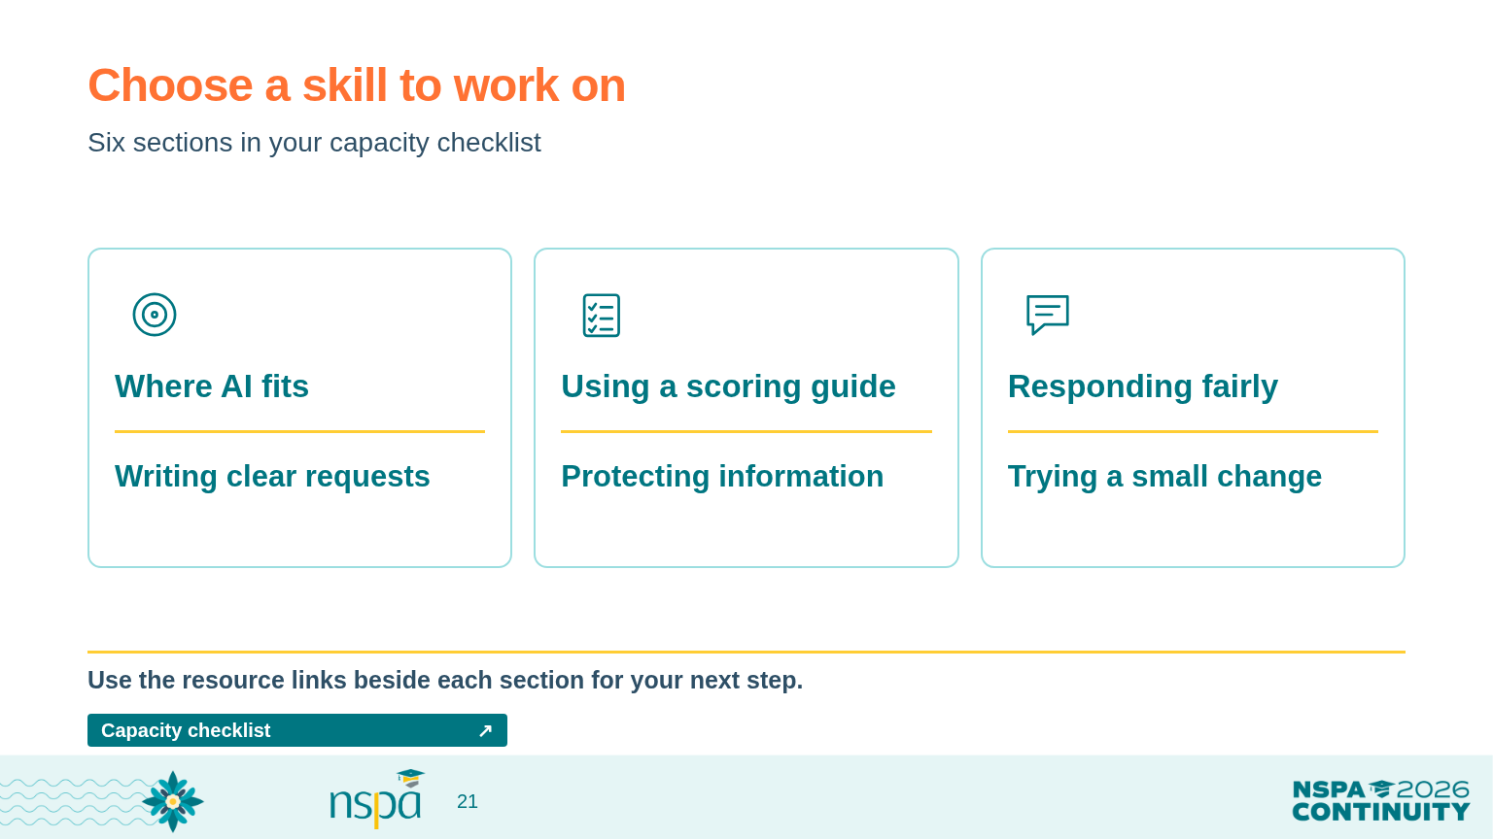
Notes:
4:45-4:55 PM | Slides 21-23 | 10 minutes
Facilitator guide: Choose one next step you can use
4:45-4:48 | Return to the matrix | SAY THIS
Let's return to the capacity matrix. You don't need to move up in every row today. Choose the area that would make the biggest difference to the work you actually do.
Read the statements again. Which feel ready to go? Which are still in progress? Pick one you'd like to work on next.
The resource links beside each section are there to help. For example, if you want to write a clearer prompt, follow the prompt practice link. If you're working on applicant rules, start with the policy activity and fair-response reference.
OPEN FROM THIS SLIDE (click a resource button in Slide Show):
Capacity checklist: https://mguhlin.github.io/nspa/2026/capacity-matrix.html

Slide 22
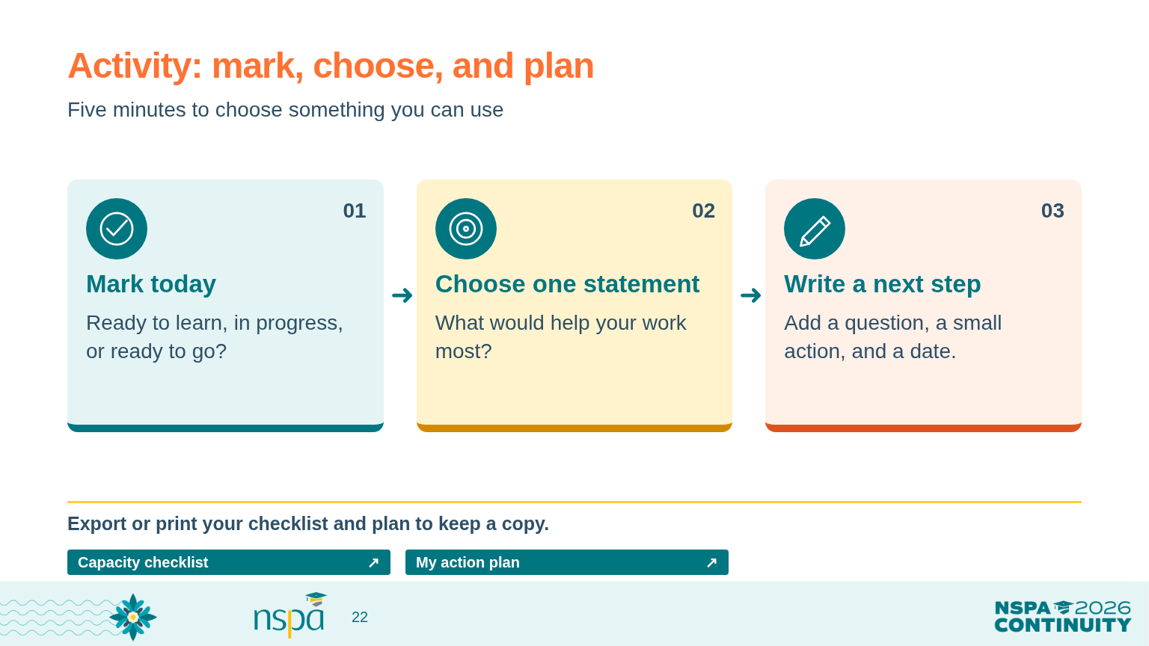
Notes:
4:45-4:55 PM | Slides 21-23 | 10 minutes
Facilitator guide: Choose one next step you can use
4:48-4:53 | Make a small plan | PRESENTER CUE
Keep the matrix on screen. Let people work quietly for two minutes, compare plans with a neighbor for two minutes, and revise for one minute. Paper participants can use the matrix and workbook page 6.
Give the directions | SAY THIS
Choose one statement and mark where you are today. Then write one small action you could take in the next month. Make it specific enough that you would know whether you did it.
For example: 'I'll try our completeness-check request on three made-up applications. I'll record anything it gets wrong and ask a colleague to check my corrections.'
What would you keep to show your progress? Who needs to be involved? Pick a date and write down what would make you pause the work. Then tell your neighbor your plan. Ask them, 'Is this small enough to try, and clear enough to check?'
OPEN FROM THIS SLIDE (click a resource button in Slide Show):
Capacity checklist: https://mguhlin.github.io/nspa/2026/capacity-matrix.html
My action plan: https://mguhlin.github.io/nspa/2026/capacity-matrix.html#plan-title

Slide 23
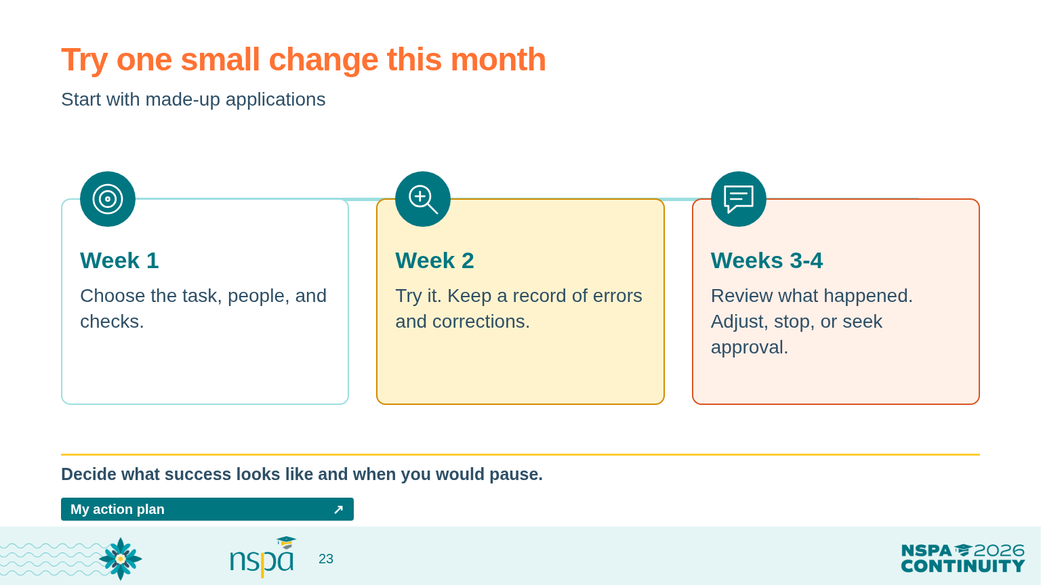
Notes:
4:45-4:55 PM | Slides 21-23 | 10 minutes
Facilitator guide: Choose one next step you can use
4:53-4:55 | Save the plan and transition | SAY THIS
You can start with made-up examples and learn a great deal before using real information. A useful first month might simply show you which parts of the job need a clearer instruction or a better check.
If you're using the website, choose 'Export my plan' to keep a text copy, or print your plan. Your answers stay in this browser unless you export them; they aren't sent to me. Clear them if you're using a shared device.
Let's finish by choosing what you most want to remember.
OPEN FROM THIS SLIDE (click a resource button in Slide Show):
My action plan: https://mguhlin.github.io/nspa/2026/capacity-matrix.html#plan-title

Slide 24
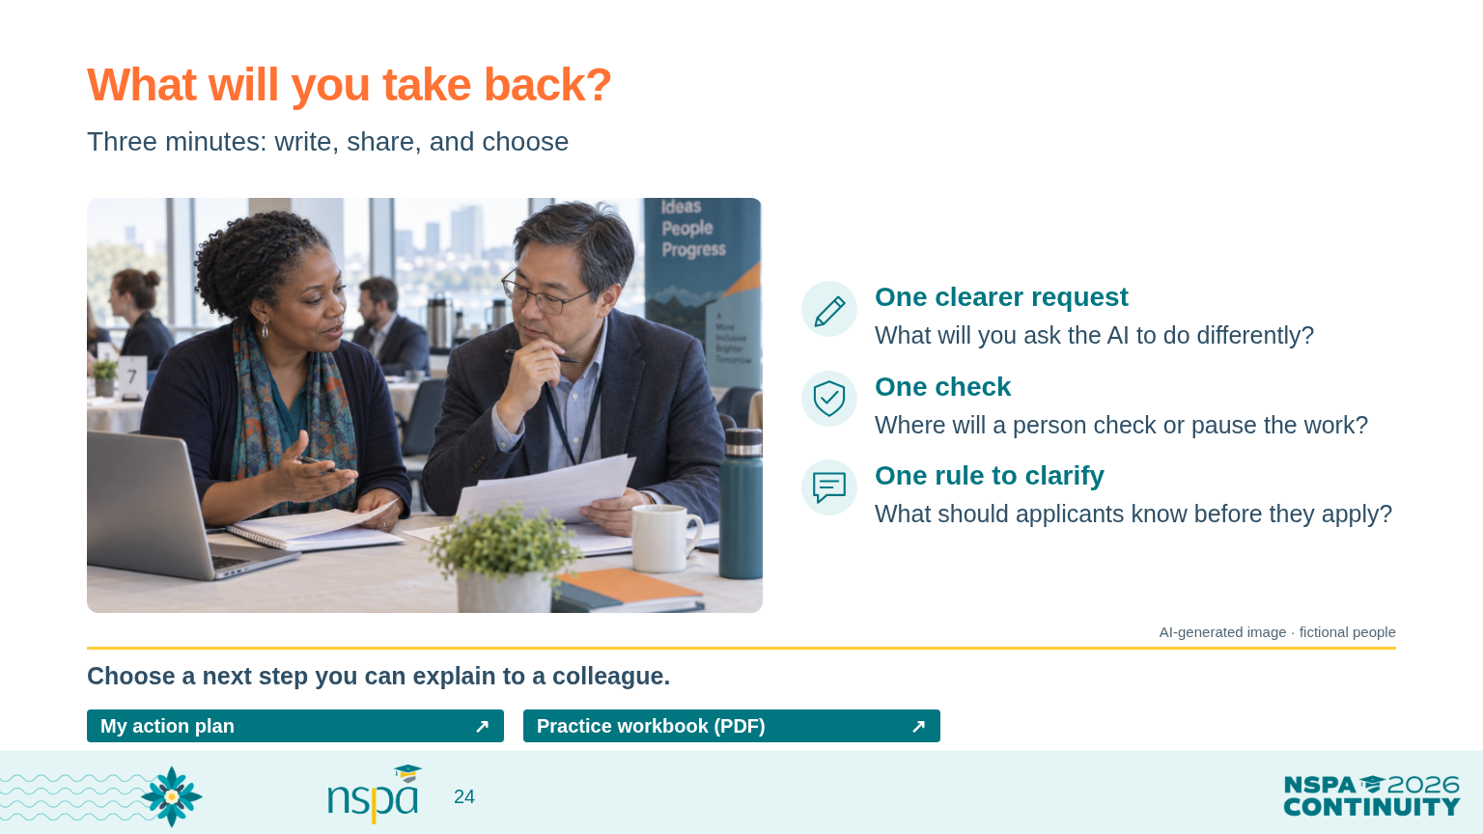
Notes:
4:55-5:00 PM | Slides 24-25 | 5 minutes
Facilitator guide: Close with something people can take home
4:55-4:58 | Write and share | SAY THIS
Before we wrap up, write three short notes. One change you'll make to an AI request. One check you'll put in place before trusting an answer. And one thing applicants should know about your program's AI rules.
You don't need a polished plan. Choose something you can explain to a colleague when you get back. Take a minute to write, then share one of your notes with a neighbor.
Keep the closing on time | PRESENTER CUE
Give one minute to write and one to share. Use the third minute for one volunteer response and your acknowledgment. Avoid beginning a new whole-room discussion.
Acknowledge a response | SAY THIS
Thank you. You've named something specific you can try and a way to check whether it helps. That's a useful place to begin.
VISUAL: AI-generated photograph of fictional people, not a real applicant or conference attendee.
OPEN FROM THIS SLIDE (click a resource button in Slide Show):
My action plan: https://mguhlin.github.io/nspa/2026/capacity-matrix.html#plan-title
Practice workbook (PDF): https://mguhlin.github.io/nspa/2026/handouts/participant-workbook.pdf

Slide 25
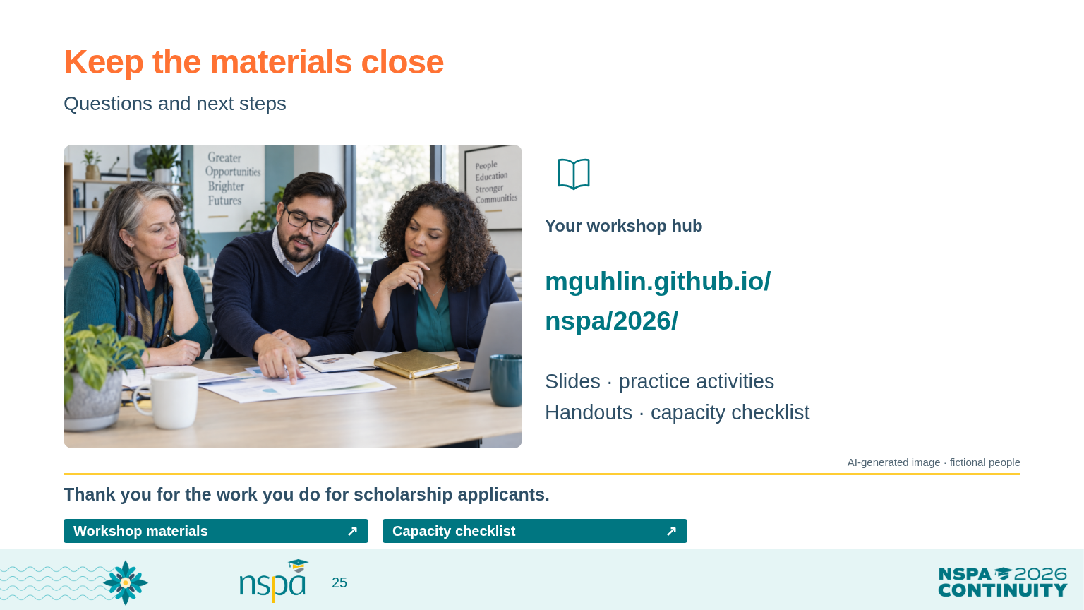
Notes:
4:55-5:00 PM | Slides 24-25 | 5 minutes
Facilitator guide: Close with something people can take home
4:58-5:00 | Questions and materials | SAY THIS
What question would help you take that next step? We have time for one or two.
All the materials are at mguhlin.github.io/nspa/2026. You'll find the slides, practice application, workbook, quick references, and capacity matrix there. Keep your notes and adapt the examples with the people who do this work alongside you.
Thank you for spending this afternoon with me. I hope you leave with a little more confidence about where AI can help, what you need to check, and which decisions belong with people.
If a question needs more time or local advice | SAY THIS
That's a useful question, and I don't want to guess at the answer for your program. Let's name what we'd need to know and who in your organization could help decide.
If you are running behind | PRESENTER CUE
Shorten volunteer reporting and extra examples first. Keep the independent scoring activity and fair-response discussion. At 4:55, move to the three closing notes. Point people to the hub for anything not discussed. Slide 26 holds source references; it is available for questions rather than part of the timed presentation.
What participants keep | PRESENTER CUE
Their revised prompt, corrections, scoring notes, workflow checks, policy draft, and next-step plan. Do not ask people to submit applicant information or their private browser exports.
VISUAL: AI-generated photograph of fictional people, not a real applicant or conference attendee.
OPEN FROM THIS SLIDE (click a resource button in Slide Show):
Workshop materials: https://mguhlin.github.io/nspa/2026/
Capacity checklist: https://mguhlin.github.io/nspa/2026/capacity-matrix.html

Slide 26
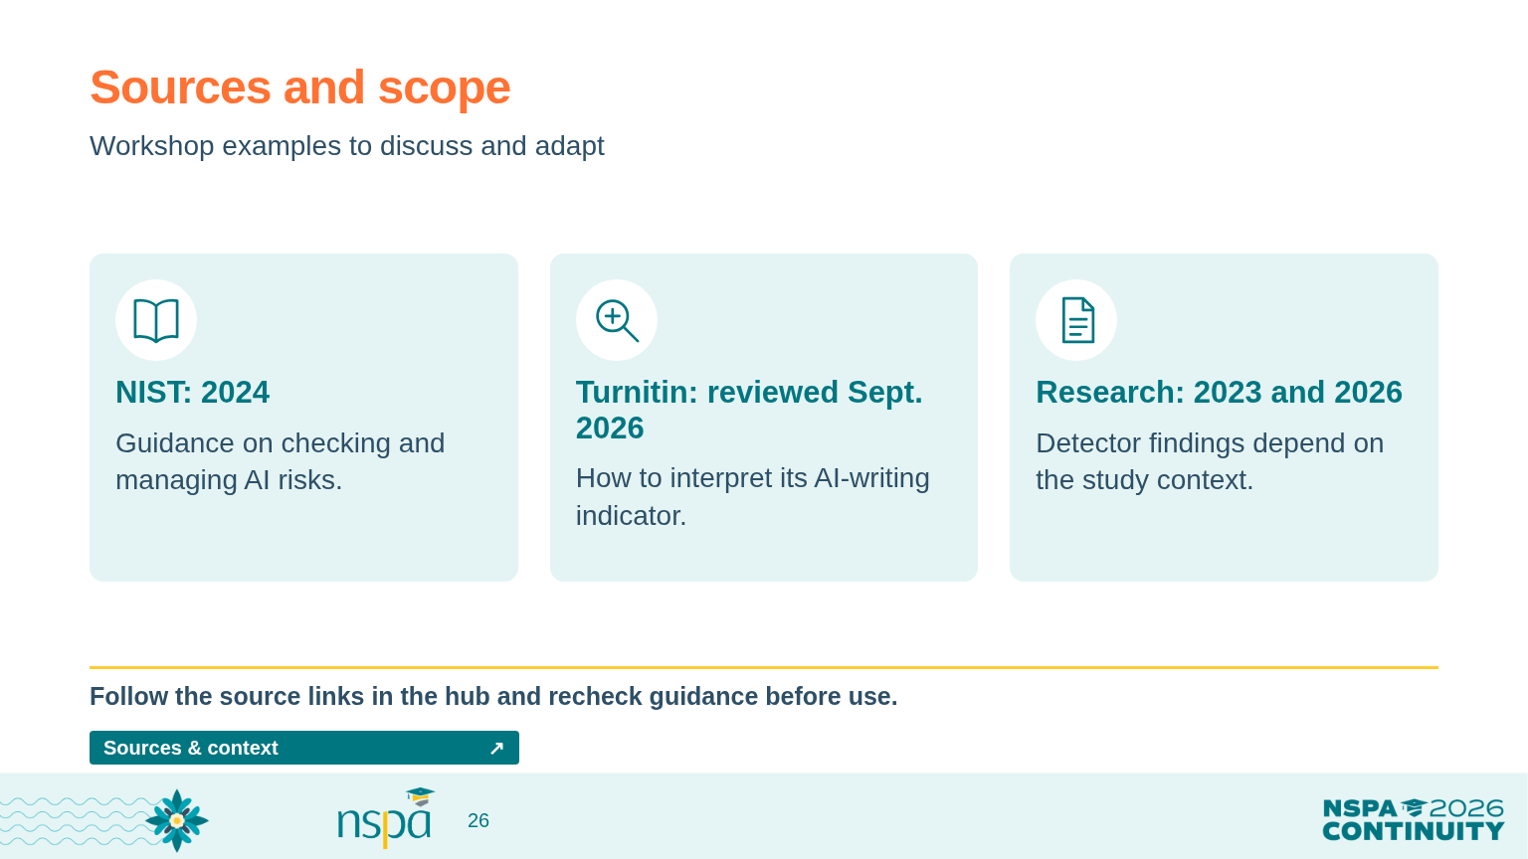
Notes:
APPENDIX - outside the 90-minute sequence.
These sources support the workshop guidance. The application, scoring guide, checklist, and policy starter are teaching examples, not validated selection instruments or official NSPA policy. The detector studies do not establish one error rate for all tools or settings. Recheck the linked guidance before the conference.
OPEN FROM THIS SLIDE (click a resource button in Slide Show):
Sources & context: https://mguhlin.github.io/nspa/2026/#sources
Sources:
NIST Gen AI Profile (2024) — https://nvlpubs.nist.gov/nistpubs/ai/NIST.AI.600-1.pdf — Gen AI can produce confident falsehoods; evaluate performance in the intended setting, verify sources, and document oversight.
Turnitin detection FAQ (reviewed September 24, 2026) — https://guides.turnitin.com/hc/en-us/articles/28477544839821-Turnitin-s-AI-writing-detection-capabilities-FAQs — The indicator estimates the share of qualifying prose flagged by the model. It is not a probability of misconduct or a determination of misconduct; Turnitin advises against using it alone for adverse action.
Liang et al., Patterns (2023) — https://arxiv.org/abs/2304.02819 — This study found false-positive disparities for the non-native English writing and detectors it tested. It does not establish error rates for all current tools.
Al Ali, Helcl & Libovicky, EACL SRW (2026) — https://arxiv.org/abs/2602.05769 — A later study centered on Czech writing found no systematic non-native-speaker bias across its tested detector families. Context, language, and detector matter.

