Slide 1
Capsone Project : The clash of Neighbours in Toronto city
This is the Final Assignment of Coursera course to Applied Data Science

Slide 2
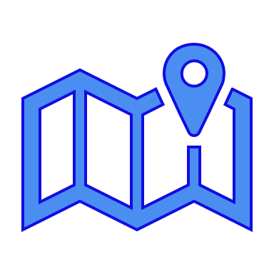
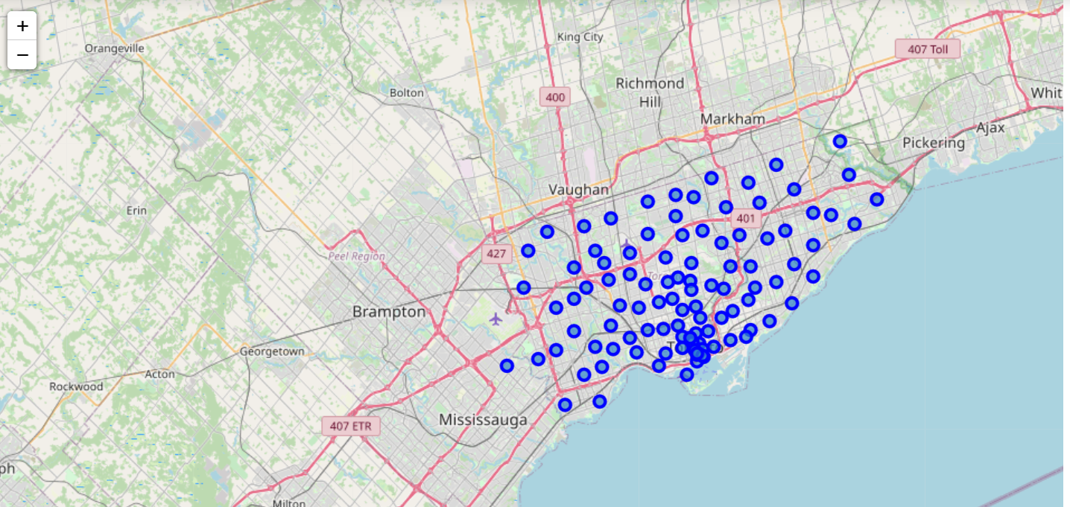

Problem : How To Find The Best Neighborhood In Toronto city Based On Specific Needs And Requirements From The Robert’s Family ?
How can I choose my Neighbours among all these possibilities ?

Slide 3

















Problem : What are the specific needs and requirements for this family ?
They need to find nearby their house :
Good schools for their kids
Sports and cultural facilities
green spaces and parks
fresh market, farmers market, grocery store and restaurant

Slide 4
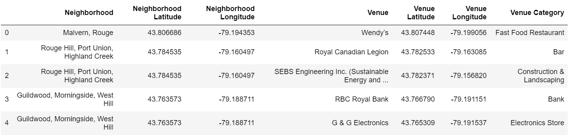
Data analysis

Slide 5
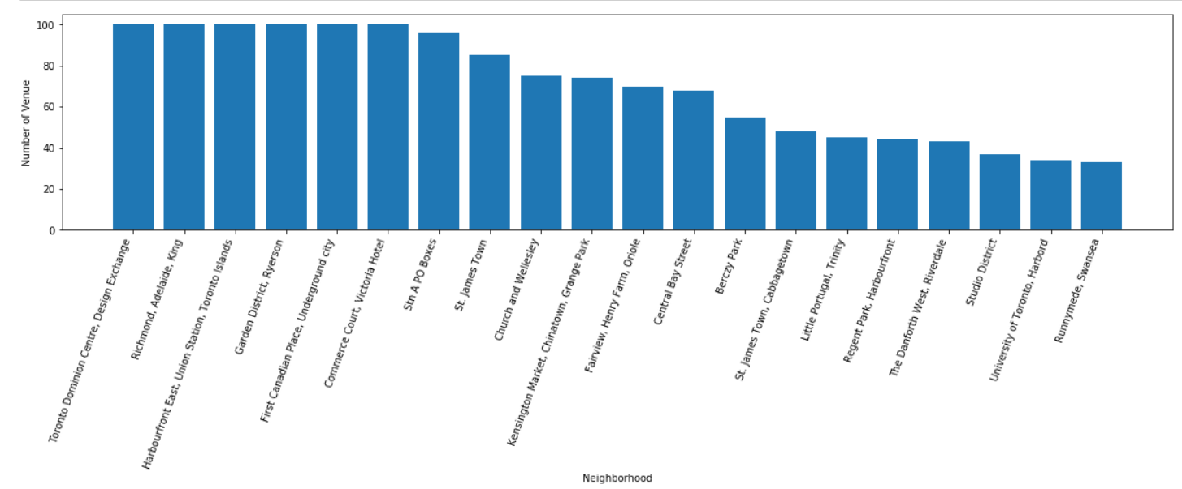
Data analysis

Slide 6
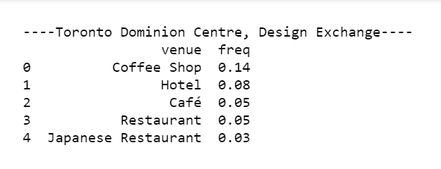
Results and Discussion
The k-means algorithm to group neighborhoods into cluster, each cluster present similar most common venue. The dataset include the frequency of the 5th most common venues

Slide 7
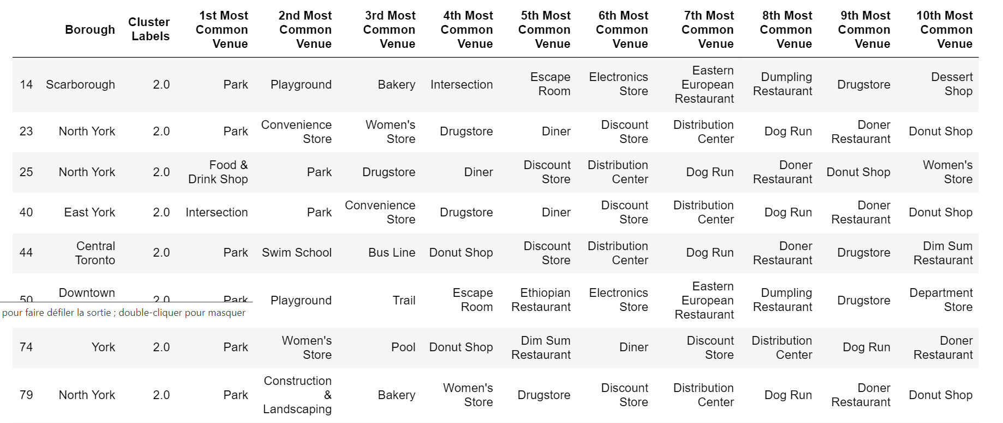
Results and Discussion
This is a summary of cluster 2 with the 10 most common venue.

Slide 8
Conclusion
The k-means algorithm to group neighborhoods into cluster, each cluster present similar most common venue.
When we analyze each of the 7 clusters, we find that only cluster 2 exhibits requirements of Robert’s family. Indeed, we see that we can find “Park” as 1st most common venue and “Playground” or “Swim school” which are among the requirements of the Robert’s family.

