Slide 1
PowerPoint as a
Powerful Tool
Tips for Effective Design and
Increased Interactivity
Luisa F. Castro
Department of Natural Resources and
Environmental Management

Slide 2
Why PowerPoint?
To hold interest
To focus attention
To guide discussions/overviews
To tell a story
To support the message being delivered
To create a poster for a conference
Notes:
One of the best reasons to use PowerPoint is the ability it gives you to present content in a qualitatively different way through the use of graphics, charts, animation, and even video or audio.
We all learn differently and a presentation using PowerPoint can help those who are Visual as well as Auditory learners

Slide 3
Tip #1 for Oral Presentations
Have only the minimum required text on each slide.
Notes:
Too much text distracts your audience and can be difficult to read.

Slide 4
Text on Slide: Too Much
When in the Course of human events, it becomes necessary for one people to dissolve the political bands which have connected them with another, to assume among the powers of the earth, the separate and equal station to which the Laws of Nature and of Nature's God entitle them, a decent respect to the opinions of mankind requires that they should declare the causes which impel them to the separation.
We hold these truths to be self-evident, that all men are created equal, that they are endowed by their Creator with certain unalienable Rights, that among these are Life, Liberty, and the pursuit of Happiness.
That to secure these rights, Governments are instituted among Men, deriving their just powers from the consent of the governed.
Notes:
Say you were discussing the Declaration of Independence and wanted your audience to follow along with you.

Slide 5
Text on Slide: Better
We hold these truths to be self-evident
  that all men are created equal,
  that they are endowed by their Creator with certain unalienable Rights, that among these are:
    life,
    liberty
    the pursuit of happiness
Notes:
Wouldn’t it be easier for them if you broke down the text to the most basic points?
A simple rule of thumb to follow is writing by the number 6
6 words per bullet item
6 bullets per slide
6 word slides in a row
Have each bullet point start with a verb or noun, if verbs use all the same tense, use capitalization

Slide 6
Tip #2
Be consistent and sparing in your use of transitions and animations.
Notes:
The rule of thumb is one method of transition and one type of animation for the whole slideshow.
Do not have some text flying in, some spiraling, etc.
Move from slide to slide with one transition, rather than trying out several.

Slide 7
Moving Text
When text appears, we don’t want the audience to be watching the animation.
Use the
    “Appear effect”
    Not
    “FANCY EFFECTS”
Notes:
I can tell that you all aren’t focusing on me but are totally fixed on what is on the screen.
If you want to use an effect to add a little animation to your text but keep it simple, use the APPEAR effect, which just makes the text appear and is the easiest for your audience to read.

Slide 8
Tip #3
Be consistent in your choice of bullets, font, and colors.

Slide 9
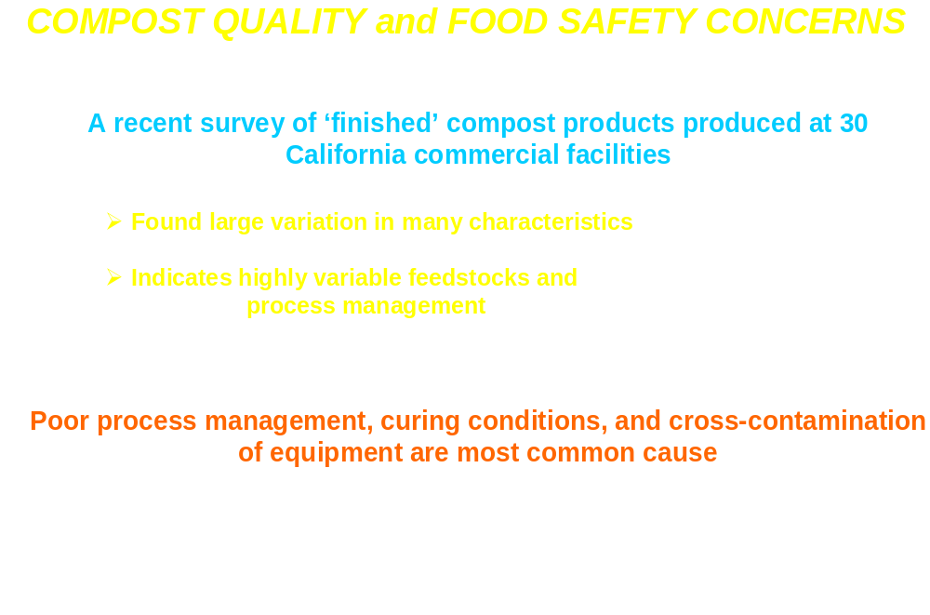
Notes:
This is from a presentation at a conference I went to. The entire PowerPoint was like this and made it difficult to read.

Slide 10
Font Sizes
This is a good title size.
Verdana 40 point = sans serif.
This is a good subtitle or bullet point size.
Times 36 point = serif.
This is about as small as you want to go for content at 24 points.
This font size is not recommended for content. Verdana 12 point.
Notes:
FONTS: The larger, the better. Remember, you want your points to be readable even at the back of the venue.
As with print documents, using a combination of serif and sans serif fonts--one for headings, the other for body text because it provides contrast and interest to your slides.
Sans serif fonts are Verdana, Arial and Helvetica. They have even lines and no appendages
Serif fonts are Times and Times New Roman.

Slide 11

Fonts and Background Colors
This is a good mix of colors. Readable!
This is a bad mix of colors. Low contrast.
Unreadable!
This is a good mix of
colors. Readable!
This is a bad mix of
colors. Avoid bright
colors on white.
Unreadable!
Notes:
My own pet peeve is the always used blue background. It’s the one I see most used at conferences. Try something different. That’s why PowerPoint comes with templates.
Choose your background based on a room's lighting: While what is most common is to design with a dark background when you plan to project your slideshow onto a screen, in reality, the best background has to do with the presentation location. Although light text on a dark background looks best in a dark or slightly darkened room, in a light room the dark background may look so faded that light text may not show up as well. For this kind of situation, it doesn't hurt to try dark text on a lighter background

Slide 12
Tip #4
Create graphics (such as tables and charts) appropriately.

Slide 13
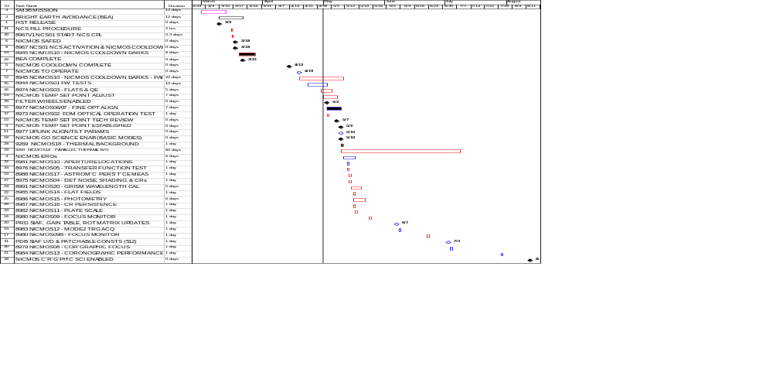
Inappropriate Use of Tables
Notes:
A bad table, too much information in an unreadable format.

Slide 14
Appropriate Use of Tables and Figures
Emphasize key parts so that your points are stronger:
Animate the graph or table elements
Use drawing tools to highlight a portion of the table or graph
Use strong contrasting color for drawing element
Use callout box drawing tool
Notes:
Appropriate use of graphs and tables is one way to enhance the message you are delivering.
Draw the audience’s attention

Slide 15

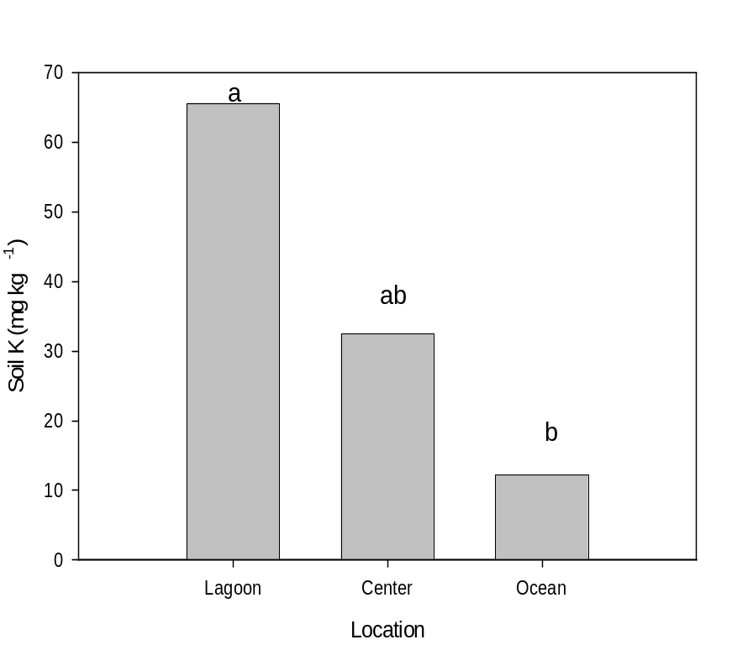
Nutrient concentration tends to decrease from lagoon to ocean side
Nutrient | Location | Concentration | Pr>F
N | Lagoon | 0.66 | 0.27
 | Center | 0.53
 | Ocean | 0.40
P | Lagoon | 44.8 | 0.20
 | Center | 34.3
 | Ocean | 15.7
K | Lagoon | 65.6 | 0.08
 | Center | 32.5
 | Ocean | 12.2
B | Lagoon | 0.38 | 0.19
 | Center | 0.29
 | Ocean | 0.28
Very important

Slide 16
Tip #5
Remember that white space is our friend.
Notes:
Too many elements on one slide will simply distract your audience.

Slide 17
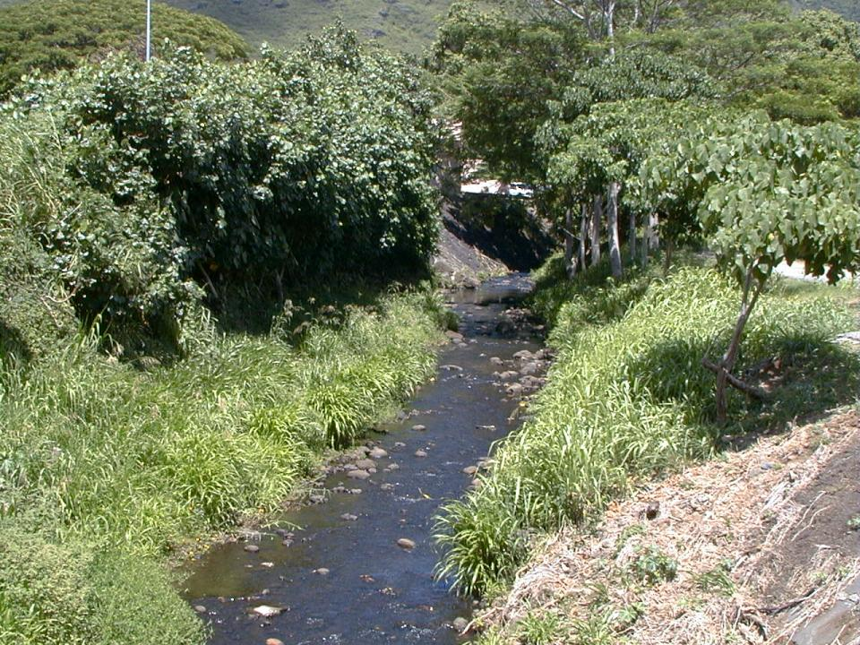
Slide Overkill
2. The data suggest that the high-level wells tap interconnected, though
bounded, aquifers whose rate of water level decline is inversely proportional
to its volume. Future well drilling for high-level potable sources must include
accurate, well-designed aquifer tests that will aid in the determination of
geologic boundaries to provide information on the geometry of the aquifer.
3. The data suggest that there may be more than geological mechanism that
created the high-level aquifer.
4. The data suggest that there is a water level pattern observed in the high-level
wells with Keopu being the “drain” for the ground-water flow system. The
ground-water flux south of Keopu is to the north, and north of Keopu, the
ground-water flow is to the south.
5. Some high-level wells do exhibit quasi-stable water levels, and show little
variation over time. Use of long-term water level transducers in these wells
should continue in conjunction with long-term water level transducers in those
wells that show water level decline. Real time correlation between water
levels in the wells with climatic conditions measured at Lanihau Rain Gage
will provide better insight into the behavior of the potable high-level aquifers.

Slide 18
Washout Picture
1. Insert a Picture by choosing Insert>Picture>From File
2. Resize it to completely fill the frame
3. Keeping the picture selected, choose Format>Picture>Image Control
4. Under Color, choose Washout

Slide 19
Tip #6
Remember that you are the show --not the PowerPoint slideshow.
Notes:
Never allow the slides to draw attention away from you for long periods of time. Take charge. Be engaging yourself.

Slide 20
What makes the design of a .ppt presentation ineffective?
Slides read word for word (60%)
Text too small (51%)
Full sentences used (48%)
Source: Bad PowerPoint Press Release 2003 survey
www.communicateusingtechnology.com
Notes:
DO NOT SIMPLY READ WHAT IS ON THE SLIDES. This is the same as passing out handouts and then just reading all of it back to your audience. You should have much more to say than what appears on the slides. If you want your audience to have copies of all that you say, pass out note pages after your presentation.
Reveal the KEY IDEA only….a bullet point is a short summation of all you know about the idea
Use consistent style: each point start with a verb or noun, if verbs use all the same tense, use capitalization

Slide 21
Tip #7
Do use some graphics in your slideshow. Nothing is more boring than an all-text slideshow. Choose them carefully, though.

Slide 22
JPG or JPEG
This stands for “Joint Photographic Experts Group”
This is the best file type to use if your image is a photo or a scan
This file type allows for a full range of colors in a small file

Slide 23
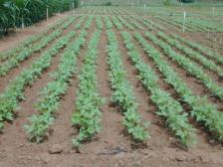
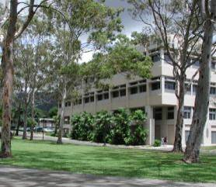



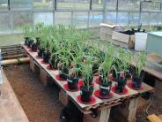
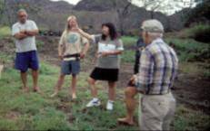
Appropriate Use of Images
Responsibilities of the Specialist
Scholarship
Synthesis
Leadership

Slide 24
GIF
This stands for “Graphical Interface Format”
This is the best file type to use for logos, line art, or other images with limited colors
GIF files only store colors that are actually used in the image

Slide 25

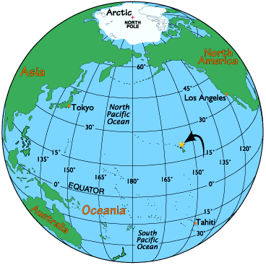


GIF Examples

Slide 26
TIF or TIFF
This stands for “Tagged Image File Format.”
This is the best file type to use if you need transparency in the image
It is the most widely used file format in desktop publishing

Slide 27


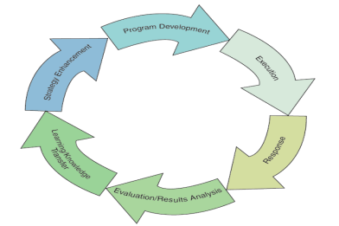

TIFF Example

Slide 28



What About Resolution?
“Resolution” = number of pixels per inch in a bitmap image
The more dots per inch (dpi), the higher the resolution
Higher resolution (“high res”) means a better quality image
one
pixel
HOWEVER…
PowerPoint only displays at 92 dpi onscreen
Notes:
“Resolution” refers to the number of pixels, or dots, per inch in a bitmap image. An image with 1 bit of color information per pixel. (all photos or scans are bitmap images)
PowerPoint only displays at 72 dpi onscreen, so a 300 dpi image will look exactly the same as a 72 dpi image while taking up a lot more memory

Slide 29

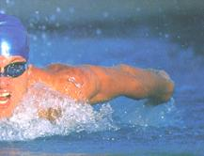
What Resolution Should I Use?
Can you tell the difference on screen? How about if you print it?
300 dpi
72 dpi

Slide 30
What Resolution Should I Use?
So what’s the difference?
300 dpi
72 dpi
This image is 1.4 MB
This image is 240 K
Notes:
NOTE: Since PowerPoint embeds images into the file, using smaller images will help prevent the PowerPoint file from getting too big and possibly crashing.

Slide 31
Tip #8 On Screen vs. Print
ON SCREEN 92 dpi
PRINTING 300 dpi
If showing PowerPoint presentation on screen only, use images at 92 dpi
If printing PowerPoint presentation, use images at 300 dpi
High res images look better when printed but make presentation file big
Never start with a low res image and try to increase it’s res. Result will be a fuzzy picture
Notes:
Recent conference, PPP was 60 MB. Caused computer to crash and the conference to be delayed by 20 minutes.
Fuzzy photo. Common error is to enlarge an image that has low resolution. I don’t have a high resolution image of this logo.
It looked good when it was smaller and at its proper size but I wanted it bigger for this presentation.
I enlarged it but you can see that it is pixelated.

Slide 32
Tip#9 Make it Interactive
Be able to jump to any slide
Blank the screen
Draw on the screen
Screen Shots
Notes:
Jump: set up links within your presentation so that your PP is non-linear and you can improvise last minute according to your audience’s needs or interests
Blank: when you want your audience’s focus hit the “B” key
DRAW: Right click, point to Pointer Options, and then click Pen. If you make a mistake just hit the “E” key

Slide 33
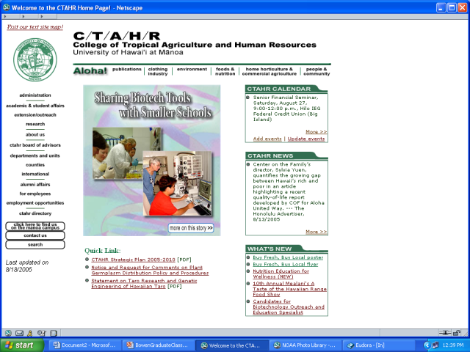

Screen Shots
Notes:
Use screen shots when you don’t have internet connection and you want to show a web site or when you don’t have the original image but need to use it in your presentation.
Be sure to follow all copyright rules.
Press the Shift and Print Screen keys at the same time on a Mac or the Print Screen button on a PC keyboard

Slide 34
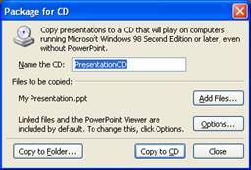
Tip #10 Package for CD
Package your presentations and all of the supporting files and run them from the CD.
Notes:
You can now package your presentations and all of the supporting files (including linked files), and automatically run them from a CD.
The updated PowerPoint Viewer is included on the CD when you package your presentations, which lets you to show your presentation on a computer that does not have PowerPoint installed.

Slide 35
Tip #1 Poster Presentations
Construct the poster to include the title, the author(s), affiliation(s), and a description of the research, highlighting the major elements that are covered in the abstract.

Slide 36

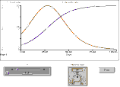

Using computer simulation software to enhance student learning
Kent D. Kobayashi
Tropical Plant & Soil Sciences Department, University of Hawaii at Manoa
Introduction
STELLA graph showing simulation output. "Slider" and "knob" icons control values of the variable and parameter. "Run" button runs the model.
How can the student-learning experience be enhanced using computer simulations?
This paper describes the use of several simulation programs to promote active, hands-on learning in a graduate course on crop modeling.
Results
Methods
Enhanced understanding of crop physiology and relationship between crop and environment.
Students had hands-on experience developing their own crop models.
Enabled exploring "what if" scenarios.
TPSS 601 Crop Modeling covers modeling crop growth and development. In the laboratory session, students discuss scientific papers.
Software to do crop simulations—CSMP, BASIC, and STELLA—were introduced into the lab session. Using these software, students developed their own crop models for homework and lab assignments, and a term project.
Software | Advantages | Disadvantages
CSMP | Simple coding. Models already available. | Crude graphs. Need to run on mainframe computer.
BASIC | Simple coding. Models already available. | Students would have to learn language. Many lines of code needed.
STELLA | Graphical icon based. Relational diagram approach. | Logistics—only Mac version used. Software is expensive.
A=INTGRL(IA,GR)
GR=RGR*A
INCON IA=1.
PARAMETER RGR=0.1
OPEN "I", #1, PS
INPUT #1, LAT
SM=.45*(24.3 - .264*LAT)
SD=SM*(.0186*LAT - .12)
STELLA is being used this fall in my other TPSS courses—"Computer applications, high technology, and robotics in agriculture" and "Plant growth and development."
Example of lines of CSMP language code.
Example of lines of BASIC language code.
Conclusions
Use of computer simulation software in a crop modeling course enabled students to develop crop models, thereby enhancing active learning through hands-on experience.
STELLA relational diagram showing variables
and their relationships.
Acknowledgements
Support from President’s Educational Improvement Fund Grant,
University of Hawaii.
Notes:
A poster is like a snapshot of your research

Slide 37
Tip #2
Minimize detail and try to use simple, jargon-free statements.

Slide 38
Using computer simulation software to enhance student learning
Kent D. Kobayashi
Tropical Plant & Soil Sciences Department, University of Hawaii at Manoa
Introduction
STELLA graph showing simulation output. "Slider" and "knob" icons control values of the variable and parameter. "Run" button runs the model.
How can the student-learning experience be enhanced using computer simulations?
This paper describes the use of several simulation programs to promote active, hands-on learning in a graduate course on crop modeling.
Results
Methods
Enhanced understanding of crop physiology and relationship between crop and environment.
Students had hands-on experience developing their own crop models.
Enabled exploring "what if" scenarios.
TPSS 601 Crop Modeling covers modeling crop growth and development. In the laboratory session, students discuss scientific papers.
Software to do crop simulations—CSMP, BASIC, and STELLA—were introduced into the lab session. Using these software, students developed their own crop models for homework and lab assignments, and a term project.
Software | Advantages | Disadvantages
CSMP | Simple coding. Models already available. | Crude graphs. Need to run on mainframe computer.
BASIC | Simple coding. Models already available. | Students would have to learn language. Many lines of code needed.
STELLA | Graphical icon based. Relational diagram approach. | Logistics—only Mac version used. Software is expensive.
A=INTGRL(IA,GR)
GR=RGR*A
INCON IA=1.
PARAMETER RGR=0.1
OPEN "I", #1, PS
INPUT #1, LAT
SM=.45*(24.3 - .264*LAT)
SD=SM*(.0186*LAT - .12)
STELLA is being used this fall in my other TPSS courses—"Computer applications, high technology, and robotics in agriculture" and "Plant growth and development."
Example of lines of CSMP language code.
Example of lines of BASIC language code.
Conclusions
Use of computer simulation software in a crop modeling course enabled students to develop crop models, thereby enhancing active learning through hands-on experience.
STELLA relational diagram showing variables
and their relationships.
Acknowledgements
Support from President’s Educational Improvement Fund Grant,
University of Hawaii.

Slide 39
Tip #3
Remember that pictures, tables, and figures are amenable to poster display

Slide 40
Using computer simulation software to enhance student learning
Kent D. Kobayashi
Tropical Plant & Soil Sciences Department, University of Hawaii at Manoa
Introduction
STELLA graph showing simulation output. "Slider" and "knob" icons control values of the variable and parameter. "Run" button runs the model.
How can the student-learning experience be enhanced using computer simulations?
This paper describes the use of several simulation programs to promote active, hands-on learning in a graduate course on crop modeling.
Results
Methods
Enhanced understanding of crop physiology and relationship between crop and environment.
Students had hands-on experience developing their own crop models.
Enabled exploring "what if" scenarios.
TPSS 601 Crop Modeling covers modeling crop growth and development. In the laboratory session, students discuss scientific papers.
Software to do crop simulations—CSMP, BASIC, and STELLA—were introduced into the lab session. Using these software, students developed their own crop models for homework and lab assignments, and a term project.
Software | Advantages | Disadvantages
CSMP | Simple coding. Models already available. | Crude graphs. Need to run on mainframe computer.
BASIC | Simple coding. Models already available. | Students would have to learn language. Many lines of code needed.
STELLA | Graphical icon based. Relational diagram approach. | Logistics—only Mac version used. Software is expensive.
A=INTGRL(IA,GR)
GR=RGR*A
INCON IA=1.
PARAMETER RGR=0.1
OPEN "I", #1, PS
INPUT #1, LAT
SM=.45*(24.3 - .264*LAT)
SD=SM*(.0186*LAT - .12)
STELLA is being used this fall in my other TPSS courses—"Computer applications, high technology, and robotics in agriculture" and "Plant growth and development."
Example of lines of CSMP language code.
Example of lines of BASIC language code.
Conclusions
Use of computer simulation software in a crop modeling course enabled students to develop crop models, thereby enhancing active learning through hands-on experience.
STELLA relational diagram showing variables
and their relationships.
Acknowledgements
Support from President’s Educational Improvement Fund Grant,
University of Hawaii.

Slide 41
Tip #4
If you can, use color in your visuals.

Slide 42
Using computer simulation software to enhance student learning
Kent D. Kobayashi
Tropical Plant & Soil Sciences Department, University of Hawaii at Manoa
Introduction
STELLA graph showing simulation output. "Slider" and "knob" icons control values of the variable and parameter. "Run" button runs the model.
How can the student-learning experience be enhanced using computer simulations?
This paper describes the use of several simulation programs to promote active, hands-on learning in a graduate course on crop modeling.
Results
Methods
Enhanced understanding of crop physiology and relationship between crop and environment.
Students had hands-on experience developing their own crop models.
Enabled exploring "what if" scenarios.
TPSS 601 Crop Modeling covers modeling crop growth and development. In the laboratory session, students discuss scientific papers.
Software to do crop simulations—CSMP, BASIC, and STELLA—were introduced into the lab session. Using these software, students developed their own crop models for homework and lab assignments, and a term project.
Software | Advantages | Disadvantages
CSMP | Simple coding. Models already available. | Crude graphs. Need to run on mainframe computer.
BASIC | Simple coding. Models already available. | Students would have to learn language. Many lines of code needed.
STELLA | Graphical icon based. Relational diagram approach. | Logistics—only Mac version used. Software is expensive.
A=INTGRL(IA,GR)
GR=RGR*A
INCON IA=1.
PARAMETER RGR=0.1
OPEN "I", #1, PS
INPUT #1, LAT
SM=.45*(24.3 - .264*LAT)
SD=SM*(.0186*LAT - .12)
STELLA is being used this fall in my other TPSS courses—"Computer applications, high technology, and robotics in agriculture" and "Plant growth and development."
Example of lines of CSMP language code.
Example of lines of BASIC language code.
Conclusions
Use of computer simulation software in a crop modeling course enabled students to develop crop models, thereby enhancing active learning through hands-on experience.
STELLA relational diagram showing variables
and their relationships.
Acknowledgements
Support from President’s Educational Improvement Fund Grant,
University of Hawaii.

Slide 43
Tip #5
Make sure your fonts are consistent and are large enough to be read from a distance, i.e., do not simply pin up a set of typed pages--reserve these for your handout.

Slide 44
Tip #6
Consider using a flow chart or some other method of providing the viewer with a guide to inspecting your display.

Slide 45
Using computer simulation software to enhance student learning
Kent D. Kobayashi
Tropical Plant & Soil Sciences Department, University of Hawaii at Manoa
Introduction
STELLA graph showing simulation output. "Slider" and "knob" icons control values of the variable and parameter. "Run" button runs the model.
How can the student-learning experience be enhanced using computer simulations?
This paper describes the use of several simulation programs to promote active, hands-on learning in a graduate course on crop modeling.
Results
Methods
Enhanced understanding of crop physiology and relationship between crop and environment.
Students had hands-on experience developing their own crop models.
Enabled exploring "what if" scenarios.
TPSS 601 Crop Modeling covers modeling crop growth and development. In the laboratory session, students discuss scientific papers.
Software to do crop simulations—CSMP, BASIC, and STELLA—were introduced into the lab session. Using these software, students developed their own crop models for homework and lab assignments, and a term project.
Software | Advantages | Disadvantages
CSMP | Simple coding. Models already available. | Crude graphs. Need to run on mainframe computer.
BASIC | Simple coding. Models already available. | Students would have to learn language. Many lines of code needed.
STELLA | Graphical icon based. Relational diagram approach. | Logistics—only Mac version used. Software is expensive.
A=INTGRL(IA,GR)
GR=RGR*A
INCON IA=1.
PARAMETER RGR=0.1
OPEN "I", #1, PS
INPUT #1, LAT
SM=.45*(24.3 - .264*LAT)
SD=SM*(.0186*LAT - .12)
STELLA is being used this fall in my other TPSS courses—"Computer applications, high technology, and robotics in agriculture" and "Plant growth and development."
Example of lines of CSMP language code.
Example of lines of BASIC language code.
Conclusions
Use of computer simulation software in a crop modeling course enabled students to develop crop models, thereby enhancing active learning through hands-on experience.
STELLA relational diagram showing variables
and their relationships.
Acknowledgements
Support from President’s Educational Improvement Fund Grant,
University of Hawaii.

Slide 46
Tip #7
Don't overwhelm the viewer with excessive amounts of information; rather, construct a poster display that enhances conversation.

Slide 47
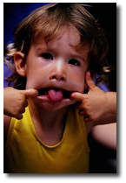
Final Word
“The purpose of using visual aids is to enhance your presentation, not upstage it.”
  Lenny Laskowski
  PowerPointers.com
Notes:
Rehearse your show several times before presenting it to a live audience. Know when you will move on and have some sense of the time required. Know how to use the computer. Don't be fumbling about trying to figure out how to move from slide to slide.
Avoid standing or sitting right behind your computer when you present. If necessary, have an assistant run the computer while you speak.
PowerPoint slideshows are intended to accompany and illustrate your own verbal presentation
Check equipment: Turn on all equipment and make sure it all works, especially the hand controller. Batteries good?
Equipment: What equipment will be used? Computer? Overhead projector? What are its features? Who is responsible for getting it all to the site and set up?
Software: What software (and its version number!) will run the presentation? Does it match what you used to create it? If not, does it matter?
Media: How will you transport the presentation to the site? Will your presentation fit on the media you plan to use to transport it? Can the computer that will run the presentation use that type of media?
(floppy disk, zip disk, USB drive, CD, DVD?)
Handouts: Who is bringing? How to distribute and when and by whom?

