Slide 1
Fresh Grads – Group Project
Online Sports Shopee System

Slide 2
Problem Statement
To Create an Online Sports Shoppe application which provides below functionalities:
Create and maintain customer information.
Create and maintain products information.
Customers can able to add and delete products to cart.
Customers can able to view cart items.
Customers can able to see saved card details for payment.
Customers can able to see all orders.

Slide 3

Road Map
Application will be developed in following Sprints –
1.Core Java +JPA with Hibernate
Spring Boot + Rest Controller
2 .Angular for UI design (Front End) + Integration with previous Sprint

Slide 4
Plan
Design
Generate the skeleton as per class design provided
TDD approach
Identify test cases for each module
Write Failing Test cases
Convert the Test Cases in GREEN
Implement the case study in incremental manner

Slide 5
Modules
User Module
Product Module
Customer
Module
Payment
Module
Order
Module

Slide 6
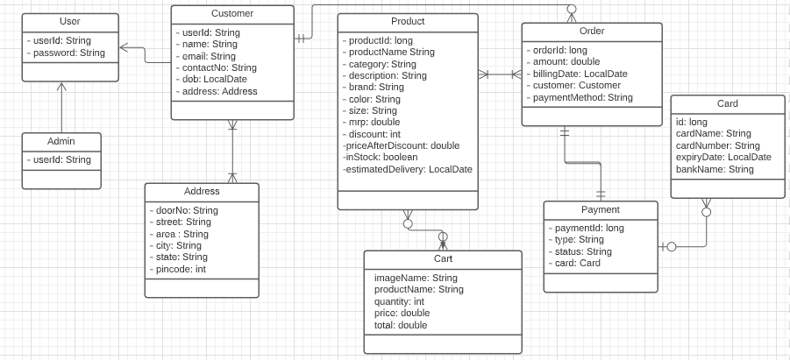
Class Design
POJO Classes:

Slide 7
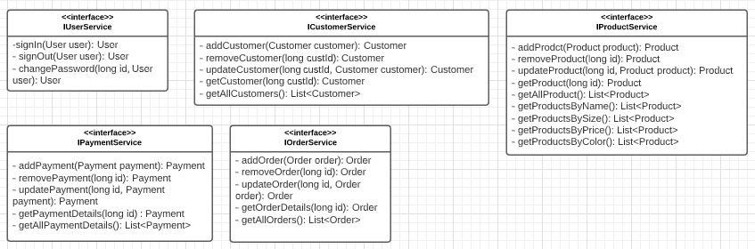
Class Design
Service Interface:

Slide 8
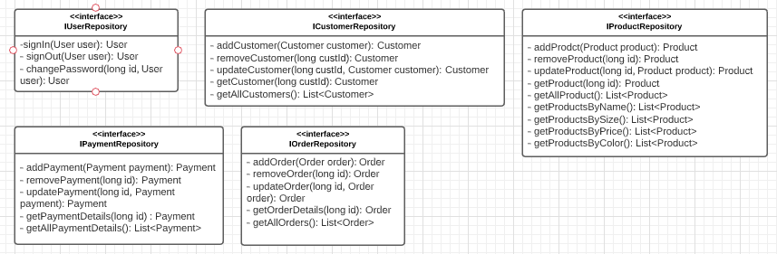
Class Design
Repository:

Slide 9




Questions

