Slide 1
Suicide Project
Suicide Data Analysis

Slide 2
Data Insights
Total no of data points is 27448 with 13 data classes
Merged with continent data
The data has been extracted from Kaggle
Focus on the data between Year 2000 and 2010 (rich of data)
94 different countries from all over the globe were involved

Slide 3
The Global Trend

Slide 4
Global Trend By Country

Slide 5
Top 5 Countries

Slide 6
Rate Per Continent

Slide 7
Age Group

Slide 8
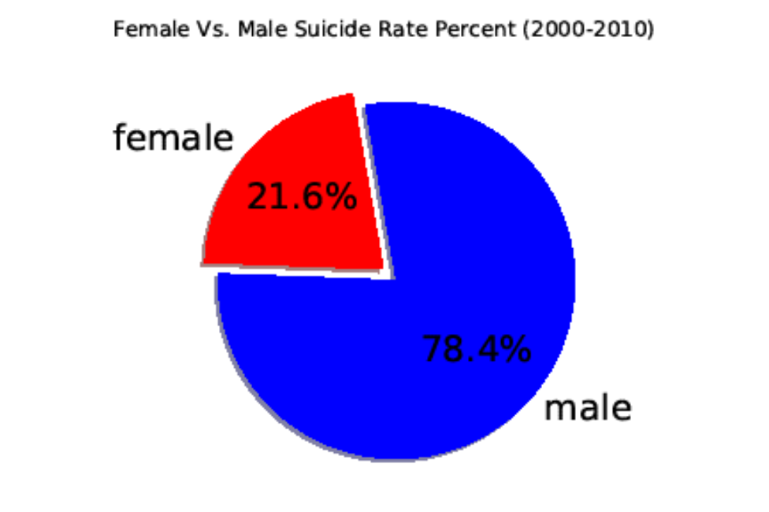
Gender Likelihood
The Male has 3.6 times higher suicide rate comparing to the female

Slide 9
Economic Impact
Correlation
The correlation coefficient between both factors is 0.09
very weak correlation between the GDP and the Suicide rate

Slide 10
Economic Impact
The R-squared value (1 %) indicates that none of the variability around its mean

Slide 11
Conclusion
The communist nations have more tendency to suicide
Europe has the highest suicide rate comparing to the other six continents
There is noticeable drop in the suicide rate in year 2005
The elderly people more vulnerable to suicide
Men are three times more likely to die by suicide than women
Although the economic analysis didn’t show any significant relation with the suicide rate; more data are needed to verify

