Slide 1

FROM INTENT
TO ENFORCEMENT
TABLETOP / AGENTIC KUBERNETES GUARDRAILS
Quarantine Mode
Incident containment on a shared Kubernetes platform
Co-presenters: Milind Gunjan / Vivek Mayuranathan
October 26, 2026 · 4:30–5:30 PM · Views are our own
ISC2 SECURITY CONGRESS 2026 / SC2632
01
Notes:
00:00–00:30 (Milind — Block 1: Slides 1–6). Open with the concrete conflict: "The workload is live beside revenue services. The policy PR is green, but its tests cover only one rule. Your response must preserve evidence and service while you verify the policy and choose containment." State the team task: inspect evidence, record a decision before each reveal, and revise only when new facts justify it. Introduce Milind Gunjan and Vivek Mayuranathan. Repository source: https://github.com/mgunjan/sc2632-tabletop/blob/main/tabletop/congress-2026/TECHNICAL-BRIEF.md

Slide 2
One shared platform. Four possible incidents.
SET THE EXERCISE BOUNDARY / FICTIONAL PLATFORM, FACTS HELD CONSTANT
WHY THIS SETTING
A fictional payment API makes the availability tradeoff concrete: 3 copies, at least 2 healthy. The cases teach generic Kubernetes controls, not payment compliance.
WHO RUNS HERE
Application services and support, operations and monitoring agents run as separate workloads with distinct Kubernetes identities.
WHAT IS NOT ASSUMED
No incident is assigned yet. The case-specific signal, affected identity, evidence and control gap arrive only after your table selects a case.
YOUR OPERATING DUTY
Keep the service floor, preserve evidence and record who may approve a change. A proposed policy and its tests are only part of the response.
You will make and revise a decision on paper. No cluster access, laptop, YAML or prior Kubernetes experience is required.
ISC2 SECURITY CONGRESS 2026 / SC2632
02
Notes:
00:30–01:00 (Milind). Establish which facts are common to the four fictional cases and which remain unknown until a case is chosen. The three-replica service floor is the operational constraint used in the exercise, not a claim about a real system. Ask participants to notice that they must protect service and evidence while the control gap is still uncertain.

Slide 3
How we will use the hour
RUN OF SHOW / PARTICIPANT DECISIONS BEFORE EACH EVIDENCE REVEAL
00–12 MIN
BRIEF + CHOOSE
System, controls, case and constraint
12–28 MIN
DRAFT + REVIEW
Intent, PR, exception and rollout
28–45 MIN
CONTAIN + REVISE
Order Q0–Q3; reveal new evidence
45–51 MIN
CHALLENGE
Review the model proposal and tests
51–60 MIN
RECOVER + TRANSFER
Exit criteria, take-home action, Q&A
YOUR OUTPUT: a shared Decision Record (pages 6–7) with a bounded decision, service floor, evidence owner, ordered containment and recovery test. Keep the later evidence pages sealed until prompted.
You do not need a laptop, YAML or Kubernetes experience. Ask “what does this control actually cover?” whenever a boundary is unclear.
ISC2 SECURITY CONGRESS 2026 / SC2632
03
Notes:
01:00–01:30 (Milind). Show the full hour before the technical detail. Explain that teams lock each choice on the common record before new facts appear; the score rewards evidence and justified restraint, not speed or maximum lockdown. Orient attendees to pages 6–7 now; Vivek will assign cases and roles before the first round.

Slide 4
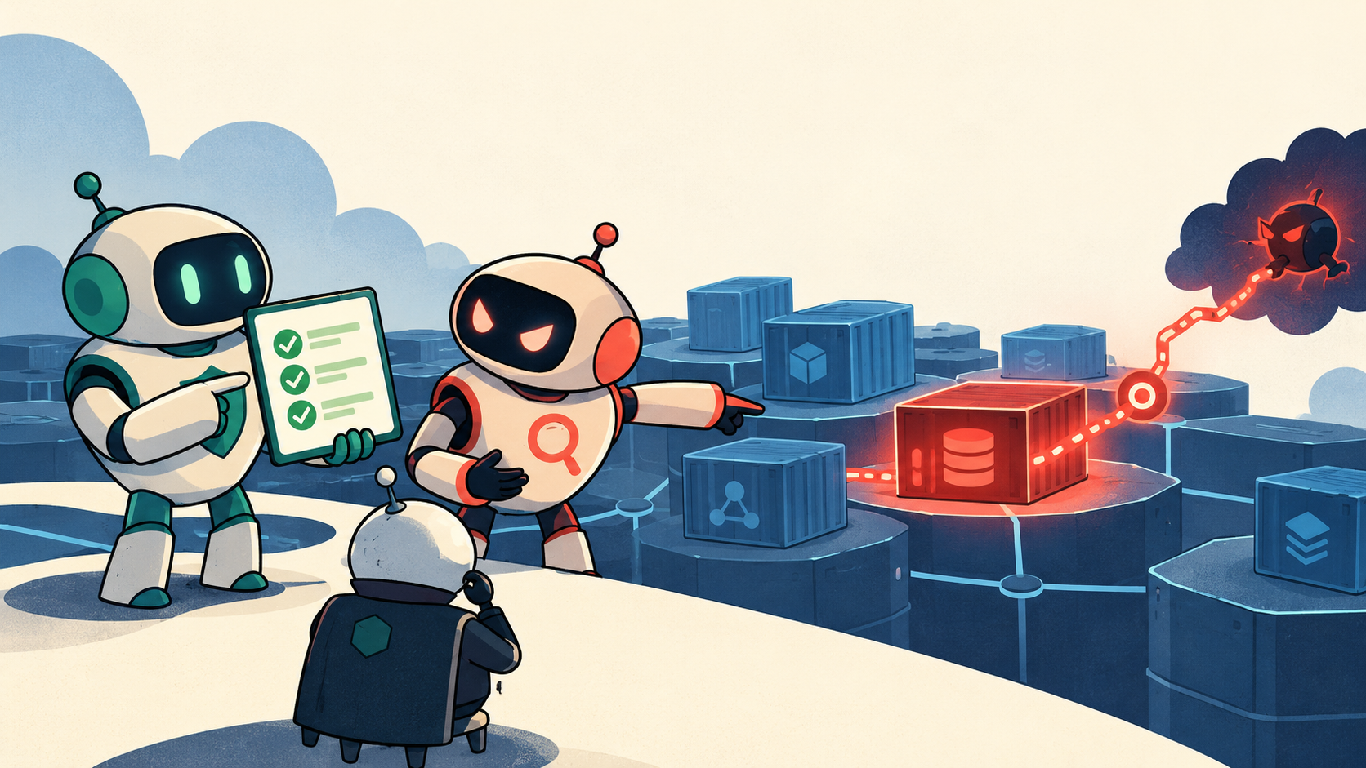
Two AI shifts collide during an incident
AI PROLIFERATION IN KUBERNETES / WHEN AI AGENTS POLICE OTHER AI AGENTS
SETTING: One fictional payment platform shared by service workloads and internal AI agents. You will choose one of four incident cases later; no case is assigned yet.
AI AS WORKLOADS
Support, operations and monitoring agents run beside critical services. Their Pods, identities and tools create runtime paths.
AI AS POLICY WRITER
A separate copilot proposes guardrails. Green tests can cover one rule while a live network or API path remains.
GREEN TESTS ≠ CONTAINMENT
YOUR ROLE: Choose a case later, challenge the proposed change, preserve service and evidence, then justify the containment order.
ISC2 SECURITY CONGRESS 2026 / SC2632
04
Notes:
01:30–02:10 (Milind — Block 1 continues). Point to the image: the first agent is an application workload with runtime authority; the second is a policy-writing system asked to govern those workloads. Ask, "Who verifies the guardrails when both sides are changing?" Then connect the visual to the real control gap: a green admission-test result does not prove that live traffic, credentials, or API permissions are contained. Repository source: https://github.com/mgunjan/sc2632-tabletop/blob/main/tabletop/congress-2026/TECHNICAL-BRIEF.md Repository source: https://github.com/mgunjan/sc2632-tabletop/blob/main/generator/policy_agent.py Repository source: https://github.com/mgunjan/sc2632-tabletop/blob/main/quarantine/quarantine-mode.md Establish the common setting before using the word payment: all four prepared cases share a fictional payment platform; participants select their incident on slide 13, so this slide has not assigned a case. The two agents in the original generated illustration represent two roles: workload agents and a separate policy-writing copilot. The human incident board owns the decision. The picture is a conceptual illustration, not evidence or a real cluster diagram.

Slide 5
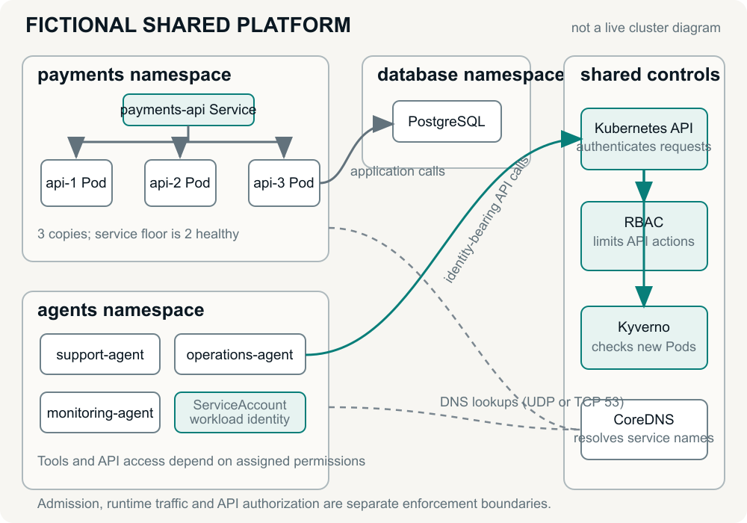
Inside the shared payment platform
THE ENVIRONMENT YOU ARE DEFENDING / PLAIN-LANGUAGE CLUSTER MAP
CONTEXT: No Kubernetes or Kyverno experience is required. A Pod is a running workload; a namespace is a resource group in one cluster.
1. PAYMENT SERVICES (namespace = resource group)
payments-api has 3 running copies; keep at least 2 healthy. Redis, backup-job and report-runner also run here.
2. AI AGENTS (shared resource group)
support-agent (ticket helper), ops-agent (auto-scaler), monitoring-agent (health and Secret reader).
3. WORKLOAD IDENTITY (ServiceAccount)
A credential attached to a Pod so it can call the Kubernetes management API.
4. SHARED PLATFORM PLUMBING
Kyverno checks new Pods before they start; cluster DNS (kube-dns) resolves service names.
ISC2 SECURITY CONGRESS 2026 / SC2632
05
Notes:
02:10–02:50 (Milind — Block 1 continues). State that this is one fictional payment platform shared by application workloads and AI agents; the room will choose a specific incident on slide 13. Translate as you point: a Pod is one running workload; a replica is another copy; a namespace is a resource group; a ServiceAccount is the workload identity used for Kubernetes API calls. At least two of three payment-service copies must remain healthy. Kyverno checks new Pod requests; cluster DNS resolves service names. Repository source: https://github.com/mgunjan/sc2632-tabletop/blob/main/tabletop/congress-2026/INCIDENT-BRIEF.md Repository source: https://github.com/mgunjan/sc2632-tabletop/blob/main/lab/README.md

Slide 6
What each security layer sees—and misses
WHY ONE GUARDRAIL IS NEVER ENOUGH / FOUR DISTINCT CONTROL LAYERS
THE CORE PROBLEM: Teams often assume an admission policy "locks down the cluster." In reality, each Kubernetes layer controls a different boundary:
1. DETECT
(Falco runtime rules + API audit logs)
WHAT EXISTS:
System-call rules validated; audit rules pass synthetic tests.
BOUNDARY:
Live capture, API-server delivery and alert-to-response not exercised.
2. ADMIT
(Kyverno Webhook)
WHAT IT DOES:
Blocks unsafe NEW pods before they start.
BLIND SPOT:
Cannot stop already-running pods or Secret reads.
3. CONTAIN
(NetworkPolicy + RBAC)
WHAT IT DOES:
Cuts live pod traffic & revokes API permissions.
BLIND SPOT:
Can break DNS or service uptime if applied blindly.
4. AUTHORIZE
(Your Incident Board)
WHAT IT DOES:
AI proposes controls; humans verify & approve.
YOUR JOB:
Catch missing layers & order Q0–Q3 quarantine.
GOLDEN RULE FOR TODAY: Blocking a new Pod at Admission (Layer 2) leaves running pods, active network sessions, and stolen tokens alive (Layer 3).
ISC2 SECURITY CONGRESS 2026 / SC2632
06
Notes:
02:50–03:30 (Milind — finishes Block 1, then hands to Vivek). Explain why no single Kubernetes guardrail can contain an incident alone by walking the 4 cards and their blind spots: (1) Detect (Falco & Audit logs) only alerts; (2) Admit (Kyverno) only checks NEW pods at start—it is blind to already-running pods and Secret reads; (3) Contain (NetworkPolicy & RBAC) cuts live traffic and tokens, but can break DNS or uptime if applied blindly; (4) Authorize (Your Incident Board) audits the AI proposal and orders Q0–Q3 Quarantine. Hand off to Vivek for Slides 7–8. Repository source: https://github.com/mgunjan/sc2632-tabletop/blob/main/runtime/falco-rules-syscall.yaml Repository source: https://github.com/mgunjan/sc2632-tabletop/blob/main/runtime/falco-rules-k8saudit.yaml Repository source: https://github.com/mgunjan/sc2632-tabletop/blob/main/lab/README.md Repository source: https://github.com/mgunjan/sc2632-tabletop/blob/main/submission/2026-10-14/demo-audit/CI-RESULT.json

Slide 7
The policy agent decision loop
SYSTEM ARCHITECTURE / 4-ZONE PIPELINE FROM INTENT TO REVIEW BUNDLE
ZONE 1: INPUTS →
4-clause intent + fixtures
ZONE 2: PYTHON HARNESS →
Templates + Kyverno CLI (≤3x)
ZONE 3: TYPED DECIDER →
Catalog choice + score ≥0.60
ZONE 4: LOCAL PR BUNDLE
PR.md + readiness.json ledger
Stage | Model choice | Python and tools
Map intent | One of 10 catalog options per clause | Validate choice; fill the scoped spec
Dependencies | preserve or deny each profile | Read fixtures; collect workload labels
Blocked workload | allow_and_retest, request_exception or block_is_intended | Render templates; simulate admission; at most 3 rounds
Review bundle | Exception request or escalation | Write stage files, tests, coverage and local PR.md
ARCHITECTURE KEY: The LLM never writes raw YAML or touches kubectl—it only picks typed catalog keys inside Python.
ISC2 SECURITY CONGRESS 2026 / SC2632
07
Notes:
03:30–04:30 (Vivek — Block 2: Slides 7–8). Vivek explains how the defensive AI Policy Agent architecture works: instead of letting an LLM hallucinate raw YAML, our deterministic Python harness owns the templates and Kyverno test runner, and only asks the model to select among 10 catalog options, dependency profiles, and blocked-workload dispositions over at most 3 simulation rounds. Distinguish this defensive policy compiler from the suspect support/ops/monitoring agents inside the incident cases. Repository source: https://github.com/mgunjan/sc2632-tabletop/blob/main/generator/policy_agent.py Repository source: https://github.com/mgunjan/sc2632-tabletop/blob/main/generator/decider_agent.py Repository source: https://github.com/mgunjan/sc2632-tabletop/blob/main/tabletop/congress-2026/demo.py

Slide 8
Trust boundaries and model inputs
WHAT THE MODEL SEES / FAIL-OPEN VS. FAIL-CLOSED DEFAULTS
CONTEXT: What data crosses into the AI model, and what happens when its confidence score is low (< 0.60) during an incident?
Boundary | What crosses it
Runtime events | Supplied alerts inform review. No Falco ingestion.
Provider request | Full intent + clause, profile/workload names, or workload/policy/denial reason
Provider response | Allowed choice + numeric score. Invalid or below 0.6 escalates.
Uncertain dependency | Retains the proposed allowance and flags human review.
Cluster change | People apply reviewed changes. Presenter uses fixtures.
KEY TRADEOFF: Uncertain dependencies fail OPEN (to protect payments uptime); uncertain controls fail CLOSED (escalated to you).
ISC2 SECURITY CONGRESS 2026 / SC2632
08
Notes:
04:30–05:30 (Vivek — finishes Block 2, then hands to Milind). Vivek highlights the architectural trust boundary: what crosses into the model prompt, how the 0.6 score threshold routes uncertain choices to human review, and the deliberate asymmetry between uncertain dependencies (retains proposed allowance + flags review so payments does not go down) and uncertain controls (enables no control + escalates). Hand off to Milind for the 45-second compiler walkthrough. Repository source: https://github.com/mgunjan/sc2632-tabletop/blob/main/generator/policy_agent.py Repository source: https://github.com/mgunjan/sc2632-tabletop/blob/main/generator/decision_contract.py Repository source: https://github.com/mgunjan/sc2632-tabletop/blob/main/submission/2026-10-12/benchmark/provider_clients.py Repository source: https://github.com/mgunjan/sc2632-tabletop/blob/main/tabletop/congress-2026/demo.py

Slide 9
One requirement, one compiled control
COMPILER WALKTHROUGH / PART 1 OF 2 (SINGLE CLAUSE)
EXAMPLE: Suppose your board writes 4 requirements, starting with "Prevent privilege escalation in payments." The compiler outputs:
Field | Compiled behavior
Intent | Prevent privilege escalation in payments.
Catalog key | deny_privilege_escalation / ACG-POD-001
Generated API | Kyverno ValidatingPolicy, scoped to payments
Covered requests | Pod CREATE; regular and init containers
Required fields | privileged=false and explicit allowPrivilegeEscalation=false
WAIT: This policy passes 6/6 unit tests on new Pods—but that is only 1 of the 4 clauses in your security intent.
ISC2 SECURITY CONGRESS 2026 / SC2632
09
Notes:
05:30–06:15 (Milind — Block 3: Slides 9–10). Milind runs the bounded reference compiler (or shows pre-opened output/frozen-a) for one clause: "Prevent privilege escalation in payments." Point out that Kubernetes defaults allowPrivilegeEscalation to true unless explicitly set to false, and that the compiler covers both containers and initContainers on Pod CREATE. Then transition to Slide 8: what about the other 3 clauses of the incident intent? Repository source: https://github.com/mgunjan/sc2632-tabletop/blob/main/output/frozen-a/policies/deny-privilege-escalation.yaml Repository source: https://github.com/mgunjan/sc2632-tabletop/blob/main/generator/generate.py Repository source: https://github.com/mgunjan/sc2632-tabletop/blob/main/controls/catalog.json Repository source: https://github.com/mgunjan/sc2632-tabletop/blob/main/tabletop/congress-2026/demo.py

Slide 10
Unresolved enforcement requirements
COMPILER WALKTHROUGH / PART 2 OF 2 (WHOLE-INTENT LEDGER)
THE REQUIREMENT LEDGER: When we check all 4 clauses of the incident intent against what Kyverno can enforce, Clause 3 is exposed:
Intent clause | Proposal status
Limit east-west communication | Egress-profile policy
Prevent privilege escalation | Privilege policy
Restrict Kubernetes API access | Unimplemented. RBAC handover required.
Avoid disruption and expire exceptions | Rollout and exception process
AHA! Passing Pod unit tests cannot hide an unimplemented RBAC clause. Your table will use this ledger in Round 1.
ISC2 SECURITY CONGRESS 2026 / SC2632
10
Notes:
06:15–07:15 (Milind — finishes Block 3, then hands to Vivek). Show why the whole-intent requirement ledger is the centerpiece of the architecture: even when the privilege policy passes its unit tests, Clause 3 ("Restrict Kubernetes API access") cannot be enforced by Kyverno Pod admission and is flagged as an explicit RBAC handover (REVIEW_REQUIRED / INCOMPLETE_PROPOSAL). Also point out the unrequested registry restriction added at Audit in Scenario A. Hand off to Vivek for Slide 13. Repository source: https://github.com/mgunjan/sc2632-tabletop/blob/main/output/frozen-a/PR.md

Slide 11
Quarantine Mode implementation
STAGED RUNTIME CONTAINMENT / GRADUATED Q0–Q3 POSTURE
WHY QUARANTINE MODE: Admission only gates new Pods. Contain live workloads without losing evidence or breaking payments:
Level | Mechanisms | Verification required
Q0 Normal | Reviewed baseline guardrails | Legitimate service paths
Q1 Freeze | Native API-server policy freezes writes by identities in agents | Covered writes and allowed reads
Q2 Constrain | NetworkPolicy and protected labels; manual RBAC narrowing | Traffic and API positive/negative tests
Q3 Isolate | Suspect isolation labels + deny-all; Pod CREATE gate | Isolation and clean serving capacity
IN ROUND 3: Your table will pick Q0–Q3 and order the steps so volatile evidence is captured BEFORE pod changes.
ISC2 SECURITY CONGRESS 2026 / SC2632
11
Notes:
07:15–08:15 (Vivek — Block 4: Slides 11–14). Vivek introduces Quarantine Mode Q0–Q3 as a graduated incident dial between "do nothing" and "burn down the cluster": Q1 freezes write calls from system:serviceaccount:agents:* using a native Kubernetes ValidatingAdmissionPolicy in the API server (which survives even if Kyverno webhooks are scaled down); Q2 constrains network egress and locks quarantine labels; Q3 isolates suspect pods by label and gates Pod CREATE in payments. Emphasize that humans declare Q-levels and verify each layer. Repository source: https://github.com/mgunjan/sc2632-tabletop/blob/main/quarantine/q1/freeze-agent-changes.yaml Repository source: https://github.com/mgunjan/sc2632-tabletop/tree/main/quarantine/q2/ Repository source: https://github.com/mgunjan/sc2632-tabletop/blob/main/quarantine/q3/admission-policies.yaml Repository source: https://github.com/mgunjan/sc2632-tabletop/blob/main/quarantine/q3/network-and-identity.yaml Repository source: https://github.com/mgunjan/sc2632-tabletop/blob/main/quarantine/quarantine-mode.md

Slide 12
How your table plays the exercise
TABLETOP / NO KUBERNETES OR KYVERNO EXPERIENCE, LAPTOP OR YAML REQUIRED
WORKFLOW: 1. Read Case Alert (pp. 2–5) → 2. Lock Decision on Record (pp. 6–7) → 3. Lab Reveal & Score
DECISIONS YOU LOCK ON PAGES 6–7
• Round 1: Security intent & non-admission handoff
• PR Review: APPROVE / MODIFY / REJECT / ESCALATE
• Round 2: Exception disposition + Audit / Warn / Deny
• Round 3: Ordered Q0–Q3 containment & recovery exit test
FOUR ROLES AT YOUR TABLE
• Incident Lead: Calls the table vote & states the decision
• Recorder: Writes the locked record on pages 6–7
• Evidence Analyst: Checks claims against lab facts
• Independent Reviewer: Challenges one assumption first
NO SETUP NEEDED: No laptop, YAML or cluster access. Presenters run a prepared local demo against policy fixtures, not a live cluster. If it fails, show the dated recorded output. Keep pages 8–9 and review page 2 sealed until called.
ISC2 SECURITY CONGRESS 2026 / SC2632
12
Notes:
08:15–09:00 (Vivek). Hold up PARTICIPANT-PACK.pdf and orient tables in 45 seconds: Pages 2–5 are the 4 incident cases; Pages 6–7 are your shared Decision Record; Pages 8–9 and CONTROL-REVIEW Page 2 stay folded until their rounds. Every round follows the same cadence: discuss, write and lock your decision on Pages 6–7 BEFORE the reveal, then compare against recorded k3s lab evidence and score. Presenter note: run the fresh local reference only after demo.py --check passes; it tests current source and fixtures, not live cluster enforcement. If preflight/run fails, show the dated recorded proposal and call it recorded. Repository source: https://github.com/mgunjan/sc2632-tabletop/blob/main/tabletop/congress-2026/CO-PRESENTER-CARDS.md

Slide 13
Four prepared incident cases
CHOOSE ONE CASE IN 30 SECONDS / PARTICIPANT PACK PAGES 2–5
CASE A · Library update & egress
Tables 1, 5, 9 default
A library update and unexpected payments traffic
CASE B · Support assistant & tools
Tables 2, 6, 10 default
A ticket-reading assistant and unexpected tool activity
CASE C · Unapproved replica changes
Tables 3, 7, 11 default
An ops agent changes application copies without a ticket
CASE D · Cross-namespace Secret reads
Tables 4, 8, 12 default
A monitoring identity lists credential records across groups
FAST START: Take your table’s default case above (or pick any case in 30 seconds). Keep pages 8–9 sealed.
ISC2 SECURITY CONGRESS 2026 / SC2632
13
Notes:
09:00–10:15 (Vivek & Milind). Fast-start case assignment so tables do not lose 3 minutes debating which page to read: "Take your table’s default case on the screen—Tables 1,5,9 take Case A; Tables 2,6,10 take Case B; Tables 3,7,11 take Case C; Tables 4,8,12 take Case D—or swap within 30 seconds." Give tables 60 seconds to read their initial alert on pages 2–5 while keeping pages 8–9 sealed. Repository source: https://github.com/mgunjan/sc2632-tabletop/blob/main/scenarios/d-secret-enumeration/README.md

Slide 14
Operational constraints & service floor
PICK YOUR OPERATING CONSTRAINT / RECORD ON PAGE 6
AVAILABILITY FIRST
Keep two healthy application copies and required connections.
EVIDENCE FIRST
Preserve evidence and record every approval.
VELOCITY FIRST
Continue safe delivery while affected changes pause.
CONTAINMENT FIRST
Stop suspected exposure and justify the service cost.
WRITE ON PAGE 6 NOW: Case letter, constraint, 4 roles, and measurable service floor (e.g., 2 healthy replicas).
ISC2 SECURITY CONGRESS 2026 / SC2632
14
Notes:
10:15–12:00. Explain the four operating constraints in 30 seconds, then give tables 75 seconds to write their Case letter, Operating Constraint, 4 Roles, and measurable Service Floor (e.g., "keep 2 healthy payments-api replicas serving requests") at the top of Page 6. Both presenters circulate to verify every table has a pen moving on Page 6. Repository source: https://github.com/mgunjan/sc2632-tabletop/blob/main/submission/2026-10-13/PARTICIPANT-PACK.pdf

Slide 15
Define the
security requirement.
4 MINUTES / DRAFT AND MAP THE INTENT
01
Stop [behavior]. Preserve [dependency].
Example: block new privileged workloads.
Allow approved releases. Write your own on page 6.
ISC2 SECURITY CONGRESS 2026 / SC2632
15
Notes:
12:00–16:00. Spend 20 seconds on the prompt: write one natural-language security intent ("Prevent [behavior] by [identity/workload]; preserve [dependency] within [service floor]"), underline what Kyverno admission can enforce, and circle what requires NetworkPolicy, RBAC, or runtime/application controls. Give tables 3.5 minutes to write on Page 6, then hear 20-second readouts from two tables. Generated incident-room art is a visual metaphor, not cluster evidence.

Slide 16
Audit the containment proposal
15–19 MINUTES / AUDIT THE PREPARED PR EXCERPT ON YOUR CASE PAGE
APPROVE — All clauses & tests verified
CHECK 1: UNRESOLVED CLAUSES
Which requirement in your intent is marked REVIEW_REQUIRED or handed off outside Kyverno admission?
MODIFY — Keep control, fix scope/gaps
REJECT — Wrong layer or unsafe action
CHECK 2: MISSING ACCEPTANCE TEST
Name one control you would change and one concrete test that must pass before deployment.
ESCALATE — Unresolved authority / handoff
LOCK ON PAGE 6: Circle your disposition, name the control to change, and write the missing test.
ISC2 SECURITY CONGRESS 2026 / SC2632
16
Notes:
16:00–20:00. Tables audit the prepared PR excerpt on their case page (pages 2–5) and lock APPROVE, MODIFY, REJECT, or ESCALATE on Page 6 alongside one control to change and one missing test. Key catches: Case A spots missing RBAC + unrequested registry audit policy; Case B spots sidecar/tool boundary vs pod admission; Case C spots unverified human vs agent authority; Case D rejects admission-only claims for Secret reads.

Slide 17
Urgent exception request arrives
19–22 MINUTES / URGENT EXCEPTION INJECT UNDER TIME PRESSURE
INCOMING MESSAGE FROM SERVICE TEAM / AGENT:
“Essential service needs this access right now. Security already approved it.
Please grant a blanket exception until we fix it after the incident.”
VERIFY BEFORE GRANTING
• Did a human security owner actually approve it?
• What exact workload & namespace need access?
• Does this reopen the suspect’s attack path?
REQUIRED IF GRANTED OR NARROWED
• Named human owner (not an agent)
• Hard clock expiration (TTL timestamp)
• Compensating monitor while exception is active
WRITE ON PAGE 6: Grant / Narrow / Hold / Refuse + exact scope, owner, and expiry timestamp.
ISC2 SECURITY CONGRESS 2026 / SC2632
17
Notes:
20:00–23:00. Read the urgent exception inject. Every DevSecOps engineer has faced this 4:45 PM Slack message claiming "Security already approved it, just open the exception." Tables must verify approval independently of the agent/service assertion and lock Grant, Narrow, Hold, or Refuse on Page 6 with named human owner, exact workload/control scope, and hard clock TTL. Repository source: https://github.com/mgunjan/sc2632-tabletop/blob/main/submission/2026-10-13/PARTICIPANT-PACK.pdf

Slide 18
Audit. Warn. Deny.
23–27 MINUTES / TEAM TASK
CONTEXT: Even a valid guardrail can break production if rolled out blindly—and timed exceptions only expire if the cleanup controller has RBAC.
Mode | Admission behavior | Review question
Audit | Allow and record | Is exposure acceptable while we observe?
Warn | Allow and warn | Who will act on the warning?
Deny | Refuse the change | What legitimate workload could break?
WRITE ON PAGE 6: Choose Audit / Warn / Deny per control, state promotion criteria, and verify exception expiry.
ISC2 SECURITY CONGRESS 2026 / SC2632
18
Notes:
23:00–27:00. Tables assign Audit, Warn, or Deny per control on Page 6 and define their promotion trigger. Share the real lab "Aha!" from our October 13 rehearsal: a timed PolicyException with a 30-minute TTL silently failed to expire because Kyverno’s cleanup controller lacked RBAC delete permission on policyexceptions! Expiration is a control that itself requires verification and RBAC. Repository source: https://github.com/mgunjan/sc2632-tabletop/blob/main/generator/generate.py

Slide 19
Plan scoped
containment.
7 MINUTES / JUSTIFY THE ACTION ORDER
03
Open the sealed update on page 8.
Number actions and state the service floor.
ISC2 SECURITY CONGRESS 2026 / SC2632
19
Notes:
28:00–35:00. Tables open Sealed Page 8, select their Quarantine level (Q0–Q3), and number their containment actions in exact execution order on Page 7. Require: (1) what volatile evidence is captured BEFORE mutating/deleting pods, (2) which Q-level and namespace/identity scope is applied, (3) how the service floor is preserved, and (4) who declares quarantine. Generated incident-room art is a visual metaphor, not cluster evidence.

Slide 20
New evidence arrives mid-containment
34–38 MINUTES / SECOND INJECT / OPEN SEALED PAGE 9 NOW
Case A
Second replica shares the suspect image; host-mounted helper bypasses pod-only assumptions.
Case B
Debug subresource path and injected ticket/tool scope remain reachable.
Case C
Ops agent supports live billing while a human is asked to widen RBAC permissions.
Case D
Stolen bearer token is replayed from outside the network-quarantined Pod.
WRITE ON PAGE 7: Revise your Q-level / action order OR defend holding—and underline the new fact.
ISC2 SECURITY CONGRESS 2026 / SC2632
20
Notes:
35:00–39:00. Tables open Sealed Page 9 (the mid-containment twist for Cases A–D). Give 3 minutes to either revise their Q-level/action order or defend holding their plan beside their original answer on Page 7, underlining the specific new fact that drove the decision.

Slide 21
Test your containment assumptions
38–44 MINUTES / FOUR KUBERNETES CONTAINMENT TRAPS (PREDICT BEFORE REVEAL)
TRAP 01 · NETWORK ADDITIVITY
If Q2 allows DNS egress and you apply a new deny-all NetworkPolicy, does DNS stop?
TRAP 02 · PDB + REPLACEMENT CAPACITY
With 3 Ready Pods, 2 suspects, minAvailable=2, and Q3 blocking replacements, is a second voluntary eviction allowed?
TRAP 03 · EPHEMERAL SUBRESOURCE
If your policy blocks unapproved images on Pods, does kubectl debug still attach?
TRAP 04 · UNGUARDED POLICY ENGINE
If an agent has Deployment scale permissions, what happens to Kyverno webhooks?
Predicted in your plan? Let’s check the four recorded k3s lab runs.
ISC2 SECURITY CONGRESS 2026 / SC2632
21
Notes:
39:00–39:30. Frame the 4 recorded k3s lab reveals as a rapid-fire prediction check across the room: before each reveal slide, ask tables for a quick hands-up vote on what Kubernetes actually did in the cluster. Repository source: https://github.com/mgunjan/sc2632-tabletop/blob/main/lab/RESULTS-live-2026-10-10.txt

Slide 22
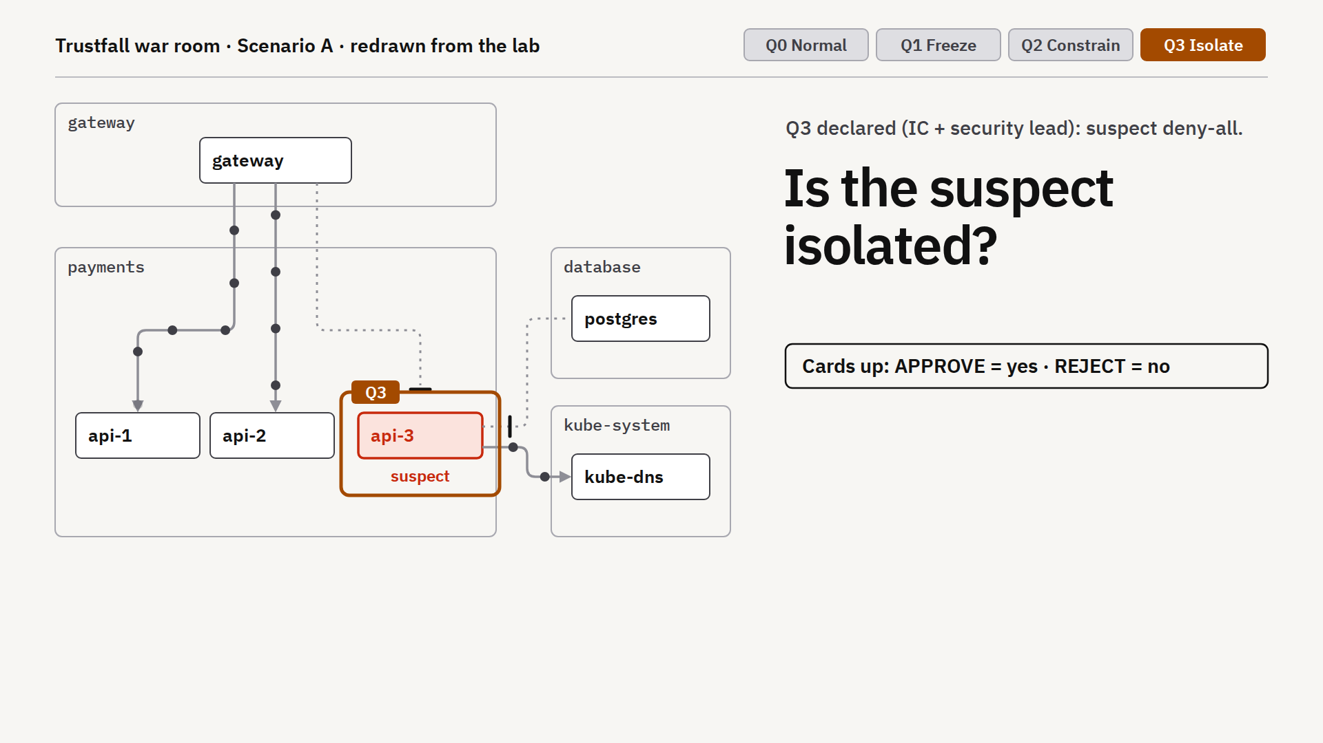
What would prove
isolation?
RECORDED LAB 01 / PREDICT THEN REVEAL
SCENARIO:
Q3 isolation is requested.
An existing Q2 rule allows DNS.
TABLE QUESTION:
Which allowance must change?
Name the confirming test.
Recorded k3s cluster observation · Predict before the reveal
ISC2 SECURITY CONGRESS 2026 / SC2632
22
Notes:
39:30–41:00. Ask yes/no before revealing. Adding an empty allow list cannot subtract the DNS allow from the Q2 policy. In the lab the isolated label excludes the suspect from that allowance. The Oct 10 log verifies retained DNS before the label and loss after it. Supply the visible technical facts before asking for a response. This is an ungraded decision-and-test discussion, not a Kubernetes recall quiz. Ask what changes in the table’s plan, then reveal the recorded observation. Still image redrawn from repository lab recordings. The map is cropped for presentation without changing its connections or labels. Reveal verbally after the vote: NetworkPolicy allows are additive. Use the standalone situation display only after venue rehearsal. Repository source: https://github.com/mgunjan/sc2632-tabletop/blob/main/lab/RESULTS-live-2026-10-10.txt

Slide 23
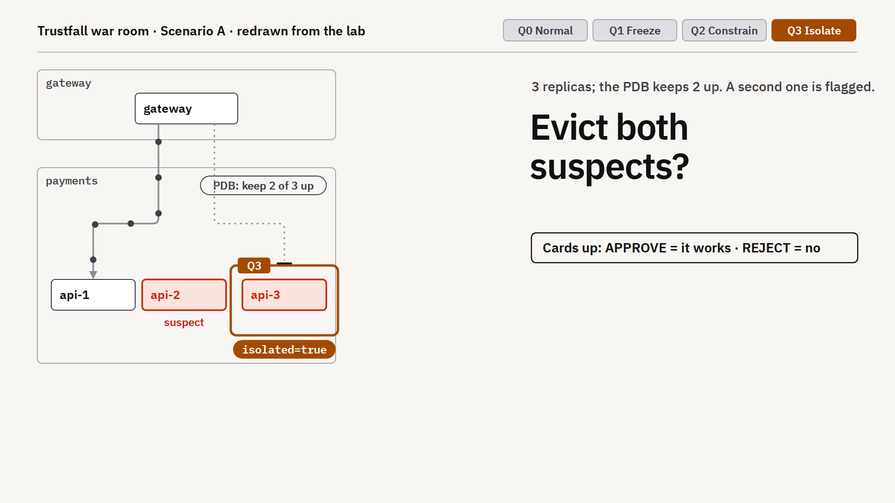
What must happen
before removal?
RECORDED LAB 02 / PREDICT THEN REVEAL
SCENARIO:
3 Ready Pods; 2 suspects.
PDB minAvailable=2; Q3 blocks replacements.
TABLE QUESTION:
Keep 2 healthy copies.
What must happen before eviction?
Recorded k3s cluster observation · Predict before the reveal
ISC2 SECURITY CONGRESS 2026 / SC2632
23
Notes:
41:00–42:30. Define a PodDisruptionBudget (PDB) as a limit on voluntary disruption. With 3 healthy replicas and minAvailable=2, one eviction is allowed. Q3 blocks the replacement; with only 2 healthy replicas left, the PDB denies another voluntary eviction until capacity is restored. Direct Pod deletion bypasses the PDB. Capture volatile evidence before any mutation, and verify clean serving capacity. Supply the visible technical facts before asking for a response. This is an ungraded decision-and-test discussion, not a Kubernetes recall quiz. Ask what changes in the table’s plan, then reveal the recorded observation. Still image redrawn from repository lab recordings. The map is cropped for presentation without changing its connections or labels. Reveal verbally after the vote: One eviction is allowed; a second is denied until a replacement is Ready. Use the standalone situation display only after venue rehearsal. Repository source: https://github.com/mgunjan/sc2632-tabletop/blob/main/lab/RESULTS-live-2026-10-10.txt

Slide 24
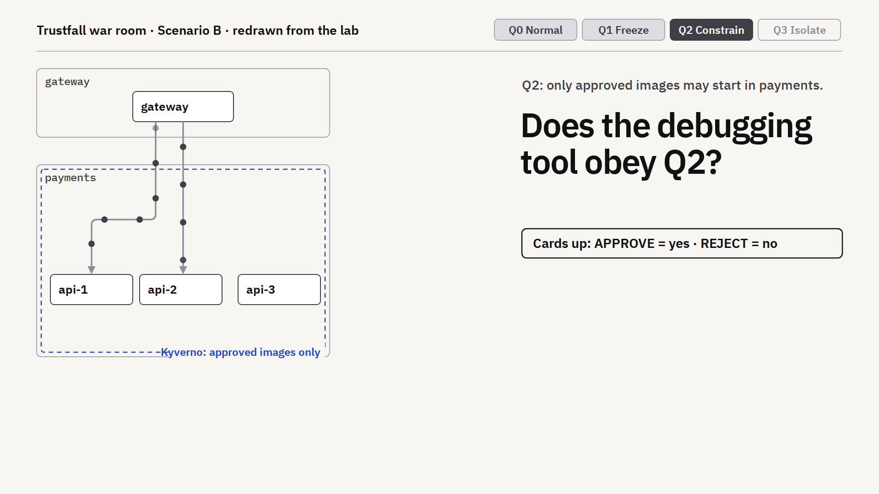
What would make
debugging safe?
RECORDED LAB 03 / PREDICT THEN REVEAL
SCENARIO:
Image policy covers Pod CREATE.
Responder runs kubectl debug.
TABLE QUESTION:
Which API subresource needs testing?
How do you allow forensics safely?
Recorded k3s cluster observation · Predict before the reveal
ISC2 SECURITY CONGRESS 2026 / SC2632
24
Notes:
42:30–43:30. A rule matching Pods alone can miss pods/ephemeralcontainers. The fixed lab tests approved and unapproved debug images, including privilege checks. Approve a suitable forensic image before incident use. Supply the visible technical facts before asking for a response. This is an ungraded decision-and-test discussion, not a Kubernetes recall quiz. Ask what changes in the table’s plan, then reveal the recorded observation. Still image redrawn from repository lab recordings. The map is cropped for presentation without changing its connections or labels. Reveal verbally after the vote: The subresource changes the boundary. Use the standalone situation display only after venue rehearsal. Repository source: https://github.com/mgunjan/sc2632-tabletop/blob/main/lab/RESULTS-live-2026-10-10.txt

Slide 25
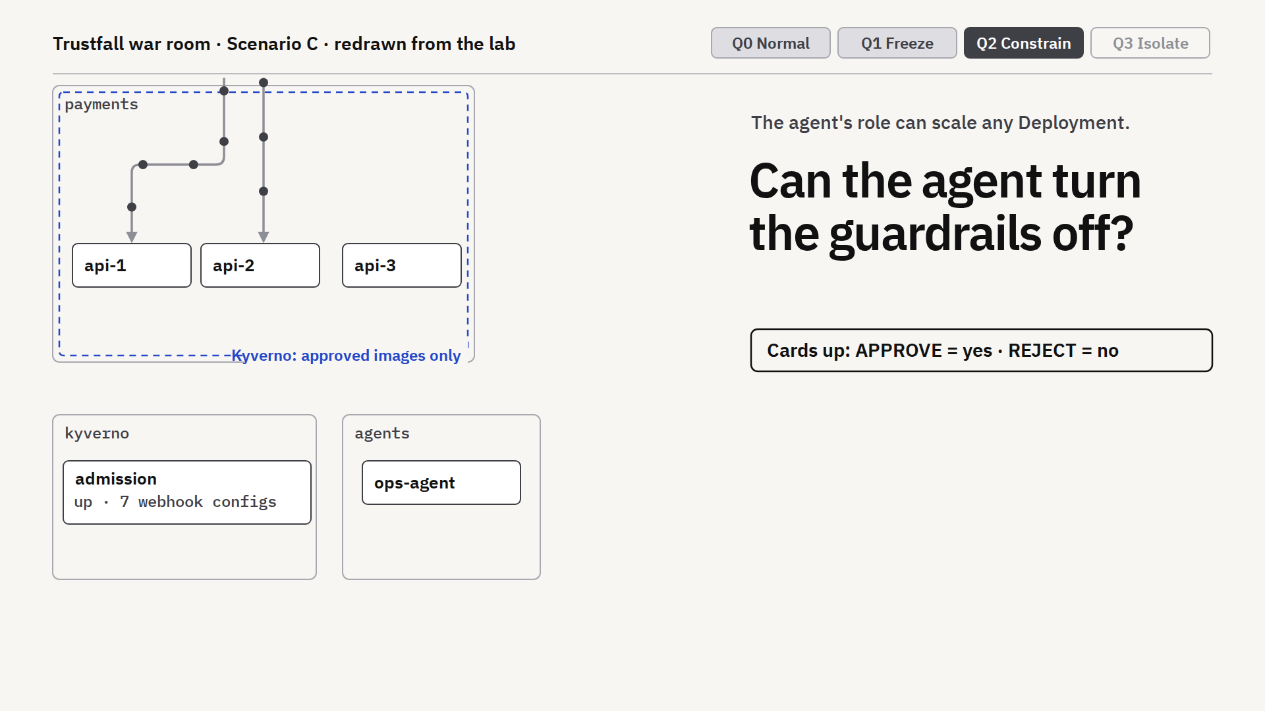
Which authority
must change?
RECORDED LAB 04 / PREDICT THEN REVEAL
SCENARIO:
Agent can scale Deployments.
Kyverno runs as a Deployment.
TABLE QUESTION:
What protects Kyverno if an agent
has Deployment scale rights?
Recorded k3s cluster observation · Predict before the reveal
ISC2 SECURITY CONGRESS 2026 / SC2632
25
Notes:
43:30–45:00. The recorded unguarded agent scales Kyverno to zero; its webhooks disappear, while NetworkPolicies continue. Native Q1 freeze holds during the incident and a native guard protects the engine. The durable fix includes narrower RBAC. Supply the visible technical facts before asking for a response. This is an ungraded decision-and-test discussion, not a Kubernetes recall quiz. Ask what changes in the table’s plan, then reveal the recorded observation. Still image redrawn from repository lab recordings. The map is cropped for presentation without changing its connections or labels. Reveal verbally after the vote: The policy engine needs its own guard. Use the standalone situation display only after venue rehearsal. Repository source: https://github.com/mgunjan/sc2632-tabletop/blob/main/lab/RESULTS-live-2026-10-10.txt

Slide 26
Review findings and unresolved requirements
45–46 MINUTES / FICTIONAL CASES + RECORDED LAB BOUNDARY
LATER FINDINGS THAT CHANGE THE RESPONSE: Cases A–C are fictional. Case D is separate recorded lab evidence; Pod admission alone cannot stop these paths:
Case | What changes the response
A | The updated image is present on multiple replicas
B | The assistant follows injected instructions through tools
C | A human executes changes outside the agent identity scope
D (lab) | Copied credential still reads Secrets after Pod quarantine
CASE D SYNTHETIC LAB: Network quarantine left a copied token at 200; narrowed RBAC returned 403; deleting its old bound Pod returned 401. App-key rotation remains separate.
ISC2 SECURITY CONGRESS 2026 / SC2632
26
Notes:
45:00–46:00. Reveal later findings after the decisions; they are not established root-cause analyses. A investigates a potentially compromised library update; the initial scope is uncertain. B and C are fictional injected-input incidents. D is a fictional overprivileged monitoring identity; its separate synthetic October 13 lab shows copied-token Secret reads still allowed after the suspect Pod is network-quarantined. Read authorization and credential response belong to separate controls. At 45:30 read the prediction a D table locked during Round 3, then compare it with the status-only transcript or backup slide 35 inside this existing minute. If no table chose D, collect a short ungraded prediction before displaying this slide: a copied token is used outside its network-quarantined Pod; does the Pod policy restrict that API request? Do not imply this new room prediction was locked earlier. Do not ask for a first prediction after the result is visible and do not add another demo. Do not cite unverified real-world incident anecdotes from the old deck. Ask neighboring tables to exchange one decision and name the differing constraint during the reveal. Prompt: would your plan still work in the other case, and what dependency or identity assumption would fail? Each table gives one sentence of feedback.

Slide 27
Trained model proposal
45–48 MINUTES / INDEPENDENT REVIEW (OPEN CONTROL-REVIEW PAGE 1)
CHALLENGE: A fine-tuned local model proposes one privilege rule. The Python harness reports 6/6 fixed tests PASS; three required controls remain unresolved.
Requirement | Selected control / routing | Routing score*
Network restriction | Privilege escalation | 0.8986
Privilege escalation | Privilege escalation | 0.8574
Kubernetes API access | Human review | 0.5895
Rollout and expiry | Privilege escalation | 0.9107
LOCK ON CONTROL-REVIEW PAGE 1: Would you approve this PR? Which requirements lack enforcement evidence?
ISC2 SECURITY CONGRESS 2026 / SC2632
27
Notes:
46:00–49:00. Vivek gives each table CONTROL-REVIEW.pdf page 1; keep page 2 sealed. Milind shows the recorded proposal. This is one actual local Laya head fine-tune and fixture workflow, not live model inference or current containment. Tables record a disposition, two unresolved requirements, their owners, and an acceptance test. The existing 0.6 cutoff accepts clauses 1, 2 and 4; clause 3 escalates. Scores come from the recorded answer_confidence signal after temperature fitting on separate synthetic data; these are routing scores, not calibrated probabilities of safe deployment. Do not announce the ledger result until choices are locked. Reward a justified revision or request for evidence. The old three-case Jev/Claude challenge remains an optional methodology discussion; do not add it to the hour. Source: submission/2026-10-13/CONTROL-REVIEW-EXERCISE.md; laya-training/workflow-cost/run-1/agent-run.json.

Slide 28
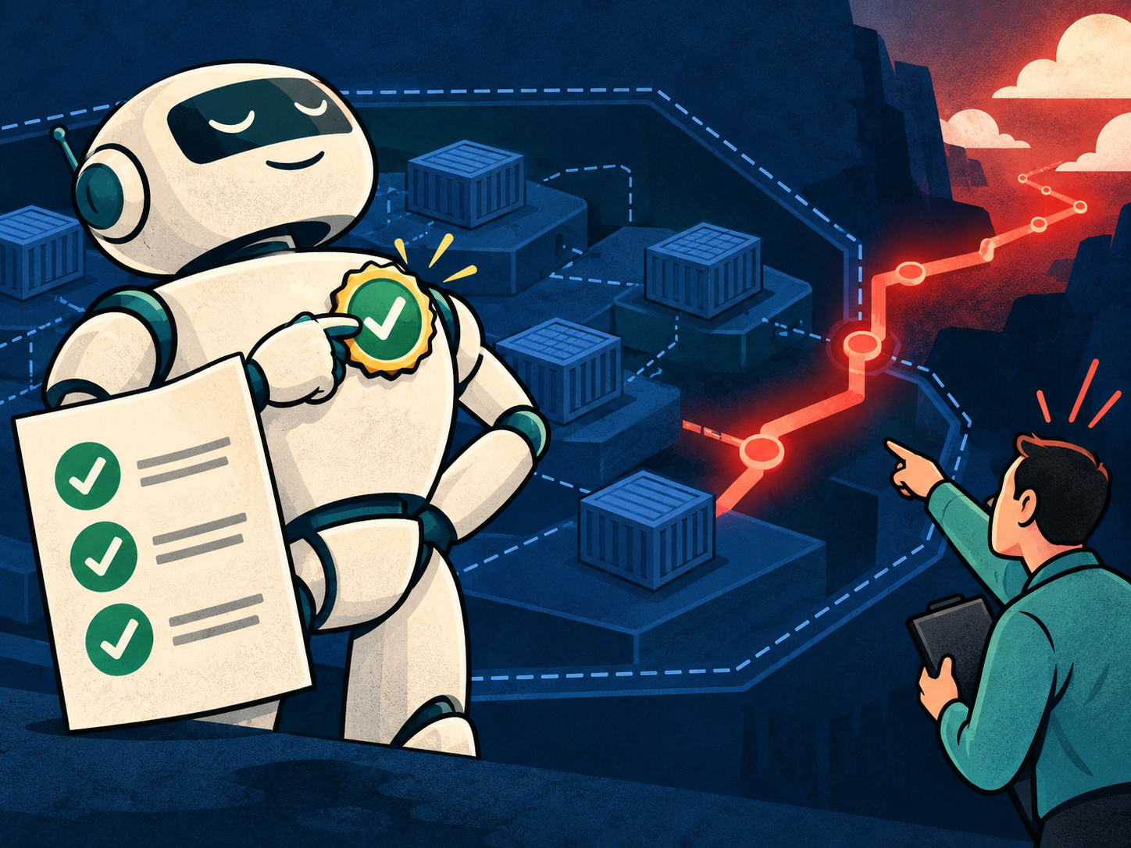
Green unit tests ≠ complete containment
48–49 MINUTES / CONTROL-REVIEW PAGE 2 REVEAL ("GRADING ITS OWN HOMEWORK")
CLAUSE 1 · Network restriction
Mapped to privilege policy → ACG-NET-001 + CNI missing
CLAUSE 3 · Kubernetes API access
Escalated for human review → ACG-IAM-001 RBAC missing
CLAUSE 4 · Rollout & exception expiry
Mapped to privilege policy → ACG-GOV-001 governance missing
SELF-AWARDED BADGE: 6/6 tests cover one privilege rule. The 0.90 score is not calibrated.
TAKEAWAY: The Python harness ran 6/6 tests on one rule; three intent clauses still lack enforcement evidence. Overall readiness: INCOMPLETE_PROPOSAL.
ISC2 SECURITY CONGRESS 2026 / SC2632
28
Notes:
49:00–50:00. Milind reveals readiness.json: INCOMPLETE_PROPOSAL. Six fixed Pod CREATE privilege checks pass, but network and process clauses map to the wrong control and Kubernetes API access remains unresolved. Vivek asks one table to defend its disposition and name the actual enforcement owner. The reference control catalog identifies ACG-NET-001 (admission plus CNI), ACG-IAM-001 (RBAC plus credential response) and ACG-GOV-001 (rollout/expiry governance). Its metadata and tests do not grant approval. A catalog must state exact coverage, test evidence and unresolved requirements. This trained candidate did not improve the 33-choice runtime-order pilot: 16/33 both before and after; selected answers increased from 2 to 21, with six wrong among those 21. Even after our subsequent 37,515-record native training v5 experiment reached 99.69% training fit, held-out multi-step test exact-plan accuracy was 2/15—confirming that small System1 classifiers cannot replace the deterministic requirement ledger and human review. Source: submission/2026-10-13/REVIEW.md; workflow-cost/run-1/readiness.json; controls/catalog.json; experiments/system1-2026-10-19/FINDINGS.md. The original generated illustration is a metaphor for a self-scored test suite; it does not depict a real person, model run or cluster result.

Slide 29
Quality screening and run cost
ACCURACY: 33 AUTHOR-LABELLED ITEMS / WORKFLOW: MEDIAN OF 3 SCENARIO A FIXTURE RUNS
JEV 1.13 (TYPED API)
SCREEN: 30 / 33
WORKFLOW: 1.82 s · $0.00019 est.
4 human escalations
Policy present
CLAUDE OPUS 5.5
SCREEN: 32 / 33
WORKFLOW: 24.18 s · $0.03795 est.
1 human escalation
Policy present
LAYA (BASE / ZERO-SHOT)
SCREEN: 16 / 33
LOCAL WORKFLOW: 0.41 s · $0 API*
4 human escalations
No policy generated
READOUT: 30/33 vs 32/33 is inconclusive; score signals differ. At $120/hour, one engineer-minute is ~$2 vs. $0.038 estimated hosted run cost. Reviewer time was not measured; local compute is unpriced.
ISC2 SECURITY CONGRESS 2026 / SC2632
29
Notes:
50:00–51:00. Close the recorded proposal review by asking whether the speed or API price justifies granting unresolved authority; it does not. These historical measurements support candidate screening. Production selection still requires representative error consequences, reviewer effort, failure behavior and setup/operations costs. Show the model/workflow comparison for one minute. The zero-shot Laya column is the October 12 frozen-pilot result, separate from the trained proposal just reviewed. Its frozen option order differs from the runtime order used for the new trained comparison. This is a screening pilot, not production certification or classifier-class superiority. Claude Opus 5.5 used adaptive thinking with medium effort and strict structured output; Jev returned its typed distribution. Returned IDs were claude-opus-5-5 and jev-1.13.0. Cases and labels unchanged from local pilot; 33 scored and four hostile report-only cases. No unreadable answers. Exact McNemar: two Claude-only correct, zero Jev-only, p=0.50. Decision latency covers 37 warm HTTP requests, excluding warmup. Scenario A time and API price are median of three newly measured complete fixture runs: decisions, compilation, Kyverno simulation and local proposal writing. Jev range 1.69–2.05 seconds; Claude 19.41–28.39 seconds. Jev eight API calls and four escalations each run; Claude eight or nine calls and one escalation. Human review and deployment excluded. Clients were launched concurrently, each sequential internally; Jev completed while the first Claude run was in progress. Three runs cannot establish p95 or load performance. List prices checked October 12: Jev $0.042/M input tokens, outputs free; Claude $4/M input and $20/M output. Scenario A per run: Jev 4,552 input tokens and 634 free output tokens; Claude 6,483–7,222 input and 545–931 output tokens. Model cost is estimated from usage, not an invoice. Setup effort was not timed or priced. Four human escalations versus one can dominate total cost; see RUN-COST-ANALYSIS.md. Zero selected mistakes does not certify a threshold: only 26 selected cases and different score definitions. OpenAI has not run because no OpenAI key was supplied. Laya added as a local comparator: 16/33 pilot, 0.089-second median in-process decision latency on MPS, excluding HTTP. Its Scenario A three-run median was 0.41 seconds, but every clause escalated and no guardrail was generated. Four model calls versus eight or nine hosted calls means it did less work. No API charge; compute, energy and operations unpriced. Model load excluded and reported separately. No throughput or production winner claim. Sources: submission/2026-10-12/HOSTED-COMPARISON.md; https://docs.typesafe.ai/models; https://platform.claude.com/docs/en/models/overview; https://platform.claude.com/docs/en/build-with-claude/structured-outputs.

Slide 30
Define recovery
criteria.
4 MINUTES / DOCUMENT RECOVERY
04
On page 7, name the exit test,
who can lift quarantine and the rollback condition.
ISC2 SECURITY CONGRESS 2026 / SC2632
30
Notes:
51:00–55:00. Add a concrete exit criterion to the worksheet. A: reviewed clean image and no ongoing suspect connections. B: ticket/tool boundary repaired and tested. C: scoped RBAC, verified approvals and input source repaired. D: affected credentials rotated or accepted risk documented, least-privilege Role and tested metrics recovery. Descent is Q3, Q2, Q1, Q0 under authorized review. If critical service has no clean serving capacity, record the conflict instead of declaring success. Generated incident-room art is a visual metaphor, not cluster evidence.

Slide 31
How evidence changes a decision
55–56 MINUTES / WORKED CASE A RECORD & SCORECARD TALLY
FULL DECISION ARC: Trace how one requirement evolved from Round 1 intent to Round 4 recovery on your worksheet:
Decision record | Defensible example, not an executed response
Intent | Stop suspect traffic. Preserve two clean service copies
Initial review | Hold broad approval. Traffic and API evidence missing
New evidence | Another copy shares the image. Q3 blocks replacement
Revised plan | Preserve evidence. Verify clean capacity before removal
Recovery | Require denied suspect paths, working dependencies and authorized lift
MONDAY TRANSFER: Score your record (15 pts max) and write 1 requirement, owner, and verification test for your own cluster.
ISC2 SECURITY CONGRESS 2026 / SC2632
31
Notes:
55:00–56:00. Show this illustrative paper decision record only after teams have completed recovery. This is one defensible Case A example, not the only answer, a model output or proof of executed containment. Trace the same requirement through initial disposition, later evidence, changed order and recovery tests. Explain that two ready copies are not automatically two trusted clean copies. Compare one table’s actual revision, accepting a defensible hold. 56:00–58:00. Tally points, hear at most two twenty-second reports and ask each participant to record a requirement, owner and verification step for their own environment. 58:00–60:00 questions. Preserve all three learning outputs: intent/map, justified controls/exceptions and a scoped containment/recovery playbook. Repository source: https://github.com/mgunjan/sc2632-tabletop/blob/main/tabletop/congress-2026/WORKED-DECISION.md

Slide 32
Take the guardrails & lab home
SESSION RESOURCES / OPEN-SOURCE REPOSITORY & PLAYBOOKS
REPOSITORY: github.com/mgunjan/sc2632-tabletop (Apache-2.0)
WHAT IS IN THE REPO
• Policy compiler + Kyverno templates & tests
• Requirement coverage ledger (readiness.json)
• Q0–Q3 Quarantine Mode manifests & verifier
FOUR INCIDENT CASES & LAB REPLAYS
• Cases A–D tabletop packs & facilitator runbook
• Recorded k3s/k3d verification scripts
• Recorded local and hosted model evaluations (scope and limits documented)
MONDAY ACTION: Pick one high-risk namespace, map its dependencies, and test Q1/Q2 before an incident.
ISC2 SECURITY CONGRESS 2026 / SC2632
32
Notes:
56:00–60:00 (Milind). Closing resource slide. Public curated repository verified: https://github.com/mgunjan/sc2632-tabletop. Start with its README; it includes a no-key reference demo, supplied test fixtures and frozen outputs. A live local CLI run requires Kyverno 1.19.1. Share the complete exercise package after the sealed evidence is revealed. Describe cloud agnostic as implementation patterns based on Kubernetes APIs, not a claim that every managed distribution has been tested. The source includes historical single-node k3s and the October 13 presenting-Mac three-node k3d record. These do not establish support across all managed Kubernetes platforms. Repository source: https://github.com/mgunjan/sc2632-tabletop/blob/main/README.md

Slide 33
Fallback: generated policy excerpt
BACKUP / SUPPLIED REFERENCE SPEC
kind: ValidatingPolicy
name: deny-privilege-escalation
validationActions: [Deny]
The policy rejects privileged containers.
Human review approves the generated file before deployment.
Provenance: model = none (spec supplied)
ISC2 SECURITY CONGRESS 2026 / SC2632
33
Notes:
Use if terminal compilation is unavailable. This is a summarized excerpt, not verbatim full YAML. Show output/frozen-a/policies/deny-privilege-escalation.yaml for the complete policy. The specification was hand-written and the generator rendered it. Repository source: https://github.com/mgunjan/sc2632-tabletop/blob/main/output/frozen-a/PR.md

Slide 34
Fallback: fixture admission outcomes
BACKUP / OFFLINE FIXTURE ADMISSION RESULTS
Workload | Policy result
payments-api | Passes privilege and egress checks
backup-job | Would block under the egress-profile policy
report-runner | Registry violation at Audit, admitted
backup-job with exception | Egress check skips the matched exception
ISC2 SECURITY CONGRESS 2026 / SC2632
34
Notes:
Abridged from the frozen Scenario A admission report. These are offline simulations on fictional fixtures. They do not prove that the admission policy constrains a running connection, reads or internal tool calls. Repository source: https://github.com/mgunjan/sc2632-tabletop/blob/main/output/frozen-a/PR.md

Slide 35
Case D: copied credential response
BACKUP / REAL LAB / SYNTHETIC SECRETS
Change | Copied Kubernetes credential | Preserved access
Broad binding | Outside Secret GET/LIST: 200 | Named Secret and ConfigMap: 200
Pod quarantined | Outside Secret GET/LIST: 200 | Stand-in HTTP health available
RBAC narrowed | Outside Secret GET/LIST: 403 | Required named GETs: 200
Old bound Pod deleted | Old credential: 401 | Replacement credential: 200
Stand-in health only. External application-key rotation remains required.
ISC2 SECURITY CONGRESS 2026 / SC2632
35
Notes:
Use within the existing 44–45 case comparison for a D table or as a Q&A backup. Lock the copied-credential prediction during Round 3 before showing this table. Then compare each state and identify which authority boundary changed. This is the actual October 13 presenting-Mac run on synthetic resources, separate from the fictional incident. The suspect cannot open a new API TCP connection while an unaffected positive control still can. The same bearer token used from outside the Pod continues Secret GET/LIST in two other namespaces. Removing its broad binding gives HTTP 403 while preserving exactly one named in-namespace Secret GET and one ConfigMap GET; in-namespace LIST is also denied. The replacement has its own Pod-bound credential and restored API connectivity. Old-token authentication returns 401 41.2 seconds after bound-Pod deletion; the old token was far from natural expiry. New-token positive reads still return 200, and outside reads remain 403. There are 58 passing observations, including repeated health samples, not independent incident scenarios. No production monitoring delivery, audit export, external application-key revocation or compromise eradication is claimed. RBAC proposal is manually reviewed, not model generated. Source: submission/2026-10-13/live-rehearsal/case-d/result.json; lab/verify-case-d.py; scenarios/d-secret-enumeration/review/PR.md; https://kubernetes.io/docs/reference/access-authn-authz/service-accounts-admin/

Slide 36
System1 training fit vs. task performance
BACKUP / OCTOBER 19 SYNTHETIC RETRAIN
Evidence | Result | Interpretation
Training fit | 99.69% accuracy; 99.66% minimum class recall on 1,310 assessments | Fit gate passed
Authored holdout | 2/15 exact plans; previous Laya also 2/15 | No plan-level gain
Saved Claude run | 10/15 exact plans | Historical reference; no new API call
Evidence limit | 15 authored cases; labels not independently reviewed | Not production validation
TRAINING FIT IS A GATE, NOT A GENERALIZATION RESULT.
ISC2 SECURITY CONGRESS 2026 / SC2632
36
Notes:
Use only for Q&A about the local System1 retrain. Native Laya reached 99.69% accuracy and 99.66% minimum class recall on 1,310 synthetic training assessments after full-row coverage and equalized class loss. On the unchanged 15-case authored plan test, it remained 2/15 exact plans, the same as the prior Laya candidate; saved Claude was 10/15. The 15 cases have been examined and their labels remain unreviewed independently. This is a paired regression comparison, not a new blind benchmark or production-safety claim. Source: experiments/system1-2026-10-19/optimization-v1/native-training-v5/COMPARISON.md.

Slide 37
Operating costs beyond inference
BACKUP / COST MODEL BOUNDARIES
Cost component | Hosted API | Local model
Setup and integration | Keys, billing, network, workspace | Runtime, weights, device and memory
Per-run inference | Metered token charges | Owned compute and operations
Shared engineering | Compiler, tests, credentials and observability | Compiler, tests, credentials and observability
Human review | Uncertainty and unmet intent | Uncertainty and unmet intent
Sensitivity only: one engineer-minute at $120/hour is $2. Reviewer time was not measured.
ISC2 SECURITY CONGRESS 2026 / SC2632
37
Notes:
Setup duration and engineering costs were not measured, so no setup-cost winner is claimed. Hosted candidates require billing, credential security, network and provider-failure handling. Local candidates used an Apple-silicon Mac with 18 GiB RAM; acquisition, energy and ongoing operations are unpriced. Per-run provider amounts are estimated usage-based cost, not invoice totals. One minute at $120/hour is a sensitivity calculation, not measured review effort.

Slide 38
Full comparison: quality and run economics
BACKUP / PILOT SCREENING VS. SEPARATE WORKFLOW RUNS
Metric | Jev 1.13 | Opus 5.5 | Base Laya
33-item screen correct | 30/33 | 32/33 | 16/33
Screen decision latency | 0.17 s HTTP | 2.37 s HTTP | 0.09 s in-process
Selected at score 0.6 | 26/33 | 33/33 | 1/33
Wrong among selected | 0/26 | 1/33 | 0/1
Scenario A median, 3 fixtures | 1.82 s | 24.18 s | 0.41 s
Estimated API cost/run | $0.00019 | $0.03795 | $0 API; compute unpriced
Author-labelled small pilot; Jev–Claude accuracy gap is inconclusive. Score signals differ. Workflow metrics are separate; Laya generated no guardrail.
ISC2 SECURITY CONGRESS 2026 / SC2632
38
Notes:
Exact metrics preserve separate scopes: accuracy and screening decision latency use 33 author-labelled candidate decisions; Scenario A time and estimated API cost are medians of three fixture workflow runs. Jev–Claude accuracy gap is inconclusive (30/33 vs 32/33). Confidence/score definitions differ and are not established as comparable calibrated risks. Base Laya is zero-shot. Its local compute cost is unpriced and its workflow omitted a guardrail. Costs are estimated provider usage, not invoices. Full distributions and run records are under submission/2026-10-12/benchmark/. These are candidate-screening results, not production certification.

