Slide 1

TABLETOP / AGENTIC KUBERNETES GUARDRAILS
FROM INTENT
TO ENFORCEMENT
Quarantine Mode
Incident containment on a shared Kubernetes platform
Co-presenters: Milind Gunjan / Vivek Mayuranathan
October 26, 2026 · 4:30–5:30 PM · Views are our own
ISC2 SECURITY CONGRESS 2026 / SC2632
01
Notes:
00:00–00:20. Welcome. The audience plays an incident change board. This shared-platform incident is fictional. The lab artifacts are real repository outputs. Milind Gunjan and Vivek Mayuranathan are co-presenters and jointly lead the session. Explain that the policy agent proposes and humans deploy. Repository source: https://github.com/mgunjan/agentic-k8s-guardrails/blob/main/tabletop/STORY.md

Slide 2
PURPOSE / SECURITY CHANGES ON A SHARED PLATFORM
Security changes during an incident
THE PROBLEM
Services and automated agents share infrastructure and credentials.
Harmful access can cross a workload’s intended boundary.
Broad restrictions can disrupt essential services.
WHAT WE BUILD
A tested change set from written security intent,
with explicit approval and containment boundaries.
Technical briefing first. Then your team reviews a case and defines recovery tests.
ISC2 SECURITY CONGRESS 2026 / SC2632
02
Notes:
00:20–01:00. Milind explains the security problem and intended artifact before the technical briefing. Services and automated agents share infrastructure, workload identities and dependencies. Harmful access can exceed its intended boundary, while a broad restriction can interrupt legitimate service. The session builds a reviewable change set from security intent, with policy tests, expiring exceptions, staged rollout and a scoped incident response. State that architecture, data boundaries and implementation come before case selection and team exercises. Do not start a case narrative or ask for a containment decision here. The policy agent proposes bounded choices; people authorize deployment and recovery. The common demo compiles a supplied reference spec, not audience prose. Quarantine Mode is a coordinated project-defined posture; each control requires its own implementation and verification. Repository source: https://github.com/mgunjan/agentic-k8s-guardrails/blob/main/tabletop/congress-2026/TECHNICAL-BRIEF.md Repository source: https://github.com/mgunjan/agentic-k8s-guardrails/blob/main/generator/policy_agent.py Repository source: https://github.com/mgunjan/agentic-k8s-guardrails/blob/main/quarantine/quarantine-mode.md

Slide 3
WHAT KUBERNETES DOES / WHY SHARED ACCESS MATTERS
The environment in plain language
Kubernetes manages application packages, called containers, across machines.
Payment services and automated agents share this platform.
Application copies
Pods: running units. Replicas: copies.
Resource groups
Namespaces: named groups, such as payments.
Workload identity
ServiceAccount: identity for management API requests.
Multiple services share infrastructure and dependencies.
A restriction for one can affect another.
ISC2 SECURITY CONGRESS 2026 / SC2632
03
Notes:
01:00–01:40. Milind starts without assuming Kubernetes knowledge: Kubernetes manages application packages, called containers, across a pool of machines. Applications and automated agents share that platform. Explain familiar functions before naming their Kubernetes equivalents: application copies, resource groups and workload identities. A cluster is the shared platform running services and agents; a namespace is a named resource group, not automatic isolation; a Pod is a running unit containing one or more containers; a ServiceAccount is the identity a workload uses to call the Kubernetes API. Replicas are copies of a workload. Point to payments and agents as example groups, with payments-api, support-agent, ops-agent and monitoring-agent appearing only when their case is selected. Keep this slide on platform structure. Introduce the four alternative fictional case alerts only after the technical briefing. The recorded enforcement environment is a separate disposable local k3s/Kyverno lab, with synthetic stand-in applications. Definitions: https://kubernetes.io/docs/concepts/overview/ ; https://kubernetes.io/docs/concepts/containers/ ; https://kubernetes.io/docs/concepts/workloads/pods/ ; https://kubernetes.io/docs/concepts/overview/working-with-objects/namespaces/ ; https://kubernetes.io/docs/concepts/security/service-accounts/ . Repository source: https://github.com/mgunjan/agentic-k8s-guardrails/blob/main/tabletop/congress-2026/INCIDENT-BRIEF.md Repository source: https://github.com/mgunjan/agentic-k8s-guardrails/blob/main/lab/README.md

Slide 4
SECURITY CONTROLS / SHARED PLATFORM
Detection, prevention and response
Detection
Falco rules flag suspicious runtime activity.
Audit logs record Kubernetes API requests.
Admission
Kyverno can deny a new Pod requesting
privilege escalation before it starts.
Containment
NetworkPolicy limits traffic. RBAC limits API access.
Agent tools need application controls.
Authority
The policy agent proposes controls for review.
People authorize containment and recovery.
Denying a new Pod leaves running workloads and copied tokens for separate response.
Falco rules passed validation. Live detection is unverified.
We supply incident alerts. The demo compiles proposals and runs policy tests.
ISC2 SECURITY CONGRESS 2026 / SC2632
04
Notes:
01:40–02:30. Vivek gives the security-control map before the exercise. Suggested spoken explanation: Falco supplies a runtime detection layer, while Kubernetes audit logs record management requests. Kyverno checks a proposed change before it takes effect, a checkpoint called admission. It can refuse a new Pod that requests privilege escalation. Traffic restrictions and API permissions require their own controls. The policy agent proposes controls, and people authorize containment and recovery. Our Falco rules passed validation, but we have not verified live alert detection; the incident alerts are supplied exercise facts. The common demo compiles a prepared proposal and runs policy tests. Point out that denying a new Pod leaves an existing Pod and a copied token requiring separate response. Define RBAC as API permissions and NetworkPolicy as traffic rules enforced by the cluster networking implementation. Runtime rules are provided for A/B, with Kubernetes audit plugin rules for C. Case D uses audit evidence and a separately executed synthetic authorization/credential lab, not a verified Falco read detector. Falco rules detect and emit signals; no alert-to-Quarantine automation is implemented here. People assess the signal, choose a scoped level and require control-specific verification. This is a control map, not a claim of a connected, production-qualified detection pipeline. Keep this fifty-second control overview separate from the following implementation walkthrough. Sources: https://falco.org/docs/ ; https://falco.org/docs/concepts/event-sources/plugins/kubernetes-audit/ ; https://kyverno.io/docs/policy-types/validating-policy/ ; https://kubernetes.io/docs/reference/access-authn-authz/admission-controllers/ ; https://kubernetes.io/docs/reference/access-authn-authz/rbac/ ; https://kubernetes.io/docs/concepts/services-networking/network-policies/ . Repository source: https://github.com/mgunjan/agentic-k8s-guardrails/blob/main/runtime/falco-rules-syscall.yaml Repository source: https://github.com/mgunjan/agentic-k8s-guardrails/blob/main/runtime/falco-rules-k8saudit.yaml Repository source: https://github.com/mgunjan/agentic-k8s-guardrails/blob/main/lab/README.md Repository source: https://github.com/mgunjan/agentic-k8s-guardrails/blob/main/submission/2026-10-14/demo-audit/CI-RESULT.json

Slide 5
PYTHON HARNESS / OPTIONAL MODEL PATH
The policy agent decision loop
Stage | Model choice | Python and tools
Map intent | One of 10 catalog options per clause | Validate choice; fill the scoped spec
Dependencies | preserve or deny each profile | Read fixtures; collect workload labels
Blocked workload | allow_and_retest, request_exception or block_is_intended | Render templates; simulate admission; at most 3 rounds
Review bundle | Exception request or escalation | Write stage files, tests, coverage and local PR.md
Python fixes the sequence. Reviewers resolve missing coverage and authorize deployment.
ISC2 SECURITY CONGRESS 2026 / SC2632
05
Notes:
02:30–03:30. Milind walks the actual Agent.run method. This is a Python harness with a fixed tool sequence; the provider chooses among typed options. Distinguish the policy agent from a support/ops/monitoring agent in the fictional case. Each intent clause maps to one of ten choices, including process and not_implementable. The harness observes fixture workload labels in the presenter path; optional core CLI live observation is a separate kubectl GET path. The model selects preserve/deny for observed dependency profiles. Code renders values into reviewed templates, simulates covered requests with Kyverno CLI and asks what to do about a blocked workload. Only egress-profile allowances can widen automatically inside the proposed spec; other widening becomes a human exception request. The loop stops after no further change or at most three render/test rounds. It writes a local PR.md review bundle, not a GitHub pull request. No deployment or approved exception occurs in this path. The reference demo bypasses these model choices using a supplied spec; authentic replay reuses recorded choices while tools execute now. A provider adapter does not change these boundaries. Repository source: https://github.com/mgunjan/agentic-k8s-guardrails/blob/main/generator/policy_agent.py Repository source: https://github.com/mgunjan/agentic-k8s-guardrails/blob/main/generator/decider_agent.py Repository source: https://github.com/mgunjan/agentic-k8s-guardrails/blob/main/tabletop/congress-2026/demo.py

Slide 6
ACTUAL DATA PATH / AUTHORITY LIMITS
Trust boundaries and model inputs
Boundary | What crosses it
Runtime events | Supplied alerts inform human review. The harness does not ingest Falco.
Provider request | Full intent + clause, profile/workload names, or workload/policy/denial reason
Provider response | Allowed choice + numeric score. Invalid or below 0.6 escalates.
Uncertain dependency | The proposal retains the allowance and flags it for human review.
Cluster change | An operator applies reviewed changes. The presenter path uses fixtures.
Scores are uncalibrated. Credentials need separate least-privilege controls.
Reference and replay make no new model request.
ISC2 SECURITY CONGRESS 2026 / SC2632
06
Notes:
03:30–04:30. Vivek traces the actual strings built in policy_agent.py and decider_agent.py. Control questions contain the current clause and full intent. Dependency questions contain full intent, profile and workload names. Block questions contain full intent, workload, policy and the first 300 characters of the denial reason. Hosted adapters transmit those task strings to the selected provider. These calls do not send the complete Pod inventory, credentials or Falco events as a designed payload; user-authored task text must still be treated as provider-visible data. The presenter uses synthetic fixtures, not production inventory. The parser requires a listed string choice and a finite score from zero to one; unknown or unreadable answers abstain. The cutoff 0.6 routes a decision for review, not calibrated deployment risk. On an uncertain dependency the code retains the proposed profile allowance and flags it, preserving availability while leaving exposure for review. Escalated control clauses enable no control. Explain those different defaults explicitly. The core CLI has an optional kubeconfig-backed read path, whereas the bounded presenter wrapper uses fixtures and issues no kubectl calls. Code having no deployment action does not isolate its process credentials; separate IAM, read-only observation and deployment identities require operator enforcement. Reference/replay performs no new inference. No Falco-to-agent or Falco-to-quarantine integration is implemented. Repository source: https://github.com/mgunjan/agentic-k8s-guardrails/blob/main/generator/policy_agent.py Repository source: https://github.com/mgunjan/agentic-k8s-guardrails/blob/main/generator/decision_contract.py Repository source: https://github.com/mgunjan/agentic-k8s-guardrails/blob/main/submission/2026-10-12/benchmark/provider_clients.py Repository source: https://github.com/mgunjan/agentic-k8s-guardrails/blob/main/tabletop/congress-2026/demo.py

Slide 7
SUPPLIED REFERENCE SPEC / COMPILER WALKTHROUGH
One requirement, one compiled control
Field | Compiled behavior
Intent | Prevent privilege escalation in payments.
Catalog key | deny_privilege_escalation / ACG-POD-001
Generated API | Kyverno ValidatingPolicy, scoped to payments
Covered requests | Pod CREATE; regular and init containers
Required fields | privileged=false and explicit allowPrivilegeEscalation=false
Local bundle: PR.md, stage files, tests, readiness and provenance.
This supplied-spec path makes no model request or deployment.
ISC2 SECURITY CONGRESS 2026 / SC2632
07
Notes:
04:30–05:15. Milind demonstrates the internal mapping using a prepared requirement before any case choice. This is the A privilege clause as a small technical example, not the table statements. Run the bounded reference compiler with a fresh output directory; use the pre-opened result if the command is unavailable or exceeds its deadline. Show the actual ValidatingPolicy API, payments match, CREATE operation, regular/init container aggregation, privileged default false and allowPrivilegeEscalation default true, which requires an explicit false. The control does not implement the full Restricted Pod Security Standard or cover existing Pods and debug subresources. Show policies/, stages/, tests/, PR.md, readiness.json and provenance.json. No GitHub pull request is opened. The reference spec bypasses inference; an authentic replay or bounded optional provider run is a different path. Keep this walkthrough to forty-five seconds and finish with the whole-intent ledger on the next slide. Repository source: https://github.com/mgunjan/agentic-k8s-guardrails/blob/main/output/frozen-a/policies/deny-privilege-escalation.yaml Repository source: https://github.com/mgunjan/agentic-k8s-guardrails/blob/main/generator/generate.py Repository source: https://github.com/mgunjan/agentic-k8s-guardrails/blob/main/controls/catalog.json Repository source: https://github.com/mgunjan/agentic-k8s-guardrails/blob/main/tabletop/congress-2026/demo.py

Slide 8
INDEPENDENT CONTRACT / PREPARED INTENT
Unresolved enforcement requirements
Intent clause | Proposal status
Limit east-west communication | Egress-profile policy
Prevent privilege escalation | Privilege policy
Restrict Kubernetes API access | Unimplemented. RBAC handover required.
Avoid disruption and expire exceptions | Rollout and exception process
The independent contract is bound to this prepared intent.
New wording requires its own reviewed contract and acceptance tests.
ISC2 SECURITY CONGRESS 2026 / SC2632
08
Notes:
05:15–06:15. This is the full four-clause Scenario A reference intent; the preceding single privilege example covers one clause. Read the missing clause first. After the technical briefing, tables will choose a case and compare their own intent with that prepared excerpt during proposal review. A table’s new wording is compared with that prepared artifact, not claimed as its model input. The current demo emits readiness.json: privilege behavior can PASS while the overall proposal remains REVIEW_REQUIRED. The authentic recorded Strands run remains INCOMPLETE_PROPOSAL because privilege coverage is missing. Admission does not enforce Secret GET/LIST. An egress-profile admission label rule also requires the corresponding NetworkPolicy to constrain actual traffic. A handover is visible incompleteness, not completed enforcement. In A, registry restriction was added at Audit although the intent did not request it. Ask whether to keep it. Repository source: https://github.com/mgunjan/agentic-k8s-guardrails/blob/main/output/frozen-a/PR.md

Slide 9
COORDINATED CONTROL CHANGES / HUMAN APPLICATION
Quarantine Mode implementation
Level | Mechanisms | Verification required
Q0 Normal | Reviewed baseline guardrails | Legitimate service paths
Q1 Freeze | Native API-server policy freezes writes by identities in agents | Covered writes and allowed reads
Q2 Constrain | NetworkPolicy and protected labels; manual RBAC narrowing | Traffic and API positive/negative tests
Q3 Isolate | Suspect isolation labels + deny-all; Pod CREATE gate | Isolation and clean serving capacity
People apply reviewed manifests and perform identity steps separately.
Quarantine Mode has no automatic Falco-triggered controller here.
ISC2 SECURITY CONGRESS 2026 / SC2632
09
Notes:
06:15–07:15. Vivek identifies the actual objects and authority before teams build their response. Quarantine Mode is a project-defined posture, implemented by reviewed manifests plus operator runbook actions. Q1 uses native ValidatingAdmissionPolicy and binding to deny writes by system:serviceaccount:agents identities while reads remain; the native location is the API server. It does not cover a sidecar using another namespace identity or a GitOps controller acting under its own identity. Q1 also adds an exception gate. Q2 applies network rules and protected quarantine labels; evidence capture, ServiceAccount authorization changes, tool/input suspension and service-capacity review are separate operator actions. Q3 adds suspect deny-all selection and a payments Pod CREATE gate with incident-commander annotation AND requester-group override. The model does not choose or apply a level. A Falco alert does not activate these changes automatically. Each layer needs its own applied-state check and positive control. State declaring/lifting authority and availability floor without revealing the later lab observations. At minute 26 teams revisit this map, open page 7 only at minute 27, then write their ordered response through minute 34. Repository source: https://github.com/mgunjan/agentic-k8s-guardrails/blob/main/quarantine/q1/freeze-agent-changes.yaml Repository source: https://github.com/mgunjan/agentic-k8s-guardrails/blob/main/quarantine/q2/ Repository source: https://github.com/mgunjan/agentic-k8s-guardrails/blob/main/quarantine/q3/admission-policies.yaml Repository source: https://github.com/mgunjan/agentic-k8s-guardrails/blob/main/quarantine/q3/network-and-identity.yaml Repository source: https://github.com/mgunjan/agentic-k8s-guardrails/blob/main/quarantine/quarantine-mode.md

Slide 10
YOUR TABLE / INCIDENT REVIEW TEAM / PLAIN LANGUAGE / NO LAPTOP REQUIRED
Your table’s task
We provide case facts, prepared proposals and enforcement evidence.
You write, review and revise decisions on page 6 before each reveal.
YOUR RECORD ON PAGE 6
YOUR TABLE ROLES
Intent and approval decision
Exception and rollout conditions
Containment order and recovery tests
Lead: states the decision
Recorder: writes page 6
Analyst: checks the evidence
Reviewer: raises a concern
Milind and Vivek co-present the demo, reviews and evidence.
Your intent stays on the record. The common demo uses a supplied reference spec.
ISC2 SECURITY CONGRESS 2026 / SC2632
10
Notes:
07:15–08:00. Vivek states the contract: We provide case facts, prepared proposals and enforcement evidence. Your decisions determine the authority you would grant, the exposure you accept and the tests you require; we do not simulate a branching production incident from your prose. Your intent stays on the worksheet; the common demo compiles a supplied reference spec. Vivek assigns the incident review role, explains the four table roles and holds up the actual pack and worksheet. The lead states the decision, recorder writes page 6, analyst checks evidence and independent reviewer raises a concern before the decision. Roles are recorded during the final setup minute. Say: Your table decides what may proceed, what it holds and what evidence must come before enforcement. Record intent, proposal disposition, exception/rollout conditions, ordered containment and recovery on page 6. Work in plain language, without laptops or YAML. Pages 2–5 are the four case cards, page 6 is the shared record, and pages 7/8 stay sealed until their rounds. Keep the CONTROL-REVIEW findings sealed too. State the sequence: discuss, write before the reveal, hear the evidence, and revise beside the first answer. At most two twenty-second table reports. Milind demonstrates the compiler and policy consequences; Vivek leads proposal reviews and evidence reveals; both share round discussions and debrief. Audience prose does not automatically run through a model or deploy. The common demo uses a supplied reference spec. Use the clock to protect writing time. Repository source: https://github.com/mgunjan/agentic-k8s-guardrails/blob/main/tabletop/congress-2026/CO-PRESENTER-CARDS.md

Slide 11
CHOOSE ONE CASE / PARTICIPANT PACK PAGES 2–5
Four prepared scenarios
A
Library update
A library update and unexpected payments traffic
B
Support assistant
A ticket-reading assistant and unexpected tool activity
C
Unexpected changes
An ops agent changes application copies without a ticket
D
Credential access
A monitoring identity lists credential records across groups
Choose as a team. Keep the sealed updates closed until the round opens.
ISC2 SECURITY CONGRESS 2026 / SC2632
11
Notes:
08:00–09:15. Give tables 75 seconds to choose and read the initial alert on pages 2–5. Every table has the four-case participant pack and selects one case. Do not disclose causes yet. A/B/C use excerpted reference PRs and fixture simulation results. D extends scenarios/05-secret-enumeration.md into an RBAC boundary exercise. D uses a human RBAC review and a separately executed synthetic read-authorization/network/credential lab. No generator scenario d or model-generated RBAC is claimed. Explain that Secrets are platform records that can contain credentials; listing them is an observed action, not proof that an application key was used. Translate replicas as application copies and namespaces as resource groups. Teams identify the owner and acceptance evidence for API reads before the recorded lab reveal. If teams cluster on one case, invite volunteers to try another, without removing choice. Repository source: https://github.com/mgunjan/agentic-k8s-guardrails/blob/main/scenarios/05-secret-enumeration.md

Slide 12
RECORD THE OPERATIONAL CONSTRAINT
Operational constraints
Availability
Keep two healthy application copies and required connections.
Evidence
Preserve evidence and record every approval.
Velocity
Continue safe delivery while affected changes pause.
Containment
Stop suspected exposure and justify the service cost.
Record your case, roles, constraint and minimum service on page 6.
ISC2 SECURITY CONGRESS 2026 / SC2632
12
Notes:
09:15–11:00. Explain the constraints for forty-five seconds, then give one minute for setup. Tables record case, roles, constraint and a measurable minimum service on page 6. With fewer than four participants, combine roles. Both co-presenters check readiness at different tables. Use the room seating plan. Explain scoring in one sentence and leave details on the scorecard. Teams choose their constraint, even if it differs from their real role. The pack offers concrete fictional floors to make choices comparable. Require a measurable floor such as two healthy service replicas and verified dependency access. Avoid treating any fictional notification threshold as legal guidance. Repository source: https://github.com/mgunjan/agentic-k8s-guardrails/blob/main/tabletop/packet/content.yaml

Slide 13
4 MINUTES / DRAFT AND MAP THE INTENT
01
Define the
security requirement.
Stop [behavior]. Preserve [dependency].
Example: block new privileged workloads.
Allow approved releases. Write your own on page 6.
ISC2 SECURITY CONGRESS 2026 / SC2632
13
Notes:
11:00–15:00. Spend no more than twenty seconds on the visible example: blocking new privileged workloads while allowing approved releases states a forbidden behavior and a preserved dependency; it does not stop an existing process. Give the remaining time to team work. The lead reads the first alert, the reader summarizes the environment and the scribe writes an intent and constraint. Vivek collects one sentence from two tables. Do not promise that the unvalidated model will translate arbitrary audience prose on stage. During the common demonstration, compare the audience wording to the reference clause map. Generated incident-room art is a visual metaphor, not cluster evidence.

Slide 14
PR REVIEW / YOUR DECISION
Record your review decision
APPROVE
One control to keep
or change.
MODIFY
REJECT
One missing test
that could change
your decision.
ESCALATE
ISC2 SECURITY CONGRESS 2026 / SC2632
14
Notes:
15:00–19:00. Teams review their case page. Every team writes a decision and one reason. A catches insufficient host protection and the unresolved RBAC clause. B distinguishes a Pod identity from a sidecar identity and tool misuse from admission. C asks whether the requester is the agent or a human and whether RBAC should have granted the action at all. D rejects an admission-only claim for Secret reads. Invite two contrasting votes. The co-presenter asks what evidence would change them.

Slide 15
ROUND 02 / EXCEPTION REQUEST / FICTIONAL INJECT
A temporary
access request
Read your case’s request. Which operation must continue?
What authority would you grant while approval is checked?
Grant / narrow / hold / refuse.
Record conditions, remaining exposure and one test that could change your answer.
ISC2 SECURITY CONGRESS 2026 / SC2632
15
Notes:
19:00–22:00. Read the case-specific request from the pack. Do not announce a preferred disposition before the table commits. Ask what legitimate operation must continue, what authority it would grant while verification is pending and what evidence would change its answer. The temporary request and approval assertions are fictional exercise facts. Teams must establish approval independently of the agent’s assertion. A: backup-job/storage may have a legitimate narrow temporary need. B: an exception that restores the suspect’s path can undo containment. C: an ops-agent request to widen access requires human identity verification and scope. D: no admission exception fixes excessive Secret-read RBAC. Record owner, clock time of expiry, exact workload/control and independent approval evidence. If refusing or holding the request, record the verification needed before reconsidering it; do not invent an approver or claim a paper-plan revocation has occurred. Repository source: https://github.com/mgunjan/agentic-k8s-guardrails/blob/main/tabletop/packet/content.yaml

Slide 16
22–26 MINUTES / TEAM TASK
Audit. Warn. Deny.
Mode | Admission behavior | Review question
Audit | Allow and record | Is exposure acceptable while we observe?
Warn | Allow and warn | Who will act on the warning?
Deny | Refuse the change | What legitimate workload could break?
Choose a mode per control and write promotion criteria.
ISC2 SECURITY CONGRESS 2026 / SC2632
16
Notes:
22:00–26:00. Audit/Warn/Deny are Kyverno validationActions. Promotion is a human decision. During a confirmed incident some controls may start at Deny, with an explicit compatibility and availability check. Scheduled exception cleanup requires the controller to be enabled and authorized. The October 13 rehearsal first failed because the cleanup controller lacked deletion permission. The scoped repair grants only PolicyException deletion in payments. Its five-minute schedule allows lag beyond the timestamp; it does not terminate an existing Pod, credential or session. See the separate live expiry evidence before claiming successful revocation. Both current compiler and agent write the staged policy manifests. The agent also writes a requirement ledger, provenance and focused independent privilege tests. Human promotion remains disabled; the new artifacts are runtime remediation, not a rerun of the frozen benchmark. All requirements still need explicit reviewer disposition. Repository source: https://github.com/mgunjan/agentic-k8s-guardrails/blob/main/generator/generate.py

Slide 17
7 MINUTES / JUSTIFY THE ACTION ORDER
03
Plan scoped
containment.
Open the sealed update on page 7.
Number actions and state the service floor.
ISC2 SECURITY CONGRESS 2026 / SC2632
17
Notes:
26:00–34:00. Teams open their Round 3 alert, number their actions, choose Q0–Q3 and name the incident commander. Require enough specificity to execute: namespace/workload/identity, evidence source, control delta, availability floor, who declares and who can lift. The lab preserves evidence before relabeling. Evidence collection can itself mutate a Pod by adding a debug container; disclose that footprint. In a real active incident, use authorized response procedures and weigh immediate containment needs, rather than claiming this order universally overrides urgency. Generated incident-room art is a visual metaphor, not cluster evidence.

Slide 18
SECOND INJECT / OPEN THE LATER FINDING
Reassess with
additional evidence
REVISE THE PLAN / ESCALATE / JUSTIFY NO CHANGE
Record which new evidence changes the scope or action order.
ISC2 SECURITY CONGRESS 2026 / SC2632
18
Notes:
34:00–38:00. A learns a second replica has the same image and a host-mounted helper bypasses the existing set. B learns a debug API path and injected ticket/tool scope matter. C learns the agent supports billing while a human is asked to widen RBAC. D learns credential rotation affects the database proxy. Give four minutes. Scribes keep the original decision visible so change is observable. Vivek records one revised and one held decision for the debrief.

Slide 19
RECORDED LAB / PREDICT BEFORE THE REVEAL
Validate the
containment assumptions
NETWORK
Does deny-all remove an existing allow?
RECOVERY
Can eviction preserve evidence and healthy capacity?
AUTHORITY
Which identity or API path can bypass your plan?
Real k3s observations. Fictional incident. Recorded, not live.
ISC2 SECURITY CONGRESS 2026 / SC2632
19
Notes:
38:00–38:30. These consequences come from stored lab recordings and the October 10 run. Say recorded lab when showing an image or animation. They are not a live attack against a real company and are not a real model run. No score. Teams predict, then revise. Budget at most six minutes for all four. Repository source: https://github.com/mgunjan/agentic-k8s-guardrails/blob/main/lab/RESULTS-live-2026-10-10.txt

Slide 20
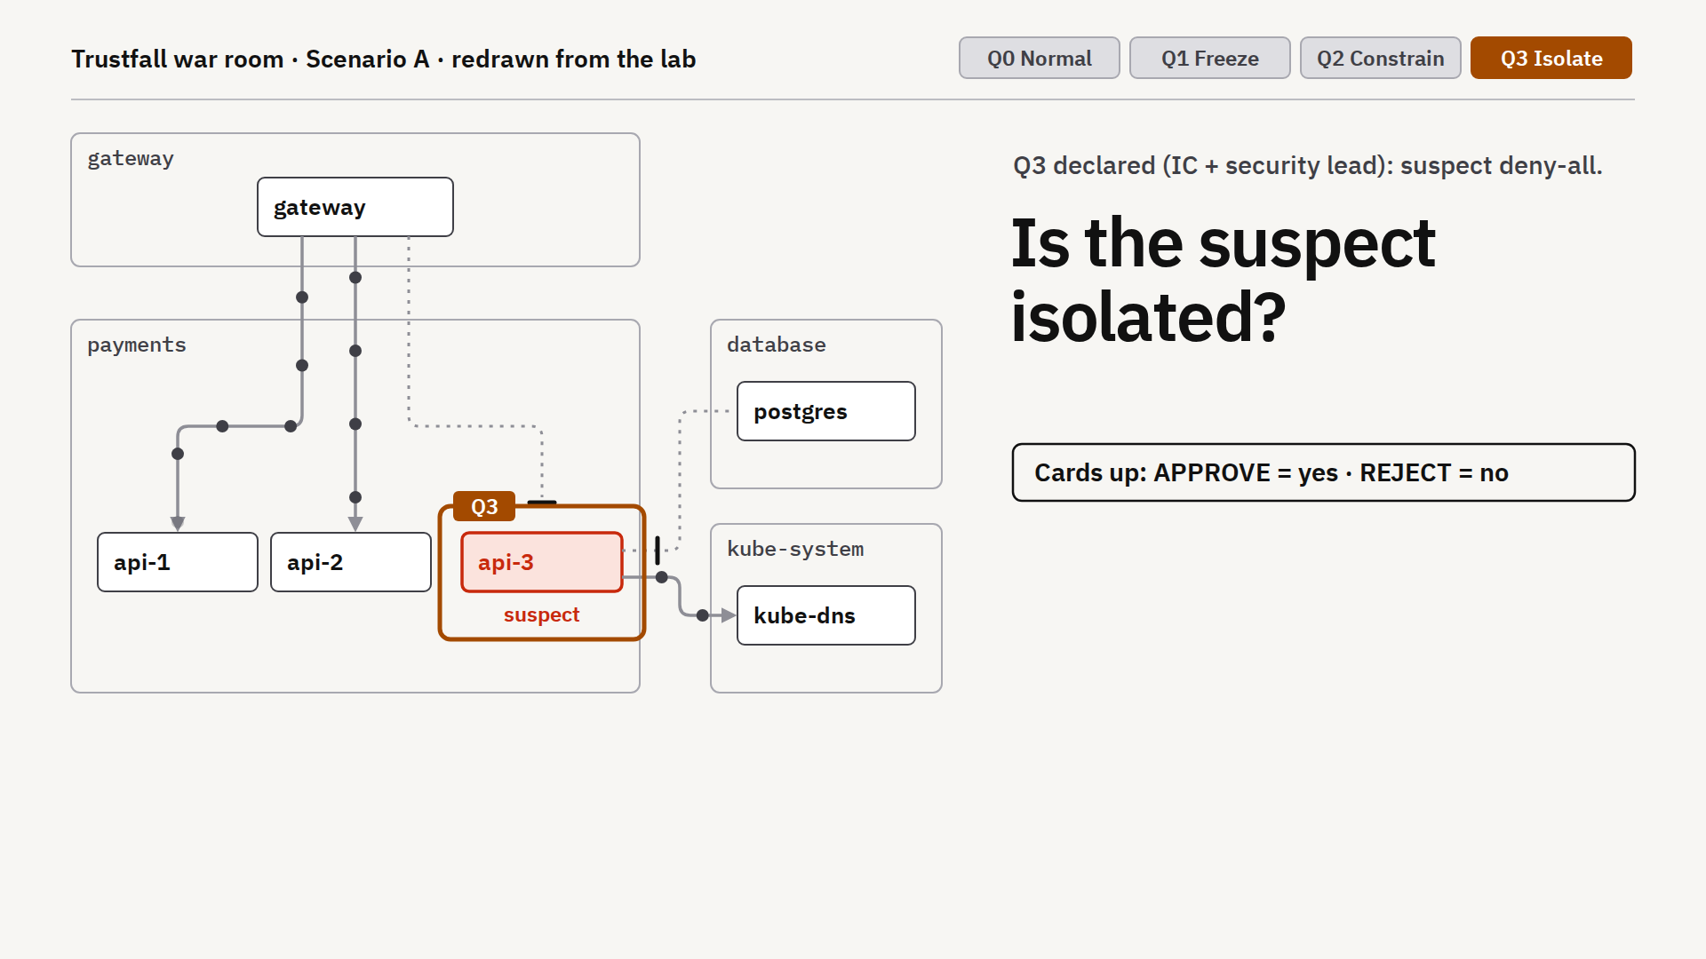
RECORDED LAB 01 / PREDICT THEN REVEAL
What would prove
isolation?
Q3 is requested.
An existing rule allows DNS.
Which allowance must change?
Name the confirming test.
Recorded k3s observations; simplified workload names. Scenario context is fictional.
ISC2 SECURITY CONGRESS 2026 / SC2632
20
Notes:
38:30–40:00. Ask yes/no before revealing. Adding an empty allow list cannot subtract the DNS allow from the Q2 policy. In the lab the isolated label excludes the suspect from that allowance. The Oct 10 log verifies retained DNS before the label and loss after it. Supply the visible technical facts before asking for a response. This is an ungraded decision-and-test discussion, not a Kubernetes recall quiz. Ask what changes in the table’s plan, then reveal the recorded observation. Still image redrawn from repository lab recordings. The map is cropped for presentation without changing its connections or labels. Reveal verbally after the vote: NetworkPolicy allows are additive. Use the standalone situation display only after venue rehearsal. Repository source: https://github.com/mgunjan/agentic-k8s-guardrails/blob/main/lab/RESULTS-live-2026-10-10.txt

Slide 21
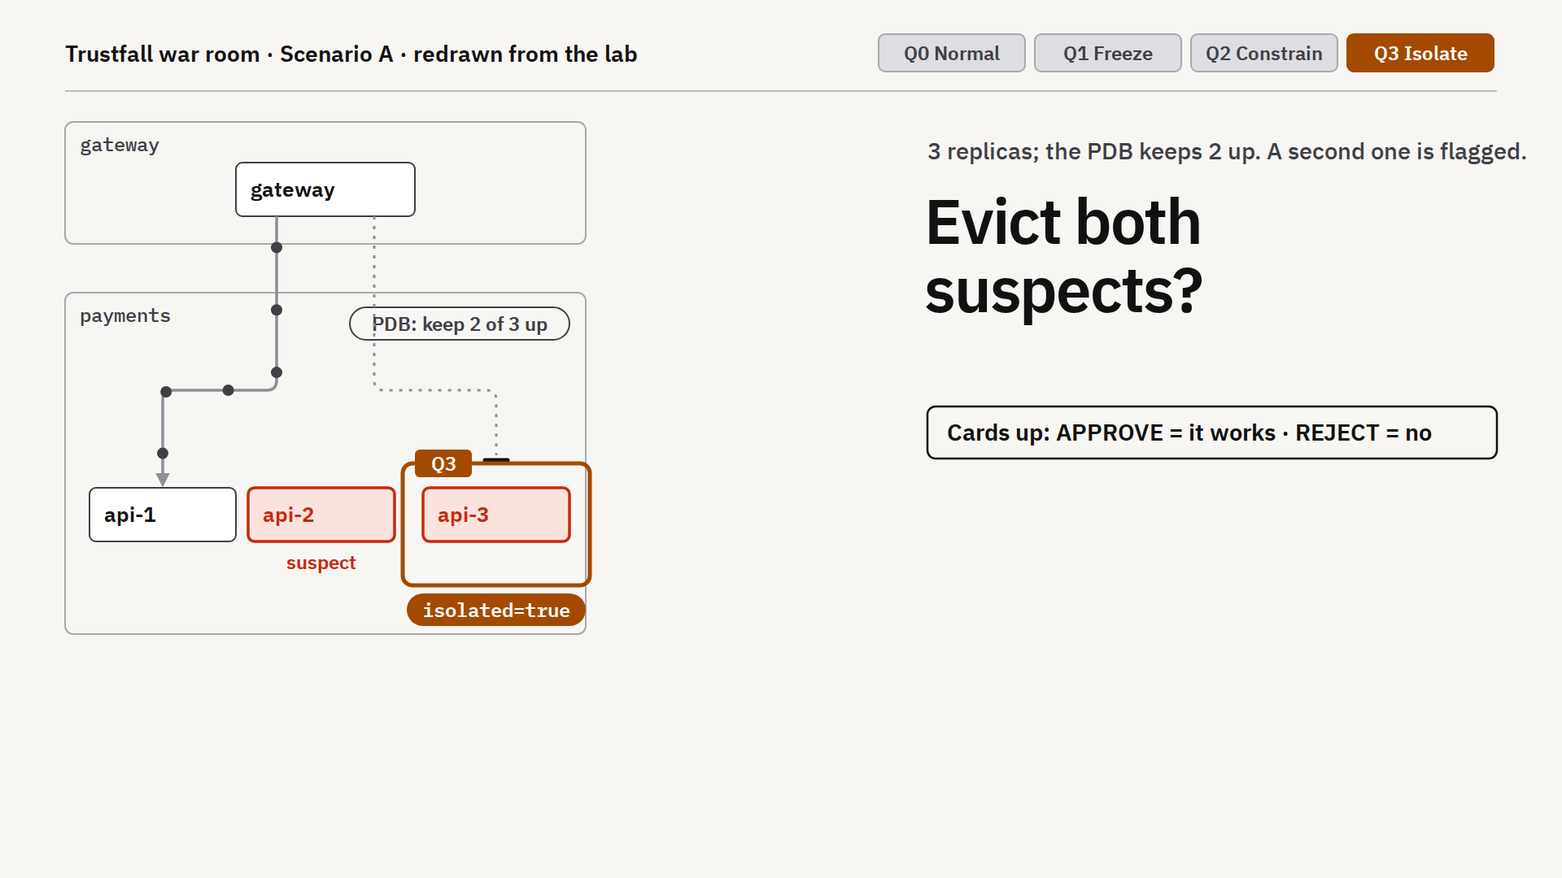
RECORDED LAB 02 / PREDICT THEN REVEAL
What must happen
before removal?
Three copies run.
Two may be affected.
Q3 blocks replacements.
Keep two healthy copies.
What evidence and capacity
do you need before removal?
Recorded k3s observations; simplified workload names. Scenario context is fictional.
ISC2 SECURITY CONGRESS 2026 / SC2632
21
Notes:
40:00–41:30. Define eviction as a voluntary request to remove a running copy, replacement as starting a new copy, and the PodDisruptionBudget as the rule limiting voluntary removal to preserve availability. Q3 refuses a replacement. After one eviction, minAvailable=2 blocks the next. The first eviction also destroys uncaptured evidence. Preserving suspects in place and checking clean capacity are part of the plan. Supply the visible technical facts before asking for a response. This is an ungraded decision-and-test discussion, not a Kubernetes recall quiz. Ask what changes in the table’s plan, then reveal the recorded observation. Still image redrawn from repository lab recordings. The map is cropped for presentation without changing its connections or labels. Reveal verbally after the vote: Recovery and evidence can deadlock. Use the standalone situation display only after venue rehearsal. Repository source: https://github.com/mgunjan/agentic-k8s-guardrails/blob/main/lab/RESULTS-live-2026-10-10.txt

Slide 22
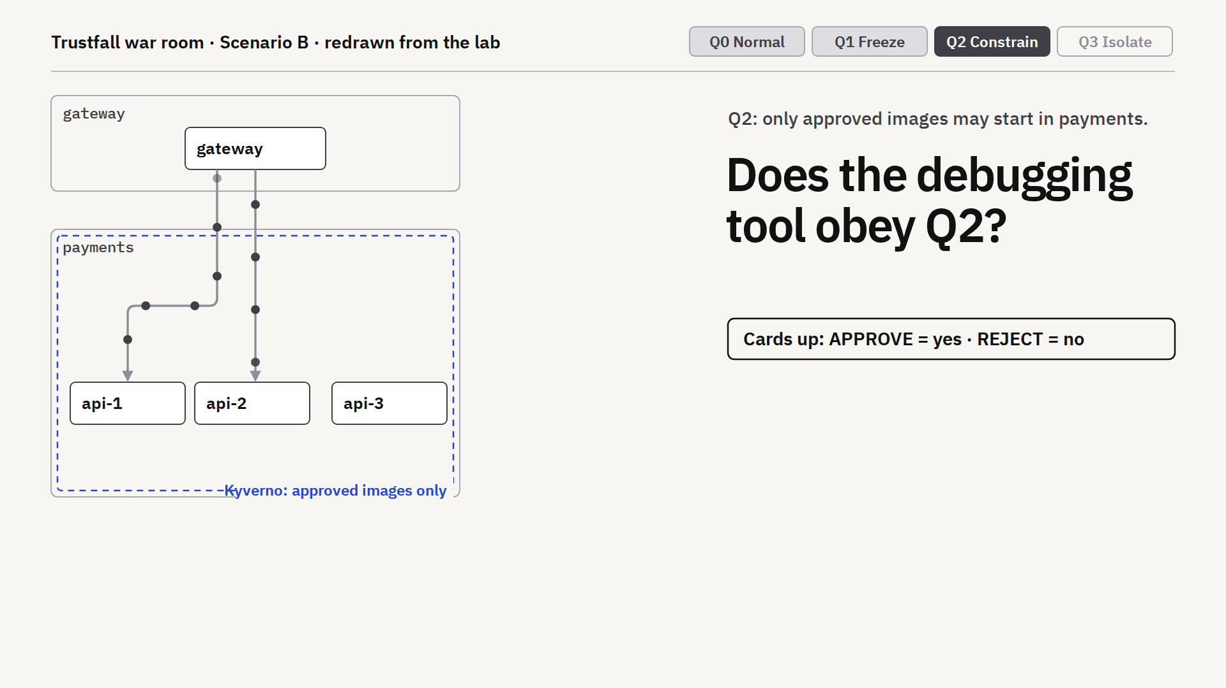
RECORDED LAB 03 / PREDICT THEN REVEAL
What would make
debugging safe?
The image rule covers Pods.
Debug uses another API path.
What request needs testing?
What forensic access would you allow?
Recorded k3s observations; simplified workload names. Scenario context is fictional.
ISC2 SECURITY CONGRESS 2026 / SC2632
22
Notes:
41:30–42:30. A rule matching Pods alone can miss pods/ephemeralcontainers. The fixed lab tests approved and unapproved debug images, including privilege checks. Approve a suitable forensic image before incident use. Supply the visible technical facts before asking for a response. This is an ungraded decision-and-test discussion, not a Kubernetes recall quiz. Ask what changes in the table’s plan, then reveal the recorded observation. Still image redrawn from repository lab recordings. The map is cropped for presentation without changing its connections or labels. Reveal verbally after the vote: The subresource changes the boundary. Use the standalone situation display only after venue rehearsal. Repository source: https://github.com/mgunjan/agentic-k8s-guardrails/blob/main/lab/RESULTS-live-2026-10-10.txt

Slide 23
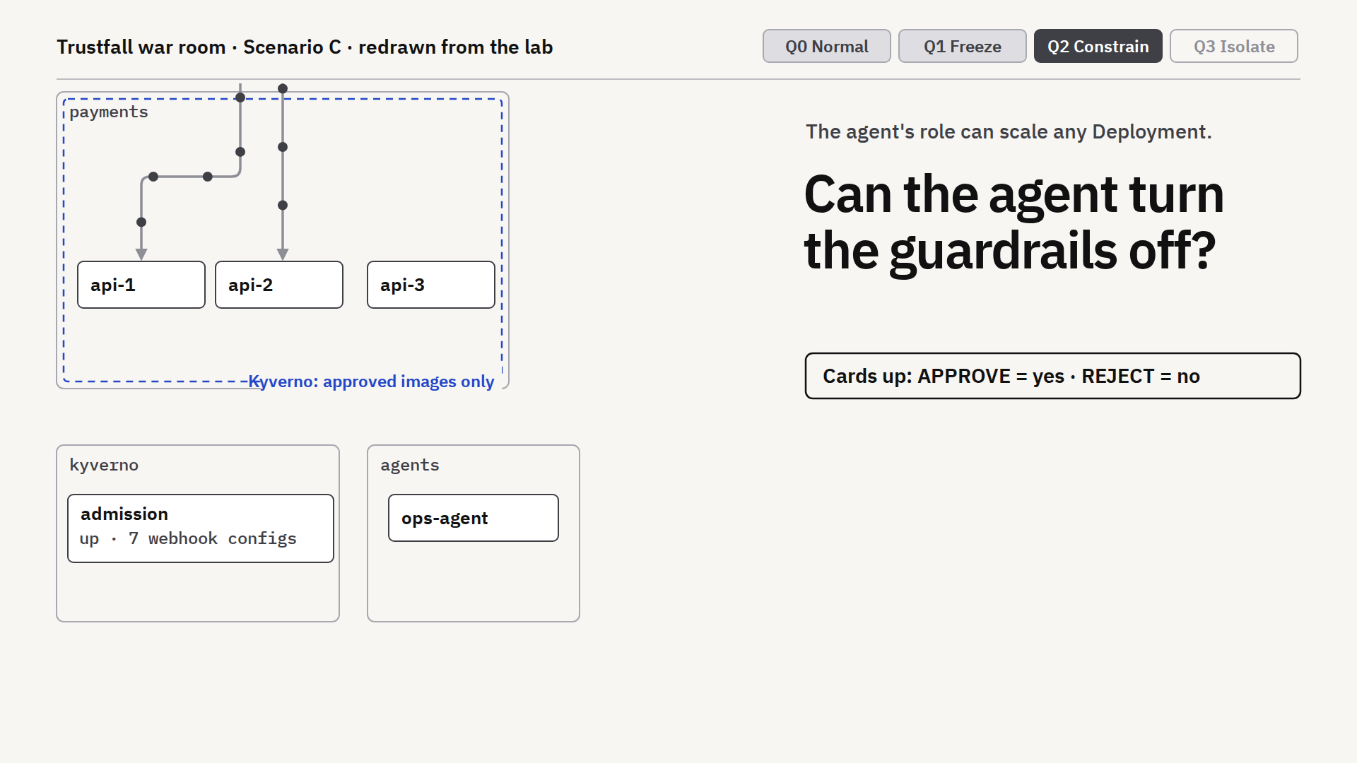
RECORDED LAB 04 / PREDICT THEN REVEAL
Which authority
must change?
Agent: can scale any Deployment.
Kyverno: runs as a Deployment.
What permission would you remove?
How will you test guardrail availability?
Recorded k3s observations; simplified workload names. Scenario context is fictional.
ISC2 SECURITY CONGRESS 2026 / SC2632
23
Notes:
42:30–44:00. The recorded unguarded agent scales Kyverno to zero; its webhooks disappear, while NetworkPolicies continue. Native Q1 freeze holds during the incident and a native guard protects the engine. The durable fix includes narrower RBAC. Supply the visible technical facts before asking for a response. This is an ungraded decision-and-test discussion, not a Kubernetes recall quiz. Ask what changes in the table’s plan, then reveal the recorded observation. Still image redrawn from repository lab recordings. The map is cropped for presentation without changing its connections or labels. Reveal verbally after the vote: The policy engine needs its own guard. Use the standalone situation display only after venue rehearsal. Repository source: https://github.com/mgunjan/agentic-k8s-guardrails/blob/main/lab/RESULTS-live-2026-10-10.txt

Slide 24
44–45 MINUTES / CASE REVIEW
Review findings and unresolved requirements
Case | What changes the response
A | The updated image is present on multiple replicas
B | The assistant follows injected instructions through tools
C | A human executes changes outside the agent identity scope
D (lab) | Copied credential still reads Secrets after Pod quarantine
ISC2 SECURITY CONGRESS 2026 / SC2632
24
Notes:
44:00–45:00. Reveal causes after the decisions. A investigates a potentially compromised library update; the initial scope is uncertain. B and C are fictional injected-input incidents. D is a fictional overprivileged monitoring identity; its separate synthetic October 13 lab shows copied-token Secret reads still allowed after the suspect Pod is network-quarantined. Read authorization and credential response belong to separate controls. At 44:30 read the prediction a D table locked during Round 3, then compare it with the status-only transcript or backup slide 32 inside this existing minute. If no table chose D, collect a short ungraded prediction before displaying this slide: a copied token is used outside its network-quarantined Pod; does the Pod policy restrict that API request? Do not imply this new room prediction was locked earlier. Do not ask for a first prediction after the result is visible and do not add another demo. Do not cite unverified real-world incident anecdotes from the old deck. Ask neighboring tables to exchange one decision and name the differing constraint during the reveal. Prompt: would your plan still work in the other case, and what dependency or identity assumption would fail? Each table gives one sentence of feedback.

Slide 25
45–48 MINUTES / INDEPENDENT REVIEW
Trained model proposal
Requirement | Selected control / routing | Score
Network restriction | Privilege escalation | 0.8986
Privilege escalation | Privilege escalation | 0.8574
Kubernetes API access | Human review | 0.5895
Rollout and expiry | Privilege escalation | 0.9107
One privilege policy. Six privilege tests pass.
Which requirements lack enforcement evidence?
ISC2 SECURITY CONGRESS 2026 / SC2632
25
Notes:
45:00–48:00. Vivek gives each table CONTROL-REVIEW.pdf page 1; keep page 2 sealed. Milind shows the recorded proposal. This is one actual local Laya head fine-tune and fixture workflow, not live model inference or current containment. Tables record a disposition, two unresolved requirements, their owners, and an acceptance test. The existing 0.6 cutoff accepts clauses 1, 2 and 4; clause 3 escalates. Scores come from the recorded answer_confidence signal after temperature fitting on separate synthetic data; deployment calibration is not established. Do not announce the ledger result until choices are locked. Reward a justified revision or request for evidence. The old three-case Jev/Claude challenge remains an optional methodology discussion; do not add it to the hour. Source: submission/2026-10-13/CONTROL-REVIEW-EXERCISE.md; laya-training/workflow-cost/run-1/agent-run.json.

Slide 26
RECORDED PROPOSAL / REVIEW FINDING
Passing privilege tests leave
the proposal incomplete
6 / 6
Network
Wrong control selected
API access
Human disposition required
Pod CREATE
privilege tests
Rollout / expiry
Wrong control selected
Record the enforcement owner and the evidence required to proceed.
ISC2 SECURITY CONGRESS 2026 / SC2632
26
Notes:
48:00–49:00. Milind reveals readiness.json: INCOMPLETE_PROPOSAL. Six fixed Pod CREATE privilege checks pass, but network and process clauses map to the wrong control and Kubernetes API access remains unresolved. Vivek asks one table to defend its disposition and name the actual enforcement owner. The reference control catalog identifies ACG-NET-001 (admission plus CNI), ACG-IAM-001 (RBAC plus credential response) and ACG-GOV-001 (rollout/expiry governance). Its metadata and tests do not grant approval. A catalog must state exact coverage, test evidence and unresolved requirements. This trained candidate did not improve the 33-choice runtime-order pilot: 16/33 both before and after; selected answers increased from 2 to 21, with six wrong among those 21. Its three complete fixture proposals took median 0.975 s, but all remained incomplete. No API charge; local compute unpriced. Source: submission/2026-10-13/REVIEW.md; workflow-cost/run-1/readiness.json; controls/catalog.json.

Slide 27
CANDIDATE SCREENING / THREE-RUN WORKFLOW MEDIANS
Evidence for model selection
Compare the work completed and the review still required.
JEV 1.13
CLAUDE OPUS 5.5
LAYA / ZERO-SHOT
30/33
32/33
16/33
1.82 s / run
24.18 s / run
0.41 s / run
$0.00019 / run
$0.03795 / run
$0 API* / run
Guardrail generated
Guardrail generated
No guardrail generated
33 authored choices. Review/deployment excluded. *Local compute unpriced; workflow incomplete.
Small pilot; no production winner. Measure error cost and reviewer effort before selecting a model.
ISC2 SECURITY CONGRESS 2026 / SC2632
27
Notes:
49:00–50:00. Close the recorded proposal review by asking whether the speed or API price justifies granting unresolved authority; it does not. These historical measurements support candidate screening. Production selection still requires representative error consequences, reviewer effort, failure behavior and setup/operations costs. Show the model/workflow comparison for one minute. The zero-shot Laya column is the October 12 frozen-pilot result, separate from the trained proposal just reviewed. Its frozen option order differs from the runtime order used for the new trained comparison. This is a screening pilot, not production certification or classifier-class superiority. Claude Opus 5.5 used adaptive thinking with medium effort and strict structured output; Jev returned its typed distribution. Returned IDs were claude-opus-5-5 and jev-1.13.0. Cases and labels unchanged from local pilot; 33 scored and four hostile report-only cases. No unreadable answers. Exact McNemar: two Claude-only correct, zero Jev-only, p=0.50. Decision latency covers 37 warm HTTP requests, excluding warmup. Scenario A time and API price are median of three newly measured complete fixture runs: decisions, compilation, Kyverno simulation and local proposal writing. Jev range 1.69–2.05 seconds; Claude 19.41–28.39 seconds. Jev eight API calls and four escalations each run; Claude eight or nine calls and one escalation. Human review and deployment excluded. Clients were launched concurrently, each sequential internally; Jev completed while the first Claude run was in progress. Three runs cannot establish p95 or load performance. List prices checked October 12: Jev $0.042/M input tokens, outputs free; Claude $4/M input and $20/M output. Scenario A per run: Jev 4,552 input tokens and 634 free output tokens; Claude 6,483–7,222 input and 545–931 output tokens. Model cost is estimated from usage, not an invoice. Setup effort was not timed or priced. Four human escalations versus one can dominate total cost; see RUN-COST-ANALYSIS.md. Zero selected mistakes does not certify a threshold: only 26 selected cases and different score definitions. OpenAI has not run because no OpenAI key was supplied. Laya added as a local comparator: 16/33 pilot, 0.089-second median in-process decision latency on MPS, excluding HTTP. Its Scenario A three-run median was 0.41 seconds, but every clause escalated and no guardrail was generated. Four model calls versus eight or nine hosted calls means it did less work. No API charge; compute, energy and operations unpriced. Model load excluded and reported separately. No throughput or production winner claim. Sources: submission/2026-10-12/HOSTED-COMPARISON.md; https://docs.typesafe.ai/models; https://platform.claude.com/docs/en/models/overview; https://platform.claude.com/docs/en/build-with-claude/structured-outputs.

Slide 28
4 MINUTES / DOCUMENT RECOVERY
04
Define recovery
criteria.
On page 6, name the exit test,
who can lift quarantine and the rollback condition.
ISC2 SECURITY CONGRESS 2026 / SC2632
28
Notes:
50:00–54:00. Add a concrete exit criterion to the worksheet. A: reviewed clean image and no ongoing suspect connections. B: ticket/tool boundary repaired and tested. C: scoped RBAC, verified approvals and input source repaired. D: affected credentials rotated or accepted risk documented, least-privilege Role and tested metrics recovery. Descent is Q3, Q2, Q1, Q0 under authorized review. If critical service has no clean serving capacity, record the conflict instead of declaring success. Generated incident-room art is a visual metaphor, not cluster evidence.

Slide 29
DEBRIEF / ILLUSTRATIVE CASE A DECISION RECORD
How evidence changes a decision
Decision record | Defensible example, not an executed response
Intent | Stop suspect traffic. Preserve two clean service copies
Initial review | Hold broad approval. Traffic and API evidence missing
New evidence | Another copy shares the image. Q3 blocks replacement
Revised plan | Preserve evidence. Verify clean capacity before removal
Recovery | Require denied suspect paths, working dependencies and authorized lift
Your environment: name one requirement, its owner and the evidence needed to proceed.
ISC2 SECURITY CONGRESS 2026 / SC2632
29
Notes:
54:00–55:00. Show this illustrative paper decision record only after teams have completed recovery. This is one defensible Case A example, not the only answer, a model output or proof of executed containment. Trace the same requirement through initial disposition, later evidence, changed order and recovery tests. Explain that two ready copies are not automatically two trusted clean copies. Compare one table’s actual revision, accepting a defensible hold. 55:00–57:00. Tally points, hear at most two twenty-second reports and ask each participant to record a requirement, owner and verification step for their own environment. 57:00–60:00 questions. Preserve all three learning outputs: intent/map, justified controls/exceptions and a scoped containment/recovery playbook. Repository source: https://github.com/mgunjan/agentic-k8s-guardrails/blob/main/tabletop/congress-2026/WORKED-DECISION.md

Slide 30
SESSION RESOURCES
Patterns to adapt across Kubernetes
github.com/mgunjan/sc2632-tabletop
Policy templates and fixture tests
Evidence capture and Quarantine levels
Four incident cases and recorded lab results
Apache-2.0 source, public repository.
Validate identity, CNI behavior and policy support on your platform.
ISC2 SECURITY CONGRESS 2026 / SC2632
30
Notes:
Closing resource slide. Public curated repository verified: https://github.com/mgunjan/sc2632-tabletop. Start with its README; the no-key reference demo compiles and tests a supplied spec and retains human review. Share the complete exercise package after the sealed evidence is revealed. Describe cloud agnostic as implementation patterns based on Kubernetes APIs, not a claim that every managed distribution has been tested. The source includes historical single-node k3s and the October 13 presenting-Mac three-node k3d record. These do not establish support across all managed Kubernetes platforms. Repository source: https://github.com/mgunjan/agentic-k8s-guardrails/blob/main/README.md

Slide 31
BACKUP / SUPPLIED REFERENCE SPEC
Fallback: generated policy excerpt
kind: ValidatingPolicy
name: deny-privilege-escalation
validationActions: [Deny]
The policy rejects privileged containers.
Human review approves the generated file before deployment.
Provenance: model = none (spec supplied)
ISC2 SECURITY CONGRESS 2026 / SC2632
31
Notes:
Use if terminal compilation is unavailable. This is a summarized excerpt, not verbatim full YAML. Show output/frozen-a/policies/deny-privilege-escalation.yaml for the complete policy. The specification was hand-written and the generator rendered it. Repository source: https://github.com/mgunjan/agentic-k8s-guardrails/blob/main/output/frozen-a/PR.md

Slide 32
BACKUP / REFERENCE SCENARIO A
Fallback: fixture admission outcomes
Workload | Policy result
payments-api | Passes privilege and egress checks
backup-job | Would block under the egress-profile policy
report-runner | Registry violation at Audit, admitted
backup-job with exception | Egress check skips the matched exception
ISC2 SECURITY CONGRESS 2026 / SC2632
32
Notes:
Abridged from the frozen Scenario A admission report. These are offline simulations on fictional fixtures. They do not prove that the admission policy constrains a running connection, reads or internal tool calls. Repository source: https://github.com/mgunjan/agentic-k8s-guardrails/blob/main/output/frozen-a/PR.md

Slide 33
BACKUP / REAL LAB / SYNTHETIC SECRETS
Case D: copied credential response
Change | Copied Kubernetes credential | Preserved access
Broad binding | Outside Secret GET/LIST: 200 | Named Secret and ConfigMap: 200
Pod quarantined | Outside Secret GET/LIST: 200 | Stand-in HTTP health available
RBAC narrowed | Outside Secret GET/LIST: 403 | Required named GETs: 200
Old bound Pod deleted | Old credential: 401 | Replacement credential: 200
Stand-in health only. External application-key rotation remains required.
ISC2 SECURITY CONGRESS 2026 / SC2632
33
Notes:
Use within the existing 44–45 case comparison for a D table or as a Q&A backup. Lock the copied-credential prediction during Round 3 before showing this table. Then compare each state and identify which authority boundary changed. This is the actual October 13 presenting-Mac run on synthetic resources, separate from the fictional incident. The suspect cannot open a new API TCP connection while an unaffected positive control still can. The same bearer token used from outside the Pod continues Secret GET/LIST in two other namespaces. Removing its broad binding gives HTTP 403 while preserving exactly one named in-namespace Secret GET and one ConfigMap GET; in-namespace LIST is also denied. The replacement has its own Pod-bound credential and restored API connectivity. Old-token authentication returns 401 41.2 seconds after bound-Pod deletion; the old token was far from natural expiry. New-token positive reads still return 200, and outside reads remain 403. There are 58 passing observations, including repeated health samples, not independent incident scenarios. No production monitoring delivery, audit export, external application-key revocation or compromise eradication is claimed. RBAC proposal is manually reviewed, not model generated. Source: submission/2026-10-13/live-rehearsal/case-d/result.json; lab/verify-case-d.py; scenarios/d-secret-enumeration/review/PR.md; https://kubernetes.io/docs/reference/access-authn-authz/service-accounts-admin/

Slide 34
BACKUP / CONTROL SELECTION ONLY
Training and classical baselines
Candidate | Correct / 27 | Selected / 27 | Wrong selected
TF-IDF + logistic regression | 20/27 | 8/27 | 0
Base Laya | 12/27 | 2/27 | 0
Trained Laya | 12/27 | 16/27 | 5
480 synthetic training states. Same task and runtime option order.
Small author-labelled pilot. Confidence needs independent validation.
ISC2 SECURITY CONGRESS 2026 / SC2632
34
Notes:
Control selection only: 27 states, six dependency/blocked-workload questions excluded from the full workflow. The TF-IDF word/character model trains in 0.101 s on CPU and takes median 0.523 ms per decision. Base and trained Laya take approximately 89 ms in-process on MPS. Synthetic test: classifier 54/60, base 36/60, trained 37/60; only ten held-out templates, not independent enterprise incidents. Classifier control-pilot ECE 0.247. No universal superiority or production readiness claim. Full-state exception features corrected an earlier unfair scope comparison, raising 2/12 to 12/12. The Qwen recording is incomplete against current states. Laya head training took 57 s. Runtime-order full-pilot accuracy stayed 16/33; six wrong among 21 selected after training. Source: submission/2026-10-13/REVIEW.md; laya-training/control-holdout-rescored/summary.json.

Slide 35
BACKUP / COST ANALYSIS
Setup and total operating cost
Cost component | Hosted API | Local model
Setup | Keys, billing, network, workspace | Runtime, weights, device and memory
Per-run inference | Metered token charges | Owned compute and operations
Shared engineering | Compiler, tests, credentials and observability | Compiler, tests, credentials and observability
Human review | Uncertainty and unmet intent | Uncertainty and unmet intent
One extra minute of review can exceed the API cost savings.
ISC2 SECURITY CONGRESS 2026 / SC2632
35
Notes:
Setup duration and engineering costs were not measured, so no setup-cost winner is claimed. Hosted candidates require no locally owned inference GPU but still require billing, credential security, network and provider-failure handling. Local candidates used the existing Apple-silicon Mac with 18 GiB RAM; there is no measured acquisition, energy or operations charge. Shared deterministic tools and testing apply to either. Total cost per accepted change = amortized setup + inference + compute/operations + human review + failure/rework. Illustrative rate only: at $120/hour, one extra minute costs $2, exceeding the approximately $0.0378 API cost difference per Scenario A run. Jev escalated four items versus Claude one in these runs; item count is not measured human time. Do not claim lower total cost from token price alone. Source: submission/2026-10-12/RUN-COST-ANALYSIS.md; benchmark/workflow-cost/.

Slide 36
BACKUP / EXACT PILOT AND WORKFLOW METRICS
Full comparison: quality and confidence
Metric | Jev 1.13 | Opus 5.5 | Laya
Correct choices | 30/33 | 32/33 | 16/33
Decision latency | 0.17 s HTTP | 2.37 s HTTP | 0.09 s in-process
Selected at score 0.6 | 26/33 | 33/33 | 1/33
Wrong among selected | 0/26 | 1/33 | 0/1
Scenario A time/run | 1.82 s | 24.18 s | 0.41 s
API cost/run | $0.00019 | $0.03795 | $0 API; compute unpriced
33 scored labels. Small pilot; confidence definitions differ. Laya generated no guardrail.
ISC2 SECURITY CONGRESS 2026 / SC2632
36
Notes:
Exact metrics preserved from the prior deck. Full confidence distributions and recordings are in benchmark/. The 0.6 scores are not matched calibrated risk. Laya in-process timing excludes HTTP; its incomplete workflow did less work. Jev versus Claude paired accuracy p=0.50 is inconclusive. Human review and deployment excluded; costs are usage-based list-price estimates, not invoices. Sources: HOSTED-COMPARISON.md and RUN-COST-ANALYSIS.md.

