Slide 1
WEB ARCHIVE SERVICES FRAMEWORK
FOR TIGHTER INTEGRATION BETWEEN THE PAST AND PRESENT WEB
By
Dr. Ahmed Alsum in May 2014
Directed by
Dr. Michael L.Nelson
Presenting today
Maheedhar Gunnam
Notes:
By looking at the title itself one can predict that by the end of this talk there will be some nicer set of Services also called (APIs) are going to be introduced using wich accessing the web archives would be enhanced
The actual dissertation has ton of useful information, very neat and beautifully elaborated with examples.. like
-> Introducing what is Web Archiving and Why it is used ?
-> Trends in web archiving and Explained about Web Archiving Process itself
-> Who uses Web archives and what it lacks currently ?
-> What improvements can be made .
And I am kind of skipping the pre-phase, keeping in mind as a part of webarchiving class so far, we already have some implicit knowledge about all these basic stuff. Andi wish to talk about the core research made by Dr.Alsum

Slide 2
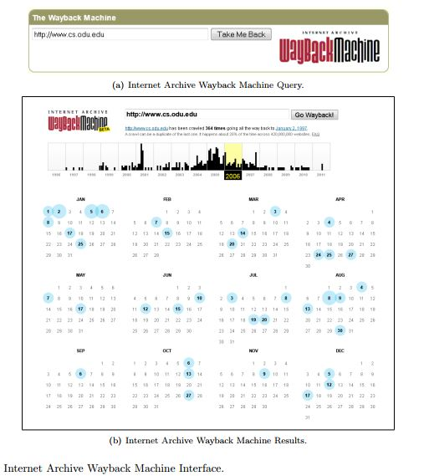
Motivation
Limited web archives interfaces
Lack of APIs
Notes:
Basically there were 3 types of web interfaces provided for the user to access the archive content.
URI-base, collection based and full-text search
We all know this figure, this is an example of our famous internet archive coffee stained wayback machine interface, where the user enters the URI and the gets the output as shown.
-> Having the ton of useful data isn’t just enough to be actually useful, This data accompanied with elegant APIs to serve this data will have more value. For example, twitter has ton data also APIs, only because of these APIs today Nouman could access the tweets from twitter and checking for deleted tweets against archived copies.
-> If there are more APIs available, more the opportunity for the developers to use this data and opportunity to build more applications. Which were actually lacking at the time this research was made.

Slide 3
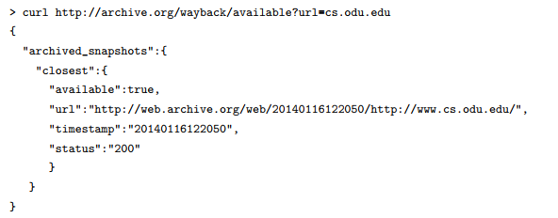
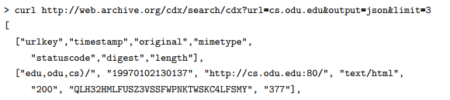
Limited and non standard APIs
Wayback Availability JSON API
Wayback CDX Server API
Notes:
-> There very only a limited set of APIs at that time which couldn’t serve all the user needs.
-> Shown here are couple of them among the very limited APIs available at that point, first one check whether a particular URI is archived and returns the closest available archived snapshot, the second one returns the complete cdx record for a specific URI
As an attempt to provide the existing WebArchives with efficient APIs endpoint, the author his advisors came with the system called as ArcSys.

Slide 4
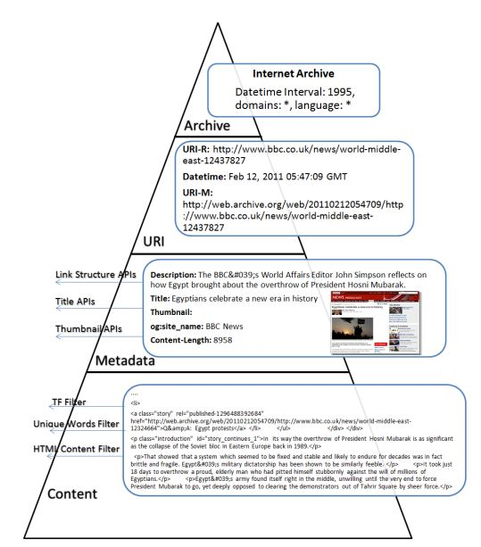
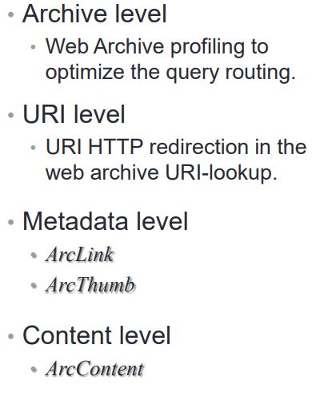
Web Archiving Service Framework - ArcSys
4-layered web archive services pyramid model
Notes:
ArcSys is a service framework contributed to expose APIs for the web archive collections. It consists of set of integrated services that can be deployed separately.
As we can see the whole web archive is shown in 4 layers and represented as a pyramid here:
Content Layer: This layer contains the raw data of the crawled web pages. Here the data could be text, images, videos, or other MIME types.
Meta Data Layer: This web archive layer exposes information about the archived web page such as title, thumbnail, content-length, etc. But the more focus is for the derived metadata which requires additional processing.
URI: for the Most web archives do not have keyword search and uses URI as the primary key for access, now it is extended with HTTP Redirection status.
Archive: Describes the main characteristics that distinguish each web archive from the others such as age and supported top-level domains.

Slide 5
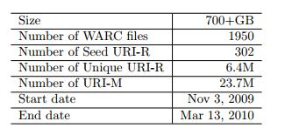
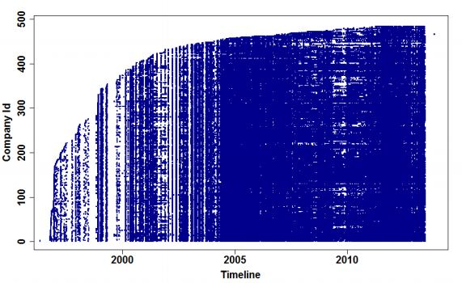
Data Sets Used
IIPC 2010 Winter Olympics Collection
DMOZ URI Collection
TimeMap distribution through the time for F500 collection listed in 2013
Notes:
IIPC 2010 Winter Olympics and
Fortune 500 list home pages - out of which 12 companies pages aren’t captured robot.txt

Slide 6

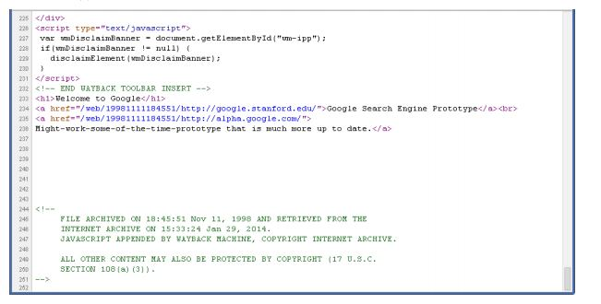
CONTENT SERVICE ArcContent
Main Responsibility is to retrieve the actual archived content
3 types of responses Raw, Modified & Extracted
Notes:
ArcContent basically works on content layer and exposes API for web archive collection content. This service is responsible for retrieving the actual content of the page as it appeared in the past. There are 3 response types from Content Access Service are: Raw, Modified & Extracted.
Raw: raw representation as crawled
Modified : returns the raw response which is being rewritten on the server side, meaning all the embedded resources and assets( Images,CSS, JS) links will be re-written to point to wayback application.
Extracted: It is the main focus here, this requires some preprocessing, example responses can be main textual content omiting the html tags , frequency of Words, unique words etc. ArcContent mainly deals with this type of response.

Slide 7


Operations for Extracted Response :
Term Frequency of Content
Featured Content
Notes:
TFContent(R): Set of words and their frequencies as appeared in all the mementos
Featured Content(R): Set of common words that appeared at least one time in each memento for this resource(R) TimeMap

Slide 8
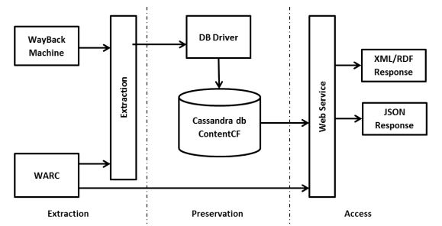
ArcContent Architecture Diagram
Notes:
Here is the Architecture for ArcContent, as show it has 3 stages Extraction, Perservation and Access
Extraction: This is the stage actual extraction of textual content from the HTML Mementos happen, once extracted is passed on to the preservation. HTML Parser is used to extract the textual content from the HTML. Apache Hadoop is used to extract the textual content in a distributed environment.
It was also discovered in the research that 40% of the processing time is saved if extraction is done from WARC as compared to using wayback machine interface.
Preservation: As show in the Architecture Cassandra DB is used to store this extracted info.
Access: The Access stage then servers the content based on different filters asked for, accepts 2 arguments as inputs URI & Filter type also optional datetime argument to determine a specific memento. ArcContent return the textual content in both XML and JSON formats.

Slide 9
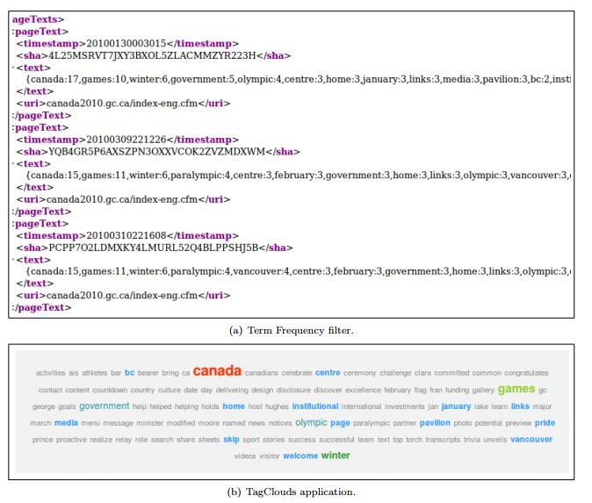
ArcContent application
Notes:
Here is the application where the top section shows the response from ArcContent that sows the words and their frequencies as appeared, the section at the bottom shows an application the particular words are highlighted based on the frequency.

Slide 10
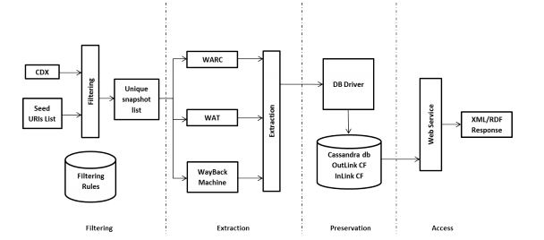
METADATA SERVICE ArcLink
Processes Link Structure and builds temporal web graph
ArcLink Architecture
Notes:
ArcLink is a distributed processing system that pre-processes the link structure information extracted from the archived web collections and build a temporal web graph. ArcLink has four main stages: filtering, extraction, storage, and access.
Stages-> Filtering, Extraction, Preservation and Access
Filtering: This stage uses the crawler log to omit the mementos that will not contribute to the final temporal web graph

Slide 11
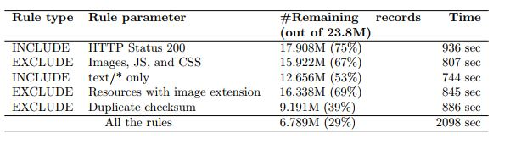
ArcLink cond.. Filtering
Filtering rules for optimization:
Results when experimented on 2010 winter olympics collection
Notes:
Filtering rules for optimization: Include, Exclude rules
Apache Pig customised with Hadoop is used for parallel processing to apply include exclude rules.

Slide 12


ArcLink cond.. Extraction.. Optimization techniques
Outgoing links are extracted
Creation of Unique URI-ID
Step 1: Canonicalize the URI into SURT format
Step 2: Encode the SURT string using simhash with 64 bit
Notes:
Extraction:
In the extraction step, the outgoing links from the web pages are extraction toward the goal of constructing the web graph.
Here are the steps introduced to for optimization, it involves creating the unique URI-ID and Extraction Mechanism.
1.Creating unique URI-ID: as explained in the slide self explanatory

Slide 13
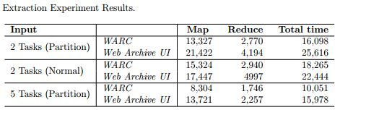
ArcLink Cond..
Extraction Mechanism
Uses Apache Hadoop
MapReduce Jobs were used
Uses HTML Parse a Java Library
Partition of input file
Results
Notes:
2. Extraction Mechanism:
Apache Hadoop allows distributed processing, is used for the actual implementation of Extraction process.
MapReduce Jobs were built using java.
Mapper starts with each memento at a time and extracts the outlinks.
Reducers job is to create the URI-ID for the extracted links .
Partition technique: Each line in the input file has the URI and the respective WARC file name, This input file is split and partitioned in the way that each warc file appear in only one split file and each split is assigned to a one map task. Hence there wont be any collision on a warc file between mapper tasks
Dataset used here is 2010 Winter Olympics web archive collection
The results here of course shows that WARC as the data source is more efficient than performing page scraping from the web archive UI.

Slide 14
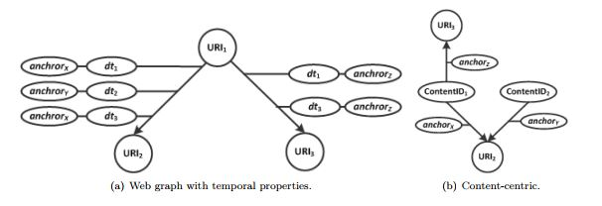
ArcLink Cond.. Preservation & Access
Introduced these Temporal Web Graph Schemas
Notes:
Apache cassandra DB is used here, this stage worries about how to effectively store these temporal web graphs so as to save space, whereas the previous stages worried about saving the computation power and saving time.
Two schemas are introduced here as the answer for Research question of how to represents the web graphs with temporal information.
Fig a : more readable as the edges now have additional properties like datetime and links
Fig b: Here the datetime and URI-R are replaced by the checksum of the content of the memento, hence making the duplicate mementos follow to a single vertex.

Slide 15
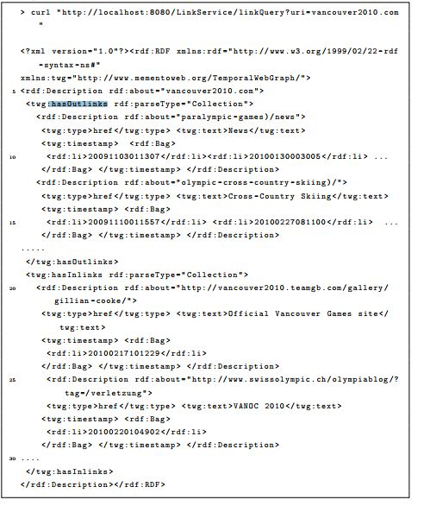
ArcLink request/response session
Notes:
Finally the Access stage of ArcLink provides xml based REST webservices API for any third party applications to access the link structure info.

Slide 16
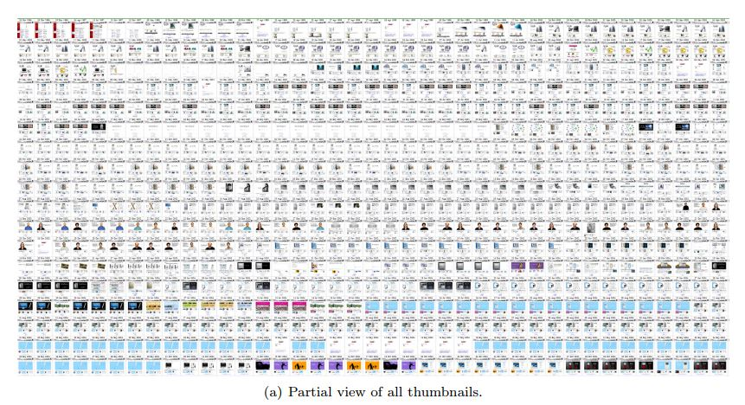
METADATA SERVICE ArcThumb
Goal: Selecting representative thumbnails to summarize the TimeMap.
Displayed here 700 thumbnails out of 10,500 available mementos for www.apple.com
Notes:
Thumbnail is nothing but a snapshot of visual representation of memento
The Main Goal of ArchThumb is to selecting the most representative thumbnails to summarize the whole TimeMap.
-> First problem is to get take snapshot for every memento, it would need heck a lot of processing time as it takes a while to load all the embedded resource before capturing the screenshot and of course need such huge space.
-> Even if there are thumbnails available as in the picture show for the apple.com, because of the cognitive loads user can never preserve the changes that took place. So there is need to select a few thumbnails that can summarize the whole timemap.

Slide 17
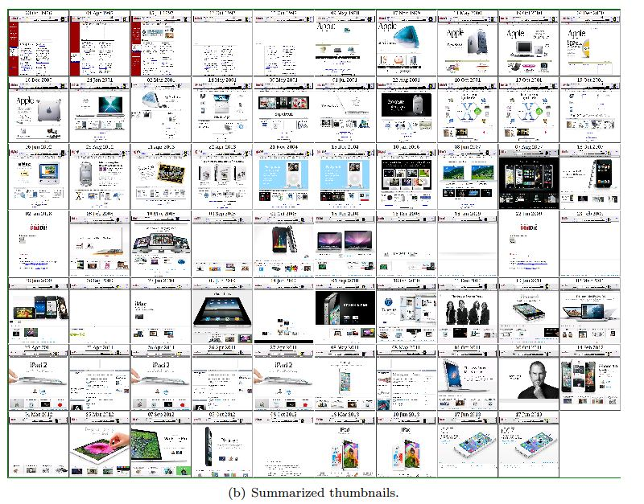
Selected 69 Thumbnails out of 10,500 Mementos.

Slide 18
Techniques to calculate the similarity between web pages:
SimHash Similarity
Levenshtein Distance between HTML DOM Tree
Embedded Resources
Memento Datetime
Notes:
Simhash Similarity: First the entire HTML content for the memento is extracted and the simhash is applied on it, which is a fingerprint technique to calculate near duplicates between webpages. The output from this technique is a 64bit simhash fingerprint. Then the Hamming distance is calculated between these simhash fingerprints.
Levenshtein distance: Each rendered Webpage has a DOM Tree, and Levenshtein distance is the number of operation (insert, deletion) to turn from one tree to another.
Embedded Resource: Each webpage may have a certain embedded resource like (Images, Style sheets and Javascript), the difference between two webpages in this case is the number of additions and removals of these resources from each categories.
Memento Datetime: the datetime of a memeto is available in cdx file, now the difference in seconds become the base, less difference indicates higher similairty.

Slide 19
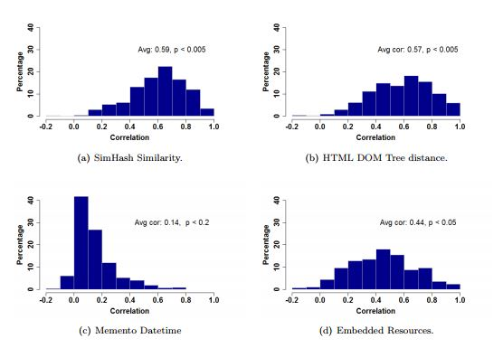
Histogram for the correlation between Thumbnail difference and various features.
X-axis -> correlation, Y-axis -> No of Timemaps
Notes:
Experiment: (Comparing the techniques)
First the thumbnails are created for each memento in timemap and pixel wise comparison was made between between two thumbnails using scipy kit, to find the manhatton distance between the pairs. And finally correlation between the similarity of webpages and difference between thumbnails is calculated.
The graphs are plotted for each technique with the x-axis being correlation and y-axis being the number of timemaps that achieve this level. Ofcourse simhash technique turns out to be the best one here.

Slide 20
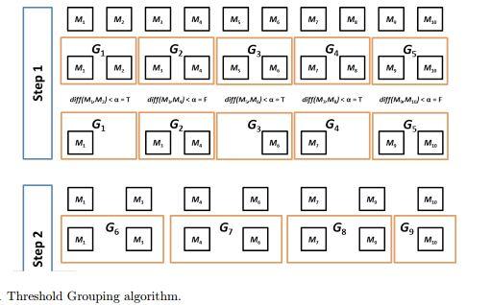
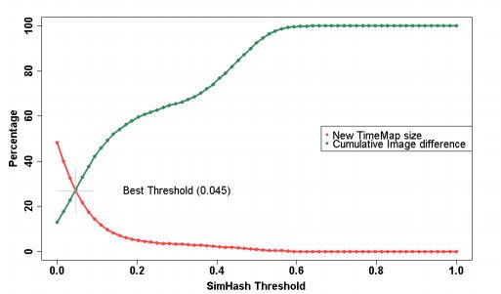
Selection Algorithm:
Threshold Grouping
Optimum SimHash threshold point for the Threshold Grouping algorithm (alpha)= 0.045, decreases timemap to 27%
Notes:
-> Initially the mementos in timemap are divided into groups, each group having two subsequent mementos and the difference between the mementos in the group is calculated and if it is less than Alpha, one of the memento from that group will be eliminated and the remaining mementos are sorted and the subsequent mementos are grouped again for step 2.
The graph shows relation between the change in simhash threshold on (x-axis) and reduction of time map and loss of image difference on (y-axis).

Slide 21
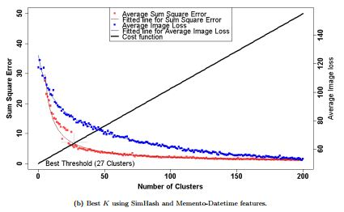
K Clustering
At the Optimal Threshold = 27 clusters, size reduction achieved = 9% to 12%
Notes:
-> In here, the mementos in the timemap are divided into k-clusters, from each cluster a random thumbnail is selected to represent the cluster.
An experiment with the set of features as F={simhash, memento-datetime), it if found that 27 cluster is the optimal value and reduces the time map to 9% to 12% of its original size

Slide 22
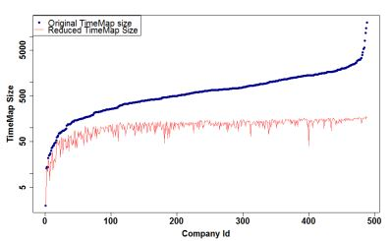
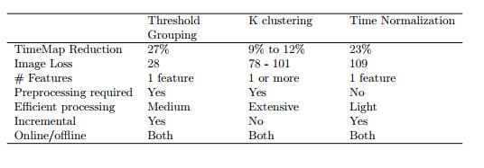
Time Normalization
With time = 1 month and k =1 thumbnail
Timemap reduced to 23%
Comparison between the selection algorithms
Notes:
-> In the Time Normalization algorithm, All preprocessing required is just the datetime of the memento which is already preserved in CDX file itself. In here Timemap is divided into fixed time slots and a random k-thumbnails are selected from each slot. As shown in the graph with time = 1 month and k=1, it reduced the timemap to 23% of original size.
-> Here is the table that compares the three selection algorithms. As shown though timemap normalization doesn’t require any preprocessing, it has the higher error rate when the average image loss is compared and gives a very poor representation of timemap.

Slide 23
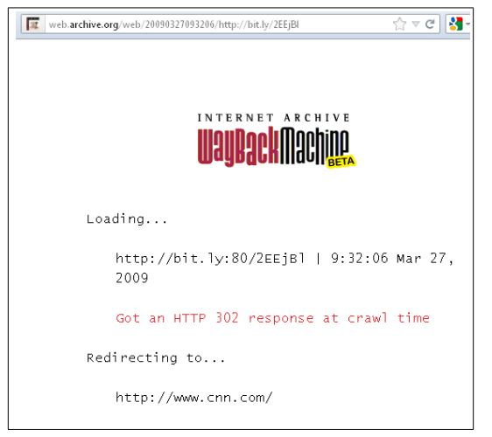
URI SERVICE
Current Wayback Machine Policies:
Live Redirect: Ignores live redirect.
Archived Redirect: Simple follows redirection.
Notes:
Live Redirect: If there exist a Redirection to the URI-R being request, the wayback machine ignores the redirection and gives only the timemap of the Requested URI-R
Archived Redirect: If the memento of a timemap has a redirection, the wayback machine simply follows redirection chances that it might hit the live web if the redirected location is not being given correctly.

Slide 24
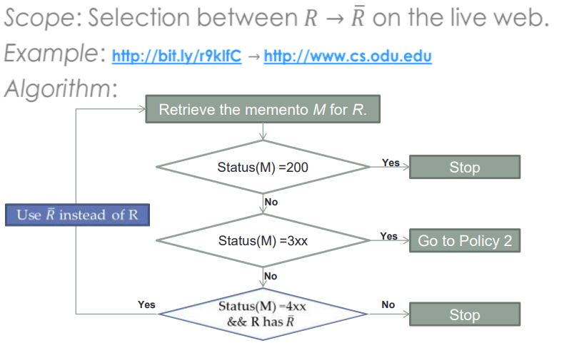
Retrieval Policies :
POLICY 1: URI−R with HTTP Redirection
Notes:
Step1 retrieves all the mementos from the Timemap of R, if there exist a memento with redirection will proceed to policy 2
If the memento is unavailable and if R has redirection RDash, then step 1 repeats with R being Replaced by RDash.

Slide 25
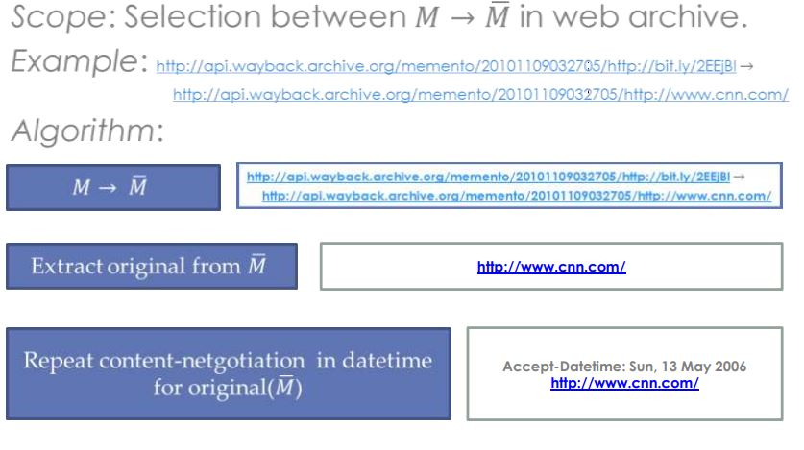
POLICY 2: URI−M With HTTP Redirection
Notes:
-> if there exist redirection, a content negotiation is made by extracting the original Link in this case cnn.com. This is especially useful in case where some webarchives don’t rewrite the memento Location header and possibly making the redirection hitting the live web.

Slide 26
ARCHIVE SERVICE
Percentage of archive web ?
What is the distribution of web archived material ?
Percentage of web archived ?
Datasources used for experiment : 1000 URIs each from
DMOZ
Delicious
Bitly
Search engine indexes
Experiment done once in 2010 and again in 2013, Generated a report on No.of URIs archived, No.of mementos and frequencies
Notes:
-> This Archive Server layer deal with two important research question: 1) How much of the web is archive ? and 2) what is the Distribution coverage of web archived material ?
-> Here measuring the absolute sizes of the web archives is not the answer, cause all the archives don’t report their sizes. Instead an experiment is conducted by sampling the URIs from a variety of sources shown.
->outcome of the experiment is a report consisting of number of URIs archived, Number and frequency of the mementos archived.
-> This experiment is repeated twice, the first one in late 2010 and the next time in late 2013.

Slide 27
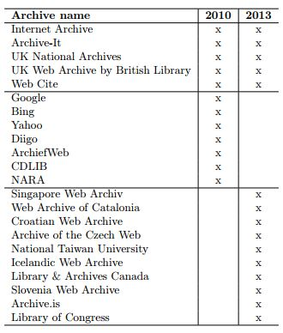
List of archives under experiment:
Notes:
-> the table shows here the list of 15 web archives that were under experiment, as we can see here, there are some archives that got added by 2013 and of course search engines caches couldn’t be accessed by 2013.

Slide 28
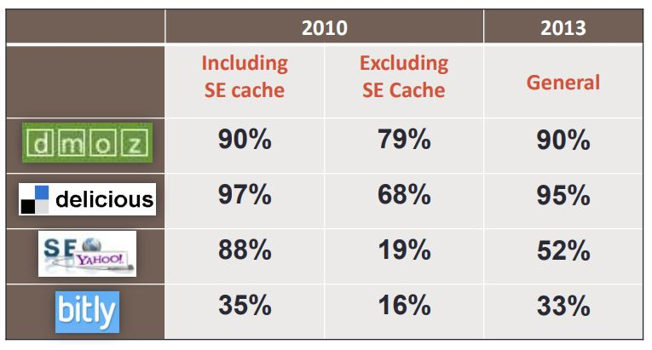
Archived percentage of each sample :
Archive percentage depends on the popularity of URI
Notes:
-> The table here shows the archived percentage for each sample, and the contribution from SE Cache is removed from 2010 to compare it with 2013.
-> As one can see here the archive percentage which are ranged from 16% to 79% in 2010 which increased to 33% to 95% in 2013.
-> From the results of this experiment made it clear that archive percentage is related to the popularity of the URI.

Slide 29
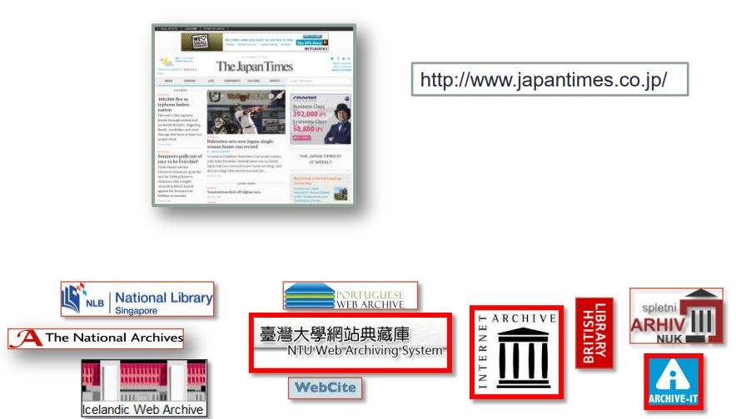
Distribution of Archived Web ?
Where to find ?
Applications like Memento Aggregator requires profiles to be built for each Web Archives
Notes:
-> To optimize an application like Memento Aggregator, it would be handy to have profiles built for each web archives. Instead of firing a request to every random web archive, the uri-r is first analysed and looks for a Web archive which has the most of its characteristics matched.

Slide 30
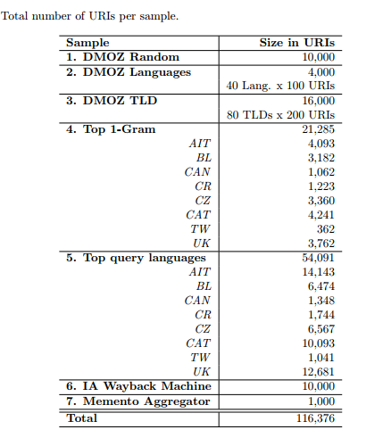
DATASET
Notes:
-> The URIs from these sources are got and are requested with each of the Webarchives under the test.
-> By analyzing the response, the summary about each archive is made and turned into Webarchive profile

Slide 31
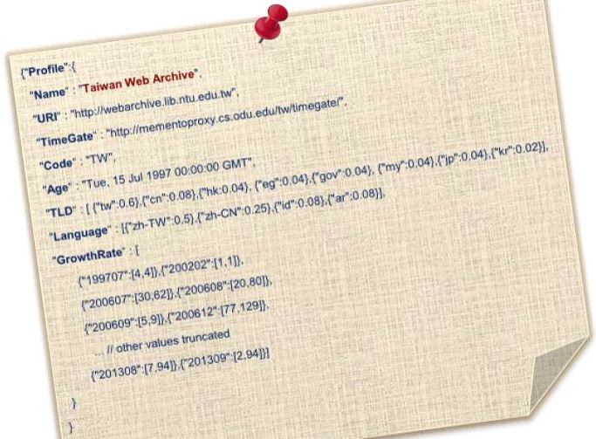
Profiles built for Web archives with characteristics below
Age
Top-level domain
Languages
Growth rate

Slide 32
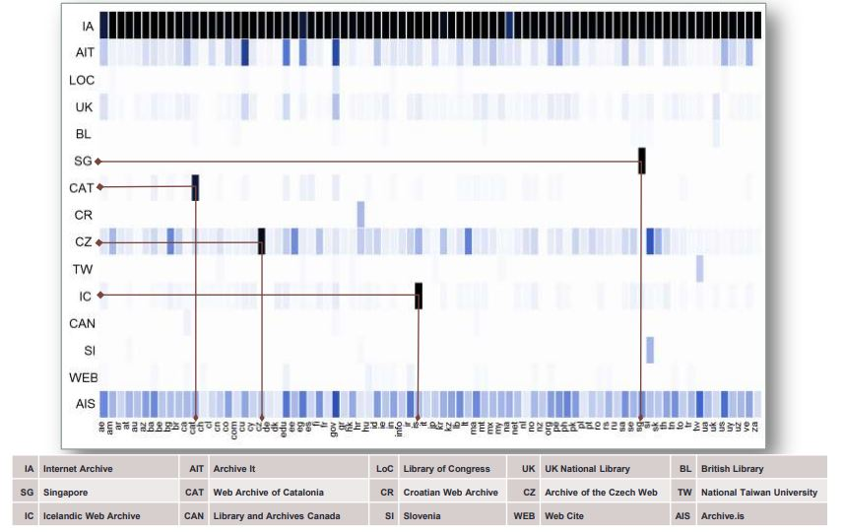
TLD Coverage
Notes:
Here is the heat map plotted with TLD on x-axis against the Web archives on y-axis. Can be seen that IA dominated all the other web archives and has covered almost all the TLDs

Slide 33
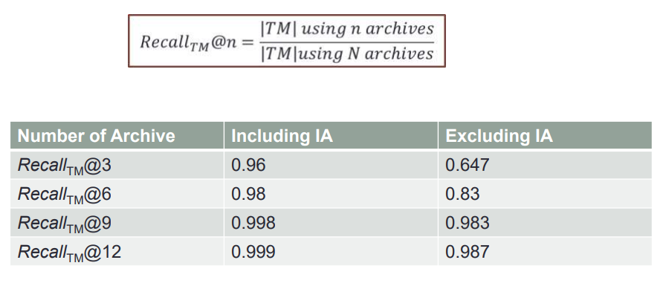
Web Archive Selection Evaluation
Total number of Archives under consideration N =15
Notes:
From the research it shows that even with the IA being excluded, there is a 98.7% chances that archived version exist in one of the top 12 Web archives.

Slide 34
CONTRIBUTIONS
These set of API altogether called ArcSystem is the contribution in this research.
Each of the API being fit in one of the layers of Webarchive pyramid model
ArcContent in Content Layer: Supports Webarchive interface with predefined filter
ArcLink in Metadata Layer: Extracts, preserve and exposes temporal web graph
ArcThumb in Metadata: Summarize the whole Timemap with few thumbnails
URI-lookup in the web archive is extended to include the HTTP redirection status code
Web Archive Profiles are built which makes the distributed search application like Memento Aggregator very efficient
Notes:
ArcContent: Makes it possible for making the content avaliable in different format for the end user by defining a set of filters
ArcLink: Make it possible to build a temporal webgraph to analyse the inlink and outlinks on a resource
Archthumb: Summarise a timemap with limited thumbnails otherwise very difficult to perceive the changes taken place over the time
With the contribution provided on URI Level URILookup is extended to include http redirection status code
In Archive Layer, profiles are built for the webarchives itself so as to make the querying process easy for the distributed search applications like memento aggregator.
Take of 23 to 26 and 29 if time doesn’t permit after rehearsing twice

