Slide 1


Open.
Agile.
Cloud-Ready.

Slide 2
PCF Workshop for Citi
Intro
Setup
Orient
Review what we are going to cover

Slide 3
Introductions
Pivotal Platform Architects
Matt Gunter (Tampa)
James Williams -Director (Jacksonville)
Vinay Upadhya (NY)
Customer Success
Doug Berends(NY)
Citi
Let’s go around the room….

Slide 4
Setup your Laptop
Pre-Requisites
Windows or Mac OS
Java Dependencies
Java JDK 1.7+
Maven / Gradle
PCF CLI (https://console.run.pivotal.io/2/tools)
PCF account (PWS or Citi’s instance)
Chrome or Firefox….(not IE)
Smoke-test
git clone https://github.com/vinayu/CloudNativeArchitectureWorkshop.git
cd CloudNativeArchitectureWorkshop
cf push My-Spring-Music-[##] –p Sample-apps/spring-music/spring-music.war
Notes:
https://apps.pcf14.cloud.fe.pivotal.io/tools
Git clone https://github.com/jrolfe-pivotal/SpringCloudWorkshop.git
java -jar build/libs/hello-actuator-0.0.1-SNAPSHOT.jar
cf login -a https://api.pcf14.cloud.fe.pivotal.io --skip-ssl-validation (use student1/carn1valc0rp)

Slide 5
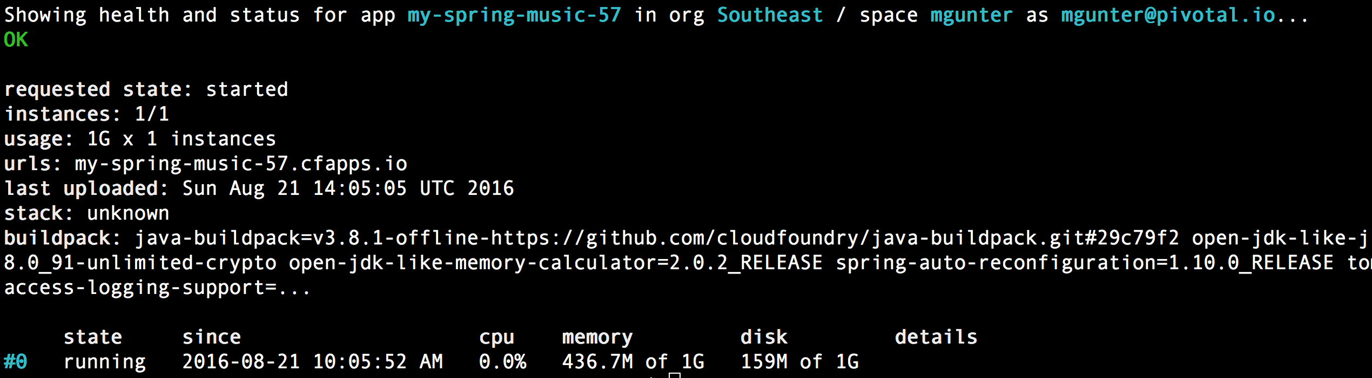
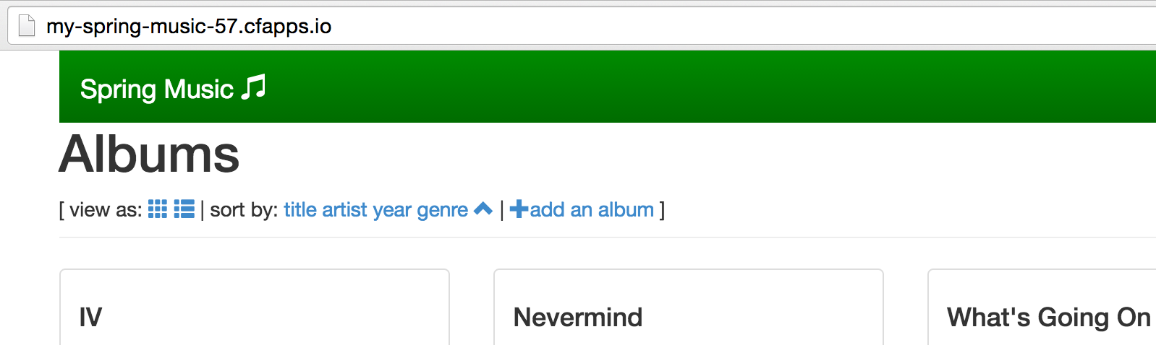
Setup your Laptop (cont)
Notes:
https://apps.pcf14.cloud.fe.pivotal.io/tools
Git clone https://github.com/jrolfe-pivotal/SpringCloudWorkshop.git
java -jar build/libs/hello-actuator-0.0.1-SNAPSHOT.jar
cf login -a https://api.pcf14.cloud.fe.pivotal.io --skip-ssl-validation (use student1/carn1valc0rp)

Slide 6
Orientation
Pivotal Cloud Foundry
What?
Why ?
Where?
How?

Slide 7

Deploying an Application
Blobstore
Service
credentials
Upload app bits and metadata
DB
push app
+ app MD
Cloud Controller
Service Broker Node(s)
Create and bind services
Stage application
Deploy application
Manage application health
Router
Container Management - DIEGO
Cell
DEA
Brain
DEA
DEA
+
=
Notes:
We keep the cf push workflow simple and don’t get into the details of DIEGO. We only keep the BRAIN and Cell.
Cloud Foundry PaaS – Pushing an Application with Diego
App deployment: what has changed?
1- Domain specific (notion of apps) -> Abstractions (notions of LRPs and Tasks). App staging is a Task. App start is launching a LRP.
2- Platform specific (linux) -> Supporting multi platform (Windows & Linux) enabling running also .NET apps, thanks to our new Container implementation: Garden
What’s more, there is a 3rd workflow supported: Docker on Linux
3- New Auction-based workload scheduler: Cloud Controller no longer in charge of deciding where AIs are spun up. Auctioneer manages the process running an auction, making it more optimized.
With Diego in place, more loosely-coupled components take part in the process, stripping down the Cloud Controller from too many previous responsibilities, making it easier to maintain and evolve the entire architecture.
The Cloud Controller handles the routing of client requests internally through the Cloud Controller Bridge. It also manages the Blobstore to store packages and droplets and the DB to store App Metadata and Service credentials. Blobstore could be internal or external, depending on the setup.
A service gateway provides an interface for services (native or external).
More in the next slide about the Cloud Controller Bridge (CC-Bridge), the Bulletin Board System (BBS) and the Auctioneer in the next slide
Apps run in a CELL, part of the new Cloud Foundry Runtime, called Diego
Routers manage application traffic.
Diego handles all health management for apps (now LRPs), through a series of single-purpose components: Nsync (part of the CC-Bridge), BBS (part of Diego DB) and the Converger (part of the Diego Brain)
Apps are accessed directly through the router while web and CLI clients (e.g., vmc, STS) access Cloud Controller via RESTful services.

Slide 8
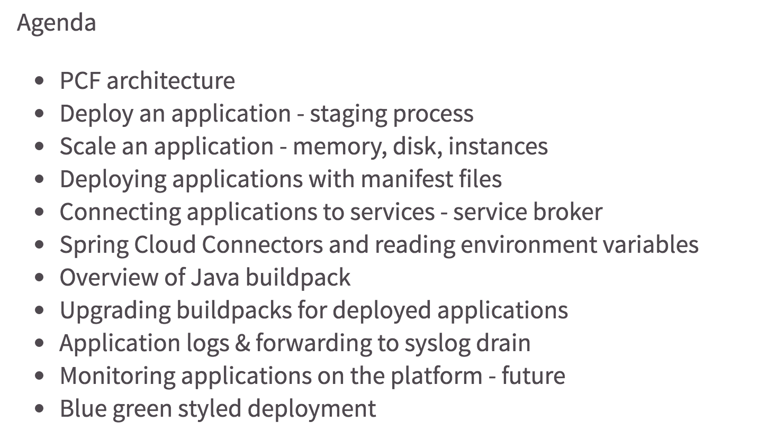
Workshop Agenda
Notes:
PCF architecture
Deploy an application - staging process
Scale an application - memory, disk, instances
Deploying applications with manifest files
Connecting applications to services - service broker
Spring Cloud Connectors and reading environment variables
Overview of Java buildpack
Upgrading buildpacks for deployed applications
Application logs & forwarding to syslog drain
Monitoring applications on the platform - future
Blue green styled deployment

Slide 9
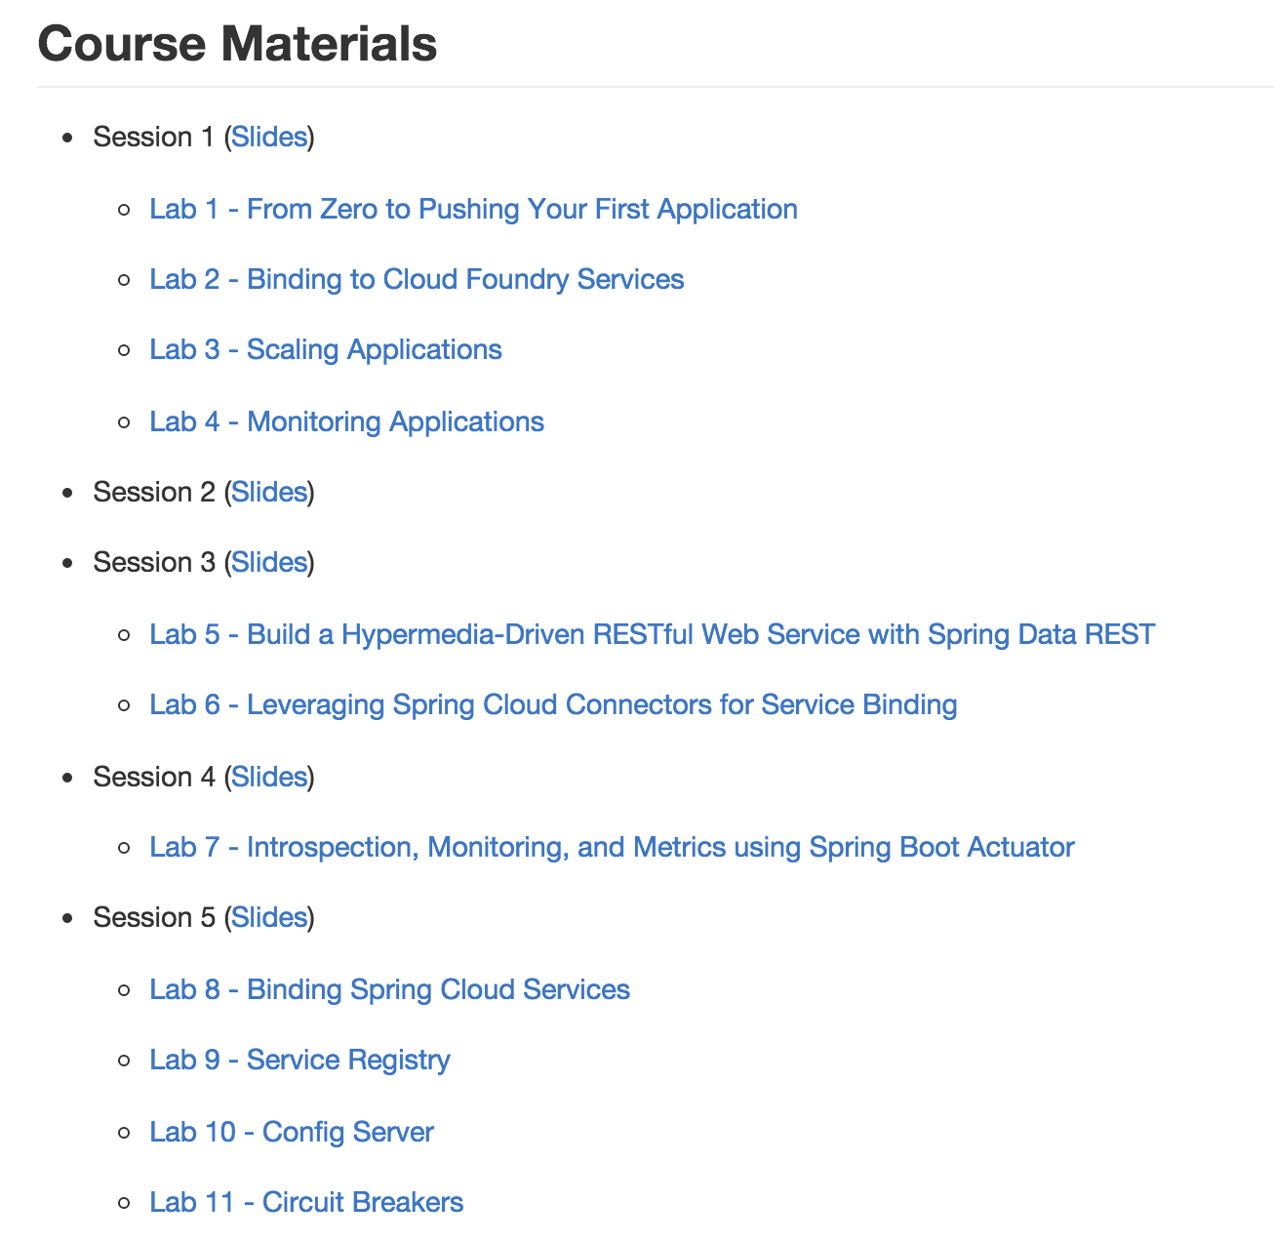
Workshop Labs (https://github.com/jrolfe-pivotal/SpringCloudWorkshop)

Slide 10
Open.
Agile.
Cloud-Ready.

