Slide 1


Open.
Agile.
Cloud-Ready.

Slide 2
Cloud Native Workshop for Citi
Intro
Setup
Orient
Review what we are going to cover

Slide 3
Introductions
Pivotal Platform Architects
Matt Gunter (Tampa)
James Williams -Director (Jacksonville)
Vinay Upadhya (NY)
Customer Success
Doug Berends(NY)
Citi
Let’s go around the room….

Slide 4
Setup your Laptop
Pre-Requisites
Windows or Mac OS
Java Dependencies
Java JDK 1.7+
Maven / Gradle
PCF CLI (https://console.run.pivotal.io/2/tools)
PCF account (PWS or Citi’s instance)
Chrome or Firefox….(not IE)
Smoke-test
git clone https://github.com/spring-cloud-samples/fortune-teller
cd fortune-teller
mvn package
Run scripts/create_services_pcf.sh
cf push -f manifest-pcf.yml (modify host config to avoid DNS conflicts.)
Notes:
https://apps.pcf14.cloud.fe.pivotal.io/tools
Git clone https://github.com/jrolfe-pivotal/SpringCloudWorkshop.git
java -jar build/libs/hello-actuator-0.0.1-SNAPSHOT.jar
cf login -a https://api.pcf14.cloud.fe.pivotal.io --skip-ssl-validation (use student1/carn1valc0rp)

Slide 5
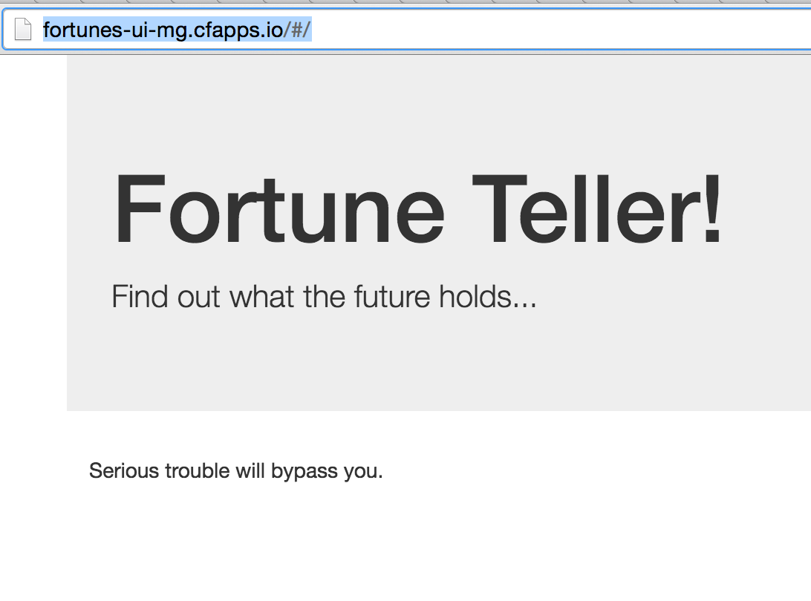
Setup your Laptop (cont)
Notes:
https://apps.pcf14.cloud.fe.pivotal.io/tools
Git clone https://github.com/jrolfe-pivotal/SpringCloudWorkshop.git
java -jar build/libs/hello-actuator-0.0.1-SNAPSHOT.jar
cf login -a https://api.pcf14.cloud.fe.pivotal.io --skip-ssl-validation (use student1/carn1valc0rp)

Slide 6
Orientation
Spring Cloud Services
What?
Why ?
Where?
How?

Slide 7
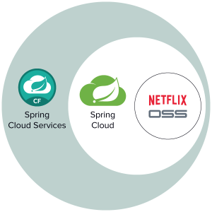
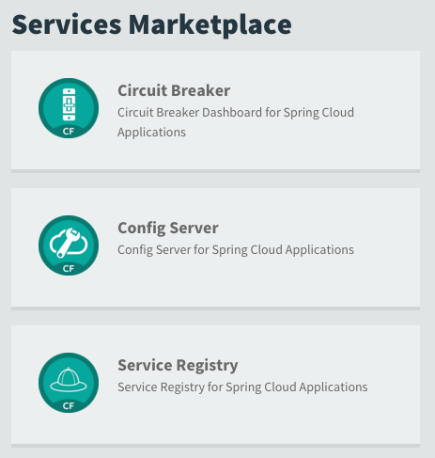
Spring Cloud Services

Slide 8




Spring Cloud Services
Service Registration and Discovery via Netflix OSS Eureka
Registration via CF Route
Service Registry
Git URL for Config Repo provided via Service Dashboard (post-provisioning)
Single tenant, scoped to CF space
Config Server
Spring Cloud
Services
Netflix OSS Turbine + Hystrix Dashboard
Aggregation via AMQP (RabbitMQ)
Circuit Breaker

Slide 9
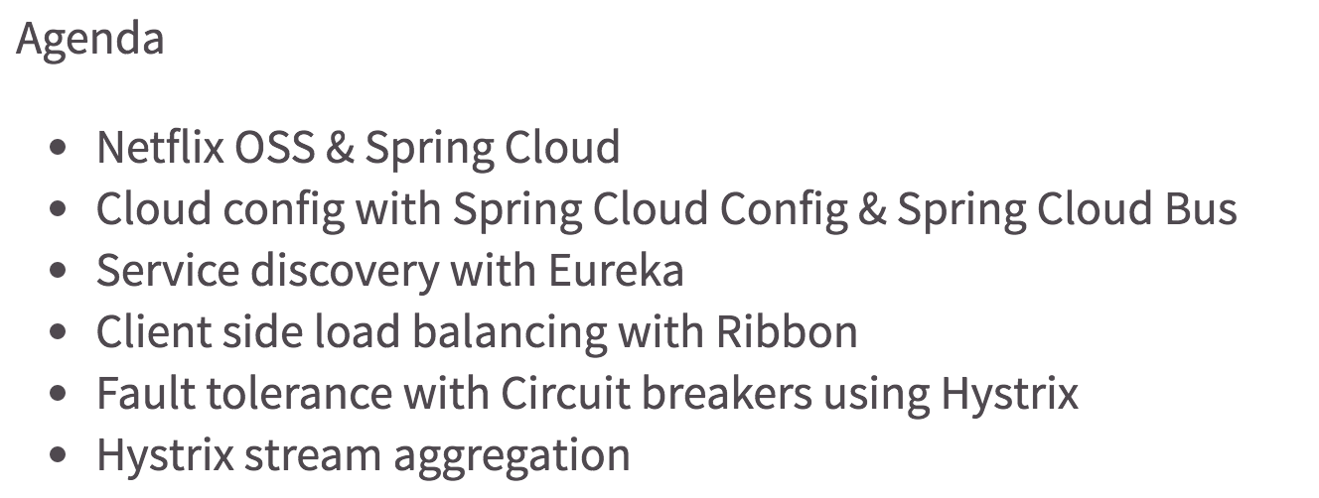
Workshop Agenda

Slide 10
Open.
Agile.
Cloud-Ready.

