Slide 1


Introduction to
Spring Cloud Services

Slide 2


Cloud Native Architectures
Light Side of the Cloud
Scalability
High Availability
Velocity: Continuous Delivery
On-Demand Provisioning

Slide 3

Cloud Native Architectures
Dark Side of the Cloud: Finding Services
Where are you?
Over here!

Slide 4
Cloud Native Architectures
Dark Side of the Cloud: Managing Configuration Differences
I’m a little different!
So am I!
Me too!
Dev
QA
Prod

Slide 5
Cloud Native Architectures
Dark Side of the Cloud: Handling Failure
Uh oh!
Uh oh!
I need you!
I need you!
I need you!
Uh oh!
I broke!

Slide 6
Cloud Native Architectures
Dark Side of the Cloud: Following call graphs
WHAT’S GOING ON?!?

Slide 7
Cloud Native Principles
Principles establish a contract between cloud native apps and the underlying platform
Cloud native apps recognize they are ephemeral, and minimize dependencies on the underlying platform
The Twelve-Factor App (http://12factor.net) is a popular and important set of principles
Twelve Factors include Dependencies, Config, Processes, and Disposability
APPS
Contract
Cloud Platform
Notes:
References:
http://12factor.net/
Architectural and development practices, that ensure an optimal experience on a cloud platform.

Slide 8

Netflix Cloud Libraries
Netflix needed to be faster to win / disrupt
Pioneer and vocal proponent of microservices – the key to their speed and success
Netflix OSS suppplies parts, but it’s not a solution
Notes:
Have to be able to scale in response to surges, add new features rapidly. Can’t go down for maintenance/upgrades.
NetFlix, an undisputed business & technology leader
34% of peak N. American internet traffic from 6-9pm
If speed was why they won, microservices was how
They pioneered / began to popularize micro service concept
All they had was Amazon EC2 back then
They had to invent a distributed platform, cloud native platform with PaaS – like features
They had to invent microservice infrastructure at the application level
All before writing one line of code that relates to the application you and I know as Netflix

Slide 9

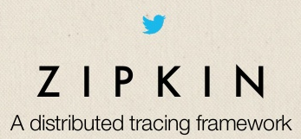
Open Source Cloud Libraries
Companies like Twitter, Facebook, and Hashicorp have open-sourced other cloud infrastructure libraries
Complementary and competing solutions from top technology companies form a bazaar of ideas

Slide 10

Spring Cloud
Provides easy developer access to a curated selection of open source cloud infrastructure libraries
Spring Cloud API encapsulates access to underlying libraries, allowing pluggable implementations.

Slide 11
Spring Cloud
Additional capabilities include Cloud Connectors and Config Server
Brings the Spring philosophy of convention over configuration, opinionated defaults, and developer simplicity

Slide 12
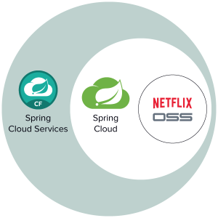
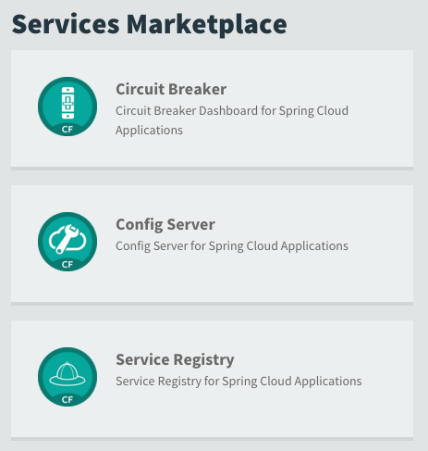
Spring Cloud Services

Slide 13




Spring Cloud Services
Service Registration and Discovery via Netflix OSS Eureka
Registration via CF Route
Service Registry
Git URL for Config Repo provided via Service Dashboard (post-provisioning)
Single tenant, scoped to CF space
Config Server
Spring Cloud
Services
Netflix OSS Turbine + Hystrix Dashboard
Aggregation via AMQP (RabbitMQ)
Circuit Breaker

Slide 14
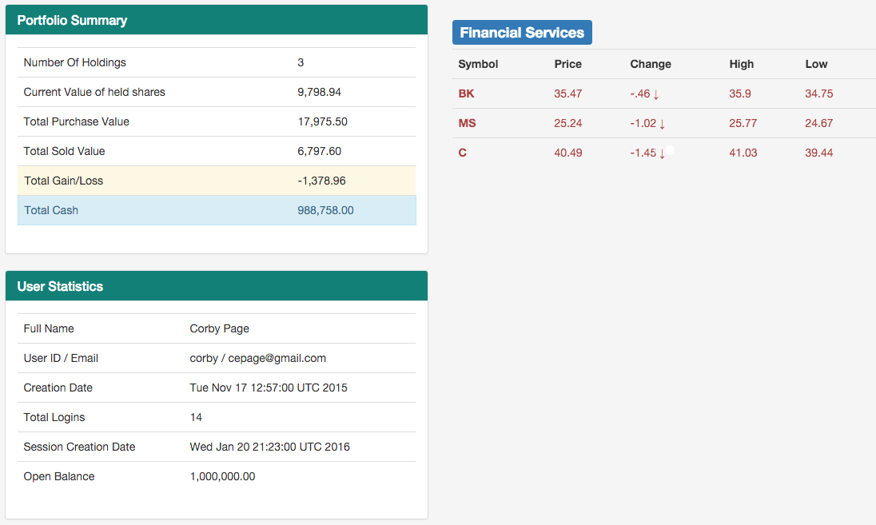
Spring Boot Trader
Reference Application
Download, Deploy, Run
http://tinyurl.com/boot-trader

Slide 15
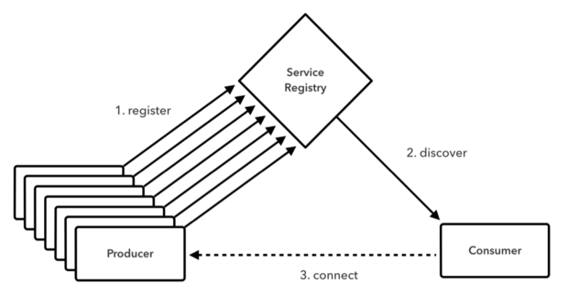
Service Discovery
Uses Service IDs, not URLs, to locate services
Client-side or server-side load balancing

Slide 16
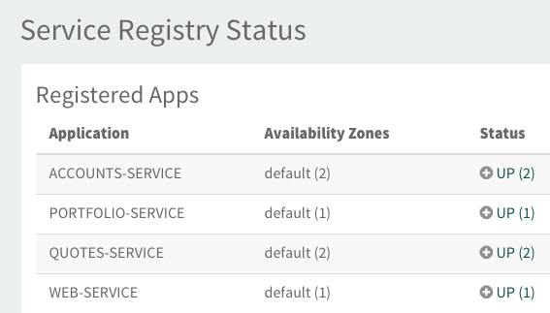


Service Discovery
Code
Manage

Slide 17
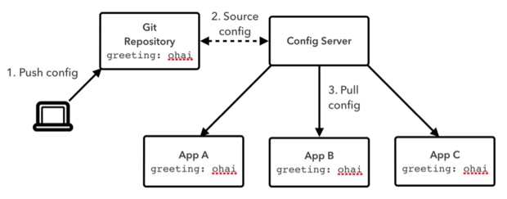
Config Server
Local or remote Git repositories
Configuration specified by environment, service, or system

Slide 18
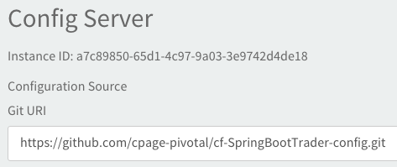
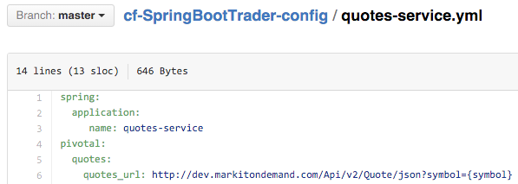

Config Server
Code
Manage

Slide 19
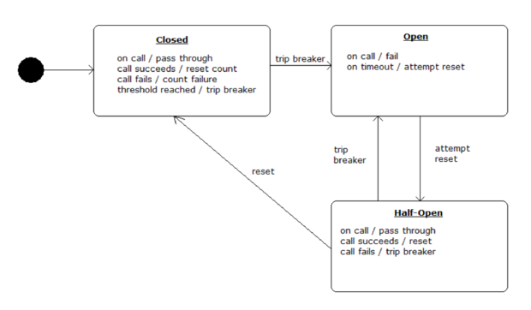
Circuit Breaker
Safe fallback limits liability of failure
Smart throttling reduces invocation of failed services

Slide 20

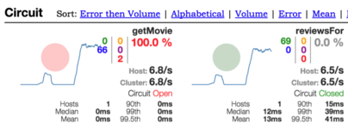

Circuit Breaker
Code
Manage

Slide 21
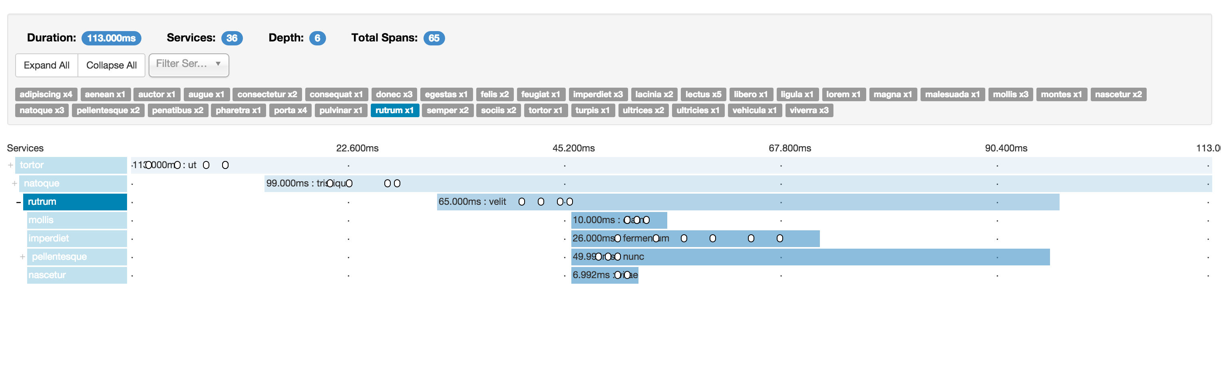
Future: Spring Cloud Sleuth
Distributed Tracing for the Cloud. Invocations are captured in logfiles, remote collector services, and realtime Web UIs.

Slide 22

Spring Cloud Services
Battle-tested Infrastructure, Out of the Box
Highly available, Enterprise-class implementations
Integrated with the logging, monitoring, and administration capabilities of Pivotal Cloud Foundry

Slide 23
Open.
Agile.
Cloud-Ready.

