Slide 1

Circuit Netlist Parser and Linear Circuit Simulator
Matt Guo
EE537
Spring 2023

Slide 2
Attempt 1 - Submatrices
R1 1 3 1000
R1 4 0 1000
1/1000 |  | -1/1000
-1/1000 |  | 1/1000
1/1000
1/1000 |  | -1/1000
-1/1000 |  | 1/1000
 |  |  | 1/1000
Works ok for NA Hard to scale with MNA
- Specifically CCCS and CCVS

Slide 3
Attempt 2 - Stamping
with open("test_file_2.txt", "r") as netlist_file:
# Read the contents of the file into a string variable
netlist = netlist_file.read()
lines = netlist.split("\n")
resistors = []
voltages = []
currents = []
vccs = []
ccvs = []
cccs = []
Known nodes
Known voltage branches
def create_lhs(self):
self.lhs = np.zeros((self.i, self.j))
R1 1 3 1000
def create_rhs(self):
self.rhs = np.zeros((self.i, 1))
class LUSolver:
def __init__(self, A, b):
self.A = A
self.b = b
def lu_solve(self):
lu, piv = lu_factor(self.A)
x = lu_solve((lu, piv), self.b)
return x
1/1000 |  | -1/1000
-1/1000 |  | 1/1000
def resistor_update_lhs(self, value, i, j):
self.lhs[i - 1][i - 1] += 1/value
self.lhs[j - 1][j - 1] += 1/value
self.lhs[i - 1][j - 1] += -1/value
self.lhs[j - 1][i - 1] += -1/value
def voltage_control_current_update_lhs(self, value, i, j, k, l):
if(i != 0 and k == 0):
self.lhs[i - 1][l - 1] = -1 * value
if(i != 0 and l == 0):
self.lhs[i - 1][k - 1] = value
if(j != 0 and k == 0):
self.lhs[j - 1][l - 1] = value
if(j != 0 and l == 0):
self.lhs[j - 1][k - 1] = -1 * value
if(i != 0 and j != 0 and l != 0 and k != 0):
self.lhs[i - 1][k - 1] = value
self.lhs[i - 1][l - 1] = -1 * value
self.lhs[j - 1][k - 1] = -1 * value
self.lhs[j - 1][l - 1] = value
LHS
RHS

Slide 4
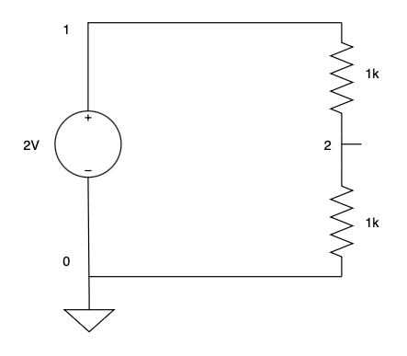
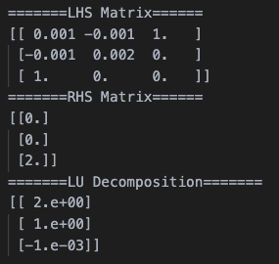

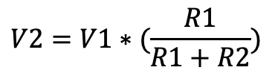
Example 1
V1 1 0 2
R1 1 2 1000 R2 2 0 1000
$$V2=V1∗(\frac{R1}{R1+R2})$$
$V2=2∗(\frac{1k}{1k+1k})$=1V
Node 1 Node 2 Node 0

Slide 5
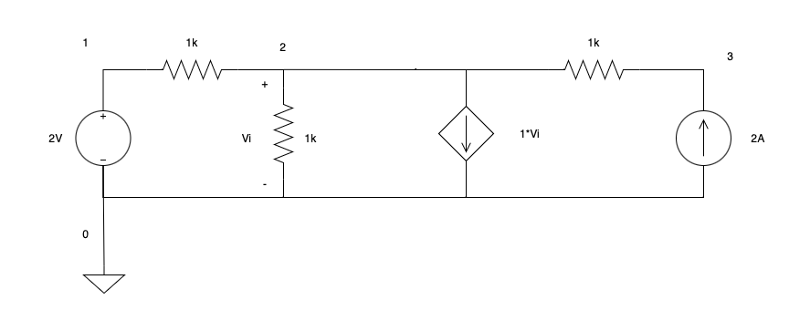
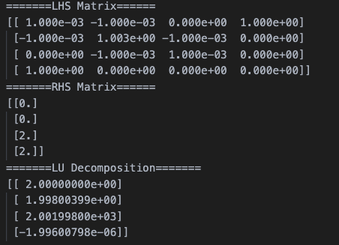




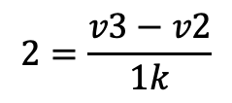

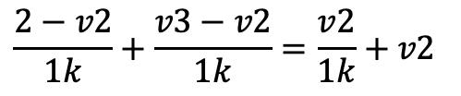


Example 2
$$\frac{2−v2}{1k}+\frac{v3−v2}{1k}=\frac{v2}{1k}+v2$$
$$2=\frac{v3−v2}{1k}$$
V1 1 0 2
R1 1 2 1000 R2 2 0 1000
R3 3 2 1000
G1 0 2 2 0 1
I1 3 0 2
$$2+v3=1003v2$$
$$2k=v3−v2$$
$$v3=1003v2−2$$
$$2k=(1003v2−2)−v2$$
$$v3=1003v2−2$$
$$v2=1.99V$$
$$v3=2001.99V$$
Node 1 Node 2 Node 3 Node 0

Slide 6
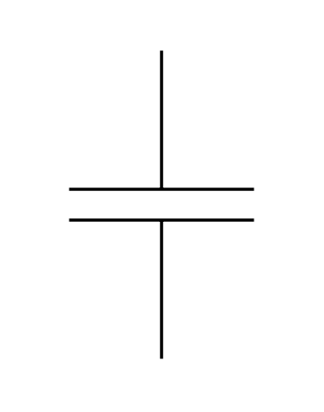
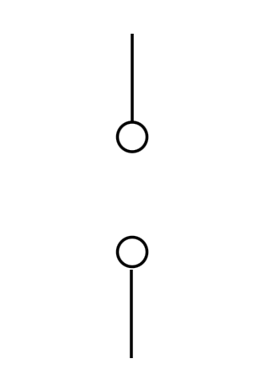
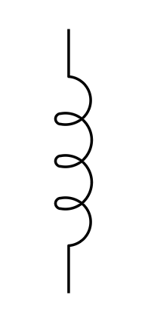
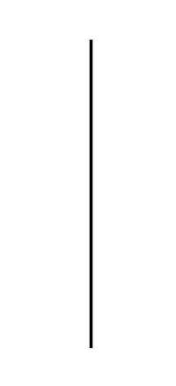
Limitations
Ground node output not exactly at 0V.
Output file message could be better organized.
Currently no support for Capacitors and Inductors treated as open and short circuits, respectively.

