Slide 1

Implementation of LIM for Fast Time-Domain Simulations
Matt Guo
EE537
Spring 2023

Slide 2
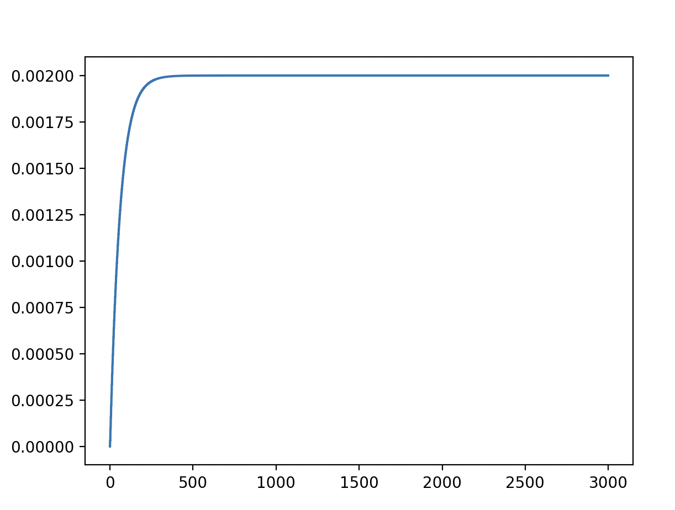
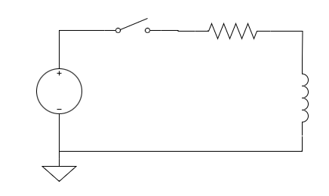
Aside: Inductors - Example
V1 1 0 PWL 0 3000 2 1 (0 0 0 1 1)
R1 1 2 1000 L1 2 0 0.0001
Inductor Current
Parameters:
- Initial Condition = 0
- Time Duration: 1
- Time Resolution: 3000
Current
1000
2
100uH
Original issue: Did not use previous values when calculating current value

Slide 3
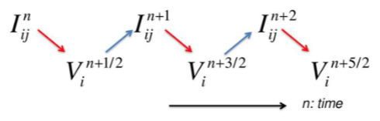

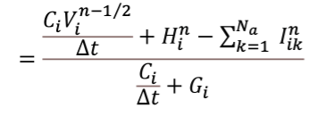

LIM - Concept
Branch Currents:
Time Step
Branch 1
Branch 2
…
Branch Nb
Node Voltages:
Time Step
Node 1
Node 2
…
Node Nn

Slide 4
LIM - Concept
Branch Currents:
Time Step
Branch 1
Branch 2
…
Branch Nb
Node Voltages:
Time Step
Node 1
Node 2
…
Node Nn

Slide 5
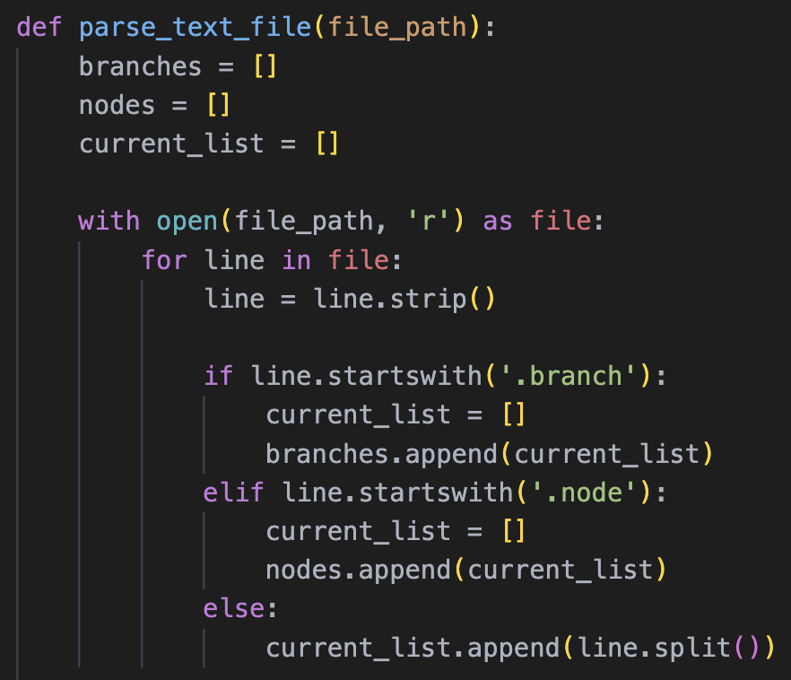
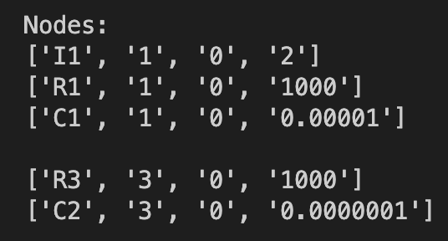
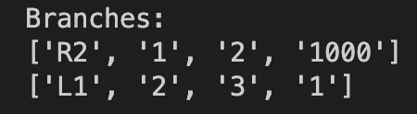
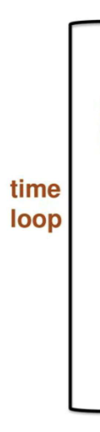
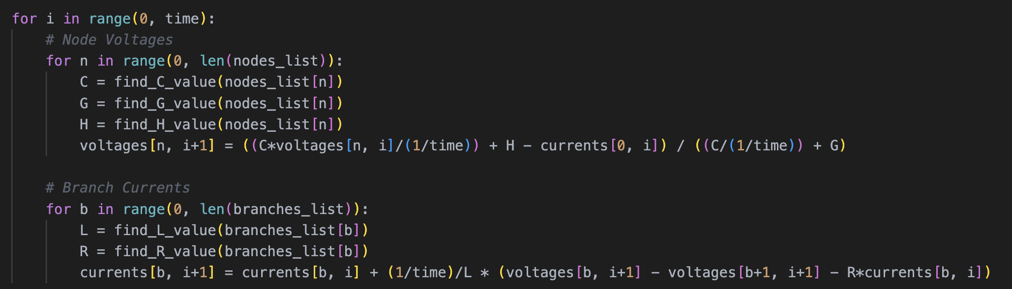
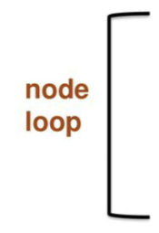

LIM - Implementation
Parsing
Algorithm

Slide 6
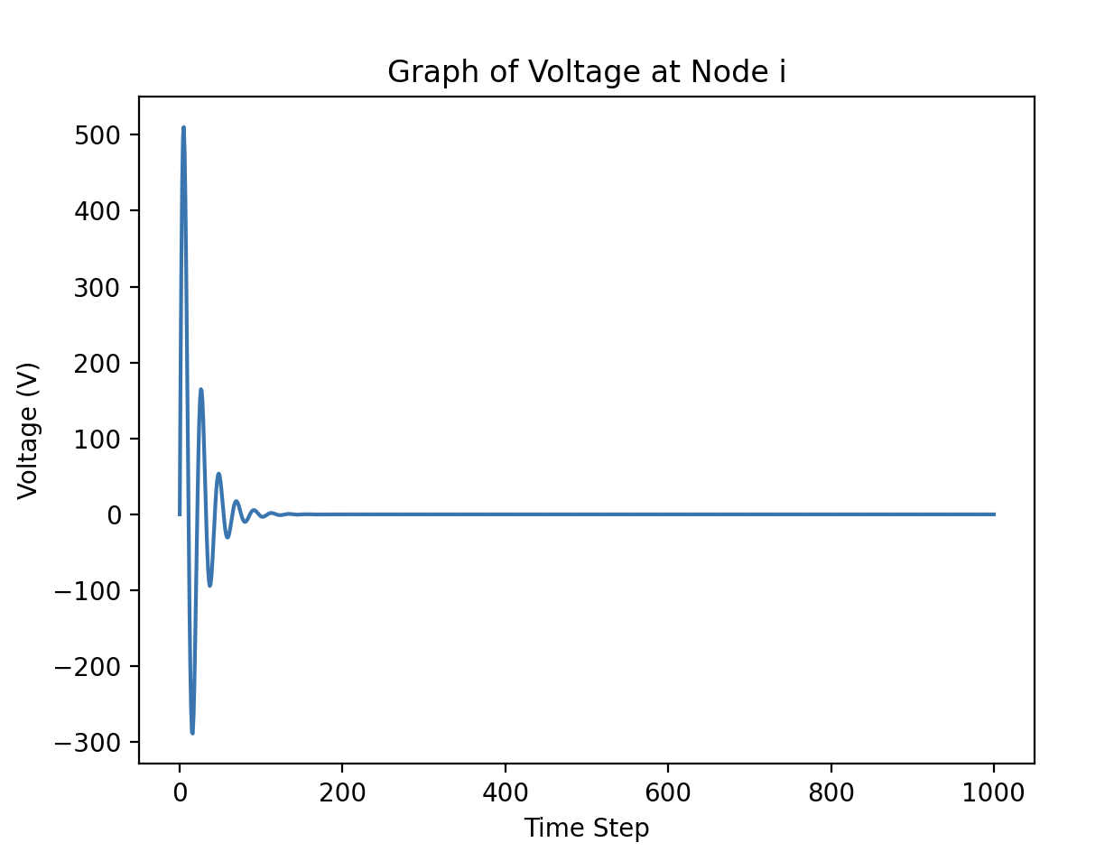
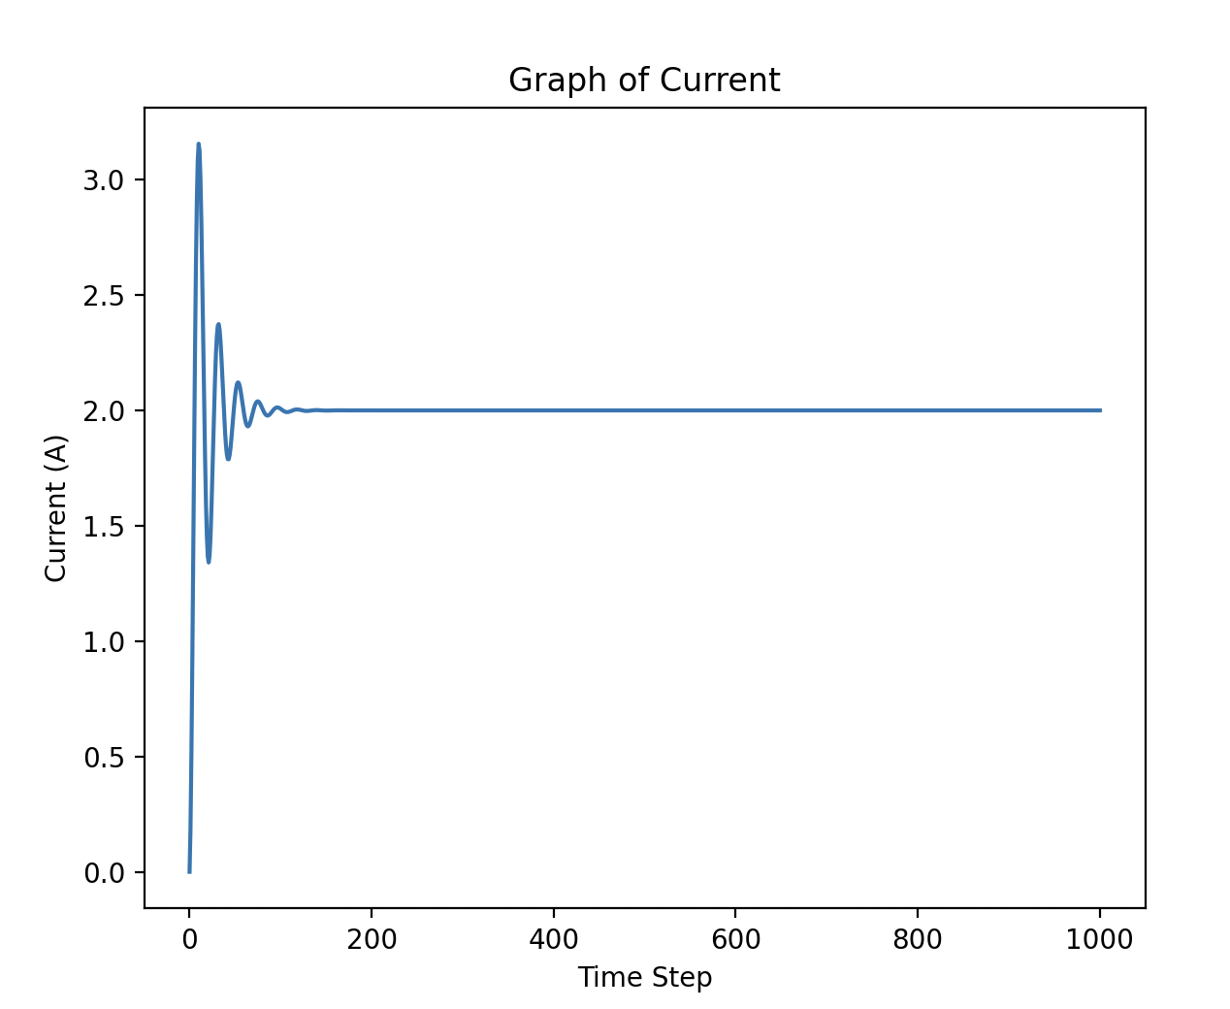
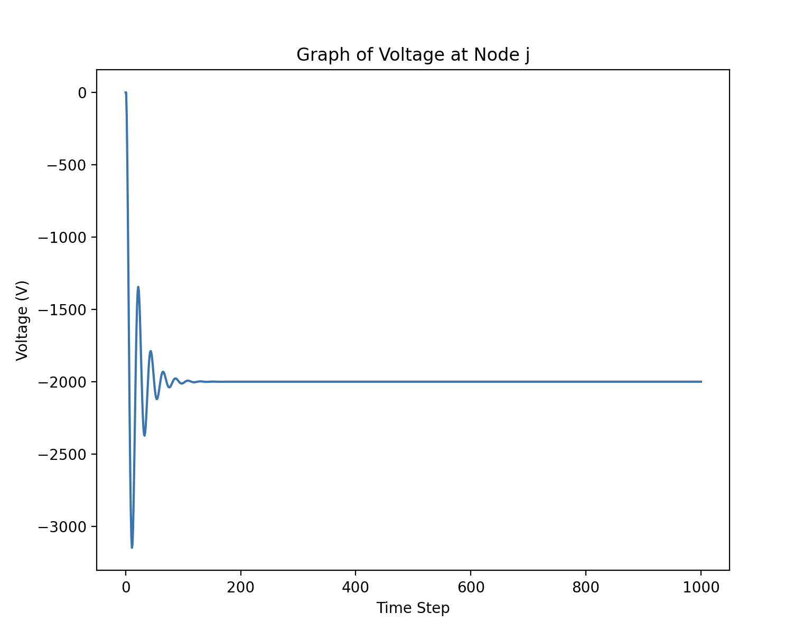
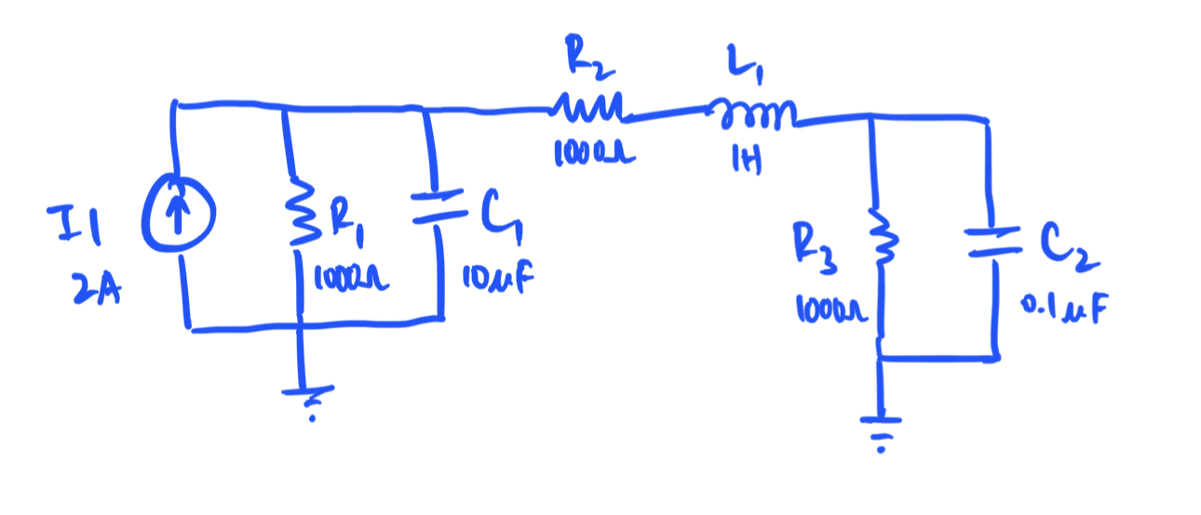
LIM - Example
.node
I1 1 0 2
R1 1 0 1000
C1 1 0 0.00001
.branch
R2 1 2 1000
L1 2 3 1
.node
R3 3 0 1000
C2 3 0 0.0000001

Slide 7
LIM - Example
.node
I1 1 0 2
R1 1 0 1000
C1 1 0 0.00001
.branch
R2 1 2 1000
L1 2 3 1
.node
R3 3 0 1000
C2 3 0 0.0000001

Slide 8
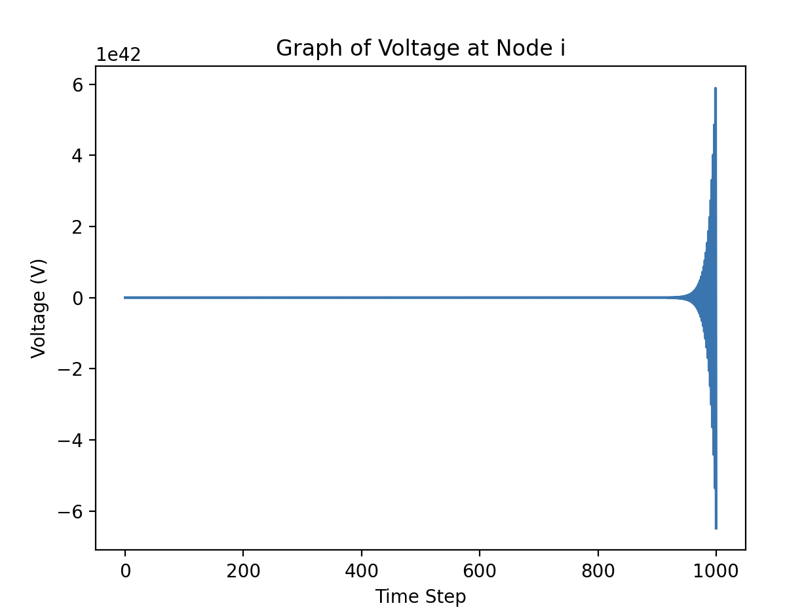
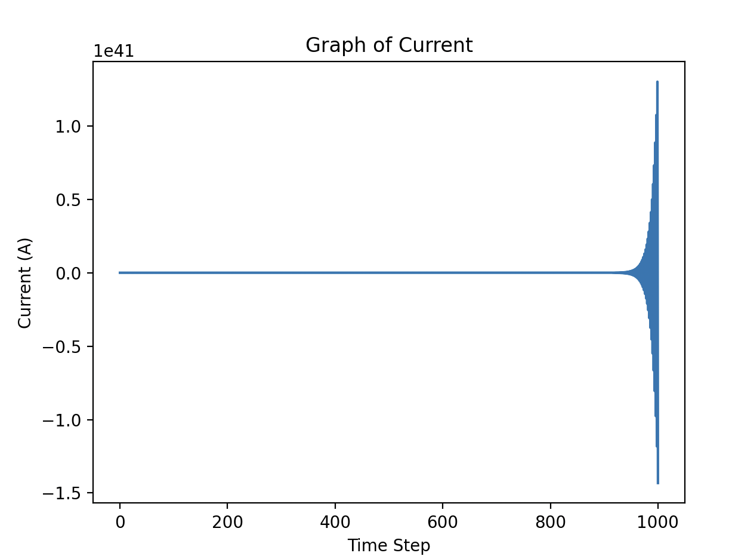
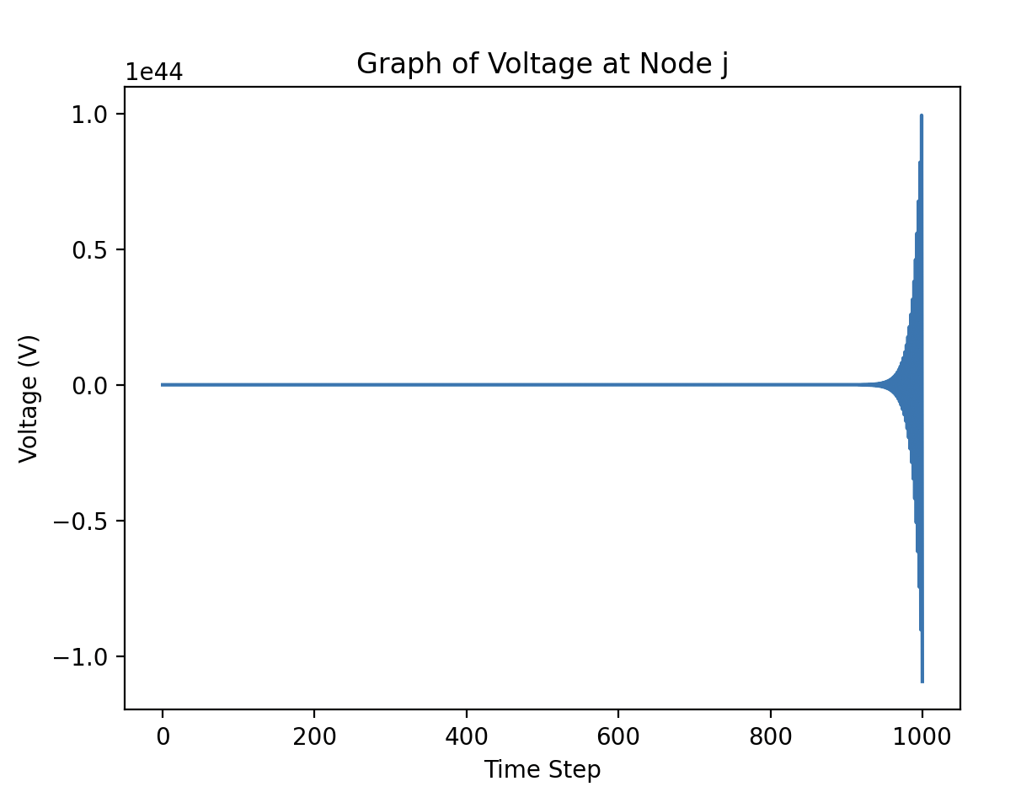
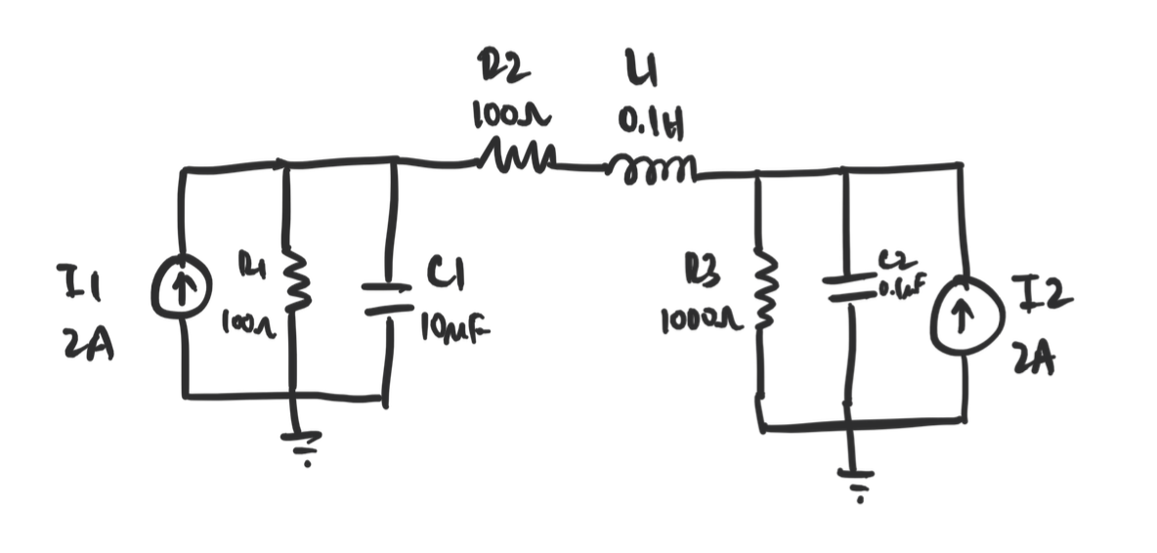
LIM – Instability Example
.node
I1 1 0 2
R1 1 0 100
C1 1 0 0.00001
.branch
R2 1 2 100
L1 2 3 0.1
.node
R3 3 0 1000
C2 3 0 0.0000001
I2 3 0 2

Slide 9
LIM vs. MNA
Iterations | LIM (sec) | MNA Factored (sec) | MNA Nonfactored (sec)
100 | 0.0004999 | 0.002651 | 0.002669
500 | 0.002037 | 0.003978 | 0.004833
1000 | 0.004136 | 0.007873 | 0.01104
5000 | 0.02173 | 0.03072 | 0.04617
10000 | 0.03926 | 0.05967 | 0.08752
50000 | 0.1936 | 0.2901 | 0.4310
100000 | 0.3854 | 0.5905 | 0.8413
*MNA Factored = LU_factor taken outside loop *MNA Nonfactored = LU_factor kept inside loop

