Slide 1

SV Code Generation for Synthesizing iSpice in Silicon
Matt Guo
EE537
Spring 2023

Slide 2
Term Concepts
Unfactored MNA
Factored MNA
Latency Insertion Method
Parsing element list
For loop iteration:
Solving node voltages
Solving node currents
Parsing element list
Elemental stamping
For loop iteration:
LU Factorization
LU Solve
Parsing element list
Elemental stamping
LU Factorization
For loop iteration:
LU Solve
Increasing efficiency

Slide 3
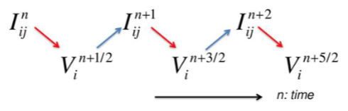

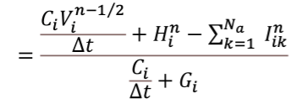

LIM - Concept
Branch Currents:
Time Step
Branch 1
Branch 2
…
Branch Nb
Node Voltages:
Time Step
Node 1
Node 2
…
Node Nn

Slide 4
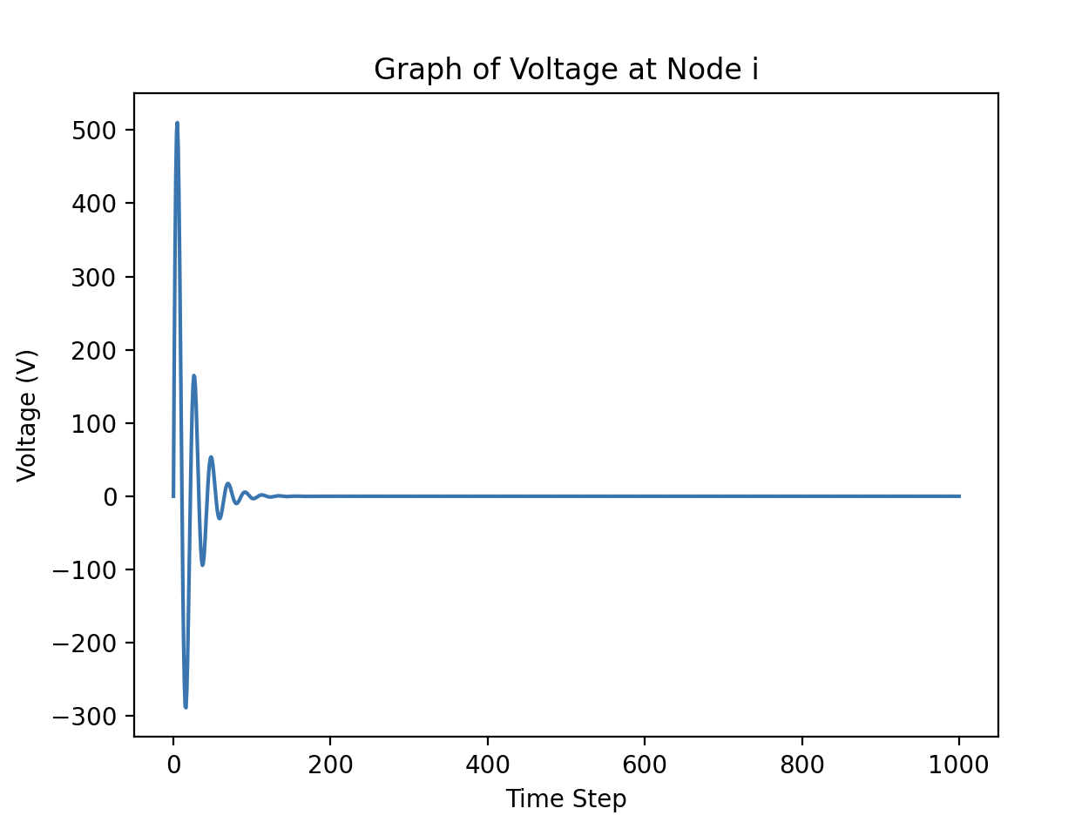
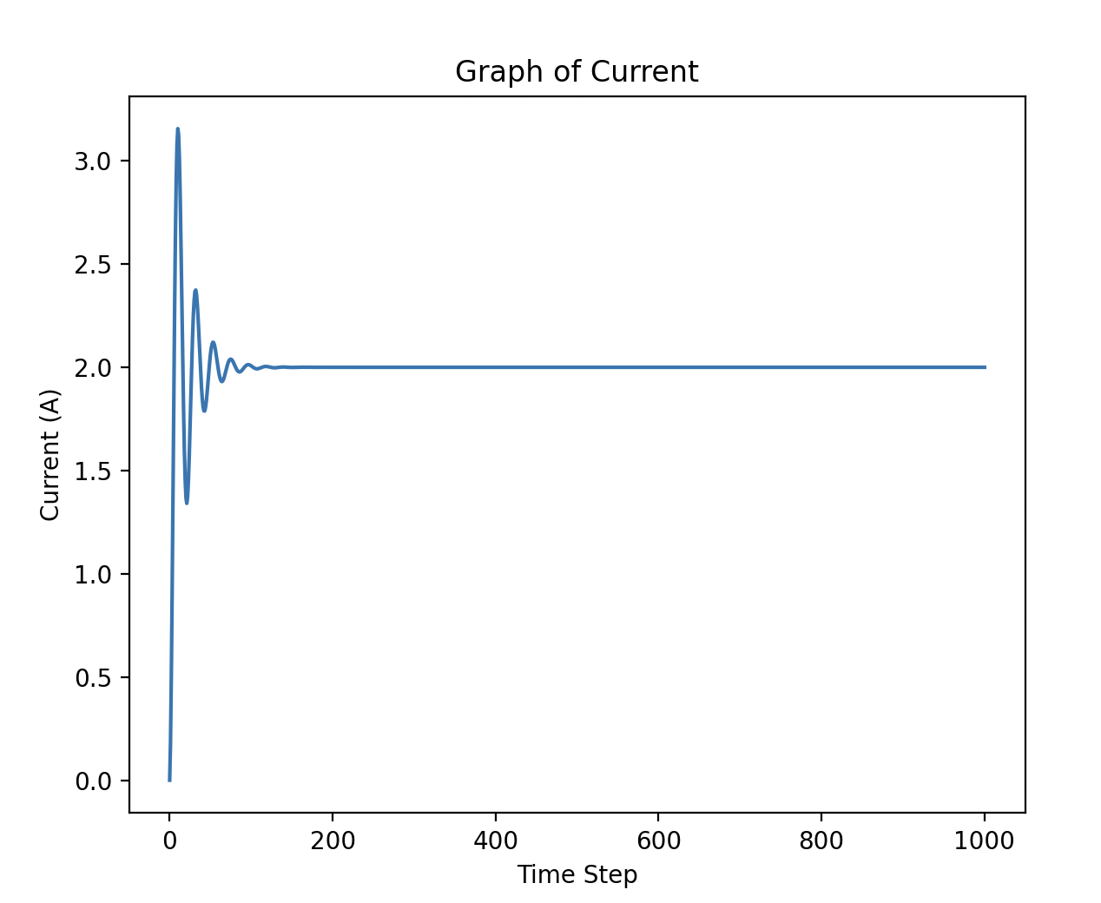
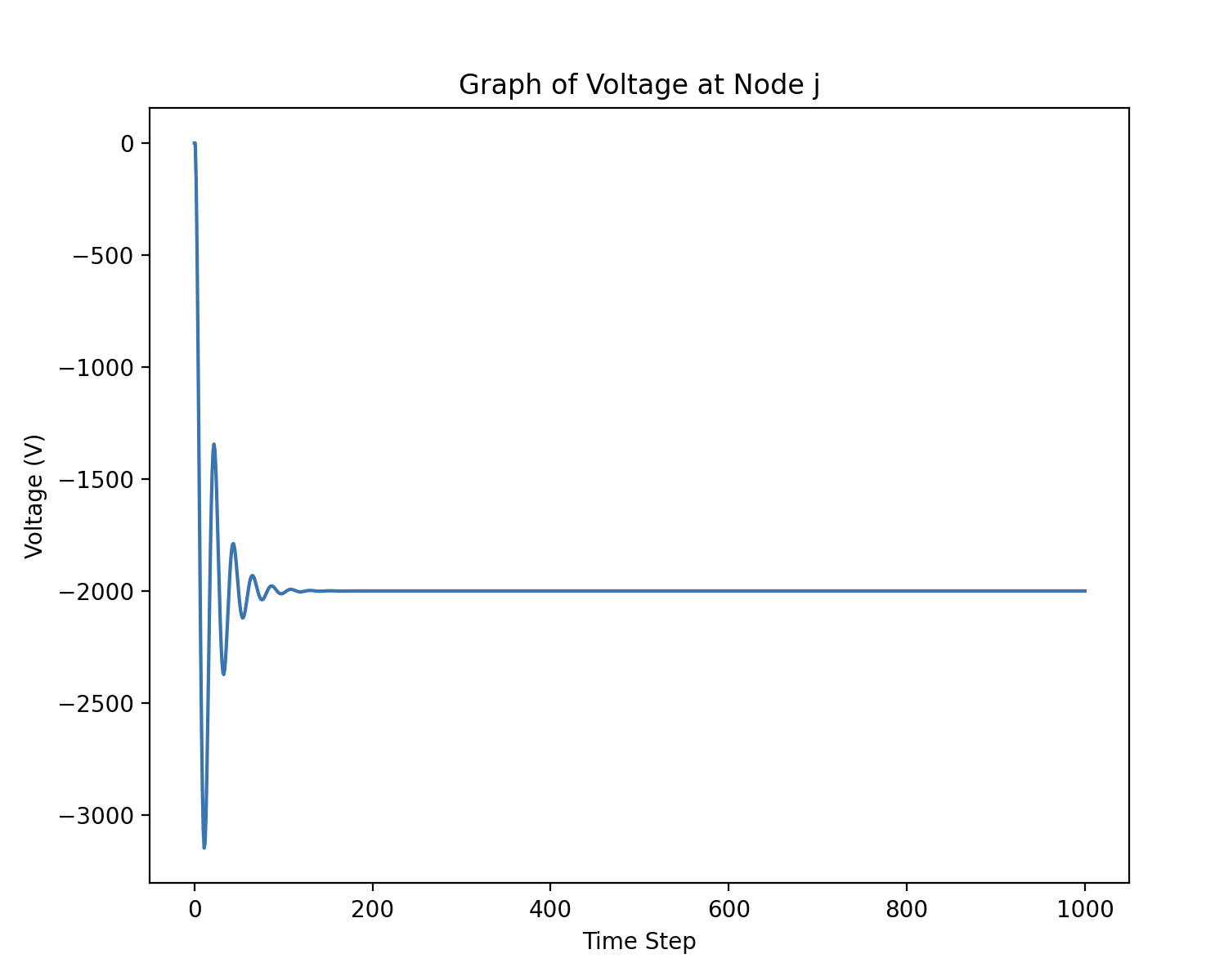
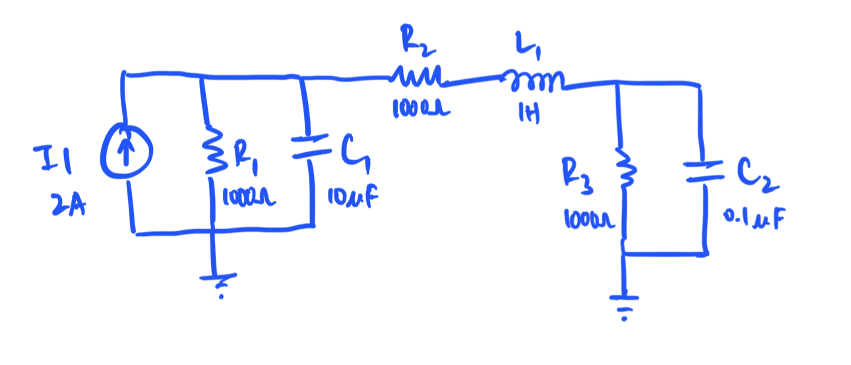
LIM - Example
.node
I1 1 0 2
R1 1 0 1000
C1 1 0 0.00001
.branch
R2 1 2 1000
L1 2 3 1
.node
R3 3 0 1000
C2 3 0 0.0000001

Slide 5
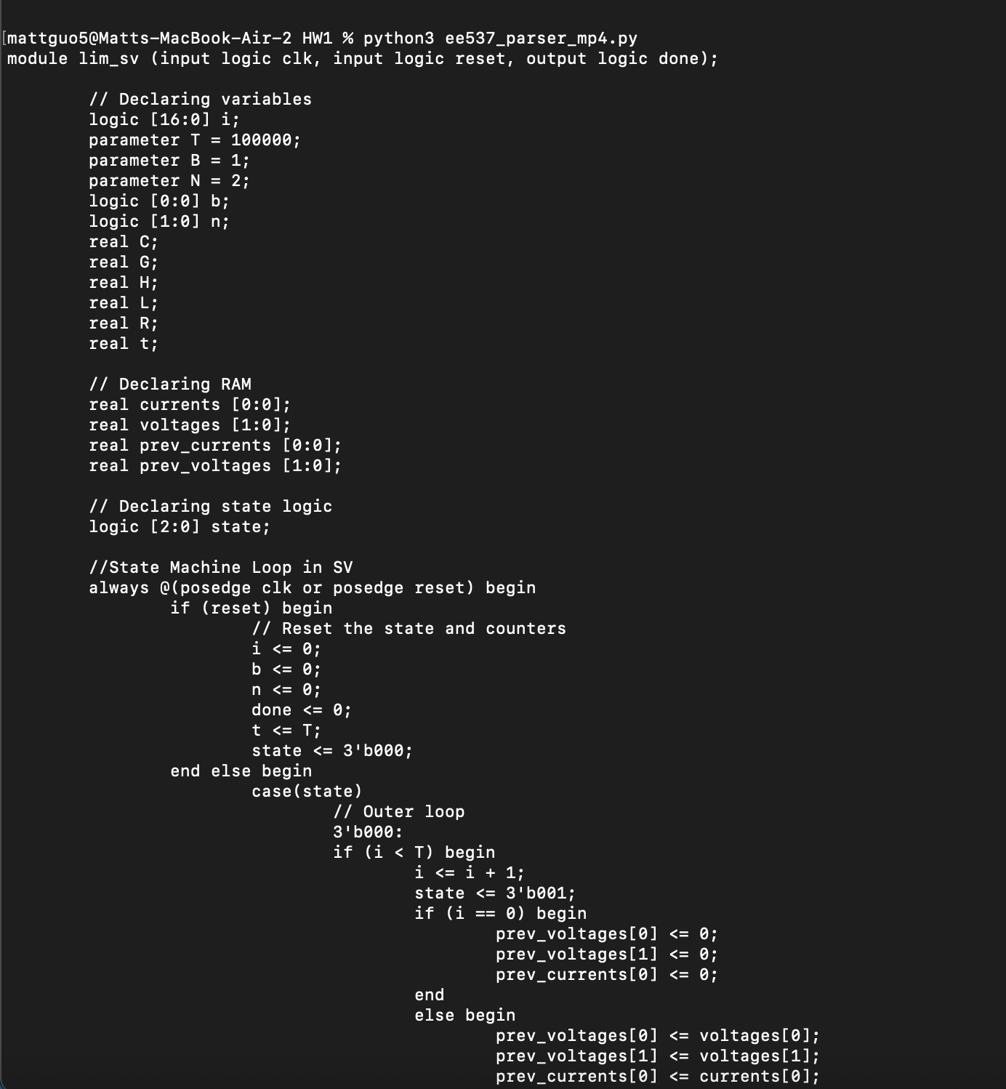
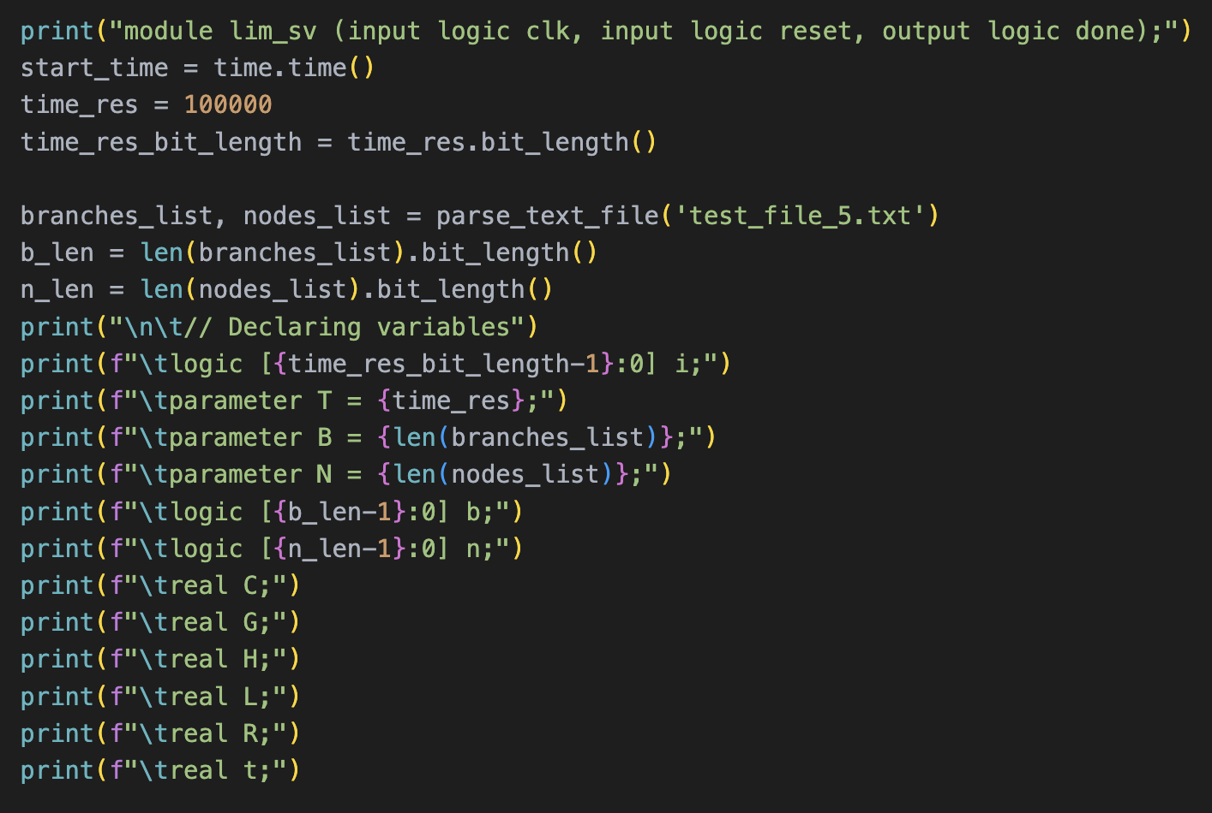
SV Code Generation
Print statements to print to terminal
Using “real” datatype

Slide 6
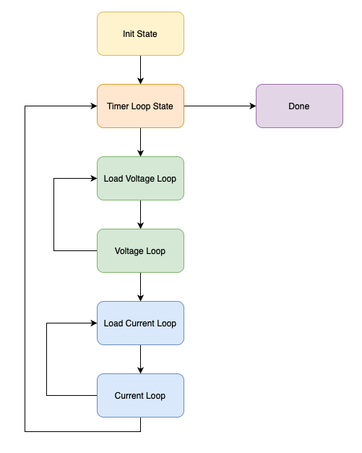
SV Code Structure
Init State: Initializes variables
Timer Loop State: Runs the outer for-loop
Node loop
Load Voltage State: Reads in the C, I, G values
Time loop
Voltage State: Performs voltage loop computation
Branch loop
Load Current State: Reads in the L, V, R values
Current State: Performs current loop computation

Slide 7
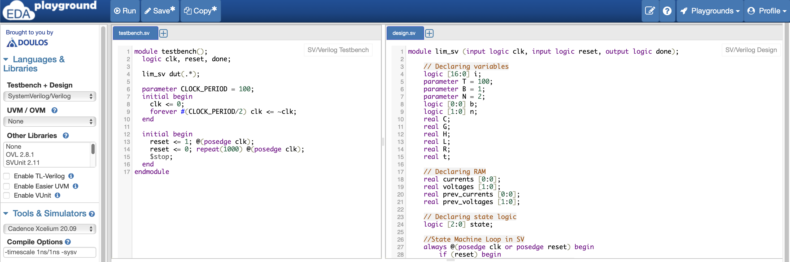
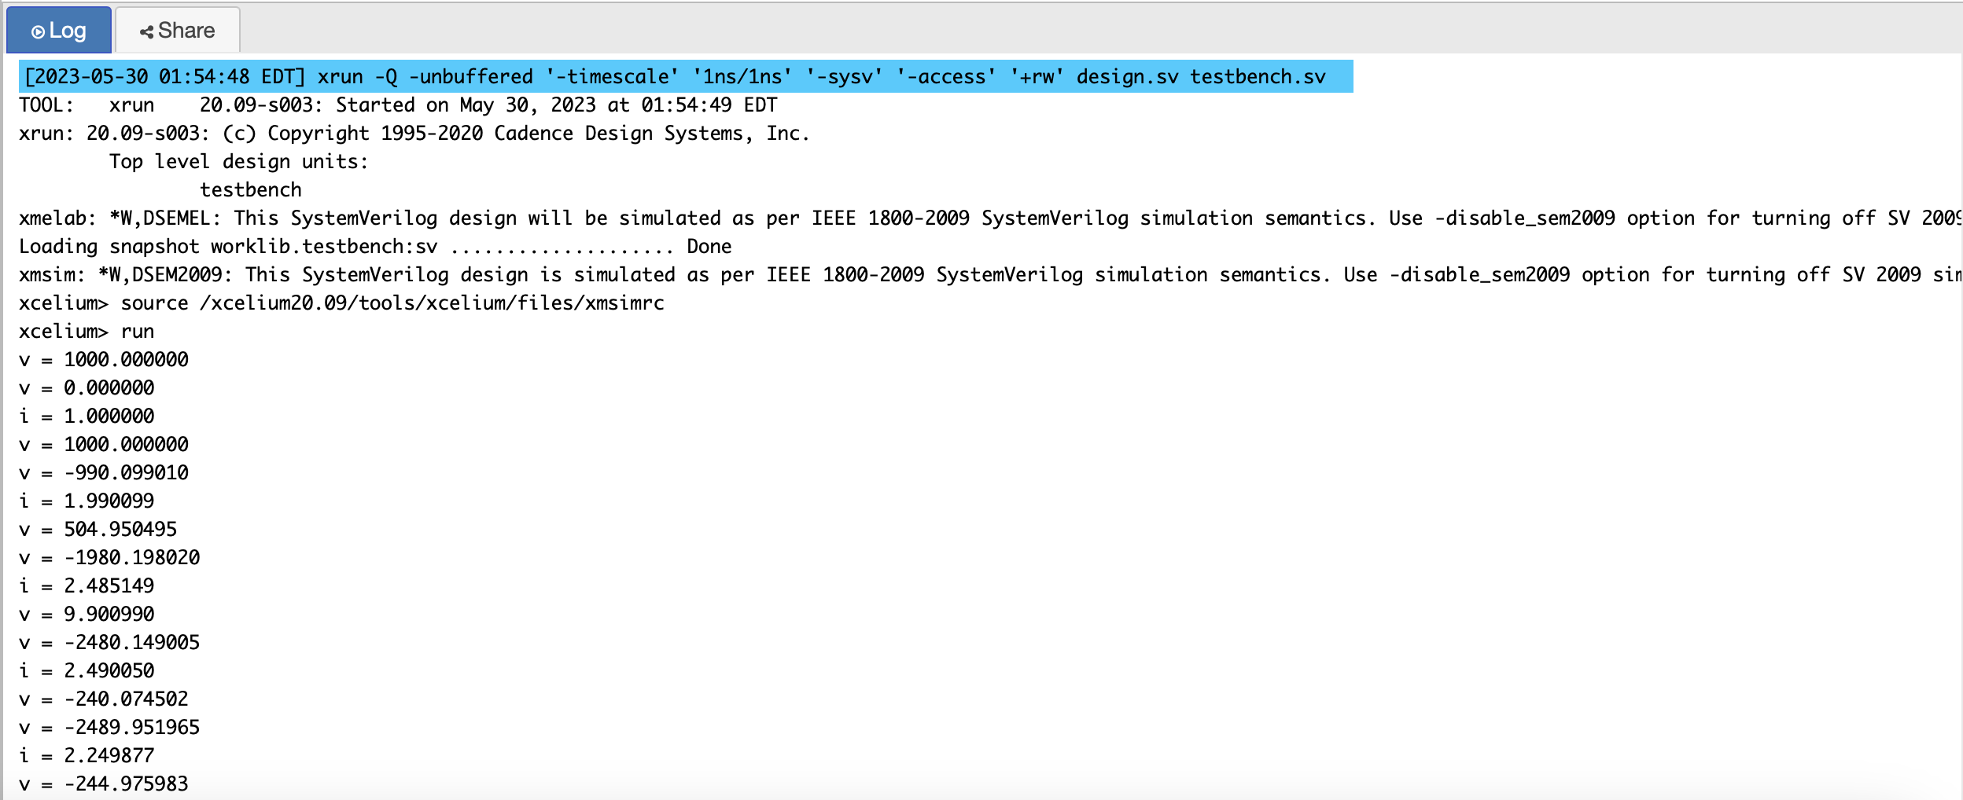
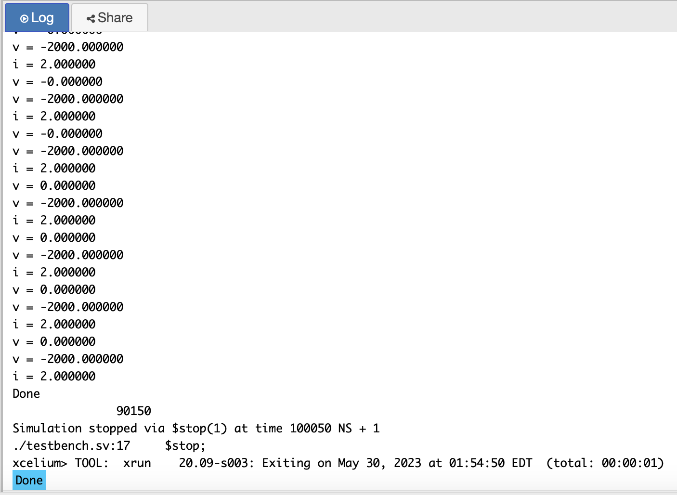
Running Simulation
Algorithm done time (in ns)

Slide 8
LIM Python vs. LIM SV vs. MNA
Iterations | SystemVerilog | LIM (sec) | MNA Factored (sec) | MNA Nonfactored (sec)
100 | 0.000090150 | 0.0004999 | 0.002651 | 0.002669
500 | 0.000450150 | 0.002037 | 0.003978 | 0.004833
1000 | 0.000900150 | 0.004136 | 0.007873 | 0.01104
5000 | 0.004500150 | 0.02173 | 0.03072 | 0.04617
10000 | 0.009000150 | 0.03926 | 0.05967 | 0.08752
50000 | 0.045000150 | 0.1936 | 0.2901 | 0.4310
100000 | 0.090000150 | 0.3854 | 0.5905 | 0.8413

