Slide 1

Linear-Circuit Time-Domain Simulator
Matt Guo
EE537
Spring 2023

Slide 2
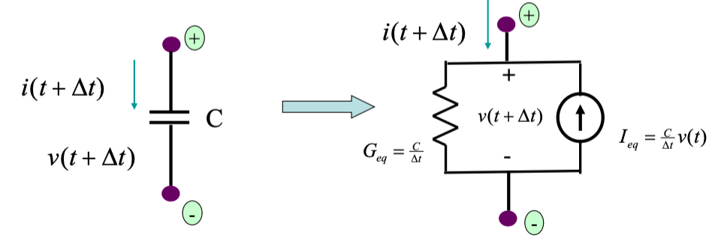
Capacitors
Parse netlist
Construct LHS
Initial RHS
LU Decomposition
C1 2 0 0.0001
LU Solve
Recompute RHS
RC1 2 0 1/(0.0001/Δt)
IC1 2 0 (0.0001/ Δt)*v(t)
Finish

Slide 3
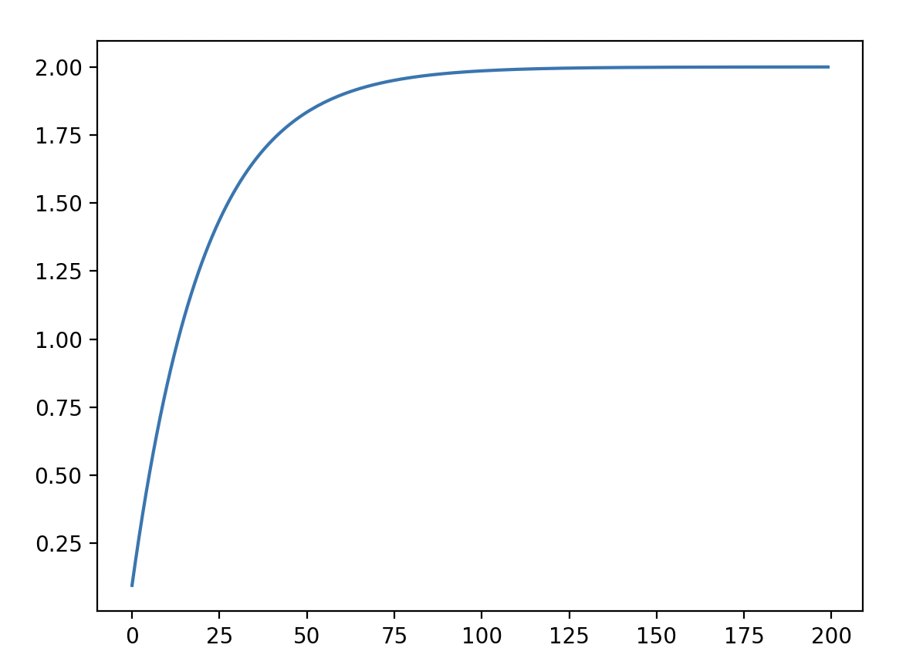
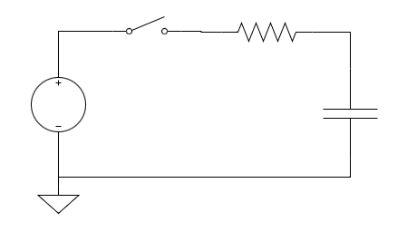
Capacitors - Example
V1 1 0 PWL 0 200 2 1 (0 0 0 1 1)
R1 1 2 1000 C1 2 0 0.0001
Capacitor Voltage Charge
Parameters:
- Initial Condition = 0
- Time Duration: 1
- Time Resolution: 200
Voltage
1000
2
100uF

Slide 4
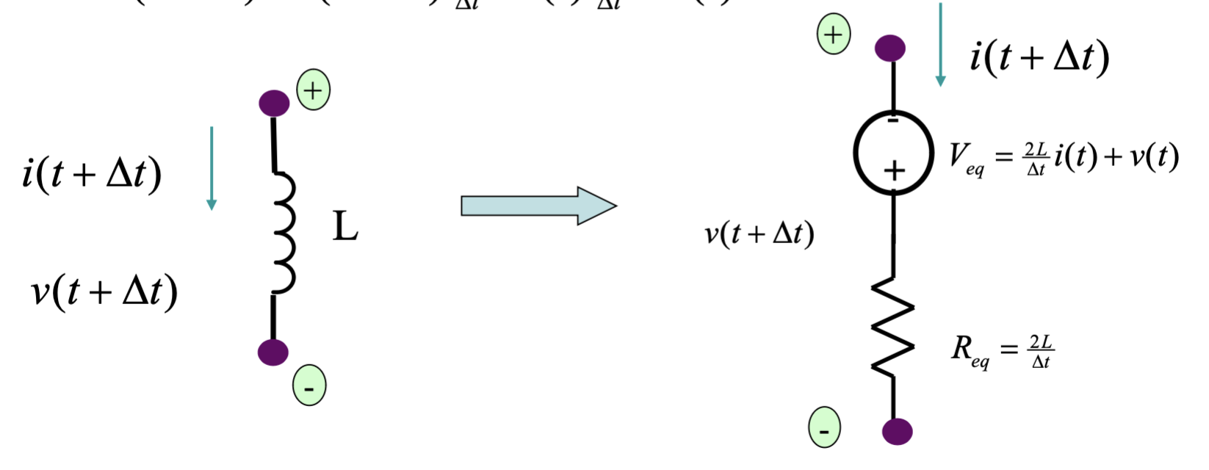
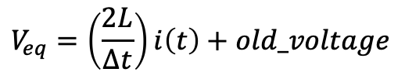
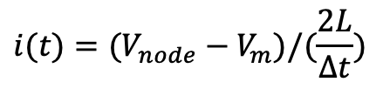
Inductors
Parse netlist
Increases num voltage source by 1 from original netlist
Construct LHS
Initial RHS
Increases num nodes by 1 from original netlist
LU Decomposition
L1 2 0 0.0001
$$i(t)=(V_{node}−V_{m})/(\frac{2L}{∆t})$$
LU Solve
$$V_{eq}=\left(\frac{2L}{∆t}\right)i\left(t\right)+old_voltage$$
Recompute RHS
node_amount++ RL1 node_amount original_node[1] (0.0001/Δt)
VL1 node_amount original_node[1] (0.0001/ Δt)*i(t)
Finish

Slide 5
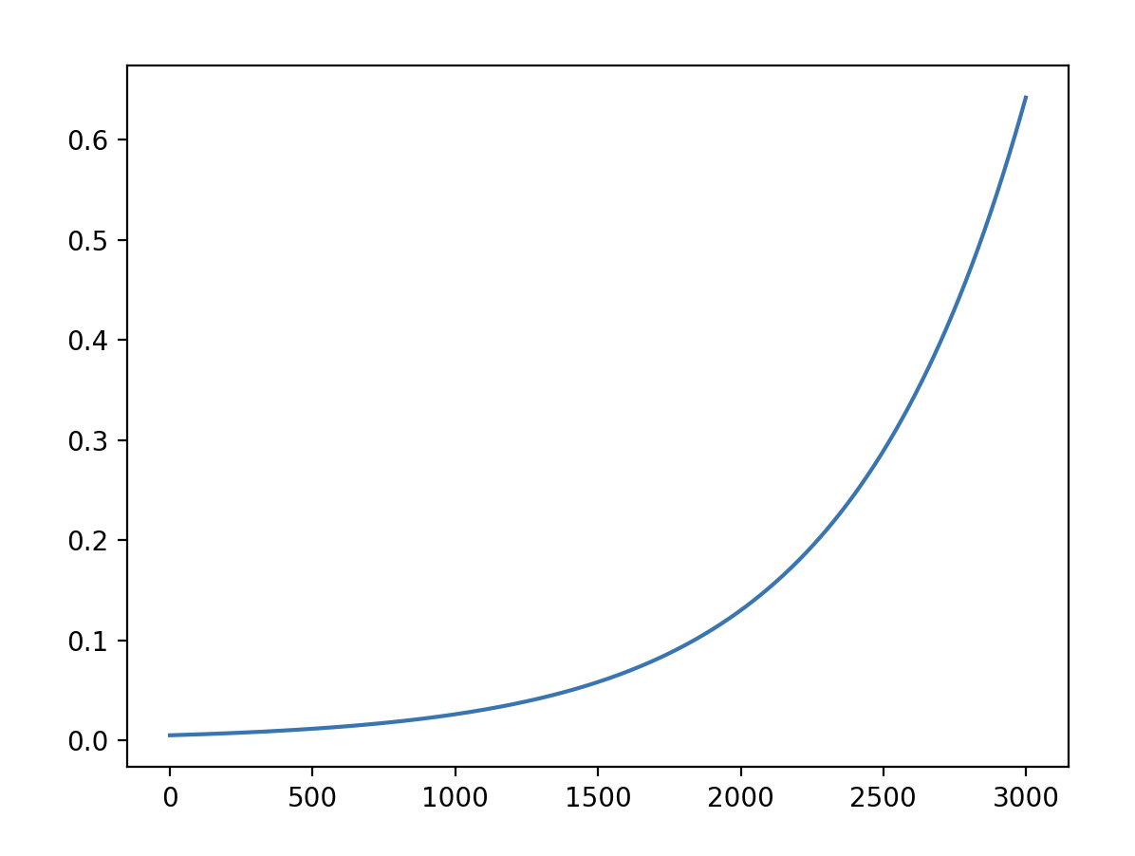
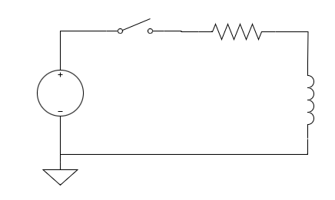
Inductors - Example
V1 1 0 PWL 0 3000 2 1 (0 0 0 1 1)
R1 1 2 1000 L1 2 0 0.0001
Inductor Current
Parameters:
- Initial Condition = 0
- Time Duration: 1
- Time Resolution: 3000
Current
1000
2
100uH

