Slide 1
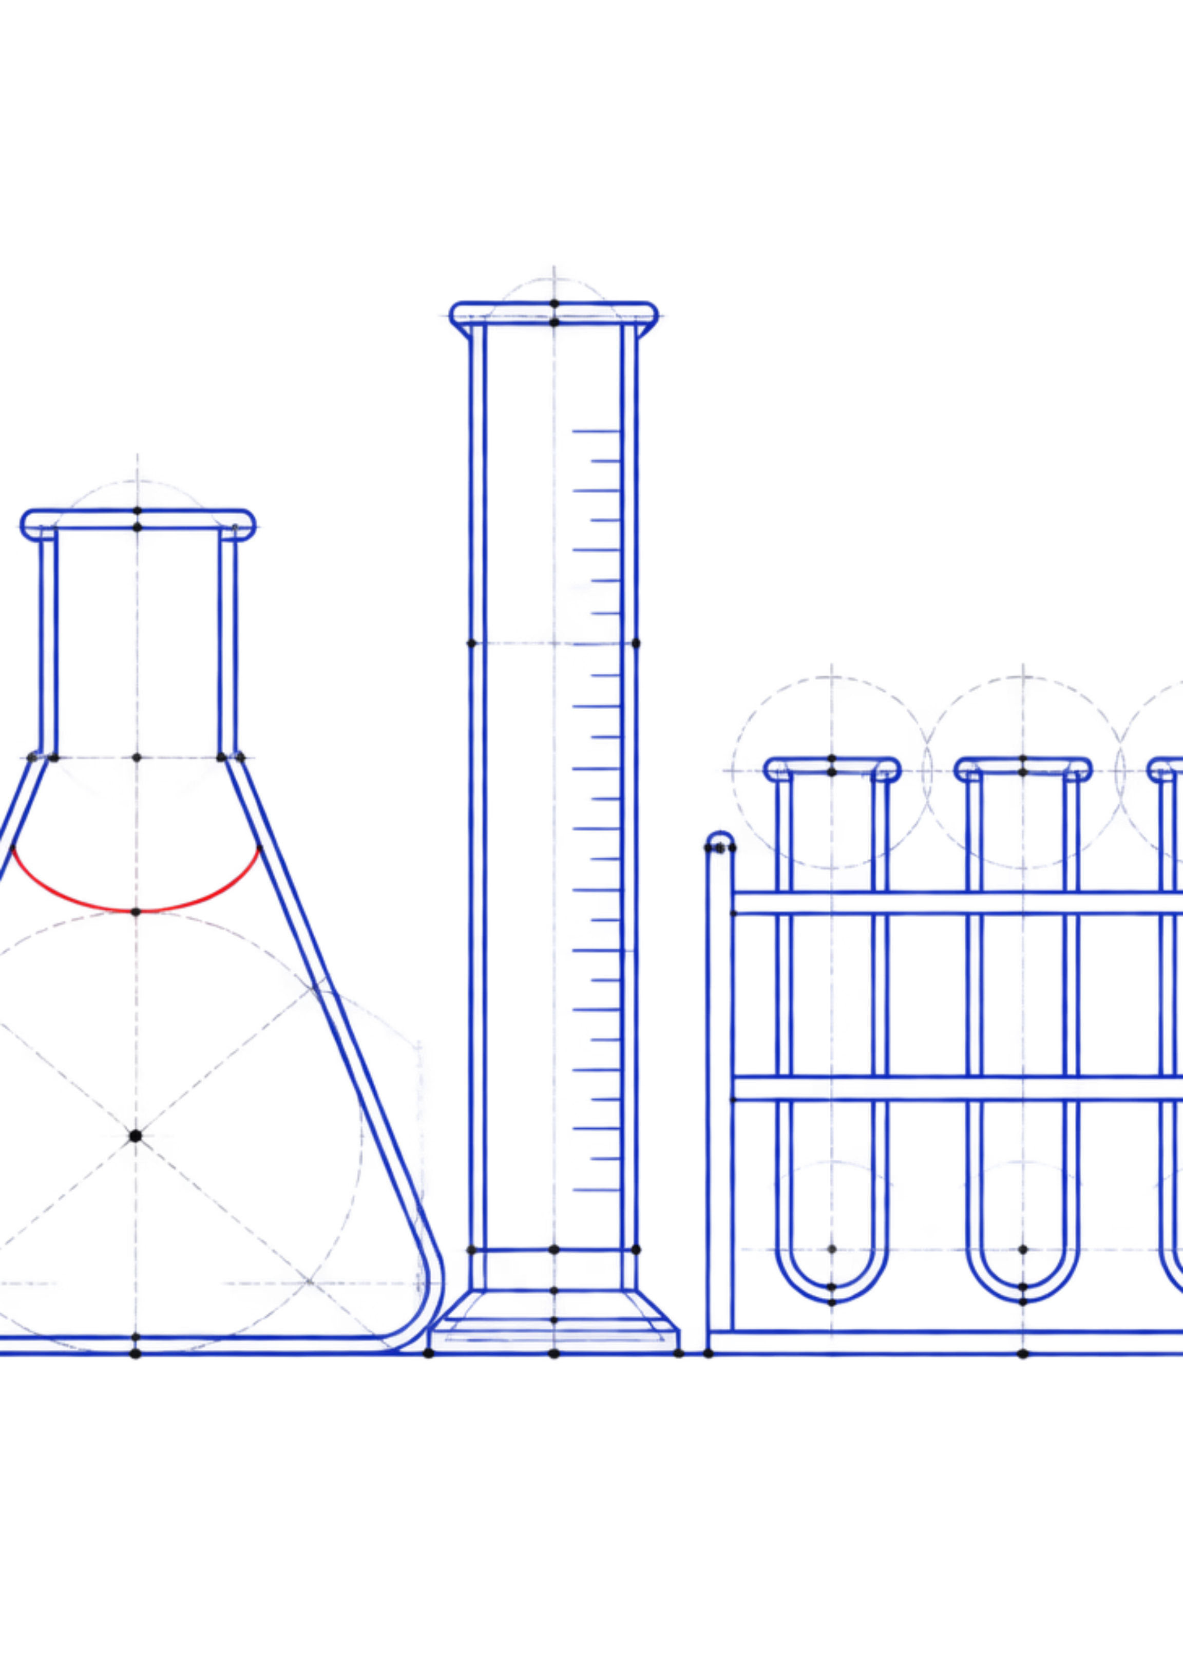
SOFTWARE ENGINEERING PROJECT
SYSTEM OVERVIEW / 01
Smart Lab Management & Continuous Evaluation System
A centralized digital platform for laboratory management and academic evaluation.
LAB HUB
ACADEMIC RECORDS
DATA SETUP
Students · Teams · Groups
Attendance · Marks · Feedback
Excel import · Reports
Team Arise · Madhav Gupta · Pratham Verma · Dishant Kumar
Notes:
Introduce Team Arise and frame the project as a centralized digital platform for laboratory management and academic evaluation.

Slide 2
01
02
Record sources
Repeated entry
CURRENT PROBLEM
Spreadsheets and physical registers
Duplication across student and team records
SYSTEM DIAGNOSTIC / 02
The Cost of Fragmented Records
Manual processes scatter student, team, group, attendance, activity, marks, feedback, and report records across spreadsheets and physical registers.
03
04
Fragmented manual management
Separate evaluation
ONE STUDENT · MANY RECORD SOURCES
Attendance, marks, feedback, and activities stay apart
Historical access is difficult and report preparation increases error risk
Notes:
The current problem is fragmentation: information exists, but it is distributed across tools and repeated manual processes.

Slide 3
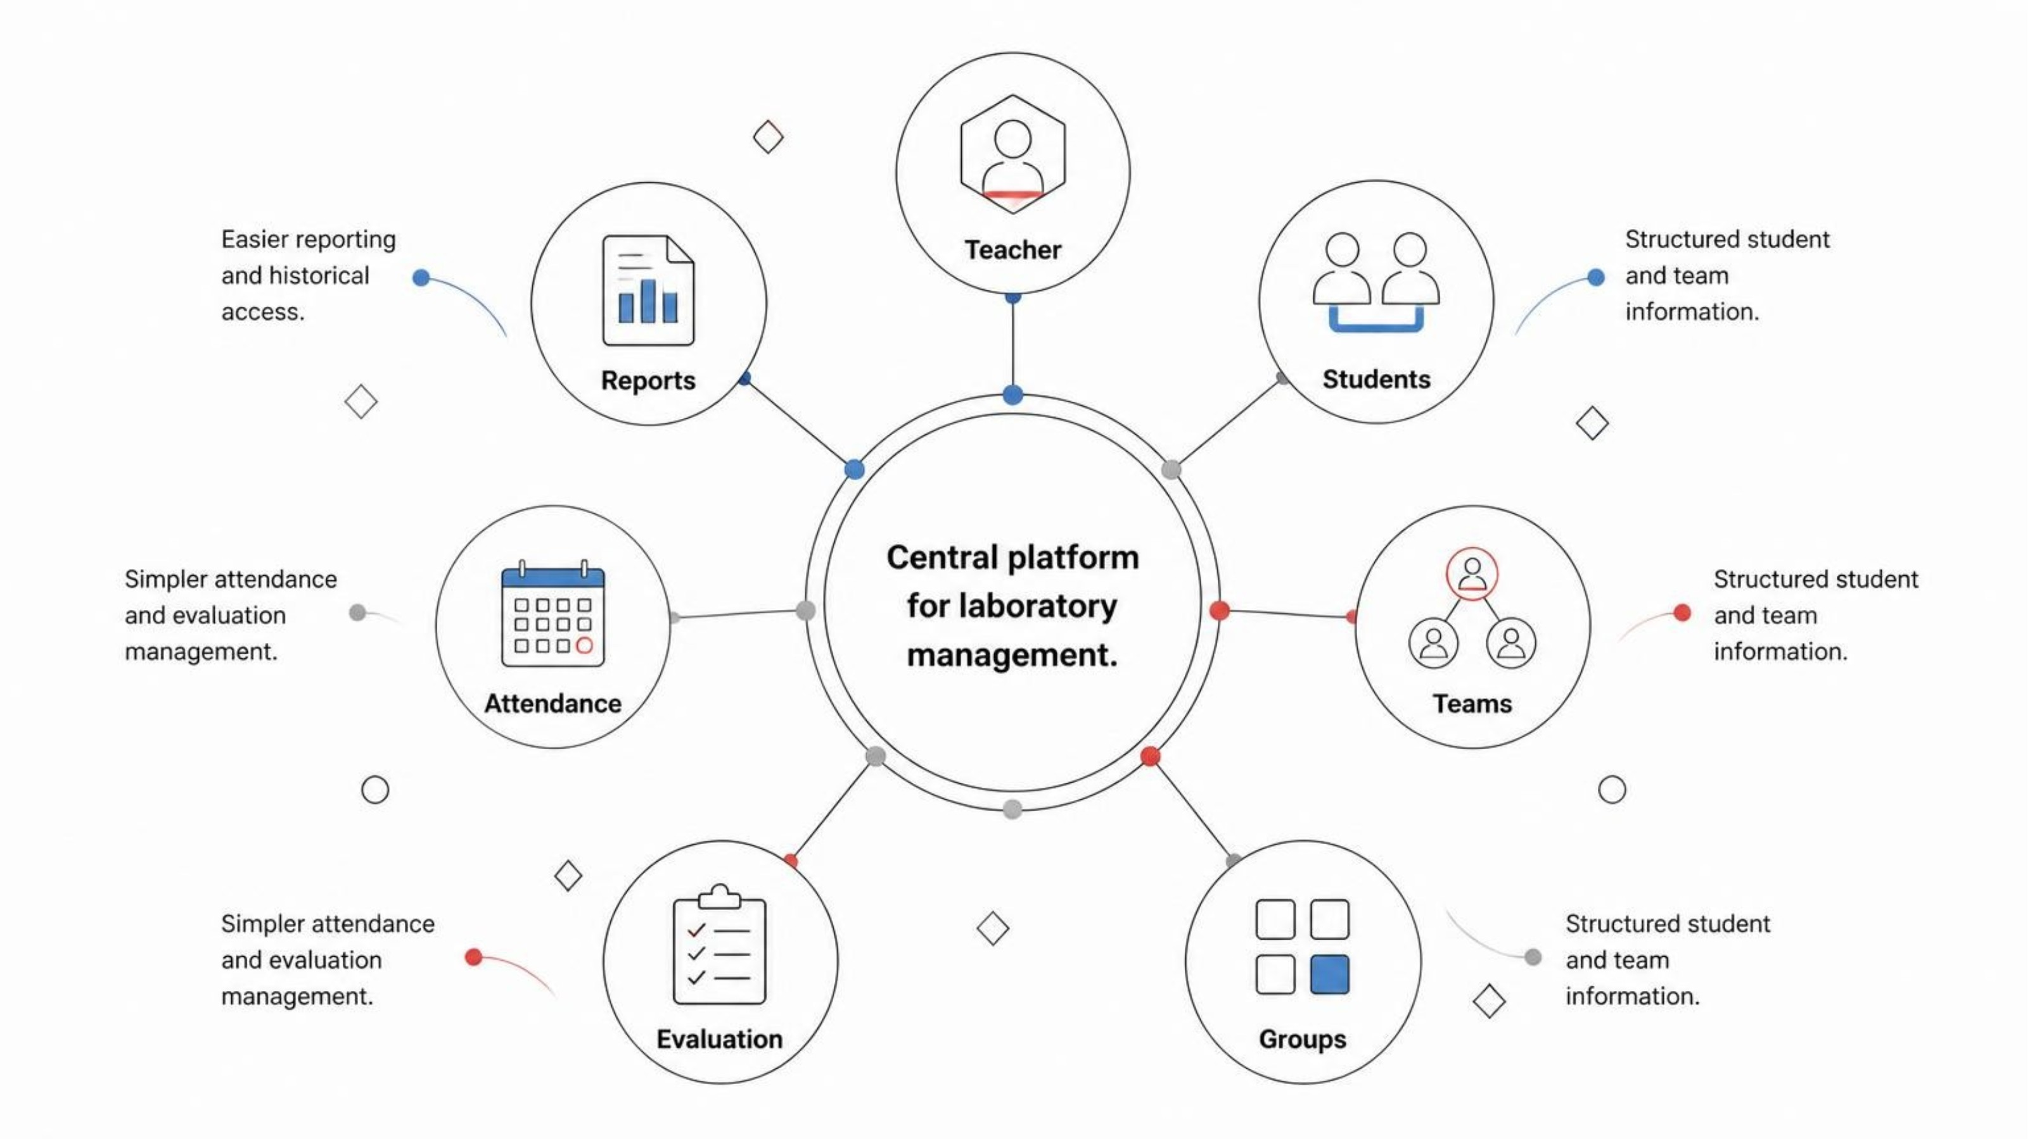
PROPOSED PLATFORM
PRODUCT SURFACE / 03
One Workspace for Lab Management
The system brings students, teams, groups, activities, attendance, evaluation, marks, feedback, and reports into one organized workspace.
CENTRALIZED ACADEMIC RECORDS
Notes:
Show the teacher as the point of coordination, with the system connecting every academic record in one workspace.

Slide 4
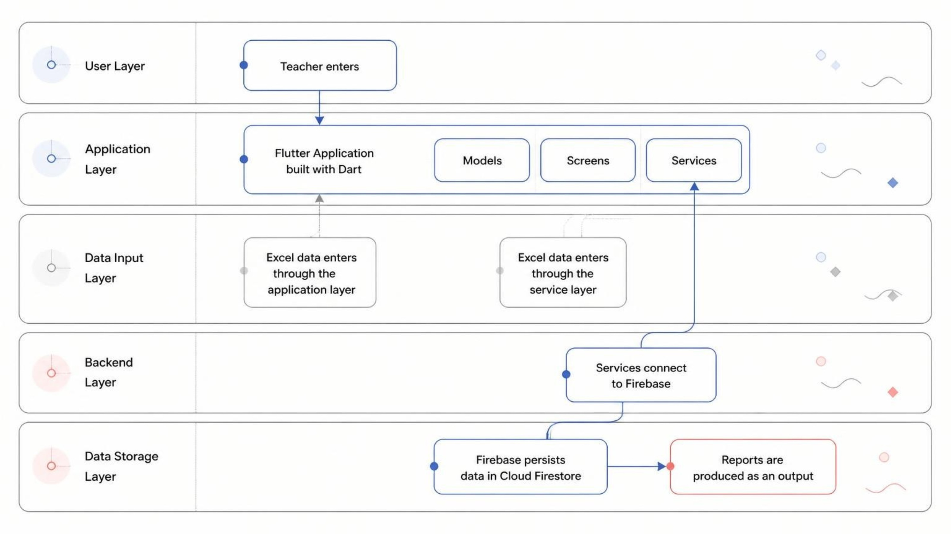
SYSTEM DESIGN
ARCHITECTURE / 04
Architecture & Technology Stack
The application separates the teacher-facing experience from services and centralized persistence.
TEACHER UI → SERVICES → FIRESTORE
Notes:
Explain the separation between the teacher-facing Flutter application, application structure, Firebase services, and Cloud Firestore persistence.

Slide 5






CURRENT SYSTEM
MODULE MAP / 05
Core Functional Modules
Dashboard
Students / Teams / Groups
Lab Activities
Laboratory overview
Manage practical work
Structured academic organization
Attendance
Continuous Evaluation
Reports / Excel Import
Record participation
Marks and feedback
Consolidated information and faster onboarding
ONE CONNECTED TEACHER WORKSPACE
Teacher moves from overview to records without switching between separate tools.
Notes:
Walk through the modules as one connected teacher workspace, rather than as separate tools.

Slide 6



DATA SETUP
Roll Number | Name | Email | Team Name | Group
INGESTION FLOW / 06
Excel Import Simplifies Data Setup
Structured upload
Organized records
Central management
The application uses Roll Number, Name, Email, Team Name, and Group to organize the corresponding information.
Student, team, and group information enters the corresponding records.
Faster onboarding, less repetitive data entry, and reduced opportunity for manual entry mistakes.
The teacher uploads structured student and team data instead of entering every record manually.
IMPORT ONCE, MANAGE CENTRALLY
Notes:
The value of Excel import is capability, not process: structured information can be brought into the system once and managed centrally.

Slide 7
ACADEMIC RECORDS
Student | Activity | Attendance | Marks | Feedback
Student A | Activity 01 | Present | — | —
Student B | Activity 01 | Present | — | —
Student C | Activity 01 | Absent | — | —
LIVE RECORD VIEW / 07
Attendance & Evaluation Records
Once students and activities are organized, teachers can record participation, marks, and feedback in the same academic workspace.
LINKED ACADEMIC RECORD
Attendance history stays linked to laboratory participation. Marks and feedback stay linked to activities. Attendance is not presented as automatically determining marks.
Notes:
Use the sample academic record to show how participation, marks, and feedback can be reviewed together without implying that attendance automatically determines marks.

Slide 8
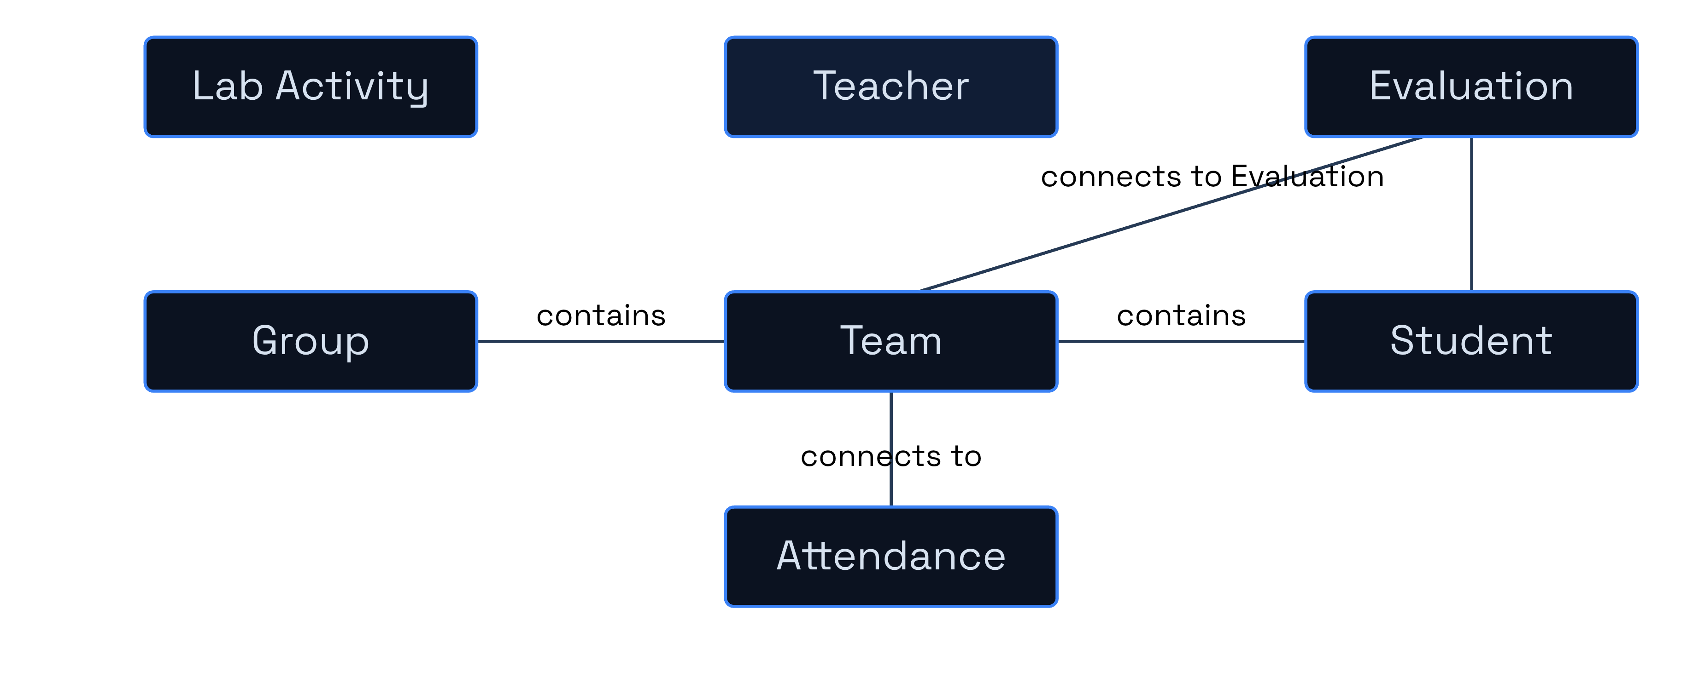
DATA MODEL
ENTITY RELATIONSHIPS / 08
Conceptual Data Model
Cloud Firestore provides centralized persistence for application data.
GROUP → TEAM → STUDENT → ACTIVITY RECORDS
Groups contain Teams. Teams contain Students. Lab Activities connect to Attendance. Students / Teams connect to Evaluation. Evaluation stores Score + Feedback.
Notes:
Keep the model conceptual: groups contain teams, teams contain students, activities connect to attendance, and evaluation stores score and feedback.

Slide 9





SMART LAB MANAGEMENT & CONTINUOUS EVALUATION SYSTEM
Teacher-Centric
Limited Student Interaction
BOUNDARIES / 09
The current system primarily focuses on teacher-side management.
A dedicated student portal is not yet integrated.
Current Limitations
Manual Attendance
Limited Analytics
Attendance currently requires teacher-side recording.
Advanced performance analytics and dashboards are not yet available.
Limited Automation
Online submissions, notifications, QR attendance and AI-assisted evaluation are future enhancements.
CURRENT STATE — FUTURE ENHANCEMENTS REMAIN DISTINCT
These limitations provide clear opportunities for future expansion and automation.
Notes:
Explain that the current system remains teacher-centric and that student interaction, advanced analytics, and automation are future enhancements rather than implemented features.

Slide 10
NEXT HORIZON
Future integrations
FUTURE — NOT CURRENTLY IMPLEMENTED
CLOSING STATE / 10
Future Scope & Conclusion
Student portal and login
Online report/project submission
Cloud file storage
The current system centralizes laboratory records, reduces manual effort, and provides a scalable foundation for digital laboratory management.
Analytics dashboard and notifications
QR attendance, role-based access, and AI-assisted evaluation
Future integrations are distinct from the current system.
Team Arise · Madhav Gupta · Pratham Verma · Dishant Kumar
Thank You — Questions?
Notes:
Close by separating the current centralized system from future integrations. The project provides a foundation that can support the listed extensions without presenting them as implemented.

