Slide 1
Automatic Tanpura Drone Tuning based on Singers' F0

Slide 2
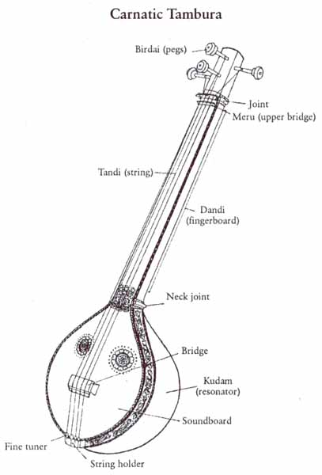

Slide 3
Existing Tanpura Applications
We need to provide
  Scale
  Semitones

Slide 4
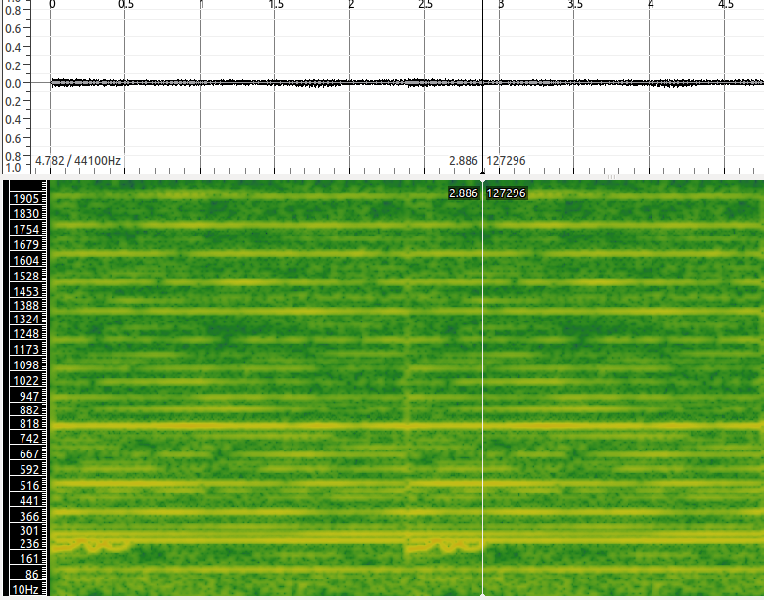

Slide 5
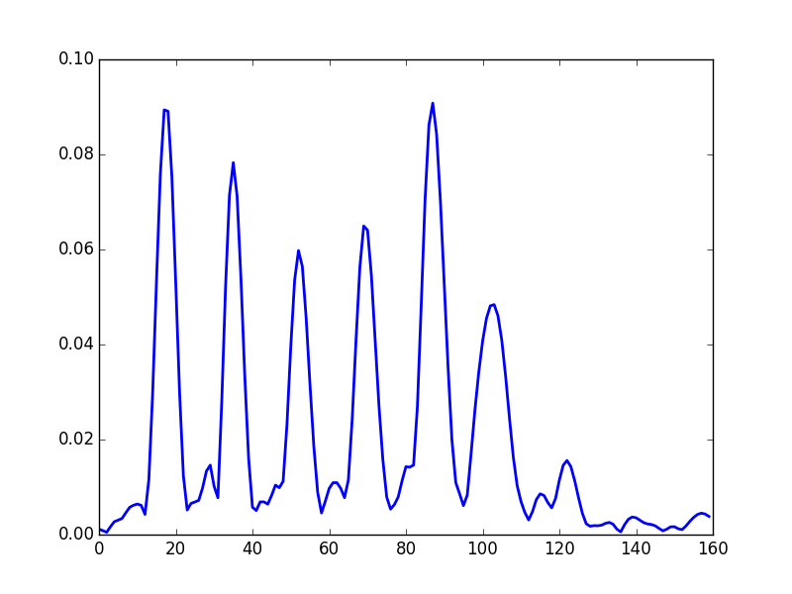

Slide 6
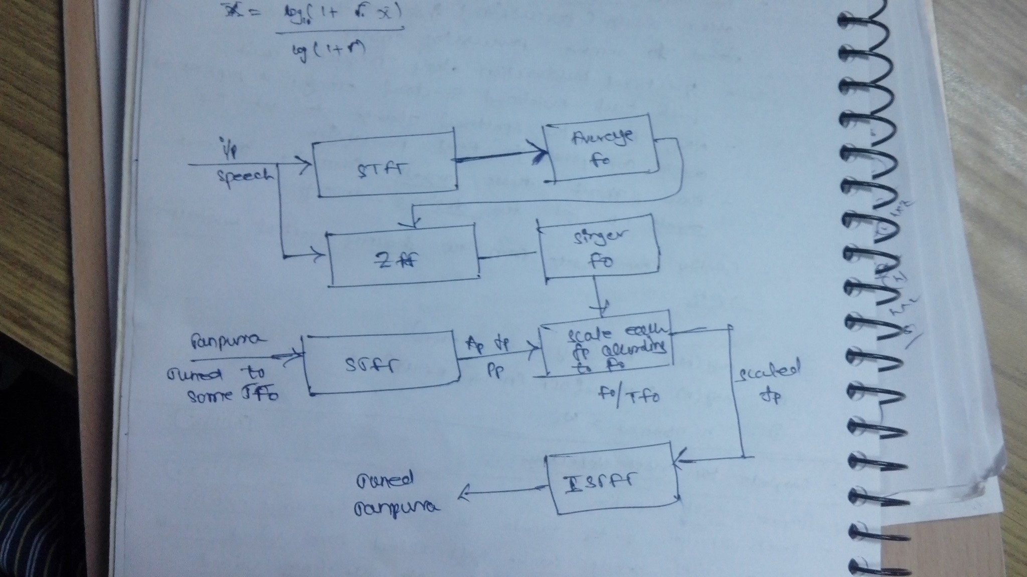
Approach

