Slide 1
Note similarity measure for singing range identification

Slide 2
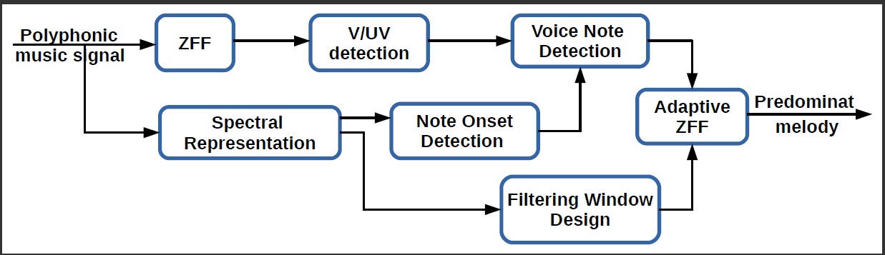
Application of the framework

Slide 3
Application
Train note sequences
  In three octaves
  sa re ga ma pa da ni Sa
Extract the melody by using proposed melody extraction system
Store the melody contours of three octaves
Get the note sequence from the trinee

Slide 4
Continued
Do the similarity measure
Give the similarity score
  Inner product and Mean square error
Also give the frequency deviation
Problem will be
  Durational missmatch
    Interpolation
    DTW

Slide 5
Methodalogy
Find the spectrum of five frames at the middle of the note ( no autocorrelation because of Drone)
Get the frequency corresponding to the dominant partial peak
ZFF the note by using pitch period of dominant peak
Do similarity measure between the test and the training melody contours.
Give vocal deviation between the test and train melody contours.

Slide 6
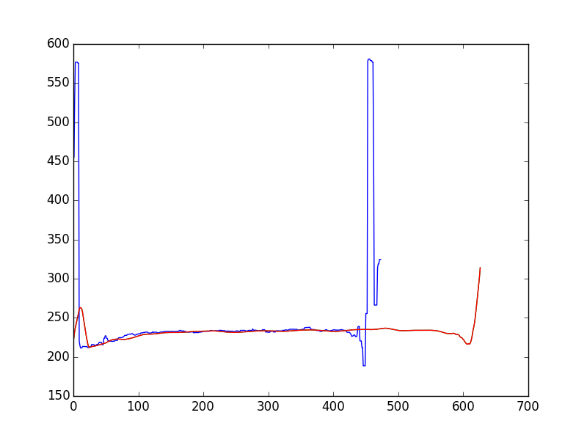
An example

