Slide 1
SARGAM Note Deviation Indicator

Slide 2
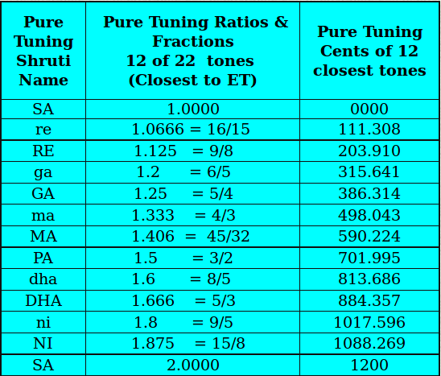
Identifying out of tune notes

Slide 3
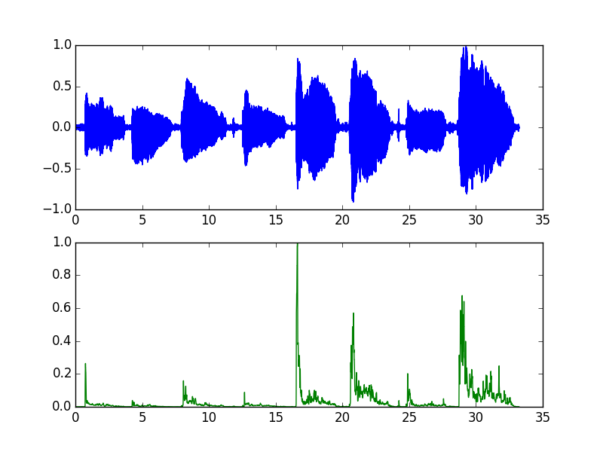
Note onset detection

Slide 4
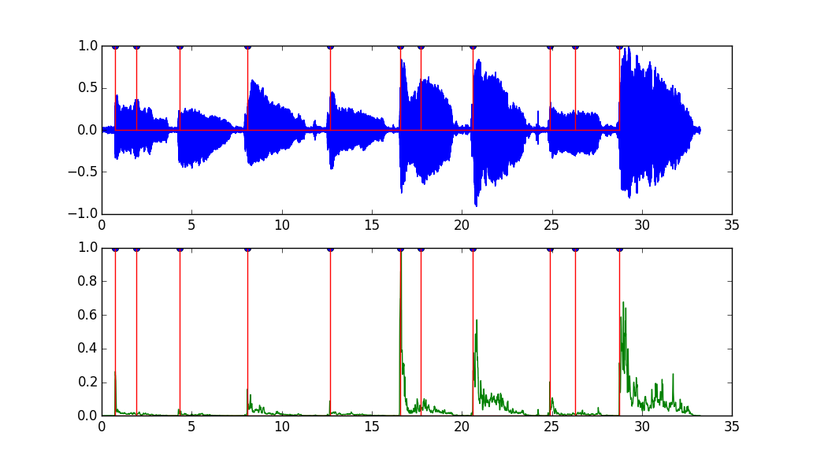
Spurious Onsets

Slide 5
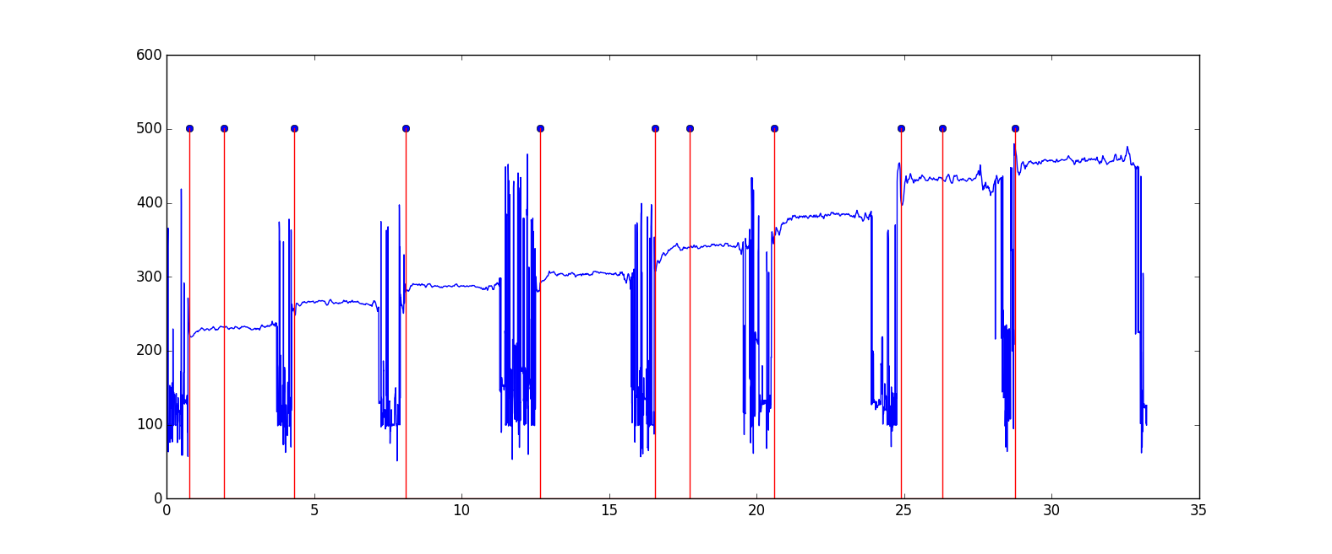
Pitch as a secondary clue

Slide 6
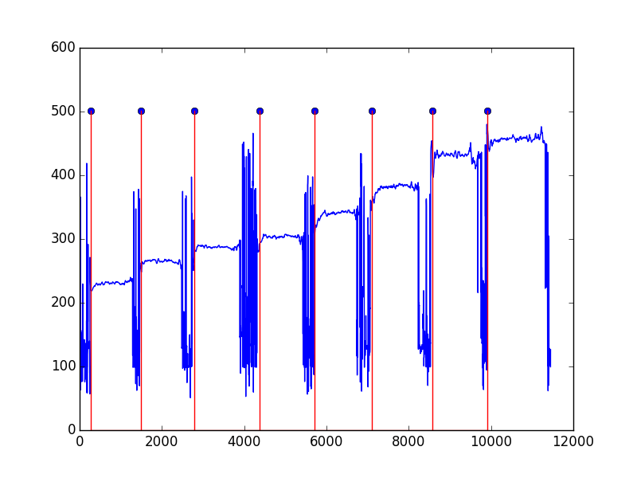
True onsets = spectral change + pitch

Slide 7
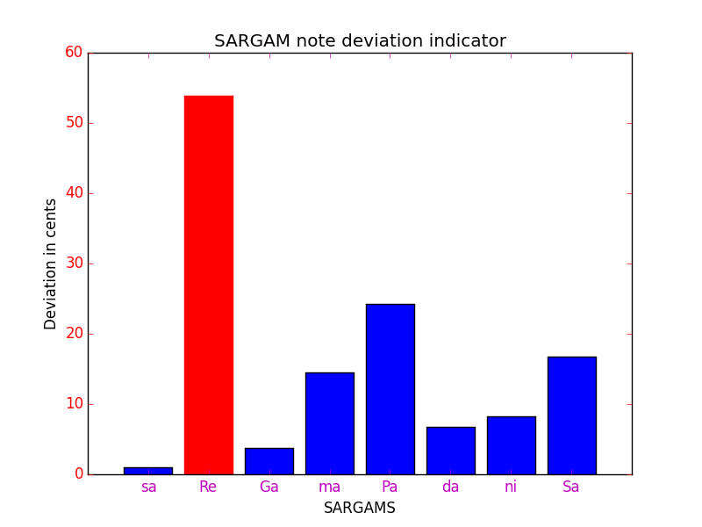
Note Deviation Plot in Cents

