Slide 1
SARGAM Note Deviation Indicator

Slide 2
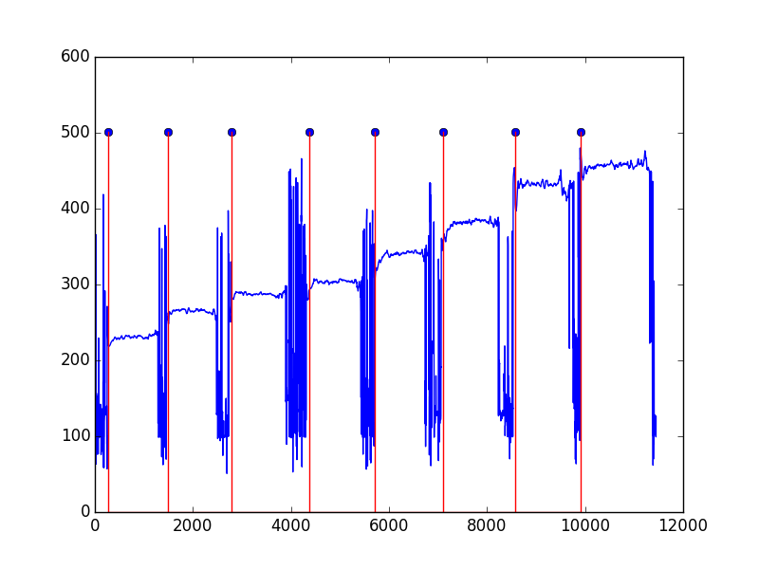
Sequence of Notes

Slide 3
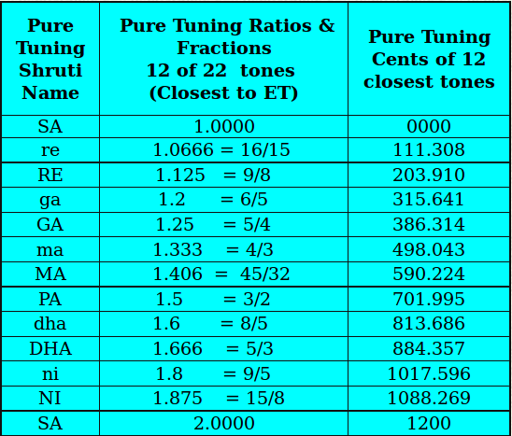
Identifying out of tune notes

Slide 4
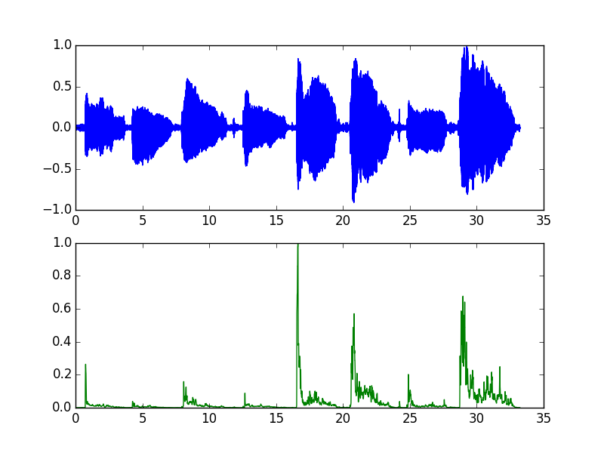
Note onset detection

Slide 5
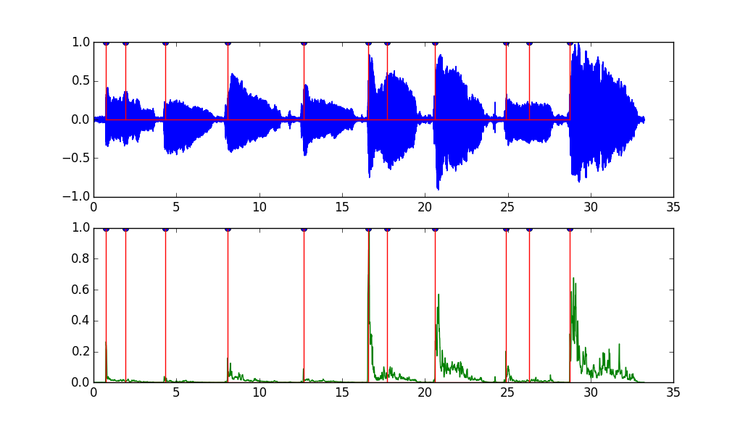
Spurious Onsets

Slide 6
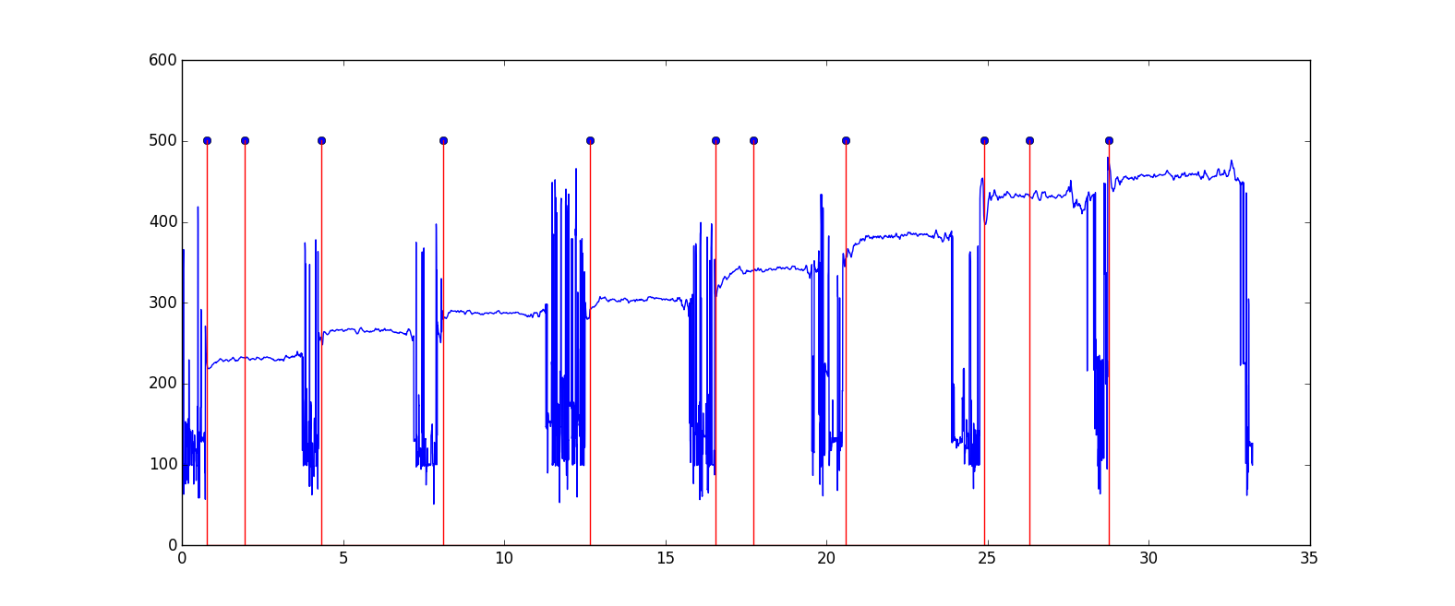
Pitch as a secondary clue

Slide 7
True onsets = spectral change + pitch

Slide 8
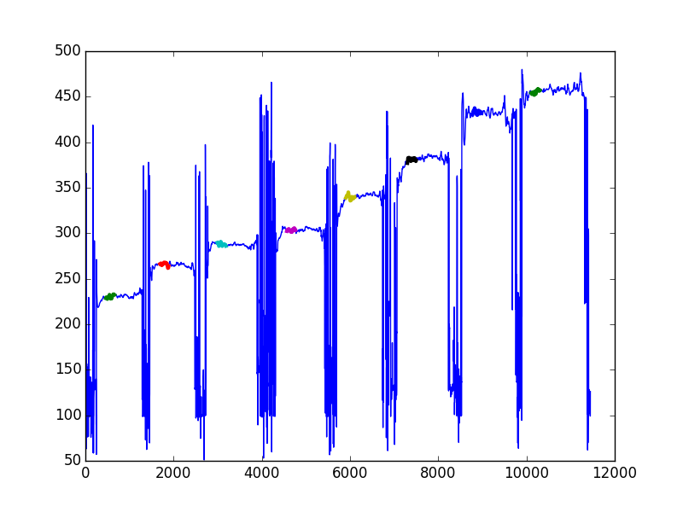
Pitch Detection from Stable Note Region

Slide 9
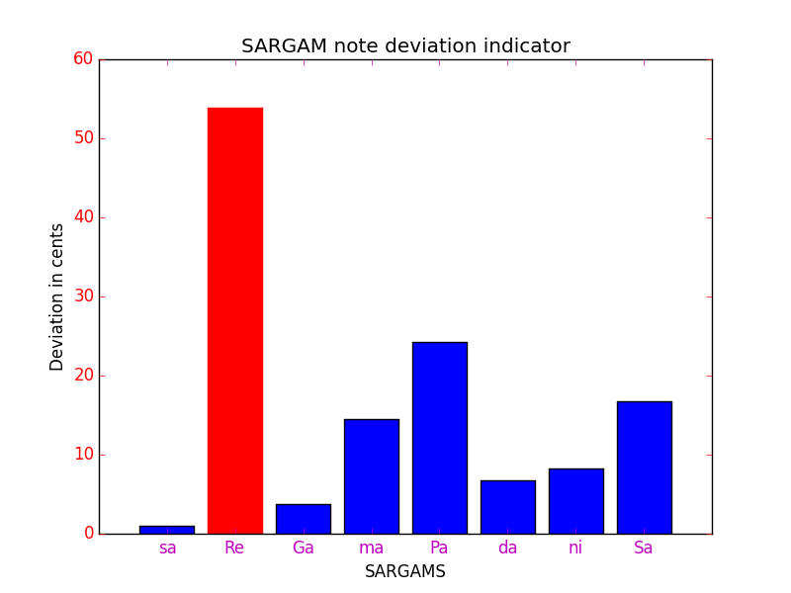
Note Deviation Plot in Cents

