Slide 1
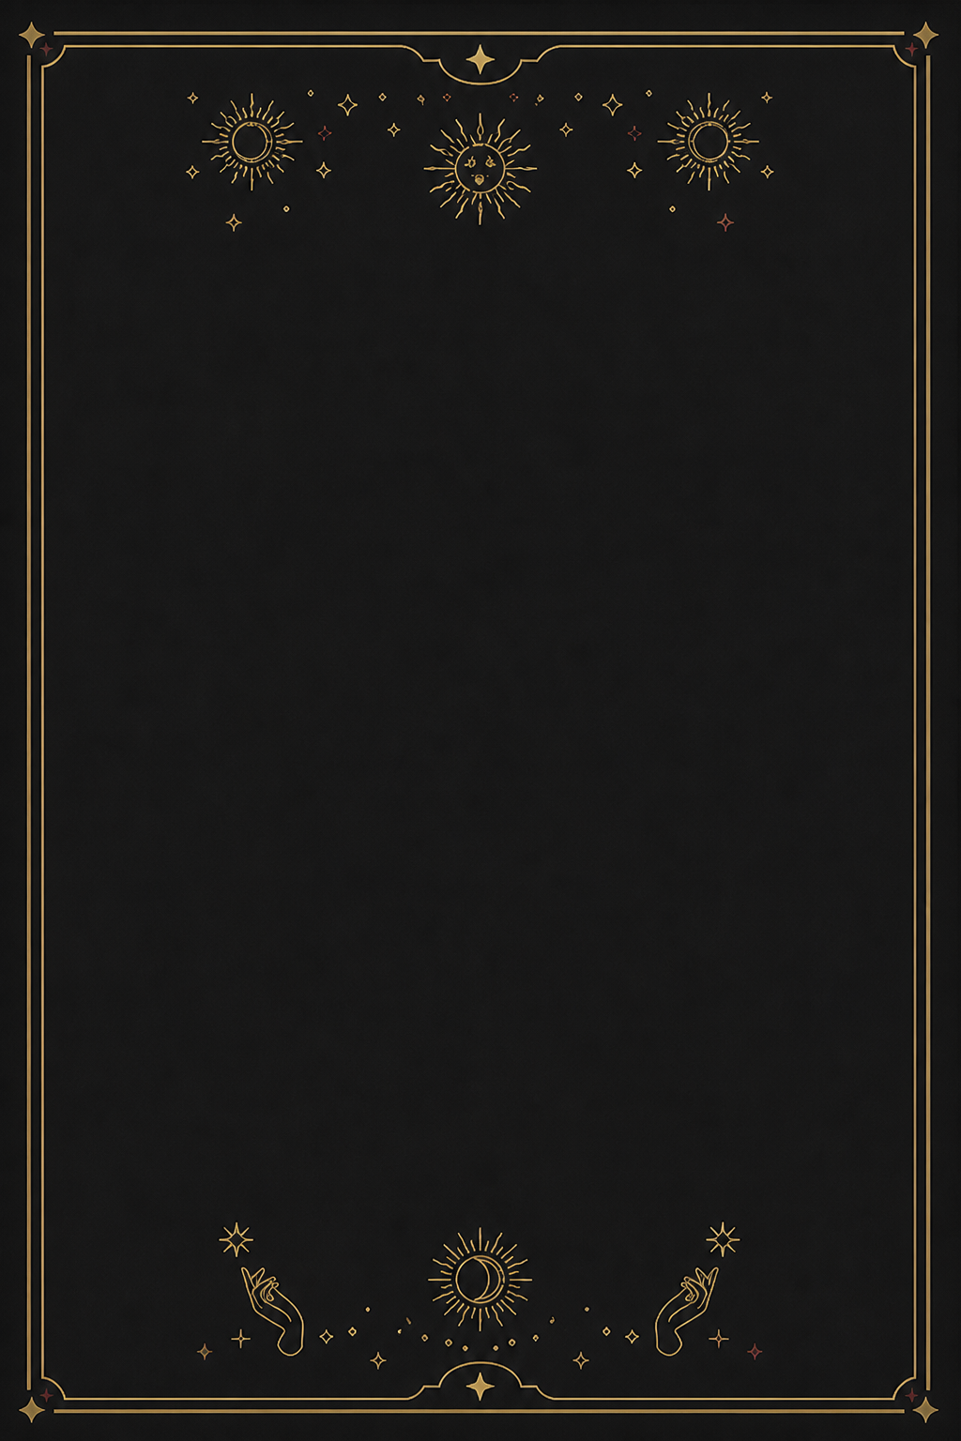

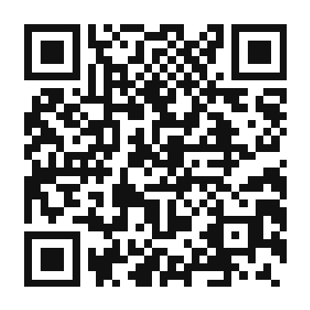
SATIR ICEBERG MODEL × AI
AI 타로 & 사주
사티어 빙산모델로 나를 이해해봐요
6가지 내면 분석
감정 · 상처 분석
생각 · 지각 분석
행동 · 대처 패턴
내면의 기대
숨은 열망
가치 · 자아 탐색
상담문의 PuBaO
GitHub에서 프로젝트 보기
github.com/mgusdn/chatbot
Notes:
[Sources]
- User-provided style reference: /var/folders/z3/3k1qp3m90d38sv0jjk5wsw1w0000gn/T/codex-clipboard-29c3efb4-72a0-4959-8f87-520cdb57d392.png
- OpenAI-generated background asset: assets/black-gold-background.png
- Project content source: /Users/chan/Developer/workspace/pume-llm-ab/backend/counsel/prompts.py
- QR destination: https://github.com/mgusdn/chatbot
[/Sources]
A clean black-and-gold standing-banner concept with a single red attention hook.
[Sources] - Nanum Brush Script: https://github.com/google/fonts/tree/main/ofl/nanumbrushscript (SIL Open Font License 1.1) [/Sources] Typography revision: AppleMyungjo for Korean display/body text; Avenir Next Condensed for supporting Latin text; brush hook rasterized to preserve print appearance.
Revision: non-hook typography changed to angular Apple SD Gothic Neo/DIN Condensed. Character-slide text changed to white. Descriptor copy changed to ‘사티어 빙산모델로 나를 이해해봐요’. Character artwork moved upward via inherited background crop.

Slide 2
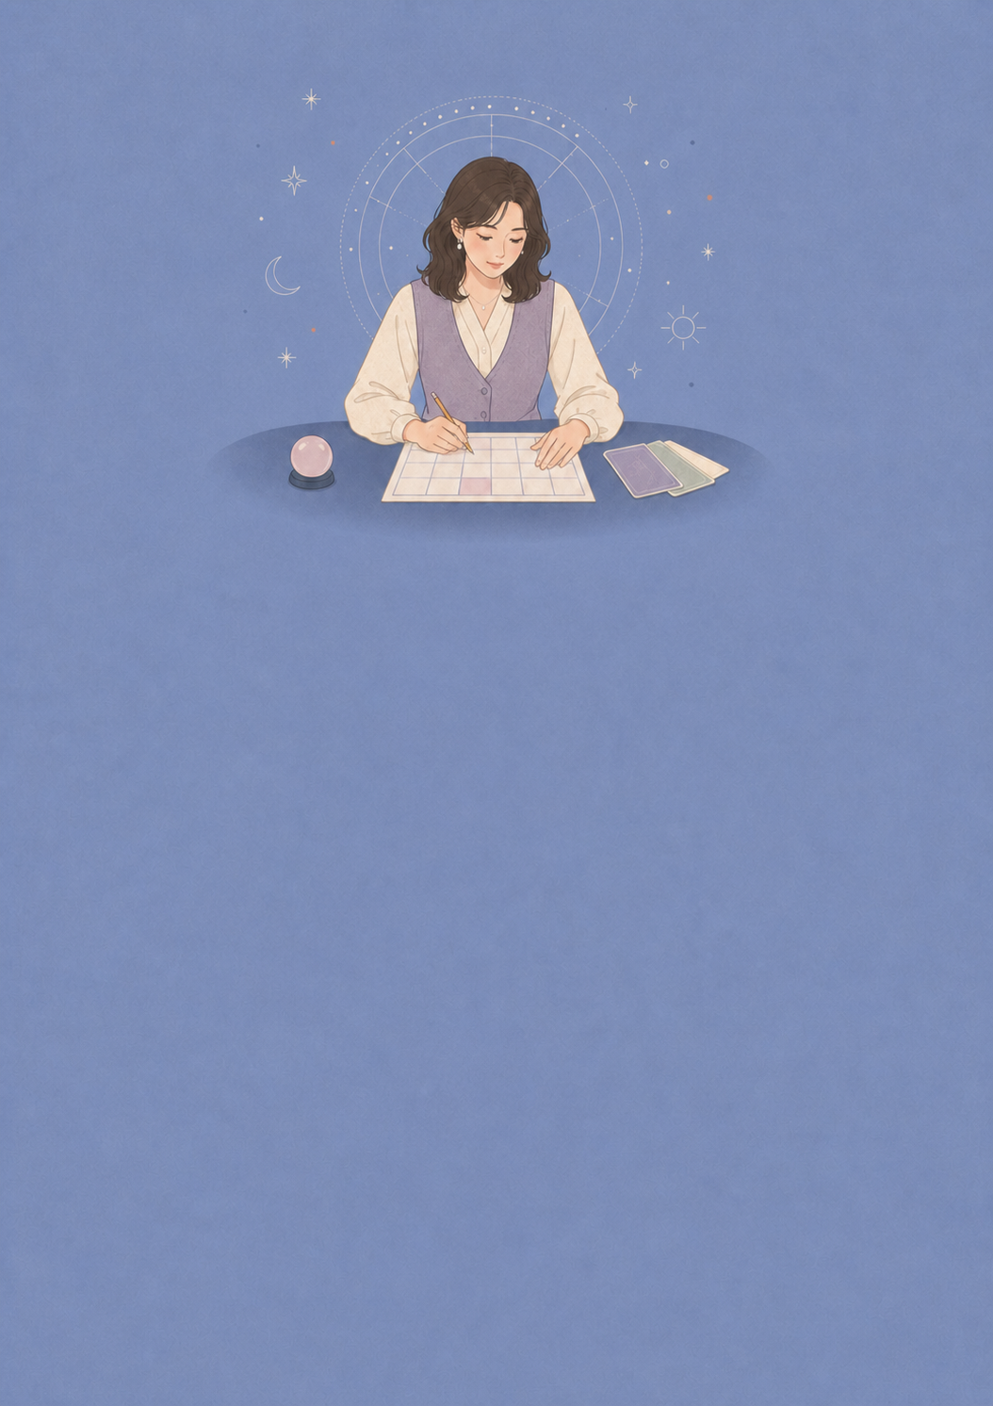

SATIR ICEBERG MODEL × AI
AI 타로 & 사주
사티어 빙산모델로 나를 이해해봐요
6가지 내면 분석
감정 · 상처 분석
생각 · 지각 분석
행동 · 대처 패턴
내면의 기대
숨은 열망
가치 · 자아 탐색
상담문의 PuBaO
GitHub에서 프로젝트 보기
github.com/mgusdn/chatbot
Notes:
[Sources]
- User-provided style reference: /var/folders/z3/3k1qp3m90d38sv0jjk5wsw1w0000gn/T/codex-clipboard-94eaefa5-151e-4dae-aac9-c758328dc192.png
- OpenAI-generated background asset: assets/sky-woman-background.png
- Project content source: /Users/chan/Developer/workspace/pume-llm-ab/backend/counsel/prompts.py
- QR destination: https://github.com/mgusdn/chatbot
[/Sources]
A low-saturation woman fortune-reader version using the same editable hierarchy as the panda concept.
[Sources] - Nanum Brush Script: https://github.com/google/fonts/tree/main/ofl/nanumbrushscript (SIL Open Font License 1.1) [/Sources] Typography revision: AppleMyungjo for Korean display/body text; Avenir Next Condensed for supporting Latin text; brush hook rasterized to preserve print appearance.
Revision: non-hook typography changed to angular Apple SD Gothic Neo/DIN Condensed. Character-slide text changed to white. Descriptor copy changed to ‘사티어 빙산모델로 나를 이해해봐요’. Character artwork moved upward via inherited background crop.

