Slide 1


Get Started with
React ReExt
and Next.js
Marc Gusmano
marc.gusmano@sencha.com

Slide 2
Agenda
What is React ReExt?
What is Next.js?
Next.js and React – How are they related?
Getting Started with React – use Next.js?

Slide 3
What is React ReExt?
A React Library that brings Sencha Ext JS Components to React
It’s Simple – 1 component with 5 props and ‘Event’ props
xtype, className, style, config, ready (and onX… event props)
The xtype prop exposes all of the Ext JS components
Custom xtypes are also supported
React ReExt is not Ext JS version, toolkit or theme dependent
It is not tied to any build environment
It can be used without any changes to the Ext JS sdk
React ReExt is available as an NPM package
<ReExt xtype='button’
className=’’
style={{}}
config={{
text:'button text’,
width:'100px’
}}
ready={(cmp)=>{
console.log(cmp)
}}
onClick={ (button, e) => {
console.log(button, e);
}}
/>

Slide 4
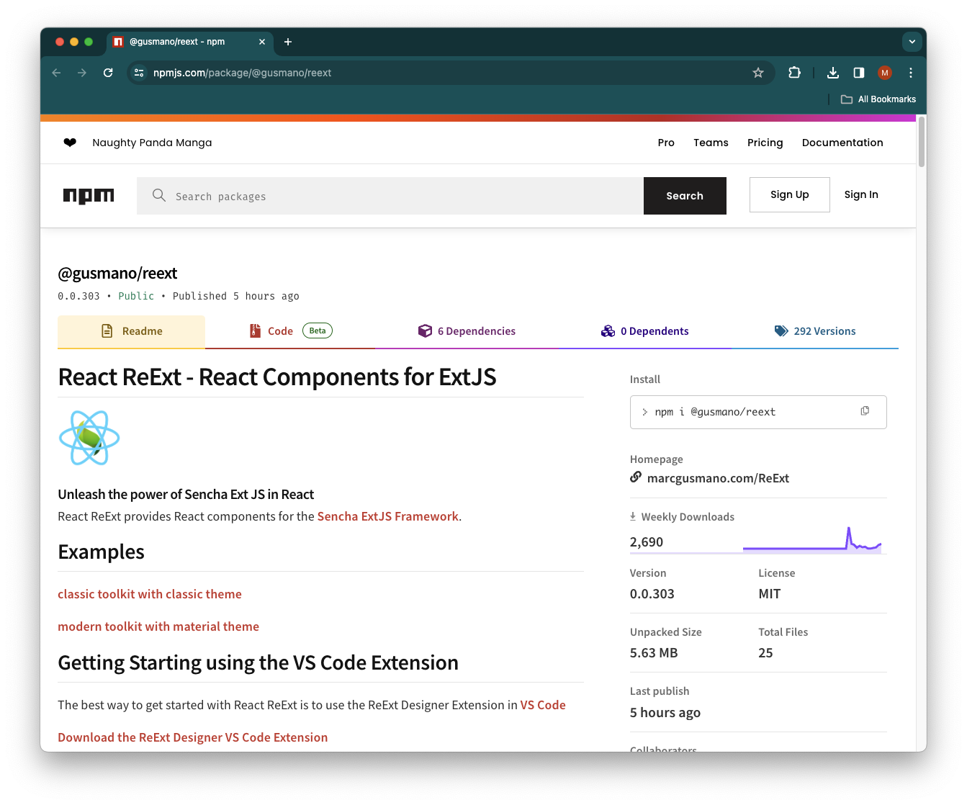
React ReExt NPM Package Page
https://www.npmjs.com/package/@gusmano/reext

Slide 5
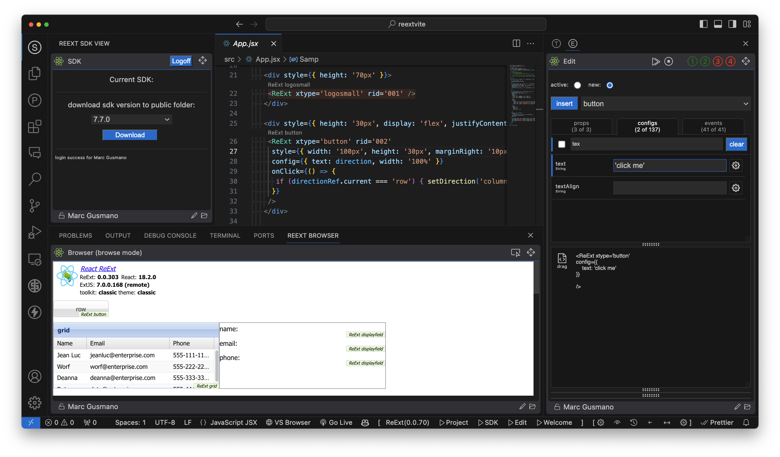
ReExt Designer VS Code Extension

Slide 6
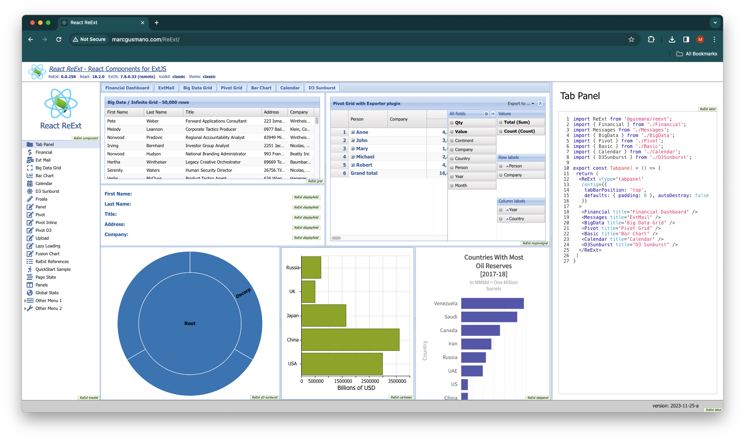
React ReExt Examples
http://marcgusmano.com/ReExt/?version=7.7.0&toolkit=classic&theme=classic
http://marcgusmano.com/ReExt/?version=7.7.0&toolkit=modern&theme=material

Slide 7
Getting other versions of the Sencha SDK
Get a version of the SDK from Sencha Support Portal
https://support.sencha.com/#download
2 zips: ext-7.7.0.zip, epa-7.7.0.zip
Unzip 2 sdk files to into vite project public folder
Adjust variables in ReExtData.json
Or, use use the ReExt Designer VS Code Extension…

Slide 8
What is Next.js?
The React Framework for the Web
https://nextjs.org/
Latest version - Next.js 14

Slide 9

Next.js and React – How are they related?
React is a flexible JavaScript library focused purely on building user interfaces.
Next.js is an opinionated framework that builds on React and provides extra functionality like server-side rendering and optimization features out of the box.
Next.js is used on top of React, expanding its capabilities and streamlining the development process.
React doesn't need to work with Next.js, but Next.js uses React to deploy apps.
https://www.imaginarycloud.com/blog/next-js-vs-react/

Slide 10

Getting Started with React – use Next.js?
React - The library for web and native user interfaces
From react.dev…
‘If you want to build a new app or a new website fully with React, we recommend picking one of the React-powered frameworks popular in the community.’
https://react.dev/learn/start-a-new-react-project
Next.js
Remix
Gatsby
https://npmtrends.com/gatsby-vs-next-vs-remix

Slide 11
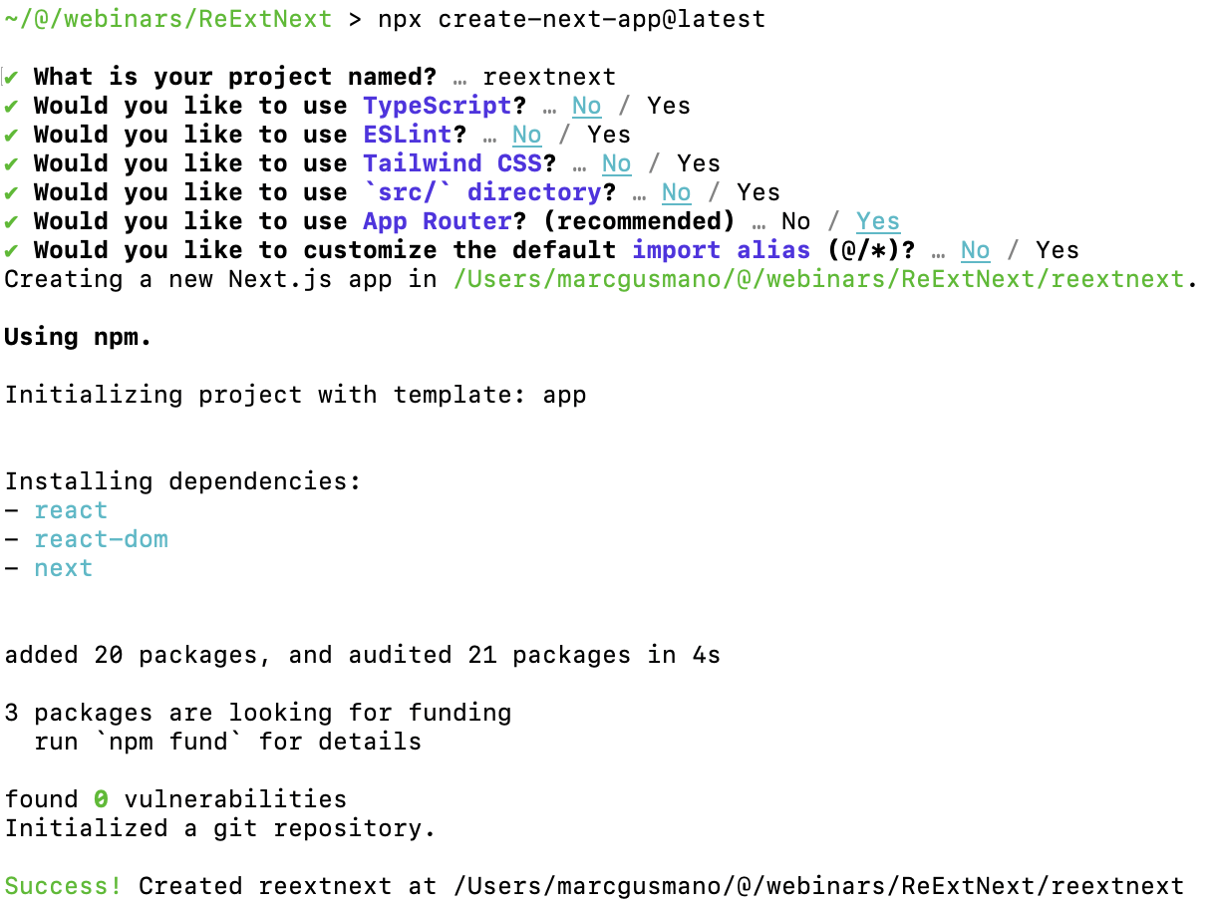
Creating a New Next.js Project
npx create-next-app@latest

Slide 12
Next.js root layout.js
"use client";
import { ReExtProvider } from '@gusmano/reext';
import './layout/global.css';
import Header from './layout/Header';
import Nav from './layout/Nav';
import Footer from './layout/Footer';
export default function RootLayout({ children }) {
return (
<html className="zcol" lang="en">
<body className="zcol">
<ReExtProvider>
<Header />
<div className="zrow">
<Nav />
<div className="zrow">{children}</div>
</div>
<Footer />
</ReExtProvider>
</body>
</html>
);
}

Slide 13
Demo

Slide 14
Thank You
Marc Gusmano
marc.gusmano@sencha.com

Slide 15
References
https://prismic.io/blog/nextjs-vs-react
https://npmtrends.com/angular-vs-react-vs-vue
https://github.com/vercel/next.js/discussions/29628

