Slide 1
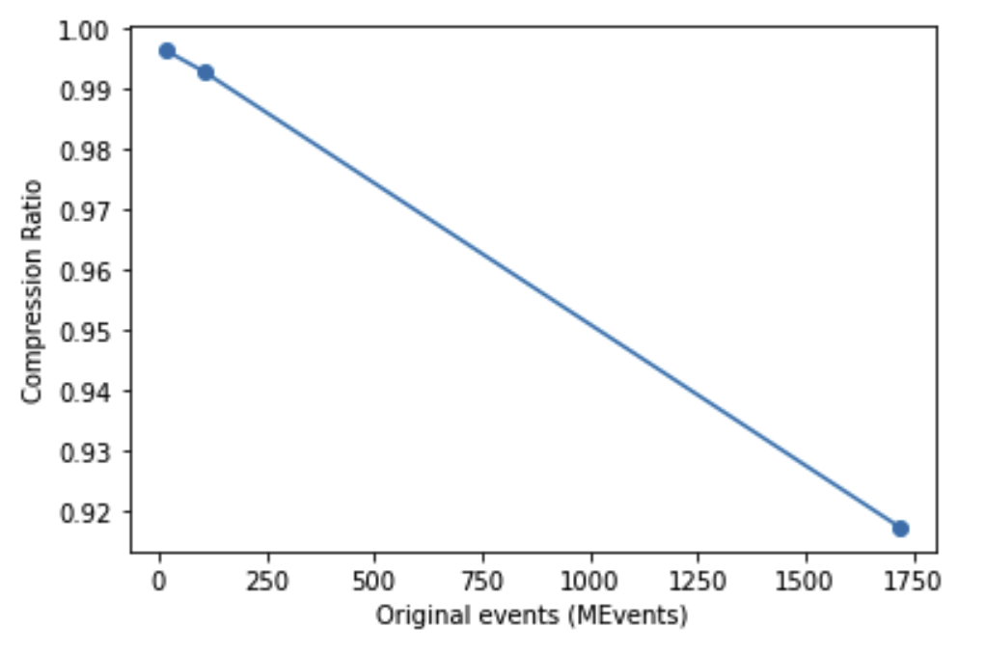
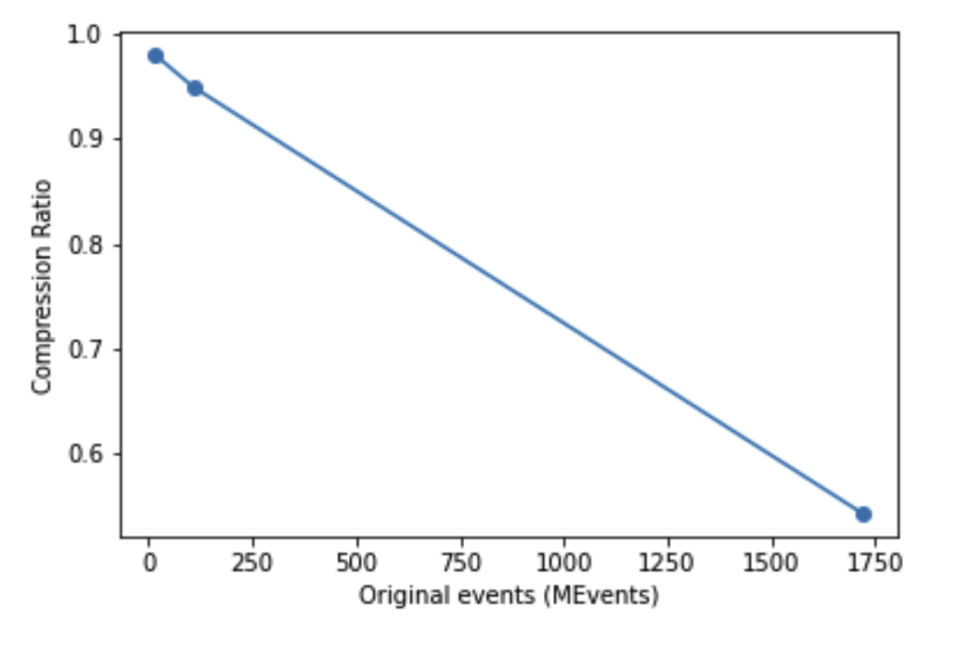
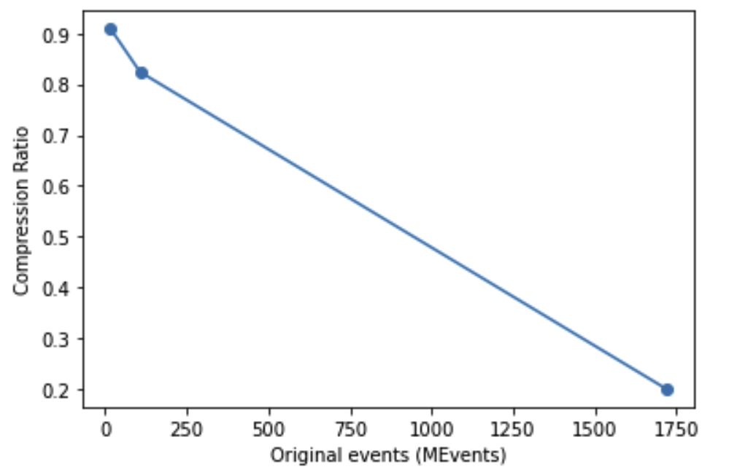
Event Compression tests (SNAP)
Case 1:
Case 2:
Case 3:
Native | Value
δT (TOF resolution) | 0.1 μs
δt (Wall clock resolution) | 0.017 s
Super pixels | 1x1
Compression Parameter | Value
δT (TOF resolution) | 1 μs
δt (Wall clock resolution) | 60 s
Super pixels | 8x8
Compression Parameter | Value
δT (TOF resolution) | 10 μs
δt (Wall clock resolution) | 60 s
Super pixels | 8x8
Compression Parameter | Value
δT (TOF resolution) | 1 μs
δt (Wall clock resolution) | 3600 s
Super pixels | 8x8
Results:
Results:
Results:
Data set | Native events (MEv) | Compression ratio
1 | 16.38 | 1.00
2 | 106.36 | 0.99
3 | 1719.09 | 0.92
Data set | Native events (MEv) | Compression ratio
1 | 16.38 | 0.98
2 | 106.36 | 0.95
3 | 1719.09 | 0.54
Data set | Native events (MEv) | Compression ratio
1 | 16.38 | 0.91
2 | 106.36 | 0.82
3 | 1719.09 | 0.20

