Slide 1
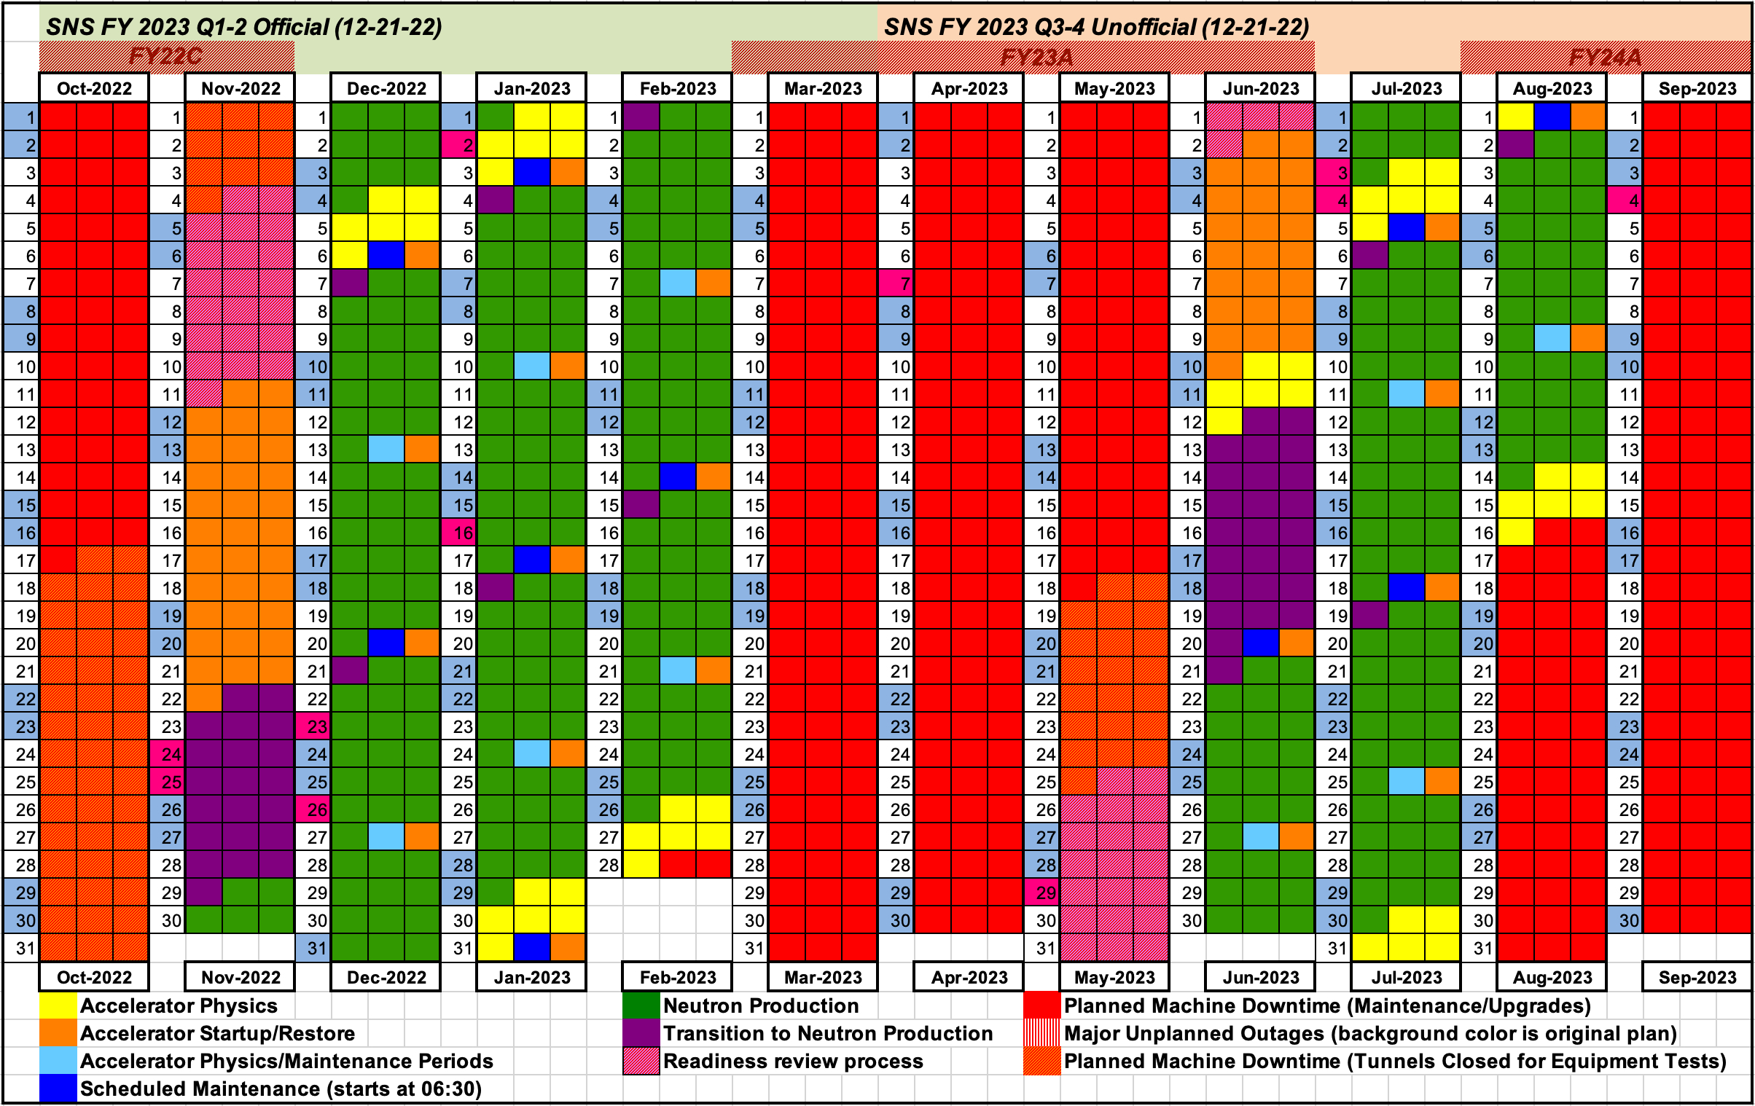
30766^{B1}
Salke
SNS 2022-B
30870^{A2}
Wildes
5
30578^{C11}
Clancy
5
LC Breakdown:
Chris – 14
Antonio – 16
Bianca – 5
Hassina – 10
Malcolm – 5
Beamtime allocation:
GUP 50 d
Commissioning, calib., PoP 2 d
Discretionary 13 d
Total 65 d
¹ RT DAC
² LT DAC
³ HT DAC
⁴ LT ST
⁵ RT ST
⁶ HT ST
⁷ Furnace
⁸ RT DT
^{A} local contact is Antonio
^{C} local contact is Chris
^{B} local contact is Bianca
^{M} local contact is Malcolm
Bold is confirmed
Typewriter is imaging
30264^{M1}
Guthrie
5
30221^{A8}
Li 2
30776^{C11}
Duan
4
⁹ LT DT
¹⁰ RT clamp cell
¹¹ LT clamp cell
¹² RT gas cell
¹³ LT gas cell
¹⁴ Can/Capillary
¹⁵ LT Can/Capillary
31056^{CD}
Gudipati
5
Imaging
30230^{A2}
Vohra
5
30415^{A13}
Wilkinson
4
30766^{B1}
Salke
5

