Slide 1
Data Visualization with ggplot2
R Users Group Meeting
August 23, 2016

Slide 2
Why do we visualize data?
To Explore
To Examine
To Communicate

Slide 3
Examine

Slide 4
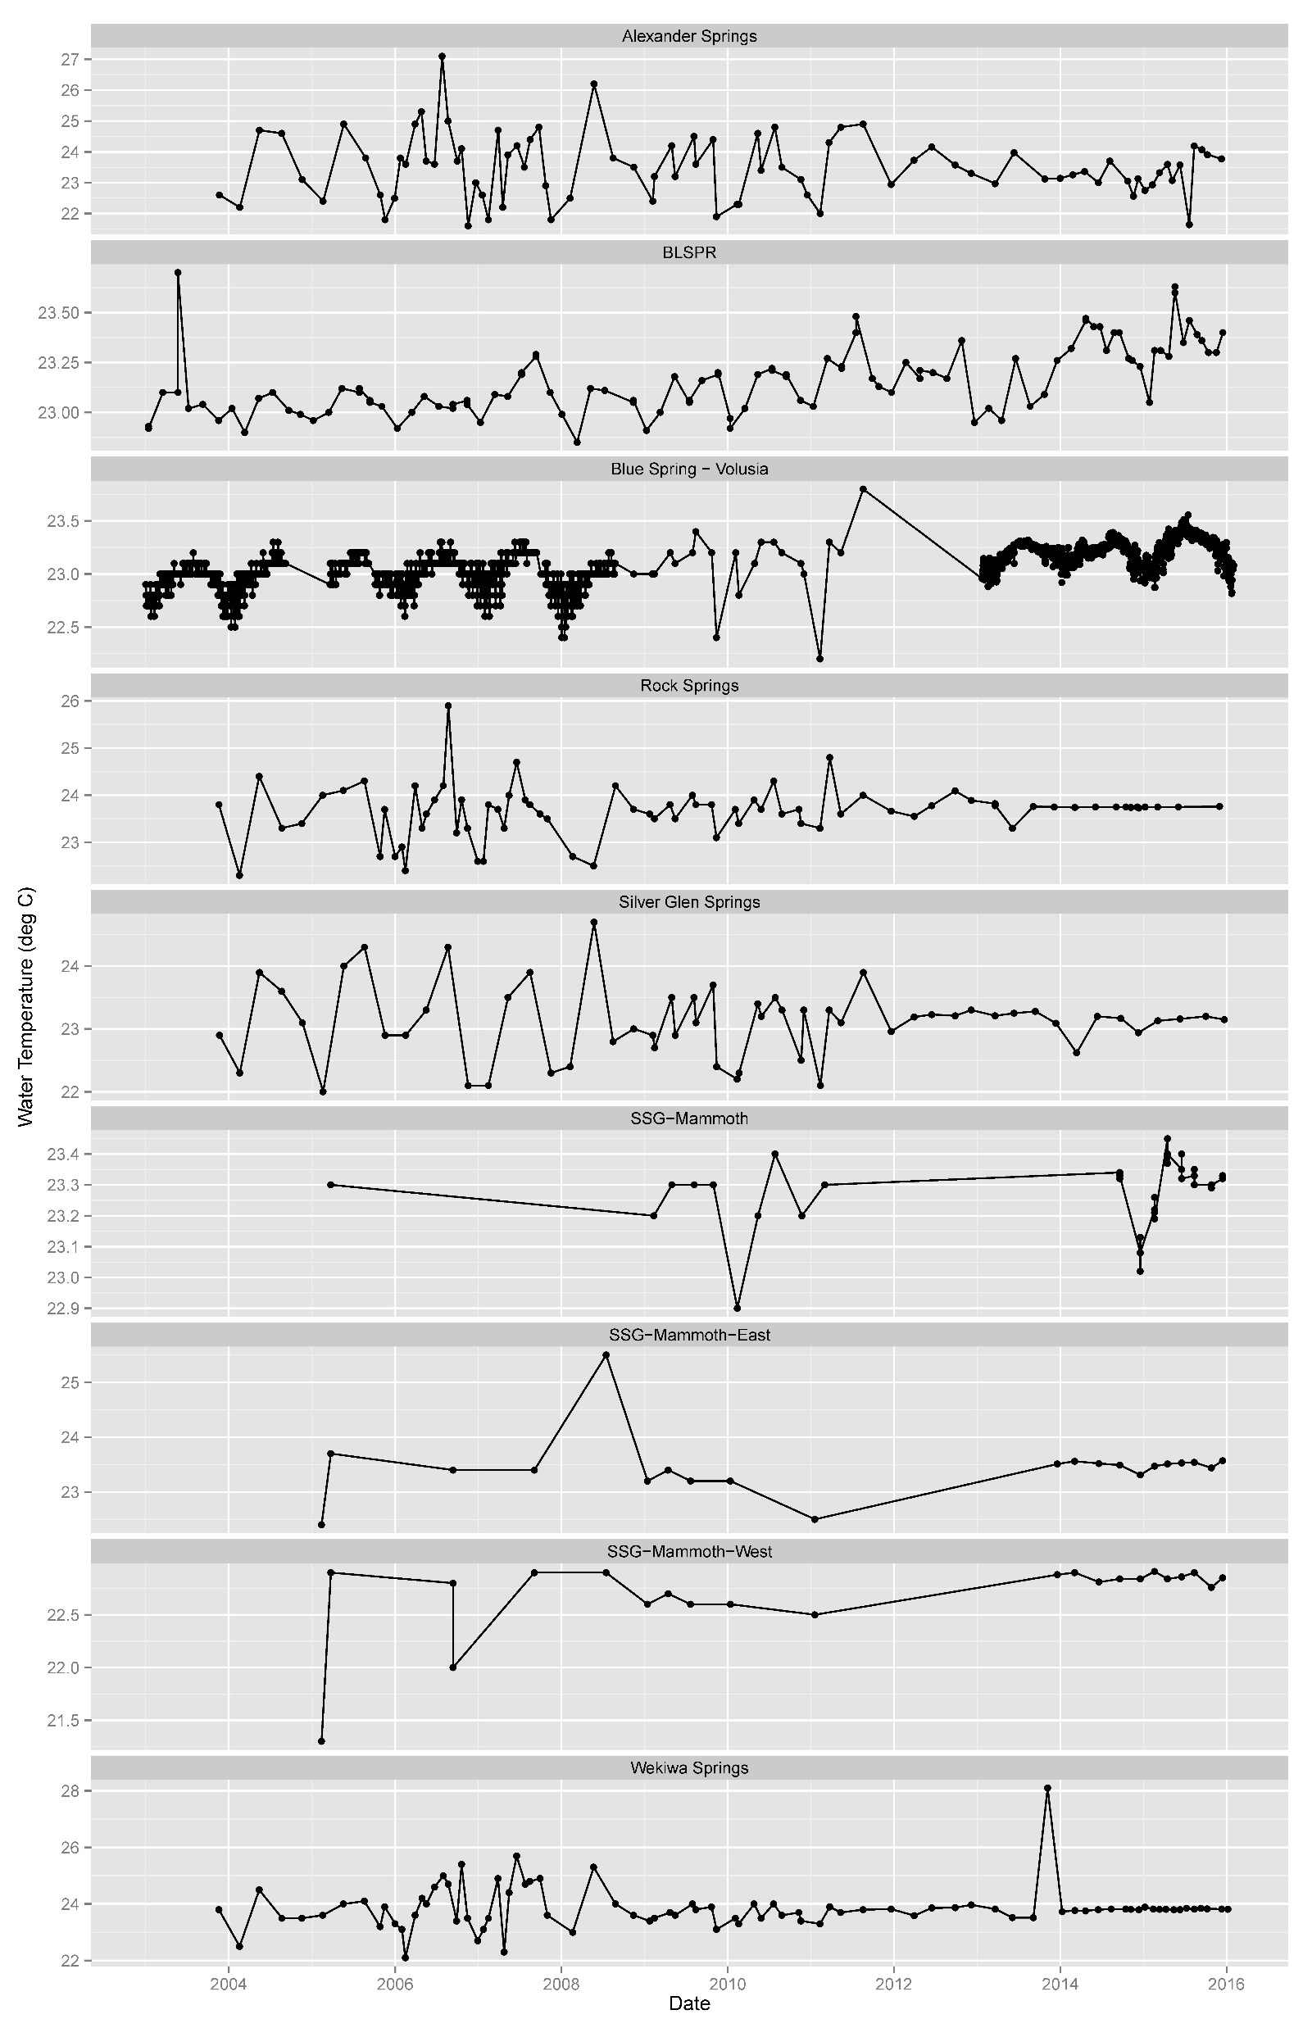
Guyette

Slide 5
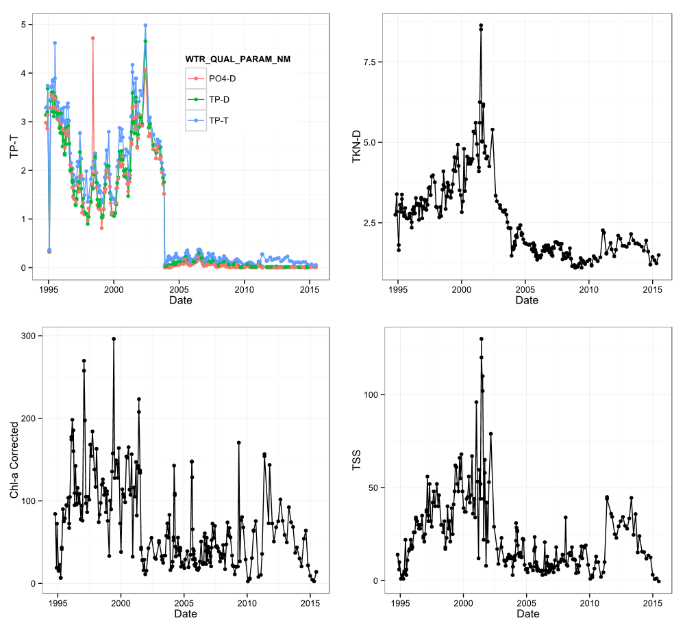
Canion
Notes:
Packages: ggplot2
Water Quality data from Emerelda Marsh showing pre and post alum treatment

Slide 6
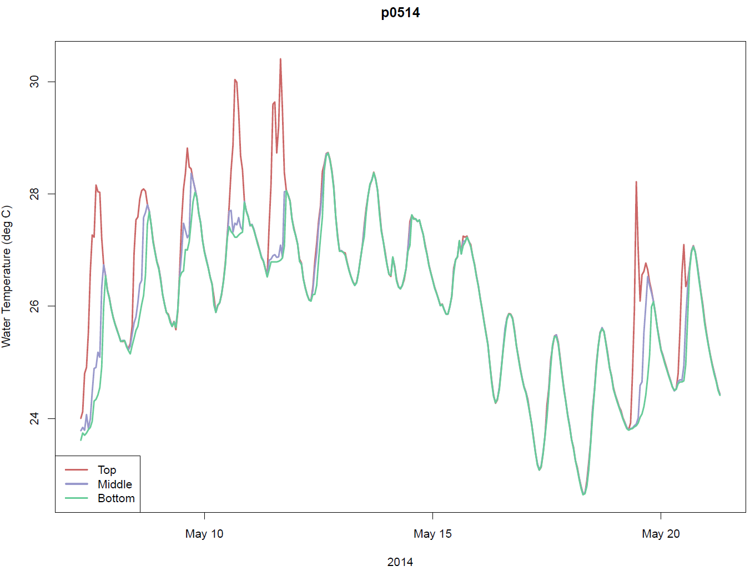
Guyette

Slide 7
Explore

Slide 8
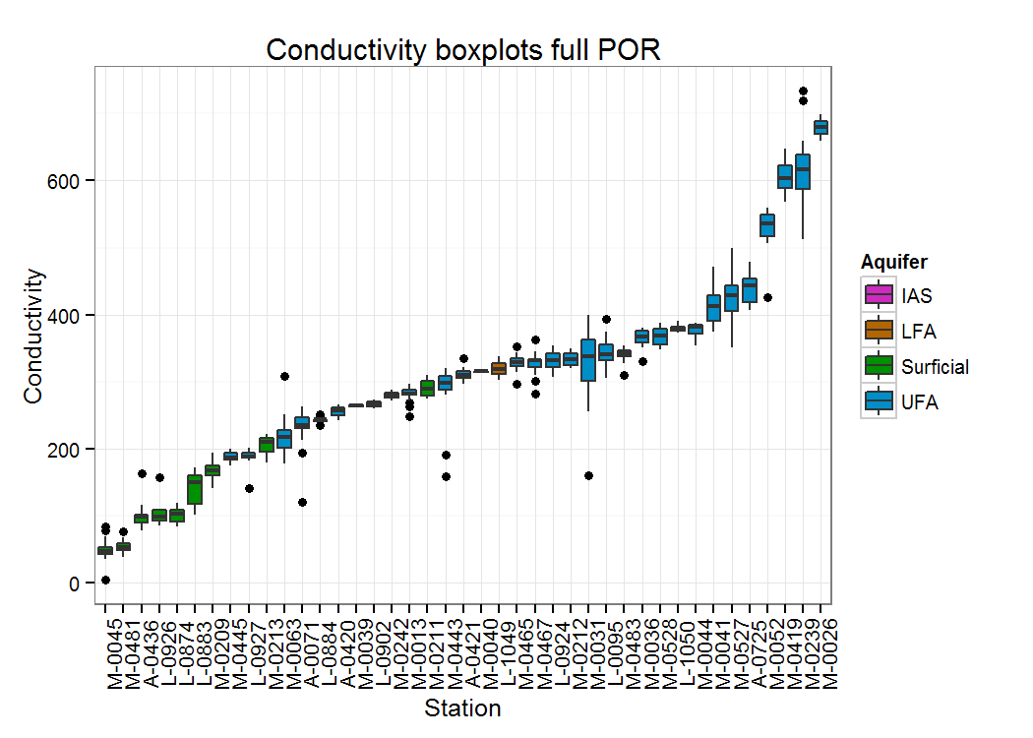
Canion
Notes:
Packages: ggplot2
Boxplots of conductivity for wells in Silver Springs area. Boxes are colored by aquifer.

Slide 9
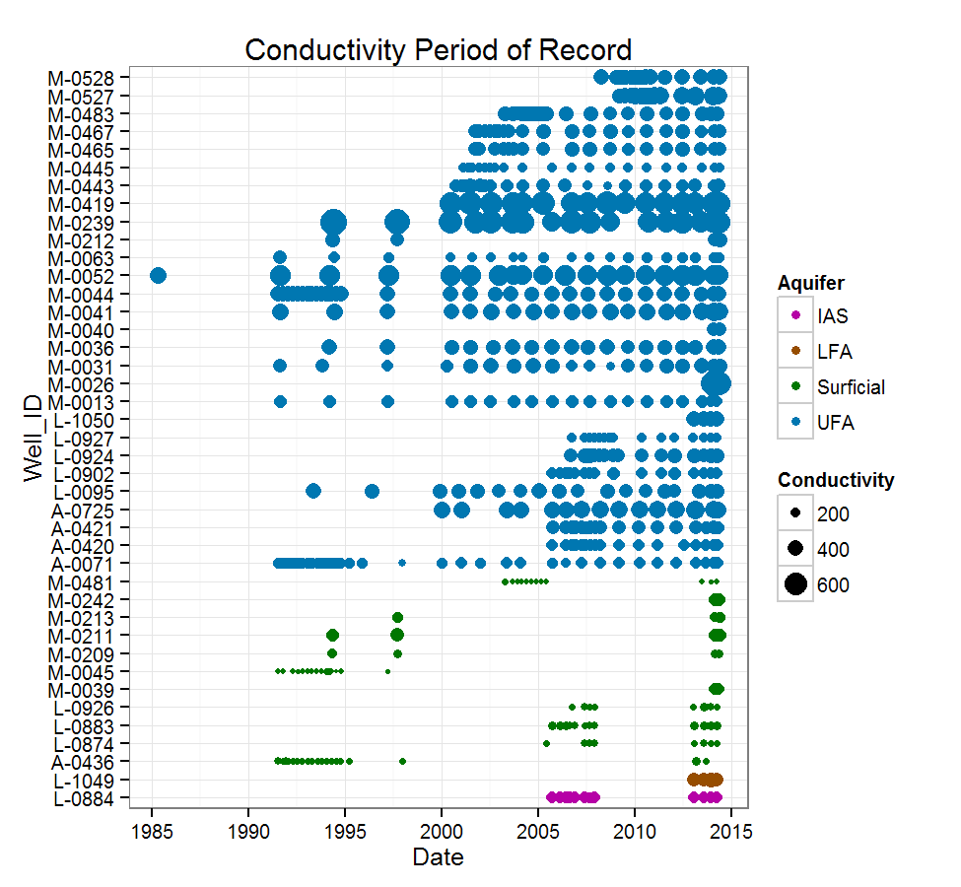
Canion
Notes:
Packages: ggplot2
Period of record plot for wells in Silver Springs area. Dots are colored by aquifer and scaled by conductivity value.

Slide 10
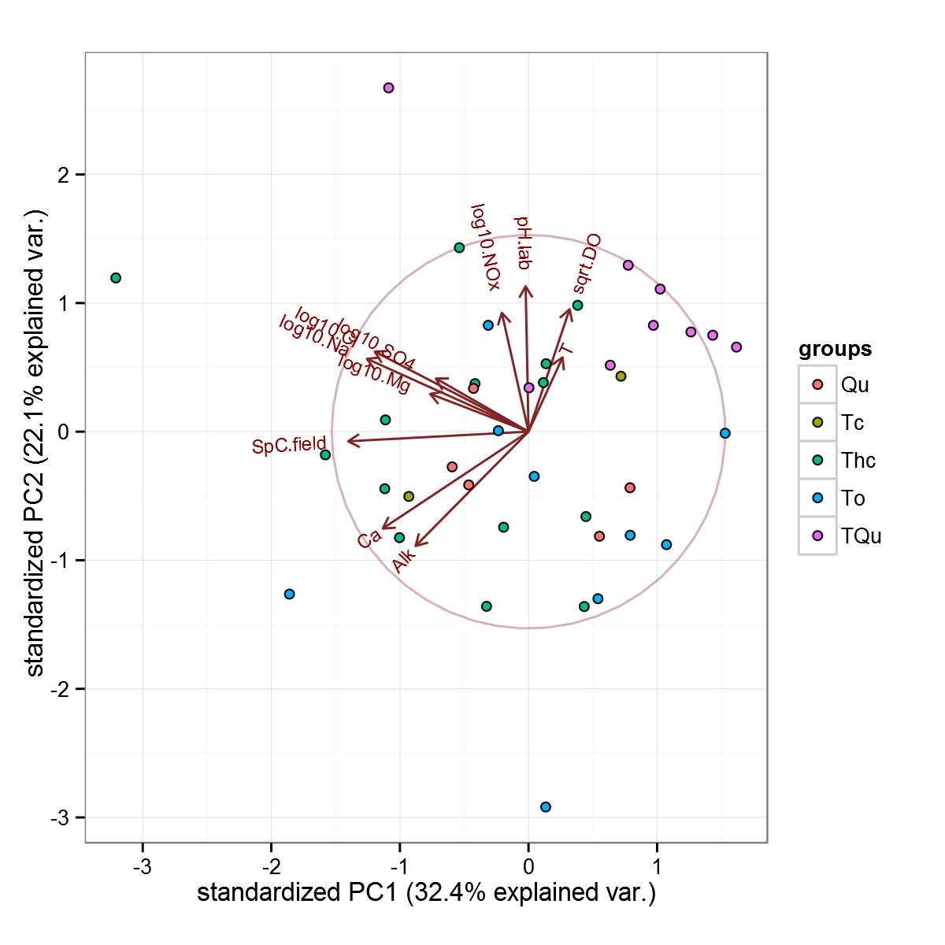
Canion
Notes:
Packages: ggplot2, ggbiplot
PCA biplot of water quality data for Silver Springs wells. Dots are colored by geologic formation.

Slide 11
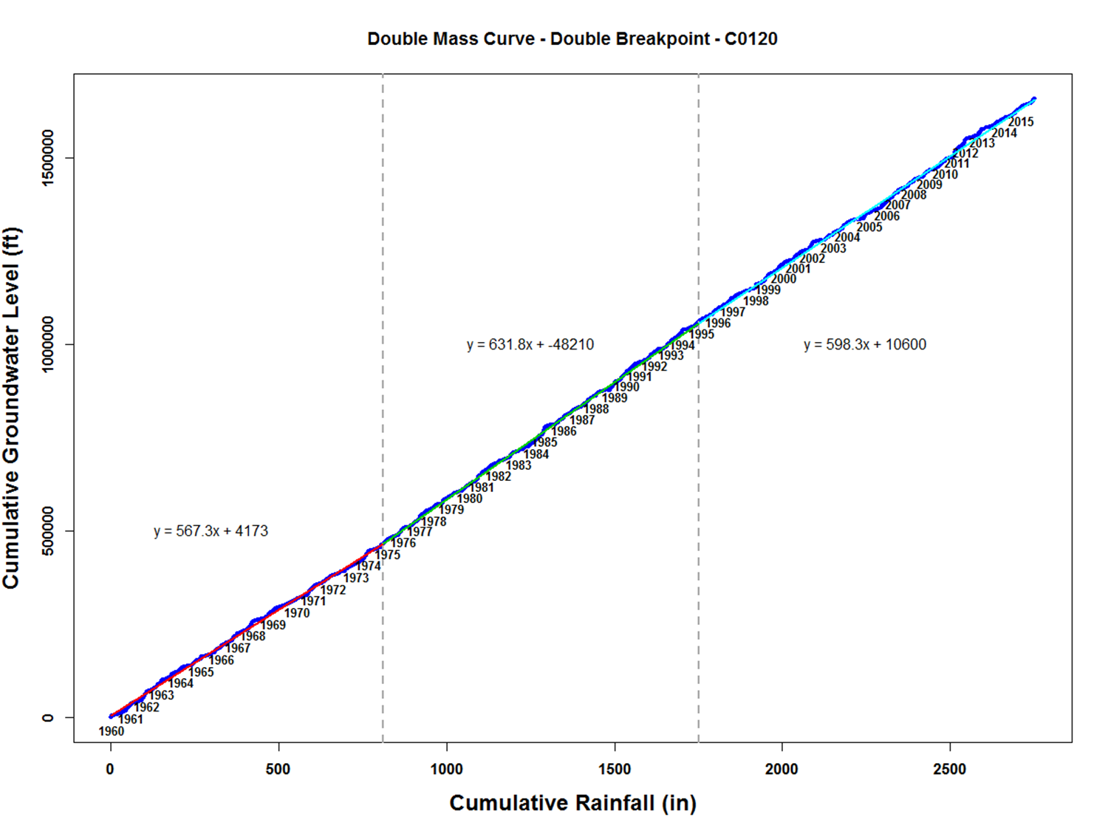
Guyette

Slide 12
Communicate

Slide 13
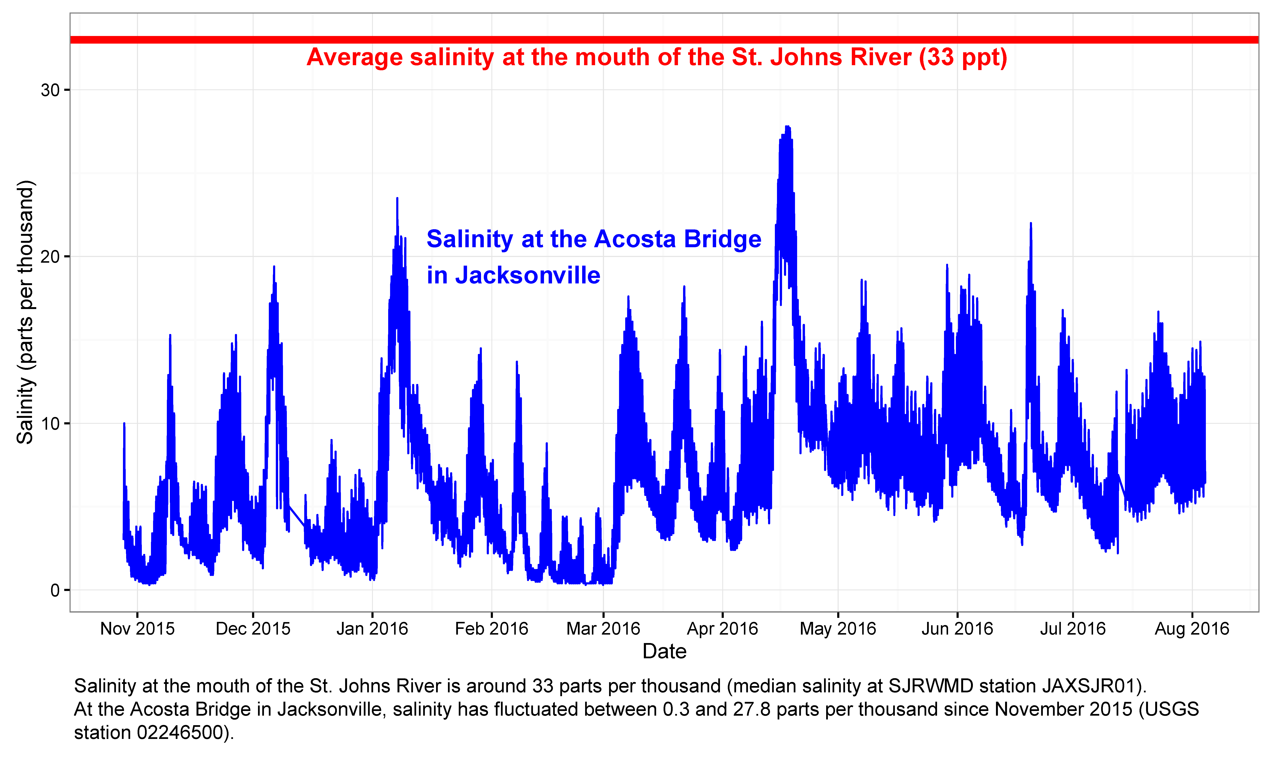
Guyette

Slide 14
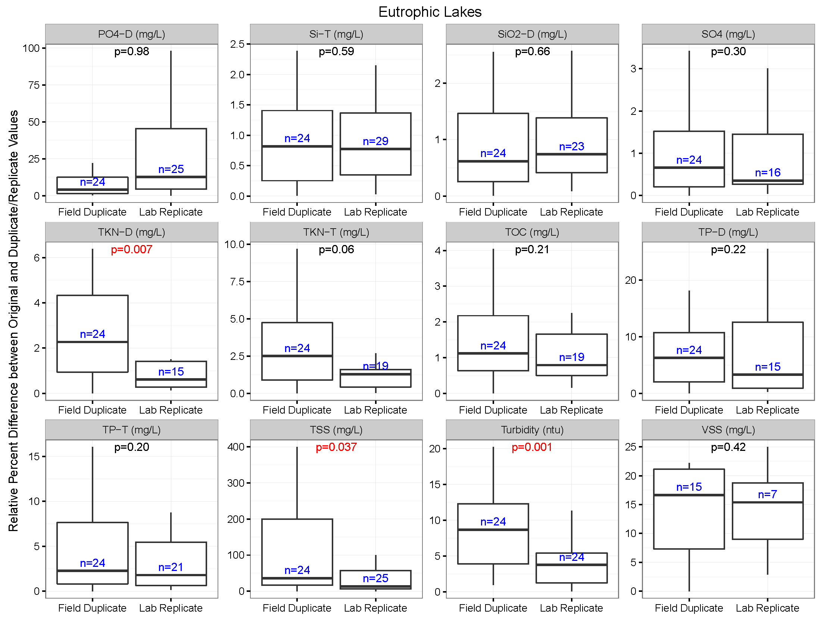
Guyette

Slide 15
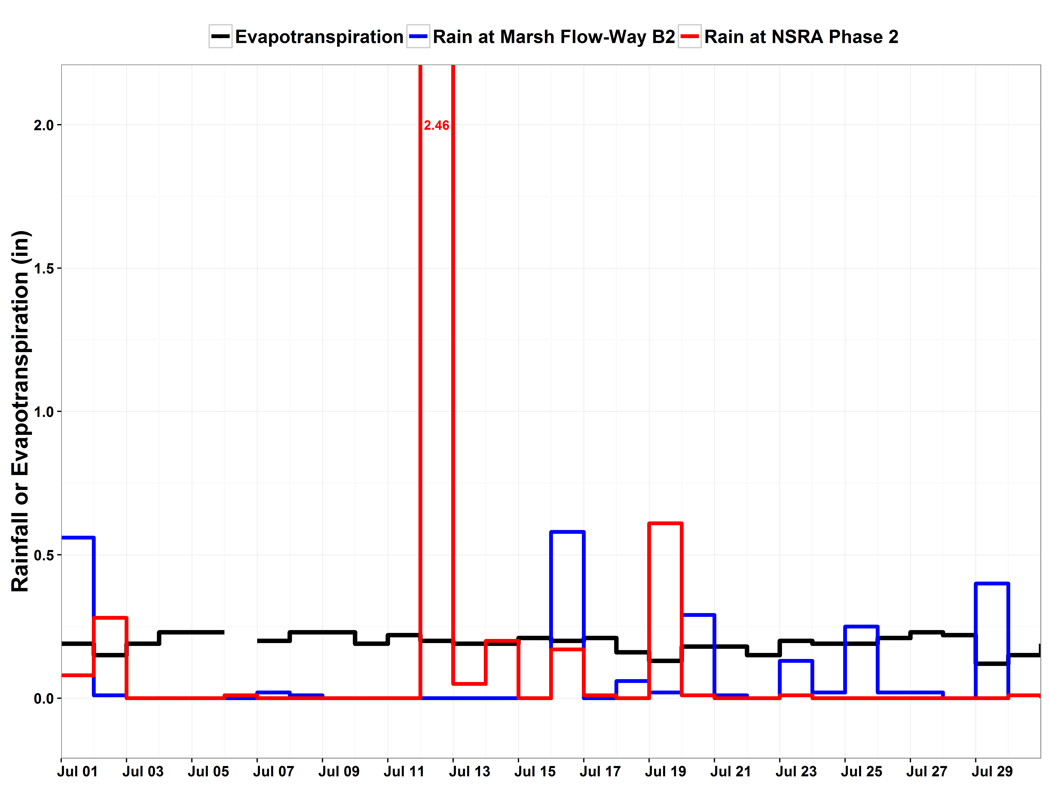
Guyette

Slide 16
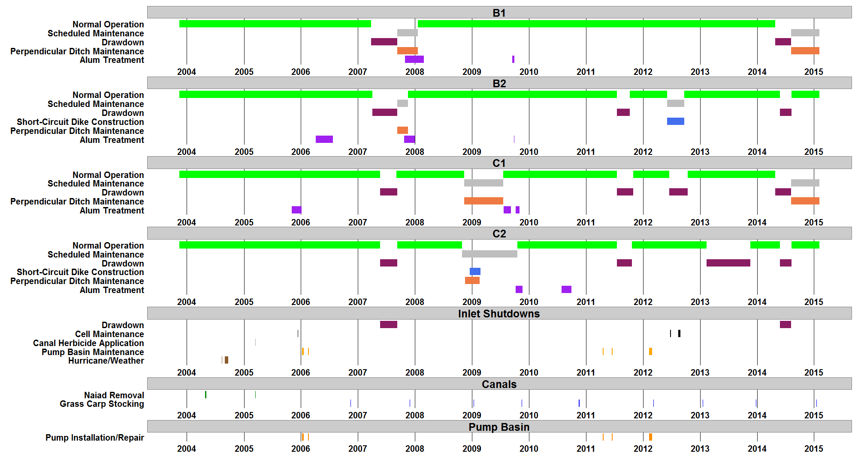
Guyette

Slide 17
ggplot2
R package
Created by Hadley Wickham, Chief Scientist at Rstudio
grammar of graphics plot

Slide 18
grammar of graphics plots
Layered components of the graphical display
data
aesthetic mapping (x, y, and more)
geometric objects
scales
statistics
facets

Slide 19
Basic function components
ggplot(data = yourdata,
aes(x = your_x_variable,
y = your_y_variable)) +
geom_point() +
scale_x_date(date_breaks = “1 month”,
date_labels = “%b %Y”) +
stat_sum() +
facet_wrap(~ your_grouping_variable) +
theme()

Slide 20
Demo

Slide 21
Resources
ggplot2 documentation site:
http://docs.ggplot2.org/current/
Cookbook for R:
http://www.cookbook-r.com/Graphs/
Quick-R dates:
http://www.statmethods.net/input/dates.html
Colors
http://www.cookbook-r.com/Graphs/Colors_(ggplot2)/
http://www.stat.columbia.edu/~tzheng/files/Rcolor.pdf

