Slide 1

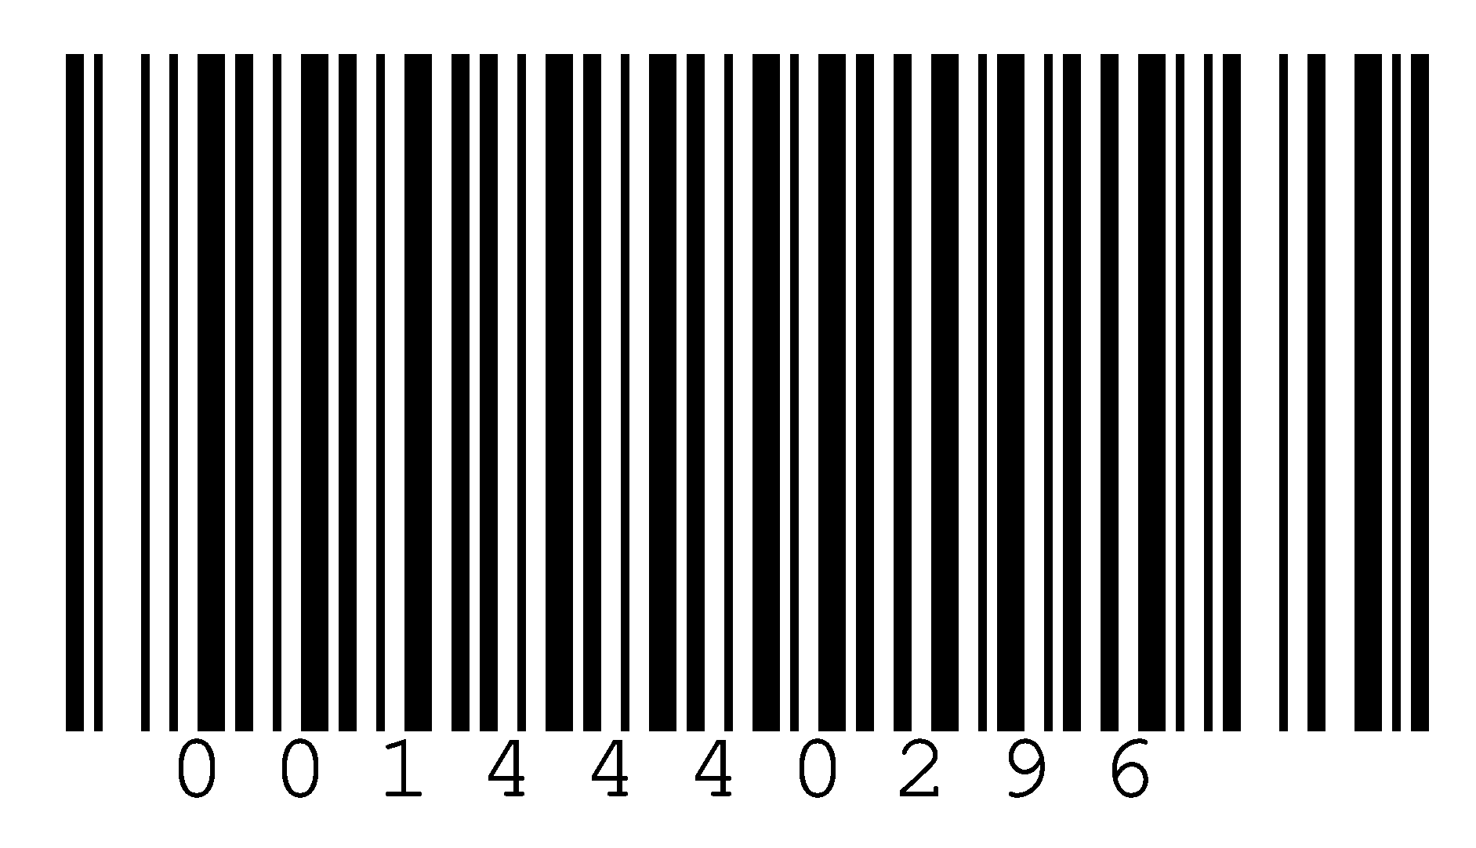
In this thesis, we introduce an unobservable message anonymization protocol named MessageVortex. It is based on the zero-trust principle, has a distributed peer-to-peer (P2P) architecture, and avoids central aspects such as fixed infrastructures within a global network. It scores over existing work by blending its traffic into suitable standard transport protocols like SMTP, making it next to impossible to block it without significantly affecting regular users of the transport medium. No additional protocol-specific infrastructure is required in public networks and allows a sender to control all aspects of a message, such as the degree of anonymity, timing, and redundancy of the message transport, without disclosing any of these details to routing or transporting nodes. We have made our prototype implementation publicly available and added an RFC-style document that contains all necessary information to build a MessageVortex node, see https://messagevortex.net/.
MessageVortex
Transport Independent, Unobservable, and Unlinkable Messaging
MessageVortex
Transport Independent, Unobservable, and Unlinkable Messaging
2021
Original document available on the edoc sever of the university of Basel edoc.unibas.ch.
This work is published under "Creative Commons Attribution-NonCommercial-NoDerivatives 3.0 Switzerland"
(CC BY-NC-ND 3.0 CH) licensed. The full license can be found at
http://creativecommons.org/licenses/by-nc-nd/3.0/ch/.

