Slide 1
Good Morning!
Content inspired by Jarrett Billingsley’s 449 notes

Slide 2
Questions?

Slide 3
How was the midterm??

Slide 4
How was the assembly lab?

Slide 5
Compilation – Overview

Slide 6
Compilation Process (Compilation Toolchain)
Preprocessor
Compiler
Linker
Loader
Everything starting with ‘#’ (i.e., #include). Exclusive to C
Converts C code into machine code (1s and 0s)
Turns pieces of programs into a ready-to-go executable
The OS loads the executable into memory (RAM) and starts the program, now called a ‘process’
Assembler step is here

Slide 7
Preprocessor
Preprocessor
Everything starting with ‘#’ (i.e., #include). Exclusive to C

Slide 8

Header files
iceberg.h
iceberg.c
Header files are the public interface
They contain public function prototypes and public variables
C files contain code
So, we could do #include “iceberg.h” inside titanic.c
We’ll see all iceberg’s public methods + use them in titanic.c
How? You’ll see during linking ☺
Preprocessor stuff, stuff with the ‘#’ doesn’t need ‘;’ at the end of it

Slide 9
Header files – include guards
#include “iceberg.h” – for your header files
#include <stdio.h> – established libraries
#inlucde “iceberg.h”
#ifndef _ICEBERG_H_
#define _ICEBERG_H_
//content
#endif
#ifndef _ICEBERG_H_
#define _ICEBERG_H_
//content
#endif
#define _ICEBERG_H_
//content
#ifndef _ICEBERG_H_
#define _ICEBERG_H_
//content
#endif
#define _ICEBERG_H_
//content
#inlucde “iceberg.h”
iceberg.c
#ifndef _ICEBERG_H_
#define _ICEBERG_H_
//content
#endif
iceberg.h
iceberg.c
iceberg.c
iceberg.c

Slide 10
Preprocessor
All preprocessor actions are just copying text into the c file
Like #define
#define CONST 1000
#define true false
😐 don’t do
#define PAGE_OFFSET_4KB(x) ((x) & 0xfff)
Called a ‘macro’
Parenthesis are important. Be very careful

Slide 11
Compiler
Preprocessor
Compiler
Everything starting with ‘#’ (i.e., #include). Exclusive to C
Converts C code into machine code (1s and 0s)
Assembler step is here

Slide 12
Compiler
.c file -> .o file (machine code)
Compilers are complicated
Compilers have built in assemblers
Yep that’s about it
Take compilers for in depth analysis

Slide 13
Object File

Slide 14
Object File
Not a program/process yet. No stack, heap, etc.
We have two main segments (sections):
.text
The machine code lives here
.data
Three sub-types
.data
globals
.bss
globals that init to 0
.rodata
read only data (aka. “Hello there”)
Can’t change values here

Slide 15
Symbol table
Symbol = name
Can actually use ‘nm’ in linux to see the symbol table of an object file
Symbol table = list of every thing in the file
Their name
What they are (function, var, etc.)
Which segment they’re in
Their address
Also lists stuff that’s not in the file… like printf!
.text
Symbol Table
main
check_user
globe
arr
_str_0001
.data
printf???
.bss
.rodata

Slide 16
Linker
Preprocessor
Compiler
Linker
Everything starting with ‘#’ (i.e., #include). Exclusive to C
Converts C code into machine code (1s and 0s)
Turns pieces of programs into a ready-to-go executable
Assembler step is here

Slide 17
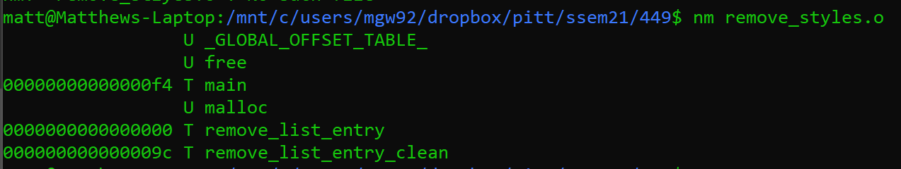
Symbol table – now time for the linker

Slide 18
The linker – linking all the parts together
Mostly linking together function calls from various parts of the program (they weren’t included in the sections mentioned previously)
Patching the holes in the previous
Like puzzle pieces
All done via function pionters
Linking is done based off names of functions + variables
So, no method overwriting like in java in C
Don’t name two functions the same thing!
Btw – the static keyword in C essentially means private from Java
Won’t be linked, other files won’t see it. Don’t put it in the header file

Slide 19
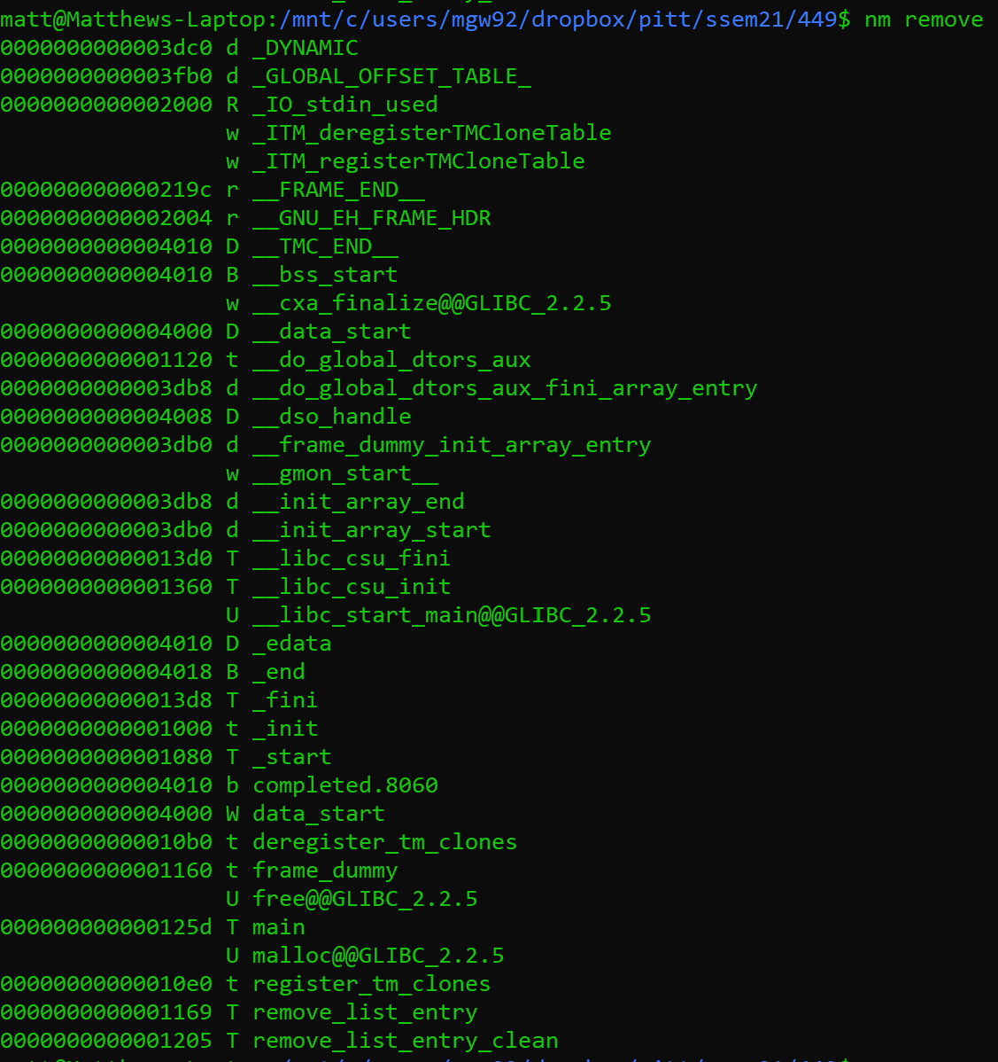
Symbol table – after the linker
gcc remove_styles.c
linker
This linking step is automatically done by gcc!
gcc –o remove remove_styles.c

Slide 20
I thought we were supposed to patch everything up?
Actually………………. two kinds of linking
Static
Dynamic
In some cases, the executable is actually ready to go
Static linking is when you put the entire library inside the executable
This is probably what you think usually happens
This makes the executable really portable! (usable on different machines)
But, if there’s a problem w/ the library, you must recompile everything and relaunch
Some programs take forever to compile
Also, the executable size is much bigger – harder to port
Dynamic linking is mostly done by the loader

Slide 21
Symbol table – now for the loader
Or statically link w/ the –static flag
https://www.systutorials.com/how-to-statically-link-c-and-c-programs-on-linux-with-gcc/

Slide 22
Loader
Preprocessor
Compiler
Linker
Loader
Everything starting with ‘#’ (i.e., #include). Exclusive to C
Converts C code into machine code (1s and 0s)
Turns pieces of programs into a ready-to-go executable
The OS loads the executable into memory (RAM) and starts the program, now called a ‘process’
Assembler step is here

Slide 23
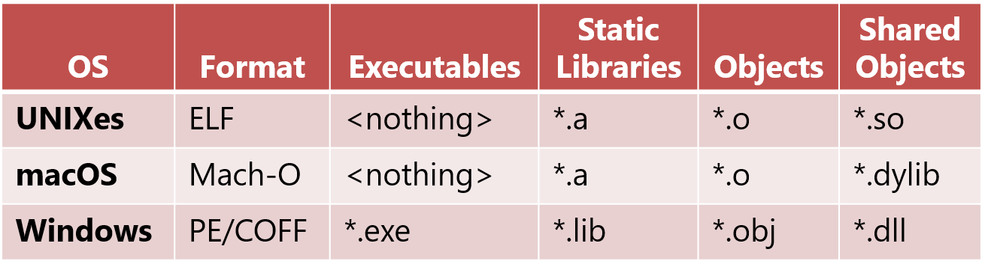
Loading
Loading is the last step and it’s actually done by the OS only when you do something like this:
./titanic
It does the following:
Dynamic linking
Setting up the program to be run inside the OS
We won’t go into all the gory detail

Slide 24
Dynamic linking (patching the holes still)
Since every file now needs libc (for stuff like printf), lets just have one local copy on the system
That local copy will be given to the program by the OS, then OS will do the rest of the loading process
It ports in a .so file instead of .a (archive file)
Shared object file

Slide 25
Use cases
Dynamic linking is the default now-a-days
Great for reducing executable size
Size will increase when it’s loaded into memory but whatever
The executable is the one that’s distributed
Static linking is old, not really used
I did actually use this once on an embedded system b/c it didn’t have libc.so or any other libraries
Probably used in other similar scenarios

Slide 26
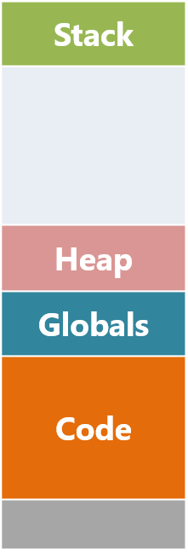
Actual loading into mem
These are now flipped – but same thing
other areas of memory are set up by the loader itself.
some parts are copied (almost) directly into RAM.
.data
.bss
.rodata
.text

Slide 27
Loading
This is all done by the OS
Does lots of other stuff too
Sets up the process’ virtual mem
Whaaaaatt?!
Find out later in the course, in 1550 (?), in 1651, in grad OS
Now that it’s loaded into RAM, the OS launches the program
The process starts execution

Slide 28
Running
Running! ☺
Preprocessor
Compiler
Linker
Loader
Everything starting with ‘#’ (i.e., #include). Exclusive to C
Converts C code into machine code (1s and 0s)
Turns pieces of programs into a ready-to-go executable
The OS loads the executable into memory (RAM) and starts the program, now called a ‘process’
Assembler step is here
Static linking
Dynamic Linking

Slide 29
That was a lot of info – questions?

Slide 30
Cache, outside looking in

Slide 31
Where is data stored?
Registers
Quick
Cache
Quick
Memory
Slow
Disk
Really slow
Server
Molasses

Slide 32
What is caching?
An intermediary that stores data from memory
We prefer this intermediary to interact with the CPU rather than memory
Usually having an intermediary is bad, more complicated
Not in this case

Slide 33
Why haven’t we seen cache before?!
Caching is done by the hardware in a good amount of modern systems
Depends on hardware
OS also optimizes chaching for us
User programs normally just sit back and let the abstraction happen*
*There are probably exceptions, especially in the HPC community

Slide 34
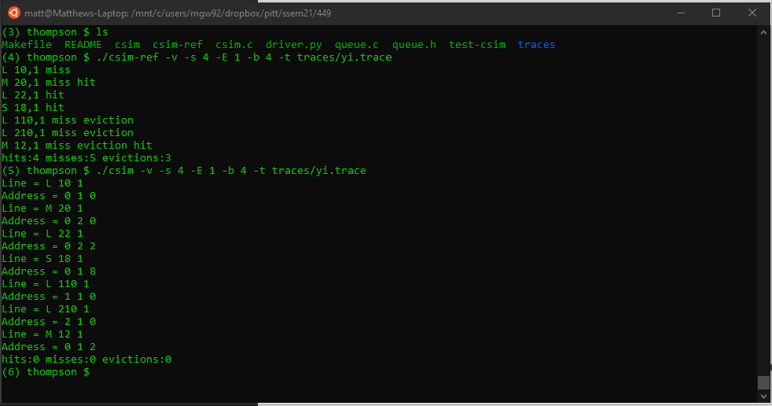
Lab Tip – Start w/ parsing, trying to get this:

Slide 35
Deadlines
Assignment | Due Date (at 11:59pm)
Wow. Beautiful ☺

