Slide 1

Good Morning!
Content inspired by Jarrett Billingsley’s 449 notes

Slide 2
Questions?

Slide 3
Please Participate in the Study!
https://pitt.co1.qualtrics.com/jfe/form/SV_dolruF7eLbBEkhn
It’s only like 5 mins and you get $15, $3/min

Slide 4
How was the pointer lab?

Slide 5
Review

Slide 6
The Stack
An area of memory provided by the OS for your program when your program starts
The stack grows and shrinks
Described as push and pop from the stack, respectively
Each program gets one stack
One thread at least
The stack grows downward!
From high to low

Slide 7
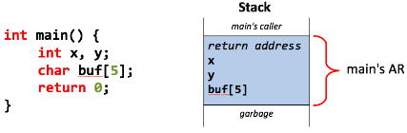
Activation Records
When a function is called, data is pushed onto the stack
Called a function’s activation record (or stack frame)
This AR contains local variables, arguments, and the return address of the function

Slide 8
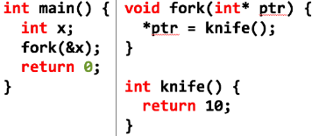
Activation Records (cont.)
Call = push
Return = pop

Slide 9
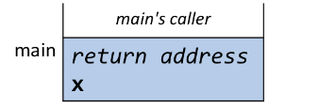
Activation Records (cont.)

Slide 10
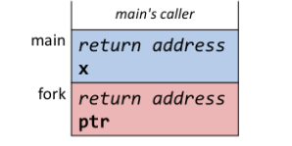
Activation Records (cont.)
Fork is the ‘callee’ here (the called function)

Slide 11
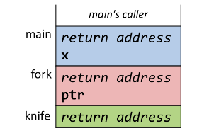
Activation Records (cont.)
Fork is now the ‘caller’ and knife is the ‘callee’

Slide 12
Activation Records (cont.)

Slide 13
Activation Records (cont.)

Slide 14
Stack Pointer
The stack is manipulated by pointers (wow what a surprise)
The stack pointer (sp) to be specific
Pushing the AR = sp down
Because the stack grows down
Popping the AR = sp up
Because shrinking the stack

Slide 15
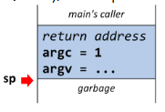
Garbage
Data is placed on the stack but never really goes away…

Slide 16
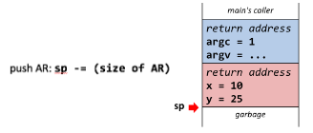
Garbage
Data is placed on the stack but never really goes away…

Slide 17
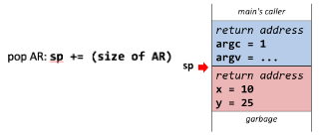
Garbage
Data is placed on the stack but never really goes away…
That’s why if there’s no null terminator in a string, you get garbage!

Slide 18
Garbage
Do not return a pointer to an array on the stack!!
Here
Because you’ll access a portion of the stack ‘doesn’t’ exist anymore
It’s out of our control – it’s not on the stack anymore!
In the below example, if we had a pointer to x, it’s value could be 10, could be 25, could be -10000000000000000, we don’t know! It’s garbage

Slide 19
Understanding Heap

Slide 20
Heap
Local variables are allocated…
To the stack!
What is their lifetime?
Global variables are put in the data segment of the program’s memory (OS) managed – last for lifetime of program
The heap is a programmer-managed area of memory (at least in C)
Not the heap data structure – that’s a different concept
You can create and destroy pieces of memory on the heap, on demand

Slide 21
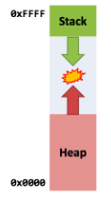
Heap
Stack grows down, heap grows up
Could collide, but unlikely on 64-bit systems – could be millions of bytes apart
If they do meet, the program is out of memory
Having them grow towards each other allows us not to have to predict their sizes

Slide 22
Accessing the Heap
You can put data on the heap using malloc()
Take data away from the heap using free()
Here

Slide 23
Heap Annoyances
1 malloc = 1 free
DO NOT FORGET TO FREE!
Memory leaks!
Your program can’t use that memory now ☹
Why are the pointers now s**t?
Same as stack example – if you use a pointer that’s not valid there will be a crazy amount of unexpected behavior!!!
Data there could’ve changed
Think of security implications
Check EVERY point of exit from a function or EVERY point after you stop using a variable to make sure you free!!

Slide 24
Heap Annoyances
You must initialize variables that you have!!!
After just mallocing, you’ll just have junk in your struct, int, string, whatever
Same as stack principle
Or just use calloc(sizeof(int), 1)
Allocates one item of size int * 1 and fills with 0s
Malloc will return NULL if it cannot allocate space!

Slide 25
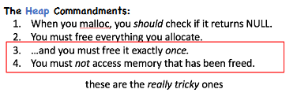
Heap ‘Rules’

Slide 26
Memory Leaks
Mathematically very difficult to garbage collect
Memory leak is when your heap memory becomes unreachable
When you don’t free anything but the pointer is gone, it becomes unreachable
Like when exiting a local function and the pointer on the stack goes away
Why didn’t you freeeeee!!!
Only way to deallocate is to exit the program
Program deallocates all the program’s memory

Slide 27
Lab Content

Slide 28
Discussion
Head = first node, tail = last node
Big-O discussion?
O(1) for size and insert tail
Reverse = reverse the order the node data is printed
Reverse the order of the nodes!
How can you change the order of the nodes?
No malloc or free
Please DON’T FORGET ABOUT THE NULL TERMINATOR!
For each string function you use, you must incorporate the null terminator, or else it’ll continue to read garbage stack/heap space!
Don’t forget about malloc’ing and free’ing the strings as well
https://www.tutorialspoint.com/c_standard_library/string_h.htm
Resource on string methods

Slide 29
Start Early
You have more time, but don’t underestimate this lab
Draw it on paper!!
Visualization
Keep it Simple Stupid (KISS)
Don’t look up code! Visualize, draw, etc.
Subsequent classes/projects will require knowledge of this!! Good that you learn now with us here to help

Slide 30
Deadlines
Assignment | Due Date (at 11:59pm)
Lab 3 (Linked List Lab) | Friday, February 26th
Homework 2 (C Programming) | Monday, March 1st
https://www.gradescope.com/

