Slide 1
Good Morning!

Slide 2
https://branchingcreativity.files.wordpress.com/2016/09/giphy-16.gif?w=328&h=328

Slide 3

Hi
My name is Matthew Wildermuth
But you guys can call me Matt
Senior, Computer Science major
Hispanic Language and Culture minor
My Interests…
Languages
Maps
Not using Java
Cycling, Triathlon
Formula 1
Soccer/Football
Baseball
OH = MW, 3-5pm, Slack. I am a student too though
I didn’t know better

Slide 4
This Course
This course will definitely make you a better programmer
You will begin to understand how a computer works, how things work ‘under the hood’
If you really like this course, you’ll probably like 1550
Take 1651! (If you get the chance)
You can take this knowledge and apply it to other languages, concepts
Everything is a file ahhhhh!!

Slide 5
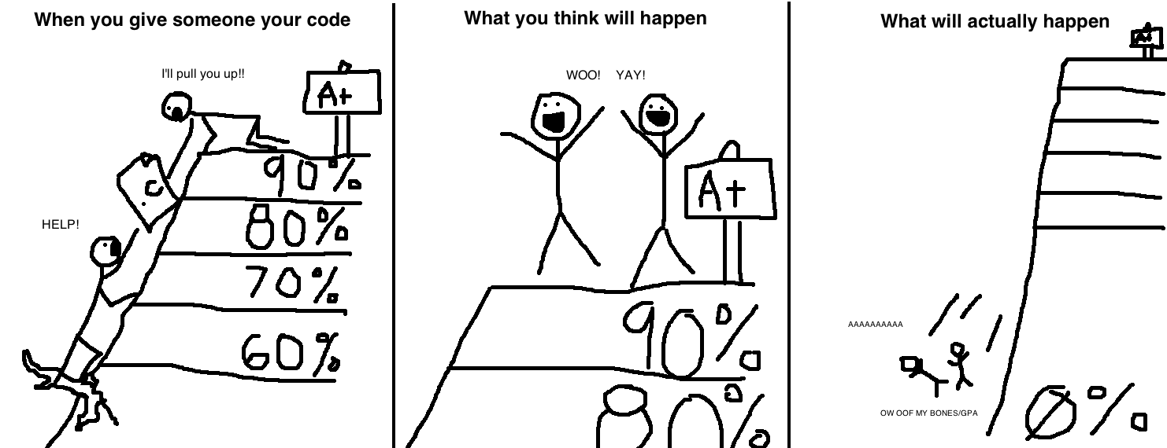
Don’t Cheat
https://jarrettbillingsley.github.io/teaching/classes/cs0447/

Slide 6
Recitations
At the beginning of recitations, we will review any general questions before we dive into anything
This is a place to ask questions, so please do! Others might have the same ones
If we run out of time for answering questions at the beginning – send me a slack dm or email with your question
Or come to office hours!
Book or just arrive
Please participate (I know it’s early)
Please read lab materials before coming to recitation (if applicable)
Please provide feedback: https://forms.gle/G5t2Zs7KprkTsQEu8

Slide 7
Setting Up a Workstation

Slide 8
Work on Thoth
This is the linux machine inside the CS department
What is linux?
A free, open-source operating system
Working on this linux machine allows you to have all the resources necessary without everyone each having to install their own versions
Easier to help debug too!
Well, how do I get to work on thoth? How do I connect to it?

Slide 9
Connecting to thoth
SSH – stands for Secure Shell
A way to access the shell program of another device remotely
Shell – the user interface that let’s you execute terminal commands
Like your programs!
FYI: Bash is the default linux shell – has more functionality
The GNU Project’s shell – collection of free software often found Unix systems, started by (guess who?!) the Free Software Foundation
GNU = GNU’s Not Unix!
Various different ways to connect to thoth using ssh

Slide 10
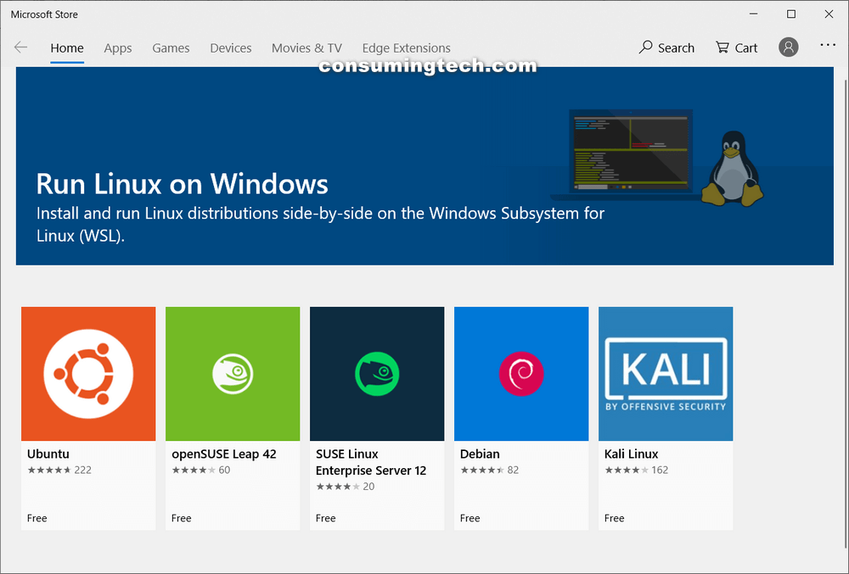
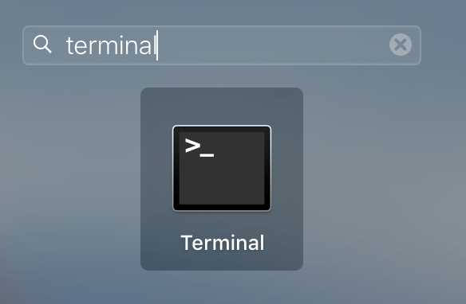

SSH
https://tophostcoupon.com/how-to-use-putty-to-connect-ssh-to-the-server/
https://consumingtech.com/install-windows-subsystem-for-linux-wsl-distros-in-windows-10/
http://crunchify.com/how-to-change-the-screenshots-save-file-location-from-desktop-to-other-folder-in-mac-os-x/

Slide 11
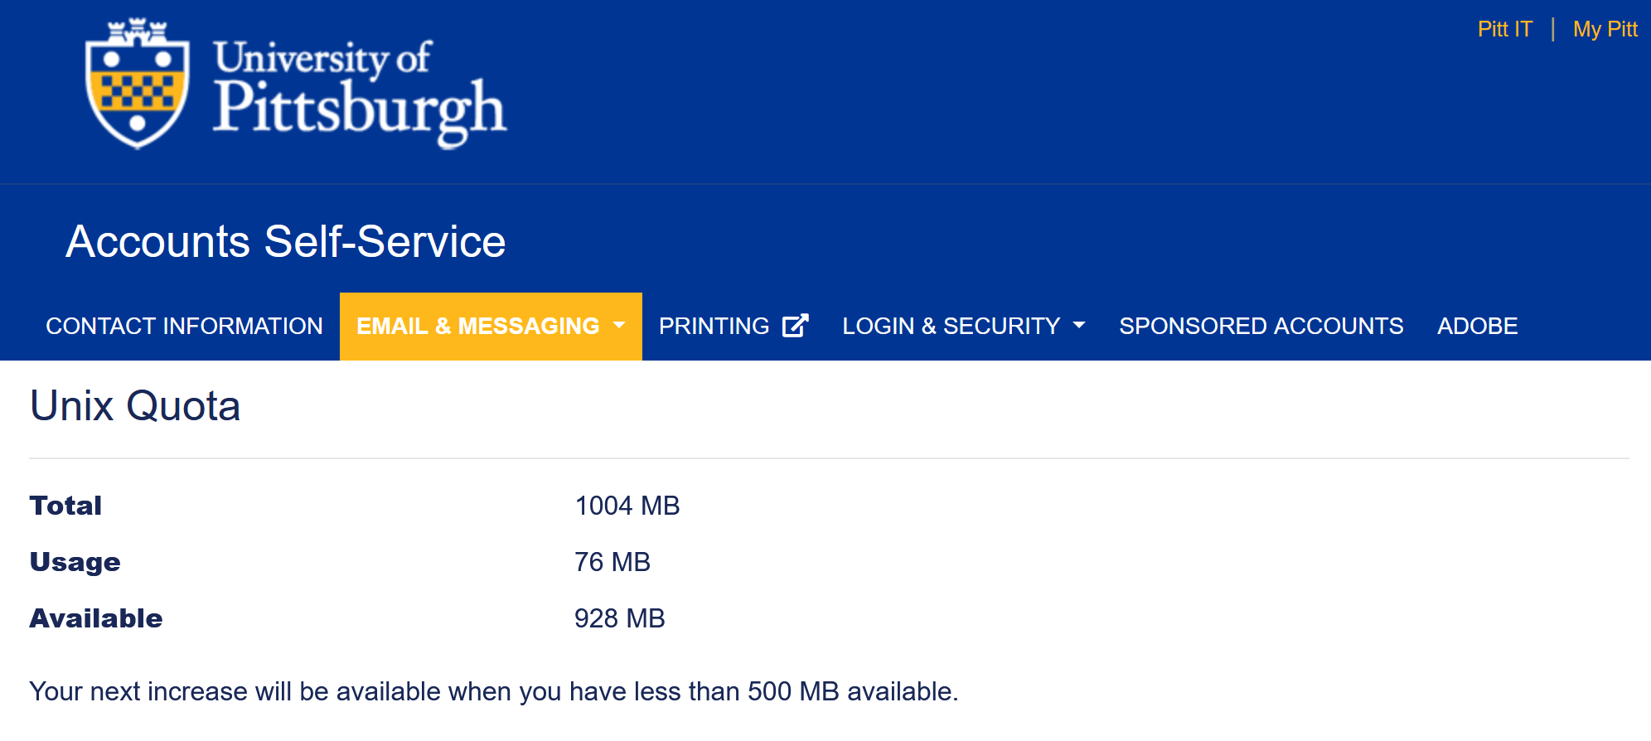
Before we do anything else…
https://accounts.pitt.edu/Unix/

Slide 12
Let’s Use Our Space
Find out what directory you’re in
AFS is down ☹
The shared file system we usually run on
Will not make an impact today
AFS backs up your files every day…
Don’t forget to backup your files though! Have a local copy!
Make a directory(folder) for the class (mkdir)
Remove a directory (rmdir)
List the items in the directory (ls [-l])
Rename a directory (mv)
Copy files (cp/scp)

Slide 13
Let’s Use Our Space (cont.)
Let’s perform the following operation:
wget https://bit.ly/2SLrNGA -O hello.c
Now let’s see what’s inside of it:
cat hello.c

Slide 14
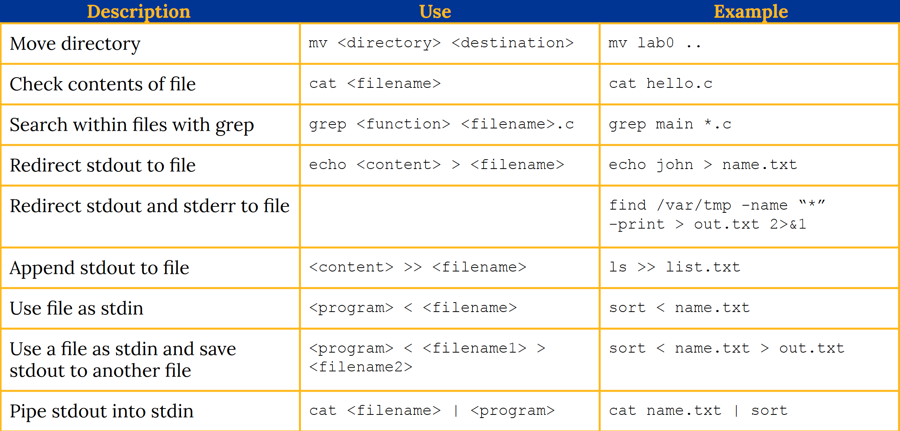
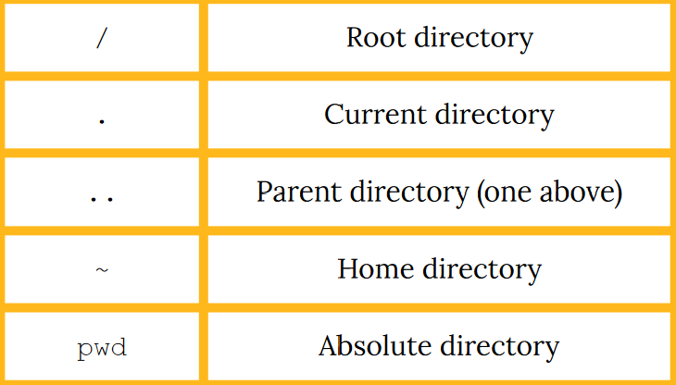
Useful Commands
https://mkd34.github.io/0.2_%20lab%200%20upload.pdf

Slide 15
Man
A command to bring you to the documentation – very useful
Can also look up info online this way

Slide 16

How do we get our own files on thoth?
FTP (SFTP) – file transfer protocol
Command line – the stuff given in the lab (scp)
Can also be done through code editors…
Atom
VSCode
Sublime
https://codexns.io/products/sftp_for_sublime
Word?! (no, please don’t edit on MS Word)

Slide 17
Working to Run a Program

Slide 18
What do we do now that we have the files?
Edit the file
Run the program

Slide 19
Editing files
Vim….?

Slide 20
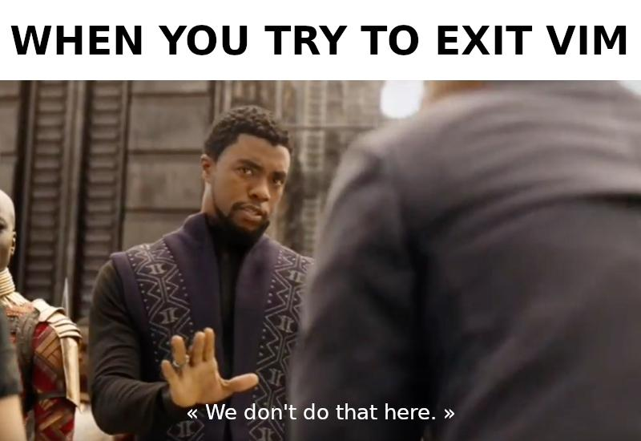
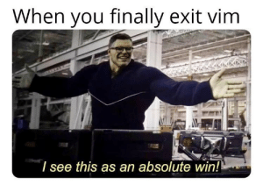

Slide 21
Editing files
Vim
https://www.openvim.com/
Keep in mind, pretty sure you can use the arrow keys to scroll around

Slide 22
Editing files
Vim
Nano
Code editor (highly recommended)
You will have to FTP files over, but the time/sanity you will save yourself… priceless
Can still use those small editors to fix small mistakes though if you don’t have FTP setup yet though

Slide 23
Compiling the program
Before we run, we have to compile!
gcc, clang
gcc hello.c [creates ‘a.out’ executable]
You’ll learn the steps like compiling, linking, etc. later in the term (how it goes from c to running in your terminal).
There is a better way of doing this though if you want to
gcc –g –Wall –Werror –std=c99 –o hello hello.c [creates ‘hello’ executable]
How can we make this easier though…
Automation!
Notes:
-g = turns on debugging symbols

Slide 24
Compiling the program… quickly
Shell scripts!
Let’s make one…
https://stackoverflow.com/questions/5725296/difference-between-sh-and-bash
Difference in using #!/bin/bash vs #!/bin/sh

Slide 25
Running the program
./hello (or ./a.out)
“When executing an executable, you need to prepend a file path in order to distinguish your command from a command like cp. The dot refers to the ‘current directory’“

Slide 26
Debugging
Programs never work first time
If they do, there’s still probably a runtime/logical error somewhere
Use print statements!
Print out the state of the program over time
Very useful to understand what’s going on, but there are a lot more... professional ways of doing this
That’s why we have gdb and valgrind

Slide 27
GDB
gdb is made by, again, GNU, and is a very useful tool to step through your program (kind like with what you did in MIPS)
With gdb…
You can set breaks in your code (as many as you want)
You can print out useful information like registers and variables
Use the split layout! It’s cool and useful
https://courses.physics.illinois.edu/cs225/fa2018/resources/gdb/
For more useful commands – simple

Slide 28
Valgrind
Used to check memory management problems
Most useful against…
Segfaults!
Segfaults (Segmentation Fault) are errors produced when you try and access memory that you can’t/are not allowed to access
Such a useless error message
Use –v for more info
https://stackoverflow.com/a/44989219
https://web.stanford.edu/class/archive/cs/cs107/cs107.1174/guide_valgrind.html

Slide 29
Thoth Workflow
SSH into thoth
Go into the right directory
Bring up FTP (if applicable) and a code editor
After the edits are made and the new file version is on thoth…
Compile and run! (Hopefully no errors)
If you seen an error, then debug using either gdb or valgrind

Slide 30
Don’t Forget the Gradescope

Slide 31
Useful Links
https://sites.google.com/view/cs449sp21/labs
http://www.pythontutor.com/c.html#mode=edit
Great resource – Great for this course especially
https://www.itexperience.net/file-extensions-file-explorer/
Shows how to enable file extensions – Windows
Useful C notes – will upload

