Slide 1
Good Morning!
Content inspired by Jarrett Billingsley’s 449 notes

Slide 2
Questions?

Slide 3
Calling conventions

Slide 4
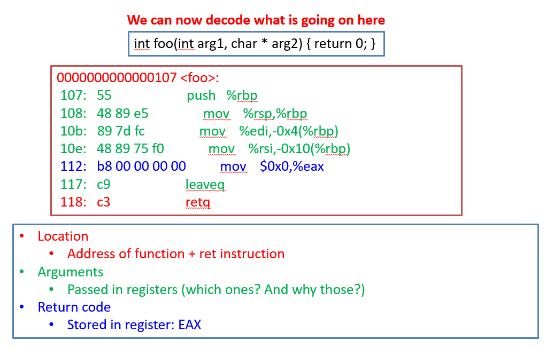
Back to this example

Slide 5
Accessing the stack
Push %rdx
Sub $0x4, %rsp
Mov %rdx, (%rsp)
Can also be done by referencing the %rbp
Pop %rdx
Mov (%rsp), %rdx
Add $0x4, %rsp
(rdx is the register to put the stuff in that you’re cleaning up)

Slide 6
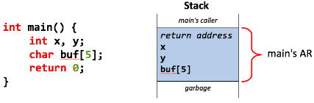
Remember when we did this?

Slide 7
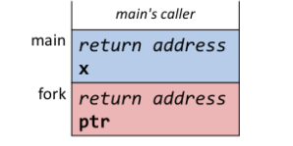
Remember when we did this?

Slide 8
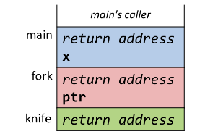
Remember when we did this?

Slide 9
Remember when we did this?

Slide 10
Remember when we did this?

Slide 11
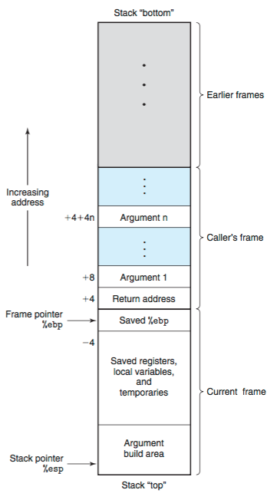
It’s actually a little more complicated – Calling Conventions
https://zhu45.org/posts/2017/Jul/30/understanding-how-function-call-works/

Slide 12
So… you’re about to call a function…
The top of this line acts as the stack pointer
Let’s say you’re in main (at address 0x1070) and you want to call function f

Slide 13
So… you’re about to call a function – Caller
~code for main~
sub $0xc, %rsp
mov $0x1 $0x8(%rsp)
mov $0x2 $0x4(%rsp)
mov $0x3 (%rsp)
Or it puts arguments in registers…

Slide 14
So… you’re about to call a function – Caller
sub $0xc, %rsp
mov $0x1 $0x8(%rsp)
mov $0x2 $0x4(%rsp)
mov $0x3 (%rsp)
call f
sub $0xc, %rsp
mov $0x1 $0x8(%rsp)
mov $0x2 $0x4(%rsp)
mov $0x3 (%rsp)
call f
add $0xc, %rsp
Caller cleans!
calls f and pushes main’s return address (0x1070) to the stack in one command

Slide 15
Function Prolog, inside function f
push %rbp
mov %rsp, %rbp
sub $0x8, %rsp
%rsp
%rbp

Slide 16
Function Prolog, inside function f
push %rbp
mov %rsp, %rbp
sub $0x8, %rsp
push %rbp
mov %rsp, %rbp
enter
Same as
%rbp
%rsp

Slide 17
Inside function f
%rbp
%rsp

Slide 18
Exiting function f – Function Epilogue
%rip
mov %rbp, %rsp
pop %rbp
ret
%rbp
%rsp

Slide 19
Exiting function f – Function Epilogue
%rbp
mov %rbp, %rsp
pop %rbp
ret
mov %rbp, %rsp
pop %rbp
leave
Same as
%rip
%rsp
mov (%rsp), %rbp
add $0x4, %rsp
Pop %rbp =

Slide 20
Exiting function f – Function Epilogue
%rbp
mov %rbp, %rsp
pop %rbp
ret
%rsp
%rip
will now return to 0x1070, the return address in main

Slide 21
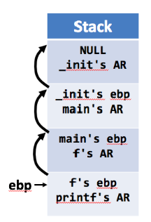
Rbp trickery
%rbp

Slide 22
Rbp trickery
Saved %rbp
%rbp

Slide 23
Rbp trickery
Saved %rbp
%rbp

Slide 24
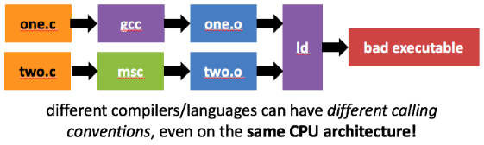
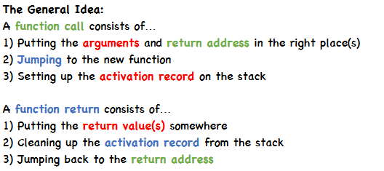
Conventions

Slide 25
We know what this all means now!!

Slide 26
Assignment Review + Example
Notes:
Steps:
Objdump – show the addresses, code
gdb over
Show gdb sheet
Show call from main to other_function
Disassemble main
Set break points:
b *main+24 (before call)
b *other_function+0 (done so it actually stops at first instruction)
b *other_function+8 (stop after enter call, pushing and setting now rbp)
b *other_function+26 (stop after local variables have been added)
b *other_function+91 (stop before leave instruction)
Run the program
Show stack at main+24, x/20gx $rsp
Print $rsp and $rbp
ni
Show stack to see how the return address has been pushed, x/20gx $rsp
Disassemble other_function
Do ni twice to get to pushing the $rbp from main
Show stack to see that, x/20gx $rsp
Do c to see how locals are pushed onto the stack
Stuff above variables is junk (stack was pushed down by 0x20, not 0x08 for the two variables)
Continue to see buffer overflow
Play with different length stuff and see how it affects the stack vars
This string representation on the stack is why we need hex2raw!
To see what happens in the return
Disassemble other_function to see where we are
Print rbp to see it before leave instruction
ni to see what happens on the stack w/ leave instruction, how rbp is popped
Print rbp again to show it change back to main’s rbp
See that the return address to main is still there
ni to see the return based off the address
Disassemble main to prove

Slide 27
Example from GitHub – what we did
Steps:
Objdump – show the addresses, code
gdb over
Show gdb sheet
Show call from main to other_function
Disassemble main
Set break points:
b *main+24 (before call)
b *other_function+0 (done so it actually stops at first instruction)
b *other_function+8 (stop after enter call, pushing and setting now rbp)
b *other_function+26 (stop after local variables have been added)
b *other_function+91 (stop before leave instruction)
Run the program
Show stack at main+24, x/20gx $rsp
Print $rsp and $rbp
ni
Show stack to see how the return address has been pushed, x/20gx $rsp
Disassemble other_function
Do ni twice to get to pushing the $rbp from main
Show stack to see that, x/20gx $rsp
Do c to see how locals are pushed onto the stack
Stuff above variables is junk (stack was pushed down by 0x20, not 0x08 for the two variables)
Notes:
How to compile with the correct flags:
https://stackoverflow.com/a/54394867
https://gcc.gnu.org/onlinedocs/gcc/Warning-Options.html#Warning-Options
Info on xmm registers: https://en.wikipedia.org/wiki/Streaming_SIMD_Extensions

Slide 28
What we did
Steps (cont.):
Continue to see buffer overflow
Play with different length stuff and see how it affects the stack vars
This string representation on the stack is why we need hex2raw!
To see what happens in the return
Disassemble other_function to see where we are
Print rbp to see it before leave instruction
ni to see what happens on the stack w/ leave instruction, how rbp is popped
Print rbp again to show it change back to main’s rbp
See that the return address to main is still there
ni to see the return based off the address
Disassemble main to prove

Slide 29
Helpful Lab Tips/Commands

Slide 30
Helpful GDB commands
https://users.ece.utexas.edu/~adnan/gdb-refcard.pdf

Slide 31
TIP
It brings an extra 00 at the end of your text
That’s considered for the null terminator by hex2raw

Slide 32
Main Tip: heavily use disassemble for functions. Then set breakpoints where you think something will change, step through (or c), and then print out the stack or a register

Slide 33
Midterm Review

Slide 34
Questions?

Slide 35
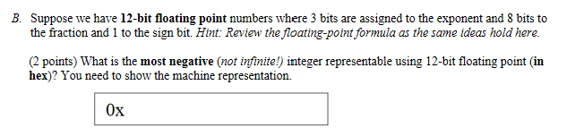
0xeff
Try and have highest exponent w/out infinity
1 110 1111 1111
0xeff
Keep in mind: having exp = 111 would mean infinity

Slide 36
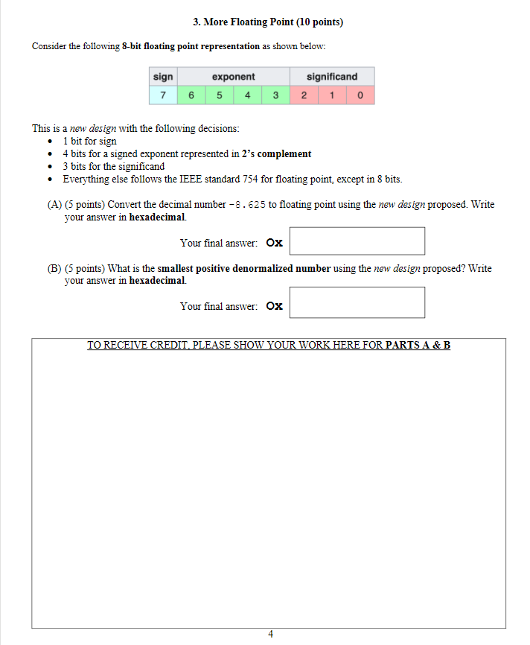
0x99
0x41
a)
-8.625 = -1000.101 or -1.000101 * 2^3
No bias b/c two’s complement representation. Exp = 0x0011
Ans = 1 0011 001 (001 b/c of rounding) = 0x99
b)
Again, two’s complement, no bias
Exp = 1000
Smallest is just with the lowest frac (001)
Ans = 0 1000 001 = 0x01
https://floating-point-gui.de/errors/rounding/

Slide 37
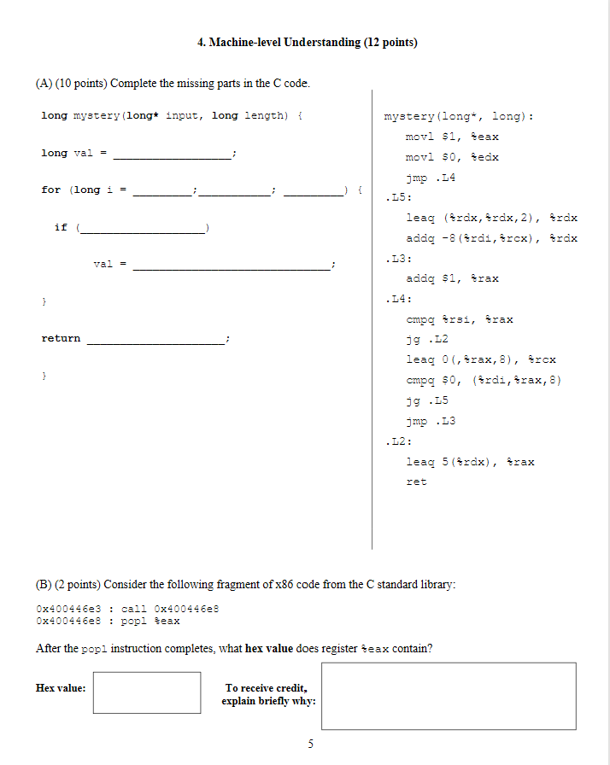
Val = edx/rdx
Input = rdi
Length = rsi
i = rax
mystery
0
L3
L4
1
i <= length
i++
input[ i ] > 0
Remember this just means rdx (val) = 3*rdx
Could say val = 3*val
Then val += input[i-1]
Remember, add is +=, not just +
L5
input[ i–1 ] + 3*val
It’s minus 1 b/c offset of 8 is the sizeof(long)
L2
(val+5)
rax = i . The times 8 is just multiplying i by the sizeof(long). C does this implicitly
Another comparison… if statement
rcx = i*sizeof(long)
Executes regardless of if statement
0x400446e8
Because the return address, the line after call, is pushed to the stack, that’s then popped of the stack and returned into eax since call just jumps to the next instruction and the ret address is never popped off by the callee

Slide 38
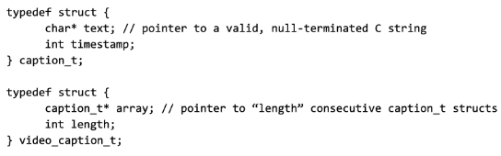

Please remember the common string.h functions (those used in the lab)

Slide 39
Deadlines
Assignment | Due Date (at 11:59pm)
Lab 4 (Assembly Lab) | Thursday, March 18th
https://www.gradescope.com/
Upcoming: Midterm next week!

