Slide 1

Good Morning!
Content inspired by Jarrett Billingsley’s 449 notes

Slide 2
Questions?

Slide 3
How was the data lab?

Slide 4
Review

Slide 5
Types
A way to categorize values
Determined based off what we can do with the data
You put the type in front of the variable name
int x;
float y;
char z;
Type constructors are where you create a new type based off the old one
In java, [] is a type constructor
You can stick [] to the end of any type to make that type an array – makes it a type constructor
Generics
Classes/structs = types, but the declaration = the type contructor

Slide 6
Understanding Memory + Pointers

Slide 7
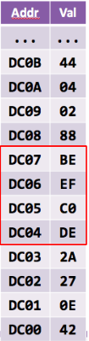
Memory
Memory is essentially just an array of bytes
Addresses start at 0 (just like array)
Each bit of an address points to one byte in memory
0x01 points to the first byte in memory
0x02 points to the second byte in memory
Etc.
The red is an int variable (4 bytes)
It’s address is 0xDC04

Slide 8
Max Size of Memory in a 32-bit System?
How about a 64-bit System?

Slide 9
sizeof()
sizeof(_type_) will tell you how many bytes something takes up
Type | sizeof(Type) | Print ‘code’
char | 1 | %c
int | 4 | %d
long int | 4 [8] | %ld
pointer | ? | %p
You can combine some types – i.e. long unsigned int (%lu)

Slide 10
What is a pointer?
It’s like a locker
Lockers contain things and they are identified by numbers
How do you get your stuff from your locker?
Go to your locker number and then take your stuff out from it
What if your friend wants to get stuff from your locker?
Give them your locker number! They’ll then be able to take stuff out

Slide 11
What is a pointer? (cont.)
Variables are like the lockers
They each have a number – it’s address
They each contain something – it’s value
To give access of your locker, give other people the locker number
Which is the memory address!

Slide 12
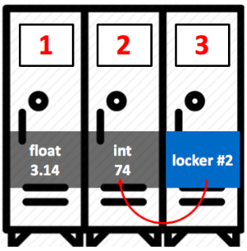
What is a pointer? (cont.)
Let’s put something in the third locker which says
the second locker’s number
The locker can now access itself (3) and the
locker it points to (2)
The locker # of locker 2 is the memory address!
You can access the pointer itself and the variable
that it points to!!

Slide 13
How to declare a pointer
int* ptr;
char* ptr;
struct my_struct* ptr;
You might see other ways like
int *ptr;
int * ptr;
All the same thing
I recommend using int* ptr
It’s more intuitive in my opinion

Slide 14
Pointer variables + values
int x; // integer
int* p; // pointer to an int
int** pp; // pointer to a pointer to an int
int* p = &x; // gets the address of the integer x
int** pp = &p; // get the address of the pointer to integer x
Can even use the & on functions! (Except temporaries – i.e. 5, &&x)
You might see other ways of declaring pointers like
int *p;
int * p;
All the same thing

Slide 15

Pointers
x
10
int x = 10;
int y = 20;
int* p = &x;
y
20
p
address of x

Slide 16

Pointers
x
10
int x = 10;
int y = 20;
int* p = &x;
p = &y;
y
20
p
address of y

Slide 17

Pointers
x
10
int x = 10;
int y = 20;
int* p = &x;
p = &y;
int** pp = &p;
y
20
p
address of y
pp
address of p

Slide 18
Dereferencing
x
10
int x = 10; int* p = &x;
p
address of x

Slide 19
Dereferencing
x
10
int x = 10; int* p = &x;
*p = 15;
p
address of x

Slide 20
Dereferencing
x
15
int x = 10; int* p = &x;
*p = 15;
p
address of x
Exception: Values inside structs are accessed through the ‘->’ dereference operator

Slide 21
Understanding Arrays

Slide 22
Arrays
Access values in that array through the [] operator
Same idea as java
int x[10]; // make an int array of size 10
x is a pointer!
Accessing items 0, 5
x[0]
x[5]

Slide 23
Accessing values
Didn’t we just say that we could use the * to get the value of a pointer?
All the following are equivalent:
x[2]
*(x+2)
*(2+x)
2[x]
offset[base], or *(base+offset)

Slide 24
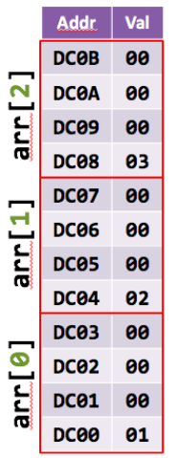
Why use an offset? – Arrays are just pointers
Let’s say we have
int arr[3] = {1, 2, 3};
arr points to address 0xDC00
sizeof(int) = 4 bytes
arr[1] means *(arr+1)
C implicitly multiplies the size of the item to the
offset
Like saying *(arr+1*sizeof(int))
arr[1] is at 0xDC04 not DC00

Slide 25
Understanding Lab Content

Slide 26
Within Same Block
Remember: each bit of a memory address points to a byte of memory
How many bits to express a 64-byte block?
2^x = 64 or ln(64)
x = 6
6 bits to represent the 64-bit chunk
0011 1111
0x3F
64-bit aligned block = address is in the same chunk (refer to above bullet)
How do I tell…?
Let’s look at an example

Slide 27
withinSameBlock Example
p1: 0x00 -> 0000 0000
p2: 0x3F -> 0011 1111
return 1;
p1: 0x00 -> 0000 0000
p2: 0x40 -> 0100 1111
return 0;
p1: 0x3F -> 0011 1111
p2: 0x40 -> 0100 0000
return 0;

Slide 28
Span
stringSpan(abcdefgh, abXXcdeZZh) = 5
Kinda like a substring, but just has to be in a row
abcdefg
abXXcdeZZh

Slide 29
Span
ab
ab

Slide 30
Span
ab__cde
abXXcde
Still in ‘order’

Slide 31
Span
ab__cde__fgh
abXXcdeZZh
Not still in ‘order’ – stop counting when out of order

Slide 32
Misc
You can cast to different types! Can even cast pointers…
int x = 5;
int* y = &x;
char* z = (char*) y; // the data is the same, but we look at it differently
The offset calculation now is *(z+offset*sizeof(char))
sizeof(char) = 1
We can now see the bytes at 0xDC00, 0xDC01, etc.
Only by incrementing z (i.e. z++)

Slide 33
Deadlines
Assignment | Due Date (at 11:59pm)
Lab 2 (Pointer Lab) | Monday, February 15th
Homework 1 (Data Representation) | Monday, February 15th
https://www.gradescope.com/

