Slide 1

Good Morning!
Content inspired by Jarrett Billingsley’s 449 notes

Slide 2
Questions?

Slide 3
How was the linked list (queue) lab?

Slide 4
How has the recitation been for you?

Slide 5
Review (Enough to get through traps + 1st buffer attack)

Slide 6
Why learn about assembly if compilers mostly write it?
OS operations are not typically expressible w/ higher level languages
  Atomic ops, page table management, system calls, etc.
  Don’t worry about these, just here for your curiosity
You can actually even write assembly in the c files directly!
  Again, don’t worry about it

Slide 7
Why learn about assembly if compilers mostly write it?
Like you learned in lecture, it’s important to understand assembly to understand the complex operations and conventions
With this understanding
  You’ll be able to better diagnose bugs
    Less time being frustrated ☺ (hopefully)
  You’ll know what’s actually going on under all that abstraction that 401, 445, 1501 teach you
    There’s a lot of abstraction
      Not in C!
      More so, not in assembly!
      More so, not in CPU architecture!
      Ok I’m done

Slide 8
x86
x86 might be unfamiliar
  Can get decently complex – more so just a lot of info and instructions
    Doubt we’ll go into that in-depth in this course
      If you want to go more in-depth w/ x86, especially from the software side, take CS1651 (advanced systems software)
But x86 is an entire CPU architecture, not just assembly
  We’ll mostly talk about the assembly portion

Slide 9
Assembly Basics
What makes up assembly code?!?
  Instructions
    Architecture specific (RISC vs CISC)
  Operands
    Registers
    Memory (specified as an address)
    Immediates
      Numbered constants
  Conventions
    Rules of the road and/or behavior models
    i.e., function calls!

Slide 10
Instructions

Slide 11
x86 Instructions
x86 is a CISC architecture
  Complex instruction something something
Ok, let’s look at some instructions
https://cs.stanford.edu/people/eroberts/courses/soco/projects/risc/risccisc/

Slide 12
OK NEVERMIND
Told you there are many and complex instructions
Might be useful if you need to look up specifics of an instruction
  Can go through table of contents and/or ctr+f for an instruction
Also good for general understanding of some concepts
  Searchable using the table of contents
But honestly… don’t bother with it in this course
  Lab provides you with link to some instructions w/ definitions

Slide 13
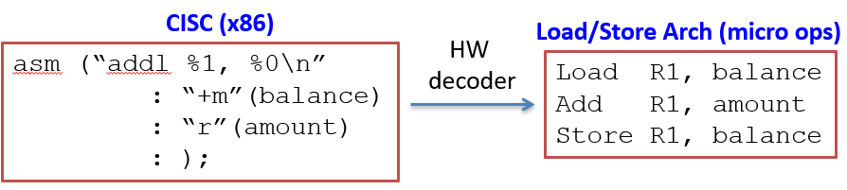
CISC instructions
You know that CISC instructions are a bit vague for the CPU, that’s why we have CPU microcode
Think of the inline asm as: addl %amount, (%balance)

Slide 14
Operands

Slide 15
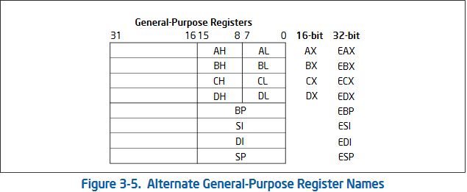
Registers
General purpose registers:
  16bit: AX, BX, CX, DX, SI, DI
  32 bit: EAX, EBX, ECX, EDX, ESI, EDI
  64 bit: RAX, RBX, RCX, RDX, RSI, RDI + others

Slide 16
Registers (cont.)
General purpose registers
Environmental:
  RSP, RIP
  RBP = frame pointer, defines local scope
    sp will be at the ‘top’ of the stack
    bp will be more towards the ‘bottom’ of the stack
      Bottom of current stack frame
    Might see the bp used often inside function stack operations
Special uses:
  Calling conventions:
    RAX == return code
    RDI, RSI, RDX, RCX… = ordered arguments
  Hardware defined
    Some instructions implicitly use specific registers
      RSI/RDI -> string instructions
      RBP -> leave, call

Slide 17
Memory
x86 allows us to more easily write assembly using memory operands
  Immediate addressing
    mov %rsi, ($0xfff000)
  Direct addressing
    mov %rsi, (%rbp)
  Offset Addressing
    mov %rsi, $0x8(%rax)
Base + (Index * Scale) + Displacement
  Occasionally seen
  Hardly ever used by hand
  movl %ebp, (%rdi,%rsi,4)
    Address = rdi + rsi * 4

Slide 18
8/16/32/64 bit operands
Programmer explicitly specifies operand length in operand
Example: mov reg, reg
  8 bits: movb %al, %bl
  16 bits: movw %ax, %bx
  32 bits: movl %eax, %ebx
  64 bits: movq %rax, %rbx
What about “movl %ebx, (%rdi)”?

Slide 19
Assembly syntax variants
There are two ways of writing x86
  AT&T
    We’ve been talking about this way the entire time
    Used almost everywhere:
      Compiler, other GNU tools like GDB, etc.
  Intel
    Better (imo)
You can set the type in gdb by using: set disassembly-flavor intel
Keep in mind that you’ll probably see more AT&T in this course and in general ☹
  Don’t forget it!

Slide 20
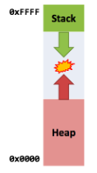


Syntax differences
Show w/ objdump
  man objdump to see args
AT&T
Intel
  DWORD PTR = 32-bit load/store
Take special note of the direction of operation!
Remember: new stack addresses are down, old are up

Slide 21
Conventions

Slide 22
Conventions
Remember:
  Stack holds activation records
    Calls push data to AR
    Returns pop data from AR
  ARs contain
    Return value, local variables, arguments (kinda like local variables)
Conventions describe the control flow of assembly language. They’re rules that everyone accepts and uses
  Kinda like the US dollar!
    It’s not backed by anything in particular, just the trust that we all value it
  With conventions, we all just do the same thing!
    Socially-accepted type of thing

Slide 23
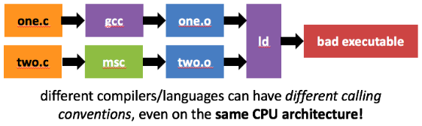
Conventions (cont.)
Conventions are not mandated by hardware, hardware just knows 1s, 0s
  They were created by programmers
Conventions for functions are typically abstracted away in HLLs (high level languages)
  Dealing with low-level software, they often rear their heads

Slide 24
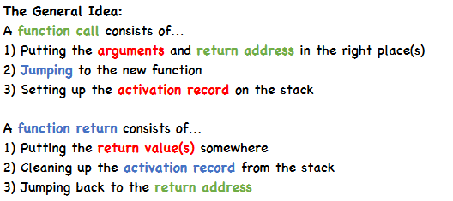
Calling conventions
Calling conventions are conventions for calling functions and define the ‘order of operations’
  We’ll always have stuff like the pc register, the stack, the sp register, along w/ other registers

Slide 25
Bringing it all together

Slide 26
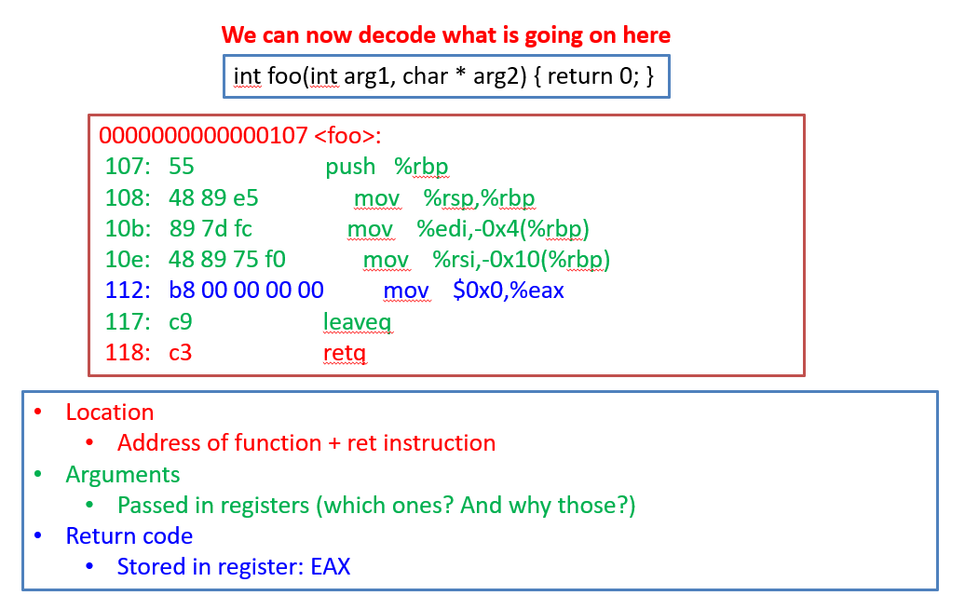
We know what this means! (for the most part)

Slide 27
Warning about the compiler
Compilers do a SCARY amount of optimization
Compilers can move instructions around and do whatever they please pretty much without your permission
  To you, compiler is a black box
Lesson: your c code -> assembly might look a bit different than when you hand-code the c function in assembly
  For instance, the compiler tries optimize register, memory use
    Functions where you hand-write using solely registers might not look like that after compiled w/ compiler like gcc
If you’re interested in a compilers, there’s a compiler course on it!

Slide 28
Helpful Lab Tips/Commands

Slide 29
Helpful Lab Tips/Overview
READ THROUGH THE ASSIGNEMNT FIRST
Targets are asking you for an input to ‘disarm’ the threat
  You have to look at the assembly, possibly step through, and see what input satisfies the ‘if statement’
  Please look primarily at the disassembled method, i.e. trap1
Give buffer overflow explanation
  Gets() doesn’t know how big array is, now variable could write to other regions of the stack!!
  Gets() only stops reading a string at the NULL terminator
  Overflow the buffer and view the stack in gdb to see this happen!
    Just make sure to set breaks in the right places so you can stop GDB after the stack has been modified
Tip: try to understand where to put break points (you’ll know how things are happening)

Slide 30
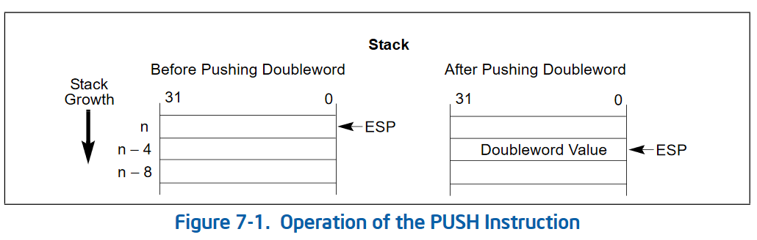
Helpful Lab Tips/Overview
Gets() doesn’t know how big array is, now variable could write to other regions of the stack!!
  Gets() only stops reading a string at the NULL terminator
  Overflow the buffer and view the stack in gdb to see this happen!
    Just make sure to set breaks in the right places so you can stop GDB after the stack has been modified
Tip: try to understand where to put break points (you’ll know how things are happening)

Slide 31
Helpful Lab Tips/Overview (cont.)
Inputs to hex2raw can have comments and new lines in them
  Take advantage of that to help make your exploit text files cleaner, easier for you to understand
  Important for buffer overflow ones!!
Use GDB to step though!
  Especially for buffer attacks

Slide 32
Helpful GDB commands
View stack
  x/20gx $rsp
View a register
  p $rax
View registers
  Info registers
    info reg, i r
Set disassembly-flavor
Disassemble function
  disassemble read_my_number

Slide 33
Helpful GDB commands (cont.)
Break at address
  b *read_my_number+59
    +59 is a specific instruction provided by gdb disassembly of the function
Next instruction (don’t use split layout for this – gives nasty ui)
  nexti
  ni
Jump back to previous line
  jump [mem to jump to]

Slide 34
TIP
It brings an extra 00 at the end of your text
  That’s considered for the null terminator by hex2raw
This will really screw you over and you might know why it’s broken
  I checked the stack and saw how it updated to figure it out

Slide 35
Main Tip: heavily use disassemble for functions. Then set breakpoints where you think something will change, step through (or c), and then print out the stack or a register

Slide 36
Deadlines
Assignment | Due Date (at 11:59pm)
Lab 4 (Assembly Lab) | Monday, March 15th
https://www.gradescope.com/

Slide 37
More on the Stack

Slide 38
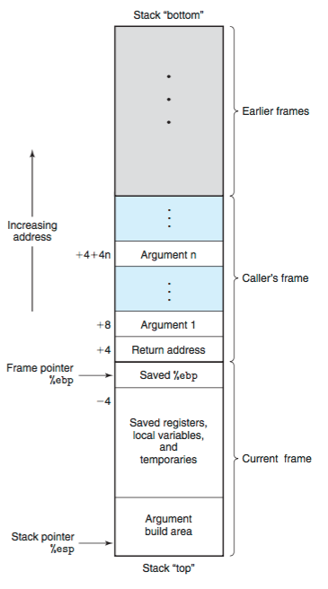
Caller-Callee Frame
https://zhu45.org/posts/2017/Jul/30/understanding-how-function-call-works/

