Slide 1
https://branchingcreativity.files.wordpress.com/2016/09/giphy-16.gif?w=328&h=328

Slide 2
Questions?

Slide 3
Data Representation

Slide 4
Basics/Review
8 bits = 1 byte
Ints = 4 bytes
Assume 32-bit system
Signed, unsigned

Slide 5
Basics/Review
There are different ways of writing numbers, but they’re all based on a similar idea
How much can we express with one digit??
The base in a number system is called a radix
Examples:
Decimal – base 10
32, 64, 128
Binary – base 2
0b00100000, 0b01000000, 0b10000000
Hexadecimal – base 16
0x20, 0x40, 0x80

Slide 6
Basics/Review
All numbers can be calculated like so:
~Get ready for some mathy-stuff~

Slide 7

Basics/Review
All numbers can be calculated like so:
$Num= \sum_{x=0}^{len}{(digit_value∗{radix}^{x−1})}$
What does this look like in practice? (where the digit is 1)
For a 4-char decimal number = 1*${10}^{3}$ + 1*${10}^{2}$ + 1*${10}^{1}$ + 1*${10}^{0}$
1,000 + 100 + 10 + 1
= 1,111
For a 4-char binary number = 1*$2^{3}$ + 1*$2^{2}$ + 1*$2^{1}$ + 1*$2^{0}$
For a 4-char hex number = 1*${16}^{3}$ + 1*${16}^{2}$ + 1*${16}^{1}$ + 1*${16}^{0}$
Why is hexadecimal used so much in computer science?

Slide 8
How many bits correspond with one hex digit?
How many hex digits in an int?

Slide 9
Basics
Binary representation
1110 0001
What is this in hex?
0xE1

Slide 10
Basics
Binary representation
1110 0001
What is this in Decimal (unsigned)?
225
What is this in Decimal (signed)?

Slide 11
Basics
Binary representation
0001 1110
What is this in Decimal (unsigned)?
225
What is this in Decimal (signed)?

Slide 12
Basics
Binary representation
0001 1111
What is this in Decimal (unsigned)?
225
What is this in Decimal (signed)?

Slide 13
Bit Operators
Name (Operator) | Example | Condition
AND (&) | 0x01 & 0x01 = 0x01 | A and B both true
OR (|) | 0x01 | 0x00 = 0x01 | A or B true
XOR (^) | 0x01 ^ 0x01 = 0x00 | A or B true, but not both
NOT (~) | ~0x01 = 0x10 | True when A is 0

Slide 14
Truth Tables
AND
OR
XOR
NOT
1 | 1 | 1
1 | 0 | 0
0 | 1 | 0
0 | 0 | 0
1 | 1 | 1
1 | 0 | 1
0 | 1 | 1
0 | 0 | 0
1 | 1 | 0
1 | 0 | 1
0 | 1 | 1
0 | 0 | 0
1 | 0
0 | 1

Slide 15
Bit Shifting
0001 1111 >> 3?

Slide 16
Bit Shifting
0001 1111

Slide 17
Bit Shifting
0000 1111

Slide 18
Bit Shifting
0000 0111

Slide 19
Bit Shifting
0000 0011

Slide 20
Bit Shifting
0000 0011
(0x03)

Slide 21
Bit Shifting
0001 1111 << 3?

Slide 22
Bit Shifting
What about a negative int??
1111 1000
(0xF8)

Slide 23
Bit Shifting - Signed
1111 1000 >> 2?

Slide 24
Bit Shifting - Signed
1111 1000

Slide 25
Bit Shifting - Signed
1111 1100

Slide 26
Bit Shifting - Signed
1111 1110

Slide 27
Bit Shifting - Signed
1111 1110
(0xFE)
The negative sign persists!
Keep in mind for the lab!

Slide 28
Bit Masks
Essentially just using the ‘&’ operation to identify a certain subsection of bits
0xFF is a popular example
1100 0011 1010 1001
&
0000 0000 1111 1111
-----------------------------
1010 1001
It doesn’t always have to be masked with 0xFF…

Slide 29
Exercises

Slide 30
Write pseudocode to get the nth bit, show as 1 or 0

Slide 31
Write pseudocode to create -1 using only <<, |, and ~
How about only using ~ ?
How about only using >> and << ?

Slide 32
Write pseudocode to bit flip using only ^ and <<, and |

Slide 33
Floating Point

Slide 34
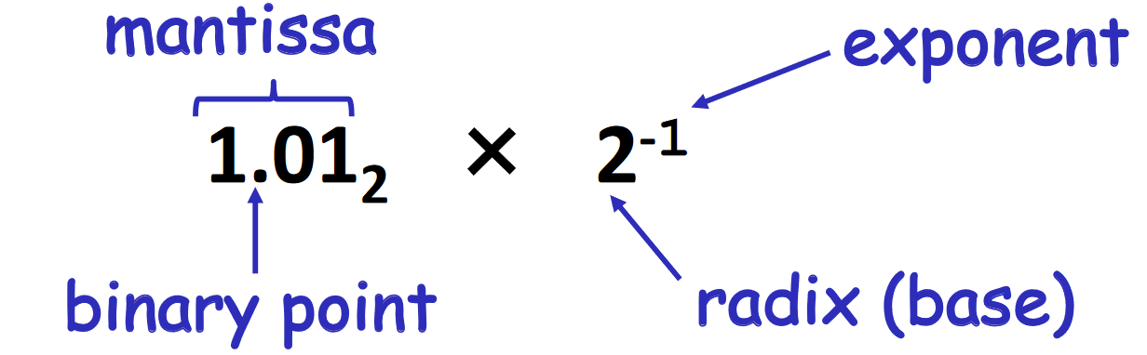

Floating Point

Slide 35
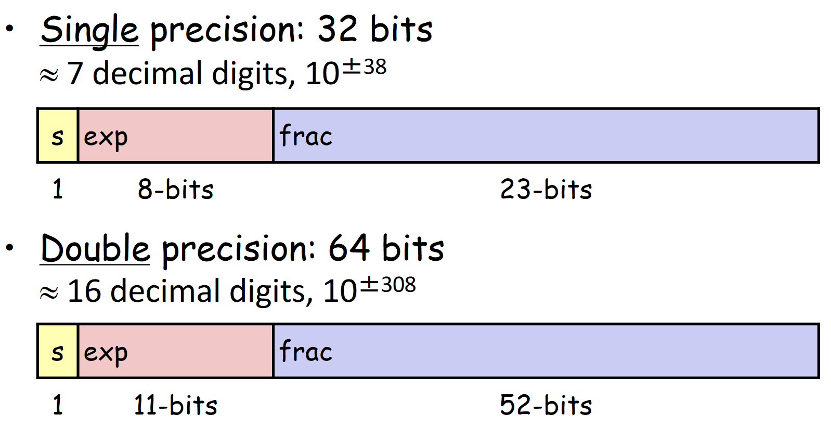
Floating Point

Slide 36
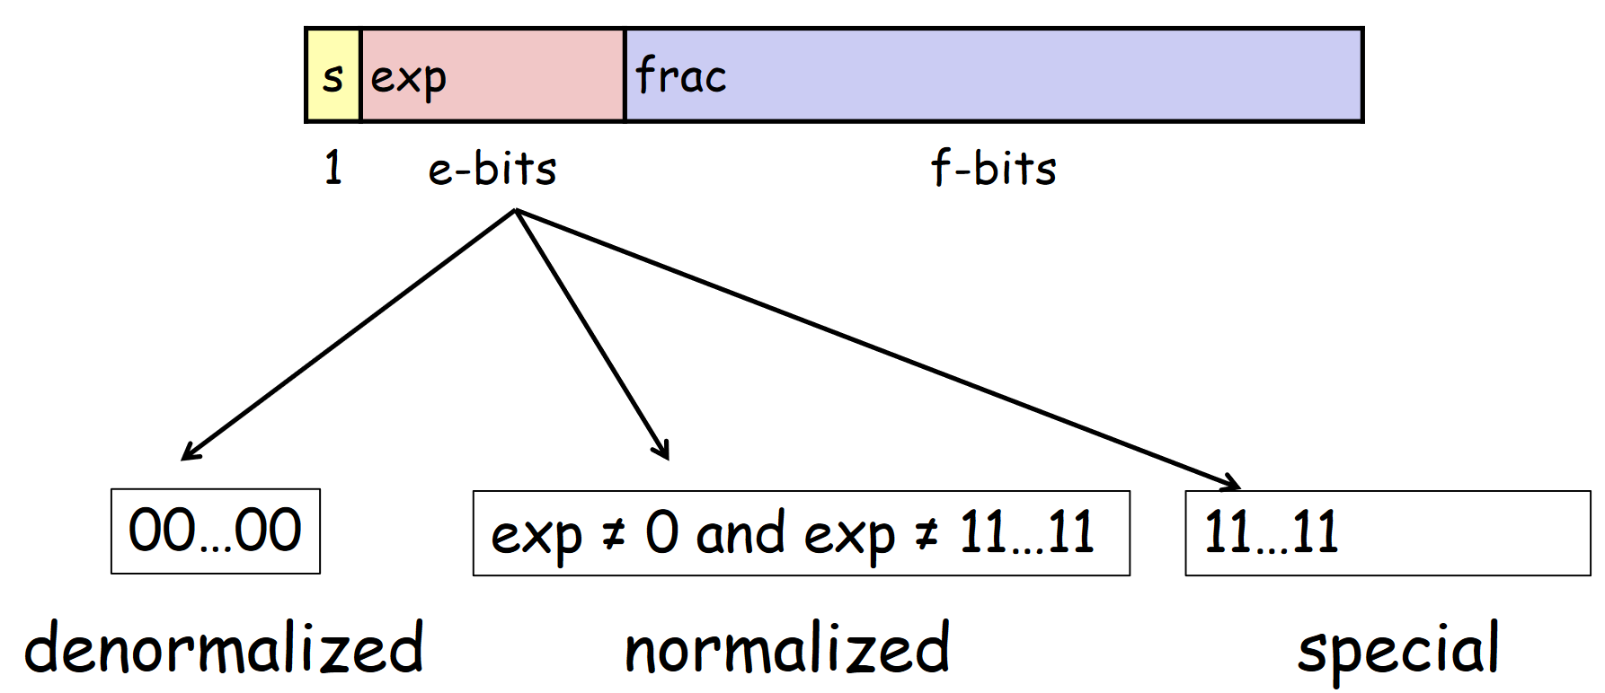
Floating Point

Slide 37
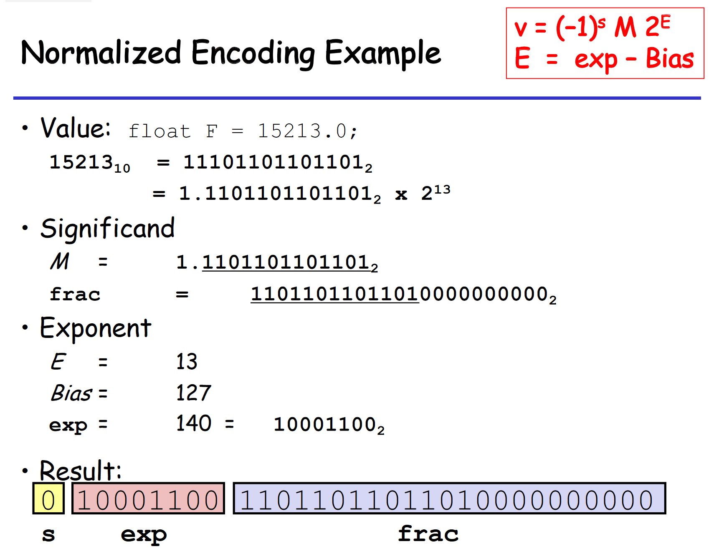
Floating Point

Slide 38
Lab 1 Specifics

Slide 39
Even Bits
Here are the even bits of 0xFF:
1111 1111

Slide 40
Two Bits
4 can be represented as:
0000 0100
Represented as 0100 in 4-bit notation
-4 can be represented as:
1111 1101
Represented as 1101 in 4-bit notation
Represented as 101 in 3-bit notation
Same thing?
5 can be represented as:
0000 0101
Represented as 0101 in 4-bit notation
Represented as ----- in 3-bit notation?
101??
Didn’t we just say that was -4 in 3-bit notation?
5 cannot be represented as 101 because of two’s complement
Need a 0 in front of it, forcing the number to be positive
Ints are signed!!

Slide 41
Extra Tips
Use make to automatically compile
There’s some complexity behind this… we’ll talk about these later
Use btest to test the functionality
Use the input arguments to specify a value to the function
i.e. ./btest –f floatFloat2Int -1 0x80000000
Don’t always worry about the operation count immediately
Use driver.py to test number of operations, the total functionality, and your score
Just have to do ./driver.py

Slide 42
Extra Tips
Writing it out on a piece of paper can be useful before you start to code
Try operating on a couple of examples
Then, after you think it should work, go to your code editor
Truth tables for basic operations
Think about what you want your solution to look like
Think about the special properties the answer, how that’s different to other numbers
If you’re using print statements, add ‘0x’ before you print out a hex number
Otherwise, you might get confused or forget that you’re printing hex. There’s a difference between 0x80 and 80.
printf(“0x%x\n”);

Slide 43
Extra Tips
Seriously… it’s best sometimes to take a break and come back to it later

Slide 44
Deadlines

Slide 45
Deadlines
Assignment | Due Date (at 11:59pm)
Lab 1 (Data Lab) | Monday, February 8th
https://www.gradescope.com/

