Slide 1
Good Morning!
Content inspired by Jarrett Billingsley’s 449 notes

Slide 2
Questions?

Slide 3
Cache, outside looking in

Slide 4
Where is data stored?
Registers
Quick
Cache
Quick
Memory
Slow
Disk
Really, really slow
Server
Molasses

Slide 5
What is caching?
An intermediary that stores data from memory
We prefer this intermediary to interact with the CPU rather than memory
Usually having an intermediary is bad, more complicated
Not in this case

Slide 6
Why haven’t we seen cache before?!
Caching is done by the hardware in a good amount of modern systems
Depends on hardware/system
User programs normally just sit back and let the abstraction happen*
*There are probably exceptions (HPC community)

Slide 7
Fetch!
Let’s try and retrieve
User Program
Preface: blocks are sized 64 bytes. The indices don’t show this. Should be 0*64, 1*64, 2*64, …
Mem read
[0x00]
Not what actually happens!
[0x00] | [0x01] | [0x02]
[0x03] | [0x04] | [0x05]
[0x05] | [0x06] | [0x08]

Slide 8
It’s hit or miss
When you try and access memory, you go through cache first
User Program
Cache read
[0x00]
This is called a ‘cache miss’
This state is called ‘cold cache’
[0x00] | [0x01] | [0x02]
[0x03] | [0x04] | [0x05]
[0x05] | [0x06] | [0x08]

Slide 9
It’s hit or miss
When you try and access memory, you go through cache first
User Program
Cache read
[0x00]
We’ll then bring it in from memory into our ‘working set’
Get
[0x00]
[0x00] | [0x01] | [0x02]
[0x03] | [0x04] | [0x05]
[0x05] | [0x06] | [0x08]

Slide 10
It’s hit or miss
When you try and access memory, you go through cache first
User Program
Cache read
[0x00]
We’ll then bring it in from memory into our ‘working set’
[0x00] | [0x01] | [0x02]
[0x03] | [0x04] | [0x05]
[0x05] | [0x06] | [0x08]

Slide 11
It’s hit or miss
When you try and access memory, you go through cache first
User Program
Cache read
[0x00]
We’ll then bring it in from memory into our ‘working set’
[0x00]
Now we can quickly access data at [0x00]
[0x00] | [0x01] | [0x02]
[0x03] | [0x04] | [0x05]
[0x05] | [0x06] | [0x08]

Slide 12
It’s hit or miss
When you try and access memory, you go through cache first
User Program
Cache write
[0x01] -> [0x01]+1
We don’t have it in cache and we need to modify it
[0x00]
[0x00] | [0x01] | [0x02]
[0x03] | [0x04] | [0x05]
[0x05] | [0x06] | [0x08]

Slide 13
It’s hit or miss
When you try and access memory, you go through cache first
User Program
Cache write
[0x01] -> [0x01]+1
[0x00]
[0x00] | [0x01] | [0x02]
[0x03] | [0x04] | [0x05]
[0x05] | [0x06] | [0x08]

Slide 14
It’s hit or miss
When you try and access memory, you go through cache first
User Program
Cache write
[0x01] -> [0x01]+1
[0x00] | [0x01]
[0x00] | [0x01] | [0x02]
[0x03] | [0x04] | [0x05]
[0x05] | [0x06] | [0x08]

Slide 15
It’s hit or miss
When you try and access memory, you go through cache first
User Program
Cache write
[0x01] -> [0x01]+1
Now we’re finished. The modified value is in cache, will get written back to memory once the cache is flushed or the index is replaced
[0x00] | [0x01]+1
[0x00] | [0x01] | [0x02]
[0x03] | [0x04] | [0x05]
[0x05] | [0x06] | [0x08]

Slide 16
Batting 1,000
Now, you can access [0x00] and [0x01] quickly!!
User Program
Cache write
[0x01] -> [0x01]+2
[0x00] | [0x01]
[0x00] | [0x01] | [0x02]
[0x03] | [0x04] | [0x05]
[0x05] | [0x06] | [0x08]

Slide 17
Batting 1,000
Now, you can access [0x00] and [0x01] quickly!!
User Program
Cache write
[0x01] -> [0x01]+2
Memory not involved… perfect!
[0x00] | [0x01]+2
[0x00] | [0x01] | [0x02]
[0x03] | [0x04] | [0x05]
[0x05] | [0x06] | [0x08]

Slide 18
When do we deposit our cache?
Multiple copies exist
Under our current policy, the one residing in the cache is the most updated
Sometimes we may skip over the cache though, idk why
Check the lecture slides for more info

Slide 19
Money Problems
What happens when the cache is full??
User Program
Cache read
[0x08]
[0x00] | [0x01] | [0x02]
[0x03] | [0x04] | [0x05]
[0x00] | [0x01] | [0x02]
[0x03] | [0x04] | [0x05]
[0x05] | [0x06] | [0x08]

Slide 20
Less money, more problems
When you try and access memory, you go through cache first
User Program
Cache read
[0x08]
[0x00] | [0x01] | [0x02]
[0x03] | [0x04] | [0x05]
[0x00] | [0x01] | [0x02]
[0x03] | [0x04] | [0x05]
[0x05] | [0x06] | [0x08]

Slide 21
Cache, specifics

Slide 22
Cache types
Cache is essentially an array of values
You can think of sets like parts of an index into that array
Splitting up the set ‘E’ ways
Direct Mapping
(each set ‘s’ contains one entry)
(mapping directly to s)
E-way Set Associative (N-set)
(each set contains ‘2^e’ (E) entries)
(mapping to any E in s)
Cache items differentiated by their ‘tag’ (just part of their address) in both cases

Slide 23
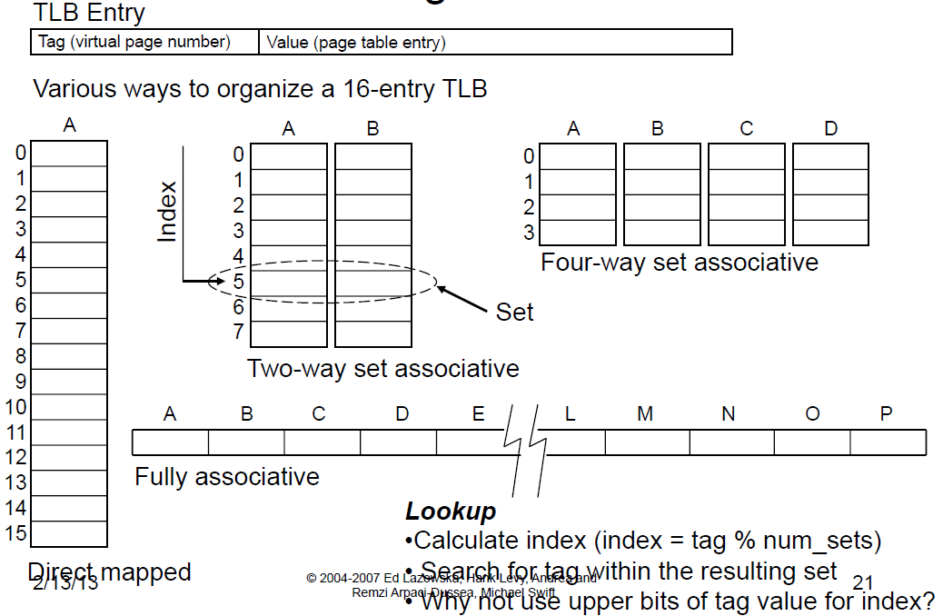
Currencies
sets
e1
e2

Slide 24

Index Fun(d)
Splitting up the set ‘E’ ways
E-way Set Associative
(each set contains ‘2^e’ (E) entries)
(mapping to any E in s)
Let’s say we have a 4-way Set Associative Cache
Address size = 8 bits, set index = 2 bits, block offset = 1 bit
1110 0010
E = 4, so e = 2 (2^2=4)
s = 2, so S = 4
b = 1, so B = 2
The rest is the tag: 5 bits
(This is the identifier)

Slide 25
Index Fun(d)
Splitting up the set ‘E’ ways
E-way Set Associative
(each set contains ‘2^e’ (E) entries)
(mapping to any E in s)
Let’s say we have a 4-way Set Associative Cache
Address size = 8 bits, set index = 2 bits, block offset = 1 bit
11100010
11100
01
0

Slide 26
Index Fun(d)
Splitting up the set ‘E’ ways
E-way Set Associative
(each set contains ‘2^e’ (E) entries)
(mapping to any E in s)
Let’s say we have a 4-way Set Associative Cache
Address size = 8 bits, set index = 2 bits, block offset = 1 bit
11100010
11100
Tag!
01
Set Index
0
Offset

Slide 27
Index Fun(d)
Splitting up the set ‘E’ ways
E-way Set Associative
(each set contains ‘2^e’ (E) entries)
(mapping to any E in s)
E = 4
S = 4
11100010
11100
Tag!
01
Set Index
0
Offset

Slide 28
Index Fun(d)
Splitting up the set ‘E’ ways
E-way Set Associative
(each set contains ‘2^e’ (E) entries)
(mapping to any E in s)
E = 4
S = 4
11100010
11100
Tag!
01
Set Index
0
Offset

Slide 29
Index Fun(d)
Splitting up the set ‘E’ ways
E-way Set Associative
(each set contains ‘2^e’ (E) entries)
(mapping to any E in s)
E = 4
S = 4
11100010
11100
Tag!
01
Set Index
0
Offset

Slide 30
Index Fun(d)
Splitting up the set ‘E’ ways
E-way Set Associative
(each set contains ‘2^e’ (E) entries)
(mapping to any E in s)
E = 4
[11100] Data
S = 4
11100010
11100
Tag!
01
Set Index
0
Offset

Slide 31
Index Fun(d)
Splitting up the set ‘E’ ways
E-way Set Associative
(each set contains ‘2^e’ (E) entries)
(mapping to any E in s)
E = 4
[00100] Data | [10100] Data | [01100] Data | [01101] Data
S = 4
11100010
Replace!
11100
Tag!
01
Set Index
0
Offset

Slide 32
Index Fun(d)
Splitting up the set ‘E’ ways
E-way Set Associative
(each set contains ‘2^e’ (E) entries)
(mapping to any E in s)
E = 4
[00100] Data | [10100] Data | [01100] Data | [01101] Data
S = 4
11100010
10100 LRU
11100
Tag!
01
Set Index
0
Offset

Slide 33
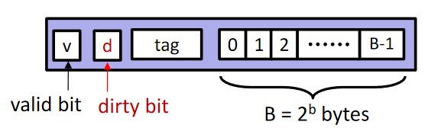
Index Fun(d)
Splitting up the set ‘E’ ways
E-way Set Associative
(each set contains ‘2^e’ (E) entries)
(mapping to any E in s)
E = 4
[00100] Data | [11100] Data | [01100] Data | [01101] Data
S = 4
11100010
11100
Tag!
01
Set Index
0
Offset

Slide 34
Swing and a miss (twice)
User Program
Cache read
[0xff]
[0x00] | [0x01] | [0x02]
[0x03] | [0x04] | [0x05]
We need a ‘memory replacement’ algorithm for data backed on disk
Mem read
[0xff]
[0x00] | [0x01] | [0x02]
[0x03] | [0x04] | [0x05]
[0x05] | [0x06] | [0x08]
Disk read
[0xff]
[0xf0] | [0xf1] | [0xf2]
[0xf3] | [0xf4] | [0xf5]

Slide 35
Money Management

Slide 36
Caching In
The goal is to keep data in the caches for as long as you possibly can
Accessing data outside the cache is really, really slow
Example: my DL homework
12hrs vs. 30minutes
My professor once said, many time problems in CS, add caching to it

Slide 37
What can we do?
Well… not all that much to tell the truth
We can’t physically go in and change the cache
In x86
There’s some OSs out there that will do predictive loading of the cache before a program starts
Those OSs are much more complex though
The things we can do though are to focus on the following:
Time Close-ness: access the same thing close together in time
Spatial Close-ness: access data that are close together (arrays)
These mainly have to do w/ arrays

Slide 38
Doing something about it
Write code that has locality!
Temporal: make sure access to the same data is not too far apart in time
Spatial: access data contiguously
How can you achieve locality?
Adjust memory accesses in code(software) to improve miss rate (MR)
Requires knowledge of both how caches work as well as your system’s parameter
Proper choice of algorithm
Loop transformations

Slide 39
Lab Tips

Slide 40
LRU
Least Recently Used is going to be the eviction policy
When we need to replace something in the cache
This is done two ways
Through a counter
Each epoch/cycle, the global counter increases
Through a linked list
FIFO queue
Least RECENTLY used, not least used

Slide 41
Misc
I would define t, the tag length, to help you get the fields of the address
Don’t forget to also define all the constants (S, B, e) not updated by the code
Don’t forget: 2d arrays are double pointers
Malloc one layer at a time
Now, malloc columns (where the entries’ll go)
Don’t forget to zero out the data layers
When you initially malloc, it’s garbage!!!

Slide 42
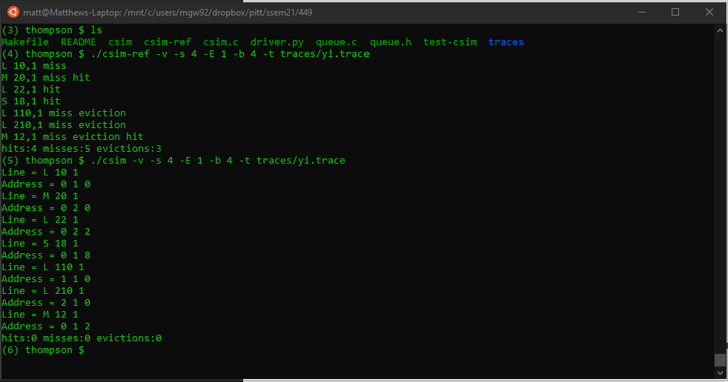
Lab Tip – Start w/ parsing, trying to get this:

Slide 43
Deadlines
Assignment | Due Date (at 11:59pm)
Lab 5 (Cache Lab) | Thursday, April 8th
https://www.gradescope.com/

