Slide 1
Good Morning!
Content inspired by Jarrett Billingsley’s Fall 2019 449 notes

Slide 2
Questions?

Slide 3
Processes Creation

Slide 4
Process Model
In linux, the first process to run is called init
Every process is started by splitting off from another process
This splitting off process is called fork()
The original process that called the function is called the parent
The new process that spawned from the original process is called the child
Fork() creates identical processes and replicates state
They even pick up at the same position in the code after the fork call is made
Same %rip
Same code, same data, but the data is not shared between the processes after fork

Slide 5
Forking
Parent
Child
Notice how everything’s the same, but now they’re essentially independent entities
Memory
Memory
%rip
%rip
Code
Code
Don’t call fork in an endless loop (i.e. while(1)). It’s called a fork bomb and it’ll halt the system
fork()

Slide 6
Process tree
init
init is the ancestor.
it spawns several daemons: processes which handle important background tasks.
acpid
crond
sshd
when you ssh into thoth, sshd gives you a bash shell.
bash
bash
and then you can run pstree to see this tree!
pstree
Content taken from Jarrett Billingsley’s Fall 2019 449 notes

Slide 7
Seeing the tree
You can see this process tree by executing pstree on your command prompt (for linux at least)
Each of these processes have a unique identifier to help the OS called a pid
Init always has a pid of 1
Use pstree –p too see the pid for every process in the tree
getpid() gets the pid of the current process, getppid() gets the parent pid
With knowledge of the pid’s, you can explicitly kill processes at whim
(some procs may require root access to be killed by a user)

Slide 8
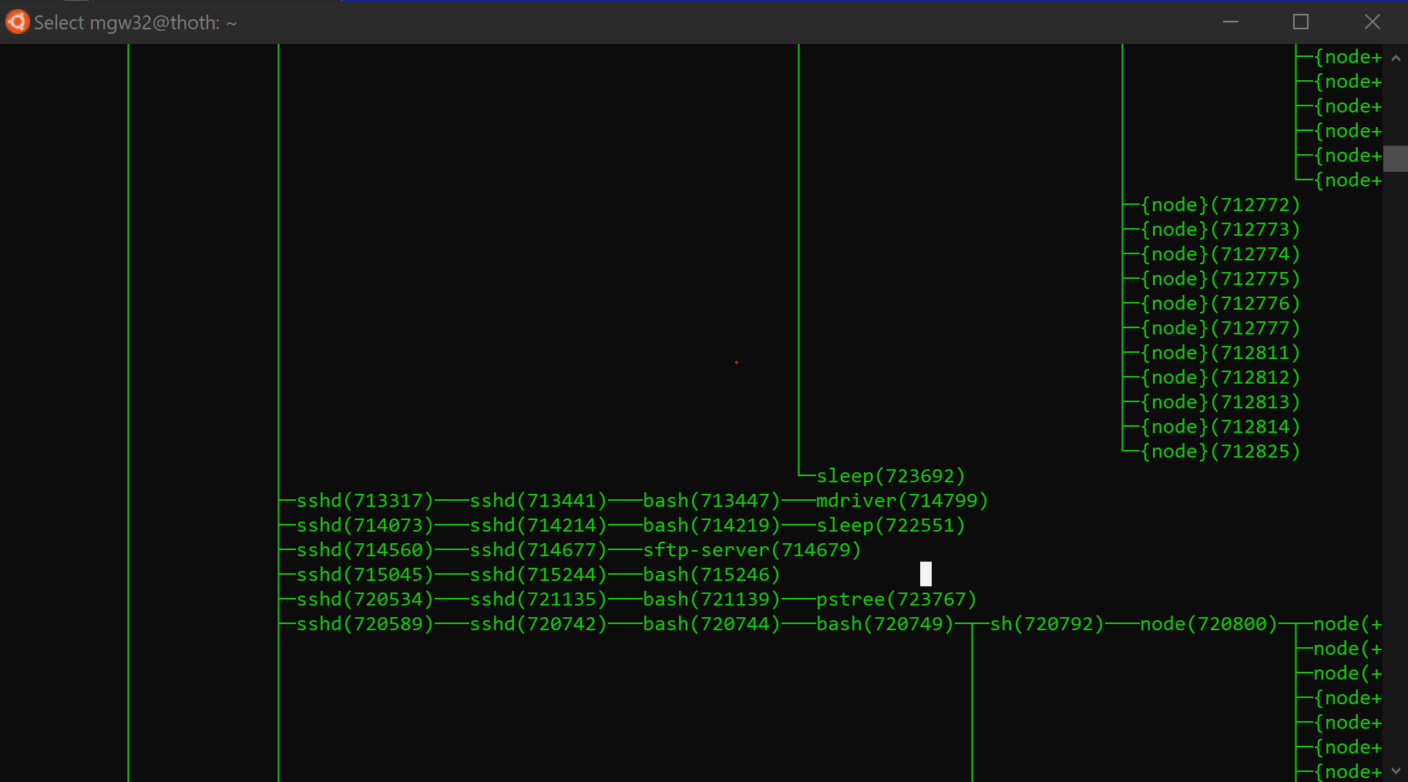
How’s the lab going?

Slide 9
Fork code
pid_t pid;
pid = fork();
if (pid == 0)
{
print(“Hello :)\n”);
}
Else
{
print(“Hello :(\n”);
}
pid_t pid;
pid = fork();
if (pid == 0)
{
print(“Hello :)\n”);
}
Else
{
print(“Hello :(\n”);
}
%rsp
%rsp

Slide 10
Fork code
pid_t pid;
pid = fork();
if (pid == 0)
{
print(“Hello :)\n”);
}
Else
{
print(“Hello :(\n”);
}
pid_t pid;
pid = fork();
if (pid == 0)
{
print(“Hello :)\n”);
}
Else
{
print(“Hello :(\n”);
}
%rsp
%rsp
Parent
Child

Slide 11
Fork code
pid_t pid;
pid = fork();
if (pid == 0)
{
print(“Hello :)\n”);
}
Else
{
print(“Hello :(\n”);
}
pid_t pid;
pid = fork();
if (pid == 0)
{
print(“Hello :)\n”);
}
Else
{
print(“Hello :(\n”);
}
%rsp
%rsp
Child pid = 0
Parent
Child

Slide 12
Fork code
pid_t pid;
pid = fork();
if (pid == 0)
{
print(“Hello :)\n”);
}
Else
{
print(“Hello :(\n”);
}
pid_t pid;
pid = fork();
if (pid == 0)
{
print(“Hello :)\n”);
}
Else
{
print(“Hello :(\n”);
}
%rsp
%rsp
Parent
Child

Slide 13
Fork code
pid_t pid;
pid = fork();
if (pid == 0)
{
print(“Hello :)\n”);
}
Else
{
print(“Hello :(\n”);
}
pid_t pid;
pid = fork();
if (pid == 0)
{
print(“Hello :)\n”);
}
Else
{
print(“Hello :(\n”);
}
%rsp
%rsp
Parent
Child

Slide 14
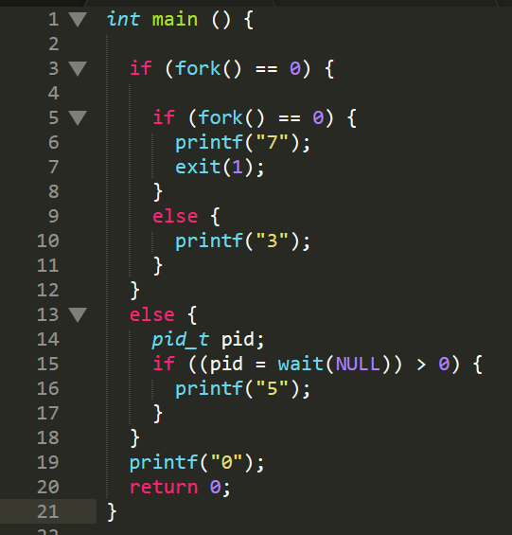

Slide 15
Multiprocessing & System Calls

Slide 16
The manager
The OS manages all of these processes
The OS encompasses hardware and software, but when most say the OS, they’re referring to the kernel, or OS software
User Space
Memory
Memory
Code
Code
OS Kernel
Kernel Space

Slide 17
What does the kernel primarily do?
The kernel primarily gives the different CPUs to run processes on
Helps in paging process (allocating physical memory after page fault)
Manage virtual memory in general
Security
Who is allowed to access/change what?
Handles all I/O requests (that’s a lot)
It makes sure that the I/O is processed correctly
Each hardware spec is different, OS makes it easy for the
process to run on whatever hardware the system has
Memory
Memory
Code
Code
OS Kernel

Slide 18
Sooooo many processes
How do we decide who runs?
That’s up the OS scheduler
It… schedules processes to run on a CPU
How do we switch then between these thousands of processes?

Slide 19
Switch
‘Context switching’ allows us to switch between processes
User Space
Memory
Memory
write()
Code
Code
Sure, I’ll do this I/O for you!
OS Kernel
Kernel Space

Slide 20
Switch
‘Context switching’ allows us to switch between processes
User Space
Memory
Memory
Code
Code
Your time is up!
OS Kernel
Kernel Space

Slide 21
Switch
‘Context switching’ allows us to switch between processes
Wow, no wait!
User Space
Memory
Memory
Code
Code
Send packet
write()
Ok proc2, your turn!
Sure, I’ll do this I/O for you!
OS Kernel
Kernel Space
Lol more like lots of waiting
Looks like the write is done
What can I schedule…

Slide 22
Mem allocation example

Slide 23
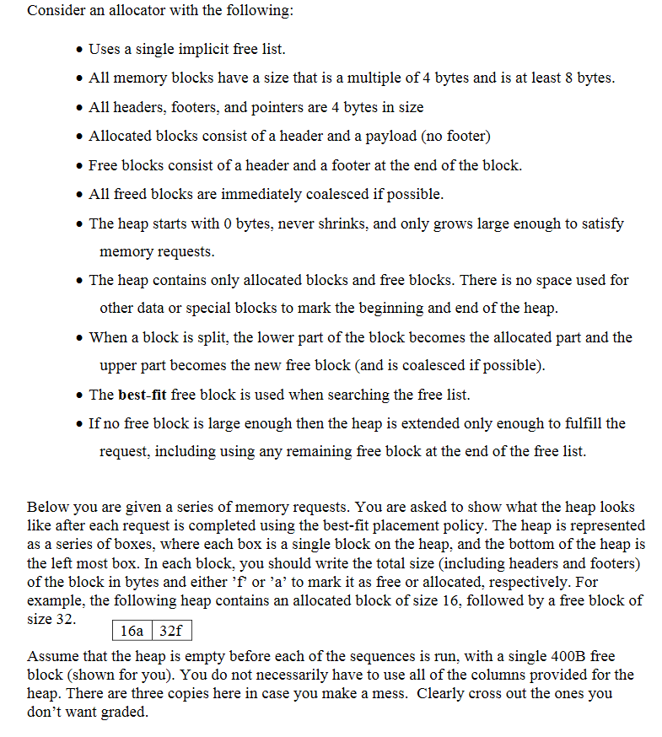

Slide 24
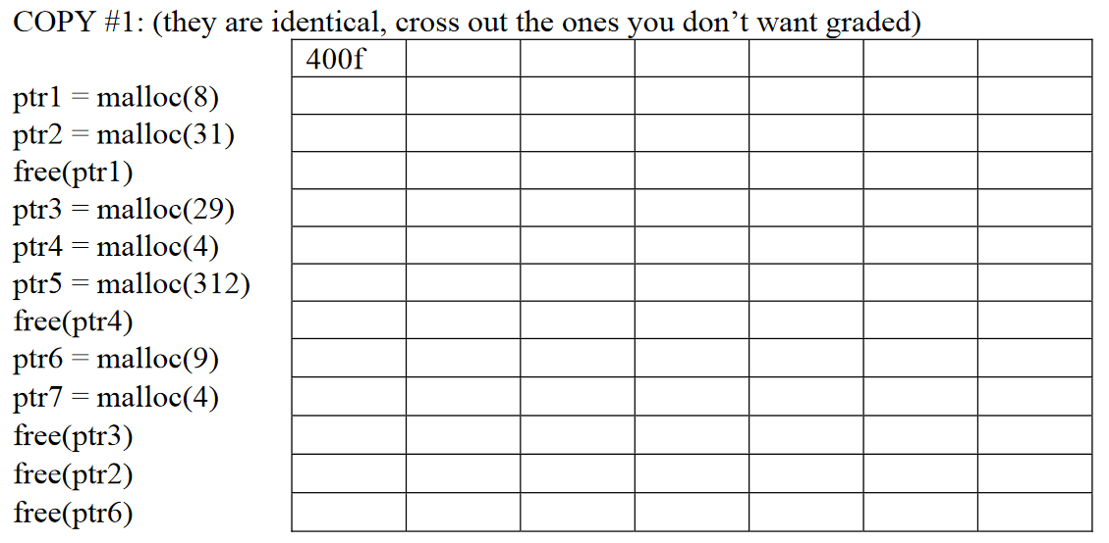
Example!
12a
388f
12a
36a
352f
12f
36a
352f
12f
36a
36a
316f
12f
36a
36a
8a
308f
12f
36a
36a
8a
316a
12f
36a
36a
8f
316a
12f
36a
36a
8f
316a
16a
12f
36a
36a
8a
316a
16a
12f
36a
36f
8a
316a
16a
84f
8a
316a
16a
84f
8a
316a
16f

Slide 25
Malloc Lab (part 2)

Slide 26
Deadlines
Assignment | Due Date (at 11:59pm)
Lab 6 (Malloc Lab) (Checkpoint 1) | Saturday, April 24th
Lab 6 (Malloc Lab) (Checkpoint 2) | Tuesday, April 27th
Homework 6 (Processes) | Tuesday, April 27th
Homework 5 (VMem & allocation) | Monday, April 23th
https://www.gradescope.com/

