Slide 1
Good Morning!
Content inspired by Jarrett Billingsley’s Fall 2019 449 notes

Slide 2
Questions?

Slide 3
Virtual Memory Overview

Slide 4
We lied again…
Memory is an array of bytes
But it’s a little more complicated than that
Virtual memory is the topic which we’ll discuss today
Virtual memory is a crucial topic to understand because it’s essentially the basis of all OS memory operations
(lots of operations)
Memory = RAM!

Slide 5
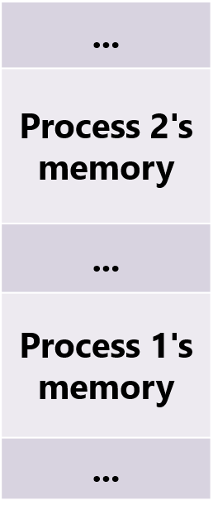
What is virtual memory?
Physical Memory
Process 1
Process 2
0xFFFF
Memory
0xFFFF
Memory
0x00667FFF
0xA000
0xA000
0x00660000
0x9FFF
Code
0x9FFF
Code
0x0040FFFF
0x8000
0x8000
This is impossible, but the programs believe it's true.
0x00408000
The address spaces are isolated!
Content taken from Jarrett Billingsley’s Fall 2019 449 notes

Slide 6

Remember loading?
other areas of memory are set up by the loader itself.
The executable
.data
Like virtual memory!!
.bss
.rodata
.text
Content taken from Jarrett Billingsley’s Fall 2019 449 notes

Slide 7

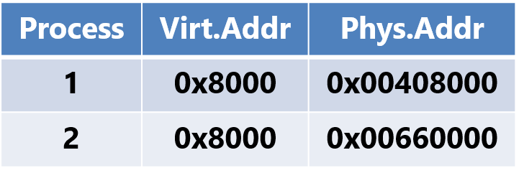
Simplified virtual memory process
hey memory... gimme 0x00408000
Physical Memory
Process 1
hey, gimme 0x8000
Code
CPU
ok, let's see…
here you go
Process 2
ok here's 0x8000, honest ;)))))
Code
Page table
Content taken from Jarrett Billingsley’s Fall 2019 449 notes

Slide 8
Virtual Memory Address Translation Overview

Slide 9
How virtual memory affects the process
User Program
I want to read
[0xff]
We need to translate to virtual memory here!!
Cache read
[0xff]
Cache read
[0x00] | [0x01] | [0x02]
[0x03] | [0x04] | [0x05]
Mem read
[0xff]
[0x00] | [0x01] | [0x02]
[0x03] | [0x04] | [0x05]
[0x05] | [0x06] | [0x08]
Disk read
[0xff]
[0xf0] | [0xf1] | [0xf2]
[0xf3] | [0xf4] | [0xff]

Slide 10
Fetching the physical address (overview)
Hey, gimme 0x8000 (VA)
CONVERTING 0x8000 TO PA
Cache read
User Process 1
[0x00] | [0x01] | [0x02]
[0x03] | [0x04] | [0x05]
CPU
VA
MMU
PA
Mem read
[0x00] | [0x01] | [0x02]
[0x03] | [0x04] | [0x05]
[0x05] | [0x06] | [0x08]
VA = virtual address
PA = physical address

Slide 11
Fetching the physical address (overview)
Hey, gimme 0x8000 (VA)
CONVERTING 0x8000 TO PA
For Process 1
Cache read
User Process 1
[0x00] | [0x01] | [0x02]
[0x03] | [0x04] | [0x05]
CPU
VA
MMU
PA
For PROCESS 1, 0x8000 VA = 0xF13CA PA
Mem read
[0x00] | [0x01] | [0x02]
[0x03] | [0x04] | [0x05]
[0x05] | [0x06] | [0x08]
Value at va 0x8000 (0xF13CA PA) for process 1
VA = virtual address
PA = physical address

Slide 12
Fetching the physical address (overview)
How does the MMU do this translation?
CONVERTING 0x8000 TO PA
FOR PROCESS 1000
Hey, gimme 0x8000 (VA)
Cache read
User Process 1
[0x00] | [0x01] | [0x02]
[0x03] | [0x04] | [0x05]
CPU
VA
MMU
PA
FOR PROCESS 1000, 0x8000 VA = 0xC1BAF PA
Mem read
[0x00] | [0x01] | [0x02]
[0x03] | [0x04] | [0x05]
[0x05] | [0x06] | [0x08]
Value at va 0x8000 (0xC1BAF PA) for process 1000
VA = virtual address
PA = physical address

Slide 13
MMU Virtual Address Translation

Slide 14
What does the MMU do?
Page Offset stays the same the entire process and is concatenated to the pa
The MMU looks up the PA address in a table (page table)
Virtual Address
MMU
CPU
VA
MMU
VA
Virtual Page Number
Page Offset
This page table is different for each process!! Even if va’s are the same in two diff processes, the OS will divert each process to separate page tables
index in page table
This is a page table entry (PTE). It’s a pa + flags
Physical Page Address
Page table in mem for process 1

Slide 15
MMU encountering an empty pte
Page Offset stays the same the entire process and is concatenated to the pa
On a page fault, the OS allocates memory + fills in the pte
Virtual Address
MMU
CPU
VA
MMU
VA
Virtual Page Number
Page Offset
OS to save the day!
(allocates new physical memory)
Physical Page Address
Page Fault
index in page table
Physical Page Address
Ah nothing there!!
How does the process give a va to the CPU if there wan’t any pa?
Physical Page Address
Page table in mem for process 1

Slide 16
OS’s Job
Complex OS job
It needs to keep track of every process’ virtual address spaces
What memory is free and what isn’t
It also needs to keep track of what’s in RAM (memory)
What memory is free and what isn’t

Slide 17
Why offset?
Memory
Memory is managed in blocks
These blocks are commonly 4kb in size
2^12 addressable bytes
Allocation happens at intervals of this size
Pte’s point to blocks of memory
Offsets then point to the specific location in that block
Offset meant to address every possible byte in the block
Offset is ln(page size)
Offset commonly 12 bits (2^12 = 4kb)
…
8kb
Page 2
4kb
Page 1
2nd byte
1st byte
Ex is here
Ex
0th byte
Points to block address
Data located at offset inside the block
Address of block 1
Offset of 1 byte

Slide 18
Ok let’s take a breath

Slide 19
Virtual Memory Specifics

Slide 20
Another cache?
The MMU is hardware so it’s naturally quick, but it can be improved
The TLB is the cache inside the MMU for looking up commonly-used va to pa conversions

Slide 21
MMU and the TLB
The MMU looks up the VA in the TLB
CPU
VA
MMU
0x8000
Directly-mapped cache shown
Index
TLB
valid
tag
process
pte
valid
tag
process
pte

Slide 22
MMU and the TLB
The MMU has a TLB hit!
CPU
VA
MMU
0x8000
0xFA12
TLB Hit!
Index
TLB
1
0x8
process 1
pte
valid
tag
process
pte

Slide 23
MMU and the TLB
The MMU has a TLB miss ☹. Now you have to look up the pte in the page table
Virtual Address
MMU
CPU
VA
MMU
0x8000
Virtual Page Number
Page Offset
0x8000
TLB Miss!
Index
TLB
1
0xF
process 1
pte
index in page table
Physical Page Address
valid
tag
process
pte
Page table in mem for process 1

Slide 24
MMU and the TLB
The MMU has a TLB miss ☹. Now you have to look up the pte in the page table
Virtual Address
MMU
CPU
VA
MMU
0x8000
Virtual Page Number
Page Offset
0x8000
0xFA12
TLB Miss!
Index
TLB
1
0x8
process 1
new pte
index in page table
Physical Page Address
valid
tag
process
pte
Page table in mem for process 1

Slide 25
Back to overview

Slide 26
Fetching the physical address (overview)
Hey, gimme 0x8000 (VA)
If miss
MMU
User Process 1
TLB lookup
Page table lookup
CPU
VA
MMU
VA
If hit
PA
PA
Cache read
[0x00] | [0x01] | [0x02]
[0x03] | [0x04] | [0x05]
Mem read
[0x00] | [0x01] | [0x02]
[0x03] | [0x04] | [0x05]
[0x05] | [0x06] | [0x08]
Value at va 0x8000 (0xF13CA PA) for process 1

Slide 27
Deadlines
Assignment | Due Date (at 11:59pm)
Lab 5 (Cache Lab) | Saturday, April 10th
Homework 4 (Mem & Cache) | Tuesday, April 13th
https://www.gradescope.com/

