Slide 1
Good Morning!

Slide 2
Questions?

Slide 3
How was the cache lab?

Slide 4
Memory allocation overview + reasoning
Malloc = memory allocate
Free = free

Slide 5
Why do we allocate memory?
That’s a great question!
We allocate memory because we don’t want to give invalid pointers!
Think what would happen if we just gave random locations in memory to the process
Oh, the security vulnerabilities
Not to mention it would steal other methods’ data
No data must overlap each other
This is a complicated task – proven NP Hard (probably)

Slide 6
How do we allocate memory?
That’s a great question!
Static allocation
Allocate all the necessary memory for a process when the process is created
Compile time
Local variables + stuff
Dynamic allocation
Last longer than just a single method, last indefinitely
Especially with bad programming practices ;)
Malloc and free whenever we want basically
How do we do this exactly, we’ll talk more in a bit

Slide 7
When do we allocate memory?
This is more complicated than you would think
Short answer: it depends
Long answer:
…

Slide 8
When do we allocate memory?
Done when there’s a malloc/free
Done w/ virtual addresses on the heap (virtual memory)
Divided up by word size (8 bytes)
User Space
Virtual Memory
Malloc

Slide 9
When do we allocate memory?
Done when there’s a malloc/free
Done w/ virtual addresses on the heap (virtual memory)
Divided up by word size (8 bytes)
User Space
Virtual Memory
Malloc
malloc(2)

Slide 10
When do we allocate memory?
Done when there’s a malloc/free
Done w/ virtual addresses on the heap (virtual memory)
Divided up by word size (8 bytes)
User Space
Virtual Memory
Malloc
malloc(2)
malloc(3)

Slide 11
When do we allocate memory?
Done when there’s a malloc/free
Done w/ virtual addresses on the heap (virtual memory)
Divided up by word size (8 bytes)
User Space
Virtual Memory
Malloc
malloc(2)
malloc(3)
malloc(1)

Slide 12
When do we allocate memory?
Done when there’s a malloc/free
Done w/ virtual addresses on the heap (virtual memory)
Divided up by word size (8 bytes)
User Space
Virtual Memory
Malloc
malloc(2)
malloc(1)
free(&data)

Slide 13
When do we allocate memory?
Done when there’s a malloc/free
Done w/ virtual addresses on the heap (virtual memory)
Divided up by word size (8 bytes)
User Space
Virtual Memory
Malloc
malloc(2)
malloc(1)
free(&data)

Slide 14
When do we allocate memory?
Virtual Address
MMU
Kernel Space (OS)
Physical memory
~It’s complicated~
Virtual Page Number
Page Offset
Done when there needs to be a page added to memory
Done w/ physical addresses in physical memory
The min size is the page size (typically 4kb)
Physical Page Address
Page Fault
index in page table
Physical Page Address
Ah nothing there!!
Physical Page Address
Page table in mem for process 1

Slide 15
When do we allocate memory?
OS must manage and tweak both for maximum performance
User Space
Virtual Memory
Malloc
Kernel Space (OS)
Physical memory
~It’s complicated~

Slide 16
How do we do memory allocation?

Slide 17
It’s complicated
People devote so many hours of research to this
We won’t be
Thank god
Basics:
Which are occupied and which are free?
Methods
How do we find free blocks?
How much do we free?
Coalescing
Boundaries

Slide 18
Keeping track
There are two main ways we’ve discussed:
Implicit list
Explicit list
Implicit list is like a “list” of all block, used and free, on the heap
It’s a “list” b/c everything’s calculated w/ math, we never store the pointers
Explicit list is a list of all the free blocks in the system
We’ll use a doubly linked list
Don’t forget to update these pointers!

Slide 19
Heap block structure
Head | Next Prev |  | Foot
Allocated
Free

Slide 20
Heap block structure
Head | LL |  | Foot | Head | LL |  | Foot | Head | LL |  |  | Foot | Head | LL |  |  | Foot
Allocated
Free

Slide 21
Heap block structure
Head | LL |  | Foot | Head | LL |  | Foot | Head | LL |  |  | Foot | Head | LL |  |  | Foot
Allocated
Free

Slide 22
How much to free?
When a free() is called, how much memory do we free based off the pointer??
We must use headers into our program
Headers and footers also allow us to look at both data and the free list blocks
This is crucial to coalescing

Slide 23
How much to free?
What if we remove this one?
 |  |  |  |  |  |  |  |  |  |  |  |  | Head | LL |  |  | Foot
Allocated
Free

Slide 24
How much to free?
What if we remove this one?
Head |  |  | Foot | Head |  |  | Foot | Head |  |  |  | Foot | Head | LL |  |  | Foot
Allocated
Free

Slide 25
How much to free?
What if we remove this one?
Head |  |  | Foot | Head |  |  | Foot | Head |  |  |  | Foot | Head | LL |  |  | Foot
Allocated
Free

Slide 26
How much to free?
What if we remove this one?
Head |  |  | Foot |  |  |  |  | Head |  |  |  | Foot | Head | LL |  |  | Foot
Allocated
Free

Slide 27
Coalescing
What if we remove this one?
Head |  |  | Foot | Head | LL |  | Foot | Head |  |  |  | Foot | Head | LL |  |  | Foot
Allocated
Free

Slide 28
Coalescing – LIFO
What if we remove this one?
Head |  |  | Foot | Head | LL |  | Foot | Head |  |  |  | Foot | Head | LL |  |  | Foot
Allocated
Free

Slide 29
Coalescing
Address-ordered policy used here
What if we remove this one?
Head |  |  | Foot | Head | LL |  | Foot | Head |  |  |  | Foot | Head | LL |  |  | Foot
Allocated
Free

Slide 30
Coalescing
Address-ordered policy on the rest of these slides
What if we remove this one?
Head |  |  | Foot | Head |  |  | Foot | Head |  |  |  | Foot | Head | LL |  |  | Foot
Allocated
Free

Slide 31
Coalescing
What if we remove this one?
Head |  |  | Foot | Head |  |  | Foot | Head |  |  |  |  | Head | LL |  |  | Foot
Allocated
Free

Slide 32
Coalescing
What if we remove this one?
Head |  |  | Foot | Head |  |  | Foot | Head | LL |  |  |  |  |  |  |  | Foot
Allocated
Free

Slide 33
Coalescing
What if we remove this one?
Head |  |  | Foot | Head | LL |  | Foot | Head |  |  |  | Foot | Head | LL |  |  | Foot
Allocated
Free

Slide 34
Coalescing
What if we remove this one?
Head |  |  | Foot | Head | LL |  | Foot | Head |  |  |  |  | Head | LL |  |  | Foot
Allocated
Free

Slide 35
Coalescing
What if we remove this one?
Head |  |  | Foot | Head | LL |  | Foot |  |  |  |  |  | Head | LL |  |  | Foot
Allocated
Free

Slide 36
Coalescing
What if we remove this one?
Head |  |  | Foot | Head | LL |  |  |  |  |  |  |  |  | LL |  |  | Foot
Allocated
Free

Slide 37
Coalescing
What if we remove this one?
Head |  |  | Foot | Head | LL |  |  |  |  |  |  |  |  |  |  |  | Foot
Allocated
Free

Slide 38
Coalescing
What if we remove this one?
Head |  |  | Foot | Head | LL |  |  |  |  |  |  |  |  |  |  |  | Foot
Allocated
Free

Slide 39
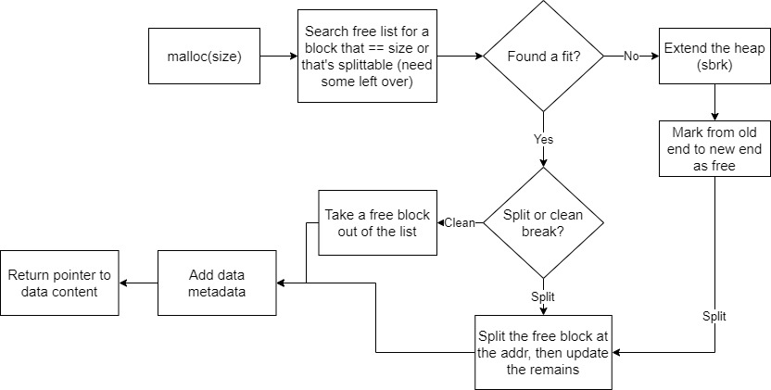
Mallocing guide

Slide 40
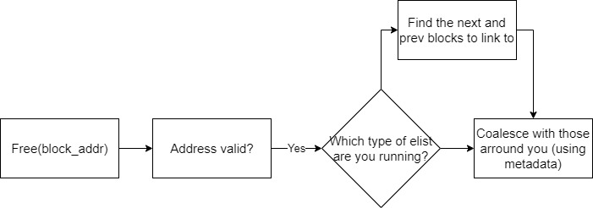
Freeing guide

Slide 41
Dynamics
Malloc is like taking away free space
Subtracting space from the heap
Taking items from the list
Splitting
Free is adding free space
Adding more blocks to the heap
Coalescing

Slide 42
Let’s go through the handout

Slide 43
Let’s go through the code

Slide 44
Deadlines
Assignment | Due Date (at 11:59pm)
Lab 6 (Malloc Lab) (Checkpoint 1) | Tuesday, April 20th
Lab 6 (Malloc Lab) (Checkpoint 2) | Tuesday, April 27th
Homework 5 (Mem & Cache) | Tuesday, April 20th
https://www.gradescope.com/

