Slide 1
PER-VIEW STABLECOIN PAYMENTS
FOR OPEN VIDEO
ARCLIGHT
Notes:
Arclight is the missing payment rail for open video — it pays creators per real view in USDC, with a privacy-preserving proof the view actually happened. Built entirely on Circle's Arc stack and already running end-to-end on testnet.

Slide 2
ABOUT ARCLIGHT
Arclight is the missing payment rail for open video.
VIDEO HAS
NO PAYMENT
RAIL OUTSIDE
THE WALL
YouTube monetizes inside its walls. Everything outside them — PeerTube, Owncast, indie streamers, the fediverse — has the audience but no way to charge for a single view.
Arclight pays creators in USDC the instant a genuine view is proven on Circle's Arc L1 — no tracking, no walled garden, embeddable in any player. The full stack runs end-to-end on testnet today.

Slide 3
PROBLEMS
Open video has
the audience
the pay rails
stop at the wall

Slide 4
PROBLEMS
MINIMUM FEE TO SETTLE A SINGLE PAYMENT, BY RAIL
PayPal
$0.34
Stripe
$0.33
Visa / Mastercard
Source: Visa, Mastercard, PayPal & ACH published rates (2024)
$0.30
The cost of
a micropayment
ACH / bank
$0.25
Arclight on Arc
<$0.001

Slide 5
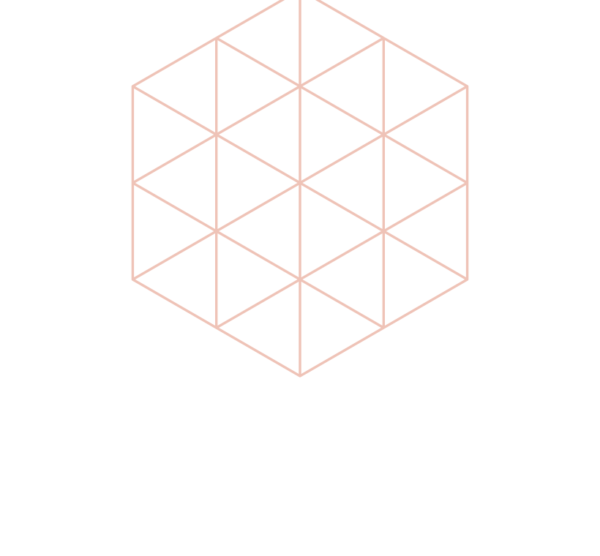
SOLUTION 1.0
PROOF
OF
VIEW
A zero-knowledge attestation proves a real view occurred — and is payable exactly once. Each view's nullifier, Poseidon(viewerSecret, campaignId, epoch), is consumed on-chain, so the same view can never be paid twice and replays are rejected. The viewer is never identified or tracked.

Slide 6
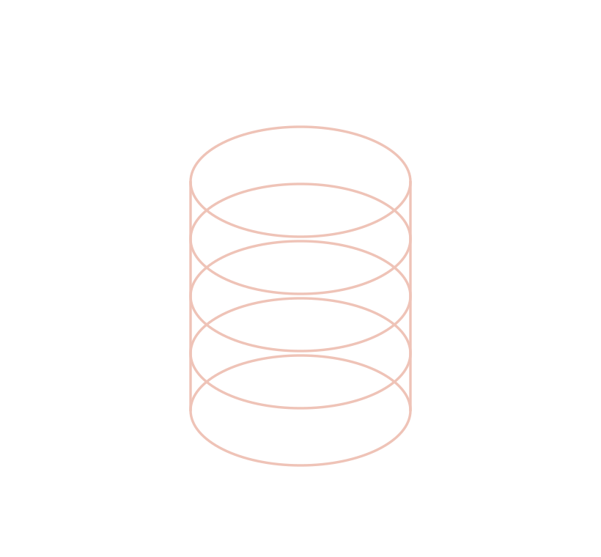
SOLUTION 2.0
STABLE-
COIN
NANO-PAY
Sub-cent USDC settles the instant a view is proven. Payments batch gaslessly through Circle Gateway (x402) so fees never swamp the amount, and clear on Arc where USDC is the native gas. The creator's balance updates in real time — no 30-day payout cycle.

Slide 7
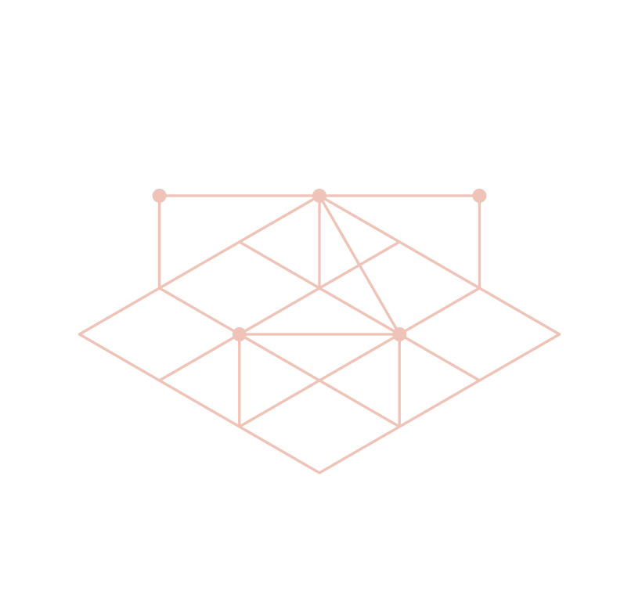
SOLUTION 3.0
EMBED-
DABLE
SDK
A drop-in SDK turns any open-web player into a paid one in a few lines of code. No ad network, no walled garden, no account migration — the creator keeps their player and their audience, and simply starts getting paid per genuine view.

Slide 8
HOW IT WORKS
One real view, settled end-to-end.
01
02
03
04
05
Watch
Attest
Pay
Accrue
Cash out
A viewer genuinely watches on any embedded open-web player.
The attestor signs an EIP-712 proof-of-view with a unique nullifier.
Circle Gateway settles a sub-cent USDC nanopayment — batched, gasless.
Earnings credit the creator's USDC balance on Arc, instantly.
Withdraw, bridge to Ethereum, or send — one click via Circle.
DOUBLE-SPEND PROOF Each nullifier is consumed on-chain, so a view can never be paid twice. Replays return a 409.

Slide 9
BUILT ON ARC
Composed from the full Circle + Arc stack.
01
02
03
CIRCLE GATEWAY
PROGRAMMABLE WALLETS
CCTP V2
Batched sub-cent x402 nanopayments settle each view.
Developer-controlled MPC wallet as creator treasury.
Real USDC round-trip: burn on Arc, mint on Sepolia.
04
05
06
NATIVE USDC GAS
STABLEFX
USYC TREASURY
Gas paid in the same dollar creators earn.
Route USDC payouts into EURC for local currency.
Idle creator earnings can flow into on-chain yield.

Slide 10
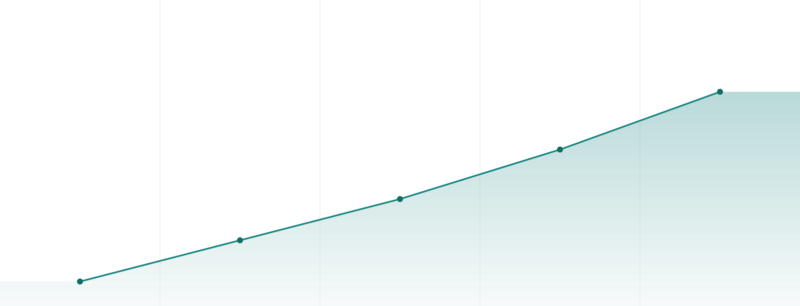
MARKET OPPORTUNITY
$480B
PROJECTED GROWTH OF THE CREATOR ECONOMY (2023–2027)
The creator economy is projected to nearly double — to roughly USD 480 billion by 2027 — as audiences and creators move online.
Data source: Goldman Sachs Research, 2023
2027
$480B
2026
$410B
2025
$350B
2024
$300B
2023
$250B

Slide 11
REVENUE MODEL
Protocol take rate
A thin cut of view-payment volume — scales with usage, never with viewer data.
SDK & platform tier
Premium campaign tooling, analytics, and support for platforms embedding Arclight.
Treasury & FX spread
Managed-wallet, USYC yield, and USDC→EURC routing on top of the core rail.

Slide 12
TRACTION & ROADMAP
From running testnet to first pilots.
NOW · Q2 2026
NEXT · GRANT
THEN · POST-RAISE
Live
Hardening
Go-to-market
—
Full stack live & source-verified on Arc testnet
—
Independent security audit
—
SDK general availability
—
End-to-end demo: attest → pay → cash out
—
ProofOfView rewrite to final spec
—
First paying campaigns
—
Public showcase deployed
—
Mainnet readiness on Arc
—
Agentic-advertiser pilots
The audit is the single gate to mainnet and real money — exactly what the grant funds.

Slide 13
FUNDRAISING
We're raising a pre-seed round to reach mainnet
$500,000
On a SAFE, alongside the Arc Builders Fund grant. The funds are allocated to the following core objectives.
SECURITY AUDIT
FOUNDER RUNWAY
PROTOCOL ENGINEER
Independent contract + ZK circuit review
Full-time focus through mainnet launch
First hire to harden the rails
$200,000
$120,000
$90,000
BD & PARTNERSHIPS
INFRA & TOOLING
CONTINGENCY
Onboard first open-video platforms
RPC, hosting, monitoring, CI
Reserve for scope changes
$40,000
$30,000
$20,000

Slide 14

THE VISION
The open web finally
has a business model.
Pay creators per genuine view, in dollars, instantly — wherever video lives.
MALEK SHARABI
Founder & Engineer, Arclight
ARCLIGHT
EMAIL
m.malek1996@hotmail.com
CODE
github.com/mgx96/arclight
DEMO
mgx96.github.io/arclight
Notes:
Close on the vision, then make it easy to act: the system is live, the code is public, the demo is one click away.

