Slide 1
Introduction to Python Session-1
Presented by
Zilani
mgzilani15@gmail.com

Slide 2
Main Agenda:
Topic1: Introduction to programming
Topic2: Print statement
Topic3: python as a calculator
Topic4: Variable concept
Topic5: Data type
Topic6: logical operation
Topic7: If..then..else (conditional statement)
Topic8: Create simple application
Challenge:

Slide 3
Topic-1: introduction to programming
Topic-2: print statement:
Print in python:
Example: print (“Hello Python”)
Or
Print(‘Hello python’)
Challenge-1
Print : ‘my name is ..’
Print: “TAFE NSW”
Print: 523
Print 25.9

Slide 4
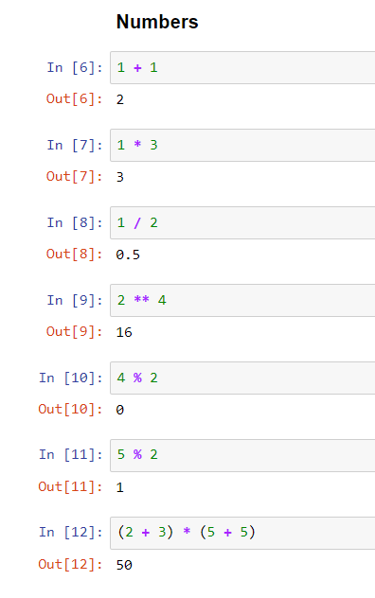
Topic-3: python as a calculator
Challenge-2
Try them all
Show 9*9 = ??
(5/2)*(2+2)
2 to the power 4
Reminder

Slide 5
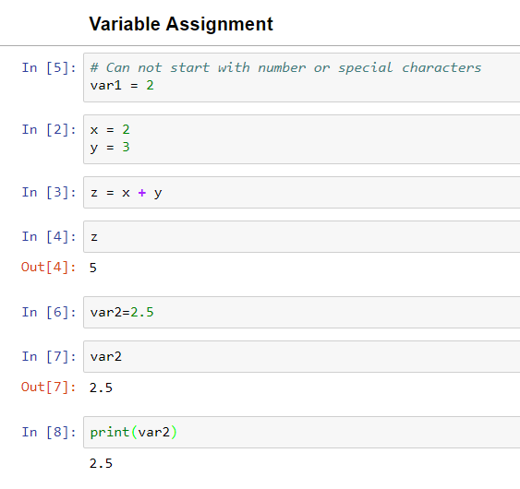
Topic-4 variable concept
What is a variable?
Challenge-3
Say there is a variable named var2, store 9.5 there and print it.
Store 6 in a variable and 3 in b variable. Show how to print a-b and what will be the output?

Slide 6
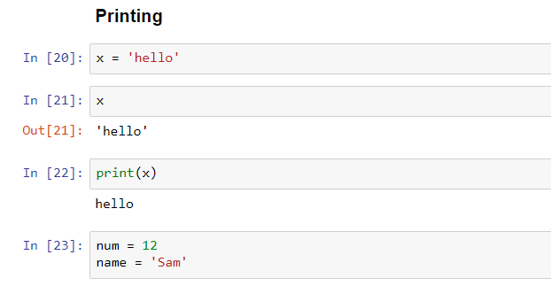
Topic-4 variable concept
What is a variable?
Challenge-4
Store your name in a variable and print it.
Can you print :
My name is Sam

Slide 7
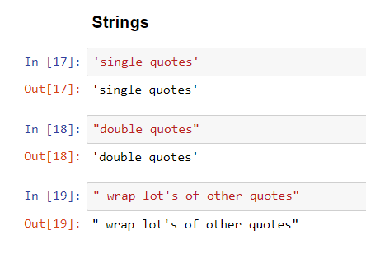
Topic-4 variable concept
Concept of string:

Slide 8
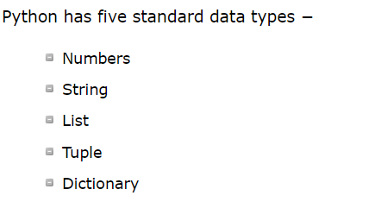
Topic-5 Data type
What is data type?

Slide 9
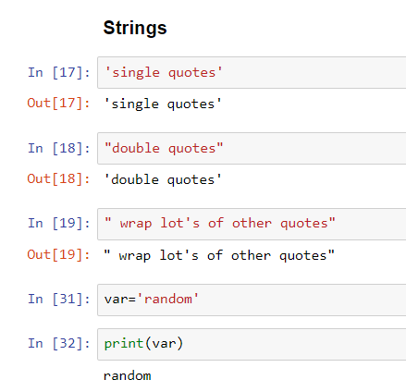
Topic-5 Data type
What is data type?

Slide 10
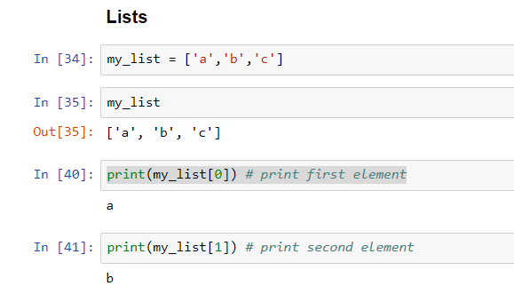
Topic-5 Data type
What is data type?
Challenge-5
Store 254, 365, 897 in a list and retrieve 897 ??

Slide 11
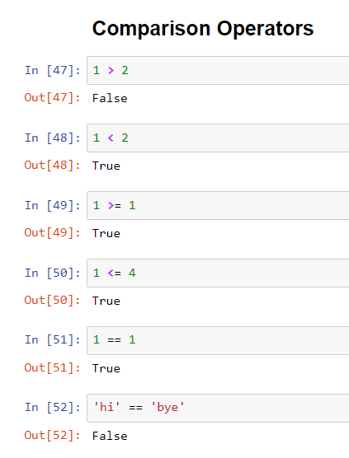
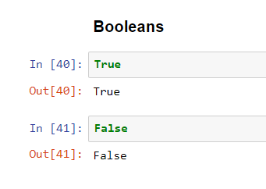
Topic-6 logical operation

Slide 12
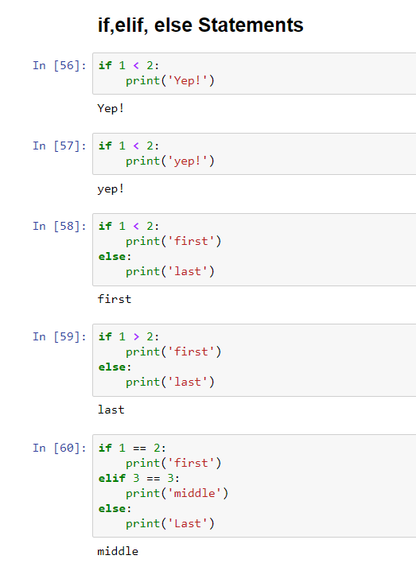
Topic-7 condition statement

Slide 13
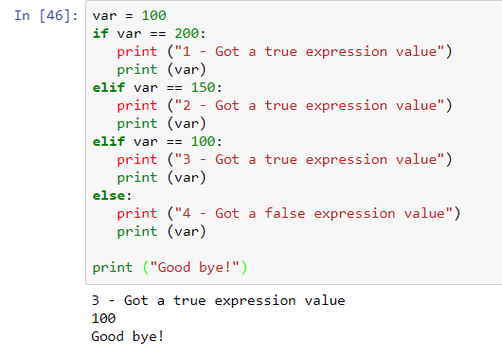
Topic-7 condition statement

Slide 14
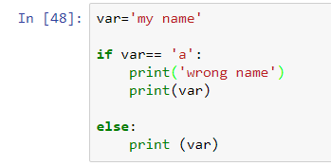
Topic-7 condition statement
Challenge-6
Write down what should be the output?

Slide 15
Thank You

