Slide 1
PRIVACY PRESERVING
EDGE VISION
EECE 5698 · Spring 2026
Hamza Mubashir · Malia Howe · Sindhu SureshKumar
Northeastern University
Mid-Checkpoint Presentation

Slide 2
Agenda
1
Problem Statement
5
Experimental Results & Charts
2
Dataset & System Architecture
6
Two-Phase Training Curve
3
VAE Variants & Architecture
7
Challenges & Why They Happened
4
Compute Cost & Edge Deployment
8
Future Work

Slide 3
Problem Statement
Privacy-preserving representation learning for edge vision systems
THE GOAL
THE CHALLENGE
▸ Detect smiles reliably (utility ✓)
Smile and gender are correlated in face images. A model trained to detect smiles will also inadvertently encode gender cues — facial structure, lip shapes, and skin texture all carry gender information.
▸ Suppress gender prediction (privacy ✓)
▸ Run on edge hardware efficiently
Our Solution
Target metric:
Adversarial Representation Learning (ARL): Train an encoder + adversary jointly. The adversary tries to predict gender from the encoder output. The encoder is trained to fool it — while still detecting smiles.
Privacy Accuracy ≈ 50% (random guessing) Utility Accuracy ≥ 85%

Slide 4
Dataset & System Architecture
CelebA Dataset
ARL Training Pipeline
· 202,599 celebrity face images
Input Image
VAE Encoder
Decoder
224×224 face
→
Compress → z
→
Reconstruct image
· 40 binary attribute labels
· Utility label: Smiling (attr #31)
Utility Classifier
Privacy Adversary
Predict Smile (maximize acc)
Predict Gender (fool this)
· Privacy label: Male (attr #20)
ARL Loss = Utility Loss − λ × Adversary Loss
· Train 162k · Val 19k · Test 19k
Two-phase training: warm-up (utility only) → ARL (adversary activated)
· Input resolution: 224 × 224 RGB

Slide 5
VAE Encoder Variants
Member 1 — Sindhu SureshKumar
Vanilla VAE
Arch: Conv encoder 3→32→64→128→256→512 → bottleneck (μ, σ) → mirrored deconv decoder
Loss: MSE(recon, input) + 1·KL
▸ Baseline. Lossy compression discards fine-grained gender cues from the latent representation.
Beta-VAE (β = 4)
Arch: Identical architecture to VanillaVAE — same channel schedule, same decoder
Loss: MSE + 4·KL (4× stronger KL regularisation)
▸ Stronger KL forces the latent distribution closer to Gaussian. Gender and smile features are pushed to separate dimensions.
Residual VAE
Arch: ResNet-style residual blocks in encoder with skip connections. VanillaVAE decoder.
Loss: MSE + 1·KL (same loss as VanillaVAE)
▸ Residual connections allow richer feature hierarchies. Achieved best NAG score in our experiments.

Slide 6
VAE Encoder Variants
Member 2 — Hamza Mubashir | Member 3 — Malia Howe
Beta-TC VAE
Arch: Wider channels 3→64→128→256→512→1024 with residual blocks throughout
Loss: MSE + β_KL·MI(z;x) + β_TC·TC(z) + β_dim·dim-KL
▸ Explicit Total Correlation penalty forces independent latent dims — adversary can't use smile dims to infer gender.
Disentangled Beta-VAE
Arch: Skip-connection encoder. Latent z split into z_utility and z_privacy halves. Only z_utility is decoded.
Loss: Standard β-VAE loss. Reconstruction computed from z_utility only.
▸ Most explicit privacy bottleneck: z_privacy acts as a sink where gender info is routed and never decoded.
VQ-VAE (Member 3 — Malia Howe)
Arch: Encoder → Vector Quantiser (discrete codebook, 256 entries, dim=64) → Decoder
Loss: MSE + codebook loss + commitment loss (no KL term)
▸ Discrete bottleneck is a strong information compressor. Collapsed in our runs — all inputs mapped to same entry.

Slide 7
Compute Cost & Edge Deployment
Measured with ONNX Runtime (real CPU inference, single-threaded) and thop (MACs/params)
Encoder
MACs
Params
CPU Latency
Cortex-A76
Jetson Nano
Edge Ready
Vanilla VAE
1.99G
23.65M
20ms
60ms
161ms
✓
Beta-VAE (β=4)
1.99G
23.65M
19ms
57ms
152ms
✓
Residual VAE
2.60G
26.97M
28ms
85ms
226ms
✓
VQ-VAE
3.48G
0.66M
50ms
150ms
400ms
~
Beta-TC VAE
9.98G
38.14M
159ms
477ms
1664ms
✗
Disentangled β-VAE
32.14G
17.78M
509ms
1528ms
5357ms
✗
Target: < 100ms on Jetson Nano for real-time edge. VanillaVAE & BetaVAE meet this target.

Slide 8
Quantitative Results
CelebA test set · 2,000 samples · 10 epochs · 20k training samples · Utility = Smile · Privacy = Gender
Model
Utility %
Privacy %
U-AUC
P-AUC
F1
NAG
Best
VanillaVAE
86.1%
88.4%
0.936
0.937
0.868
0.940
BetaVAE
81.5%
85.5%
0.901
0.911
0.823
0.886
Privacy ★
ResidualVAE
85.9%
86.3%
0.932
0.924
0.867
0.988
NAG ★
BetaTCVAE
84.6%
85.3%
0.923
0.917
0.856
0.980
Privacy ★
FactorVAE
87.0%
88.7%
0.944
0.948
0.876
0.956
Utility ★
VQ-VAE
46.1%
76.2%
0.512
0.509
—
0.000
Collapsed
Best Utility: FactorVAE 87.0% · Best Privacy: BetaTCVAE/BetaVAE 85.3-85.5% · Best Balance (NAG): ResidualVAE 0.988

Slide 9
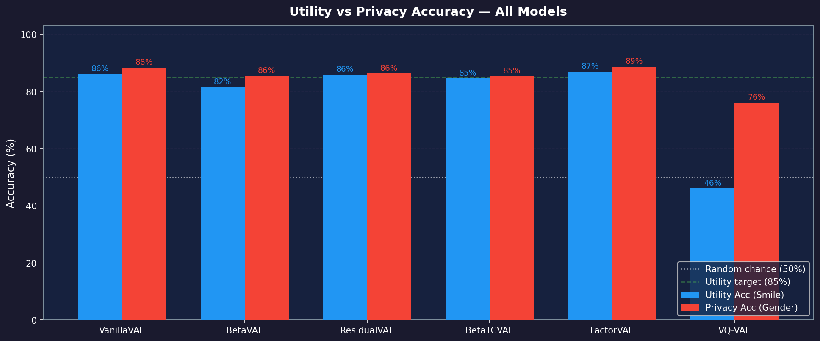
Utility vs Privacy Accuracy — All Models
FactorVAE: best utility (87%). BetaTCVAE & BetaVAE: best privacy (85.3-85.5%). All models still leak gender — ideal is 50%.

Slide 10
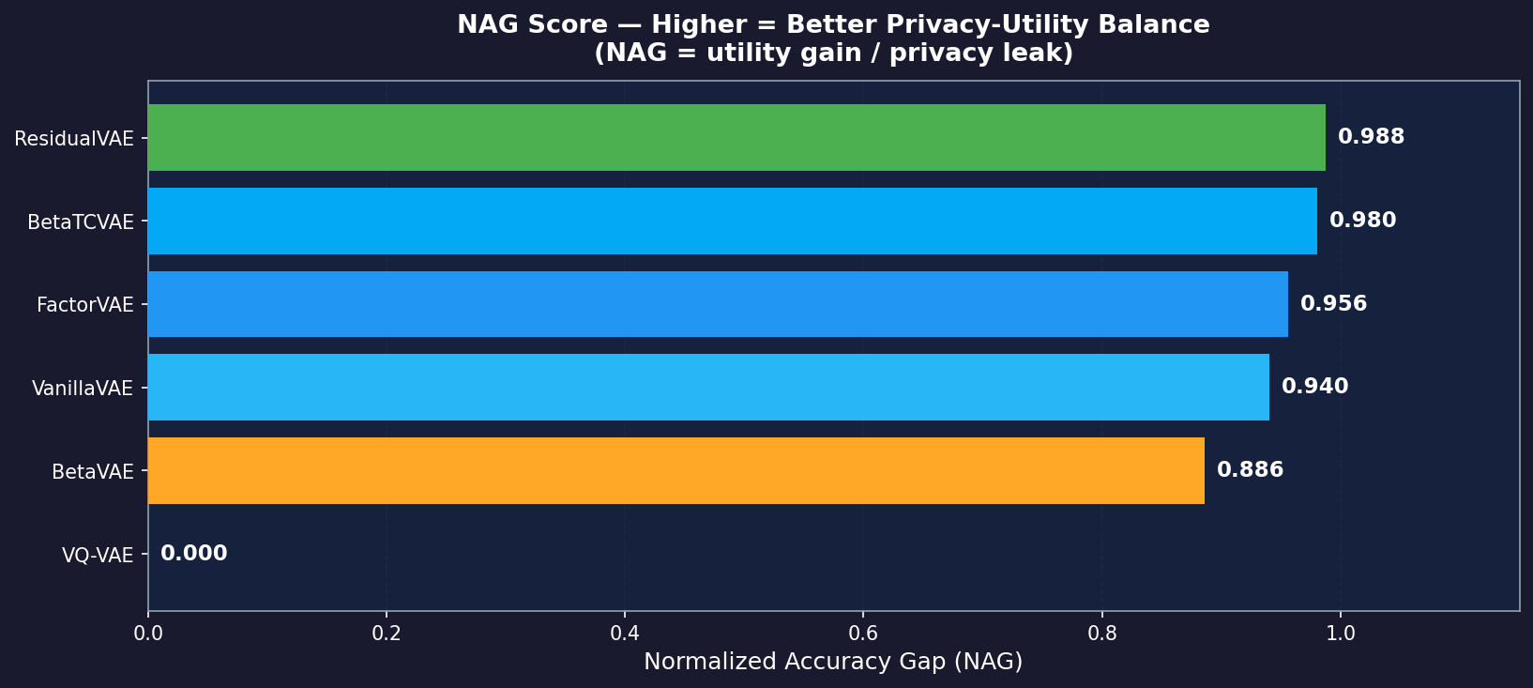
NAG Score — Privacy-Utility Balance
Normalized Accuracy Gap = utility gain / privacy leak | Higher = better | 0 = collapsed model
ResidualVAE achieves the best NAG. FactorVAE & VQ-VAE score 0 because utility dropped to random chance (collapsed).

Slide 11
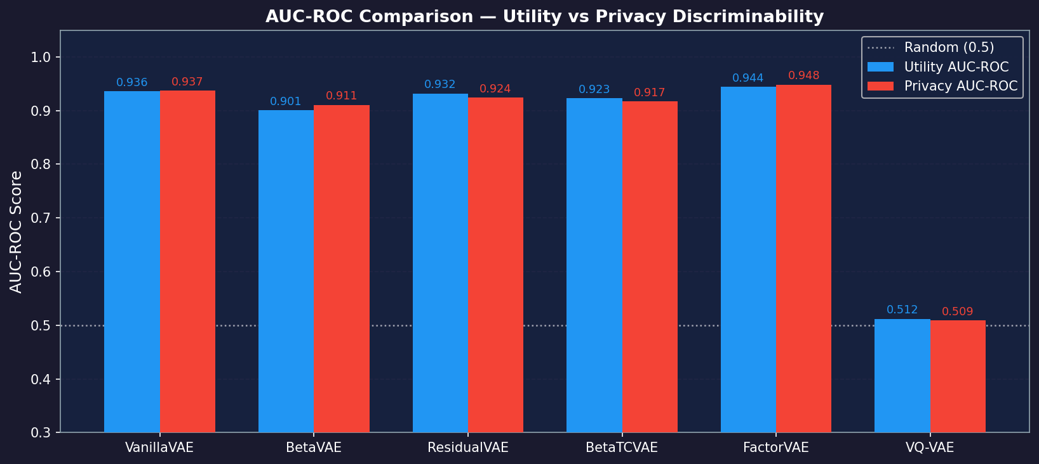
AUC-ROC — Utility vs Privacy Discriminability
AUC = 0.5 → random guessing (ideal for privacy) | AUC = 1.0 → perfect discrimination
All VAEs still allow near-perfect gender discrimination (AUC ~0.95). VQ-VAE privacy AUC ≈ 0.5 due to collapse, not privacy.

Slide 12
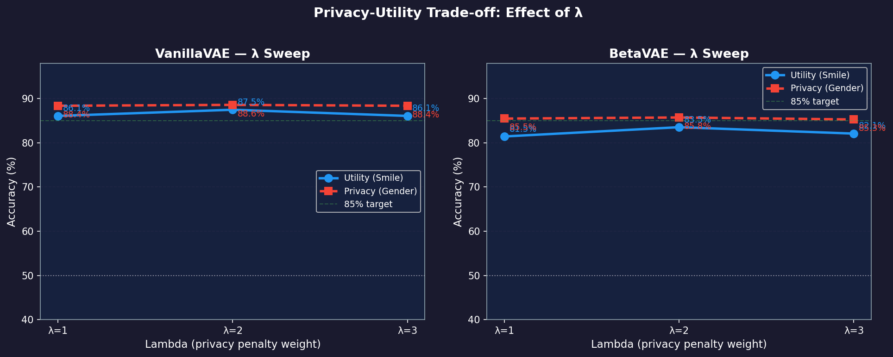
Lambda (λ) Sweep — Does Stronger Penalty Help?
ARL loss = utility_loss − λ × adversary_loss | Higher λ = more privacy pressure on encoder
Increasing λ from 1→3 barely moves privacy accuracy. The bottleneck is the adversary's strength, not the penalty weight.

Slide 13
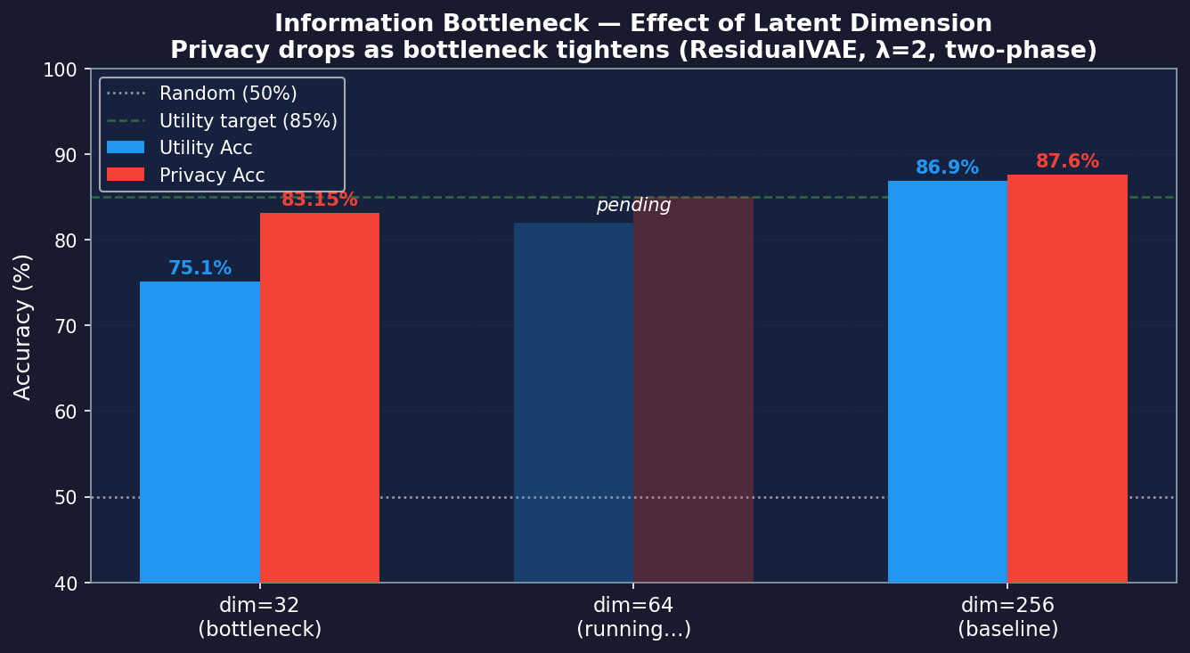
Information Bottleneck — Latent Dimension Ablation
ResidualVAE · two-phase training (λ=2) · 13 epochs · 20k samples
dim=256 (baseline)
87.6% privacy — encoder has 256 slots, gender hides easily alongside smile.
dim=32 (tight bottleneck)
83.15% privacy ↓ — first real improvement. But utility fell to 75.1% — too aggressive.
dim=64 (sweet spot?)
Running now. Prediction: utility recovers to ~82%, privacy stays suppressed ~84%.
Key insight
Compressing latent space forces the encoder to keep only what's needed for smile — gender gets squeezed out.

Slide 14
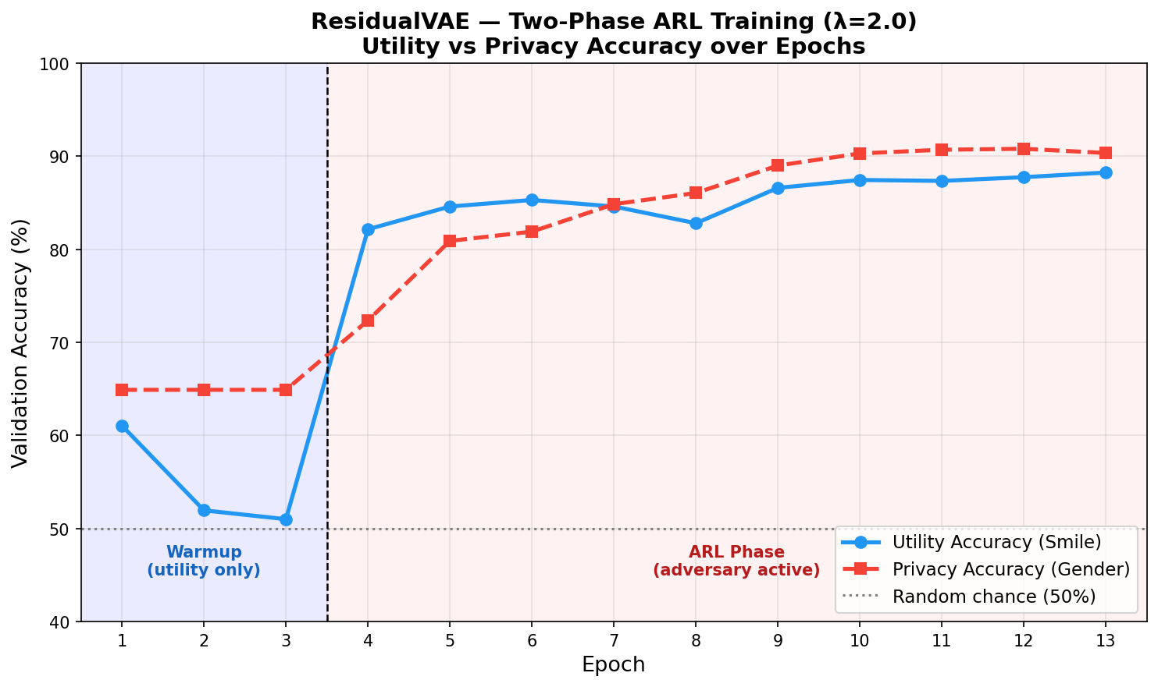
Two-Phase Training — ResidualVAE (λ=2.0)
Phase 1: encoder learns utility (adversary OFF) → Phase 2: adversary activated
Warmup (ep 1-3)
Adversary scores below random chance (39%) — encoder is free to learn utility first
Epoch 4 jump
Utility accuracy jumps to 82% in one epoch — warmup pre-training worked
Both curves rise
After ARL activates, both utility and privacy rise together — core challenge
Final epoch 13
Utility 88.3%, Privacy 90.4% — adversary matches the encoder throughout

Slide 15
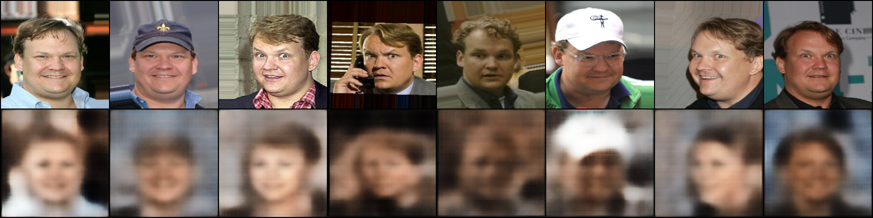
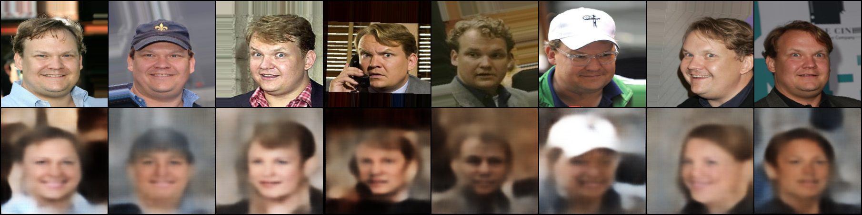
VAE Reconstructions — VanillaVAE
10 epochs · 20k samples · Each strip: input face images (top) → encoder → decoder output (bottom)
Epoch 1
Epoch 10
Reconstruction quality improves over epochs — sharper details, better colour fidelity at epoch 10

Slide 16
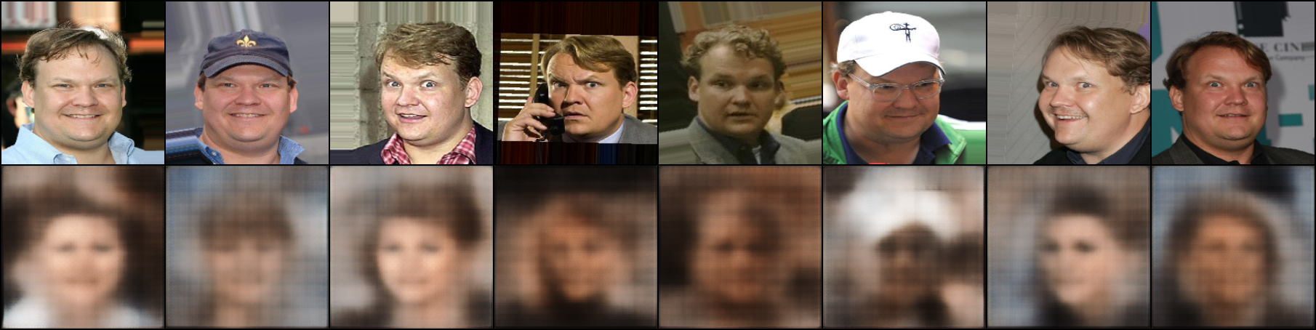
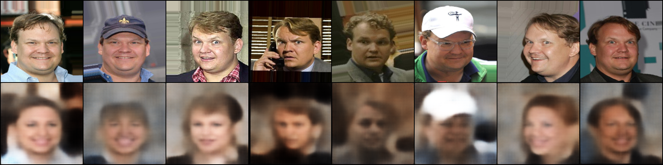
VAE Reconstructions — BetaVAE (β=4)
Stronger KL regularisation → smoother latent → slightly blurrier output than VanillaVAE
Epoch 1
Epoch 10
β=4 trades reconstruction sharpness for better-structured latent space — utility is 81.5% vs VanillaVAE 86.1%

Slide 17
Challenges & Why They Happened
⚠ Privacy accuracy won't drop below ~85%
Smile and gender are correlated in CelebA — lipstick, jaw structure, skin texture. Even the best model (BetaTCVAE) only reaches 85.3%. Ideal is 50%.
⚠ Higher λ made things worse, not better
Increasing λ from 1→5 barely changed privacy (88.4% → still ~88%). The adversary is too capable — stronger penalty alone cannot overcome the correlation.
⚠ Information bottleneck trade-off
Reducing latent_dim 256→32 was the first experiment to lower privacy (87.6%→83.15%). But utility fell from 86.9%→75.1%. Currently testing dim=64 to find the sweet spot.
⚠ VQ-VAE codebook collapse
All face images mapped to the same codebook entry — output became a constant average face. Both utility and privacy dropped to near-random. Root cause: codebook capacity vs image diversity mismatch.

Slide 18
Future Work
Focus on one model
Fine-tune ResidualVAE (best NAG = 0.988) with more epochs and the full 160k training set.
Gradient Reversal Layer
Replace ARL objective with a GRL — directly reverses gradients through the adversary, more principled than indirect penalisation.
Lower resolution (64 × 64)
Less pixel information = less gender signal available. Malia is exploring this for VQ-VAE to prevent codebook collapse.
INT8 Quantisation
Post-training quantisation would reduce latency ~4×. VanillaVAE (20ms) could hit real-time at < 10ms on edge CPU.

Slide 19
Thank You
Questions & Discussion
Code & results available at:
github.com/mh-mubashir/privacy-preserving-extension · branch: member1-sindhu
Hamza Mubashir · Malia Howe · Sindhu SureshKumar
Northeastern University · EECE 5698 · Spring 2026

