Slide 1
CHAMELEON: Hierarchical
Clustering with Dynamic Modeling

Slide 2
Graph-Based Clustering: General Concepts
Graph-Based clustering needs a proximity matrix
  Each edge between two nodes has a weight which is the proximity between the two points
Sparsify the proximity graph
Define a similarity measure between two objects
  Based on the number of nearest neighbors that they share
  Useful for overcoming problems with high dimensionality and clusters of varying density
Use proximity graph to provide evaluation of whether two clusters should be merged
  two clusters are merged only if the resulting cluster will have characteristics similar to the original two clusters

Slide 3
Sparsification
The m by m proximity matrix for m data points can be represented as a dense graph and the weight of the edge between any pair of nodes reflects their pairwise proximity
Every object has some level of similarity to every other object
  This property can be used to sparsify the proximity graph (matrix)
  By setting low-similarity values to 0 before beginning the actual clustering process
Many methods for sparsification may be performed:
  By breaking all links that have a similarity below a specified thereshold
  By keeping only links to the k-nearest neighbors of point (k-NNG)
k-nearest neighbors graph (k-NNG)
p and q are connected if q is among the top k closest neighbors of p

Slide 4
Sparsification: Several beneficial effects
Data size is reduced
  The amount of time required to cluster the data is drastically reduced
  Sparsification can eliminate more than 99% of the entries in a proximity matrix
Clustering often works better
  Sparsification techniques keep the connections to their nearest neighbors of an object while breaking the connections to more distant objects
  This reduces the impact of noise and outliers and sharpens the distinction between clusters
Graph partitioning algorithms can be used
  CHAMELON and OPOSSUM Clustering

Slide 5
Graph-Based Clustering: CHAMELEON
Introduced in 1999 by Han and Kyarpis
An Agglomerative Hierarchical clustering

Slide 6
Limitations of Current Merging Schemes
Existing merging schemes in hierarchical clustering algorithms are static in nature
  MIN: Merge two clusters based on their closeness (or minimum distance)
  Group-Average: Merge two clusters based on their average connectivity

Slide 7
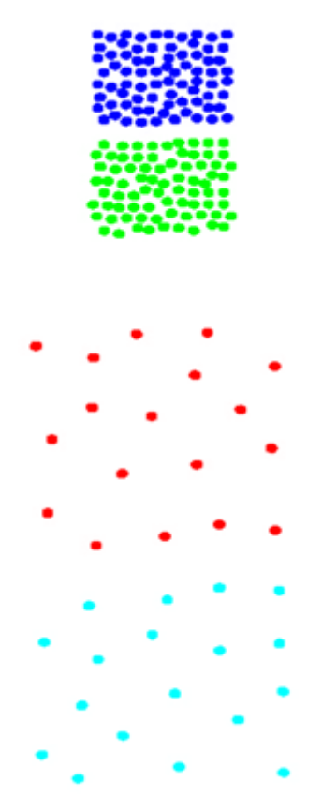
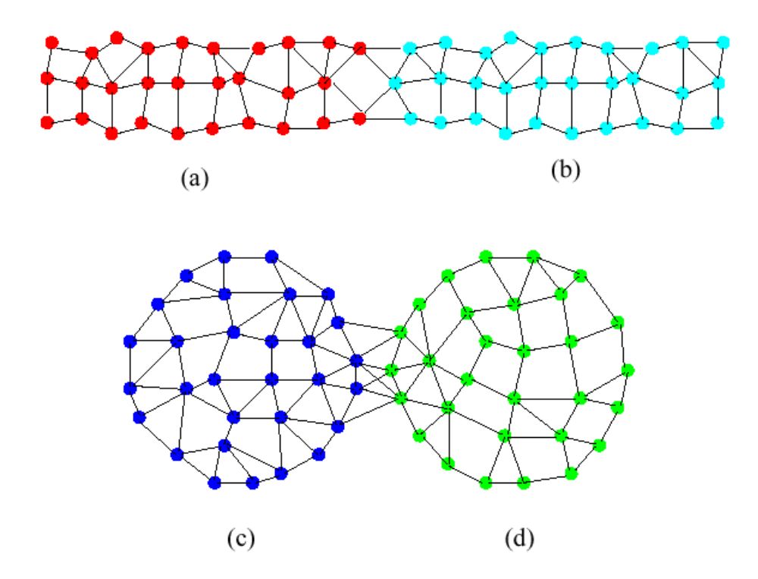
Limitations of Current Merging Schemes
Closeness schemes
will merge (a) and (b)
Average connectivity schemes
will merge (c) and (d)

Slide 8
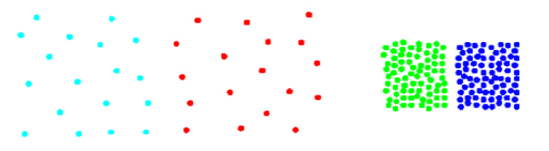
CHAMELEON: Clustering Using Dynamic Modeling
Adapt to the characteristics of the data set to find the natural clusters
Use a dynamic model to measure the similarity between clusters
  Main properties are the relative closeness and relative inter-connectivity of the cluster
  Two clusters are combined if the resulting cluster shares certain properties with the constituent clusters
  The merging scheme preserves self-similarity

Slide 9
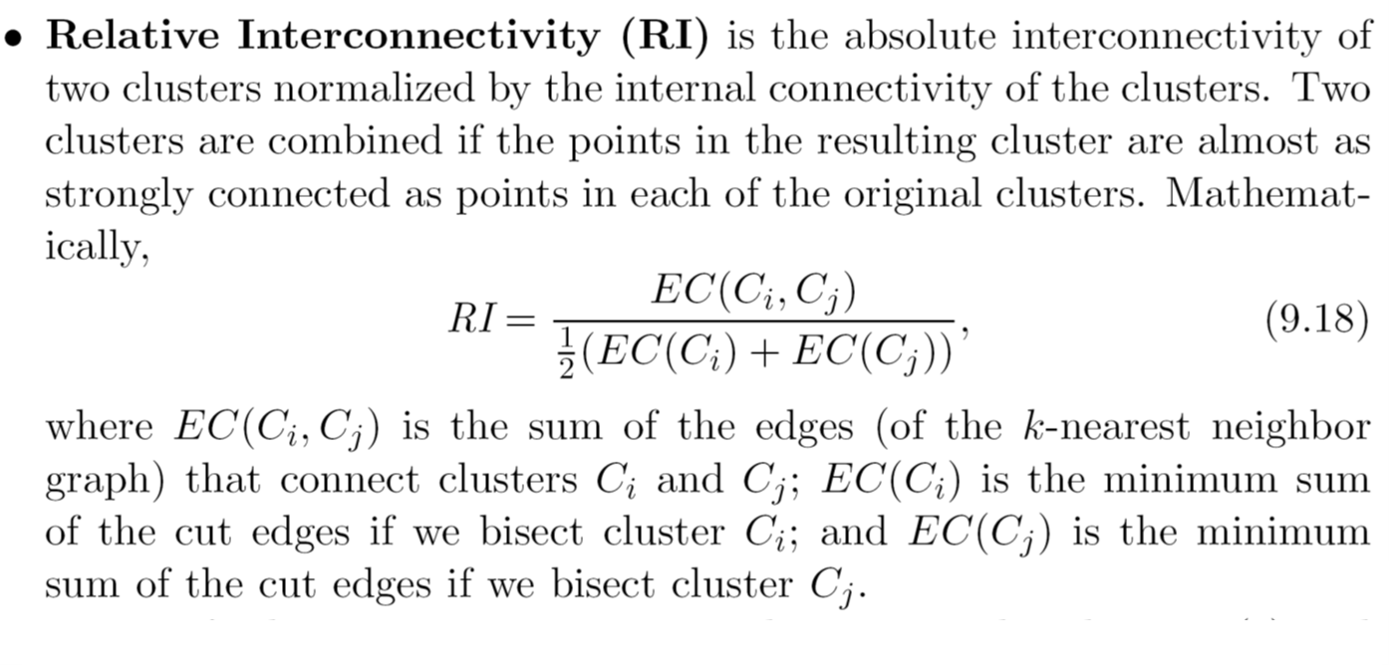
Relative Interconnectivity

Slide 10
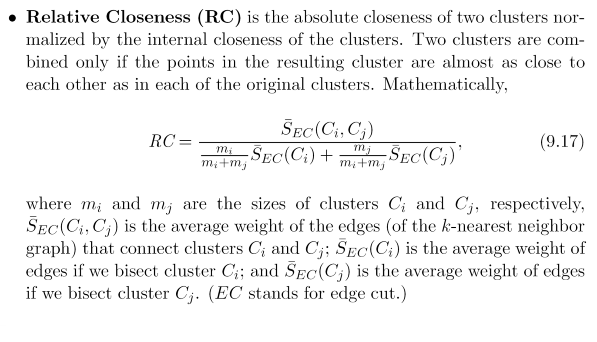
Relative Closeness

Slide 11
CHAMELEON: Steps
Preprocessing Step: Represent the data by a graph
  Given a set of points, construct the k-nearest neighbor (k-NNG) graph to capture the relationship between a point and its k nearest neighbors
  Concept of neighborhood is captured dynamically (even if region is sparse)
Phase 1: Use a multilevel graph partitioning algorithm on the graph to find a large number of clusters of well-connected vertices
  Each cluster should contain mostly points from one “true” cluster, i.e., be a sub-cluster of a “real” cluster

Slide 12
CHAMELEON: Steps
Phase 2: Use Hierarchical Agglomerative Clustering to merge sub-clusters
  Two clusters are combined if the resulting cluster shares certain properties with the constituent clusters
Two key properties used to model similarity:
  Relative Interconnectivity: Absolute interconnectivity of two clusters normalized by the internal connectivity of the clusters
  Relative Closeness: Absolute closeness of two clusters normalized by the internal closeness of the clusters

Slide 13
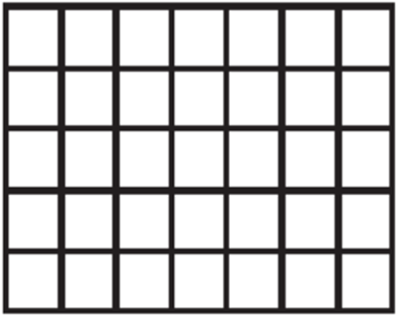
Overall Framework of CHAMELEON
Modify Proximity matrix
Proximity matrix
Sparse Graph
Data Set
k-NN Graph
Merge Partitions
Partition the Graph
Final Clusters

