Slide 1
Geometric applications of Linear Algebra
Notes:
Why linear Algebra? (Applications introduction)
Deep learning. Tensorflow
image processing. Pil

Slide 2
01
Table of contents
Matrix
02
Determinant

Slide 3
01
Matrix

Slide 4
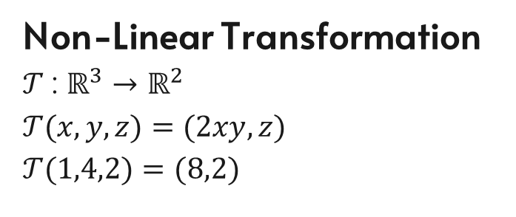
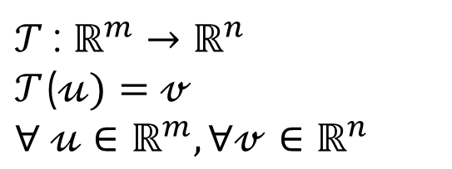
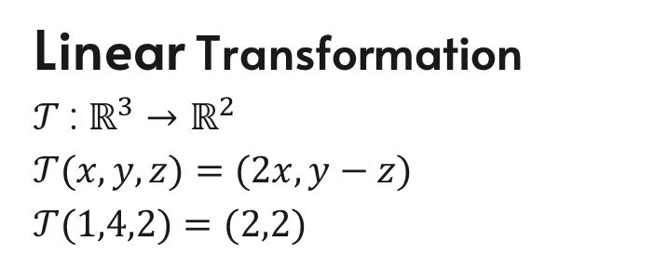
Transformations
Non-Linear Transformation
$𝒯$: $ℝ^{3}→ℝ^{2}$
$𝒯$($x,y,z)=$ $(2xy,z)$
$𝒯$(1$,4,2)=$ $(8,2)$
$𝒯$: $ℝ^{m}→ℝ^{n}$
$𝒯$($𝓊)=$ $𝓋$
$∀ 𝓊∈ℝ^{m},∀𝓋$ $∈ℝ^{n}$
Linear Transformation
$𝒯$: $ℝ^{3}→ℝ^{2}$
$𝒯$($x,y,z)=$ $(2x,y−z)$
$𝒯$(1$,4,2)=$ $(2,2)$

Slide 5
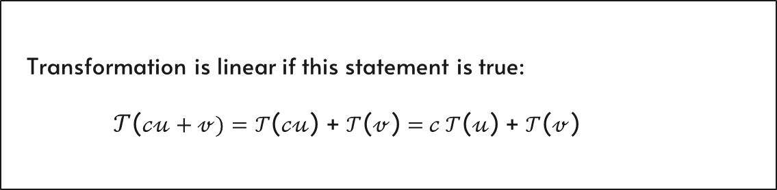
Linear Transformation
Transformation is linear if this statement is true:
$𝒯$($𝒸𝓊+𝓋)=𝒯$($𝒸𝓊$) + $𝒯$($𝓋$) =$𝒸 𝒯$($𝓊$) + $𝒯$($𝓋$)
Prove linearity or non-linearity of given examples

Slide 7


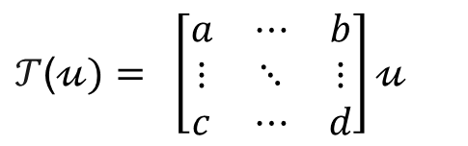
Additivity
Matrix as a transformation
scaling
$ℳ\text{(}𝓊+𝓋\text{)}=ℳ$($𝓊$) +$ℳ$($𝓋$)
$𝒯$($𝓊)= \left[\begin{matrix}a & ⋯ & b \\ ⋮ & ⋱ & ⋮ \\ c & ⋯ & d\end{matrix}\right]𝓊$
$$ℳ\text{(}𝒸𝓊\text{)}=𝒸ℳ\text{(}𝓊\text{)}$$

Slide 8
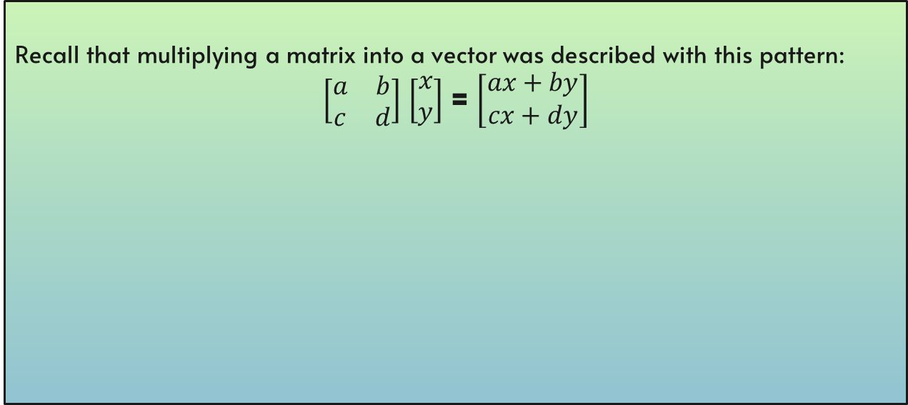



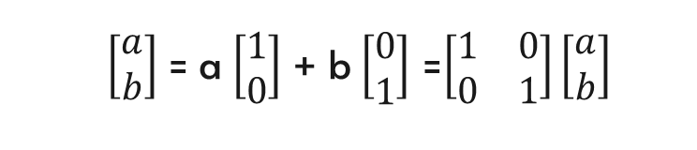
Deeper understanding of a matrix
Recall that multiplying a matrix into a vector was described with this pattern:
$\left[\begin{matrix}a & b \\ c & d\end{matrix}\right]$ $\left[\begin{aligned}x \\ y\end{aligned}\right]$ = $\left[\begin{aligned}ax+by \\ cx+dy\end{aligned}\right]$
here is why:
$\left[\begin{aligned}a \\ b\end{aligned}\right]$ = a $\left[\begin{aligned}1 \\ 0\end{aligned}\right]$ + b $\left[\begin{aligned}0 \\ 1\end{aligned}\right]$ =$\left[\begin{matrix}1 & 0 \\ 0 & 1\end{matrix}\right]\left[\begin{aligned}a \\ b\end{aligned}\right]$
$$𝒾$$
$$𝒿$$
$\left[\begin{aligned}x′ \\ y′\end{aligned}\right]$ = x $\left[\begin{aligned}a \\ b\end{aligned}\right]$ + y $\left[\begin{aligned}c \\ d\end{aligned}\right]$ =$\left[\begin{matrix}a & c \\ b & d\end{matrix}\right]\left[\begin{aligned}x \\ y\end{aligned}\right]$
Notes:
Some examples)demonstrate):
Scaling
Shear
random
Rotation
Generalize to 3 dimensions

Slide 9
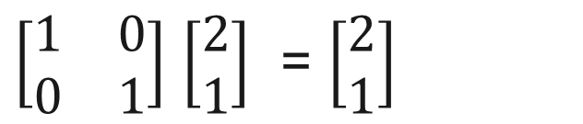
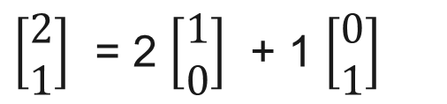
$\left[\begin{aligned}2 \\ 1\end{aligned}\right]$ = 2 $\left[\begin{aligned}1 \\ 0\end{aligned}\right]$ + 1 $\left[\begin{aligned}0 \\ 1\end{aligned}\right]$
$\left[\begin{matrix}1 & 0 \\ 0 & 1\end{matrix}\right]$ $\left[\begin{aligned}2 \\ 1\end{aligned}\right]$ = $\left[\begin{aligned}2 \\ 1\end{aligned}\right]$

Slide 10
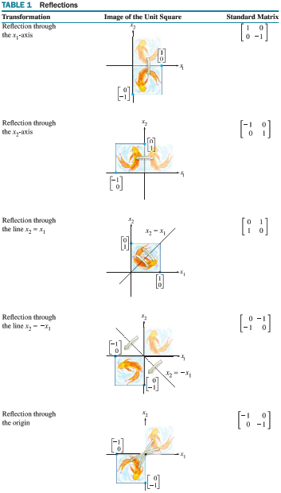
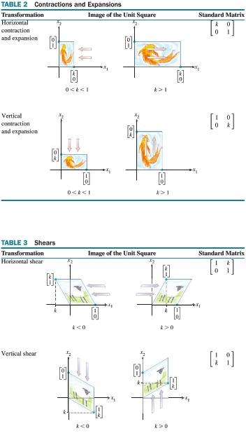

Slide 11
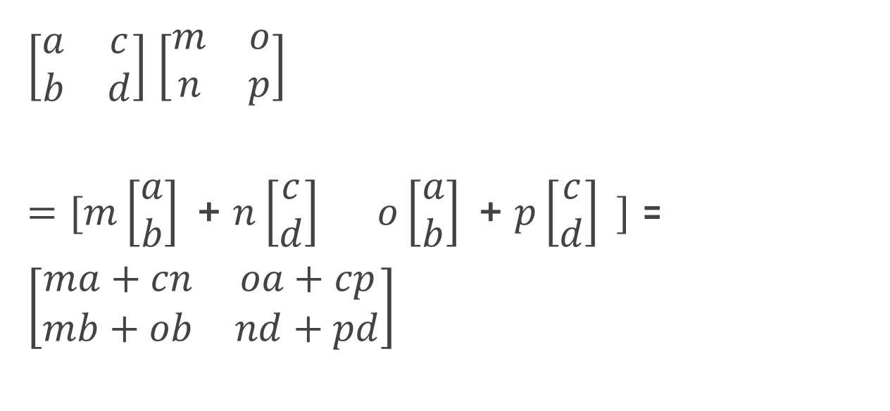


Composition of 2 matrices
$\left[\begin{matrix}a & c \\ b & d\end{matrix}\right]$ $\left[\begin{matrix}m & o \\ n & p\end{matrix}\right]$
$=[\begin{matrix}m\left[\begin{aligned}a \\ b\end{aligned}\right]\text{ + }n\left[\begin{aligned}c \\ d\end{aligned}\right] & o\left[\begin{aligned}a \\ b\end{aligned}\right]\text{ + }p\left[\begin{aligned}c \\ d\end{aligned}\right] \end{matrix}]$ = $\left[\begin{matrix}ma+cn & oa+cp \\ mb+ob & nd+pd\end{matrix}\right]$
$$𝒾$$
$$𝒿$$
Notes:
visualize

Slide 12

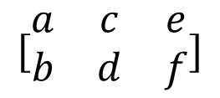



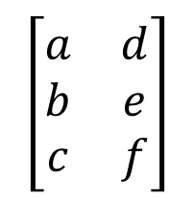
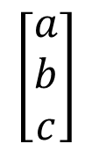

Dimensional transformations
$$\left[\begin{matrix}a & d \\ b & e \\ c & f\end{matrix}\right]$$
$$\left[\begin{aligned}a \\ b \\ c\end{aligned}\right]$$
$${:ℝ}^{2}→ℝ^{3}$$
$${:ℝ}^{1}→ℝ^{3}$$
3x1
3x2
$$[\begin{matrix}a & c & e \\ b & d & f\end{matrix}]$$
$$\begin{matrix}[a & b & c]\end{matrix}$$
$${:ℝ}^{3}→ℝ^{1}$$
$${:ℝ}^{3}→ℝ^{2}$$
1x3
2x3

Slide 13
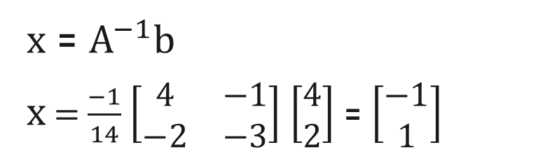
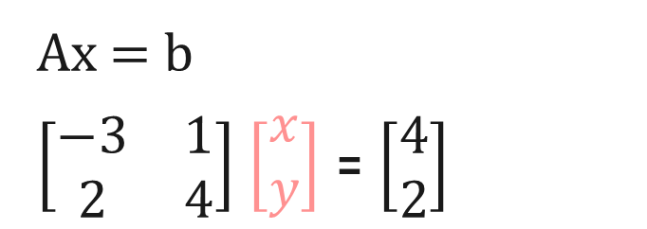
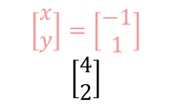
Linear equations
Ax = b
$\left[\begin{matrix}−3 & 1 \\ 2 & 4\end{matrix}\right]$ $\left[\begin{aligned}x \\ y\end{aligned}\right]$ = $\left[\begin{aligned}4 \\ 2\end{aligned}\right]$
$$\left[\begin{aligned}x \\ y\end{aligned}\right]=\left[\begin{aligned}−1 \\ 1\end{aligned}\right]$$
$$\left[\begin{aligned}4 \\ 2\end{aligned}\right]$$
x = $A^{−1}b$
x = $\frac{−1}{14}$ $\left[\begin{matrix}4 & −1 \\ −2 & −3\end{matrix}\right]$ $\left[\begin{aligned}4 \\ 2\end{aligned}\right]$ = $\left[\begin{aligned}−1 \\ 1\end{aligned}\right]$

Slide 14
Eigenvalues/Eigenvectors
AX = ∆X
(A-∆)X=0
X != 0
det(A-∆I)=0
Mathmatical statements above indicate that there is a vector X that is immune to matrix transformation A. Only one attribute of X is affected by A transformation and that is it’s length, ∆.

Slide 15
Rank
One common definition is that rank is the number of basis vectors in column/row space.
Away from the formal definition, rank is the number of dimensions after matrix transformation

Slide 16
02
Determinant

Slide 17
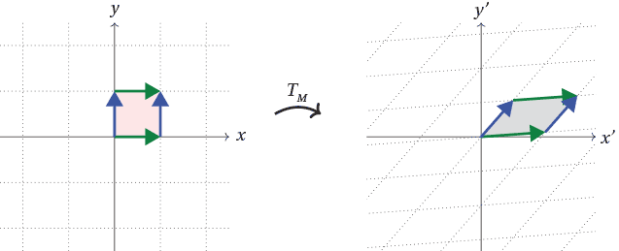


Determinant in Linear Transformation
$$S$$
$$S^{′}$$

Slide 18



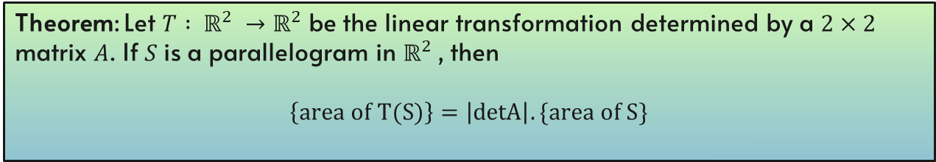





Theorem: Let $T : ℝ^{2} →ℝ^{2}$ be the linear transformation determined by a $2×2$ matrix $A$. If $S$ is a parallelogram in $ℝ^{2}$, then
$$\left\{area of T(S)\right\}=\left|detA\right|.\{area of S\}$$
Proof:
$A=\left[\begin{matrix}a_{1} & a_{2}\end{matrix}\right]$
Matrix of Linear Transformation
$$S=\left\{s_{1}b_{1}+s_{2}b_{2} :0≤s_{1}≤1, 0≤s_{2}≤1\right\}$$
A Parallelogram at the origin in $ℝ^{2}$
$$T\left(S\right)=T\left(s_{1}b_{1}+s_{2}b_{2}\right) =s_{1}T\left(b_{1}\right)+s_{2}T\left(b_{2}\right)$$
$=s_{1}Ab_{1}+s_{2}Ab_{2}$
$$0≤s_{1}≤1 and 0≤s_{2}≤1$$
$T\left(S\right)$is a Parallelogram determined by the columns of matrix $\left[\begin{matrix}{Ab}_{1} & {Ab}_{2}\end{matrix}\right]$
$$B=\left[\begin{matrix}b_{1} & b_{2}\end{matrix}\right]$$
$\left[\begin{matrix}{Ab}_{1} & {Ab}_{2}\end{matrix}\right]$
$$\left[\begin{matrix}{Ab}_{1} & {Ab}_{2}\end{matrix}\right]=AB$$
$$\left\{area of T(S)\right\}=\left|detAB\right|=\left|detA\right|.\left|detB\right|$$
$=\left|detA\right|.\{area of S\}$

Slide 19
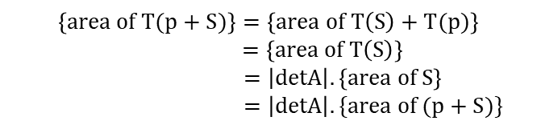

Proof (Continued):
$$p+S$$
An arbitrary Parallelogram
A vector
A parallelogram at the origin
$$\left\{area of T(p+S)\right\}=\left\{area of T\left(S\right)+T(p)\right\}$$
$=\left\{area of T\left(S\right)\right\}$
$=\left|detA\right|.\left\{area of S\right\}$
$=\left|detA\right|.\{area of (p+S)\}$
Translation
Translation
So this shows that theorem holds for all parallelograms in $ℝ^{2}$.

Slide 20


Theorem: Let $T : ℝ^{3} →ℝ^{3}$ be the linear transformation determined by a $3×3$ matrix $A$. If $S$ is a parallelepiped in $ℝ^{3}$, then
$$\left\{volume of T(S)\right\}=\left|detA\right|.\{volume of S\}$$
Proof:
Similar to Previous Theorem

Slide 21
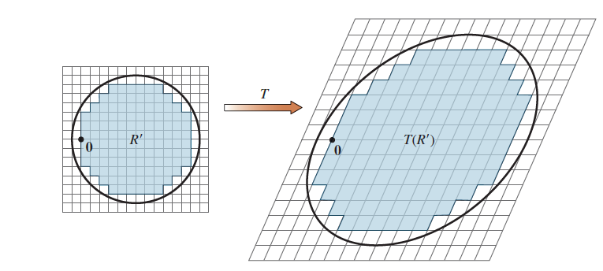
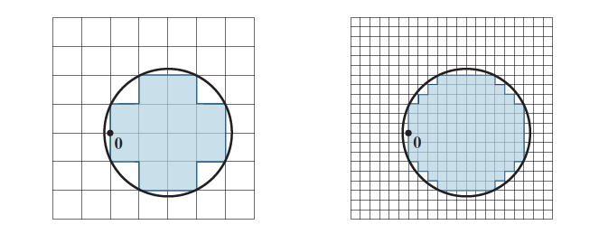

The conclusions of Previous hold whenever $S$ is a region in $ℝ^{2}$ with finite area
or a region in $ℝ^{3}$ with finite volume.

Slide 22

Determinant as Area and Volume
$$y$$
$$z$$
$$y$$
$$x$$
$$x$$

Slide 23
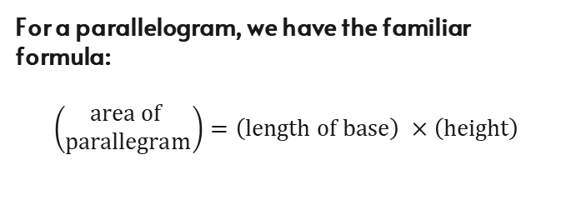
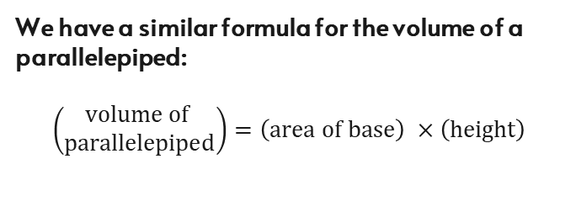
For a parallelogram, we have the familiar formula:
$$\left(\begin{aligned}area of \\ parallegram\end{aligned}\right)=\left(length of base\right) ×\left(height\right)$$
We have a similar formula for the volume of a parallelepiped:
$$\left(\begin{aligned}volume of \\ parallelepiped\end{aligned}\right)=\left(area of base\right) ×\left(height\right)$$
height
height
base
base

Slide 24




Theorem: if $A$ is a $2 × 2$ matrix, the area of the parallelogram determined by the columns of $A$ is $|\det{A}|$.
Proof:
The theorem is obviously true for any $2 × 2$diagonal matrix:
$$y$$
$$\left[\begin{matrix}0 \\ d\end{matrix}\right]$$
$$\left|\begin{matrix}a & 0 \\ 0 & d\end{matrix}\right|=\left|ad\right|= \left\{\begin{aligned} area of \\ rectangle\end{aligned}\right\}$$
$$x$$
$$\left[\begin{matrix}a \\ 0\end{matrix}\right]$$

Slide 25



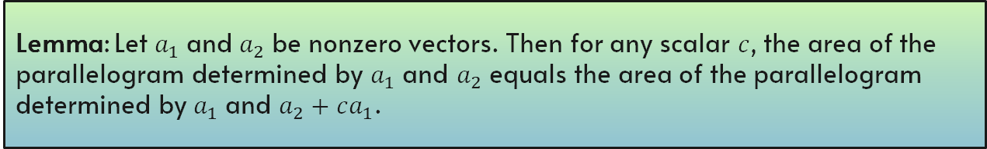






Lemma: Let $a_{1}$ and $a_{2}$ be nonzero vectors. Then for any scalar $c$, the area of the
parallelogram determined by $a_{1}$ and $a_{2}$ equals the area of the parallelogram
determined by $a_{1}$ and $a_{2}+ca_{1}$.
Proof:
Suppose that $a_{2}$ is not a multiple of $a_{1}$:
$$a_{2}+ca_{1}$$
$$a_{2}$$
$$L^{′}$$
$$L$$
$${ca}_{1}$$
$$0$$
$$a_{1}$$
$$S_{1}=S_{2}$$

Slide 26

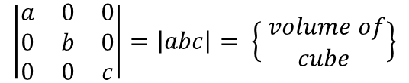
Theorem: if $A$ is a $3 ×3$ matrix, the volume of the parallelepiped determined by the columns of $A$ is $|\det{A}|$.
Proof:
The theorem is obviously true for any $3 ×3$diagonal matrix:
$$z$$
$$\left|\begin{matrix}a & 0 & 0 \\ 0 & b & 0 \\ 0 & 0 & c\end{matrix}\right|=\left|abc\right|= \left\{\begin{aligned} volume of \\ cube\end{aligned}\right\}$$
$$y$$
$$x$$

