Slide 1



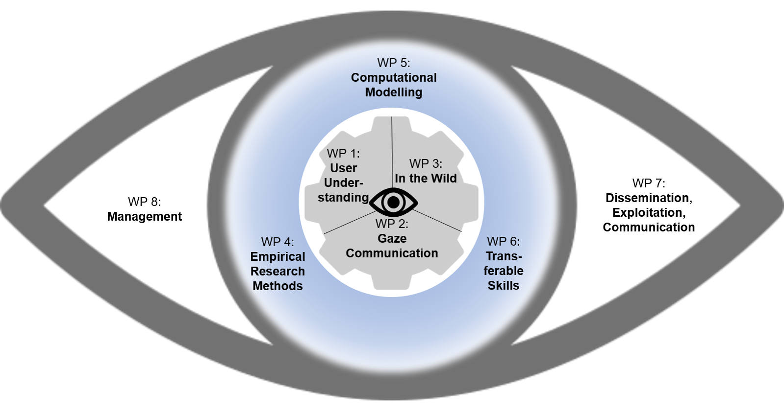


PyEtSimul
An Open-Source Python Framework for Eye-Tracking Simulation
Mohammadhossein Salari¹ · Diederick C. Niehorster² · Dan Witzner Hansen³ · Roman Bednarik¹
1
2
3
Funded by the EU Horizon Europe programme, grant number 101072410 Eyes4ICU project.

Slide 2
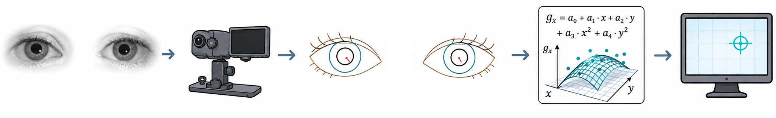
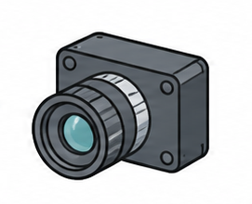
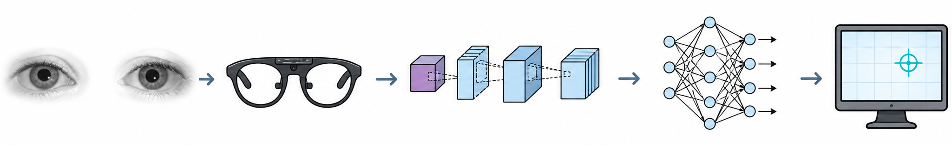
Video-based eye tracking: from eye images to gaze data
The images on this slide were generated using ChatGPT
Notes:
A video-based eye tracker estimates gaze from the eye image
Two routes to get there:
hand-crafted features — find the pupil + corneal reflection, then fit a geometric / polynomial gaze model (top row)
end-to-end — a deep network (CNN) maps the eye image straight to a gaze point (bottom row)
Both pipelines depend on the eye's optics — the cornea reflects and refracts, and the pupil projects through the cornea to the camera.
That geometry is known and modelable — not a mystery we have to learn from data.

Slide 3
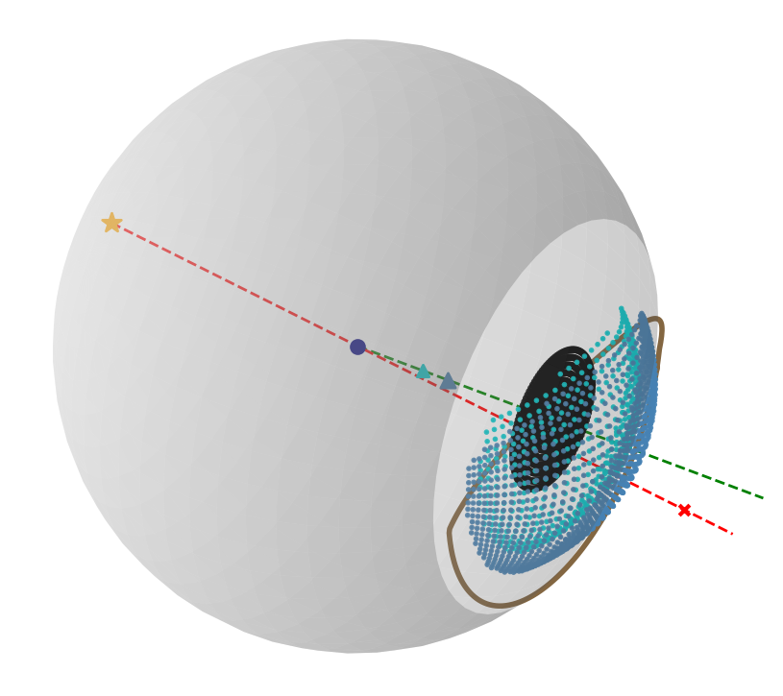
PyEtSimul: a feature-based simulator
Models the eye's geometry explicitly at the feature level — exact pupil and corneal-reflection positions
It opens the black box of eye tracking : isolate one factor, change it, and watch its effect
Every eye and setup parameter can be set
Notes:
- Factors: angle kappa, pupil center, corneal shape; camera & light placement; noise
- Black box → you can't change one factor at a time and watch its effect
- Feature level = exact pupil + corneal-reflection positions; full control of every parameter → isolate each factor and "open the black box"

Slide 4
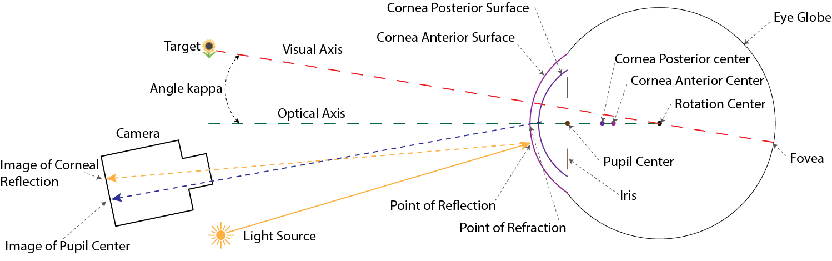
The eye model
Le Grand two-sphere eye model (Le Grand 1957; Le Grand & El Hage 2013)
Notes:
- Default eye parameters (corneal radii, axial length, …) — Boff, Kaufman & Thomas (1986)

Slide 5
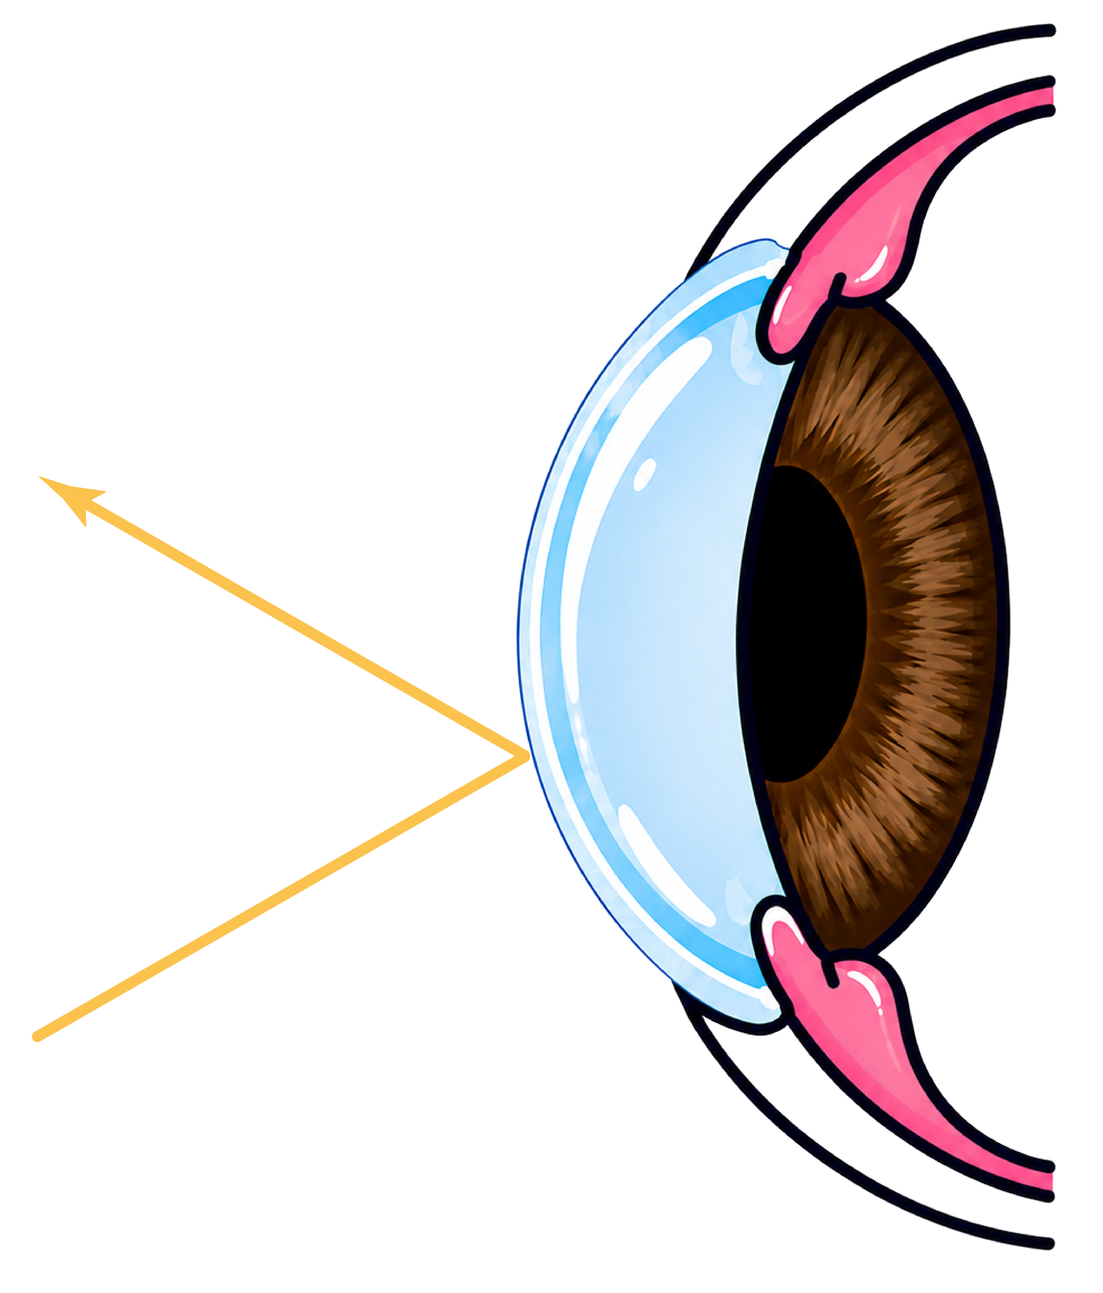
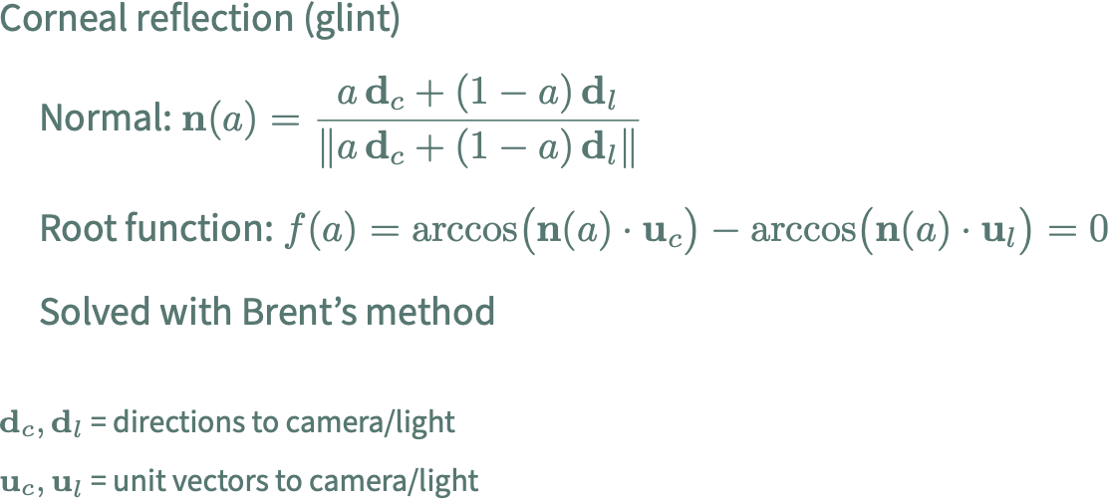
Corneal reflection
The imageson this slide were generated using ChatGPT
Notes:
Corneal reflection (glint)
Normal: n(a) = [a·d_c + (1−a)·d_l] / ‖a·d_c + (1−a)·d_l‖
Root function: f(a) = arccos(n(a)·u_c) − arccos(n(a)·u_l) = 0
Solved with Brent's method
d_c, d_l = directions to camera/light
u_c, u_l = unit vectors to camera/light

Slide 6
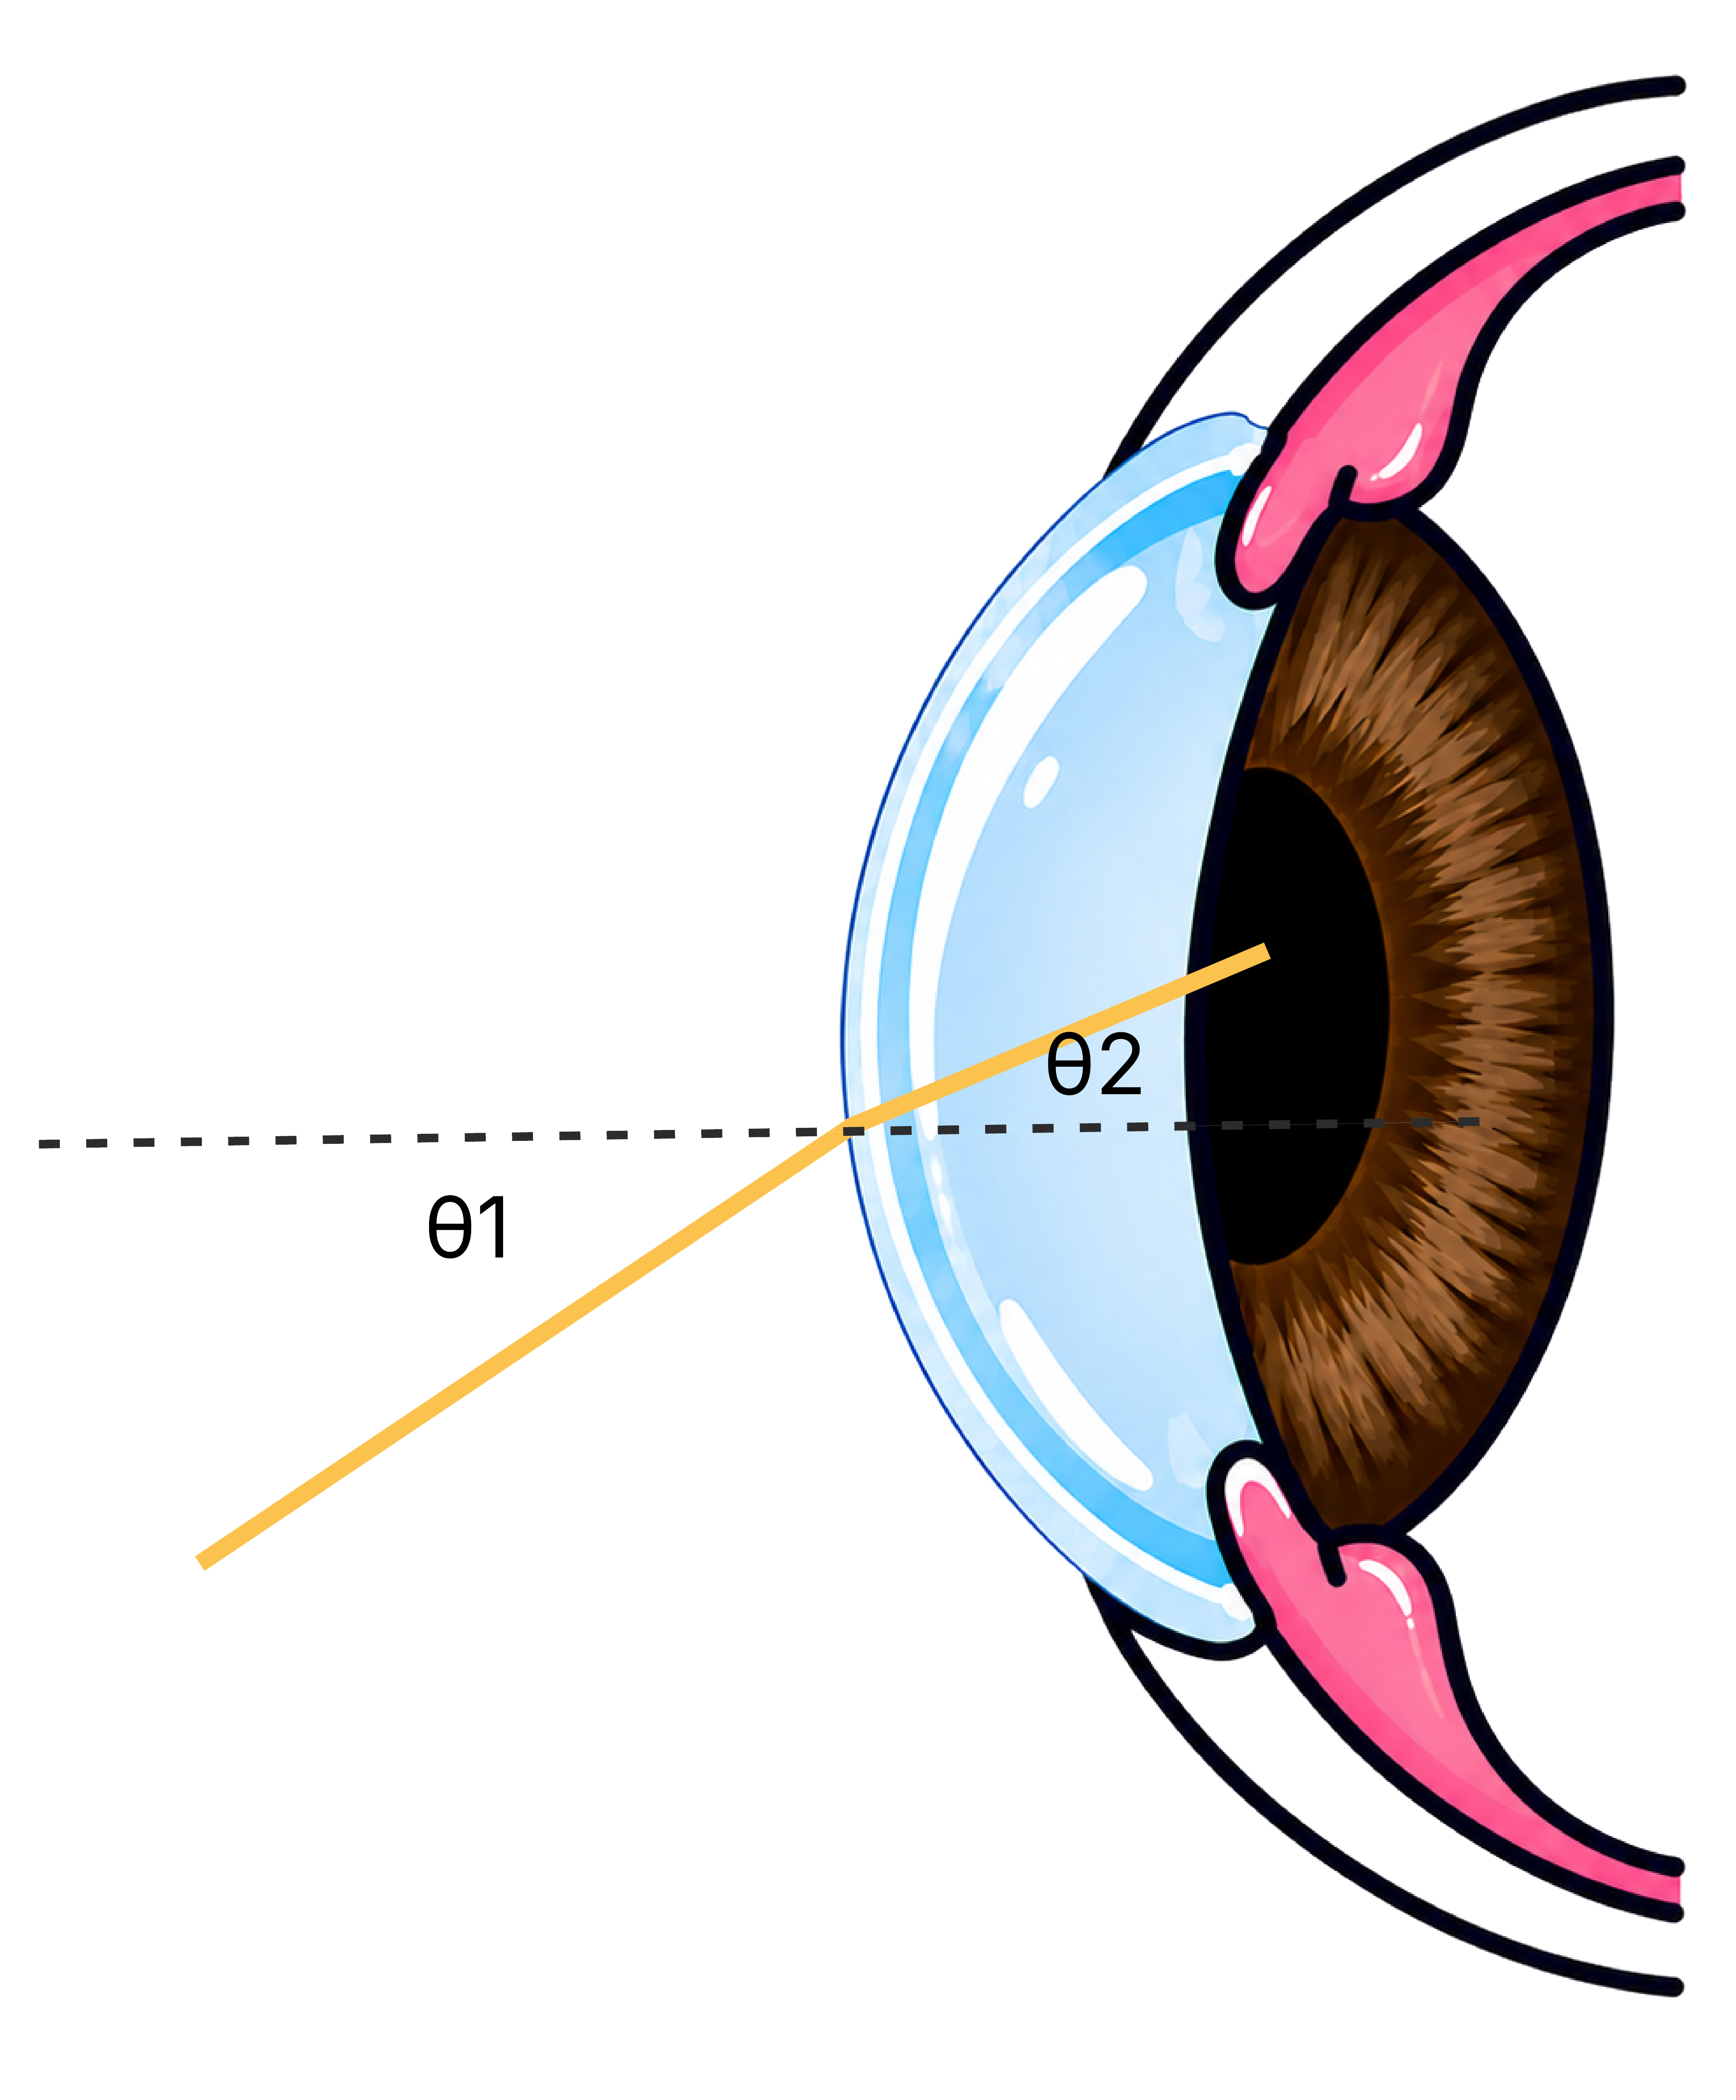
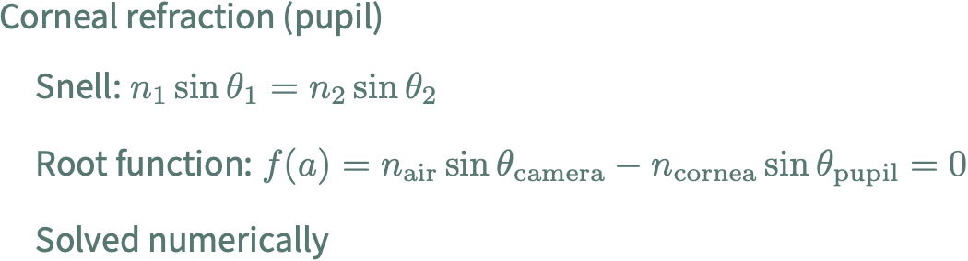
Corneal refraction
The image on this slide were generated using ChatGPT
Notes:
Corneal refraction (pupil)
Snell: n₁ sin θ₁ = n₂ sin θ₂
Root function: f(a) = n_air·sin θ_camera − n_cornea·sin θ_pupil = 0
Solved numerically

Slide 7
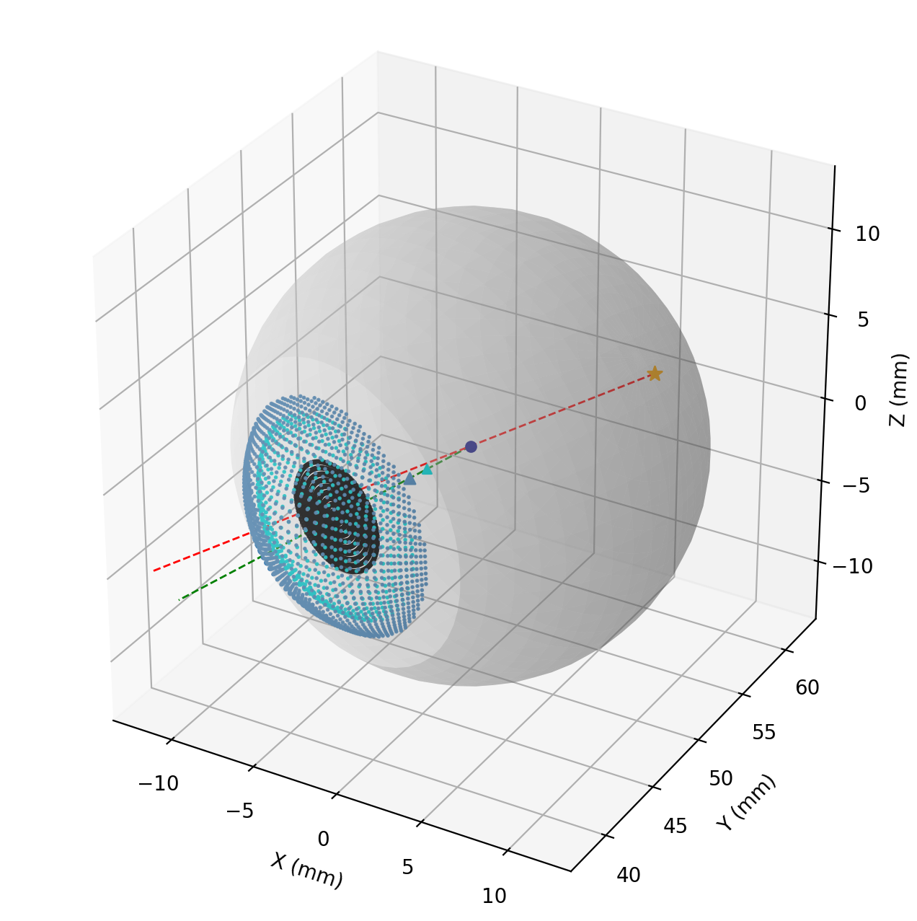
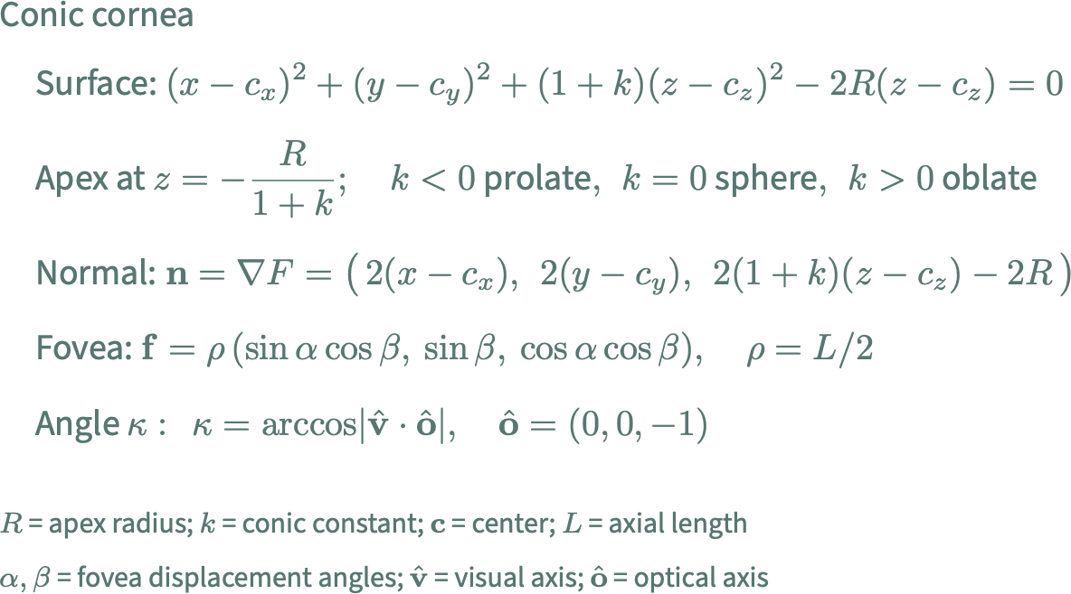
Conic cornea
Notes:
Conic cornea
Surface: (x−cₓ)² + (y−c_y)² + (1+k)(z−c_z)² − 2R(z−c_z) = 0
apex at z = −R/(1+k); k<0 prolate, k=0 sphere, k>0 oblate
Normal: n = ∇F = ( 2(x−cₓ), 2(y−c_y), 2(1+k)(z−c_z) − 2R )
Fovea: f = ρ ( sin α cos β, sin β, cos α cos β ), ρ = L/2
Angle kappa: κ = arccos | v̂ · ô |, ô = (0, 0, −1)
R = apex radius of curvature; k = conic constant; c = center; L = axial length
α, β = fovea displacement angles; v̂ = visual axis (to fovea); ô = optical axis

Slide 8
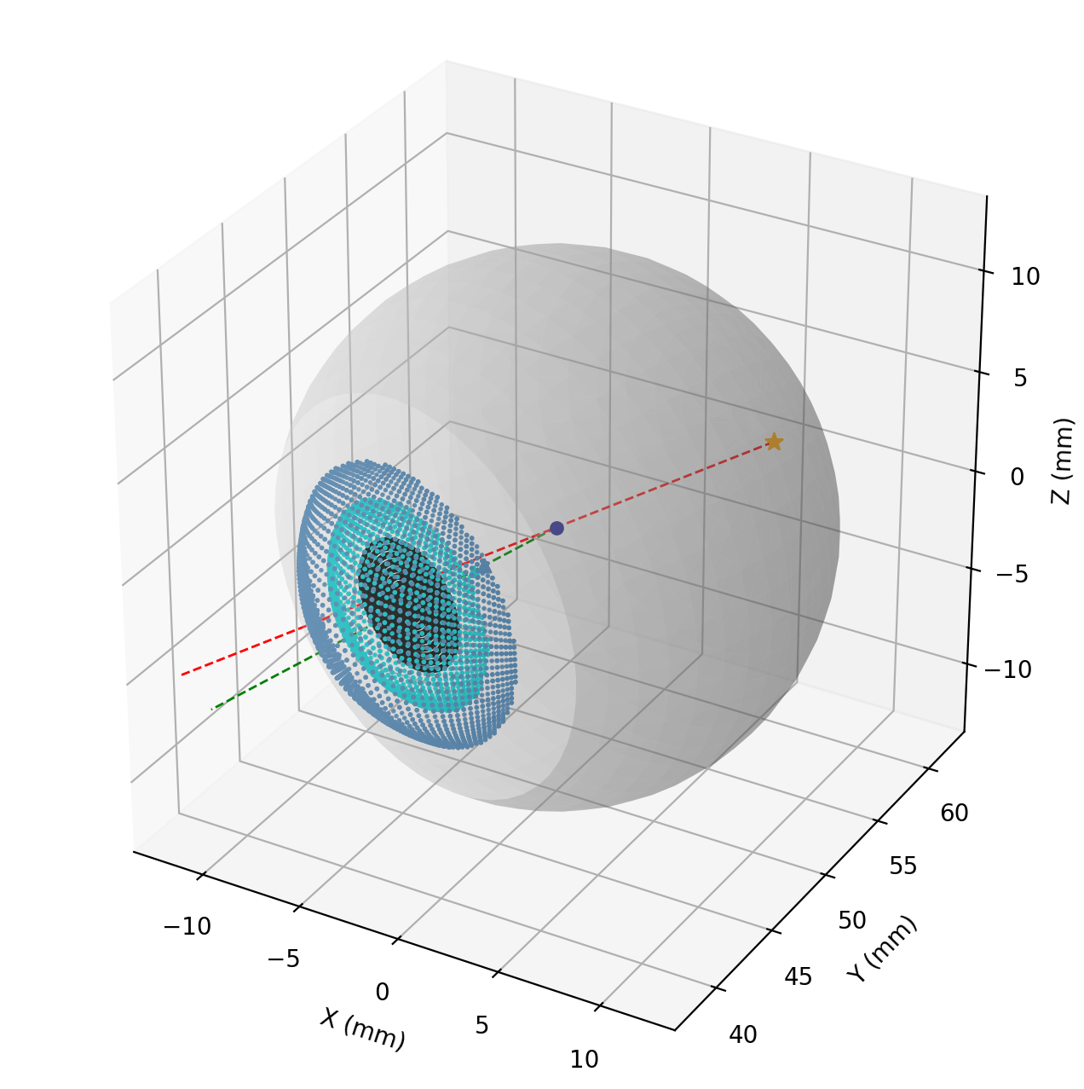
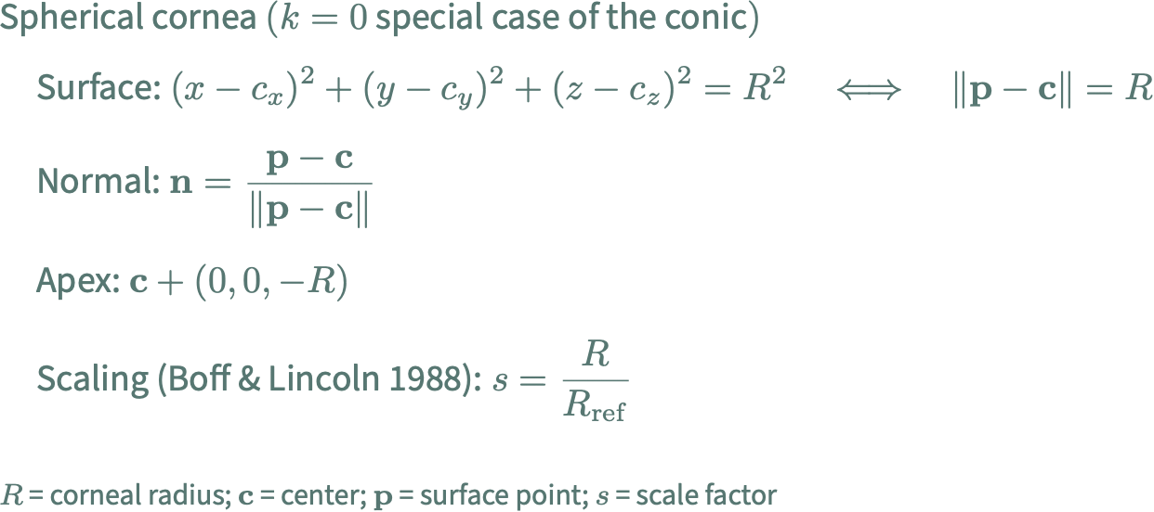
Spherical cornea
Notes:
Spherical cornea (k = 0 special case of the conic)
Surface: (x−cₓ)² + (y−c_y)² + (z−c_z)² = R² i.e. ‖p − c‖ = R
Normal: n = (p − c) / ‖p − c‖
Apex: c + (0, 0, −R)
Scaling (Boff & Lincoln 1988): s = R / R_ref → posterior radius & thickness scale by s
R = corneal radius; c = center; p = surface point; s = anatomical scale factor

Slide 9
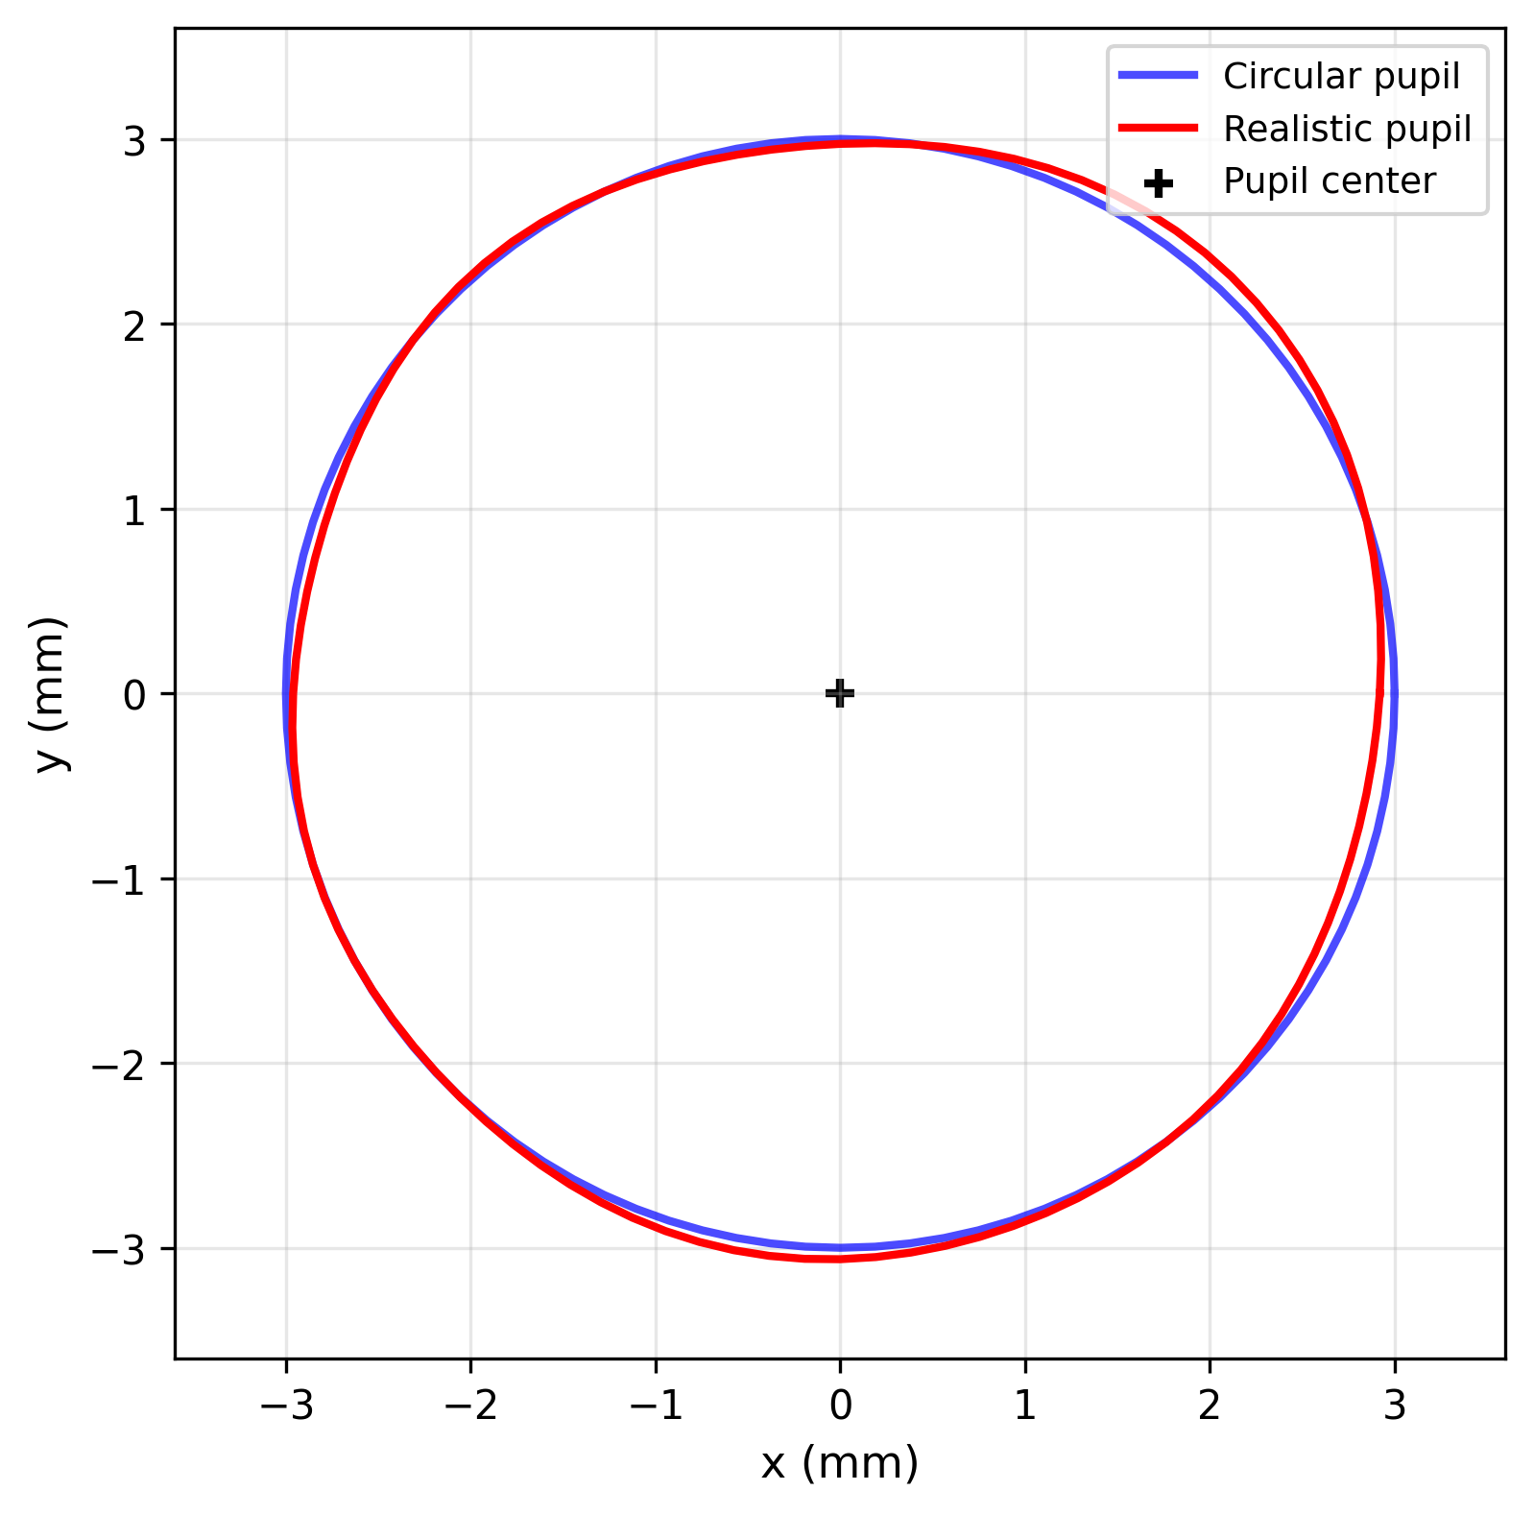
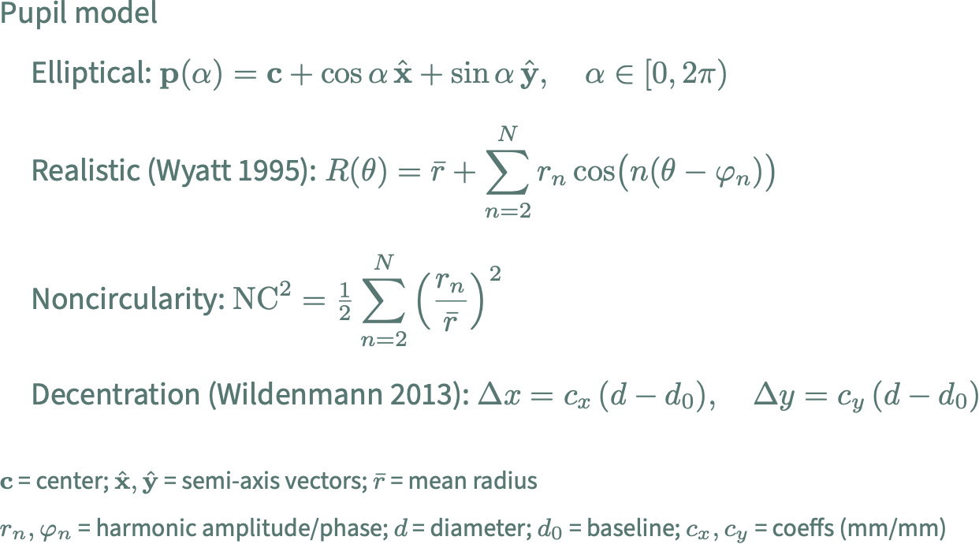
Pupil model
Notes:
Pupil model
Elliptical: p(α) = c + cos α · x̂ + sin α · ŷ, α ∈ [0, 2π)
Realistic (Wyatt 1995): R(θ) = r̄ + Σ rₙ cos( n(θ − φₙ) ), n = 2…N
noncircularity: NC² = ½ Σ (rₙ / r̄)², n = 2…N
Decentration (Wildenmann 2013, linear):
Δx = cₓ (d − d₀), Δy = c_y (d − d₀)
c = pupil center; x̂, ŷ = semi-axis vectors; r̄ = mean radius
rₙ, φₙ = harmonic amplitude / phase; d = diameter; d₀ = baseline; cₓ, c_y = coeffs (mm/mm)

Slide 10
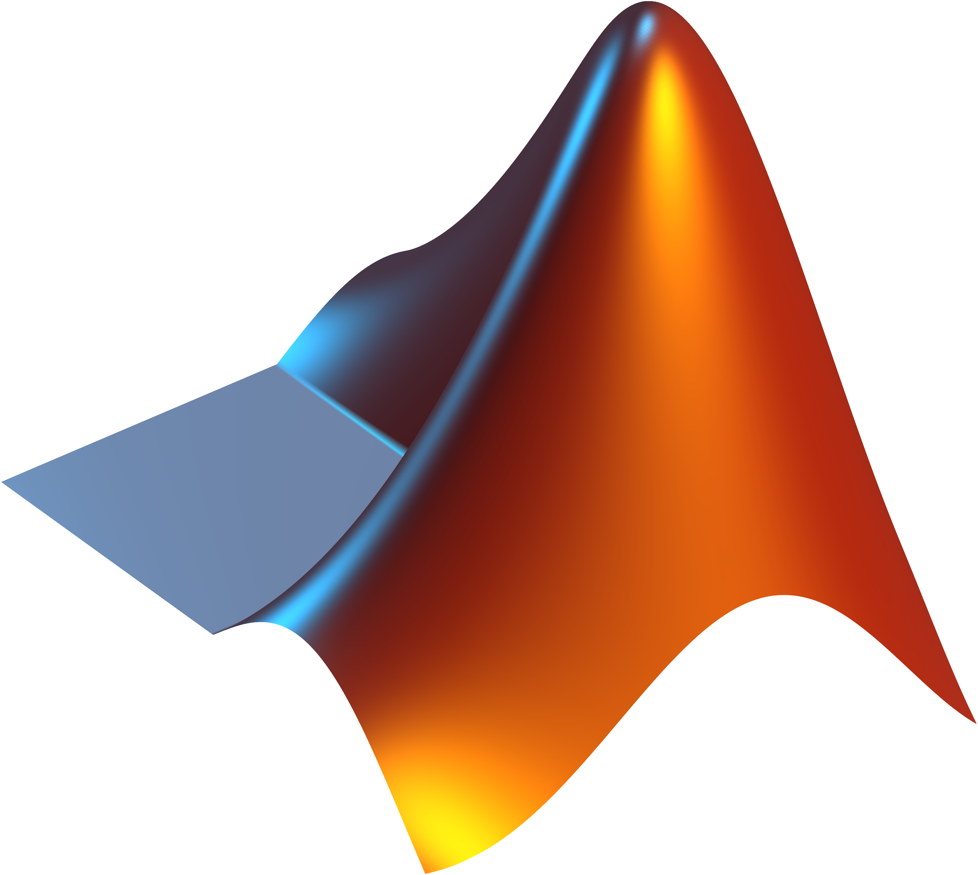
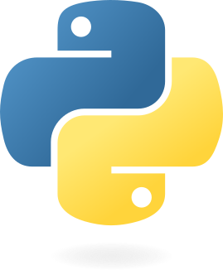
PyEtSimul: built on et_simul (Böhme et al. 2008), substantially extended
 | et_simul | PyEtSimul
Spherical cornea | ✓ | ✓
Pinhole camera | ✓ | ✓
Pupil + corneal-reflection projection | ✓ | ✓
Conic cornea | ✗ | ✓
Non-circular pupil + decentration | ✗ | ✓
Eyelid occlusion | ✗ | ✓
Camera lens distortion + noise | ✗ | ✓
Multiple cameras + import real calibration | ✗ | ✓
Systematic parameter sweeps + evaluation | ✗ | ✓
Built-in gaze estimation algorithms* | ✓ | ✓
License | MATLAB (paid) | Python (free)
* both have gaze estimation algorithms, but different models — PyEtSimul ships 7 polynomial models + homography + easy registration of custom models
Notes:
PyEtSimul core components reproduce et_simul's MATLAB output exactly (numerical equivalence)
- et_simul = MATLAB only → needs a paid license (adoption barrier)
No new development since its initial release (Böhme 2008)

Slide 11
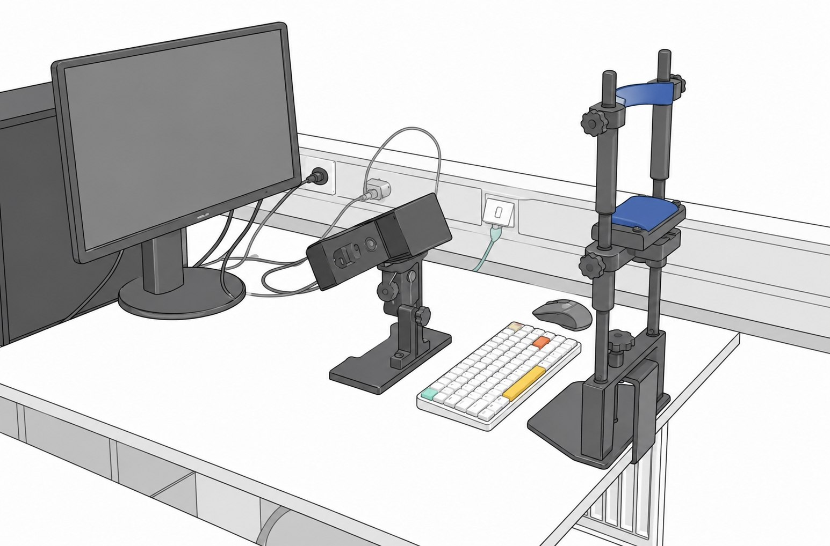
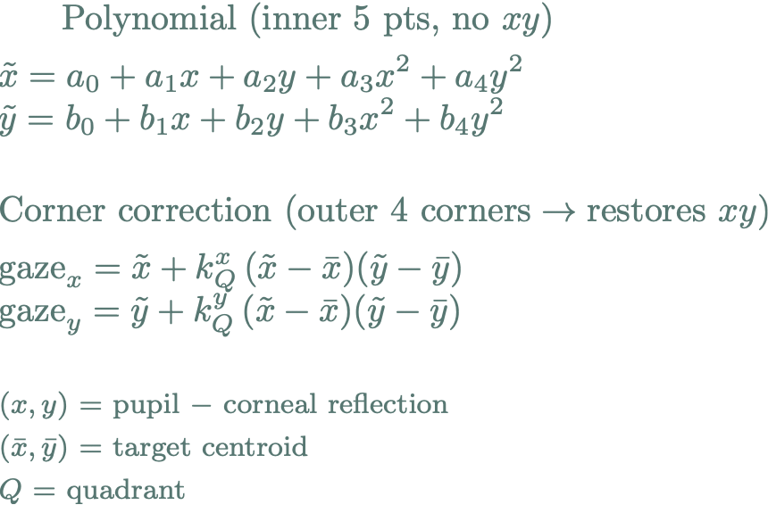
Setup for the demo
Stampe (1993) — cross-term-free 2nd-order polynomial + per-quadrant corner correction
① Polynomial (inner 5 pts, no xy)
② Corner correction (outer 4 corners → restores xy)
Our EyeLink 1000 Plus setup at UEF / Lund
eye-to-screen ~83.5 cm
camera-to-eye ~47.6 cm
IR light ~19.5 cm beside the camera
The image on this slide was generated using ChatGPT
Notes:
Stampe (1993) — cross-term-free 2nd-order polynomial + per-quadrant corner correction
① Polynomial (inner 5 pts, no xy)
x̃ = a₀ + a₁x + a₂y + a₃x² + a₄y²
ỹ = b₀ + b₁x + b₂y + b₃x² + b₄y²
② Corner correction (outer 4 corners → restores xy)
gaze_x = x̃ + kˣ_Q (x̃ − x̄)(ỹ − ȳ)
gaze_y = ỹ + kʸ_Q (x̃ − x̄)(ỹ − ȳ)
(x, y) = pupil − corneal reflection (x̄, ȳ) = target centroid Q = quadrant
Stampe, D. M. (1993). Heuristic filtering and reliable calibration methods for video-based pupil-tracking systems. Behavior Research Methods, Instruments, & Computers, 25(2), 137-142.

Slide 12
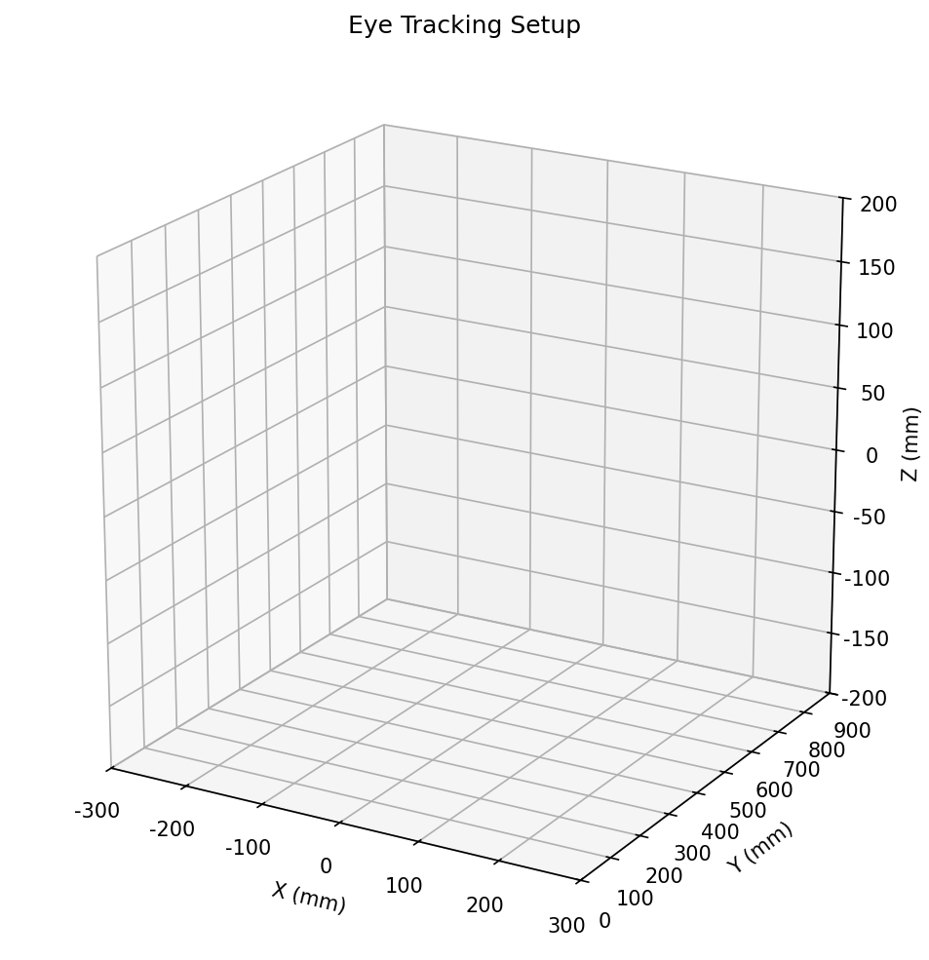
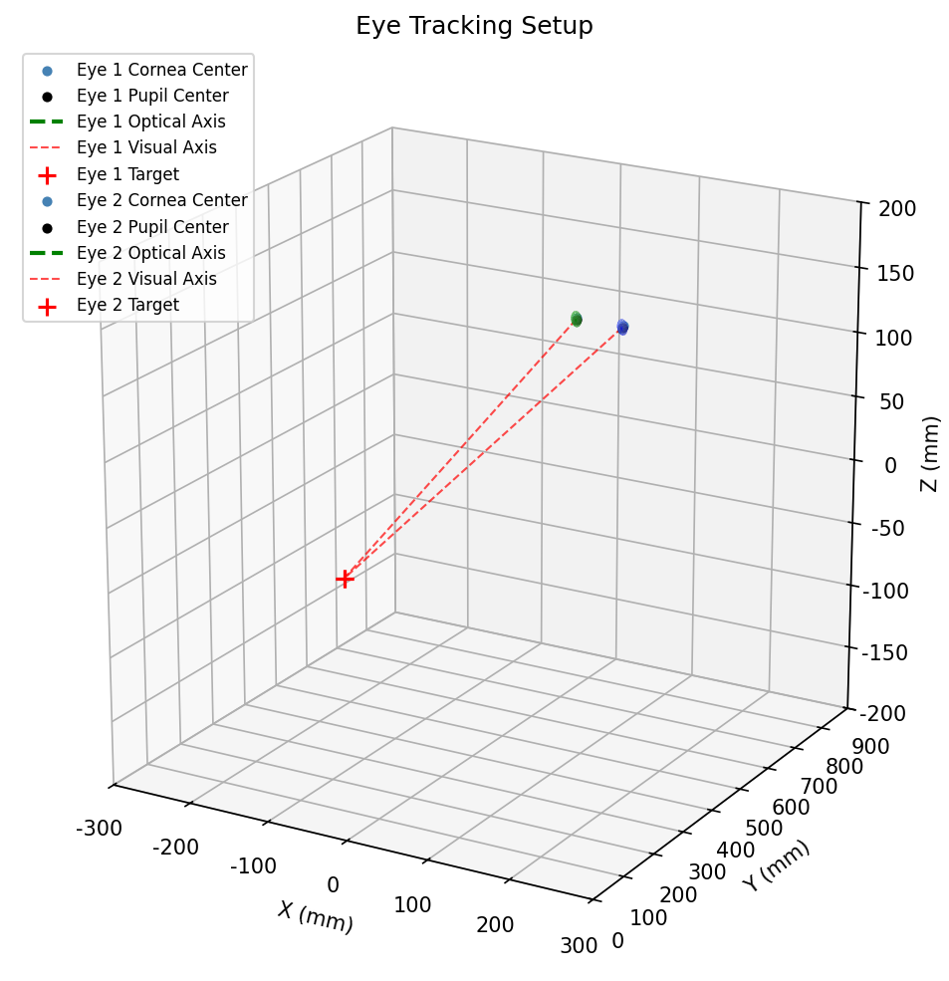
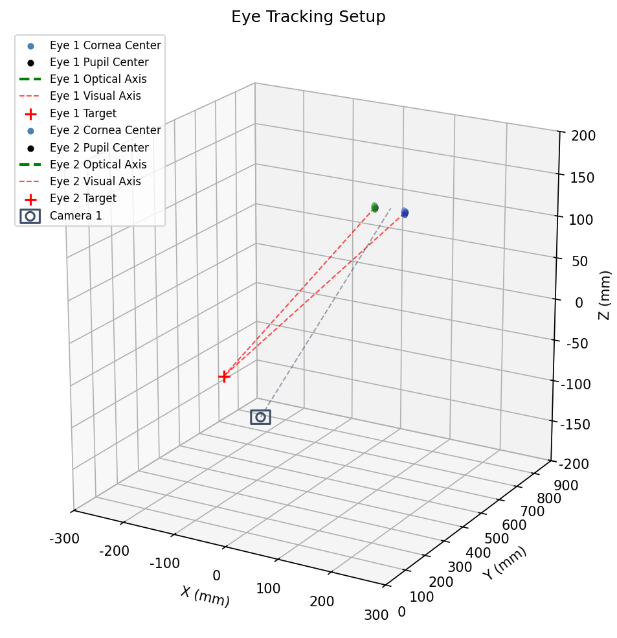
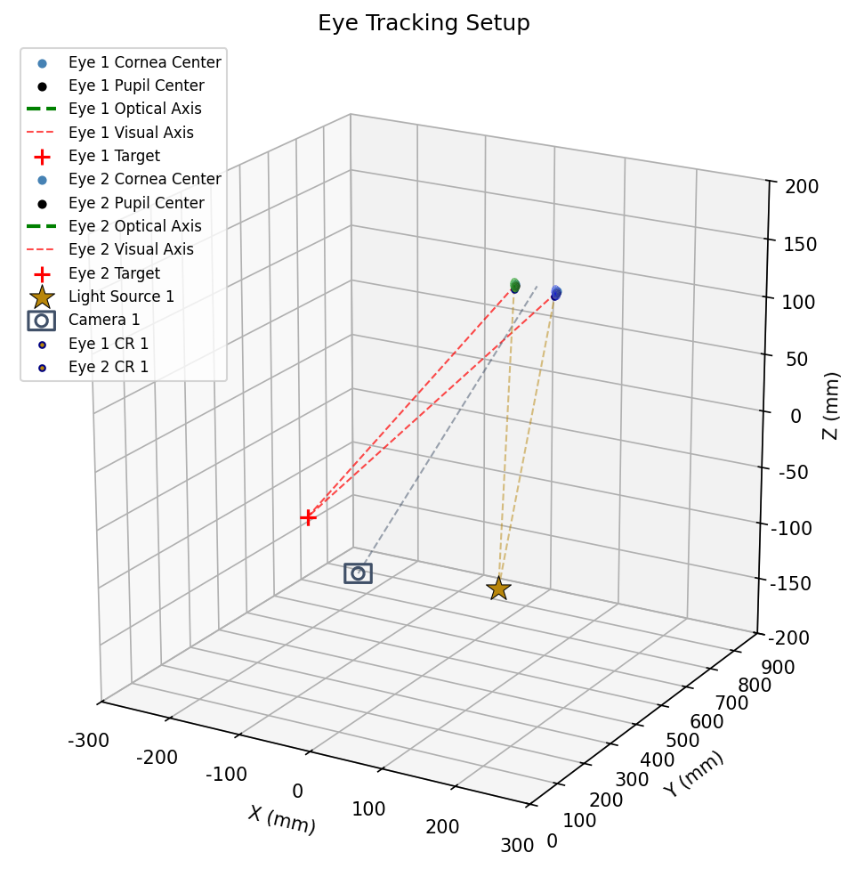
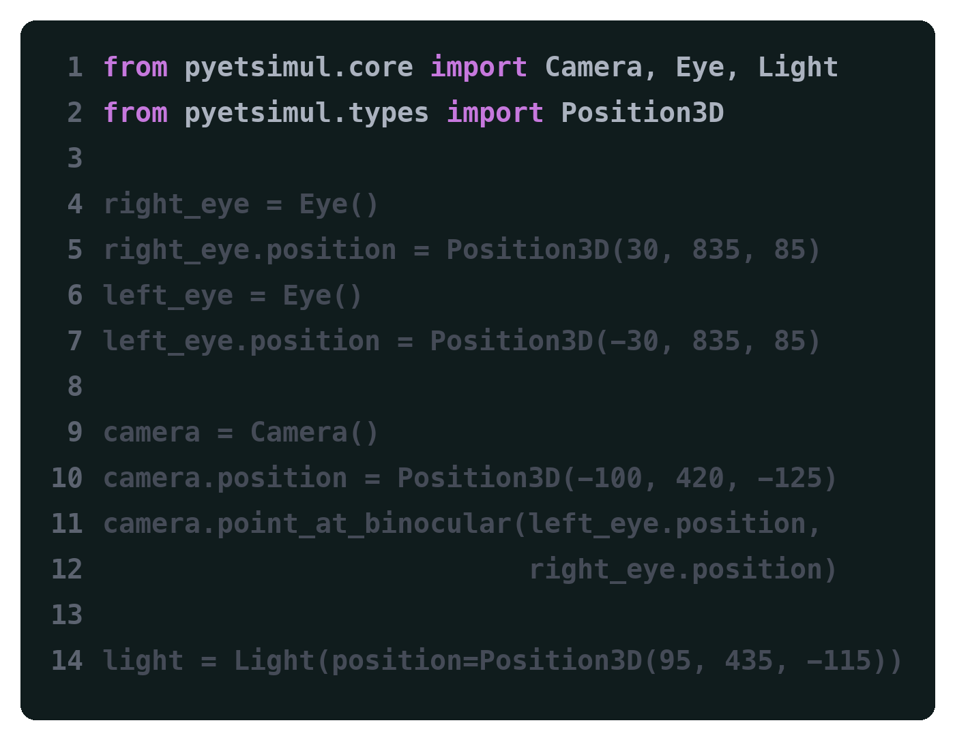
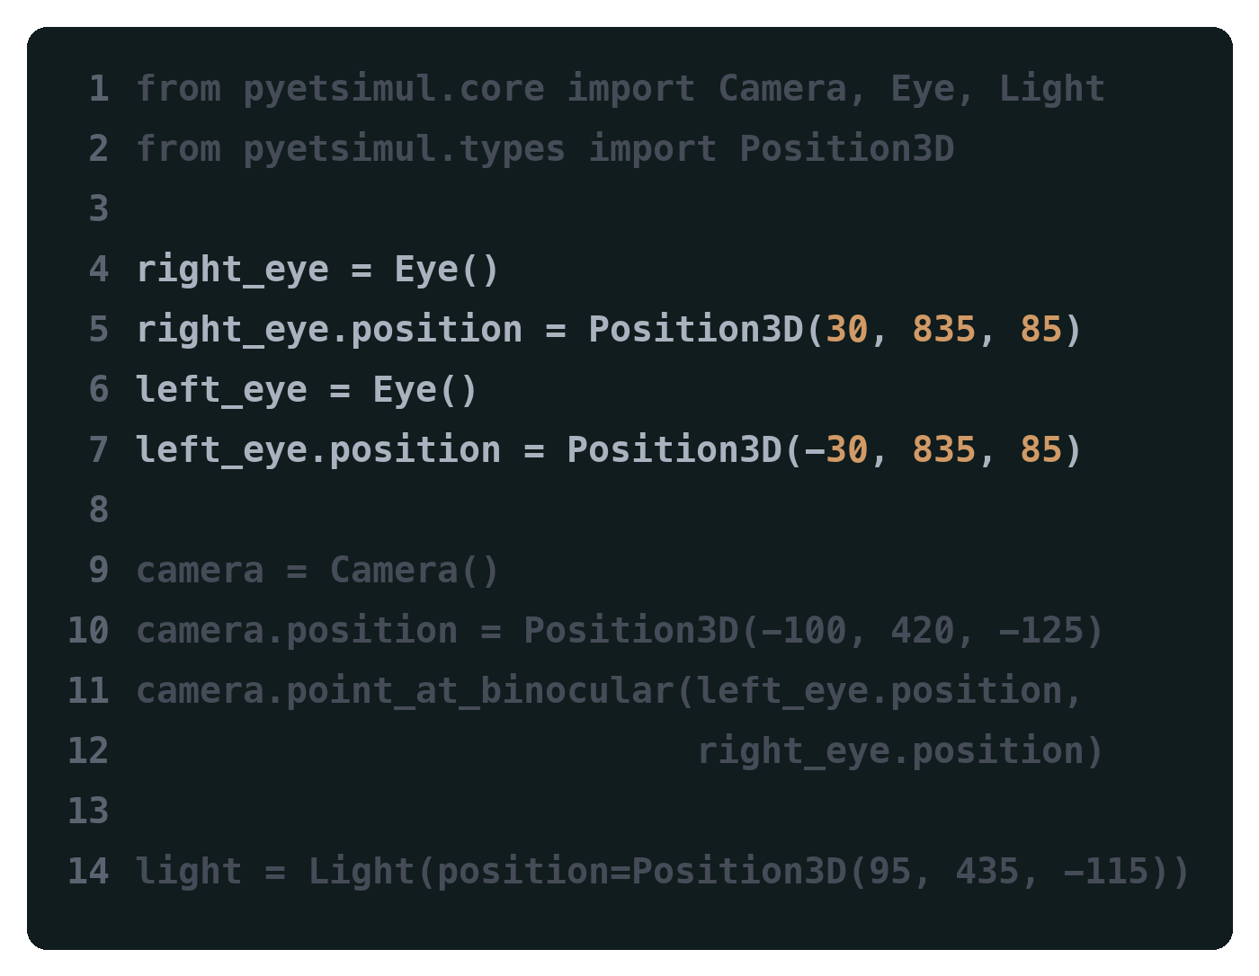
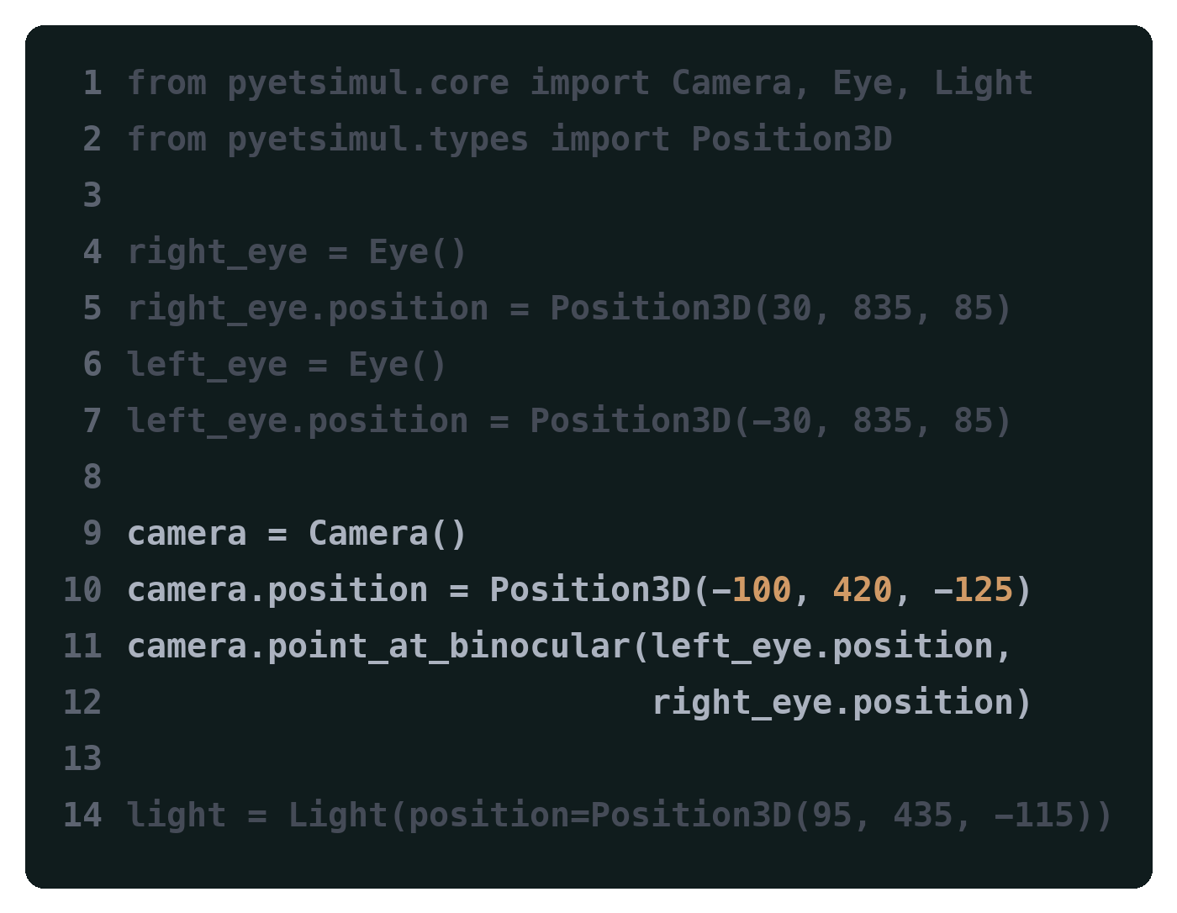
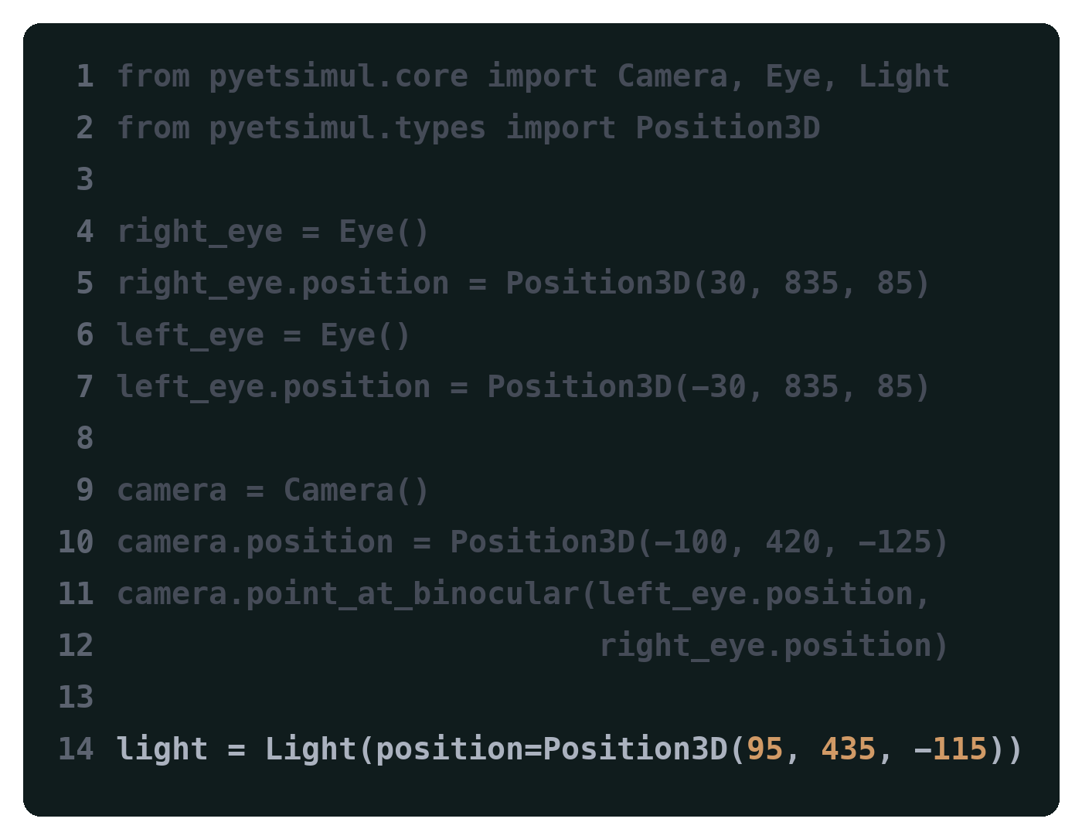
Demo: building a Stampe (1993) eye tracker
① Define a setup, in a few lines of Python
First, we need to import pyetsimul:
Then we need some eyes to track. Let's add two:
And a camera to capture the eyes:
And an infrared light source to make a glint (corneal reflection):

Slide 13
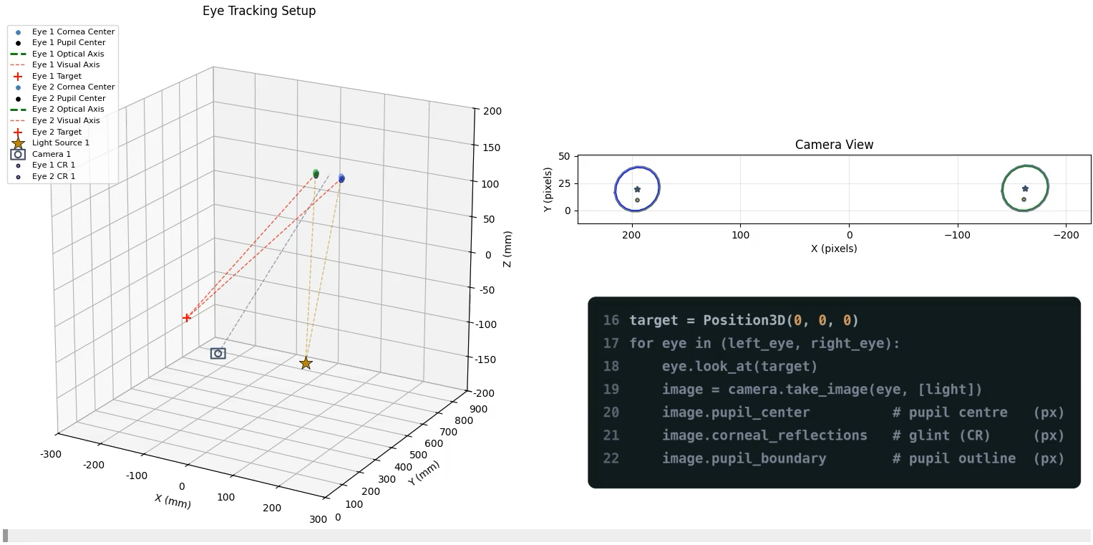
Demo: building a Stampe (1993) eye tracker
② It computes the pupil + glint for any gaze
Notes:
The simulator computes the pupil shape and glint location as the eyes rotate to look at different targets.
Dark ellipse = the pupil (seen through the cornea)
no eyelid, so the pupil is fully visible in this setup
Bright dot = the glint (reflection of the IR light on the cornea)

Slide 14
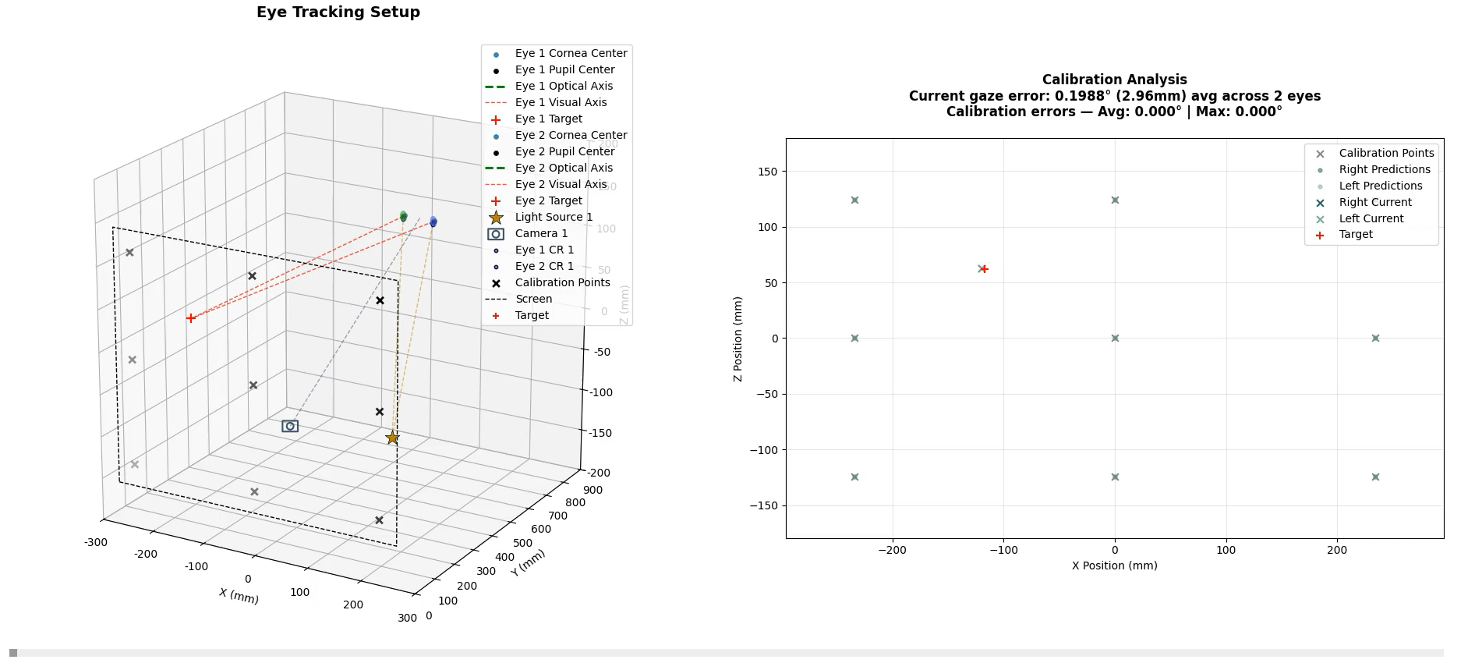
Demo: building a Stampe (1993) eye tracker
③ Calibrate → a working eye tracker
Notes:
With the pupil and glint computed, we can build an eye tracker.
Inputs: pupil center + glint → the pupil-glint (P-CR) vector, per eye
We fit a Stampe 1993 model per eye on the HV9 points
Why ~0 calibration error: HV9 = 5 inner (center + edges) fix the 5 coeffs exactly, 4 corners fix the 4 corrections exactly → all 9 points fit exactly

Slide 15
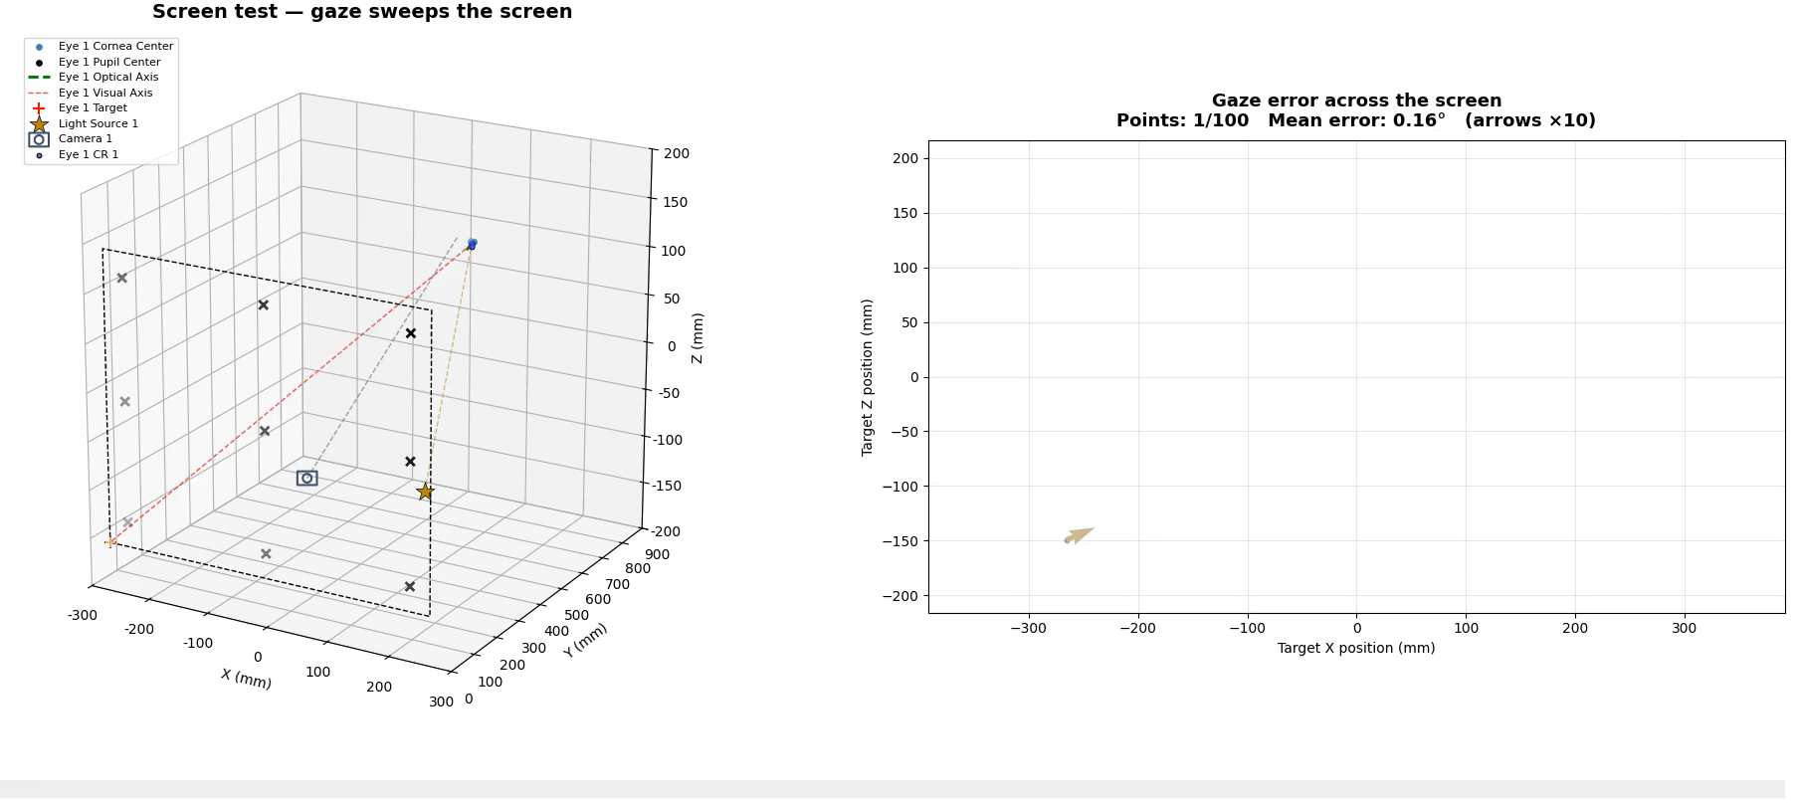
Demo: building a Stampe (1993) eye tracker
Screen Test — the gaze moves across the screen
Notes:
Screen Test = eye stays in place; the target moves across a grid
Error stays low; smallest right at the calibration points (robust to gaze direction)
In the paper we used a different polynomial and geometry than this deck

Slide 16
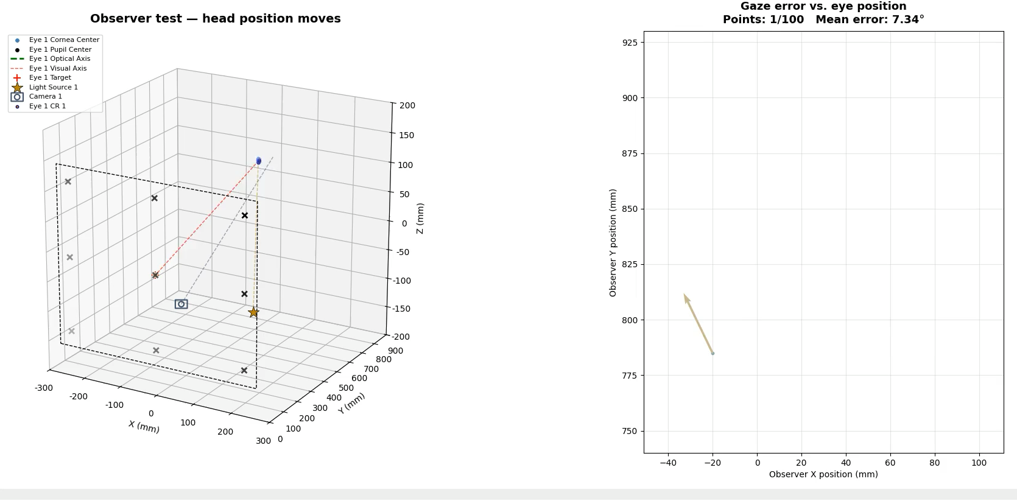
Demo: building a Stampe (1993) eye tracker
Observer Test — the eye position moves
Notes:
Observer Test = gaze stays on a single central target; the head/eye position moves across a grid
Error grows with head movement — Stampe uses only pupil + corneal reflection, no head-movement compensation
In the paper we used a different polynomial and geometry than this deck

Slide 17
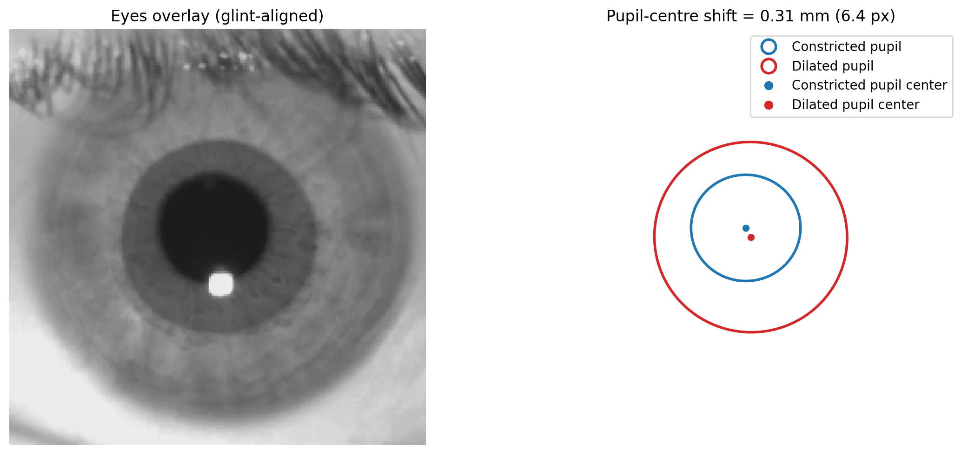
The pupil-size artifact (PSA)
Notes:
The final experiment investigates the effect of pupil center shift on gaze estimation in more detail, along with the pupil size artifact (PSA)---the systematic error in video-based eye trackers where changes in pupil size produce apparent gaze shifts in the absence of eye rotation~\citep{hooge2021pupil, salari2025effect}. One proposed mechanism behind PSA is physiological pupil decentration~\citep{hooge2021pupil, salari2025effect}---as the pupil dilates or constricts, its geometric center shifts rather than scaling concentrically~\citep{wildenmann2013variations}, which can bias gaze estimates.

Slide 18
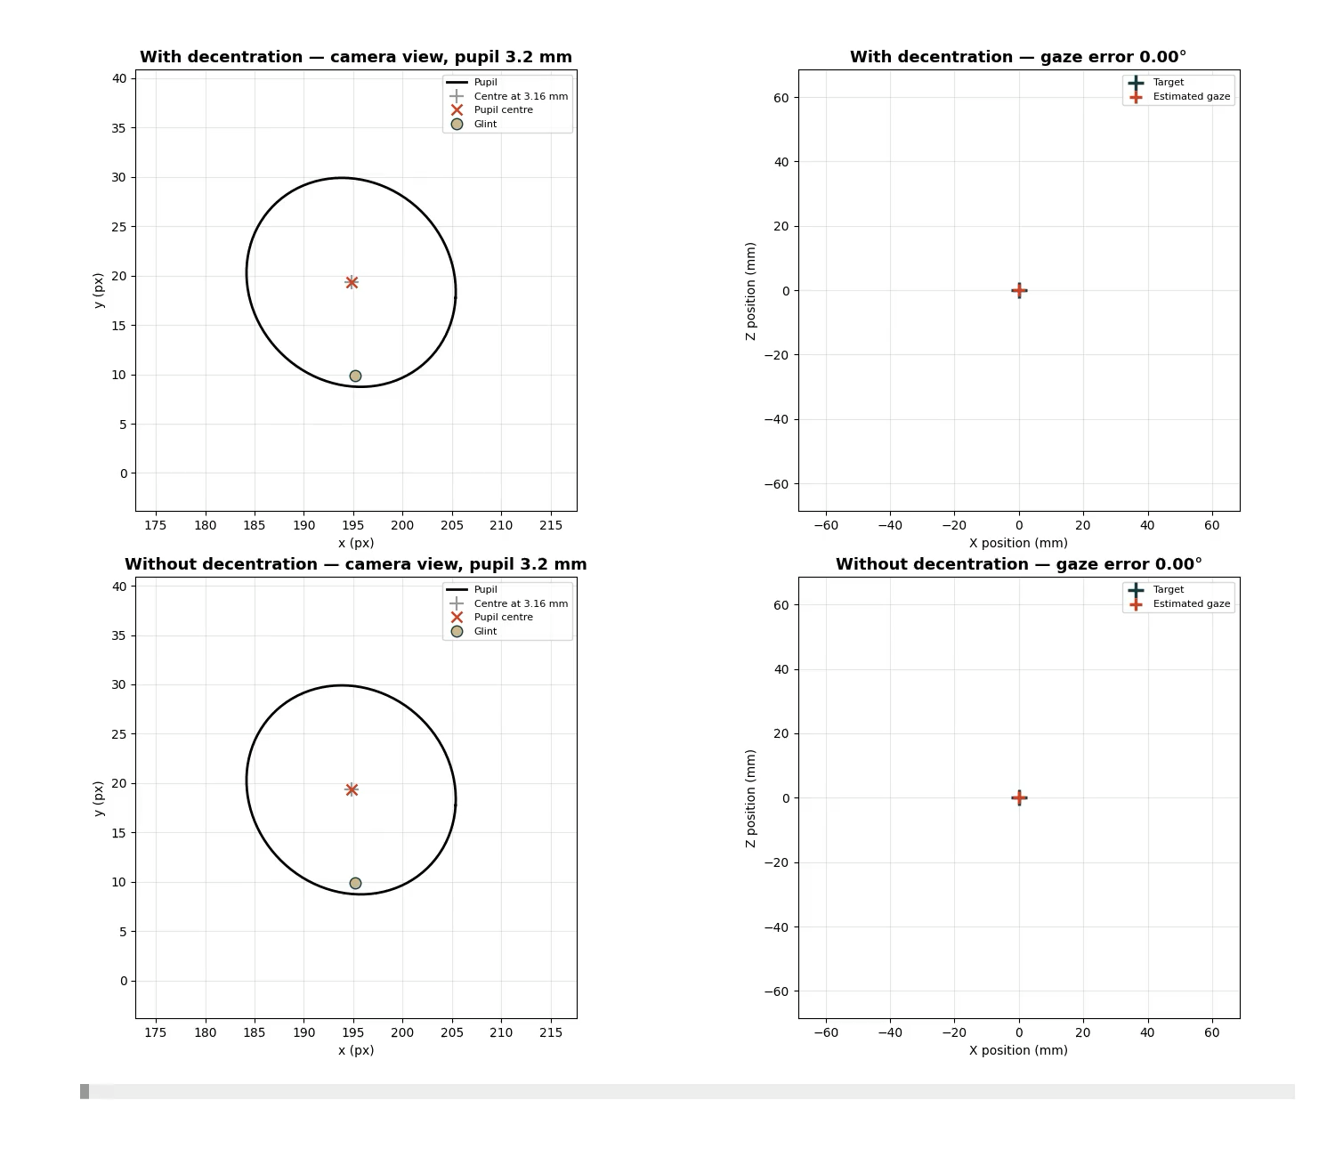
Only in simulation: the pupil-size artifact
Notes:
Constricted → dilated: 3.16 → 5.61 mm (Δ 2.45 mm)
Pupil‑centre shift: (0.15, 0.27) mm
Linear decentration: cx = 0.060, cy = 0.110 mm/mm
Calibrated at the Constricted 3.16mm

Slide 19
PyEtSimul vs other simulators
How PyEtSimul compares
Complementary to image-rendering simulators (UnityEyes, NVGaze) that generate eye images to train deep-learning gaze models
Feature-level access opens the black box — letting you isolate the factors that affect gaze
The only open-source Python tool with a complete eye-tracking simulation workflow
Limitations
Feature-level / analytical — no image-level effects (detection errors, illumination, imaging artifacts)
No limbus, iris texture, or crystalline lens
Point light sources only (no spatial extent)
No posterior corneal-surface refraction
Notes:
UnityEyes (Wood 2016), NVGaze (Kim 2019)
Visisipy (2024) — clinical eye optics only; no light sources, no gaze algorithms

Slide 20


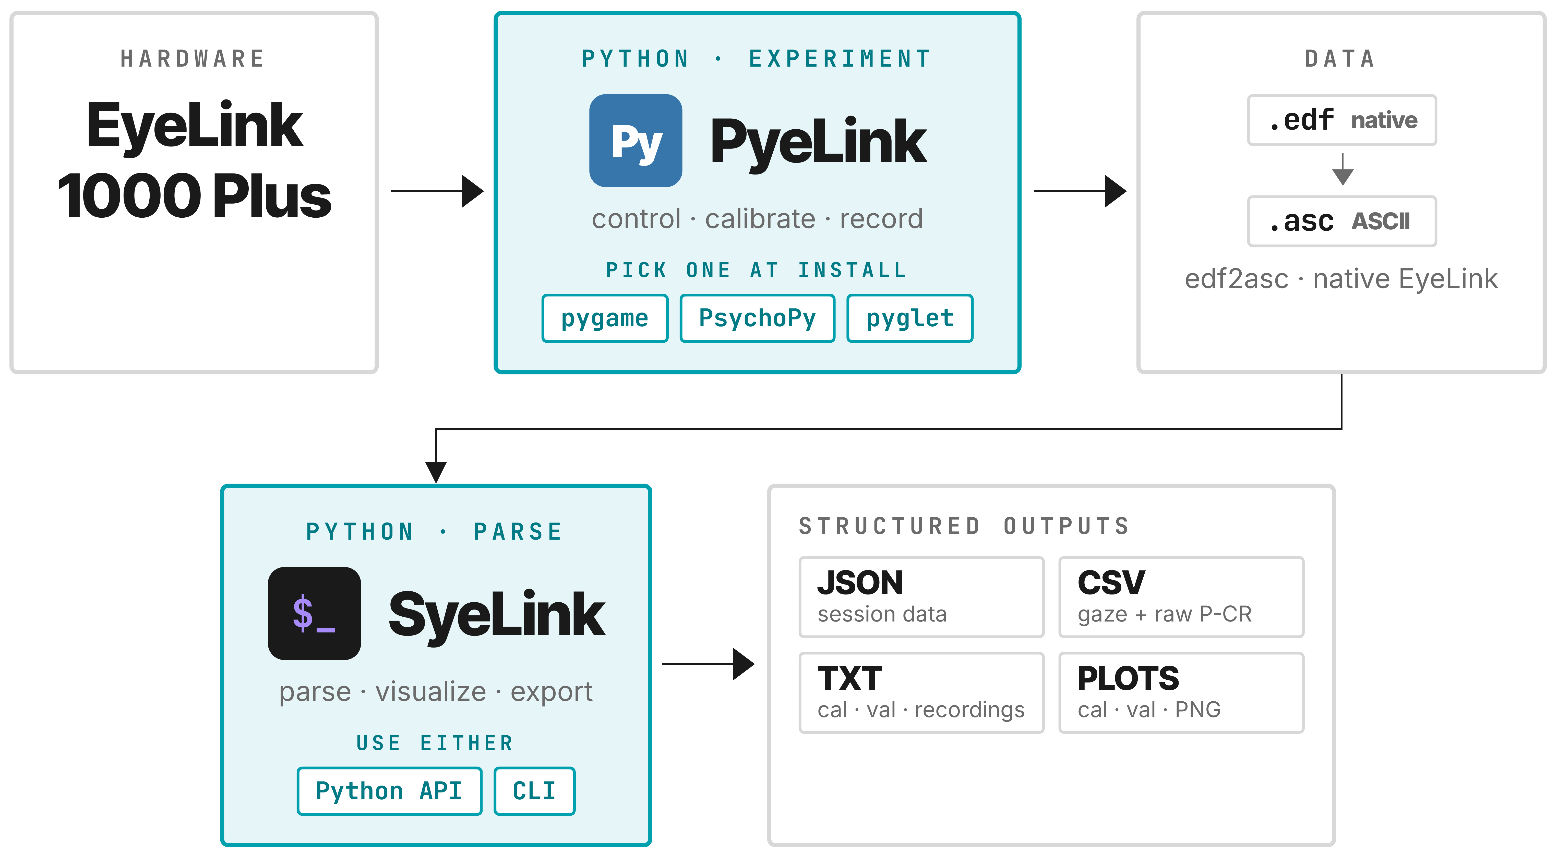

Thank you! Any questions?
Get the code, slides, and more at: mh-salari.ir/news/ETRA2026

Slide 21
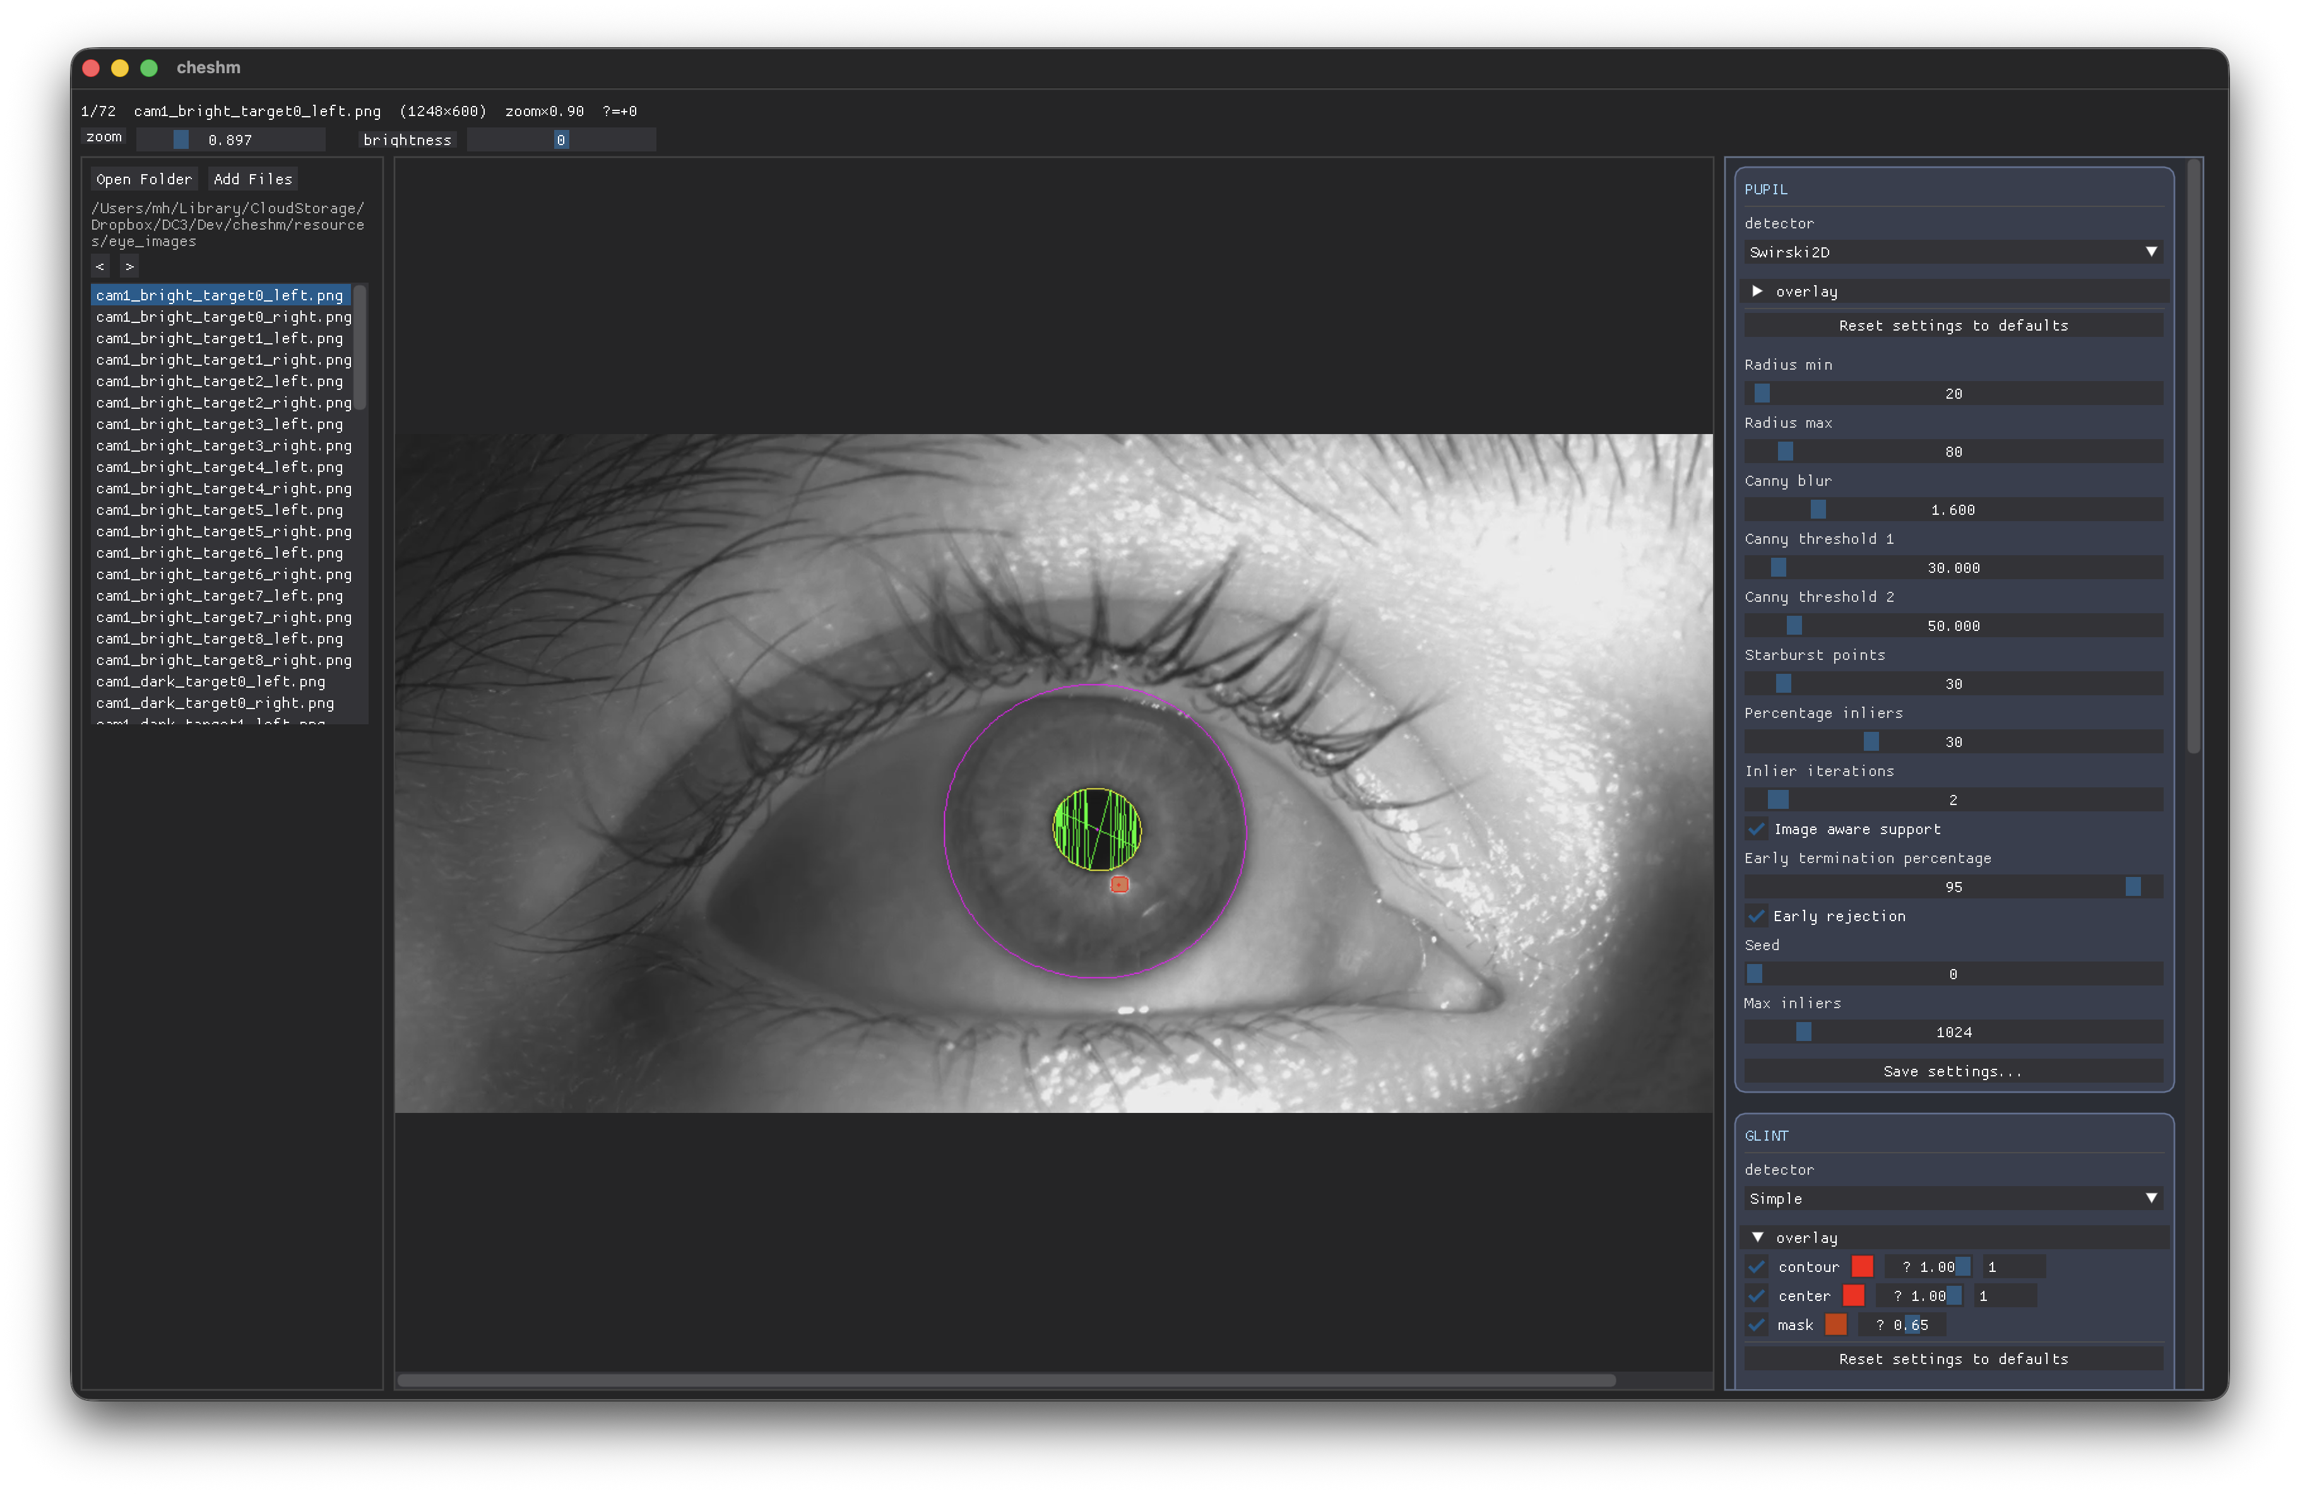
Cheshm
Pupil
Simple
Starburst
Swirski2D
ExCuSe
ElSe
PuRe
PuReST
PupilLabs2D
Glint:
Simple
Limbus
Daugman integro-differential
Daugman active contour
Pupil-guided active contour
Notes:
Cheshm is a cross-platform (Linux, macOS, Windows) C++ library with Python bindings. It packages pupil, glint, and limbus detectors for grayscale eye images, plus rigid alignment of two eye images (glint, pupil, or iris-texture based) and helpers for saving the resulting visualizations to PNG.

Slide 22
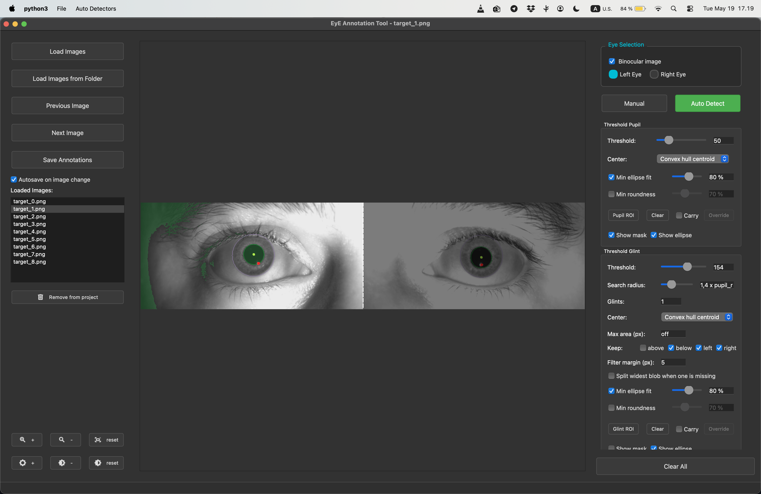
EyE Annotation Tool
Notes:
A Qt-based desktop tool for annotating pupil, limbus (iris), eyelid, and glints in eye images. Supports monocular and binocular projects, auto-detectors for each annotation type, and per-eye carry-across-frames workflows.

