Slide 1
Components of a Graph
Vertex (Node): represents an object
Edge: connection between two nodes
Example: Cities connected by roads
V
Edge
V
V

Slide 2
Directed Graph (Real-life Example)
Example: Instagram/Twitter Follow
If A follows B, it doesn't mean B follows A
A
B

Slide 3
Undirected Graph (Real-life Example)
Example: Facebook friendship
If A is friend of B, B is friend of A
A
B

Slide 4
Connected Graph
A graph is connected if every node can reach every other node
There exists at least one path between nodes
V1
Edge1
V2
Edge3
Edge2
V3

Slide 5
Fully Connected Graph (Complete Graph)
Every pair of nodes has a direct edge
V1
Edge1
V2
Edge3
Edge2
V3

Slide 6
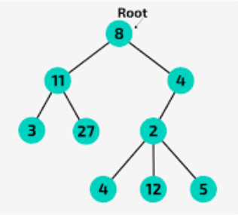
Is a Tree a Connected Graph?
Yes. Trees are always connected
Every node can reach another node
Trees do not contain cycles

Slide 7
What Makes a Tree Different from a Graph?
A Tree is a special graph:
Connected
No cycles
Edges = n − 1

Slide 8
Rooted Tree
One node is selected as the root
Parent-child relationships exist
Root
C1
C2

Slide 9
Leaf Node
A node with no children
Located at the bottom of a tree
Root
Leaf
Leaf

Slide 10
Number of Edges in a Tree
If number of nodes = n
Edges = n − 1
Example: 5 nodes → 4 edges

Slide 11
Simple Paths Between Two Nodes in a Tree
There is exactly ONE simple path
Because trees do not contain cycles

Slide 12
Weighted Graph
Edges have weights (cost, distance, time)
Example: Distance between cities
A
5
B

